Slide 1
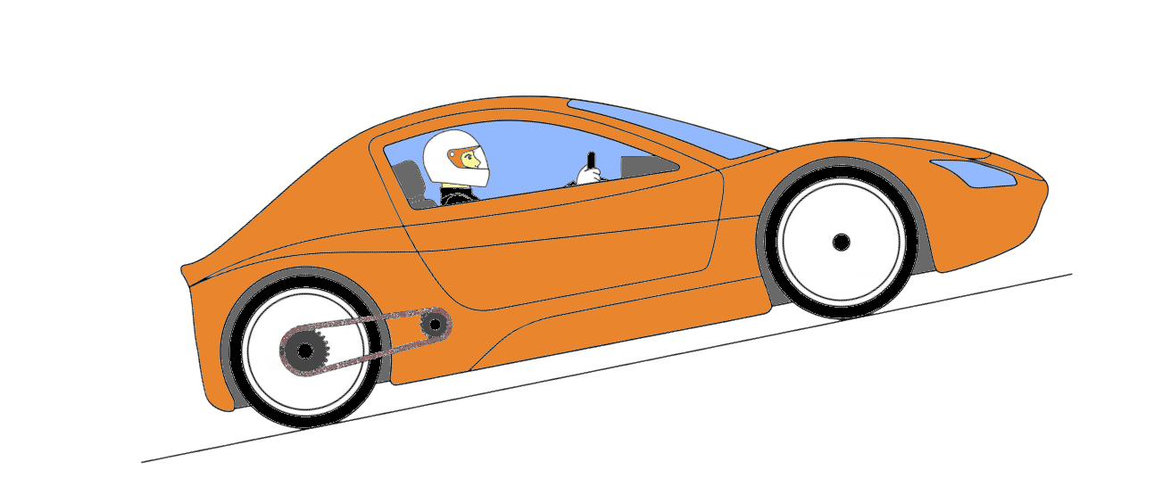




$$\left\|\frac{1}{2}ρ.S.C_{x}.v²\right\|$$
z_{pignon}
G
r_{roue}
z_{couronne}
$$\left\|f_{v}.v\right\|$$
$$\vec{P} \left\|m.g\right\|$$
$$\left\|f_{s}.m.g\right\|$$

