Slide 1
对于出国的学生来说，应该先考托福还是先考GRE？
是否有必要组织小学生是否要去参观大学校园？
樱花又开了，是否要向参观大学校园的游客收费？
是否有必要让学生参与教务处的管理？
大学校园应该限制网络的使用？

Slide 2
Analyse an Issue

Slide 3

2
ISSUE
有的放矢
深度破题
关键论证
Score 6 — Outstanding
In addressing the specific task directions, a 6 response presents a cogent, well-articulated examination of the argument and conveys meaning skillfully.
A typical response in this category clearly identifies aspects of the argument relevant to the assigned task and examines them insightfully, develops ideas cogently, organizes them logically and connects them with clear transitions, provides compelling and thorough support for its main points, conveys ideas fluently and precisely, using effective vocabulary and sentence variety demonstrates superior facility with the conventions of standard written English (i.e., grammar, usage and mechanics), but may have minor errors.
Score 5 — Strong
In addressing the specific task directions, a 5 response presents a generally thoughtful, well-developed examination of the argument and conveys meaning clearly.
A typical response in this category clearly identifies aspects of the argument relevant to the assigned task and examines them in a generally perceptive way develops ideas clearly, organizes them logically, and connects them with appropriate transitions offers generally thoughtful and thorough support for its main points conveys ideas clearly and well, using appropriate vocabulary and sentence variety demonstrates facility with the conventions of standard written English but may have minor errors.
Score 4 — Adequate
In addressing the specific task directions, a 4 response presents a competent examination of the argument and conveys meaning with acceptable clarity.
A typical response in this category identifies and examines aspects of the argument relevant to the assigned task but may also discuss some extraneous points, develops and organizes ideas satisfactorily but may not connect them with transitions, supports its main points adequately but may be uneven in its support, demonstrates sufficient control of language to convey ideas with acceptable clarity generally demonstrates control of the conventions of standard written English but may have some errors.

Slide 4
2
ISSUE
有的放矢
深度破题
关键论证
Clear and insightful position
Develop the position fully
Content
Compelling reasons and persuasive examples
Structure
Well-focused
Well-organized
Connecting ideas logically
Effective vocabulary
Language
Sentences variety
Minor errors

Slide 5
2
ISSUE
有的放矢
深度破题
关键论证
As people rely more and more on technology to solve problems, the ability of humans to think for themselves will surely deteriorate.

Slide 6
2
ISSUE
有的放矢
深度破题
关键论证
Score 6 — Outstanding
However, this reliance on technology does not necessarily preclude the creativity that marks the human species. The prior examples reveal that technology allows for convenience. The car, computer and phone all release additional time for people to live more efficiently. This efficiency does not preclude the need for humans to think for themselves. In fact, technology frees humanity to not only tackle new problems, but may itself create new issues that did not exist without technology. For example, the proliferation of automobiles has introduced a need for fuel conservation on a global scale. With increasing energy demands from emerging markets, global warming becomes a concern inconceivable to the horse-and-buggy generation.
6分范文段落

Slide 7
2
ISSUE
有的放矢
深度破题
关键论证
Score 5 — Strong
With all this evidence, it’s easy to believe that tech trends and the incorporation of technological wizardly into our everyday lives have served mostly to enforce conformity, promote dependence, heighten consumerism and materialism, and generally create a culture that values self-absorption and personal entitlement over cooperation and collaboration. However, I argue that we are merely in the inchoate stages of learning to live with technology while still loving one another. After all, even given the examples provided earlier in this essay, it seems clear that technology hasn’t impaired our thinking and problem-solving capacities. …
5分范文段落

Slide 8
2
ISSUE
有的放矢
深度破题
关键论证
Score 4 — Adequate
If you think about it, using technology to solve complicating problems gives humans a chance to expand their thinking and learning, opening up whole new worlds for many people. Many of these people are glad for the chance to expand their horizons by learning more, going to new places, and trying new things. If it wasn’t for the invention of new technological devices, I wouldn’t be sitting at this computer trying to philosophize about technology. It would be extremely hard for children in much poorer countries to learn and think for themselves without the invention of the Internet….
4分范文段落

Slide 9
2
ISSUE
有的放矢
深度破题
关键论证
题型剖析
1.Write a response in which you discuss the extent to which you agree or disagree with the statement and explain your reasoning for the position you take. In developing and supporting your position, you should consider ways in which the statement might or might not hold true and explain how these considerations shape your position.
1.Write a response in which you discuss the extent to which you agree or disagree with the statement and explain your reasoning for the position you take. In developing and supporting your position, you should consider ways in which the statement might or might not hold true and explain how these considerations shape your position.
Extent——全完同意、完全反对、部分同意、部分反对、某些情形下同意、某些情形下反对。
Statement——陈述合理或不合理的方面。

Slide 10
2
ISSUE
有的放矢
深度破题
关键论证
题型剖析
2.Write a response in which you discuss the extent to which you agree or disagree with the recommendation and explain your reasoning for the position you take. In developing and supporting your position, describe specific circumstances in which adopting the recommendation would or would not be advantageous and explain how these examples shape your position.
2.Write a response in which you discuss the extent to which you agree or disagree with the recommendation and explain your reasoning for the position you take. In developing and supporting your position, describe specific circumstances in which adopting the recommendation would or would not be advantageous and explain how these examples shape your position.
Specific circumstances——对这个建议有益或无益的具体情况和条件进行分类讨论。

Slide 11
2
ISSUE
有的放矢
深度破题
关键论证
题型剖析
6.Write a response in which you discuss your views on the policy above and explain your reasoning for the position you take. In developing and supporting your position, you should consider the possible consequences of implementing the policy and explain how these consequences shape your position.
6.Write a response in which you discuss your views on the policy above and explain your reasoning for the position you take. In developing and supporting your position, you should consider the possible consequences of implementing the policy and explain how these consequences shape your position.
consequences of implementing the policy——从结果出发，
考虑各种可能的结果。

Slide 12
2
ISSUE
有的放矢
深度破题
关键论证
例1：The human mind will always be superior to machines because machines are only tools of human minds.
Write a response in which you discuss the extent to which you agree or disagree with the statement and explain your reasoning for the position you take. In developing and supporting your position, you should consider ways in which the statement might or might not hold true and explain how these considerations shape your position.
What kind of times?
Always:
是一个绝对化的词，故要对其进行展开。
展开模式通常有：时间/空间
What kind of machines?

Slide 13
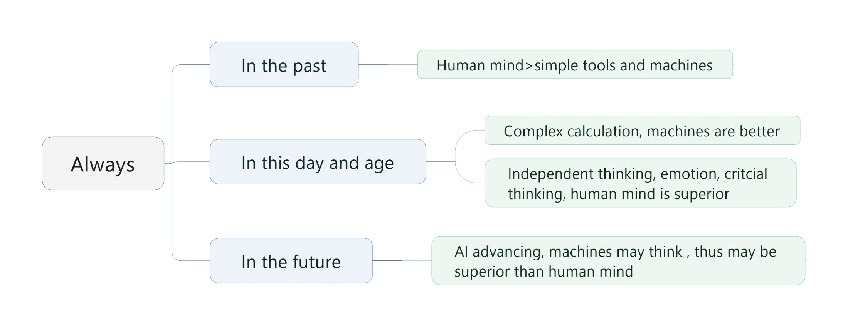

Slide 14
2
ISSUE
有的放矢
深度破题
关键论证
例2：Educators should take students’ interests into account when planning the content of the courses they teach.
Write a response in which you discuss the extent to which you agree or disagree with the recommendation and explain your reasoning for the position you take. In developing and supporting your position, describe specific circumstances in which adopting the recommendation would or would not be advantageous and explain how these examples shape your position.
Educator should
Can they?
Students’ interests
What kind of students?
Should do? 第一：建议是否可行？（第一段，80词左右 时间精力有限/兴趣多种）第二：接下来的分类建立在可行/不可行的观点上。对学生进行分类：小学生（都行）。中学生：标准化考试，最大的任务，固定科目，不存在兴趣科研。//竞赛，兴趣使然，提升在这个方面的兴趣和能力，有助于其更好的发展和智力发掘。//大学生：基础性学科（打好基础学科）//研究生：要考虑兴趣，长期研究，需要兴趣。分类三种到五种

Slide 15
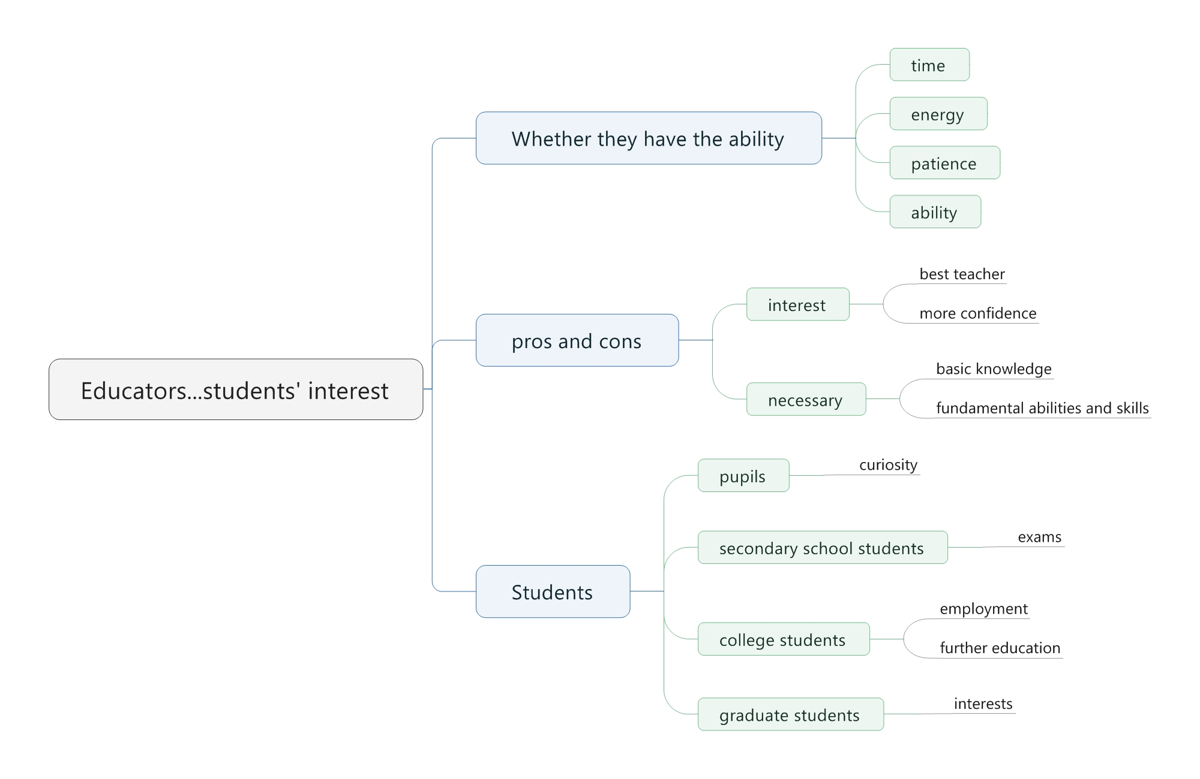
将第二点放到第三点中展开。不用单独说。

Slide 16
2
ISSUE
有的放矢
深度破题
关键论证
例3：The best way to teach is to praise positive actions and ignore negative ones.
Write a response in which you discuss the extent to which you agree or disagree with the statement and explain your reasoning for the position you take. In developing and supporting your position, you should consider ways in which the statement might or might not hold true and explain how these considerations shape your position.
The best way
Pros and Cons
To teach
Whom?
For whom is best? For whom not?
考试的时候要用三分钟的时间来构建思路和准备思维导图。

Slide 17
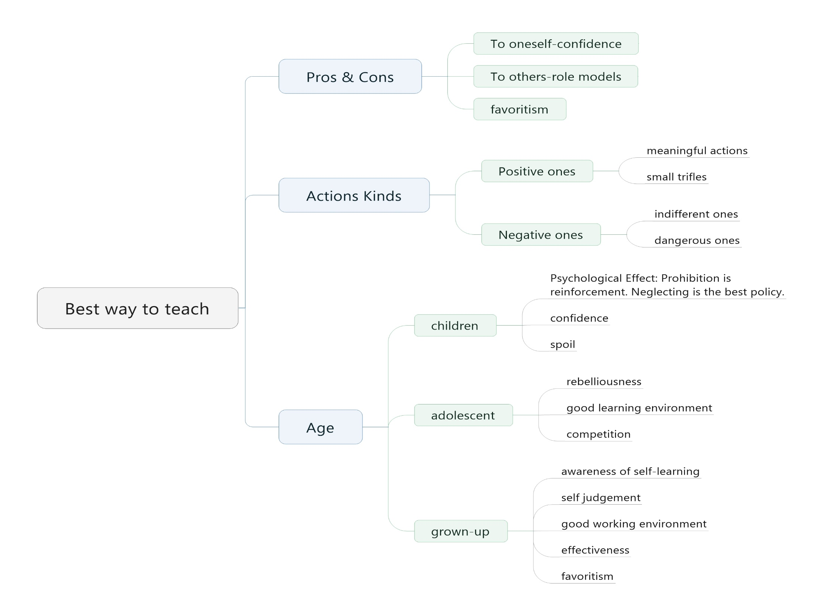
小孩：会有反作用，增强。禁止即是强化。中学生：会有叛逆心理。以上忽略消极的做法是正确的。大学生：都有自己的判断能力，表扬不起作用。
对自己：增加信息
对别人：榜样/过度表扬->偏爱
小事
表扬营造好的学习氛围，促进竞争。
危险的事物不能忽视
Reinforcement
/ˌriɪn‘fɔrsmənt/增强
Rebelliousness
/ri‘beljəsnis/ n.造反
不需要表扬去引导，已经有自己的判断力了。
Effectiveness
/əˈf ɛktɪvnɪs/ 有利，有效
Favoritism
/‘fevərɪt,ɪzəm/ 偏爱，偏袒

Slide 18
2
ISSUE
有的放矢
深度破题
关键论证
例11：A nation should require all of its students to study the same national curriculum until they enter college.
Write a response in which you discuss the extent to which you agree or disagree with the recommendation and explain your reasoning for the position you take. In developing and supporting your position, describe specific circumstances in which adopting the recommendation would or would not be advantageous and explain how these examples shape your position.
Advantages and Disadvantages

Slide 19
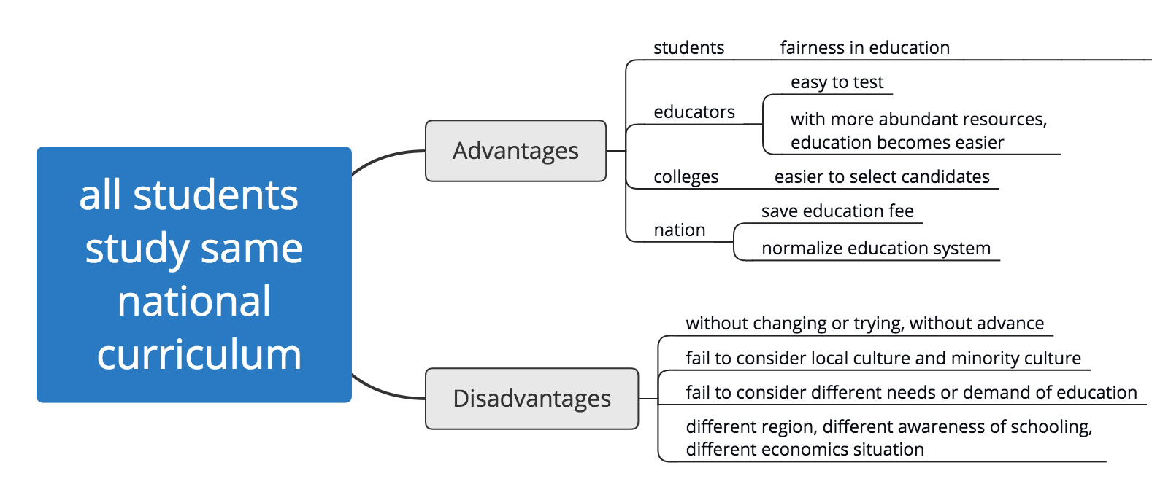
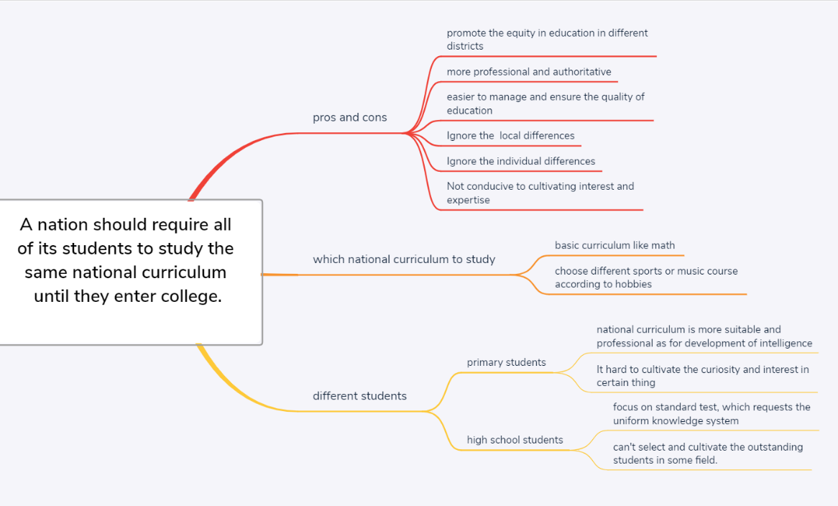
自己的回答的问题：
1、分类不要只分两类（学生）
2、不要纠结于national curriculum是不是只有部分之类的。这就是一种体系

Slide 20
2
ISSUE
有的放矢
深度破题
关键论证
例12：Colleges and universities should require their students to spend at least one semester studying in a foreign country.
Write a response in which you discuss the extent to which you agree or disagree with the recommendation and explain your reasoning for the position you take. In developing and supporting your position, describe specific circumstances in which adopting the recommendation would or would not be advantageous and explain how these examples shape your position.
Strengths
正负分析
Weaknesses
参考

Slide 21
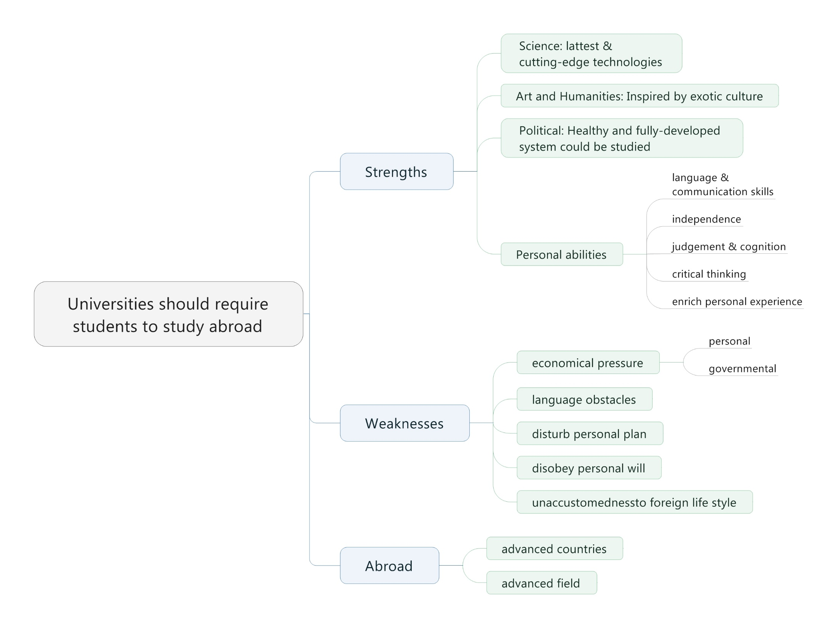

Slide 22
2
ISSUE
有的放矢
深度破题
关键论证
例4：Unfortunately, in contemporary society, creating an appealing image has become more important than the reality or truth behind that image.
Write a response in which you discuss the extent to which you agree or disagree with the statement and explain your reasoning for the position you take. In developing and supporting your position, you should consider ways in which the statement might or might not hold true and explain how these considerations shape your position.
Contemporary society
What kind of characters?
An appealing image
What kind of fields?

Slide 23
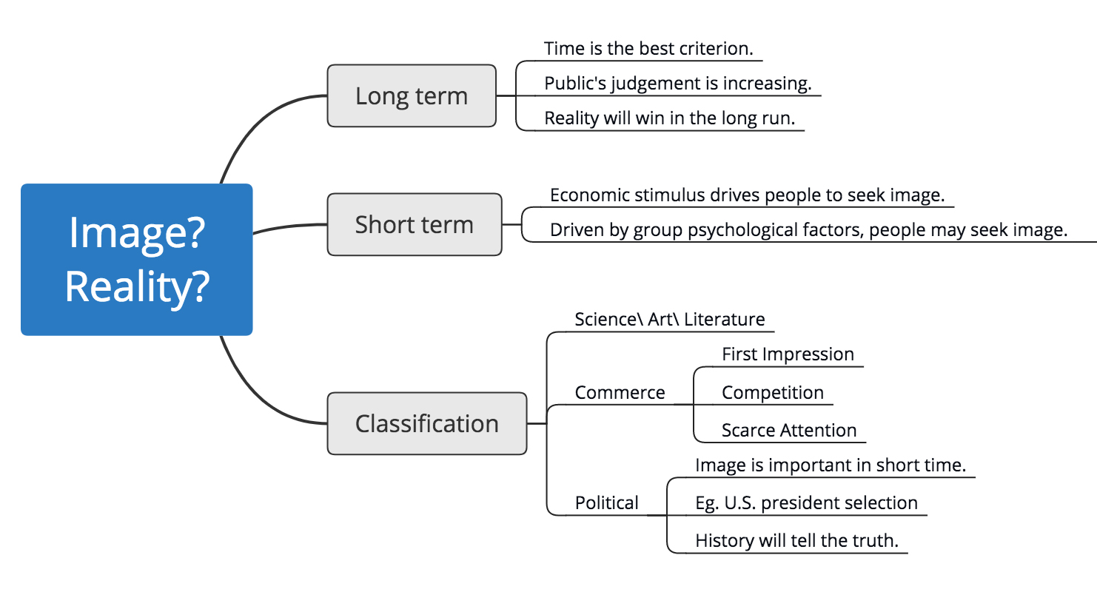
Answer from Zhu

Slide 24
2
ISSUE
有的放矢
深度破题
关键论证
题型剖析
3.Write a response in which you discuss the extent to which you agree or disagree with the claim. In developing and supporting your position, be sure to address the most compelling reasons or examples that could be used to challenge your position.
3.Write a response in which you discuss the extent to which you agree or disagree with the claim. In developing and supporting your position, be sure to address the most compelling reasons or examples that could be used to challenge your position.
Compelling:具有说服力的时候
Address …challenge your position——反驳对立面
常用表达：
It could be argued that… because… However…
It might be also claimed that… However
Someone might argue that…because… However
Some people believe that… Further, they argue that… In my opinion…
帮对面立场想一个观点，然后反驳它。
这事实上就是中国人的中庸思维，也就是我们要写一些让步段

Slide 25
2
ISSUE
有的放矢
深度破题
关键论证
Write a response in which you discuss the extent to which you agree or disagree with the claim. In developing and supporting your position, be sure to address the most compelling reasons or examples that could be used to challenge your position
题型剖析
例5：The best way for a society to prepare its young people for leadership in government, industry, or other fields is by instilling in them a sense of cooperation, not competition.
Are they contradict with each other?
The best way?
Can they coexist?
A or B?
Where could they coexist?
竞争一段/合作一段/
竞争和合作一段
这题我们由中庸的思路，将竞争和合作都重要作为个人观点，但这不是立场。
要讲三个方面：竞争/合作/竞争和合作

Slide 26
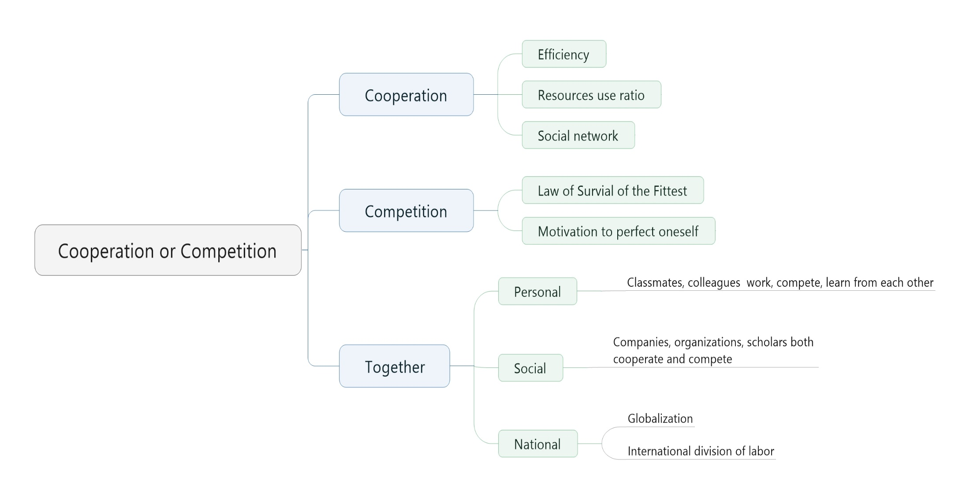
效率/资源利用率/人脉
适者生存/自我提升的动力。
第一段：personally, cooperation 和competition都重要。提观点：认为两者都并重。立场还是某一个更重要（要全面，但是不能没有立场。）
问题：让步写在哪里。别人的观点是什么

Slide 27
2
ISSUE
有的放矢
深度破题
关键论证
例7： Educational institutions have a responsibility to dissuade students from pursuing fields of study in which they are unlikely to succeed.
Write a response in which you discuss the extent to which you agree or disagree with the claim. In developing and supporting your position, be sure to address the most compelling reasons and/or examples that could be used to challenge your position.
Have a responsibility
But do they have the ability?
Encourage or discourage?
Strengths and weaknesses

Slide 28
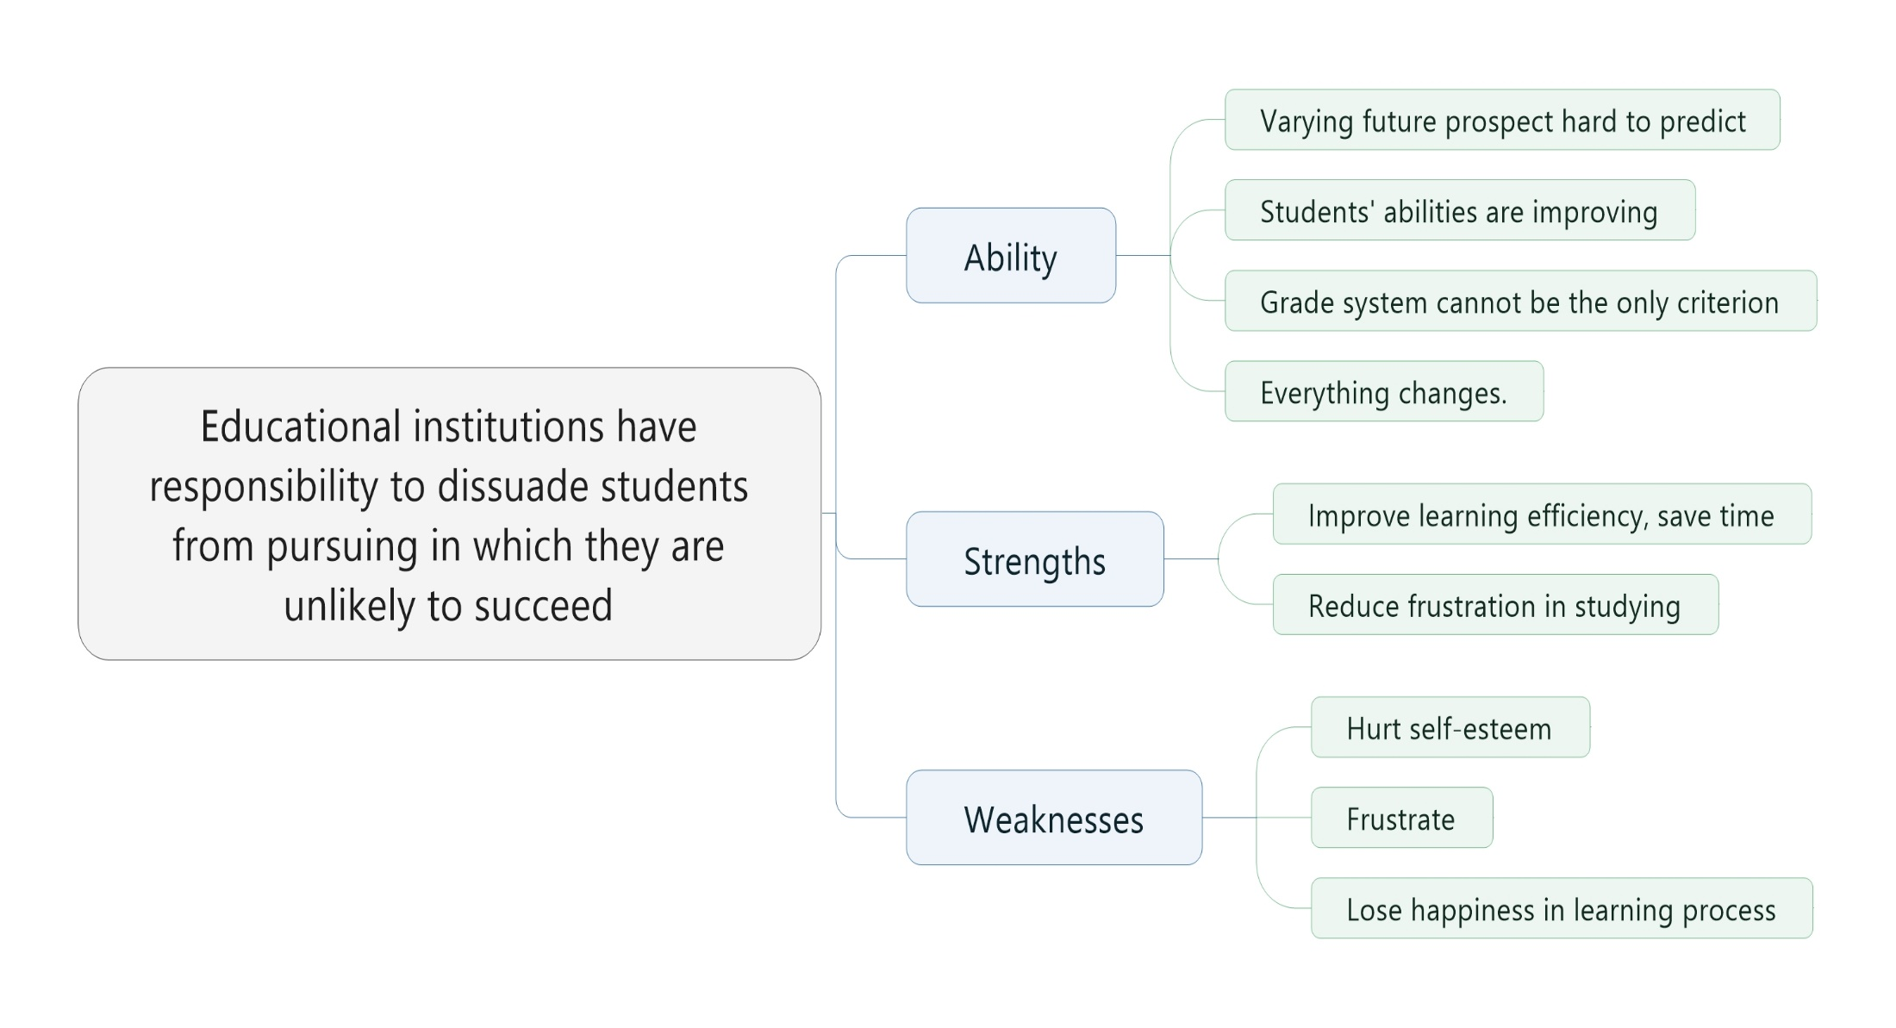

Slide 29
2
ISSUE
有的放矢
深度破题
关键论证
题型剖析
4.Write a response in which you discuss which view more closely aligns with your own position and explain your reasoning for the position you take. In developing and supporting your position, you should address both of the views presented above.
4.Write a response in which you discuss which view more closely aligns with your own position and explain your reasoning for the position you take. In developing and supporting your position, you should address both of the views presented above.
address both of the views——全面性

Slide 30
2
ISSUE
有的放矢
深度破题
关键论证
例6： Some people believe that in order to be effective, political leaders must yield to public opinion and abandon principle for the sake of compromise. Others believe that the most essential quality of an effective leader is the ability to remain consistently committed to particular principles and objectives.
Write a response in which you discuss which view more closely aligns with your own position and explain your reasoning for the position you take. In developing and supporting your position, you should address both of the views presented above.
Public opinion?
Good or not?
Some,,,, others,,,
Can’t they comply with each other?
2+0.3 但是需要有态度。还是要写比较同意哪个方面。然后全面展开。
1:需要听从民众观点 2：需要听从政府观点 0.3：这两个观点不冲突，都要听。两者都要听/或者两者是重合的。

Slide 31
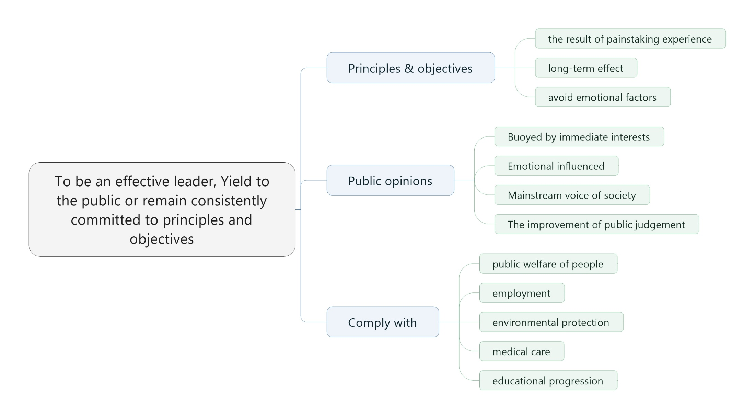
Buoy [ˈbui,]鼓励
疑问：假设站在public opinions那方，那还要不要写人民群众很容易受感情驱动这种不利因素，以及要把这种因素写在哪一段啊？
Answer from Zhu 如果支持A：一个段：A的好+B的不好；
一个段：同时A确实也存在不好，B也有点好处；
再来一段：有时候A和B是统一的。
总结起来就是，自己观点，让步一下，升华总结

Slide 32
2
ISSUE
有的放矢
深度破题
关键论证
题型剖析
5.Write a response in which you discuss the extent to which you agree or disagree with the claim AND the reason on which that claim is based.
5.Write a response in which you discuss the extent to which you agree or disagree with the claim AND the reason on which that claim is based.
Reason一段
Claim一段
Reason 和Claim的关系一段
Agree with reason | Agree with claim
Disagree with reason | Agree with claim
Agree with reason | Disagree with claim
Disagree with reason | Disagree with claim
Partly agree with reason | Partly disagree with claim

Slide 33
2
ISSUE
有的放矢
深度破题
关键论证
例8：Claim: Imagination is a more valuable asset than experience.
Reason: People who lack experience are free to imagine what is possible without the constraints of established habits and attitudes.
Write a response in which you discuss the extent to which you agree or disagree with the claim AND the reason on which that claim is based.
Claim
Reason
拆分
深化。
Reason → Claim

Slide 34
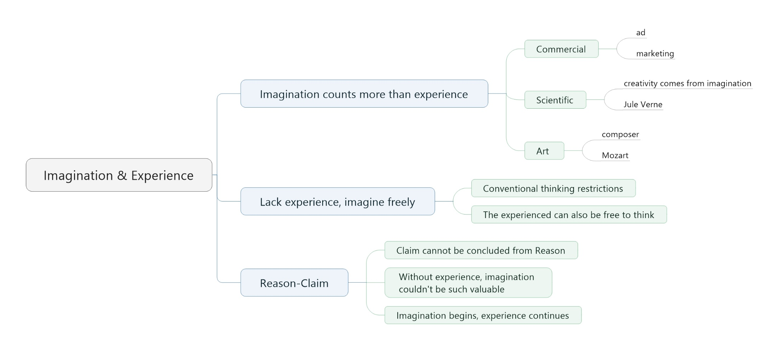
疑问：所以这个思维导图的思维是：
同意claim，部分支持reason 以及不支持两者之间的关系是吗？
Answer from Zhu:
思维导图只是把可能性都展开了。
图中Commercial里就有ad依赖创意，marketing依赖经验的分别。所以claim里面可以分开写。Reason部分也是如此。
基本上这类题目都是reason不支持claim。
然后深化主题，展现个人看法。Experience和imagination其实不是对立面。

Slide 35
2
ISSUE
有的放矢
深度破题
关键论证
例9：Claim: Many problems of modern society cannot be solved by laws and the legal systems.
Reason: Laws cannot change what is in people’s hearts or minds.
Write a response in which you discuss the extent to which you agree or disagree with the claim AND the reason on which that claim is based.
What’s in people’s minds
Change?
Many problems

Slide 36
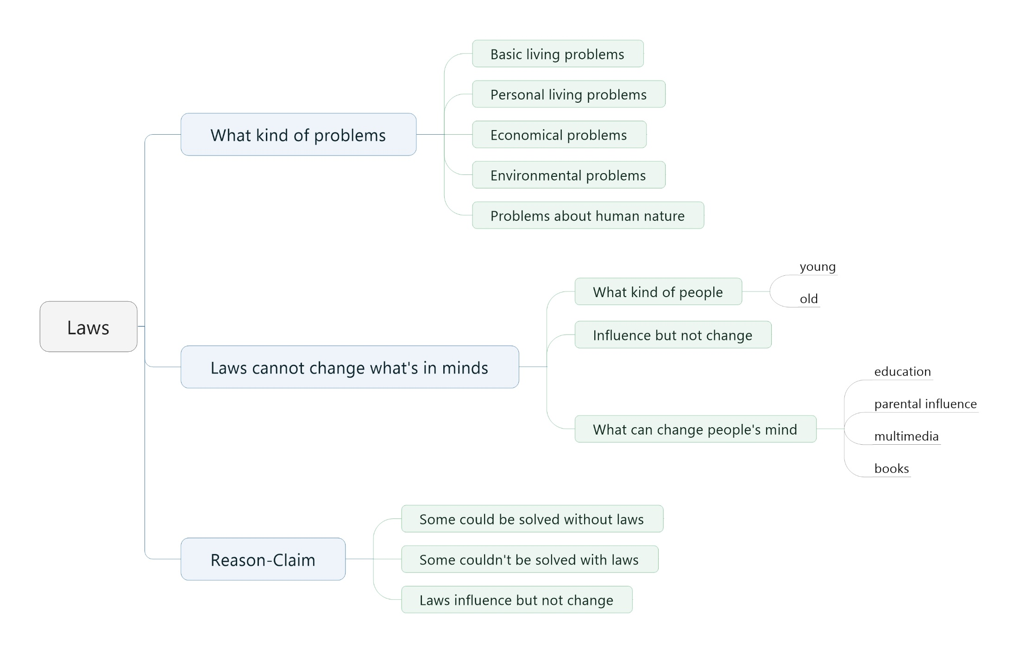

Slide 37
2
ISSUE
有的放矢
深度破题
关键论证
例10：To understand the most important characteristics of a society, one must study its major cities.
Write a response in which you discuss the extent to which you agree or disagree with the statement and explain your reasoning for the position you take. In developing and supporting your position, you should consider ways in which the statement might or might not hold true and explain how these considerations shape your position.
Most important characteristics
Major cities can reflex what?
What else could be studied?

Slide 38
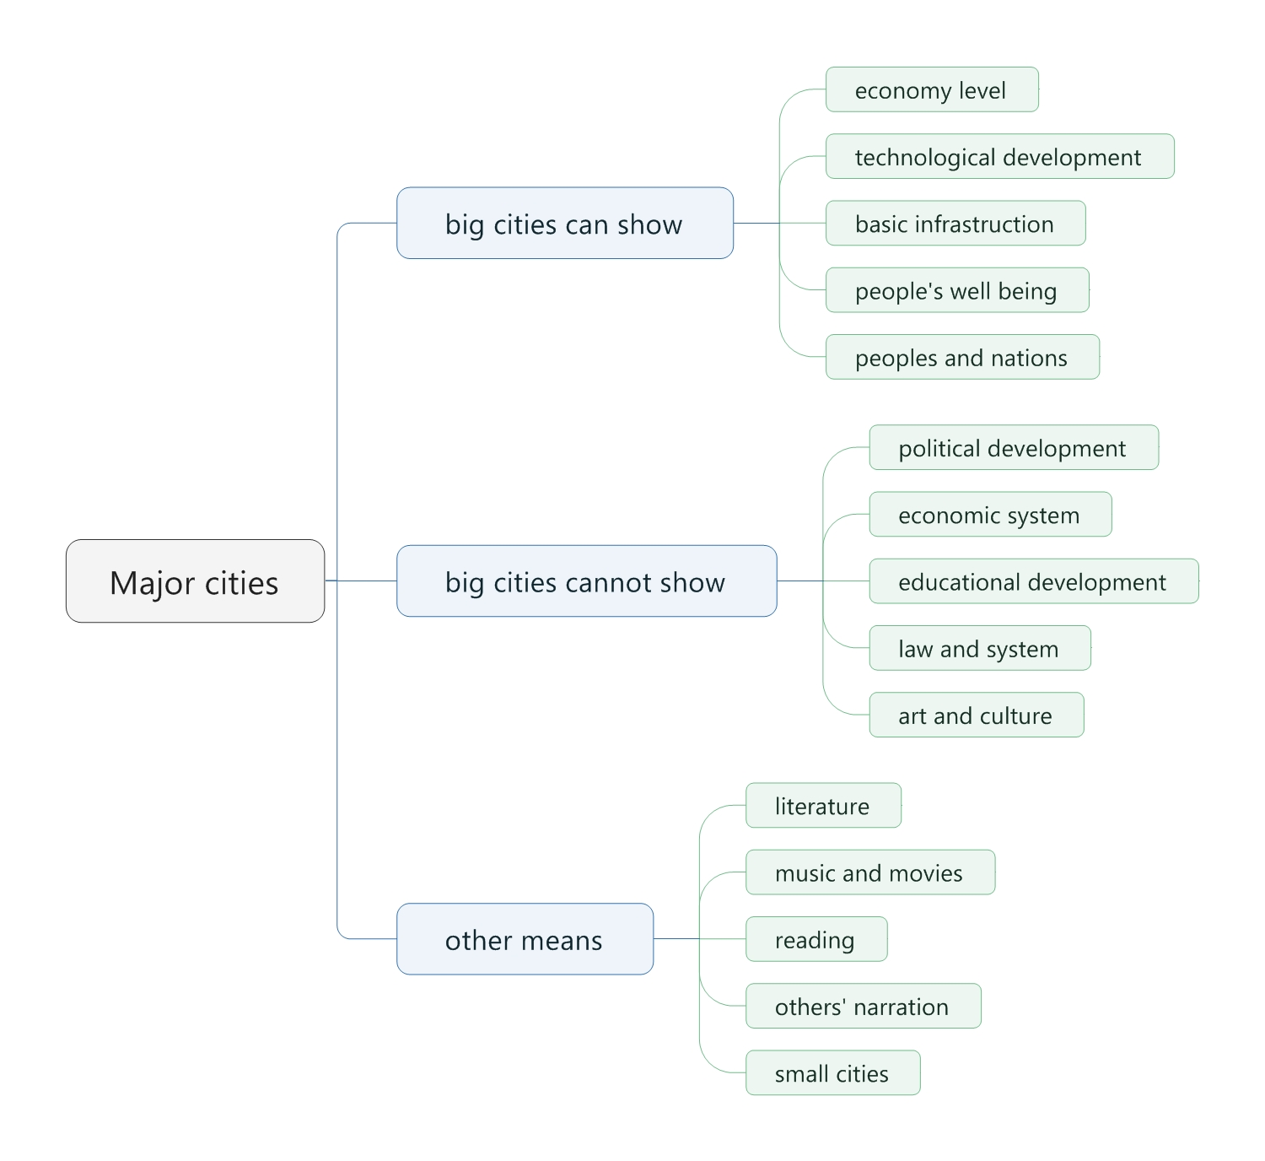

Slide 39
2
ISSUE
有的放矢
深度破题
关键论证
例13：In order to become well-rounded individuals, all college students should be required to take courses in which they read poetry, novels, mythology, and other types of imaginative literature.
Write a response in which you discuss the extent to which you agree or disagree with the recommendation and explain your reasoning for the position you take. In developing and supporting your position, describe specific circumstances in which adopting the recommendation would or would not be advantageous and explain how these examples shape your position.
Strengths
正负分析
Weaknesses

Slide 40
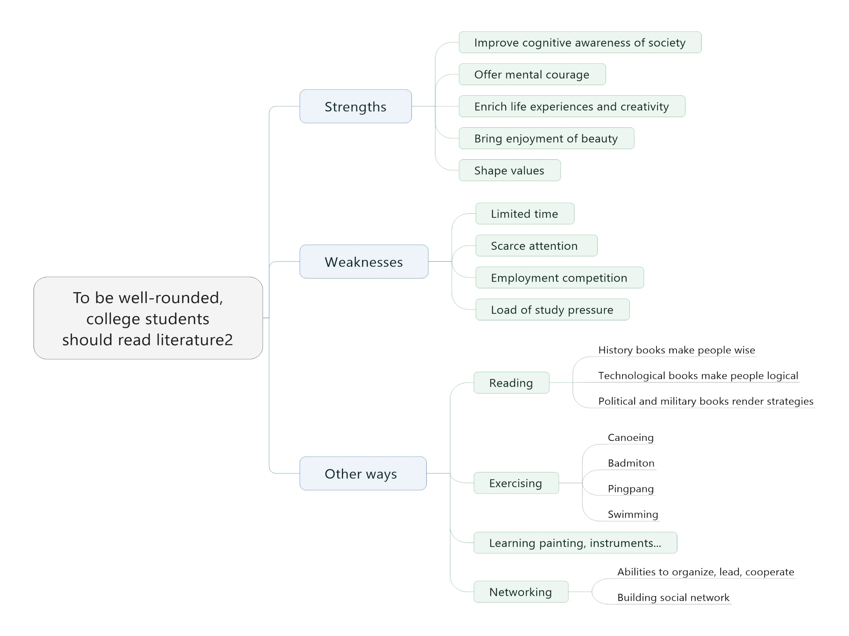

Slide 41
2
ISSUE
有的放矢
深度破题
关键论证
例14：Educators should teach facts only after their students have studied the ideas, trends, and concepts that help explain those facts.
Write a response in which you discuss the extent to which you agree or disagree with the recommendation and explain your reasoning for the position you take. In developing and supporting your position, describe specific circumstances in which adopting the recommendation would or would not be advantageous and explain how these examples shape your position.
Strengths
正负分析
Weaknesses
参考

Slide 42
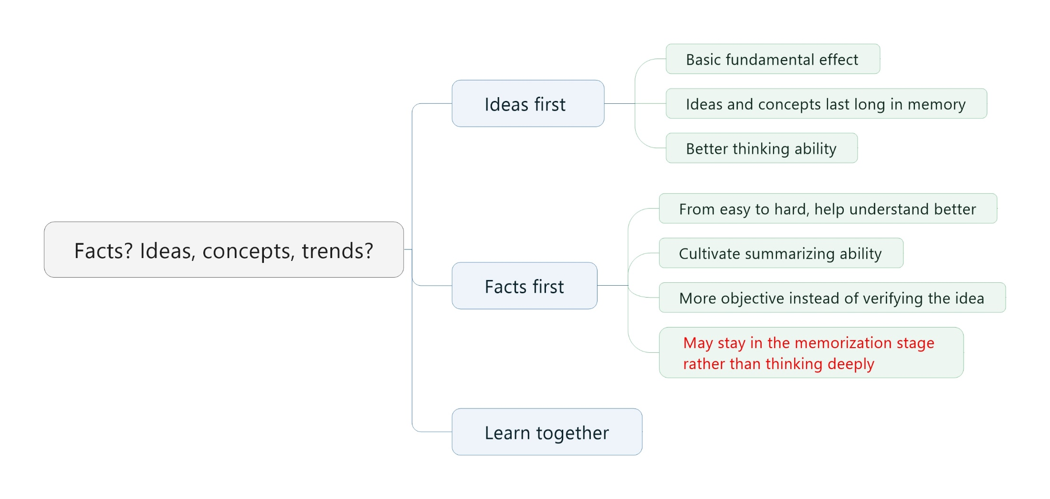
Fact first还可以帮助学生提高注意力，生动一些。
可以对学生分类。小学生Idea first 过于困难。大学生需要培养思维和形成长期该概念，所以需要ideas first。
另外中学生以成绩为目标，怎么好怎么来，可能可以learn together.

Slide 43
2
ISSUE
有的放矢
深度破题
关键论证
例15：The surest indicator of a great nation is represented not by the achievements of its rulers, artists, or scientists, but by the general welfare of its people.
Write a response in which you discuss the extent to which you agree or disagree with the statement and explain your reasoning for the position you take. In developing and supporting your position, you should consider ways in which the statement might or might not hold true and explain how these considerations shape your position.
surest
A great nation?
General welfare of its people?
参考

Slide 44
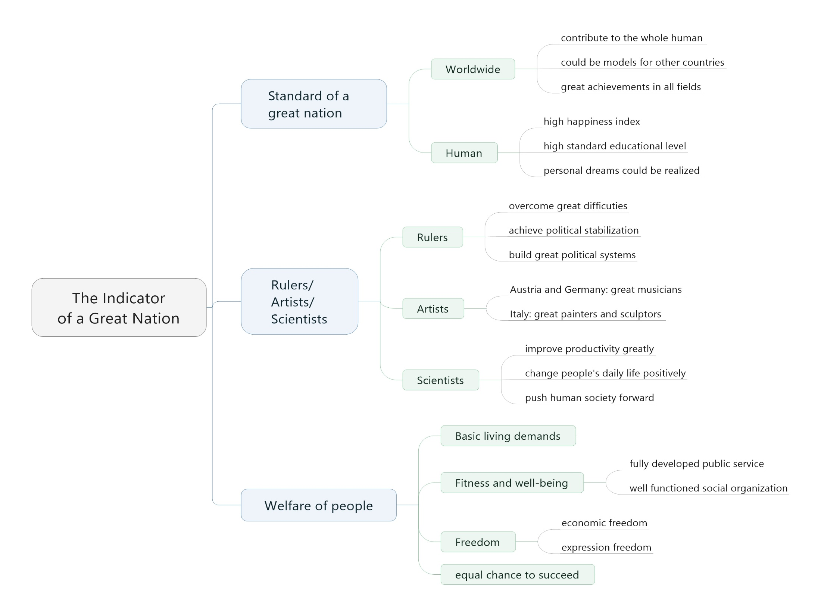

Slide 45
2
ISSUE
有的放矢
深度破题
关键论证
(114)Any leader who is quickly and easily influenced by shifts in popular opinion will accomplish little.
Write a response in which you discuss the extent to which you agree or disagree with the statement and explain your reasoning for the position you take. In developing and supporting your position, you should consider ways in which the statement might or might not hold true and explain how these considerations shape your position.

Slide 46
2
ISSUE
有的放矢
深度破题
关键论证
GRE写作ISSUE相比托福独立写作的特点？
Classified
Comprehensive
Insightful
发展阶段：
Maslow's hierarchy of needs
physiological needs （生理需求）
safety needs（安全需求）
Love and belonging needs（社会需求）
esteem needs （尊严需求）
need for self-actualization(自我实现需求)
Over Actualization（超我）
ISSUE常见分类标准？
年龄
时间
由个人到国家
领域：science/engineer/art, literature/commerce/
sociology/politics/
humanities

Slide 47
2
ISSUE
有的放矢
深度破题
关键论证
全篇结构
开头段
引出要论述的话题
主体段1
全面/分类讨论和例证
主体段2
全面/分类讨论和例证
主体段3
全面/分类讨论和例证
结尾段
总结和深化主题

Slide 48
2
ISSUE
有的放矢
深度破题
关键论证
解释抽象词
【Topic91】The primary goal of technological advancement should be to increase people’s efficiency so that they have more leisure time.
What kind of technological advancement does it refer to?
要具体化：communication、medical field/medical care system, healthcare area医疗、
Hygiene, public hygiene卫生等等。但不一定是提高效率，可能是更安全
之类的。
【Topic18】The well-being of a society is enhanced when many of its people question authority.
What does well-being mean? Which area does it refer to? Well-being, wellbeing, welfare or wellness is a general term for the condition of an individual or group, for example their social, economic, psychological, spiritual or medical state; a high level of well-being means in some sense the individual or group's condition is positive, while low well-being is associated with negative happenings.
What does authority mean? Which area does it refer to?

Slide 49
2
ISSUE
有的放矢
深度破题
关键论证
评价绝对词
every | all | any | few
best | most | highest | surest
only | always | little | greatest
【Topic13】University should require every student to take a variety of courses outside the student’s field of study.
【Topic10】Nations should pass laws to preserve any remaining wilderness areas in their natural state, even if these areas could be developed for economic gain.

Slide 50
2
ISSUE
有的放矢
深度破题
关键论证
评价绝对词
【Topic139】Claim: Major policy decisions should always be left to politicians and other government experts. Reason: Politicians and other government experts are more informed and thus have better judgment and perspective the do members of the general public.
【Topic124】All college and university students would benefit from spending at least one semester studying in a foreign country.
【Topic146】The best test of an argument is the argument’s ability to convince someone with an opposing viewpoint.

Slide 51
2
ISSUE
有的放矢
深度破题
关键论证
评价情态用语
will | willing | should | have a responsibility | must
likely | could | can | cannot | be able to
possible | impossible | necessary | primarily
【Topic1】As people rely more and more on technology to solve problems, the ability of humans to think for themselves will surely deteriorate.
【Topic27】In any field of inquiry, the beginner is more likely than the expert to make important contributions.

Slide 52
2
ISSUE
有的放矢
深度破题
关键论证
评价情态用语
【Topic76】We can usually learn much more from people whose views we share than from people whose views contradict our own.
【Topic131】Claim: Researchers should not limit their investigations to only those areas in which they expect to discover something that has an immediate, practical application.
Reason: It is possible to predict the outcome of a line of research with any certainty.
【Topic2】To understand the most important characteristics of a society, one must study its major cities.

Slide 53
2
ISSUE
有的放矢
深度破题
关键论证
开头段
1、转述话题
The statement asserts/ maintains /claims/ believes/ argues that...
According to the statement, ...
(101) Although innovations such as video, computers, and the Internet seem to offer schools improved methods for instructing students, these technologies all too often distract from real learning.
The statement asserts that innovations such as video, computers, and the Internet too often distract from "real" learning in the classroom. I strongly agree that these tools can be counterproductive in some instances, and ineffectual for certain types of learning. Nevertheless, the speaker's assertion places too little value on the way in which these innovations can facilitate the learning process.

Slide 54
2
ISSUE
有的放矢
深度破题
关键论证
开头段
1、转述话题
The statement asserts/ maintains /claims/ believes/ argues that...
According to the statement, ...
(34) In any situation, progress requires discussion among people who have contrasting points of view.
The statement contends that progress is best made through discourse among people with opposing opinions and viewpoints. I strongly agree with this contention. In all realms of human endeavor, including the behavioral and natural sciences as well as government and law, debate and disagreement form the foundation for progress.

Slide 55
2
ISSUE
有的放矢
深度破题
关键论证
开头段
2、设问
把Issue改写成一个疑问句：Do/Should/Have…?
(76) We can usually learn much from people whose views we share than from people whose views contradict our own.
Do we learn more from people whose ideas we share in common than from those whose ideas contradict ours, as the statement asserts? I concede that undue discord can impede learning. Otherwise, in my view we learn far more from discourse and debate with those whose ideas we oppose than from people whose ideas are in accordance with our own.
Concede 承认
Undue 过分的 discord不和谐，不一致
Impede 妨碍，阻碍
in accordance with 与…一致 in accord with 符合

Slide 56
2
ISSUE
有的放矢
深度破题
关键论证
开头段
2、设问
把Issue改写成一个疑问句：Do/Should/Have…?
(41) The greatness of individuals can be decided only by those who live after them, not by their contemporaries.
Can a person's greatness be recognized only in retrospect, by those who live after the person, as the statement maintains? In my view the speaker unfairly generalizes. In some areas, particularly the physical sciences, greatness, must be tested over time before it can be confirmed. In still other areas, such as business, the incubation period for greatness varies from case to case.

Slide 57
2
ISSUE
有的放矢
深度破题
关键论证
结尾段
有时间大总结，没时间小总结。
(33) As we acquire more knowledge, things do not become more comprehensible, but more complex and mysterious.
In sum, the statement overlooks a paradox about knowledge acquired, at least when it comes to understanding the physical world. When through knowledge a thing becomes more comprehensible and explainable we realize at the same time that it is more complex and mysterious than previously thought.

Slide 58
2
ISSUE
有的放矢
深度破题
关键论证
结尾段
(93) Unfortunately, in contemporary society, creating an appealing image has become more important than the reality or truth behind that image.
In the final analysis, it seems that in every endeavor where success depends to some degree on persuasion, marketing, or salesmanship, image had indeed become the central concern of those who seek to persuade. And as our lives become busier, our attention spans briefer, and our choices among products and services greater, I expect this trend to continue unabated.
Salesmanship:销售

Slide 59
2
ISSUE
有的放矢
深度破题
关键论证
整体思路
（42） always be skeptical
In my view, although undue skepticism might be counterproductive for a young child's education, I strongly agree with the speaker otherwise.
Skepticism is perhaps most important in the physical sciences.
The value of skepticism is not limited to the physical sciences, of course. In the fields of sociology and political science, students must think critically about the assumptions underlying the status quo.
Even in the arts, students must challenge established styles and forms rather than learn to imitate them otherwise, no genuinely new art would ever emerge.
Admittedly, undue skepticism might be counterproductive in educating young children. 从反面进行全面论述。Counterproductive:有反面作用的
To sum up, skepticism is the very stuff that progress is made of, whether it be in science, sociology, politics, the law, or the arts. Therefore, skepticism should be encouraged at all but the most basic levels of education.

Slide 60
2
ISSUE
有的放矢
深度破题
关键论证
整体思路
（55） In order for any work of art—for example, a film, a novel, a poem, or a song—to have merit, it must be understandable to most people.
The speaker's assertion that art must be widely understood to have merit is wrongheaded. The speaker misunderstands the final objective of art, which has little to do with cognitive “understanding.”
First consider the musical art form.
Next consider the art forms of painting and sculpture.
Finally, consider art forms such as poetry, song, and prose, where the use of language is part-and-parcel of the art.
Have merit 获得优点，拥有价值
Prose 散文
part-and-parcel 一部分

Slide 61
2
ISSUE
有的放矢
深度破题
关键论证
过渡衔接
1. 承上启下
…could not be held responsible for …. There had to be another cause, and there was, ….
Nonetheless, returning soldiers could not be held responsible for the social upheaval that America experienced. There had to be another cause, and there was, the media.
…is not limited to…. In the fields of …
The value of skepticism is not limited to the physical sciences, of course. In the fields of sociology and political science, students must think critically about the assumptions underlying the status quo.

Slide 62
2
ISSUE
有的放矢
深度破题
关键论证
过渡衔接
2. 引出例子
A quick reflection on …reveals how…
快速回顾一下典型的一天就会揭示科技是如何变革这个世界的。
A quick reflection on a typical day reveals how technology has revolutionized the world.
History is replete with examples…
历史是充满了艺术的伟大的例子，立即得到承认，然后证实。
History is replete with examples of artistic greatness immediately recognized, then later confirmed.

Slide 63
2
ISSUE
有的放矢
深度破题
关键论证
过渡衔接
3. 例子表达
For example, in challenging the notion that the Earth was in a fixed position at the center of the universe, Copernicus paved the way for the corroborating observations of Galileo a century later, and ultimately for Newton's principles of gravity upon which all modern science is based.
The staggering cumulative impact of Copernicus' rejection of what he had been taught is proof enough of the value of skepticism.
In the area of dance Balanchine showed by way of his improvisational techniques his skepticism about established rules for choreography.
不要背整个句子。会查重。只要背短语。比如Newton’s principles of gravity.
例子要简短，细节不要太多，写完例子加一个简单的解释。

Slide 64
2
ISSUE
有的放矢
深度破题
关键论证
Q: Many important discoveries or creations are accidental: it is usually while seeking the answer to one question that we come across the answer to another.
Discovery often occurs accidentally
Geography: Columbus discovered continent
Science: Fleming discovered penicillin
Anthropology: archeological artifacts

Slide 65
2
ISSUE
有的放矢
深度破题
关键论证
Turning first to discoveries, I agree that discovery often occurs when we unexpectedly happen upon something in our quest for something else—such as an answer to an unrelated question or a solution to an unrelated problem. A variety of geographical, scientific, and anthropological discoveries aptly illustrates this point. In search of a trade route to the West Indies Columbus discovered instead an inhabited continent unknown to Europeans; and during the course of an unrelated experiment Fleming accidentally discovered penicillin. In search of answers to questions about marine organisms, oceanographers often happen upon previously undiscovered, and important, archeological artifacts and geological phenomena; conversely, in their quest to understand the Earth’s structure and history geologists often stumble upon important human artifacts. In light of the foregoing examples, “intentional discovery” might seem an oxymoron; yet in fact it is not. Many important discoveries are anticipated and sought out purposefully.

