Slide 1
刷题？
1、单词记忆声音化
2、掌握基本听力词汇
3、牢记托福专业词汇
4、注意长句的理解，有意识地注意断句
5、利用逻辑关系
6、控制住自己

Slide 2
掌握听力词汇
1. 专业词汇按学科学习
2. 熟悉通用的动词、形容词、大类别的名词

Slide 3
第一轮听写
捕捉课程名称

Slide 4
1、Contemporary art
2、Geology
3、Archaeology
4、Biology
5、Botany
6、Astronomy
7、Environmental science
8、Literature
9、Chemistry
10、Economics
11、Earth science
12、Theater history
13、Animal behavior
14、Marine biology
15、Ecology
16、Anthropology
17、Sociology
18、Psychology
19、Linguistics
20、Philosophy
21、Architect

Slide 5
基础词汇辨音小测

Slide 6
T34L3
You can see that the relationship between pollinators and plants are , so any number of factors can them.

Slide 7
You can see that the relationship between pollinators and plants are delicate, so any number of factors can disturb them.

Slide 8
T6L2
It remained for so long because it's so . There are only about 200 of them in existence.

Slide 9
It remained hidden for so long because it's so rare. There are only about 200 of them in existence.

Slide 10
we found fossils that old that bear remarkable to the tree.
so it's a tree.

Slide 11
we found fossils that old that bear remarkable resemblance to the tree.
so it's a primitive tree.

Slide 12
利用逻辑关系

Slide 13
It appears that the shell has to crack open or break down somewhat to allow the seed to soak up water.

Slide 14
but that's not an irrelevant or inappropriate behavior.

Slide 15
Now in disinhibition, the basic idea is that two drives that seem to inhibit, to hold back, a third drive.

Slide 16
T21L3
Ok, venomous snakes are the ones that secrete or venom, like the snakes of the viper family or cobras, then there is snakes like constrictors and pythons.

Slide 17
Ok, venomous snales are the ones that create poisonous substances or venom, like the snakes of the viper family or cobras, then there is non-venomous snakes like constrictors and pythons.

Slide 18
T23L3
And dolphins, well, they actually produce two types of sounds.
Uh, one being you are probably all familair with, which they emit through their blowhole.

Slide 19
And dolphins, well, they actually produce two types of sounds.
Uh, one being the vocalizations you are probably all familair with, which they emit through their blowhole

Slide 20
T4L1
Ok, the next kind of animal behavior I want to talk about might be familiar to you.You may have seen, for example, a bird that's in the middle of ritual, and suddenly it stops and preens, you know, takes a few moments to , and then returns to the
ritual.
This kind of behavior, this doing something that , is what we call a "Displacement Activity".

Slide 21
T4L1
Ok, the next kind of animal behavior I want to talk about might be familiar to you.You may have seen, for example, a bird that's in the middle of a mating ritual, and suddenly it stops and preens, you know, takes a few moments to straighten its feathers, and then returns to the mating ritual.
This kind of behavior, this doing something that seems completely out of place, is what we call a "Displacement Activity".

Slide 22
T23L3
Now, the melon is kind of a large sac-like pouch, made up of .

Slide 23
Now, the melon is kind of a large sac-like pouch, made up of fat tissue.

Slide 24
Nectar

Slide 25
T34l3
Nectar is mainly a sugar solution, while pollen is a grain made up of part of the plant's cell structure.

Slide 26
T6L2
so the shell somehow has to be broken down before this germination ability expires.

Slide 27
专业词汇
“
mammal, reptile, amphibian
herbivore（Grazer）, carnivore
rodent, primate
vertebrate, invertebrate (insect/pest ;worm)
beaver, squirrel, rhinoceros
”

Slide 28
Anatomy
newborn：egg， larva，caterpillar, chick，fledgling，hatchling, young animal，pup, baby，calf，cub, whelp
mature：adult，experienced，seasoned
offspring， descendant
claw, paw, jaw, skull, skeleton, backbone, rib, cranial, fur, feather, coat , limb, extremity,core, shell, lung, liver, kidney, gland, tissue,fat
muscle, muscular
nerve, neuro， nose， nasal
Notes:
aa

Slide 29
词汇学习--动物行为
survive
survival, adaptation, adjust : defense （camouflage, disguise, mimic, blend with, transform ） escape, attack, migrate
digest, digestive, respire, expire
forage, hunt, prey, predator
nest, inhabit/ habitat, reside, nestle
preen, groom, straighten, tidy-- mate--reproduce, breed, proliferate, spawn-- brood, hatch, incubate--feed, feed on; cope, allocate-- align
thrive
“
”

Slide 30
第二轮听写
捕捉主题（主旨）词

Slide 31
关键词原则
1、重音
2、线性(意群停顿)
3、注意否定
4、主语

Slide 32
Focus Identification; 05:42
A:I lost my hat.
B:What kind of hat?
A:It was a rain hat.
B:What colour rain hat?
A:It was a white hat. White plastic.
B:Mmmm.There was a white hat in the car.
A:Which car? Where is the car?
B:I've sold the car.

Slide 33
对话合作原则
清晰地传递信息
顺利地开展对话
听
说

Slide 34
It remained hidden for so long because it's so rare. There are only about 200 of them in existence.

Slide 35
T48L3
Well, if the ants don't feed regularly on the liquid from the caterpillar's honey gland, the gland overloads and gets infected.The infection will kill the caterpillar and it will never reach its final stage of development, becoming a butterfly.

Slide 36
线性
Well, if the ants don't feed regularly on the liquid from the caterpillar's honey gland, the gland overloads and gets infected.The infection will kill the caterpillar and it will never reach its final stage of development, becoming a butterfly.

Slide 37
ABC
C-DE
C+DE

Slide 38
第三轮听写
捕捉语气词

Slide 39
It's a strong case to me.
The case is that.

Slide 40
T25L4
That hypothesis makes a lot of sense, like, maybe the most sense of all the theories we read about.

Slide 41
Oh, I don't know about that, I mean, some of the things the young animal does while playing are totally different from the things they will do as an adult.

Slide 42
2
So this self-handicapping is important to take this into account before just deciding to go with that first explanation.
And in fact, there really isn't much in the way of solid experimental evidence to support the play-as-preparation hypothesis.
before 两个事件的矛盾

Slide 43
3
This notion, the flexibility hypothesis, well, many of my colleagues find it quite persuasive.

Slide 44
T4L1
How about an animal that, um, instead of fighting its enemy or running away, it attacks a plant or a bush?
That's really good suggestion, Karl. But that's called "redirecting".

Slide 45
听懂暗示
多少、有无、大小表示修饰重要性
mean a lot, mean so much/ so little
( not) make sense
play a part in
someone, somebody, nobody
big day, small influence

Slide 46
考考你的表达是否地道：
1.理所当然
2.机会很小
3.开玩笑
4.极好的
5.搞砸了

Slide 47
考考你的表达是否地道：
1.理所当然 Tell me about it ! Is ice cold?
2.机会很小 There is a short window of opportunity. The chance is very slim.
3.开玩笑 It's a joke! I'm kidding ! Are you pulling my leg?
4.极好的 Terrific!
5.搞砸了 I messed up. I screwed it up.

Slide 48
长句
1、假长句
2、真长句

Slide 49
T4L1
Ok, the next kind of animal behavior I want to talk about might be familiar to you.You may have seen, for example, a bird that's in the middle of a mating ritual, and suddenly it stops and preens, you know, takes a few moments to straighten its feathers, and then returns to the mating ritual.
This kind of behavior, this doing something that seems completely out of place, is what we call a "Displacement Activity".

Slide 50
2
That's exactly what I mean.Displacement occurs because the animal's got two conflicting drives - two competing urges, in this case, fear and hunger.
And what happens is, they inhibit each other, they cancel each other out in a way, and a third seemingly irrelevant behavior surfaces through a process that we call "Disinhibition".

Slide 51
定语从句练习T6L2

Slide 52
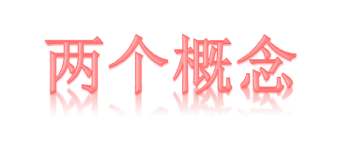
先行词：
被定语从句修饰的名词或代词；= C
连接词：
连接主句和从句。

Slide 53
定语从句练习 T6L2
the Nightcap Oak

Slide 54
定语从句练习
Now another interesting thing about the Nightcap Oak is that it is, it represents, er... a very old type, er... kind of tree that grew a hundred million years ago.

Slide 55
It's not a remnant of some huge population that has dwindled in last few hundred years for some reason.

Slide 56
And it, it's probably a kind of tree from which other trees that grow in Australia today evolved.

Slide 57
T34L3
It can fragment habitats in a variety of ways reducing the number of pollinators which in turn may reduce the number or size of the flowers which of course affect the animals that feed on them.

Slide 58
T34L3
It can fragment habitats in a variety of ways, reducing the number of pollinators which, in turn, may reduce the number or size of the flowers which, of course, affect the animals that feed on them.

Slide 59
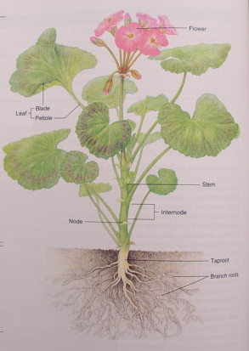
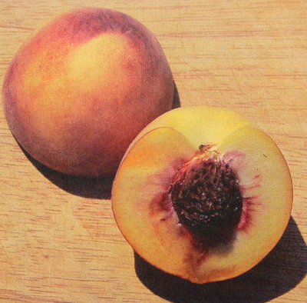
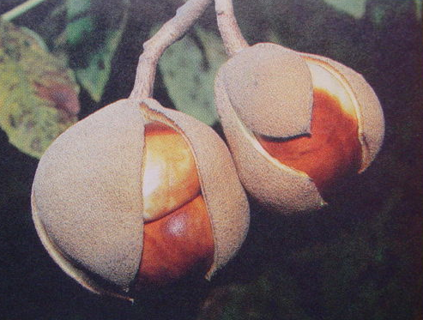
花（flower）
叶（leaf）
茎（stem）
根（root）
果实（fruit）
种子（seed）

Slide 60
pollinator
nectar
pollen
odor, fragrance, scent
germinate, bloom/flower, wither, disperse, scatter
evolution, mutation,demotion

Slide 61
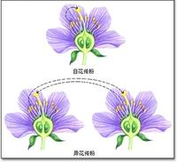
传粉（pollination）：花粉以各种方式传送到雌蕊柱头上的过程
异花传粉(cross-pollination) cross-fertilize
传粉方式
自花传粉（self-pollination)
传粉媒介
风媒
水媒
虫媒
水媒
鸟媒

Slide 62
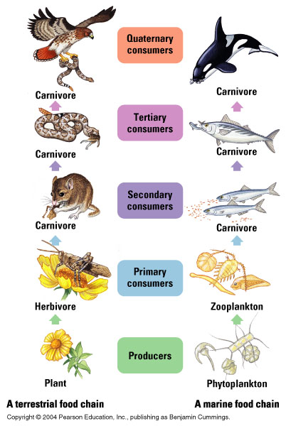
Example of Food chain

Slide 63
作业
1、必做作业：复习课上PPT词汇朗读，T4L1；T34L3；T6L2
2、选做作业：完成T16L3；T28L3；T25L4

