Slide 1
生命学科
听力练习2

Slide 2
So if there're people or dogs on the beach, the in the nests are really .

Slide 3
So if there're people or dogs on the beach, the eggs and fledglings in the nests are really vulnerable.

Slide 4
OK. Well, Watson makes the assumption that activity is thinking.

Slide 5
OK. Well, Watson makes the assumption that muscular activity is equivalent to thinking.

Slide 6
So a decline in starfish , the starfish population can increase.

Slide 7
So with a decline in starfish predators, the starfish population can increase.

Slide 8
One hypothesis is that it's , that the starfish naturally undergo following particularly good .

Slide 9
One hypothesis is that it's a natural phenomenon, that the starfish naturally undergo population fluctuations following particularly good spawning years.

Slide 10
so this can cause a kind of .

Slide 11
so this can cause a kind of mass feeding frenzy.

Slide 12
听力预测
开头
主旨句
结构
内容
表达

Slide 13
T14L2 微气候
1、判断主旨句
2、预测结构、内容、结构
3、验证

Slide 14
And microclimates are affected by a huge number of other variables.
Obviously weather conditions in the surrounding area are a factor.
But other aspects of the location like... um... the elevation of the land, the plant life nearby and so on have a substantial effect on microclimates.
And of course the human development in the area... um... a road will affect a nearby microclimate.

Slide 15
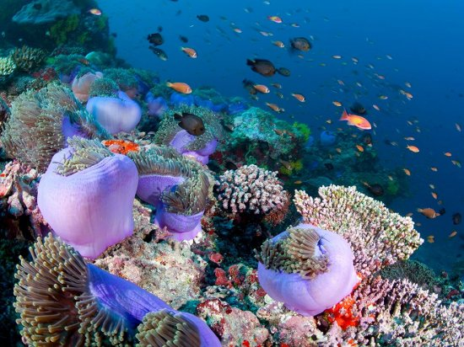
T31L3

Slide 16
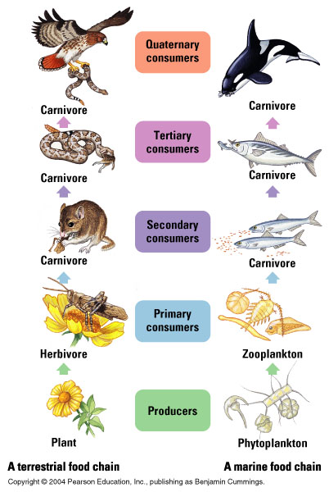
Example of Food chain

Slide 17
 | Symbiosis Mutualism | Prey Predator | Competitor | Decomposer Producer Consumer

Slide 18
Q1
Coral reefs VS The Crown of Thorns （ Cot starfish）关系？

Slide 19
What cause the population to increase so suddenly?
Hypotheses | Explanations | Attitudes

Slide 20
Natural phenomenon
One hypothesis is that it's a natural phenomenon, that the starfish naturally undergo population fluctuations following particularly good spawning years.

Slide 21
runoff
drawback
pickup
breakdown
runaway
breakthrough
outbreak
output
input
income
outcome

Slide 22
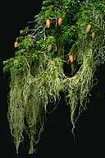
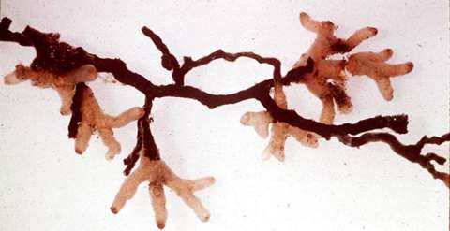
Symbiosis（共生） - mutualism
Lichen(fungus+algae)
Parasitism寄生
parasite
Lichen
地衣
Notes:
Symbiosis – 2 or more species live together in close association
Mutualism = both benefit
Lichen = algae + fungi
Mycorrhizae – fungus + plant, fungus helps with water absorption, ion transfer; tree supplies fungus with food (carbohydrates)
Lichens are a symbiosis between a photosynthetic organism (alga or cyanobacterium) and a fungus (sac or club). Mycorrhizae are fungi (usually a zygomycete or basidiomycete) symbiotic with the roots of plants. Both relationships are mutualistic: both parties benefit. Fungi provide nutrients from the substrate, the phototroph provides food. Plants with mycorrhizae grow better: the plant gets nutrients from the fungus in exchange for carbohydrates.
The word "mycorrhizae" literally means "fungus-roots" and defines the close mutually beneficial relationship between specialized soil fungi (mycorrhizal fungi) and plant roots. About 95% of the world’s land plants form the mycorrhizal relationship in their native habitats. It is estimated that mycorrhizal fungal filaments explore hundreds to thousands more soil volume compared to roots alone. Benefits include:
Improved nutrient and water uptake
Improved root growth
Improved plant growth and yield
Improved disease resistance
Reduced transplant shock
Reduced drought stress
http://www.mycorrhizae.com/WhatAreMyco.php

Slide 23
T48L3共生关系
symbiosis VS mutualism?

Slide 24
主旨
Example:
Explanation:
Reason:
what makes this relationship obligatory for the caterpillar?

Slide 25
主旨
Example:
Explanation:
Reason:
what makes this relationship obligatory for the caterpillar?
Well, if the ants don't feed regularly on the liquid from the caterpillar's honey gland, the gland overloads and gets infected.
The infection will kill the caterpillar and it will never reach its final stage of development, becoming a butterfly.

Slide 26
肯定否定 形容词
It doesn't make him a neuroscientist.

Slide 27
against
before
beyond
beside
off
out of

Slide 28
语气语调
Is everyone with me so far?
You are onto something.
On second thought, um, I'm probably way off.
You are pretty close actually.
You are almost here.
Ok, I just want to make sure I'm following here.
So it's still called mutualism even though it seems like the caterpillar's getting way more out of it.
There are ways around the last one.
They went around the town, not through it.

Slide 29
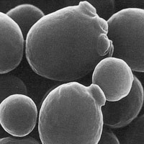
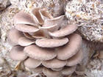
Effects of bacteria on other organisms
Benefits：
Decompose dead materials and wastes
Produce foods，chemicals，protein and
antibiotics and vitamins
Metabolize oil
Inhibit pathogenic bacteria
Aid digestion by releasing nutrients and enzymes，
Fix nitrogen

Slide 30
Types of microorganisms
bacteria
algae
yeast
mold
mushroom
germ
Fungi (真菌）

Slide 31
Element
Zinc, lead, Carbon, Carbonic acid,
Phosphorus,Oxygen,Hydrogen
hydrate, dehydrate
Sulfur, Sulfuric
fossil fuel: oil, coal, natural gas, methane
molecule, molecular, atom,compound
green house effect

Slide 32
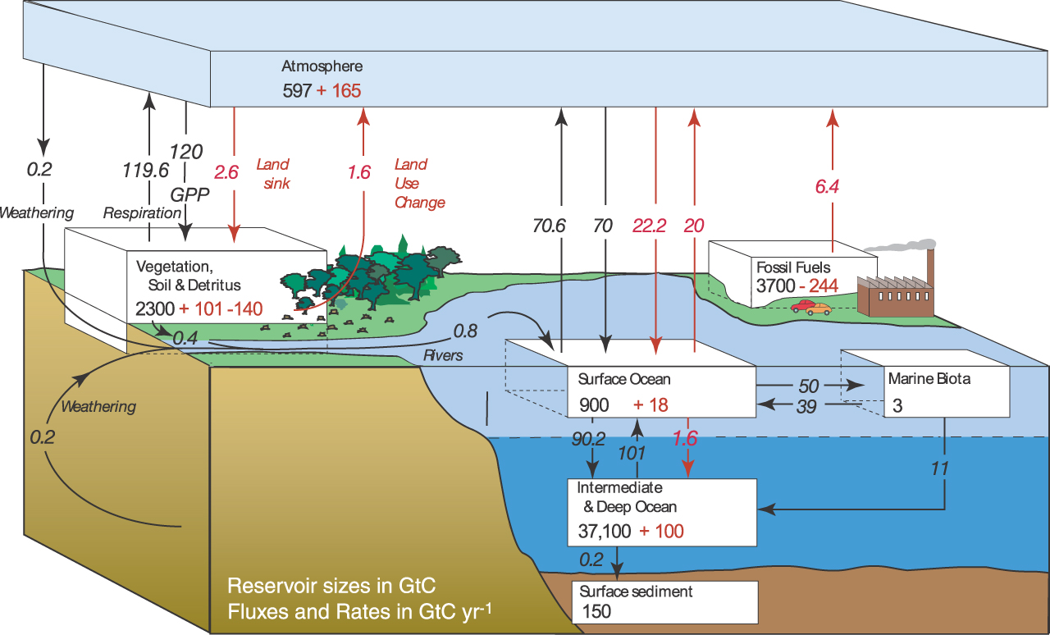

Slide 33
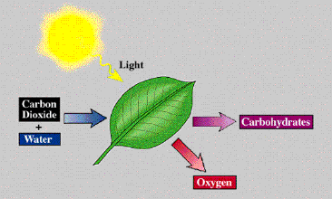
Enzyme

Slide 34
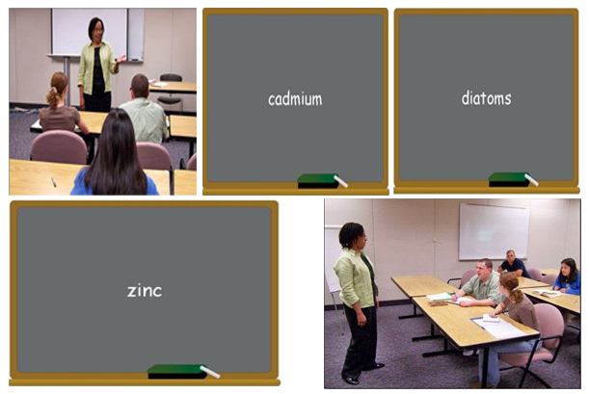
T26L2 碳循环

Slide 35
Name | Explanation | Function
zinc
cadium
diatoms

Slide 36
What is the lecture mainly about?
A. The discovery of a previously unknown trace metal
B. The role trace metals play in carbon cycling
C. Ways that living organisms rid themselves of trace metals
D. Ways that zinc interacts with carbon dioxide

Slide 37
What does the professor imply about the conversion of carbon dioxide molecules in plants?
A. It is an unusually complex chemical process.
B. It only takes place in full sunlight.
C. It proceeds slowly when cadmium is present.
D. It is regulated by an enzyme that may contain zinc.

Slide 38
According to the professor, why is it surprising that many marine plants are able to survive near the surface of oceans?
A. Weather conditions near the surface disrupt certain life processes.
B. The salt content of surface waters is constantly changing.
C. Surface waters contain low quantities of zinc.
D. Surface waters absorb large amounts of carbon dioxide.

Slide 39
According to the professor, what important function do diatoms serve?
A. They alter cadmium so it is less toxic to humans.
B. They help cycle zinc in places where it is scarce.
C. They distribute carbon throughout the ocean.
D. They remove cadmium from the ocean floor.

Slide 40
What point does the professor make when she talks about cadmium being poisonous to humans?
A. That cadmium and zinc can serve a similar function in plant enzymes
B. That both cadmium and zinc are rare in plant enzymes
C. That most trace metals are poisonous to humans
D. That cadmium does not serve any biological purpose

Slide 41
The professor states that the discovery of an enzyme containing cadmium is important. What are two reasons that this discovery is important?
Click on 2 answers
A. It may lead to the discovery of new enzymes that use other trace metals.
B. It may explain the ocean’s increased level of carbon dioxide.
C. It may explain the scarcity of some elements in the ocean.
D. It may help scientist better understand global warming.

Slide 42
作业
1、复习词汇，朗读发音频。
2、精听T26L2，发做题截图。
3、选做辨音音频，T27L1，阅读T17P3。

