Slide 1
绘画练习
听力练习5

Slide 2
The work gave its name, yet scholars have debated exactly where and when it was made.

Slide 3
The work gave the Impressionist movement its name, yet scholars have debated exactly where and when it was made.
该作品掀起了印象派运动，它的创作地点及时间还一度成为学者们口中争论的对象。

Slide 4
But Neel wasn't satisfied with , she went beyond that.

Slide 5
But Neel wasn't satisfied with photo-like realism, she went beyond that.

Slide 6
Along with this extraordinary ability, these and
geckos could also survive long sea passages on rafts, and even the force of cyclones.

Slide 7
Along with this extraordinary ability, these thick-skinned and salt-resistant geckos could also survive long sea passages on rafts, and even the force of cyclones.
除了这特别的能力外，这些厚皮耐盐的壁虎还能搭乘浮木在海上长途漂泊，甚至能经受住气旋的巨大威力。

Slide 8
the only way to check had been to remove a piece .

Slide 9
the only way to check the canvas had been to remove a piece destructively.
但是检验画布的方法只能是破坏性的扯下一块。

Slide 10
technology -- known as three-D -- gives to objects that would otherwise appear two-dimensional, or flat.

Slide 11
Three-dimensional technology -- known as three-D -- gives depth to objects that would otherwise appear two-dimensional, or flat.
三维技术(3D)使得原本以二维表现的平面物体有了厚度，不显得平。

Slide 12
听力套路
听力考点
可预测
听力结构
很单一
听力表达
多重复
听力内容
勿需全懂全记

Slide 13
结构
并列 | 主旨 | 论点1 | 论点2 | 论点3 | 评价总结
比较 | 主旨 | AB比较 | AB比较 | AB比较 | 评价总结
时间 | 主旨 | 时间点1 | 时间点2 | 时间点3 | 评价总结
过程 | 主旨 | 步骤1 | 步骤2 | 步骤3 | 评价总结
问答 | 主旨 | 回答1 | 问答2 | 问答3 | 评价总结

Slide 14
听懂
背景知识
音
反应
词性转换
相似音
难音
词
活用
习惯表达
一词多义
句
重点
逻辑关系
解释
转折
比较
并列
因果
假设
篇章

Slide 15
篇章
段落
3
句
2
1
听懂阶段

Slide 16
关键词提取
1、单词的重音
predator, competitor
record, record
2、语句的重音
a、在于对句子结构的强调，在不考虑特殊情况与语境时，一般实词要重读（名词，动词，形容词，副词，数词等）而虚词不需要重读。
b、句子需要强调某个内容，重音转移到该内容。

Slide 17
重读名词
In fact, she was the first full-time female at the Pennsylvania Academy of the Fine Arts.And she was of the National Academy of Design.
These are pretty important , so, yeah, she definitely made headway for women artists.

Slide 18
T20L1
It was so intuitive, so sensible that the Earth was the center of the universe that astronomers found ways to explain those seemingly inconsistent phenomena within the geocentric view.

Slide 19
In fact, she was the first full-time female instructor at the Pennsylvania Academy of the Fine Arts.And she was a full member of the National Academy of Design.
These are pretty important institutions, so, yeah, she definitely made headway for women artists.
Instructor 讲师
full member 正式成员
institute institution

Slide 20
听不清
1、听不清某词汇，等等后面的解释；
如果没有，很有可能不考；
如果考了，根据关键词，排除选项
2、听语气能决定
3、准备出重听题，再放一遍

Slide 21
T19L4
And also, they make the woman seem very , seems like she is thinking pretty seriously about something.

Slide 22
T19L4
And also, they make the woman seem very contemplative, seems like she is thinking pretty seriously about something.

Slide 23
T19L4
What do you see is about it?
Well, the background behind the woman is pretty
.

Slide 24
What do you see is dreamlike about it?
Well, the background behind the woman is pretty vague.
Like, maybe there is no real context, like no definite surroundings, expecially compared to the woman herself, since she is so clear and well-defined.
-like 像...的
fish-like wife-like life-like dome-like
vague well-difined well-structured well-polished well-decorated

Slide 25
T7L4
You already know that ice is brittle.
If you hit it with hammer, it'll shatter like glass.
But ice is also plastic, it can change shape without breaking.
If you leave, for example, a bar of ice supported only at one end.
The end, the unsupported end will deform under its own weight, kind of flatten out at one end and get distorted,defrom...

Slide 26
T7L4
what does the professor explain when he says this:
A. A characteristic of ice that is related to glacial movement
B. How scientists first discovered that glaciers could move
C. That factors like temperature can affect the strength of ice
D. Why deformation is the most common type of glacial movement

Slide 27
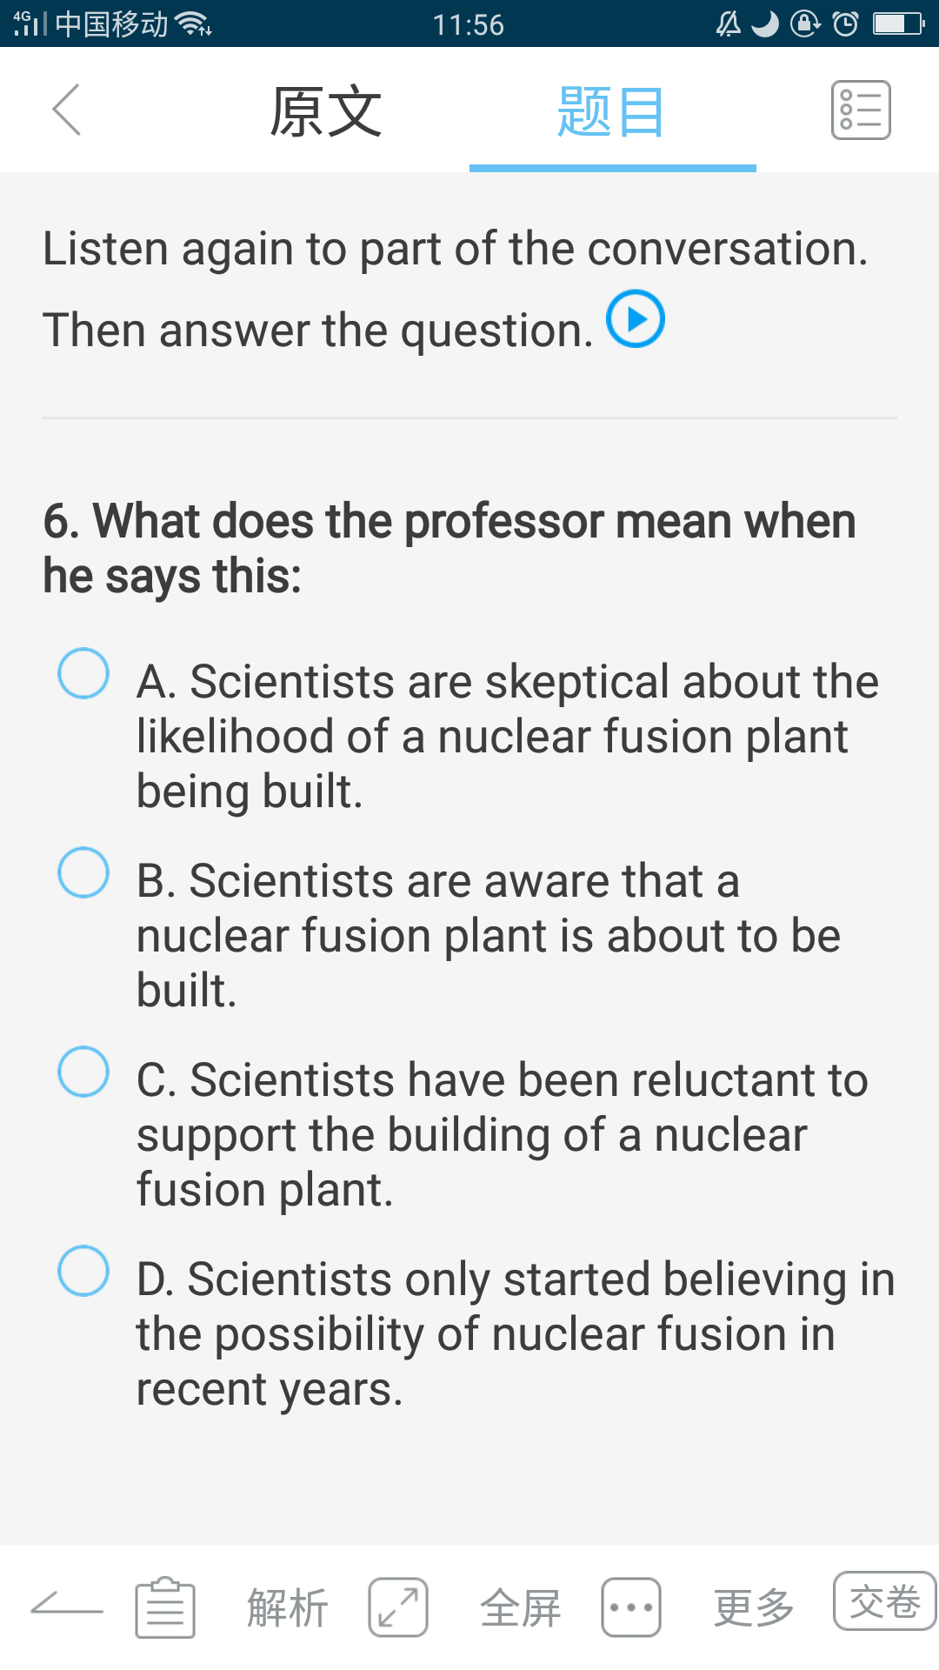
T36L1

Slide 28
???
An often heard joke about fusion is that nuclear fusion plant has just been decades away from being created for several decades now.

Slide 29
听不清
1、听不清某词汇，等等后面的解释；
如果没有，很有可能不考；
如果考了，根据关键词，排除选项;
2、准备出重听题，再放一遍
3、听语气决定
4、根据关键词和逻辑关系，排除选项

Slide 30
逻辑关系
1、解释
2、因果
3、并列
4、对比
5、类比
6、澄清
7、否定
8、肯定
9、过程

Slide 31
解释：听不懂生词
Sales Barn

Slide 32
解释
And the Sales Barn, it was basically this place where the local farmers bought and sold their cattle, their farm animals.

Slide 33
人名练习
1、记忆人名前面还是后面？
2、如果人名大量连续出现，需要记忆吗？
3、除了记忆音，还要注意什么？

Slide 34
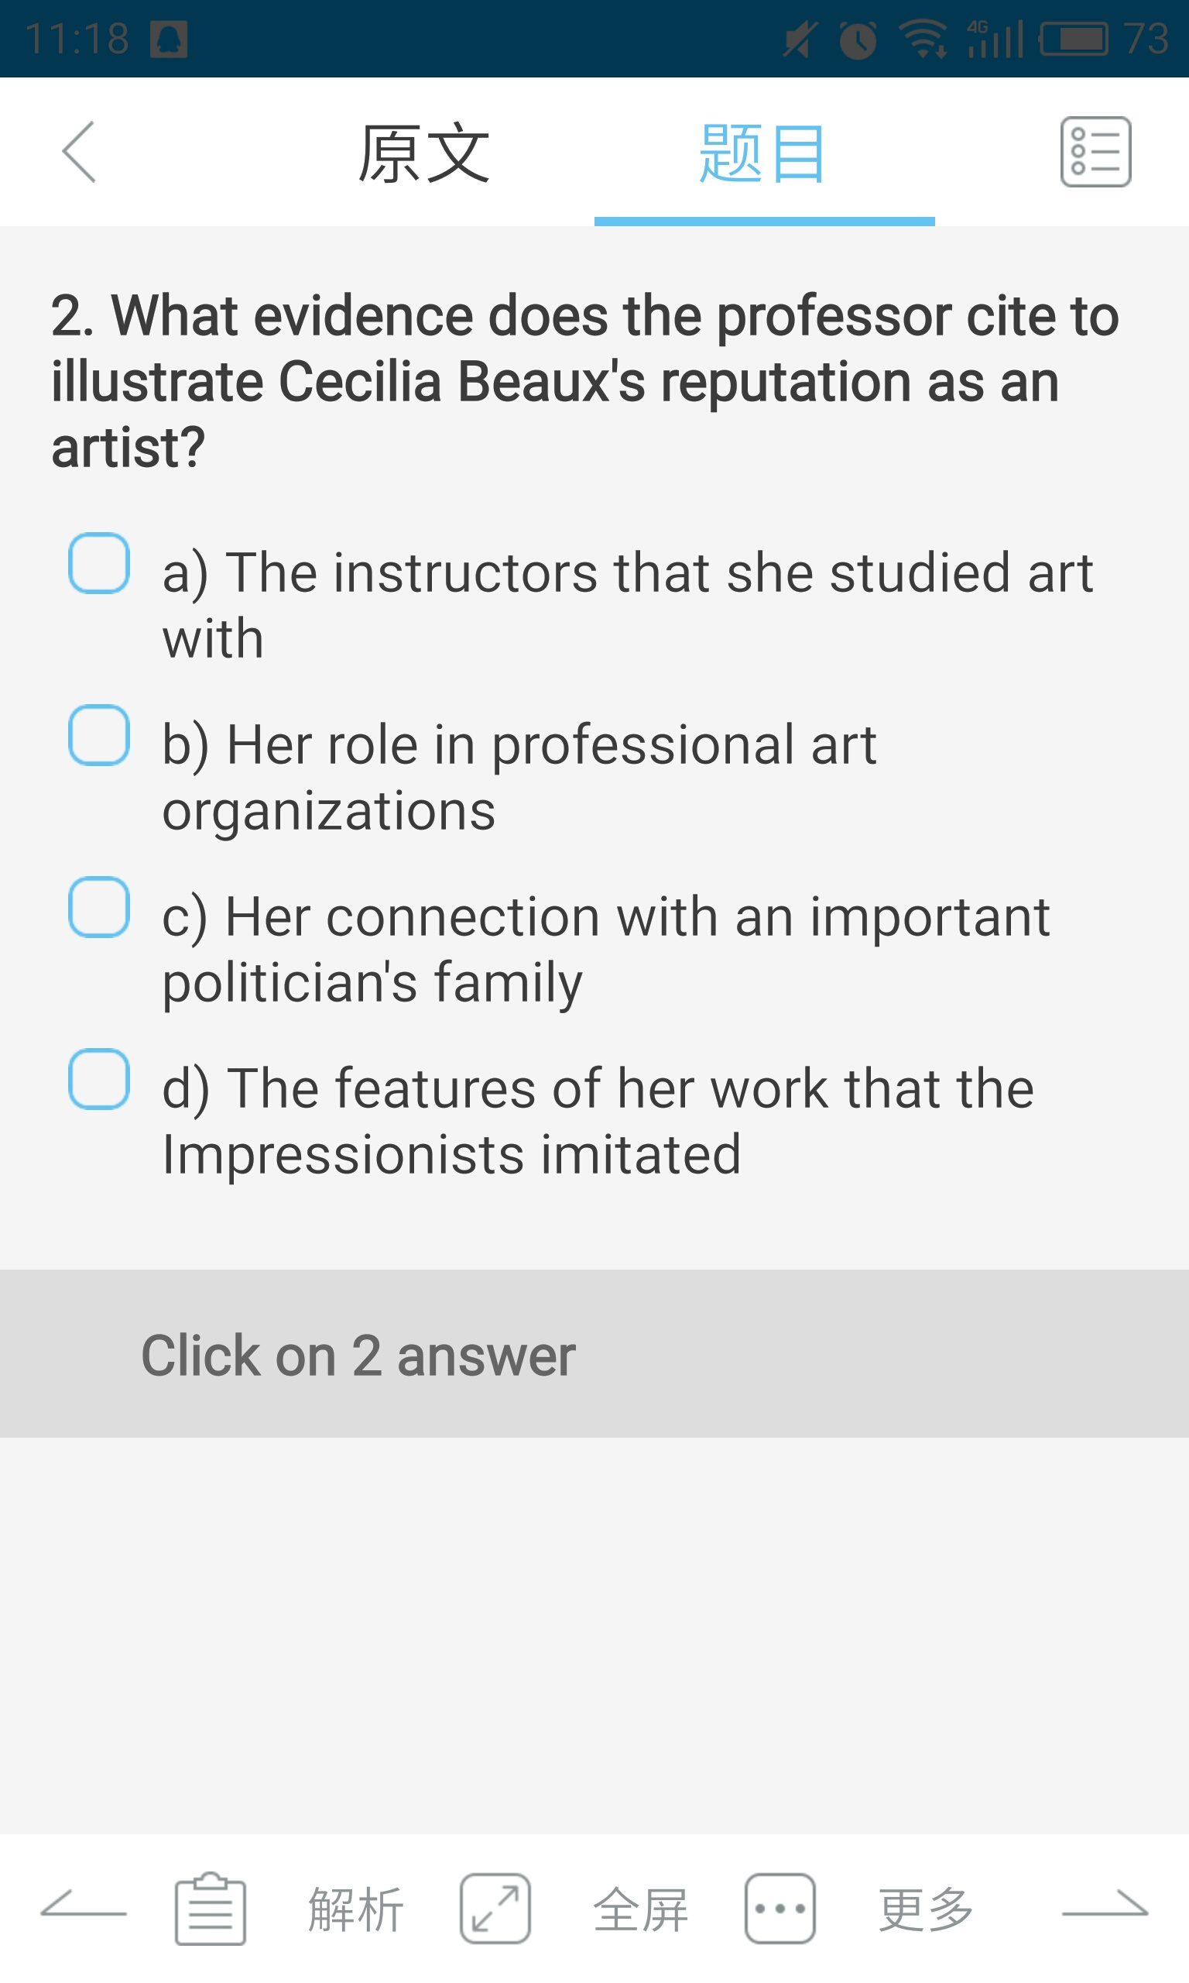
解释

Slide 35
解释
even had portraits of the wife and children of , while was president.

Slide 36
解释
She even had portraits of the wife and children of Theodore Roosevelt, while he was president.

Slide 37
1、几个人名（提醒记后面的音）
2、人物之间的关系

Slide 38
What do the speakers say about Cecilia Beaus use of contrasting colors in the Dreamer?
A. The technique was unusual in portraits of the period.
B. The technique was used by an artist that she respected.
C. Several modern artists copied the technique.
D. The function of the technique is to unify several parts of the painting

Slide 39
总结
术语/生词
音
人名，记录后面的
首字母 Vs大致的音
身份/性别
类别
解释
并列
对比
对应
下文匹配
代词

Slide 40
因果
Could blue be an important color? and why?

Slide 41
因果
lt was believed that blue couldn't be an important color in a painting because...Well...it tends to recede into the background. Not good for your main subject.
recede 逐渐远去（直至消失）

Slide 42
类比
like
equally,identical
as
same
as well as
analogous，similar
much the same as
not different from
no difference
ultramarine VS gold leaf T46L3

Slide 43
类比
And you even have the wealthy ordering paintings with ultramarine to show others that they could afford something made from this precious pigment, much in the same way they would order gold leaf.

Slide 44
比较T1L1
Frantzen Vs other artists

Slide 45
对比
I find Frantzen to be a very accessible artist.I mean, some artists, to appreciate them, you have to know their life story.

Slide 46
对比
compare with
unlike
different
contrary
as opposed to
not the same as
Instead (of)
rather than

Slide 47
并列T46L3
The process

Slide 48
并列
The process was time-consuming, which also contributed to the high cost of producing ultramarine, and it didn't even yield much usable pigment.
energy-consuming labor-saving

Slide 49
并列T19L4
Besides

Slide 50
并列
Besides her excellent technical skills, like her use of brushstrokes and color to make an impression. Beaux's perspectives come through. Her portraits reveal her own interpretation of her subject's state of mind.

Slide 51
转折
Beaux used some impressionist techniques and share much of their philosophy, but her style, it was all her own.
but
yet, while, whereas,nevertheless,nonetheless
that being said 话虽如此，表示转折=however
Be that as it may

Slide 52
判断肯定否定
T17L4
T4L2
T29L2(重听题) that being said 话虽如此，表示转折=however
T31L3

Slide 53
You see, everything must be planned down to the last detail in order to predict the acoustic performance of a room.
That being said, there's something that can't be controlled by the architect.
The audience has an effect on acoustics too.
The heads of people are good diffusers of sound.
And Architects try to account for this effect in their design, but they can't guarantee a full auditorium.

Slide 54
听力出题顺序
听力出题按照内容展开
第一题第一段，第二题第二段……
重听题
1、语气特别的部分，
2、老师指导课程进展的部分
3、师生的评价态度

Slide 55
判断出题位置
1、逻辑词汇分段：论点+论据（+总结）；论点+解释
2、逻辑关系判断考点（因果、对比、过程、态度……）
3、
文章位置 | 题目
内容1 | 题目1
内容2 | 题目2
内容3 | 题目3
内容4 | 题目4
内容5 | 题目5
不定 | 重听题 / 表格题

Slide 56
Impasto

Slide 57
定位
1.What is the lecture mainly about?
(A) The different skills between impasto and oil painting
(B) The effects of impasto techniques that artists can achieve
(C) Reasons why the impasto texture remains experimental
(D) Changes over time in the way impasto characteristics are created

Slide 58
2.Why does the professor mention icing on a cake?
(A) To stress how easy it is to use the impasto technique
(B) To claim that impasto involves the application of thin layers of paint
(C) To make it clear that impasto should have a flat surface
(D) To describe the type of appearance that impasto gives to a painting

Slide 59
3.According to the professor, why did fifteenth-century painters used impasto techniques?
(A) To ensure that colors would not fade
(B) To create deep, mysterious shadows in a painting
(C) To give the sense that objects in a painting were reflecting light
(D) To show the illusion of distance on a landscape painting

Slide 60
4.Why does the professor show a painting by Van Gogh?
(A) To explain that he is the first artist who created the impasto technique
(B) To illustrate that he used impasto to convey motion in his work
(C) To show the effects of a thin layer of impasto
(D) To suggest that impasto is more effective in landscapes than in portraits

Slide 61
5.According to the professor, why do some painters use impasto techniques today?
(A) They have more options of tools to use than artists did in the past.
(B) They want viewers to focus on the surface of a painting.
(C) They are interested in changing painting styles of the past.
(D) Their works with impasto are more precise than the works done in the past.

Slide 62
6. What two keys to using the impasto technique does the professor talk about? Click on 2 answers.
(A) Applying a large amount of paint to a canvas
(B) Pressing one layer of paint firmly into a canvas, then spreading more paint over the bottom layer
(C)Paint over bottom layer
(D)Applying paint to a canvas and then scrubbing it into the canvas
(E)Manipulating the paint with quick movements

Slide 63
T1L1
painters tended to apply paint really , and in , so the
of the canvas was .

Slide 64
Impressionist painters tended to apply paint really thickly, and in big brushstrokes, so the texture of the canvas was rough.

Slide 65
诸如此类
尝试机会
勇气
瞎猜的

Slide 66
So I should plan to take my books and stuff with me.
Giving everybody a fair shot. And working together to give all of our kids a better life.
让每个人都有公平尝试机会。共同努力，为我们的子孙创造更美好的生活。
I never have the guts to tell my parents what I really wanted.
我没有勇气告诉父母我真正想要的。
Well maybe she didn't move to Australia… maybe she just got a new job… but I'm just taking a shot in the dark.
可能她没有搬到澳大利亚去……可能她只是换了新工作……不过这都是我瞎猜的。

Slide 67
作业
完成T46L3，T19L4
预习词汇

