Slide 1
音乐类
练习听力6

Slide 2
but it's of music like the symphony or the concerto.

Slide 3
but it's a genre of music like the symphony or the concerto.
但和交响乐或协奏曲一样 也是音乐体裁。

Slide 4
How can your something exactly as it is and at the same time it with emotions?

Slide 5
How can you portray something exactly as it is and at the same time distort it with emotions?

Slide 6
Now, a tree should be a huge challenge for a bat, right?

Slide 7
Now, a tree should be a huge acoustical challenge for a bat, right?

Slide 8
Use of voice. It makes you sound kind.

Slide 9
Use a soft tone of voice. It makes you sound kind.

Slide 10
The researchers found that music get treated differently.

Slide 11
The researchers found that vocal and instrumental music get treated differently.
研究人员们发现声音以及乐器音乐信息是被不同的大脑区域加工处理。

Slide 12
Musical periods
古代音乐 The Ancient (communication)
中世纪音乐 The Medieval
文艺复兴音乐 The Renaissance
启蒙运动 The Enlightenment
巴洛克音乐 The Baroque (polyphonic ;homophonic) mono
古典主义音乐 The Classic
浪漫主义音乐 The Romantic
现代音乐 The Modern Music

Slide 13
Music instruments
1、弦乐器（String instrument）：
竖琴(harp)
吉他（guitar）
小提琴（violin）violinist
大提琴（cello）cellist

Slide 14
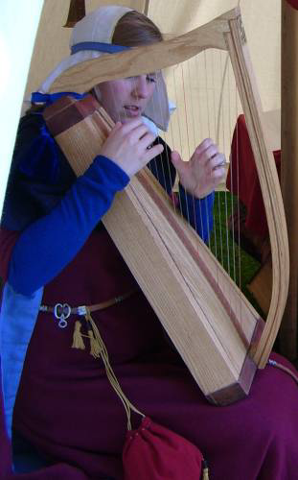
A 竖琴
Harp

Slide 15
2、管乐器（Wind/Band instrument）：
A 竖笛(Recorder)
B 横笛(Flute)
C 肖姆管(Shawm)

Slide 16
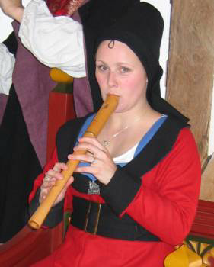
A 竖笛
Recorder

Slide 17
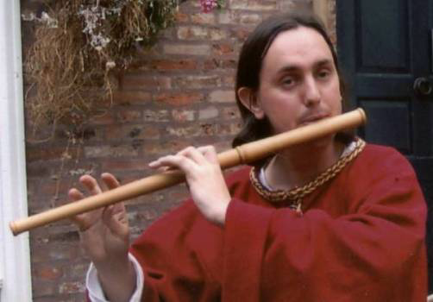
B 横笛
Flute

Slide 18
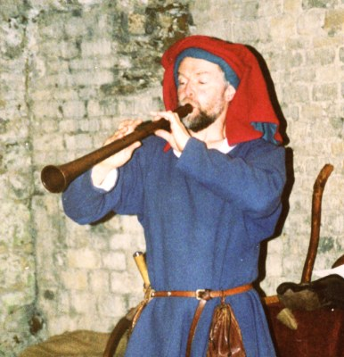
C 肖姆管
Shawm

Slide 19
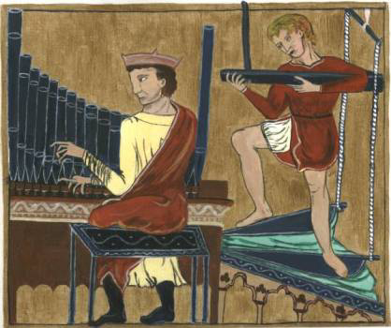
管风琴
Pipe Organ

Slide 20
3、打击乐器(percussion) percussive
A 鼓 drum
B 三角铁 triangle

Slide 21
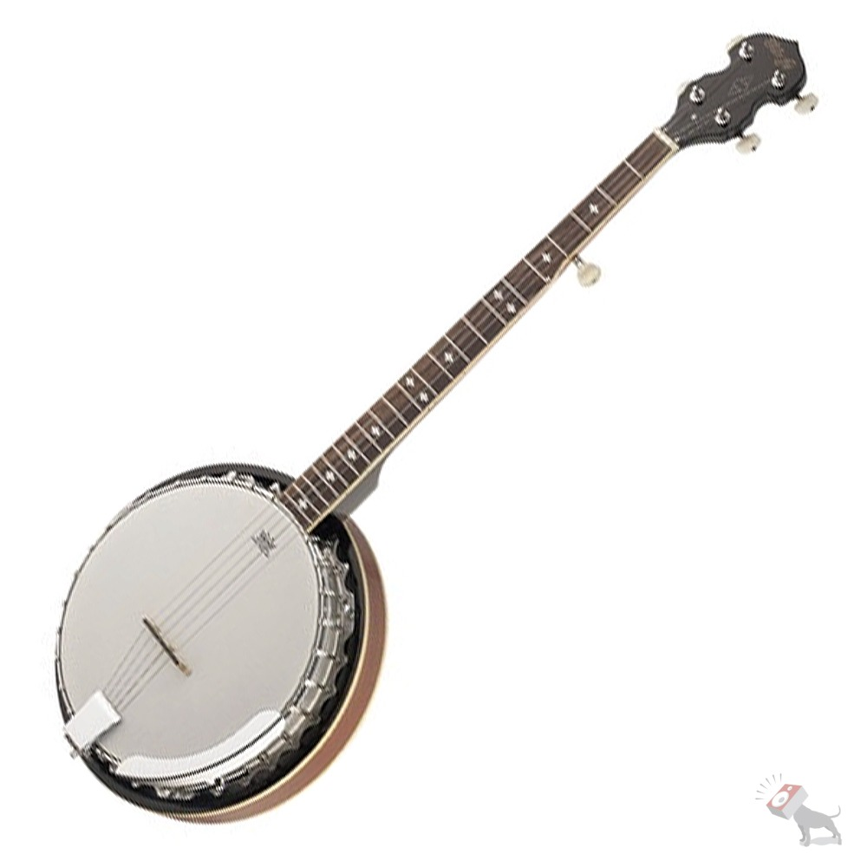
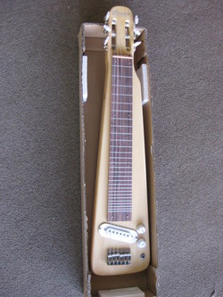
竖琴（Autoharp）
钢棒吉他（Steel Guitar）
班卓琴（Banjo）
贝司（Bass）

Slide 22
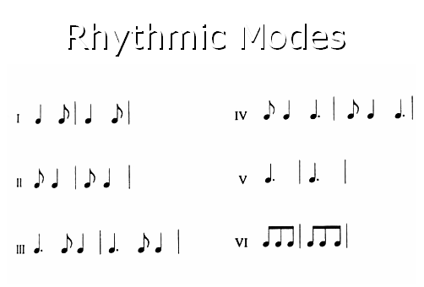
节奏模式

Slide 23
古典主义器乐最重要的四种形式：
1、奏鸣曲(sonata)：贝多芬《32首钢琴奏鸣曲》
2、弦乐四重奏(string quartet)：海顿 《C大调弦乐四重奏》Op.33
3、交响曲(symphony)：海顿《第103交响曲》。Orchestra
4、协奏曲(concerto)：莫扎特《D大调钢琴协奏曲》K.107

Slide 24
lyric
composer
note
time/beat
score
movement
soundtrack OST
chamber music
recital
choir chorus
orchestra concert
choreography
salon
episode
rehearse rehearsal
pitch
accompany
pace

Slide 25
lyric
composer
note
time/beat
score
movement 乐章
soundtrack OST 影视原声
chamber music
recital
choir chorus
orchestra concert
choreography
salon
episode
rehearse rehearsal
pitch
accompany
pace and pitch

Slide 26
T27L2
compare with
unlike
different
contrary
as opposed to
not the same as
Instead
rather than

Slide 27
Now, the harpsichord which came before it, the piano is .
You see, the harpsichord is actually classified as , since pressing a key of a harpsichord causes a tiny quill that's connected to the key to pluck the strings that are inside the instrument, a guitar pick plucks the strings of a guitar.

Slide 28
Now, unlike the harpsichord which came before it, the piano is a percussion instrument.
You see, the harpsichord is actually classified as a string instrument, since pressing a key of a harpsichord causes a tiny quill that's connected to the key to pluck the strings that are inside the instrument, much the same as a guitar pick plucks the strings of a guitar.

Slide 29
T27L2 对比
skill

Slide 30
These vintage Cremonese violins are considered the best in the world.But it's not like the makers of those violins were their modern-day counterparts. They weren't.
Today's top violin makers can pretty much replicate all the physical attributes of a Cremonese violin.
But it's generally thought that the acoustical quality of modern violins
of the vintage ones.
vintage 老式的
counterparts ones n.与对方地位作用相当的人(或物)

Slide 31
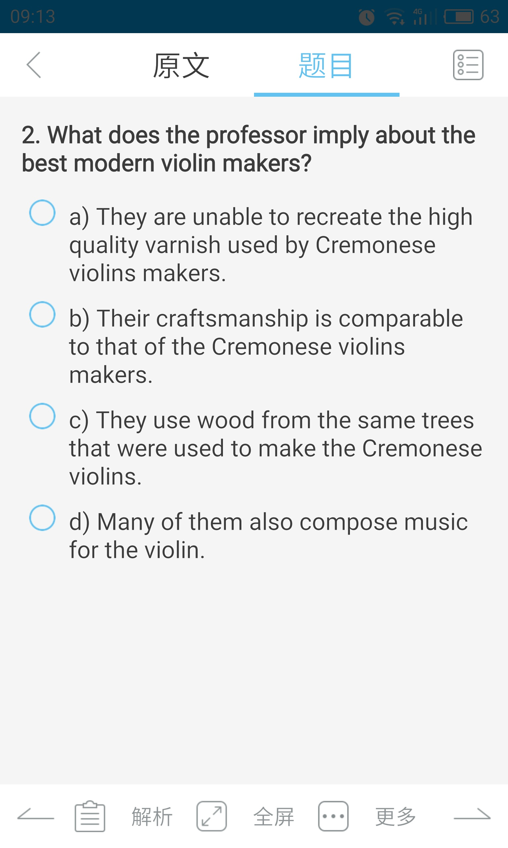

Slide 32
These vintage Cremonese violins are considered the best in the world.But it's not like the makers of those violins were any more skilled than their modern-day counterparts. They weren't.Today's top violin makers can pretty much replicate all the physical attributes of a Cremonese violin.But it's generally thought that the acoustical quality of modern violins doesn't live up to the quality of the vintage ones.

Slide 33
People thought the varnish used to coat and protect the violins was special.
But research showed it was
varnish used on furniture.
However, researchers have discovered that there are something special about
the violins were made from.And recently they have been able to that too.

Slide 34
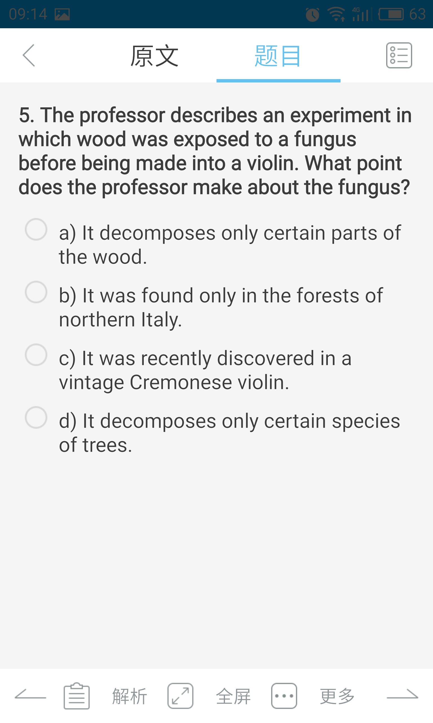

Slide 35
Few writers even begin to approach Shakespeare's greatness.
In the forest, fungi are decomposers.They break down dead wood.But this particular fungus nibbles away only at certain layers in the wood, leaving other layers alone.As a result, the density differential of the fungi-treated wood approach that of the Cremonese wood.
approach （在空间或时间上）接近, 靠近（某人[某事物]）； （在性质或特点上）

Slide 36
比较 T32L4
1、区别比较主体、比较对象，忌张冠李戴
2、有比较必出题：对比、类比
3、考比较的结论

Slide 37
According to the professor, what interior features of the house Irwin designed were especially beneficial?
Click on 2 answers
A. Circular rooms with windows in the ceiling.
B. Floors that were easy to clean.
C. A large, spacious common area.
D. A single-fireplace system that heated the entire house.

Slide 38
as opposed to
So one important thing was that the rooms were arranged around a chimney in the center of the house, which could provide heat for the whole house through flues, uh, small air passageways into each room, as opposed to having a fireplace in every room, which would require more cleaning and make the air inside the house dirtier.

Slide 39
T38L3
Avanti-garden
John Cage

Slide 40
Robert Rauschenberg

Slide 41
Anechoic chamber

Slide 42
4'33”

Slide 43
1.What is the lecture mainly about?
(A) The ideas behind a piece by an avant-garde composer
(B) The influence of twentieth-century painting on avant-grade music
(C) The traditional elements in a famous piece of avant-garde music
(D) Development of reactions to twentieth-century experimental art forms

Slide 44
2.According to the professor, how did Rauschenberg's white paintings influence John Cage?
(A) They made him realize that artists should not be concerned with their audience.
(B) They made him realize that an artwork with little content could still be rich in meaning.
(C) They demonstrated the importance of collaborating with artists in other fields.
(D) They inspired him to compose music that created visual impressions in listeners.

Slide 45
3.Why was the experience of visiting anechoic chamber significant for Cage?
(A) He realized that he could still hear sounds inside the chamber.
(B) He realized that echoes could be eliminated from a musical piece.
(C) He learned the possibility of recording his body’s natural sound.
(D) He discovered that music did not need to be composed in silence.

Slide 46
4.What was Cage’s attitude toward found sound?
(A) He considered found sound to be a theoretical concept with no practical use.
(B) He believed any noises could be musical if arranged carefully.
(C) He believed that unintentional noises could serve as replacements for musical instruments.
(D) He believed that compositions with random noises could be interpreted in different ways.

Slide 47
5.What does the professor imply when he discusses the audience at the first performance of 4’33"?
(A) He believes that outside noise might have distracted the audience.
(B) He thinks that music critics appreciated the piece more than the general audience did.
(C) He thinks that the audience was not mature enough to appreciate the piece.
(D) He thinks that the audience’s response to the piece was understandable.

Slide 48
6.Why does the professor think that many of today’s performances of 4’33" are misinterpreted?
(A) They are performed mostly outdoors.
(B) They contain intentional sounds.
(C) They last longer than 4 minutes and 33 seconds.
(D) They do not include an actual piano.

Slide 49
免费
少见
走捷径
顺其自然

Slide 50
This is the fruit combination. It's on the house. I hope you've enjoyed yourselves.
这是水果拼盘，使我们赠送的。我希望各位吃得满意。
But I only see her once in a blue moon, which, as you know, is almost never.
One common response to this time pressure is that they cut corners by taking easier classes, copying assignments from other students, cutting class, or refusing to do work assigned by their teachers.
So perhaps you are wondering why not let nature take its course now?

Slide 51
作业：
朗读音乐背景词汇
预习预习
完成T16L2，T30L4

