Slide 1

综合写作
Integrated Writing

Slide 2
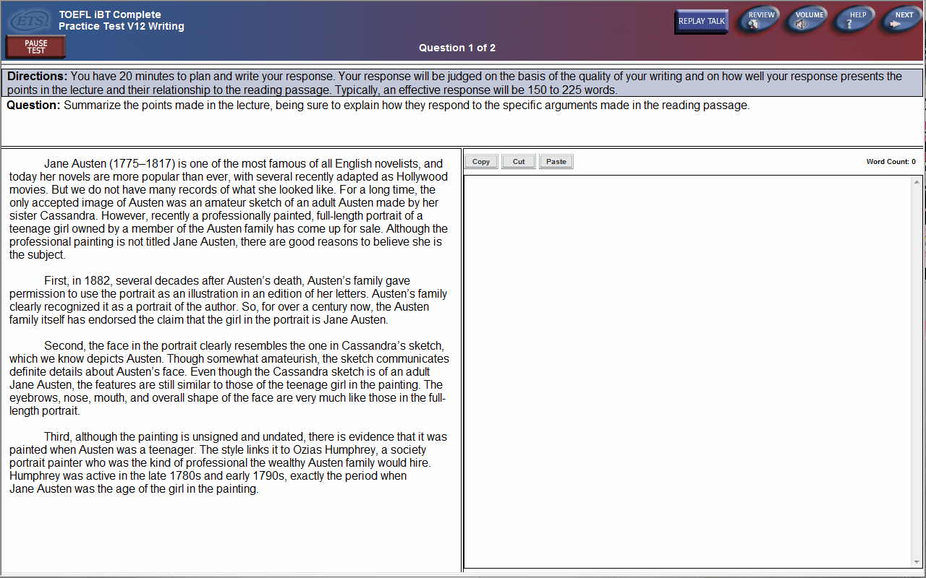
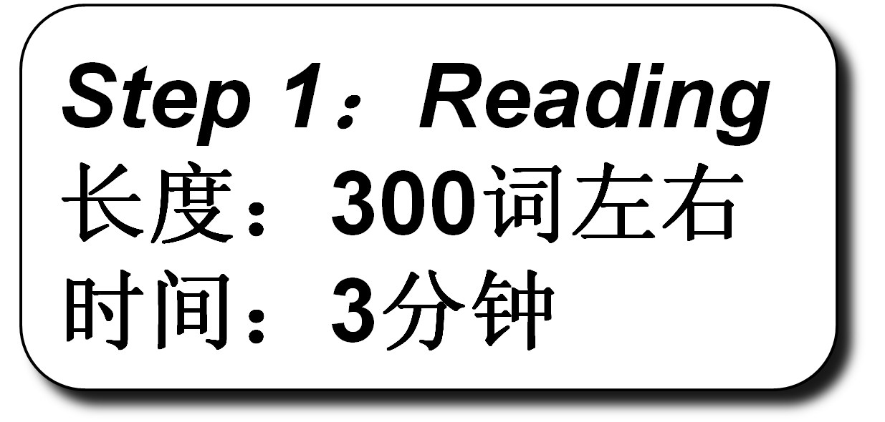


Slide 3
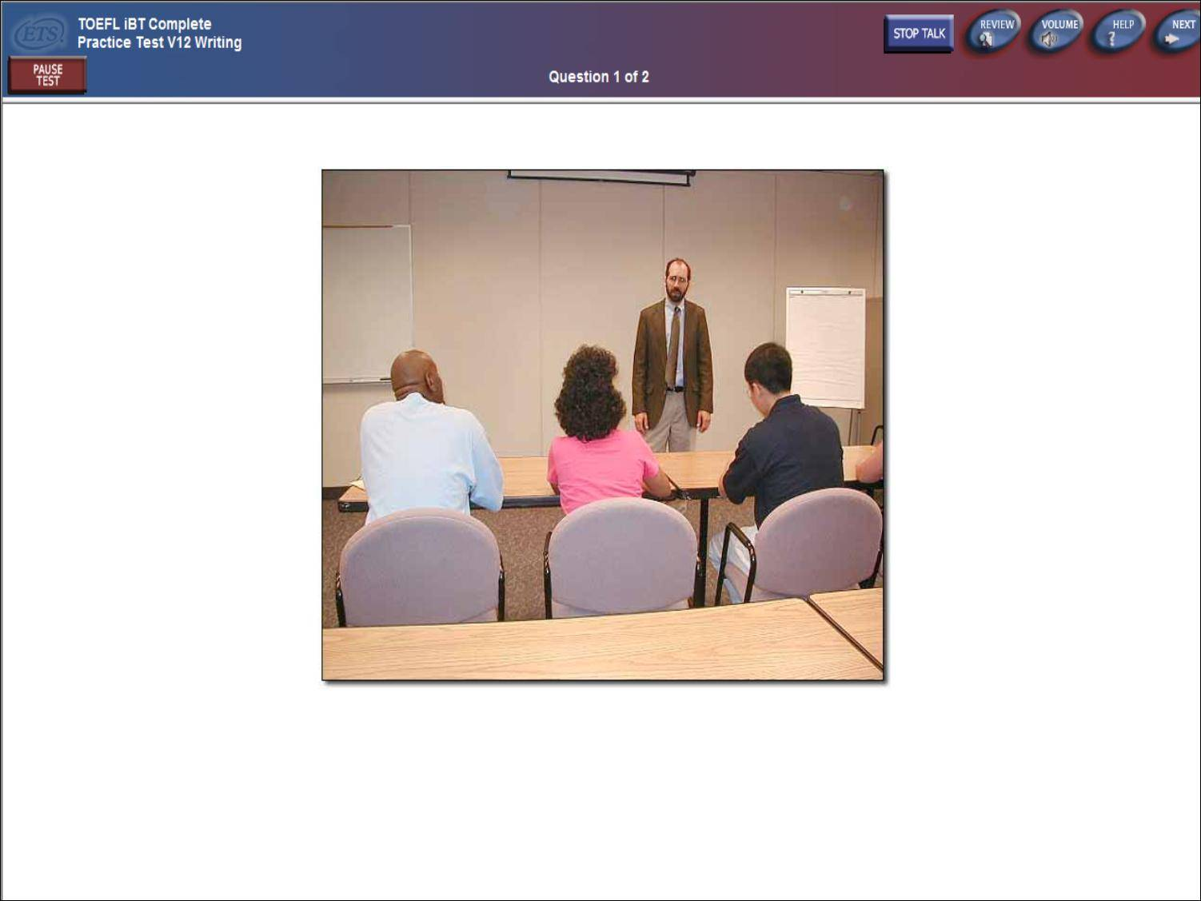


Slide 4

综合写作模式
A完全反驳
B完全赞同
C原因措施

Slide 5
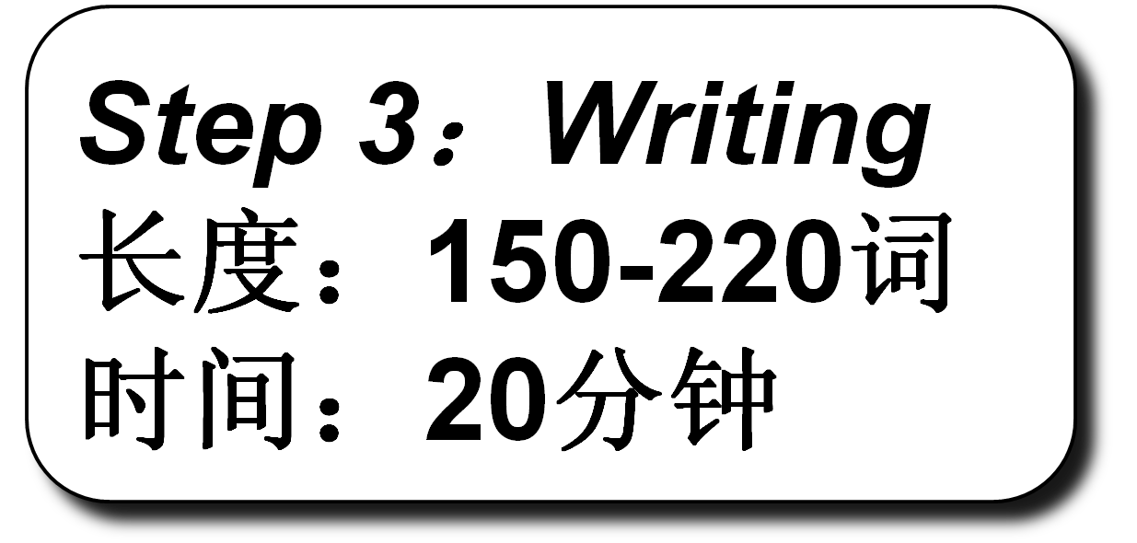


Slide 6


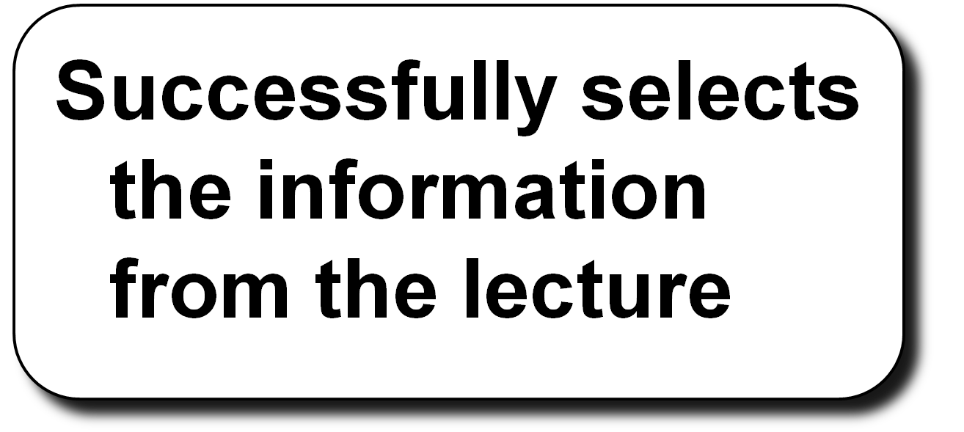

Slide 7

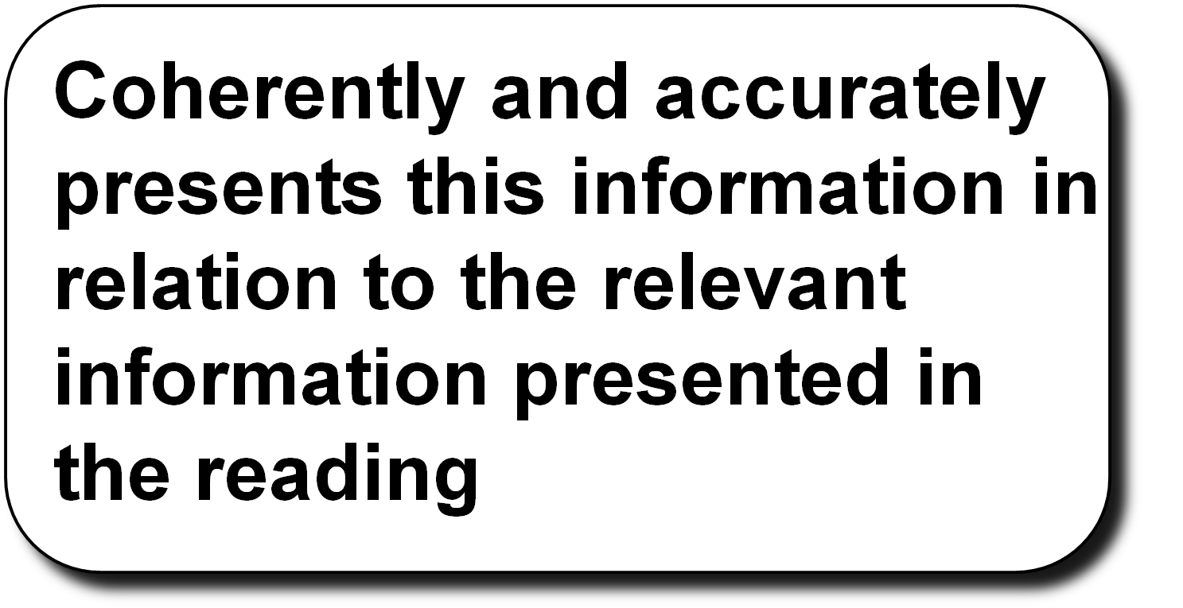

Slide 8
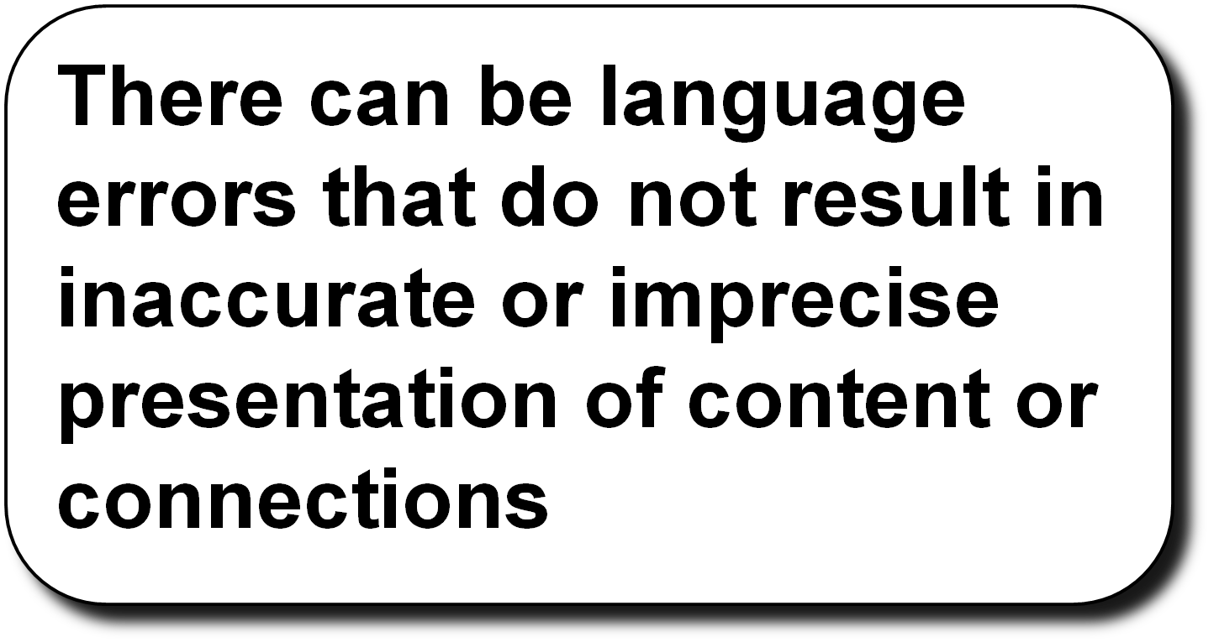

Slide 9

综合写作5分标准
阅读内容准确把握要点；
听力内容准确把握要点以及细节；
阅读与听力之间的关系阐述清楚；
可以容忍一些语言上的不至于影响理解的小错误。

Slide 10
综合写作4分标准
阅读内容准确把握要点，但若大段抄阅读内容则会扣分；
听力内容准确把握要点，但如果细节遗漏（或写错）得4分；
阅读与听力之间的关系阐述或有不清楚之处；
语言上出现了影响理解文章的某些严重错误。

Slide 11
综合写作3分标准
阅读内容把握要点，但若大段照抄阅读内容则会扣分；
听力内容漏掉（或写错）一个要点直接得3分；
阅读与听力之间的关系阐述不清或有错；
语言上出现了较多错误以至于影响理解。

Slide 12
综合写作2分标准
大段照抄阅读内容；
听力内容有要点以及细节，但如果漏掉（或写错）两个要点得2分；
阅读与听力之间的关系没有阐述清楚；
阐述自己观点；
语言上出现了较多错误。

Slide 13
综合写作1分标准
写了听力和阅读内容中的只言片语。

Slide 14
综合写作0分标准
写的不是英文；
写的不是正常人类能够看懂的字符；
写的内容跟阅读和听力完全没有关系。

Slide 15
Jane Austen (1775-1817) is one of the most famous of all English novelists, and today her novels are more popular than ever, with several recently adapted as Hollywood movies. But we do not have many records of what she looked like. For a long time, the only accepted image of Austen was an amateur sketch of an adult Austen made by her sister Cassandra. However recently a professionally painted, full-length portrait of a teenage girl owned by a member of the Austen family has come up for sale. Although the professional painting is not titled Jane Austen, there are good reasons to believe she is the subject.
First, in 1882, several decades after Austen's death, Austen's family gave permission to use the portrait as an illustration in an edition of her letters. Austen's family clearly recognized it as a portrait of the author. So, for over a century now, the Austen family itself has endorsed the claim that the girl in the portrait is Jane Austen.
Second, the face in the portrait clearly resembles the one in Cassandra's sketch, which we know depicts Austen. Though somewhat amateurish, the sketch communicates definite details about Austen's face. Even though the Cassandra sketch is of an adult Jane Austen, the features are still similar to those of the teenage girl in the painting. The eyebrows, nose, mouth, and overall shape of the face are very much like those in the full-length portrait.
Third, although the painting is unsigned and undated, there is evidence that it was painted when Austen was a teenager. The style links it to Ozias Humphrey, a society portrait painter who was the kind of professional the wealthy Austen family would hire. Humphrey was active in the late 1780s and early 1790s, exactly the period when JaneAusten was the age of the girl in the painting.

Slide 16

听力
题材不确定
电脑打字

Slide 17





Summary
Comparison
结构式笔记
Structured Notes

Slide 18

Team responsible for plan/ get work done
free-ride people not do much—recognition
Real contribution—not recognized
attitude opporeading
not move quick
take long – consensus many meets the other
无结构
无关系
漏观点

Slide 19

L
R
M
1.
Ex
2.
Ex
3.
Ex:
M
1.
Ex
2.
Ex
3.
Ex:

Slide 20

Reading
以词为单位

Slide 21
R
L
M: hyd FC promis/ alter
advan
hyd ava/renew
Ex: 多—gas/
solve pollu
Ex: H2O—produ
no CO2
￥/
Ex: effici/ 少 ener
M:
1.
Ex:
2.
Ex:
3.
Ex:

Slide 22
Reading
以词为单位
够用即可
观点是重点

Slide 23
R
L
M: hyd FC promis/ alter
advan
hyd available/renew
Ex: plenti—gas/
solve pollu
Ex: H2O—produ
no CO2
economi/
Ex: effici/ less energy
M:
1.
Ex:
2.
Ex:
3.
Ex:

Slide 24

Listening
以词为单位
尽可能详细
例子和解释是重点

Slide 25
R
L
M: hyd FC promis/ alter
advan
hyd available/renew
Ex: plenti—gas/
solve pollu
Ex: water—produ
no CO2
economi/
Ex: effici/ less energy
M: hyd not solut to pollut
not easily avail
Ex: liquor state—difficult
store—cooling
not practi -253
not solve probl-cars
produ hyd—pollut
Ex: coal/oil burn –pollut –
factory—pollut
expensi
Ex: made of p—expen
effort—repla—not success

Slide 26
The lecturer points out several problems with the use of hydrogen-based fuel-cell engines in support of her claim that substituting them for internal-combustion engines is technologically unfeasible, environmentally unfriendly, and economically unviable.
First, the lecturer argues that it is impractical to replace internal-combustion engines with fuel-cell engines because using the latter requires pure liquid hydrogen, which is technologically challenging to both obtain and store for it must be kept very very cold at minus 253 degrees Celsius. However, the reading touts it as an attractive advantage because hydrogen is an infinite source of energy.

Slide 27
Second, the lecturer refutes the claim in the reading that hydrogen cells are environmentally friendly. She argues that although engines that use hydrogen cells produce less pollution, the manufacturing of hydrogen cells generates large amounts of harmful by-products due to the burning of fossil fuels（coal or oil） in the purification process.
Third, although the reading suggests that hydrogen-based engines are more fuel-efficient and thus economically competitive than internal-combustion engines, the professor argues that such an advantage is undermined by the fact that fuel-cell engines are extremely expensive to manufacture because they require the addition of platinum, a very rare and expensive material. All the efforts to replace platinum with a cheaper material have so far been unsuccessful.

Slide 28
The lecturer addresses each of the three criticisms of communal online encyclopedias mentioned in the Reading passage.
The lecturer admits that communal online encyclopedias, like any reference book, may contain errors, but she claims that these errors can be corrected much more easily and quickly than those printed in a paper encyclopedia. The Reading passage, in contrast, points to the inaccuracy of information in online encyclopedias, presenting the argument that errors in these resources are due to lack of professional knowledge among contributors.

Slide 29
The lecturer then gives two strategies that have been proven very effective in protecting online encyclopedias from malicious alteration. She explains that contents that consist of indisputable facts are stored and presented in a read-only format so that nobody can make changes to them. In addition, she says, there are specialists who constantly monitor contents online so that they can quickly remove a suspicious change once it is detected.
The lecturer also challenges the final point in the reading regarding the nature of topics covered in online encyclopedias. She says that because of virtually unlimited space on the Internet. there is no need to worry about what is important enough for inclusion in an online encyclopedia.
Moreover, the greater variety of topics in online encyclopedias more truly reflects the genuine interests of the general public, even if some of these topics are less serious or academic than those in traditional encyclopedias.

Slide 30
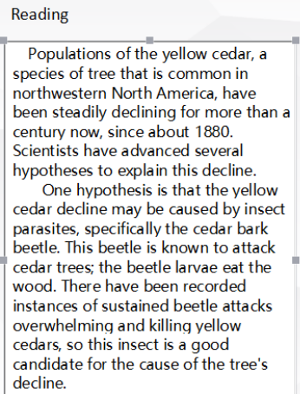
现象解释型
TPO23

Slide 31
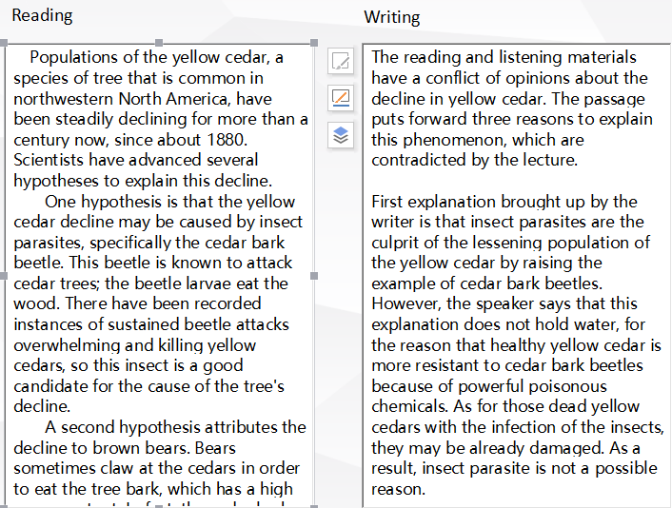
Reading
Writing

Slide 32
In the reading passage, it talks about the hypotheses of decline of the yellow cedar populations. In the lecture, the professor talks about the same issue, however he does not agree what the reading passage says.
To begin with, in the reading passage, it talks about that the of yellow cellar decline due to the insect parasites. Cedar bark beetle is an example. The beetles attack yellow cedar and eat the wood. They should be responsible for the decline. However, the professor does not agree with the idea. He indicates that the healthy trees are able to secrete poison to resistant with the beetle. He thinks if the trees are attacked by the beetle, they must be already sick.

Slide 33
In addition, the reading passage notes that the bears claw the bark of the trees as the tree offer them food. Base on the fact, the reading passage concludes that the bear may be the reason. The professor does not agree with it, he counteracts it by saying that the yellow cedar in the islands, where no bears at al are, are not avoid of being declining.
As a final point, the reading passage thinks that the Climate change is a possibility blamed for the decline. But the professor is against the idea. He argues that if the climate is the reason, the yellow cellar in high level should decline, but the fact is just on the concentrate.
In conclusion, the reading passage gives the three hypotheses of yellow cellar decline, but the professor thinks none of these is reasonable.

Slide 34
综合写作听力
用缩写表示名词概念、动词、部分形容词
用符号替代逻辑关系
结构：1、2、3
因果：→
转折
增加或减少
大于或小于

Slide 35

The sea otter is a small mammal that lives in waters along the western coast of North America from California to Alaska. When some sea otter populations off the Alaskan coast started rapidly declining a few years ago, it caused much concern because sea otters play an important ecological role in the coastal ecosystem. Experts started investigating the cause of the decline and quickly realized that there were two possible explanations: environmental pollution or attacks by predators. Initially, the pollution hypothesis seemed the more likely of the two.
The first reason why pollution seemed the more likely cause was that there were known sources of it along the Alaskan coast, such as oil rigs and other sources of industrial chemical pollution. Water samples from the area revealed increased levels of chemicals that could decrease the otters' resistance to life-threatening infections and thus could indirectly cause their deaths.
Second, other sea mammals such as seals and sea lions along the Alaskan coast were also declining, indicating that whatever had endangered the otters was affecting other sea mammals as well. This fact again pointed to environmental pollution, since it usually affects the entire ecosystem rather than a single species. Only widely occurring predators, such as the orca (a large predatory whale), could have the same effect, but orcas prefer to hunt much larger prey, such as other whales.
Third, scientists believed that the pollution hypothesis could also explain the uneven pattern of otter decline: at some Alaskan locations the otter populations declined greatly, while at others they remained stable. Some experts explained these observations by suggesting that ocean currents or other environmental factors may have created uneven concentrations of pollutants along the coast.

Slide 36
Well, ongoing investigations have revealed that predation is the most likely cause of sea otter decline after all. Well, ongoing investigations have revealed that predation is the most likely cause of sea otter decline after all.
First, the pollution theory is weakened by the fact that no one can really find any dead sea others washing off on Alaskan beaches. That's not what you would expect if infections caused by pollution started killing a lot of otters. On the other hand, the fact that it's so hard to find dead otters is consistent with the predator hypothesis. If an otter is killed by a predator, it's eaten immediately so it can't wash up on shore.
Second, although orcas may prefer to hunt whales, whales have essentially disappeared from the area because of human hunters. That means that orcas have had to change their diet to survive and since only smaller sea mammals are now available, orcas have probably started hunting those. So it probably is the orcas that are causing the decline of all the smaller sea mammals mentioned in the passage - the seals, the sea lions and the sea otters.
And third, the uneven pattern of otter decline is better explained by the orca predation theory than by the pollution theory. What happens to otters seems to depend on whether the location where they live is accessible to orcas or not. In those locations that orcas can access easily, the number of sea otters has declined greatly. However, because orcas are so large, they can't access shallow or rocky locations. And shallow and rocky locations are precisely the types of locations where sea otter populations have not declined.

Slide 37
The lecturer and the reading passage suggest two competing theories, the predation theory vs. the pollution theory, to explain why the sea otter population is in rapid decline.

Slide 38
The professor reasons that the absence of dead sea otters washed up the coast suggests that their decline is not caused by sea pollution but rather by sea predators who consume their bodies after killing them. However, the reading passage attributes the death of sea otters to pollution, which is totally different from the lecture.

Slide 39
Furthermore, the lecturer argues that orcas are likely factors in the disappearance of sea otters, because the scarcity of whales, their usual prey, has left them with no other choice but to start hunting smaller mammals like the otters for food. And this directly contradicts the reading passage that the pollution theory as the only explanation for the decline of small sea mammals.

Slide 40
Finally, according to the lecturer, the uneven pattern of sea otter decline corresponds to the distribution of the orcas; she argues that the fact that their population has declined the least where it is shallow or rocky and orcas are most prevalent further validates the predation theory. However, the reading passage points out that changeable environmental factors better explains the varying pattern of sea otter decline.
Therefore, the lecturer completely argues against the reading passage.

Slide 41
表示反驳类的单词
differ to ,disagree with, cast doubt on, conflict with, challenge，refute，confute，contradict，controvert，combat，talk back，re-examine，disprove

Slide 42
表示认为，提出的单词
point out，present，state，think，believe，，emphasize，demonstrate，assert，claim，stress，

Slide 43
阅读
Reading
Passage
Reading material
Writer
Author
听力
Listening
Professor
Lecturer
Arguer
Teacher
Instructor

Slide 44
模版一
The lecture is mainly discussing ______, ________ and ___________ by _________, challenging what are stated in the reading passage that _________, _________ and _______.

Slide 45
First of all, the speaker thinks that ___________. In contrast, the reading passage believes that _____________. So, the lectures totally disagree with the view made in the reading.

Slide 46
Second, the speaker discusses ___________, Contradicting what is stated in the reading that _____________________.

Slide 47
Finally, the speakers raises the issue that ___________. This point disagrees with the point that ________________ demonstrated in the reading.

Slide 48
So, the contents in the reading passage are totally jeopardized by the speaker and the speaker has totally different ideas on the topics made in the reading.

Slide 49
模版二
The speaker in the lecture principally argues that ________（听力中心大意，一句话归纳）, which contradict the main statement in the reading, thus refuting the
reading passage totally. In order to substantiate his contention as well as to jeopardize the reading passage, the speaker later reexams the supporting detailsin the reading passage and forwards alternative explanations.

Slide 50
In terms of ________（听力第一个分论点）, the speaker argues that ________（进行解释说明）, challenging the notion in the reading that ________（阅读第一个分论点）

Slide 51
Referring to________（听力第二个分论点）, the speaker, believes that ________（进行解释说明）. In contrast, the reading passage ________（阅读第二个分论点）

Slide 52
Finally, the speaker raises the issue that________（听力第三个分论点）, which was simply noted as ________（阅读第三个分论点）in the reading.

Slide 53
To sum up, based on thorough analysis of the whole situation (the nature of the reasons in the reading, the speaker disagrees with the reading passage
completely.

Slide 54
模版三
In the lecture, the professor made several points about________（听力中心大意，一句话归纳）, while the reading states that________（阅读中心大意，一句话归纳）

Slide 55
The first point that the professor used to cast doubt on the reading is that________（听力第一个分论点）According to the professor________（对前面那句话进行稍微解释）However, the reading notes that________（阅读第一个分论点）

Slide 56
The second point that the professor challenged the reading is that________（听力第二个分论点） Also, ________（对前面进行补充说明） On the contrary, the reading contends that ________（阅读第二个分论点）

Slide 57
Finally, the professor argued that________（听力第三个分论点）In other words,________（进行解释说明） This contradicts the point in the reading that________（阅读第三个分论点）

Slide 58
In short, the points asserted by the professor are different from what the reading says. The professor demonstrated that ________（对听力文章进行总结）

