Slide 1
EdgeGuard
WAIT
ASIDE
GO
Interim Use Case and Architecture Report
MEC-based worker–forklift collision prediction with oneM2M and ETSI MEC
2026 oneM2M International Hackathon · Team EdgeGuard · Sejong University · October 2026
Notes:
EdgeGuard interim report: use case, high-level oneM2M + ETSI MEC architecture, and the development plan to the final.

Slide 2
Summary
Use case
Architecture
Warehouse workers and forklifts share aisles. EdgeGuard predicts collisions 1–3 s ahead on the MEC edge and tells each worker WAIT, STEP ASIDE or GO, while the forklift slows only as much as needed.
Devices register their own oneM2M AEs on an edge CSE co-located with the EdgeGuard MEC app. ETSI MEC Location and RNIS reach the app as oneM2M resources through a MEC-IPE. Cloud IN-CSE via Mcc.
Status today
Plan to Nov 20
Working end to end on Mobius and ACME. Already built: SDT flexContainer data model with SAREF semantics, CSE handover between zone MN-CSEs (3–9 ms interruption), federated learning through oneM2M, an AI safety agent over MCP. Collisions 100 → 4 in simulation.
group and pollingChannel, MQTT for devices and TLS; MEC Location zone events for geofencing and handover; multi-host deployment; ESP32 board demo, user study, hackster.io article, final video, public repository.
Notes:
One slide per required item: use case, architecture, current status, development plan.

Slide 3
Problem: forklifts and people share the same aisles
2,559
USD 116k
85 %
forklift accident casualties in Korea, 2021–2022
total cost of one workplace injury, including indirect costs
of alerts from a 5 m proximity alarm are false, so workers learn to ignore them
KOSHA statistics
NSC Injury Facts · OSHA 3885
EdgeGuard simulation baseline
Why existing systems fall short: distance alarms fire on forklifts that will pass safely; a single buzz says "danger" but not what to do, so workers step back into the lane too early; and server-based systems go silent when the network fails.
Notes:
The problem scenario. Over 2,500 forklift casualties in two years in Korea; one injury costs about USD 116k. Proximity alarms exist but produce mostly false alerts.

Slide 4



Use-case scenario: three moments in a warehouse aisle
1 · Blind-corner crossing
2 · Worker standing in the lane
3 · Network or server failure
A worker walks toward a cross-aisle; a forklift approaches behind racks.
The forklift stopped for a worker who is standing in its path; nobody can move.
The edge server or Wi-Fi drops while people keep working.
Tag: WAIT (pulses until the forklift passes) → GO.
Forklift: slowed just enough to pass safely.
Tag: STEP ASIDE to the nearer edge, then WAIT.
Forklift: holds, then passes; worker gets GO.
Devices range each other over UWB and exchange state directly (D2D); neighbours relay alerts; stop only as a last resort.
Actors: workers (tag), forklift drivers (module), safety manager (dashboard, near-miss reports). Site: 10,000 m² warehouse, 50 workers, 10 forklifts.
Notes:
Three concrete moments define the requirements: a blind-corner crossing, a standoff with the worker in the forklift lane, and a network failure.

Slide 5
Requirements and how oneM2M and ETSI MEC meet them
Requirement (ESTIMED theme) | Why this use case needs it | oneM2M / MEC enabler in EdgeGuard
Low latency | Warning must arrive 1–3 s before contact | CSE and MEC app co-located on the MEC host: 25 ms median alert latency
Local processing | Positions of people stay on site | EdgeGuard MEC app; only alerts and near misses go to the cloud IN-CSE
Context awareness | Positions without UWB fix; cell load | MEC Location (013) and RNIS (012) mapped into oneM2M by the MEC-IPE
Service continuity | Safety cannot stop when a server fails | CSE handover between zone MN-CSEs (3–9 ms, 0 lost), active-standby MEC app (0.73 s), D2D fallback
Orchestration | Deploy per site / per zone | MEC app per zone MEC host; AdvantEDGE and the ETSI MEC Sandbox; multi-host orchestration next
Distributed intelligence | Devices must act when isolated | Local rules on each device, D2D state exchange, alert relay
Notes:
The requirements follow the ESTIMED themes: low latency, local processing, context awareness, service continuity, orchestration, distributed intelligence.

Slide 6
High-level architecture: oneM2M + MEC on the edge
Cloud /
infrastructure
IN-CSE
Mobius (cloud)
Safety dashboard
near-miss heatmap, reports
Other oneM2M apps
subscribe to alerts
Field domain
Mcc
Edge: ETSI MEC host (deployment option C, co-location)
Worker tag
ESP32 + UWB · vibration, LED
Mca (HTTP)
MN-CSE
ACME / Mobius
AE per device
CNT · SUB · ACP
EdgeGuard MEC app
tracking → prediction →
collision course → cue
(Docker, HA pair)
MEC platform
app lifecycle, Mp1
AdvantEDGE /
ETSI MEC Sandbox
Notify
Forklift module
UWB + IMU · speed limit
Mp1
Camera node
untagged people (YOLOv8n)
alert
D2D fallback: ESP-NOW + HMAC between devices
MEC-IPE
MEC data → oneM2M
MEC services
Location 013 · RNIS 012
Notes:
Deployment option C of the ESTIMED continuum: oneM2M MN-CSE and the MEC app share the MEC host. Devices talk Mca to the edge CSE; the CSE notifies the MEC app; alerts go back the same way. MEC Location and RNIS reach the app as oneM2M resources through the MEC-IPE. The edge CSE registers with the cloud IN-CSE over Mcc for dashboards and other apps.

Slide 7
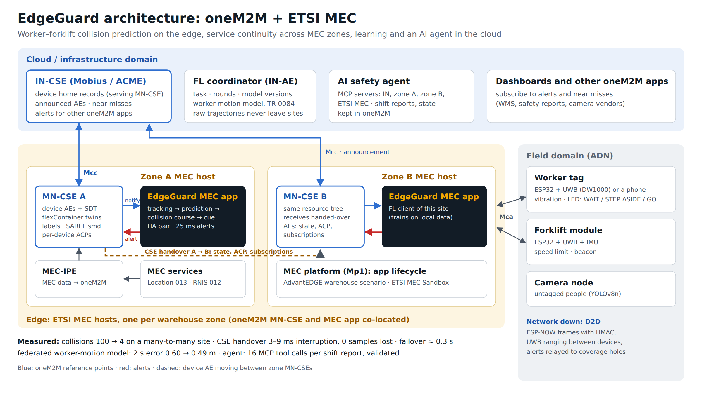
Zones, cloud and continuity: the full picture
Notes:
Each warehouse zone has its own MEC host with an MN-CSE and the EdgeGuard MEC app. The MN-CSEs register with the IN-CSE over Mcc. Devices hand over between zones; the IN-CSE keeps their home records, the federated learning coordinator and the AI safety agent.

Slide 8
oneM2M resource design and access control
Who | Own device AE | Other device AEs | MEC app AE
Device (e.g. SWorker01) | all | none | retrieve, subscribe
MEC app (SEdgeGuard) | retrieve, discover, create SUB only (chty 23) | same | all
MEC-IPE | retrieve, discover | same | none
/cse-mn-a (zone MN-CSE on the MEC host)
├─ worker_01 AE SWorker01, lbl egs:role/worker
│ ├─ tag flexContainer egs:wrkTg
│ │ ├─ kinematics egs:kinSt (mni 100)
│ │ ├─ cue · battery (cod:bat)
│ │ └─ smd SAREF semanticDescriptor
│ ├─ relay · status CNT
│ └─ acp_worker_01 ACP
├─ forklift_01 AE: module egs:frkMe
│ kinematics · speedLimit
└─ EdgeGuard AE (MEC app)
├─ risk · alert · control CNT
└─ nearmiss (mni 2000) · mec_lease
SUB kinematics (net=update) → MEC app
found by lbl egs:module/kinematics
Verified in CI on every commit
Real Mobius: 8 of 8 checks pass, including a forged write from another device rejected with 403. The same tree runs on ACME.
Data model (in use)
SDT flexContainers (own domain org.edgeguard.safety + standard cod:bat), labels for discovery-based onboarding, SAREF semantic query. Next: <group>, <pollingChannel>.
Notes:
Each device registers its own AE with its own ACP. The MEC app's decisions are oneM2M resources in its own AE, so any oneM2M app can subscribe. Planned additions target the rubric: FlexContainer, discovery, group, pollingChannel, announcement.

Slide 9
ETSI MEC integration
MEC services through oneM2M
The MEC-IPE polls MEC 013 Location and MEC 012 RNIS and writes them as oneM2M resources (location/<ue>, rnis/<cell>), so the MEC app reads MEC data like any other device data.
Location: positions for people without a UWB fix
RNIS: cell load → adaptive reporting rate, alert priority
MEC application deployment
The EdgeGuard MEC app runs as a Docker container on the MEC host, next to the edge CSE; an active-standby pair shares a lease container in oneM2M.
Self-hosted AdvantEDGE with a custom warehouse scenario: 70 alerts in 2 minutes
Live ETSI MEC Sandbox
Connected to the public Sandbox (try-mec.etsi.org): Location and RNIS queries feed the same pipeline as the local mock.
Planned: Location zone subscriptions → geofencing events into oneM2M (bidirectional)
Notes:
MEC services reach the application through oneM2M via the MEC-IPE. The MEC app is deployed on AdvantEDGE with a custom warehouse scenario and connected to the public ETSI MEC Sandbox.

Slide 10
End-to-end flow: from a position to a cue
1
2
3
4
5
6
Sense
Notify
Predict
Decide
Cue
Confirm
Tag / module updates its kinematics flexContainer
zone MN-CSE notifies the MEC app (subscription)
Kalman tracking, forklift turn model or shared route
Collision course: LOS rate + closest approach
Alert CIN → tag WAIT / STEP ASIDE / GO, forklift limit
Device reports its cue / speed limit in its twin
25 ms
2.4 s
0.73 s
median alert latency on the edge (cloud only: 85 ms)
median warning lead time; 100 % detected ≥ 1 s before contact
standby MEC app takeover
Failure path: no heartbeat from the MEC app for 2 s → devices switch to UWB ranging and D2D state exchange; neighbours relay alerts to devices in coverage holes; stop only when nothing else is known.
Notes:
Six steps from a position to a confirmed cue, all through oneM2M resources and subscriptions. If the MEC app goes silent, devices degrade gracefully to local decisions.

Slide 11

Status today: working end to end
Per-device AEs and ACPs (CREATE limited to subscriptions); access checks in CI
100 → 4
SDT flexContainer twins, labels, discovery onboarding, SAREF semantic query
collisions, many-to-many site (8 workers, 4 forklifts, 750 conflicts)
CSE handover between zone MN-CSEs with announcement and home records
61.7 → 86.0 %
Federated learning through oneM2M; AI safety agent over 4 MCP servers
forklift throughput on the same site
ETSI MEC Sandbox and AdvantEDGE; MEC app with HA, monitoring, dashboard
180 → 2
ESP32 firmware run unmodified against a real CSE in CI; hackster.io draft
collisions during a total network outage
Closed-loop simulation; baseline = our v1.0 vibration-only alert, same simulator.
Notes:
What already works, with evidence. Numbers are from closed-loop simulation against our own first version.

Slide 12
Built ahead of plan: measured in CI on every commit
Data model
CSE handover
SDT flexContainer twins (own domain + standard cod:bat), labels, SAREF semantic query
forklift AE moves between zone MN-CSEs with state, ACP, subscriptions; announcement + home record
self-registered device onboarded in ≈ 9 s · 6/6 checks
3–9 ms interruption, 0 samples lost · failover ≈ 0.3 s
Federated learning
AI safety agent
TR-0084 roles as oneM2M resources: task, participants, rounds, model lineage; dropout, late join
MCP servers for IN-CSE, zone A, zone B and ETSI MEC; state in oneM2M; routing to the serving CSE
2 s prediction error 0.604 → 0.486 m · 8/8 checks
shift report in 16 tool calls, validated · 9/9 checks
Notes:
Four items from the original plan are already built and verified in CI: the SDT data model, CSE handover, federated learning and the AI safety agent.

Slide 13
Development plan: Oct 12 – Nov 25
Oct 12
Oct 19
Oct 26
Nov 2
Nov 9
Nov 16
Nov 23
Done: data model, CSE handover, FL, MCP agent
M2 group, pollingChannel, MQTT for devices, TLS
M3 MEC Location zones: geofencing, handover trigger, multi-host
M4 Agent and FL polish; FL model used by the risk engine
M5 ESP32 boards, user study, article, video, public repo
Finals
Oct 20 interim
Nov 20 code freeze
Built ahead of plan (Oct 11): SDT data model, CSE handover, federated learning, AI agent · Blue: oneM2M depth · Orange: MEC · Green: AI · Red: demo and communication
Notes:
Five milestones to the November 20 code freeze, ordered by rubric impact. Hardware, user study and communication work run in parallel from Nov 10.

Slide 14
Milestones, rubric criteria and acceptance checks
Milestone | Deliverables | Rubric criteria | Done when
Done · Oct 11 | SDT flexContainers + SAREF; CSE handover (3–9 ms, 0 lost); FL through oneM2M (2 s error 0.60 → 0.49 m); safety agent over 4 MCP servers | Data interop., CSE handover, FL, AI agents | CI: check_sdt 6/6, handover 10/10 + 8/8, FL 8/8, agent 9/9
M2 · Oct 31 | <group> fan-out of alerts per zone; <pollingChannel> for tags; MQTT for devices, HTTP for apps; TLS | Innovative use of oneM2M, Protocols, Security | Same scenarios pass over MQTT; alerts reach tags behind NAT
M3 · Nov 10 | MEC Location zone subscriptions → geofence events in oneM2M and handover trigger; bidirectional MEC–oneM2M; multi-host | Geolocation, MEC services, Deployment | Zone event triggers a handover in a scripted run
M4 · Nov 17 | Learned worker-motion model delivered to the MEC apps; agent questions with Claude | Federated learning, AI agents | Risk engine uses the federated model; agent answers validated
M5 · Nov 20 | ESP32 board demo; user study (10+); hackster.io article; final video; public GitHub | Article, Video, GitHub, Promotion | Article published; repo public; video under 3 min
Notes:
Each milestone names its deliverables, the rubric criteria it targets, and an acceptance check we can demonstrate.

Slide 15
Risks and mitigations
Scope: many features in five weeks
Ordered by rubric impact; each feature lands with a CI test, so the working demo never breaks
CSE feature support differs (pollingChannel, FlexContainer, MQTT)
Advanced features on ACME first; Mobius kept for the base flow; differences documented
Hardware delivery or wiring issues
Firmware already verified against a real CSE in CI; boards only replace the PC runtime
Human behaviour is modelled, not measured
User study with a phone tag; measured compliance fed back into the simulation
Sandbox availability
Self-hosted AdvantEDGE and a local MEC mock run the same scenarios
Notes:
Main risks and how we contain them.

Slide 16
Next: deeper oneM2M, continuity across MEC zones, and a real-world demo
Team EdgeGuard · Sejong University
Thank you
Notes:
Thank you.

