Slide 1

GEOGRAPHIC
DATA SCIENCE
THE CASE FOR SPACE IN DATA SCIENCE
LEVI JOHN WOLF
levi.john.wolf@bristol.ac.uk
@levijohnwolf
ljwolf.org

Slide 2
WHY ARE GEOGRAPHERS?
GEOGRAPHY IS EVERYWHERE
HOW CAN GEOGRAPHY HELP?
HOW TO LEARN MORE

Slide 3
WHY ARE GEOGRAPHERS?
GEOGRAPHY IS EVERYWHERE
HOW CAN GEOGRAPHY HELP?
HOW TO LEARN MORE
can’t say I know myself

Slide 4








Slide 5
GEOGRAPHY IS WHAT GEOGRAPHERS DO
Apocryphal, attributed to Wilson (1970), also earlier by Johston & Sidaway (2015)

Slide 6
GEOGRAPHY IS WHAT GEOGRAPHERS DO
¯\_(ツ)_/¯
Apocryphal, attributed to Wilson (1970), also earlier by Johston & Sidaway (2015)

Slide 7
GEOGRAPHY
the systematic study of relationships
between people and their environments.

Slide 8
GEOGRAPHY
the systematic study of relationships
between people and their environments.
commuting, segregation, climate change, urban planning, campaigns, elections, and voting,
housing markets, energy forecasting, operational research, conservation, community dynamics,
disease spread, violent conflict, school efficacy, ecology, economic development & cluster policy,
digital economy, program evaluation, migration, risk, resilience & social vulnerability, ice sheets, rugby

Slide 9
GEOGRAPHERS
use the relationships between people and
their environments to solve problems.

Slide 10
GEOGRAPHERS
use the relationships between people and
their environments to solve problems.
What drives a healthy digital community, and how can we build them?
How can we drive engagement with our social media platform within and across neighborhoods?
How can we expose relevant commercial opportunities (classified, local advertisements) to users?

Slide 11
GEOGRAPHERS
use the relationships between people and
their environments to solve problems.
What kind of twitter users engage which hashtags, where, & why?
How do trends spread? Is it just social network structure, or are there other dampeners/drivers?
Can we deliver packages to customers in a more efficient manner?

Slide 12
GEOGRAPHERS
use the relationships between people and
their environments to solve problems.
How can we extract meaningful knowledge from terabytes of imagery/locational data?
What do you really gain from adding geographical information to machine learning methods?
Can we do a better job modeling how crowds interact with the built environment?
Are there fundamental/consistent structures in cities that emerge across social/cultural contexts?

Slide 13
WHY ARE GEOGRAPHERS?
GEOGRAPHY IS EVERYWHERE
HOW CAN GEOGRAPHY HELP?
HOW TO LEARN MORE
Geographers use relationships between people & environment to help
I apologize for the above pun

Slide 14
NOT EVERYONE SHOULD BE A GEOGRAPHER

Slide 15
EVERYONE SHOULD USE GEOGRAPHY
especially if you’ve got data!

Slide 16
NYT: ONE NATION TRACKED
https://nyti.ms/2uwMIUZ

Slide 17
Every minute of every day, everywhere on the planet dozens of companies are logging the movements of tens of millions of people.
Without much effort we spotted visitors to the estates of Johnny Depp, Tiger Woods and Arnold Schwarzenegger, connecting the devices’ owners to the residences.
NYT: ONE NATION TRACKED
https://nyti.ms/2uwMIUZ

Slide 18
UBIQUITY
Everything has a geographical location & time of occurrence
Every minute of every day, everywhere on the planet dozens of companies are logging the movements of tens of millions of people.
Without much effort we spotted visitors to the estates of Johnny Depp, Tiger Woods and Arnold Schwarzenegger, connecting the devices’ owners to the residences.
CONTEXT
Location enhances information
that is already available

Slide 19
Everything has a geographical location & time of occurrence

Slide 20
Everything has a geographical location & time of occurrence
Every Monday without fail, a final-year undergrad knocks on my door at 17:55, right as I’m packing up to leave my office, to ask if they can meet to talk about their dissertation.

Slide 21
Everything has a geographical location & time of occurrence
Event E happens

Slide 22
Everything has a geographical location & time of occurrence
Event E happens
at 17:55
every Monday
as I pack up to leave
occurrence

Slide 23
Everything has a geographical location & time of occurrence
Event E happens
at 17:55
every Monday
as I pack up to leave
occurrence
periodicity

Slide 24
Everything has a geographical location & time of occurrence
Event E happens
at 17:55
every Monday
as I pack up to leave
occurrence
periodicity
causality

Slide 25
Everything has a geographical location & time of occurrence
Event E happens
at 17:55
every Monday
as I pack up to leave
occurrence
periodicity
causality
(G-)

Slide 26
Everything has a geographical location & time of occurrence
Event E happens
at 17:55
every Monday
as I pack up to leave
occurrence
periodicity
causality
TIME: MORE THAN CLOCK POSITION
(G-)

Slide 27
Everything has a geographical location & time of occurrence
Event E happens
at 51°27'N 2°35'W
in Bristol
near me
location
containment
proximity
SPACE: MORE THAN EARTH POSITION

Slide 28
EVEN IF
YOU DON’T COLLECT IT, YOU HAVE IT

Slide 29
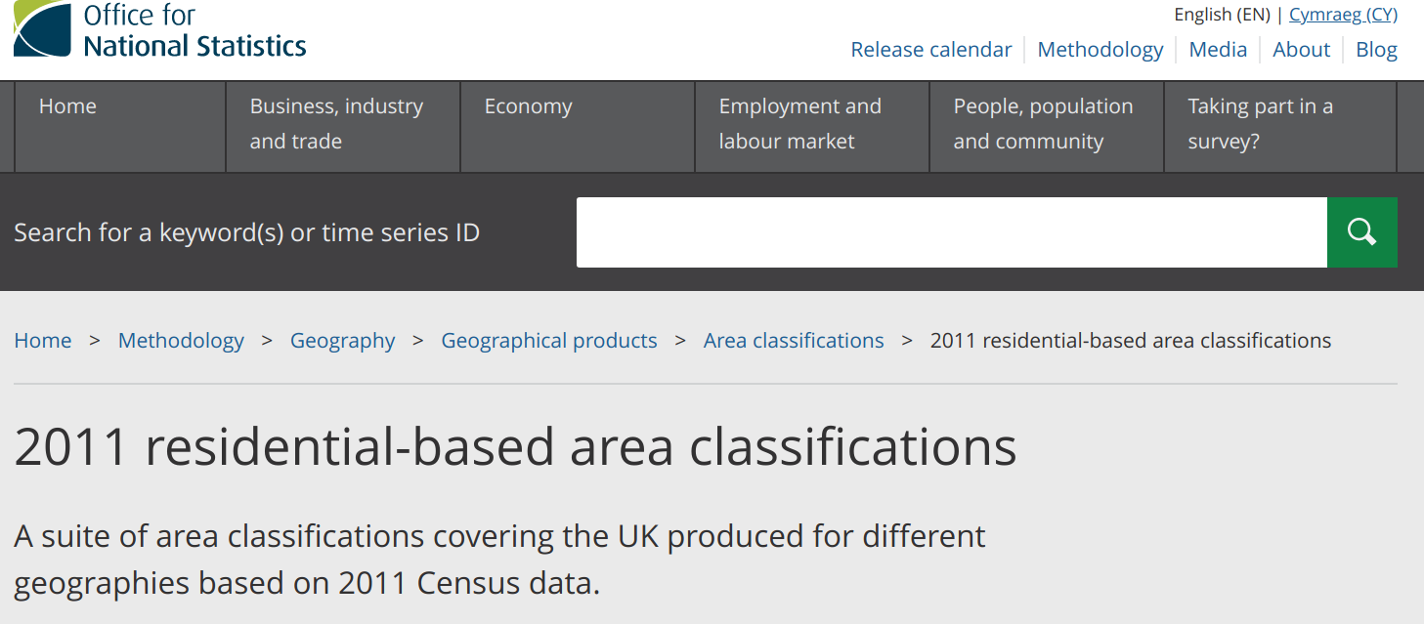
Massive amounts of government-collected contextual data is OK for commercial use

Slide 30

New, high-quality imagery is increasingly cheap

Slide 31
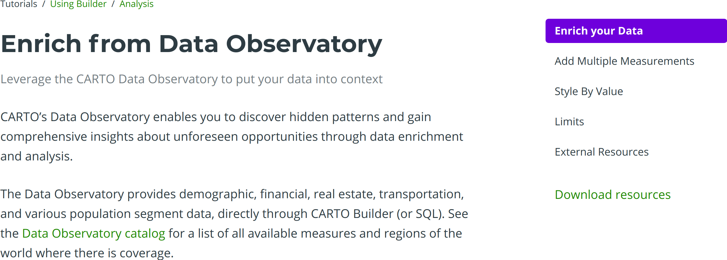
Companies can do the mixing, matching, & merging for you with your data & public data automatically.

Slide 32
WHY ARE GEOGRAPHERS?
GEOGRAPHY IS EVERYWHERE
HOW CAN GEOGRAPHY HELP?
HOW TO LEARN MORE
Geographers use relationships between people & environment to help
Geography, like time, is ubiquitous & helps us contextualize knowledge
I’m not sure, ask your neighbor.

Slide 33
GEOGRAPHIC DATA SCIENCE
COMMODITY:
Do standard analysis on your standard data
& chuck the results into Tableau/Alteryx to map

Slide 34
GEOGRAPHIC DATA SCIENCE
COMMODITY:
Do standard analysis on your standard data
& chuck the results into Tableau/Alteryx to map
ENRICHED:
Do standard analysis on data after you have
augmented it using spatial feature engineering
EXTENDED:
Use methods that explicitly learn from, analyze, or summarize the
geographical structure in your data

Slide 35
GEOGRAPHICDATA.SCIENCE/BOOK
COMMODITY:
Do standard analysis on your standard data
& chuck the results into Tableau/Alteryx to map
ENRICHED:
Do standard analysis on data after you have
augmented it using spatial feature engineering
EXTENDED:
Use methods that explicitly learn from, analyze, or summarize the
geographical structure in your data

Slide 36
GEOGRAPHICDATA.SCIENCE/BOOK
ENRICHED:
Do standard analysis on data after you have
augmented it using spatial feature engineering

Slide 37
GEOGRAPHICDATA.SCIENCE/BOOK
ENRICHED:
Do standard analysis on data after you have
augmented it using spatial feature engineering
synthesizing information using spatial relationships within or across data.

Slide 38
GEOGRAPHICDATA.SCIENCE/BOOK
ENRICHED:
Do standard analysis on data after you have
augmented it using spatial feature engineering
synthesizing information using spatial relationships within or across data.
Say you’re modelling the price-per-head of an Airbnb

Slide 39
GEOGRAPHICDATA.SCIENCE/BOOK
ENRICHED:
Do standard analysis on data after you have
augmented it using spatial feature engineering
synthesizing information using spatial relationships within or across data.
Say you’re modelling the price-per-head of an Airbnb
How many pubs are within a 200m walk of this Airbnb?
How far is this Airbnb from the closest noisy major road?
How pretty is the area this Airbnb is in?
What’s the burglary rate in the ward the Airbnb is in?

Slide 40
GEOGRAPHICDATA.SCIENCE/BOOK
ENRICHED:
Do standard analysis on data after you have
augmented it using spatial feature engineering
synthesizing information using spatial relationships within or across data.
Say you’re modelling the price-per-head of an Airbnb
How many pubs are within a 200m walk of this Airbnb?
How far is this Airbnb from the closest noisy major road?
How pretty is the area this Airbnb is in?
What’s the burglary rate in the ward the Airbnb is in?
MAP
MATCHING
Using spatial relationships between two datasets to transfer information

Slide 41
GEOGRAPHICDATA.SCIENCE/BOOK
ENRICHED:
Do standard analysis on data after you have
augmented it using spatial feature engineering
synthesizing information using spatial relationships within or across data.
Say you’re modelling the price-per-head of an Airbnb
How many other Airbnbs are within a 200m walk?
Are there any Airbnbs within a 200m walk that are kid-friendly?
What’s the average number of people accommodated by nearby Airbnbs?
Is this Airbnb co-located with other similar Airbnbs that compete?

Slide 42
GEOGRAPHICDATA.SCIENCE/BOOK
ENRICHED:
Do standard analysis on data after you have
augmented it using spatial feature engineering
synthesizing information using spatial relationships within or across data.
Say you’re modelling the price-per-head of an Airbnb
How many other Airbnbs are within a 200m walk?
Are there any Airbnbs within a 200m walk that are kid-friendly?
What’s the average number of people accommodated by nearby Airbnbs?
Is this Airbnb co-located with other similar Airbnbs that compete?
Using spatial relationships between observations in a dataset to synthesize new features
MAP
SYNTHESIS

Slide 43
GEOGRAPHICDATA.SCIENCE/BOOK
EXTENDED:
Use methods that explicitly learn from, analyze, or summarize the
geographical structure in your data

Slide 44
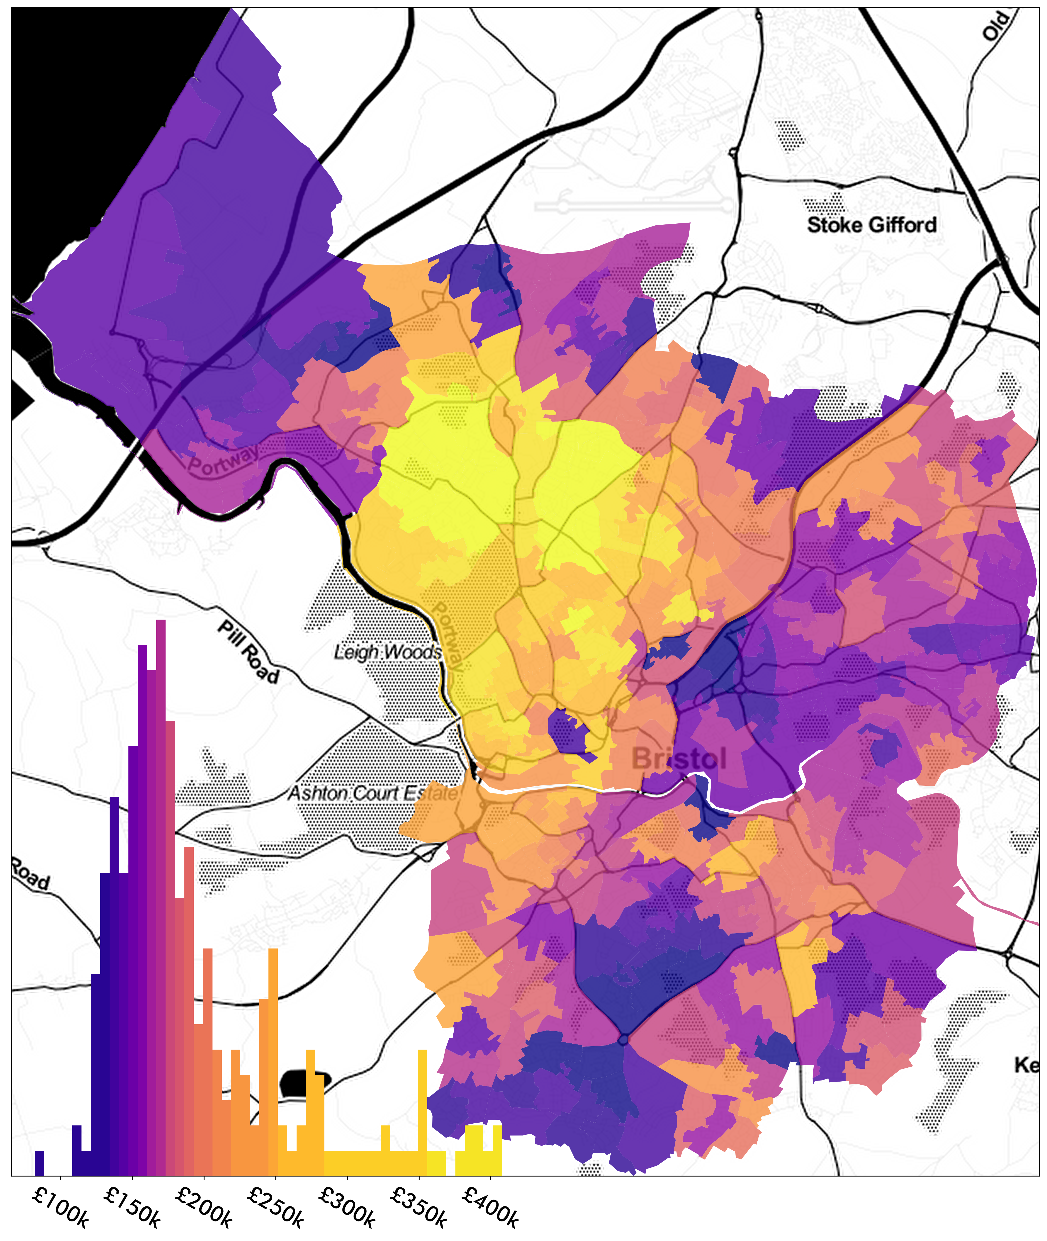
USE METHODS THAT EXPLICITLY LEARN FROM GEOGRAPHIC STRUCTURE

Slide 45
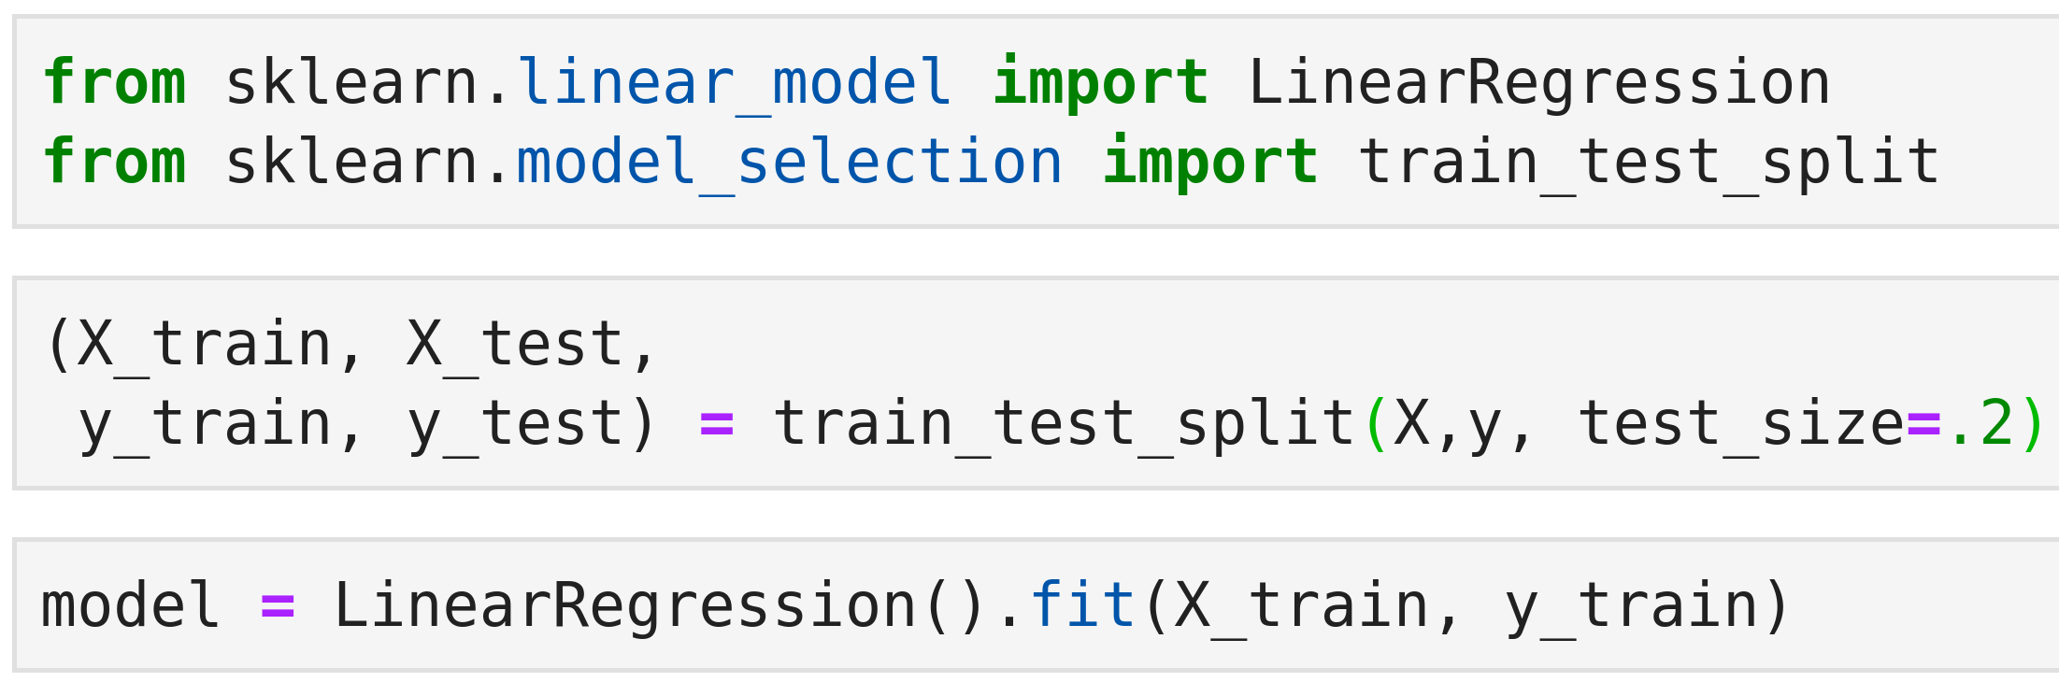
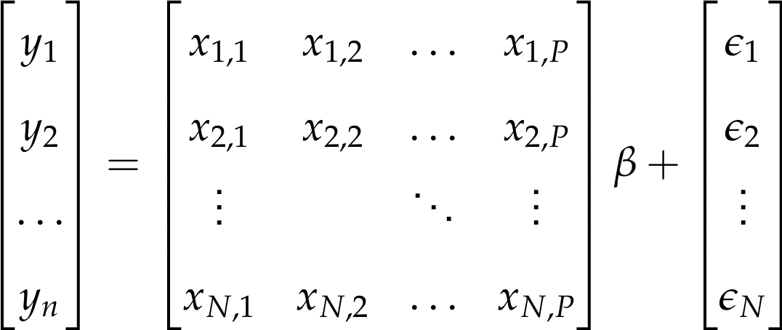
USE METHODS THAT EXPLICITLY LEARN FROM GEOGRAPHIC STRUCTURE

Slide 46
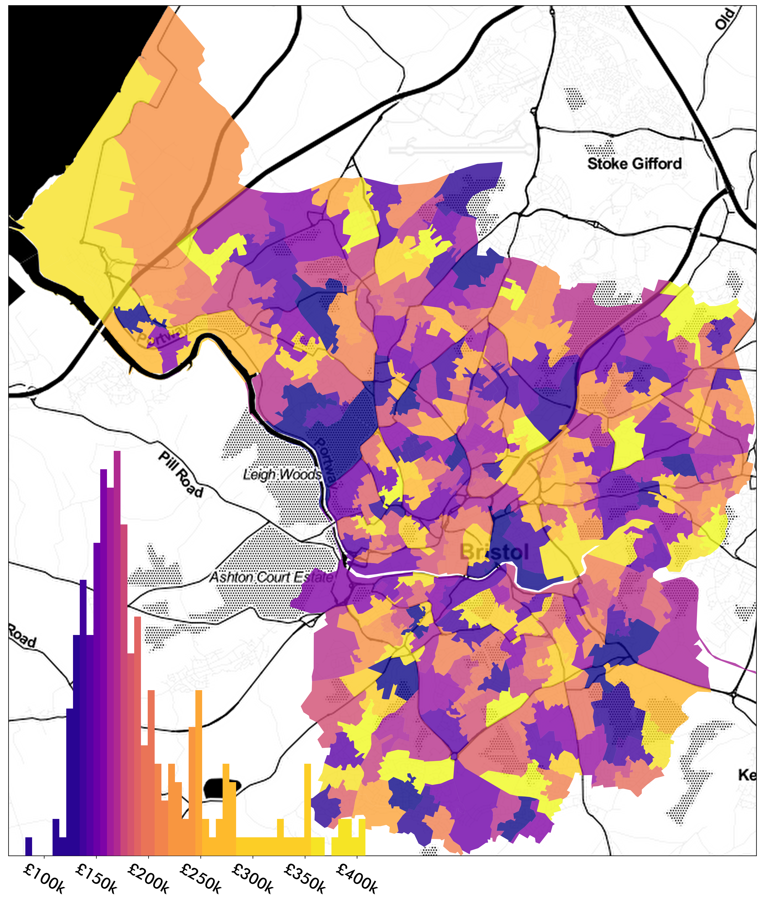
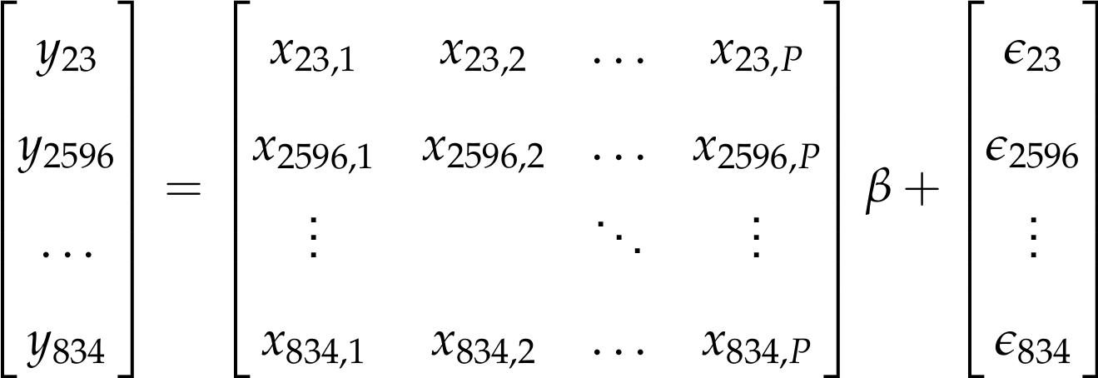
USE METHODS THAT EXPLICITLY LEARN FROM GEOGRAPHIC STRUCTURE

Slide 47
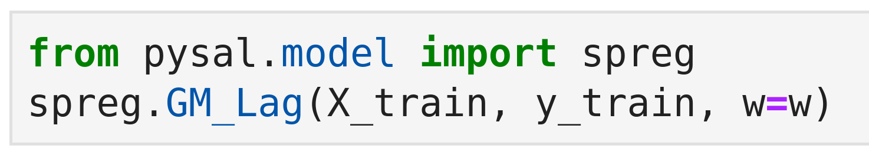
USE METHODS THAT EXPLICITLY LEARN FROM GEOGRAPHIC STRUCTURE

Slide 48
Graph that encodes information about adjacency, proximity, etc. between obs.
USE METHODS THAT EXPLICITLY LEARN FROM GEOGRAPHIC STRUCTURE

Slide 49
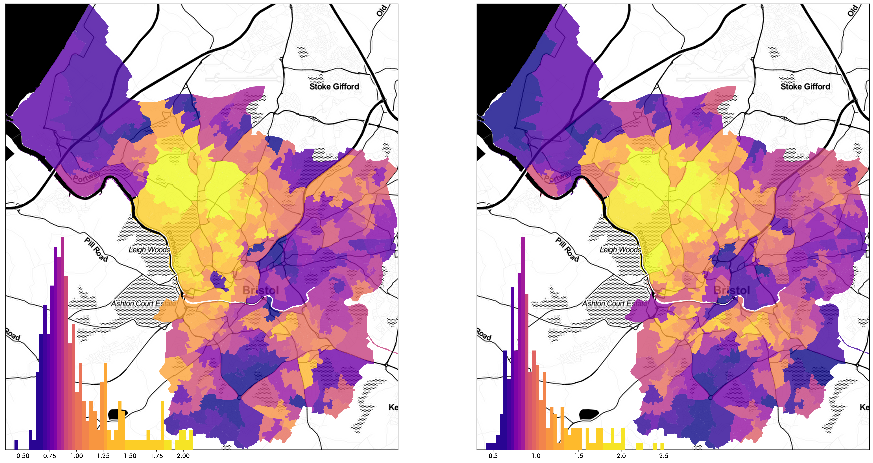
MARCH 2008
MARCH 2019
USE METHODS THAT EXPLICITLY LEARN FROM GEOGRAPHIC STRUCTURE

Slide 50
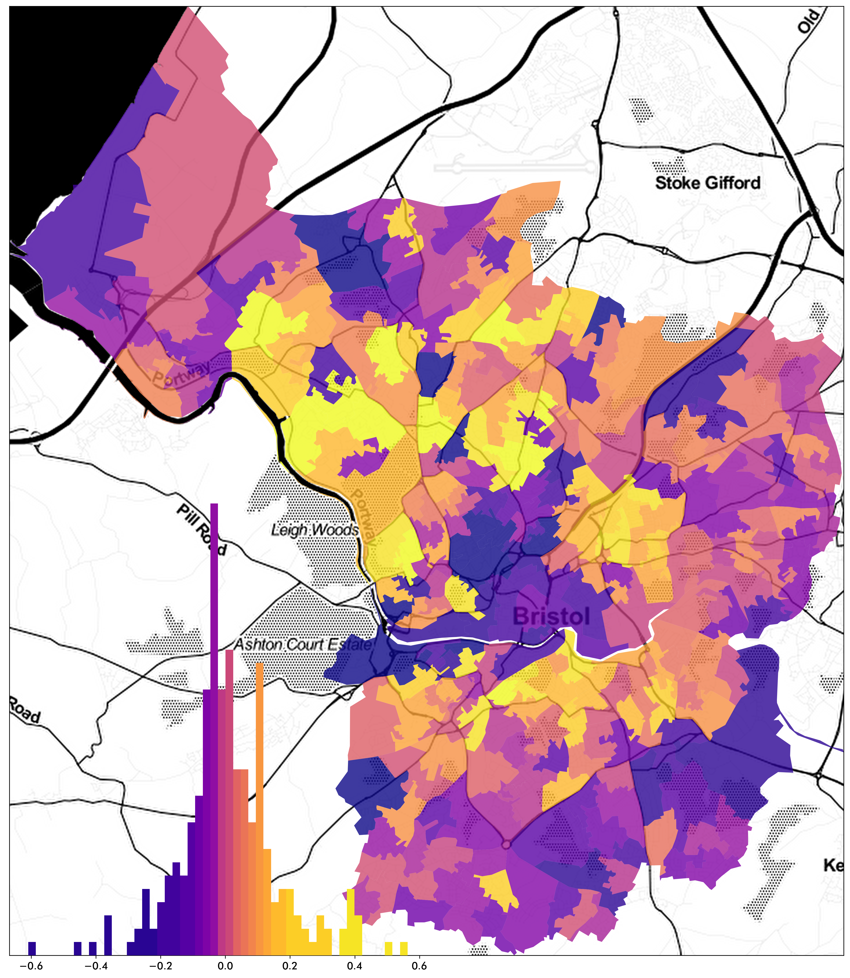
USE METHODS THAT EXPLICITLY LEARN FROM GEOGRAPHIC STRUCTURE

Slide 51
IS ERROR CLUSTERED?
USE METHODS THAT EXPLICITLY LEARN FROM GEOGRAPHIC STRUCTURE

Slide 52
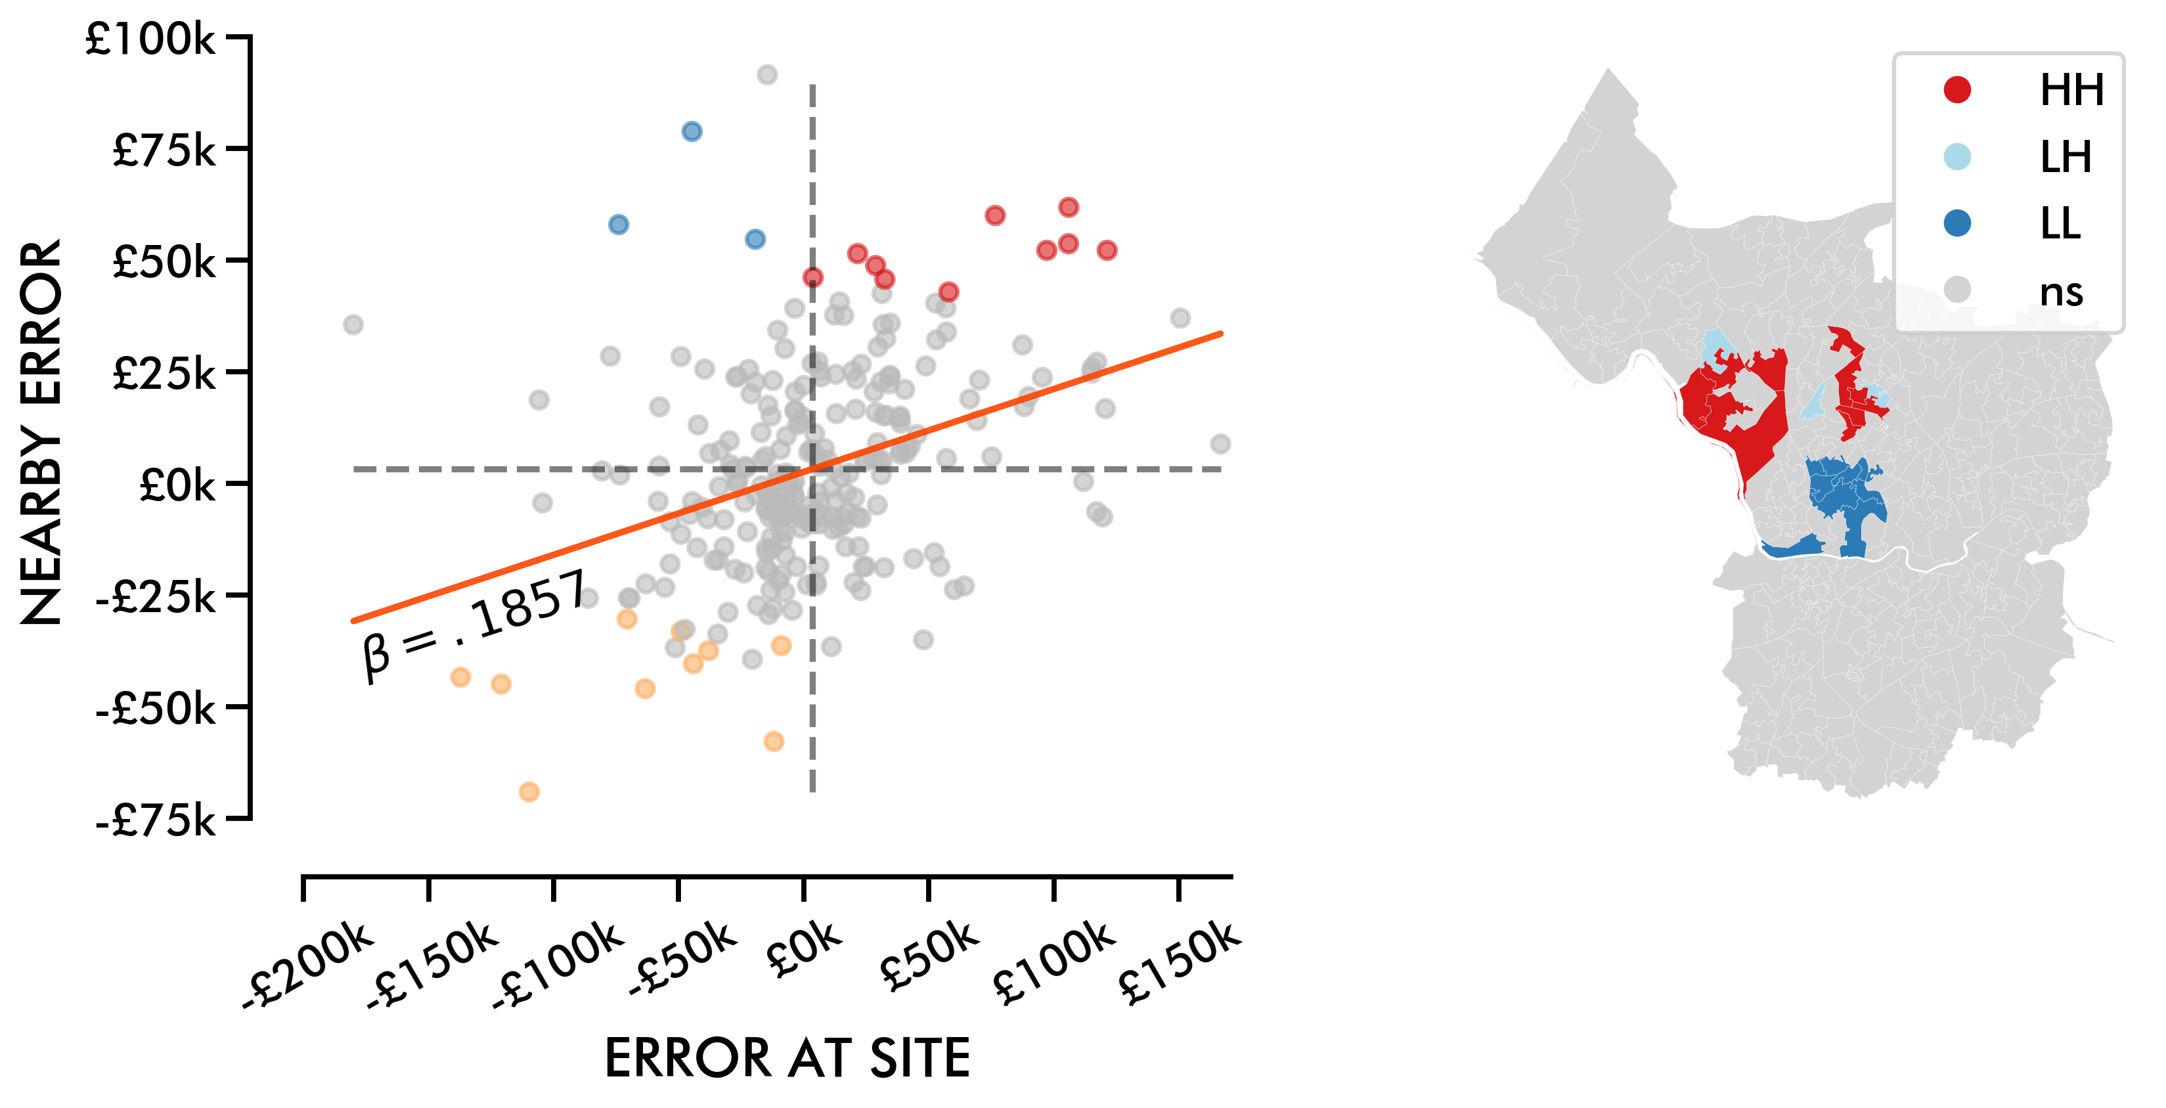
USE METHODS THAT EXPLICITLY LEARN FROM GEOGRAPHIC STRUCTURE

Slide 53
USE METHODS THAT EXPLICITLY LEARN FROM GEOGRAPHIC STRUCTURE

Slide 54
WHY ARE GEOGRAPHERS?
GEOGRAPHY IS EVERYWHERE
HOW CAN GEOGRAPHY HELP?
HOW TO LEARN MORE
Geographers use relationships between people & environment to help
Geography, like time, is ubiquitous & contextualizes knowledge
Spatial feature engineering & explicitly-geographic learning helps analysis

Slide 55
AUTOMATING GIS PROESSES
Henrikki Tenkanen & Vuokko Heikinheimo
Solving Geographic Information Processing problems
with high-performance Python. CRC Press, 202X.
automating-gis-processes.github.io

Slide 56
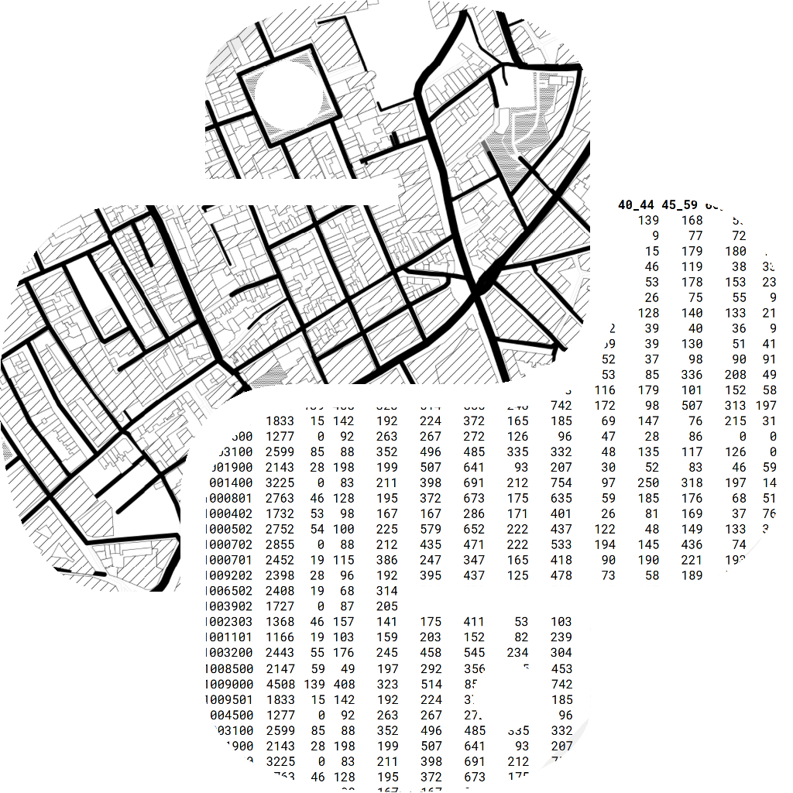
GEOGRAPHIC
DATA SCIENCE
Sergio Rey
Daniel Arribas-Bel
Levi John Wolf
Methods & models that do (un)supervised learning with Python using PySAL & Scikit-Learn. CRC Press, 2022.
geographicdata.science/book

