Slide 1
Yofficial
Capstone Design 1 Class No.4 / Team No.9
이재원
중앙대학교 컴퓨터공학부
20132697

Slide 2
Content
1. Feedbacks
2. Progression and Trouble Shooting
3. Schedule

Slide 3


FeedBacks
01
Noise Test?

Slide 4
FeedBacks
01
영상넣기

Slide 5


FeedBacks
01
Ingredient Input
삼겹살 200g
돼지고기 삼겹살 200g

Slide 6
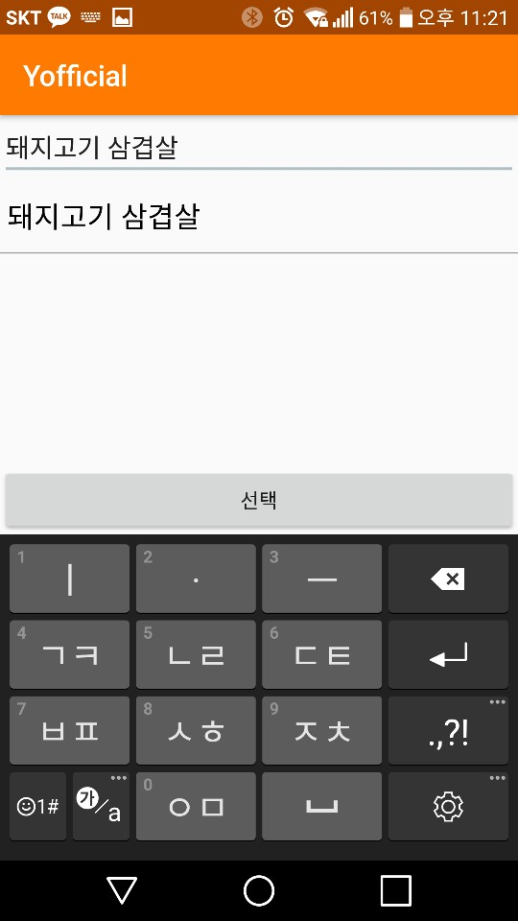
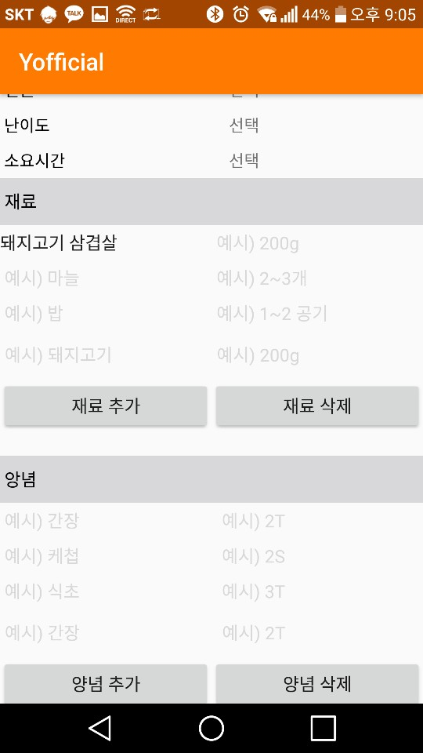
FeedBacks
01
Click!

Slide 7
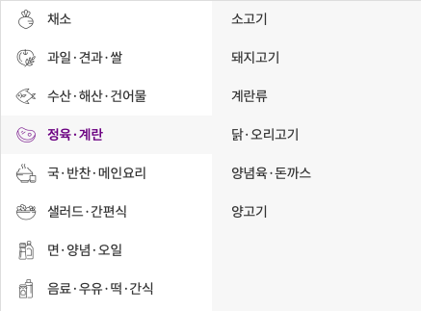
FeedBacks
01
Classification

Slide 8
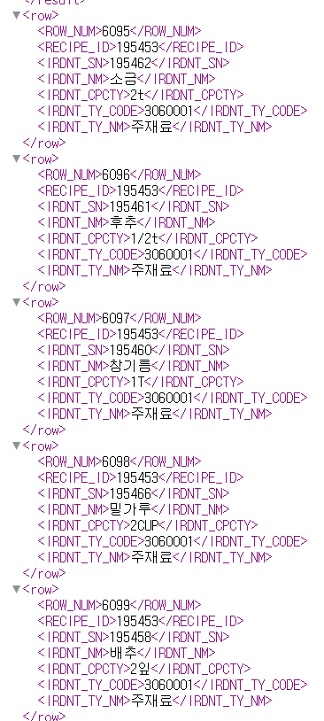
FeedBacks
01
Agricultural Products API

Slide 9
Progression
02

Slide 10
FeedBacks
01

Slide 11
FeedBacks
01

Slide 12
FeedBacks
01

Slide 13
Project proposal review
02
Main
Functions
Sub
Recipe with video
Step by step
With Voice Recognition
Community
Gamification
Interlocking with other apps
Recommendation System

Slide 14

Progression and Changes with feedbacks
01
Changes with Feedbacks
Battery issue
How to change tiers
Money
Tier
\
Recognition
act by motion
using proximity sensor.
Self evaluation system about their results.
Generating revenue
using ad and partnership other service

Slide 15
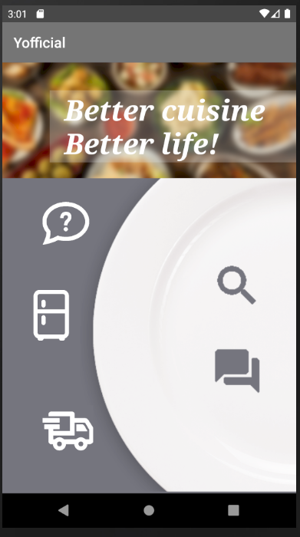
Progression and Changes with feedbacks
01
Progression of UI

Slide 16
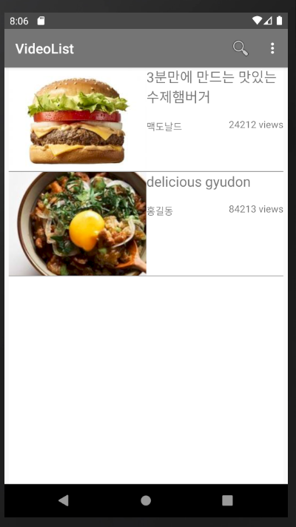
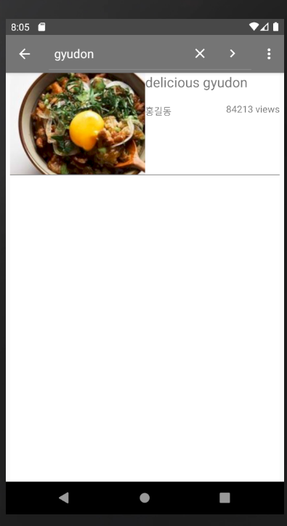
Progression and Changes with feedbacks
02
Progression of UI

Slide 17
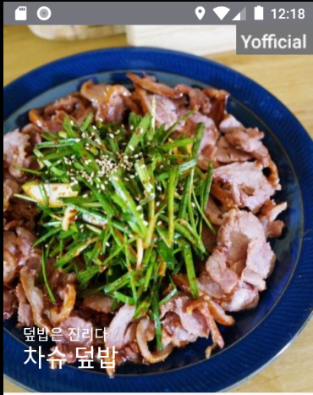
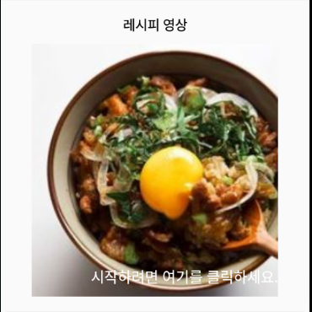
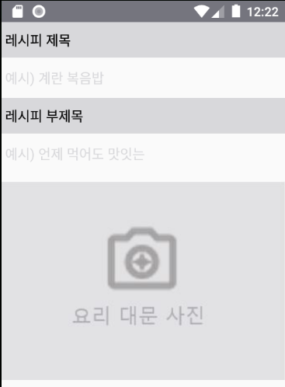
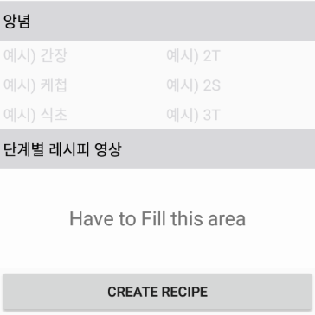
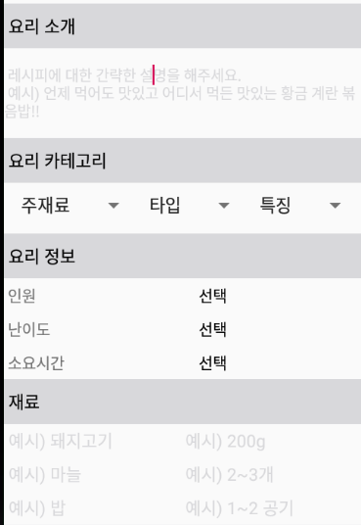
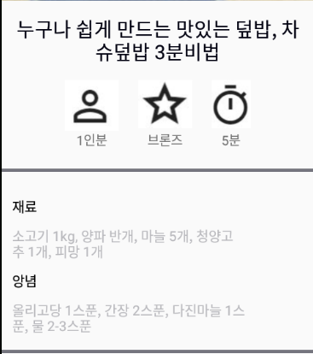
Progression and Changes with feedbacks
03
Progression of UI

Slide 18
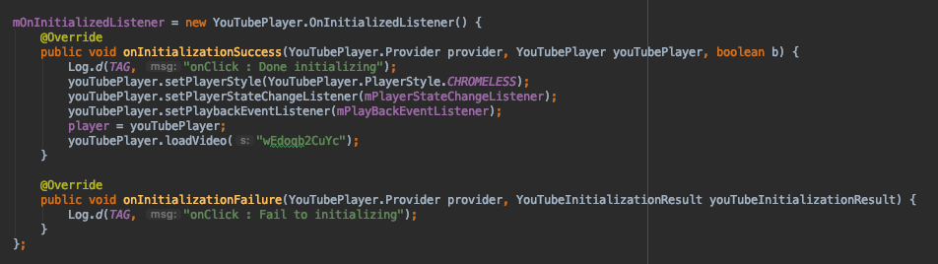

Progression and Changes with feedbacks
04
Progression of functions
Video loading and parsing
Start video playing

Slide 19
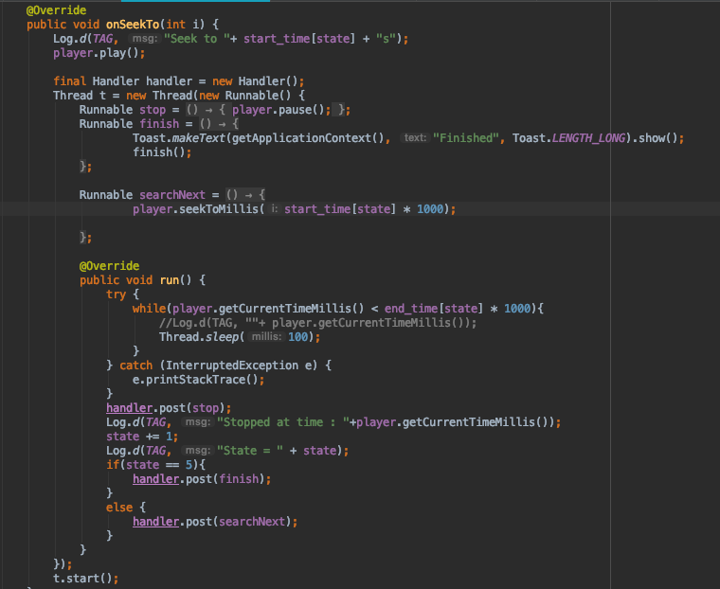
Progression and Changes with feedbacks
05
Progression of functions
Video playing by steps

Slide 20
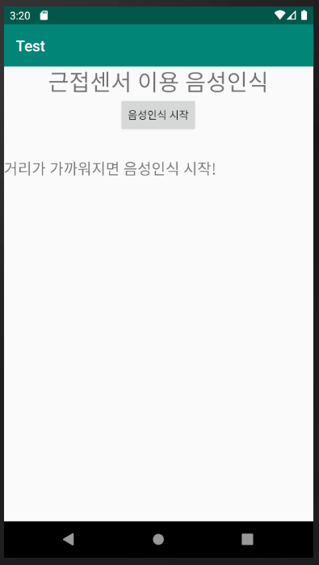
Progression and Changes with feedbacks
06
Progression of functions

Slide 21
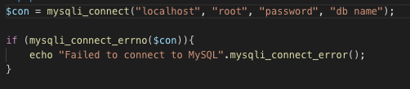
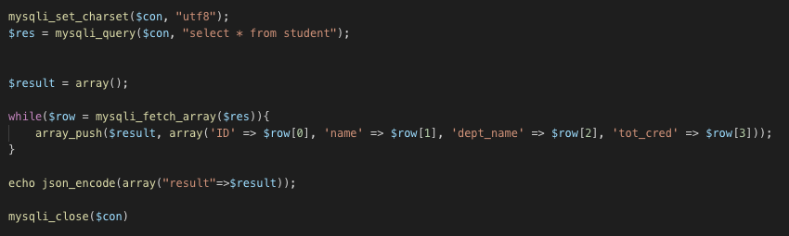
Progression and Changes with feedbacks
07
Progression of Back-End
PHP part
Connecting DB and Encoding to JSON format in server

Slide 22
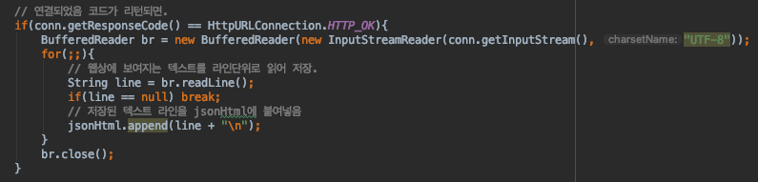
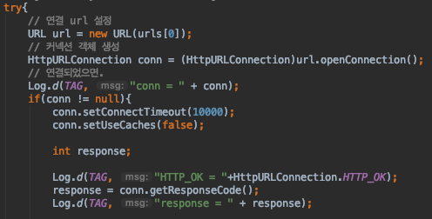
Progression and Changes with feedbacks
08
Progression of Back-End
Connecting PHP in server
Getting a data

Slide 23
Sche
01
WEEK 10
Prototype of Recommendation
WEEK 12
Completion of main functions
WEEK 14
Completion of Yofficial
WEEK 9
Completion of Video service
Completion of Log-In
WEEK 11
Completion of Recommendation & Gamification
WEEK 13
UI upgrade
Completion of sub functions

Slide 24
The end
Thank you

