Slide 1
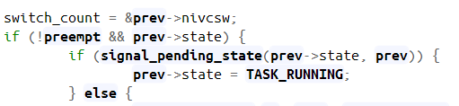
return
__switch_to Macro
Balance_callback(rq)
Update run_time and states of prev
Context Switch
rq_unlock_irq
Yes
No
Is next != prev?
Pick_next_task
Clear TSK flag

Slide 2
Module Loaded
When timer expire, call the callback function
Proc_init
Tasklet_schedule
Timer_setup
Tasklet_schedule
Mod_timer
Remove Previous (if any)
Add timer_list and assign func
Remove Previous (if any)
Update expire time
Update information
mod_timer
To set expire
Update information
for_each_process (struct task_struct *tsk)
Make Directory
Make Directory
Make Proc/files
Make Proc/files

Slide 3
Proc_exit
Remove_data
proc_remove
del_timer
Tasklet_kill
kfree mm_info list
Remove file
Module Unload
Remove directory

Slide 4
Cat /proc/hw2/pid
proc_open
Seq_open
Save pid to global char * pid_name
Seq_start
if(pid == info->pid)
Yes
Seq_show (print)
To Compare
No
Seq_next
Seq_stop
Iteration
No more Items in list

Slide 5
mm_list
mm_info
mm_info
pid_t pid
pid_t pid
Char *comm
Char *comm
mm_struct *mm
mm_struct *mm
*pgd, *pud, *pmd, *pte
list_head list
list_head list

Slide 6
Hardware
Hardware
Interrupt
Schedule tasklet
CPU
Interrupt
Kernel
Interrupt Handler
Ksoftirqd
→ Run tasklet_action
Delayed
Work
Return

Slide 7
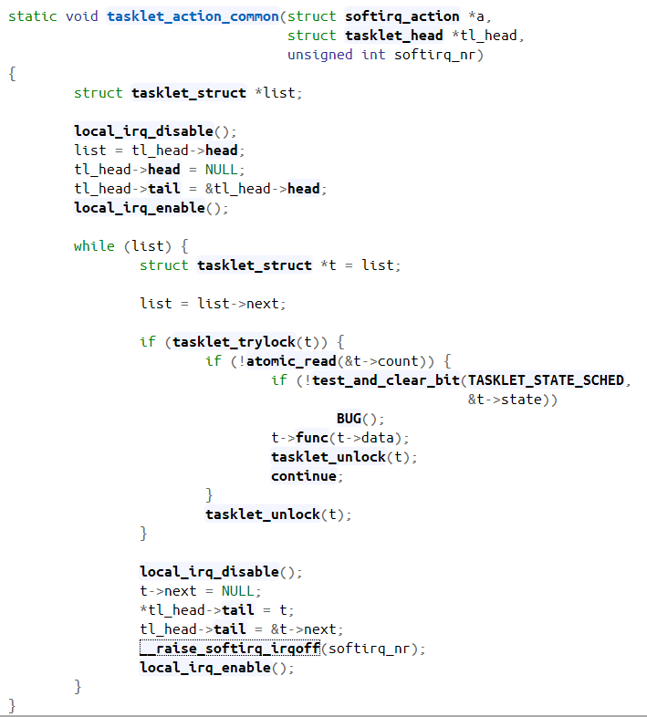
Tasklet list initialization
Run all the tasklet in the list
Tasklet iteration
Bug, since we set state to TASKLET_STATE_RUN
Set TASKLET_STATE_RUN
Check tasklet enables
Execute function
Set state 0
Update
Tasklet list

Slide 8
Struct task_struct
Struct mm_struct
mm_struct *mm
Pgd_t *pgd
Page Global directory
Page Middle directory
Page Table
pte_offset_kernel(dir, address)
Macros
pmd_offset(dir, address)
pte_page(x)
pgd_offset(mm, address)
pgd_t
pmd_t
pte_t
pfn_to_page(x)
pgd_val(x) macro
pmd_val(x) macro
pte_pfn(x)
Struct page
Physical page
Struct address_space *mapping
pgoff_t index
Used when WANT_PAGE_VIRTUAL flag is set
Void *virtual

Slide 9
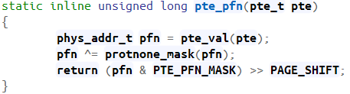
Struct task_struct
Struct mm_struct
mm_struct *mm
Pgd_t *pgd
Page Global directory
Page Upper directory
Page Middle directory
Page Table
Inline Functions
(value + index)
pte_offset_kernel(*pmd, address)
pmd_offset(*pud, address)
pud_offset(*p4d, address)
pud_t
p4d_offset(*pgd, address)
pgd_t
p4d
pmd_t
pte_t
pte_page(x)
pgd_offset(mm, address)
(p4d_t *) pgd
pfn_to_page(x)
pgd_val(x) macro & PTE_PFN_MASK
pud_val(x) macro & pud_pfn_mask(pud)
pmd_val(x) macro & pmd_pfn_mask(pmd)
Macro
p4d_val(x) macro & PTE_PFN_MASK
pte_pfn(x)
Struct page
Physical page
Struct address_space *mapping
pgoff_t index
Used when WANT_PAGE_VIRTUAL flag is set
(If not kmapped)
Void *virtual

