Slide 1
The Scarring Effect of Youth Unemployment on Trajectories of Mental Health and Subjective Wellbeing
Liam Wright
Department of Epidemiology and Public Health
University College London

Slide 2
Background (I)
Evidence from multiple countries that those unemployed while young have worse outcomes (‘scars’) in later life.
Occupational outcomes (e.g., Gregg and Tominey, 2005)
Physical health (e.g., Nygren et al., 2015)
Somatic complaints (e.g., Brydsten et al., 2016)
Health behaviours (e.g., Mossakowski, 2008)
Mental health problems (e.g., Voßemer et al., 2018)
Subjective wellbeing (e.g., Bell and Blanchflower, 2011)
Most studies on mental health and subjective wellbeing assess outcomes at single point(s) in time.
Yet, measuring trajectories important for understanding underlying processes (Lersch et al., 2018).
Most of these also use data from older cohorts (e.g. NCDS or Northern Swedish Cohort).
Two studies with more recent data do not consistently show significant results(Bynner and Parson, 2002; McQuaid et al., 2014).

Slide 3
Background (II)
Arguments in the literature that the effects of unemployment have increased for women as they have entered the workforce in greater numbers.
Finally, there is a wide body of research on the long-term costs of graduating during a recession, with several studies looking at whether this moderates the scarring effect of youth unemployment.
However, data used in these studies is inadequate.

Slide 4
Research Questions
What is the association between experiencing youth unemployment between ages 18-21 and trajectories in mental health and subjective wellbeing?
Is this association different between genders? Is it changing by year of birth, and is it changing by year of birth differently by gender?
Is the association moderated by economy-wide unemployment rates?

Slide 5
Dataset
British Household Panel Survey (BHPS)
Annual interviews from 1991-2008 (18 Waves)
~ 10,000 participants per Wave from ~ 5,000 households
Understanding Society (UKHLS)
Annual interviews from 2009-Present (7 Waves available)
~ 50,000 participants per Wave from ~ 30,000 households
BHPS participants joined UKHLS in Wave 2.
Sample sizes:
Observations: 734 - 358,425
Participants: 551 - 49,508

Slide 6

Outcome I: GHQ-12 Likert Score
12 Item screening device for minor psychiatric disorders focussing on two areas:
Appearance of new, distressing phenomena
Inability to carry out normal functions
Range = 0-36
Higher values indicate worse health
Collected in BHPS Waves 1-18 and UKHLS Waves 1-7
$$μ=11.18$$
$$SD=5.43$$

Slide 7

Outcome II: Life Satisfaction
Single-item measuring person’s subjective assessment of their life as a whole.
BHPS wording: “…how dissatisfied or satisfied are you with your life overall?”
UKHLS wording: “Please tick the number which you feel best describes how dissatisfied or satisfied you are with the following aspects of your current situation…your life overall.”
Range = 1-7
7 = Completely Satisfied
Collected in BHPS Waves 4-18 and UKHLS Waves 1-7
$$μ=5.19$$
$$SD=1.42$$
Notes:
Answer categories also different. BHPS: 1. Not satisfied at all; 7. Completely satisfied. UKHLS: 1. Completely dissatisfied; 7. Completely satisfied.

Slide 8

Outcome III: SF-12 Mental Component Summary
Derived from weighting responses to the Short Form 12 Item Health Survey.
Survey has questions physical and mental health with a recall period of four weeks. Mental health questions relate to symptoms of common depressive and anxiety disorders.
Range = 0-100
Higher values indicate better health
Captured in UKHLS Waves 1-7
Face-to-face interview Wave 1
Self completion Wave 2 onwards
$$μ=49.79$$
$$SD=9.86$$

Slide 9

Exposure
Cumulative months unemployment between ages 18-21 inclusive
Collected from retrospective self-reports of main activity.
Captured in three separate survey modules.
Full-time education >
Annual History >
Life History
‘Seam’ effects observed and recall bias likely (Paull, 2002)
Range = 0-47
Individuals Exposed = 4,694
$$μ=13.43;Median=8$$
$$SD=13.51$$
Notes:
Note mistake in coding.

Slide 10


Moderators
1. Birth Year
2. Average monthly UK unemployment rate between ages 18-21
$$Median=1960$$
$$min=1895; max=1994$$
$$μ=7.74;SD=2.29$$
$$min=4.03; max=11.72$$

Slide 11
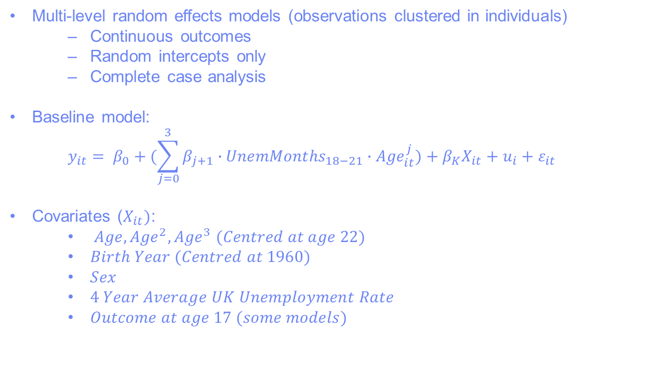
Methods
Multi-level random effects models (observations clustered in individuals)
Continuous outcomes
Random intercepts only
Complete case analysis
Baseline model:
$$y_{it}= β_{0}+(\sum_{j=0}^{3}{β_{j+1}∙{UnemMonths}_{18−21}∙{Age}_{it}^{j})}+β_{K}X_{it}+u_{i}+ε_{it}$$
Covariates ($X_{it})$:
$Age,{Age}^{2}, {Age}^{3} (Centred at age 22)$
$Birth Year (Centred at 1960)$
$Sex$
$4 Year Average UK Unemployment Rate$
$Outcome at age 17 (some models)$

Slide 12
Results (I)
Research Question:
What is the association between experiencing youth unemployment between ages 18-21 and trajectories in mental health and subjective wellbeing?

Slide 13
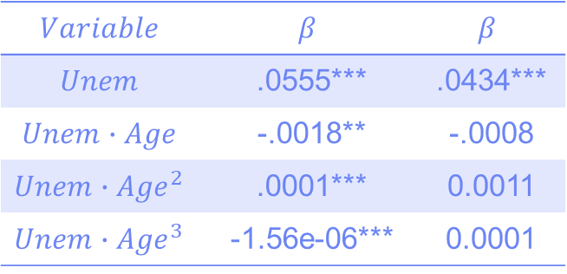

Results (I): GHQ-12
Research Question:
What is the association between experiencing youth unemployment between ages 18-21 and trajectories in mental health and subjective wellbeing?
$$Variable$$ | $$β$$ | $$β$$
$$Unem$$ | .0555*** | .0434***
$$Unem∙Age$$ | -.0018** | -.0008
$${Unem∙Age}^{2}$$ | .0001*** | 0.0011
$${Unem∙Age}^{3}$$ | -1.56e-06*** | 0.0001
$∗∗∗p<0.01$;$∗∗p<0.05; ∗p<0.1$

Slide 14
Results (I): GHQ-12
Research Question:
What is the association between experiencing youth unemployment between ages 18-21 and trajectories in mental health and subjective wellbeing?
$$Variable$$ | $$β$$ | $$β$$
$$Unem$$ | .0555*** | .0434***
$$Unem∙Age$$ | -.0018** | -.0008
$${Unem∙Age}^{2}$$ | .0001*** | 0.0011
$${Unem∙Age}^{3}$$ | -1.56e-06*** | 0.0001
$∗∗∗p<0.01$;$∗∗p<0.05; ∗p<0.1$

Slide 15
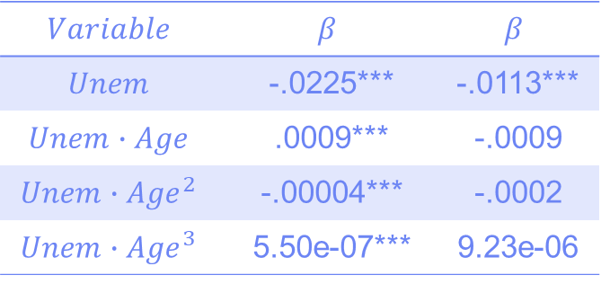
Results (I): Life Satisfaction
Research Question:
What is the association between experiencing youth unemployment between ages 18-21 and trajectories in mental health and subjective wellbeing?
$$Variable$$ | $$β$$ | $$β$$
$$Unem$$ | -.0225*** | -.0113***
$$Unem∙Age$$ | .0009*** | -.0009
$${Unem∙Age}^{2}$$ | -.00004*** | -.0002
$${Unem∙Age}^{3}$$ | 5.50e-07*** | 9.23e-06
$∗∗∗p<0.01$;$∗∗p<0.05; ∗p<0.1$

Slide 16
Results (I): Life Satisfaction
Research Question:
What is the association between experiencing youth unemployment between ages 18-21 and trajectories in mental health and subjective wellbeing?
$$Variable$$ | $$β$$ | $$β$$
$$Unem$$ | -.0225*** | -.0113***
$$Unem∙Age$$ | .0009*** | -.0009
$${Unem∙Age}^{2}$$ | -.00004*** | -.0002
$${Unem∙Age}^{3}$$ | 5.50e-07*** | 9.23e-06
$∗∗∗p<0.01$;$∗∗p<0.05; ∗p<0.1$

Slide 17
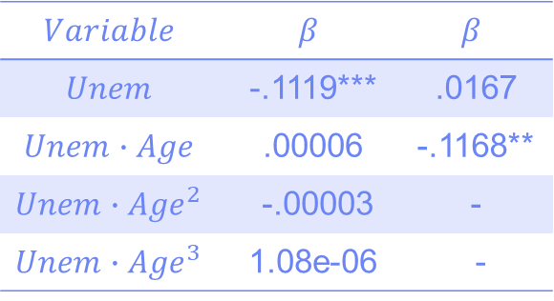
Results (I): SF-12 MCS
Research Question:
What is the association between experiencing youth unemployment between ages 18-21 and trajectories in mental health and subjective wellbeing?
$$Variable$$ | $$β$$ | $$β$$
$$Unem$$ | -.1119*** | .0167
$$Unem∙Age$$ | .00006 | -.1168**
$${Unem∙Age}^{2}$$ | -.00003 | -
$${Unem∙Age}^{3}$$ | 1.08e-06 | -
$∗∗∗p<0.01$;$∗∗p<0.05; ∗p<0.1$

Slide 18
Results (I): SF-12 MCS
Research Question:
What is the association between experiencing youth unemployment between ages 18-21 and trajectories in mental health and subjective wellbeing?
$$Variable$$ | $$β$$ | $$β$$
$$Unem$$ | -.1119*** | .0167
$$Unem∙Age$$ | .00006 | -.1168**
$${Unem∙Age}^{2}$$ | -.00003 | -
$${Unem∙Age}^{3}$$ | 1.08e-06 | -
$∗∗∗p<0.01$;$∗∗p<0.05; ∗p<0.1$

Slide 19
Results (II)
Research Question:
Is the association different between genders? Is it changing by year of birth, and is it changing by year of birth differently by gender?

Slide 20
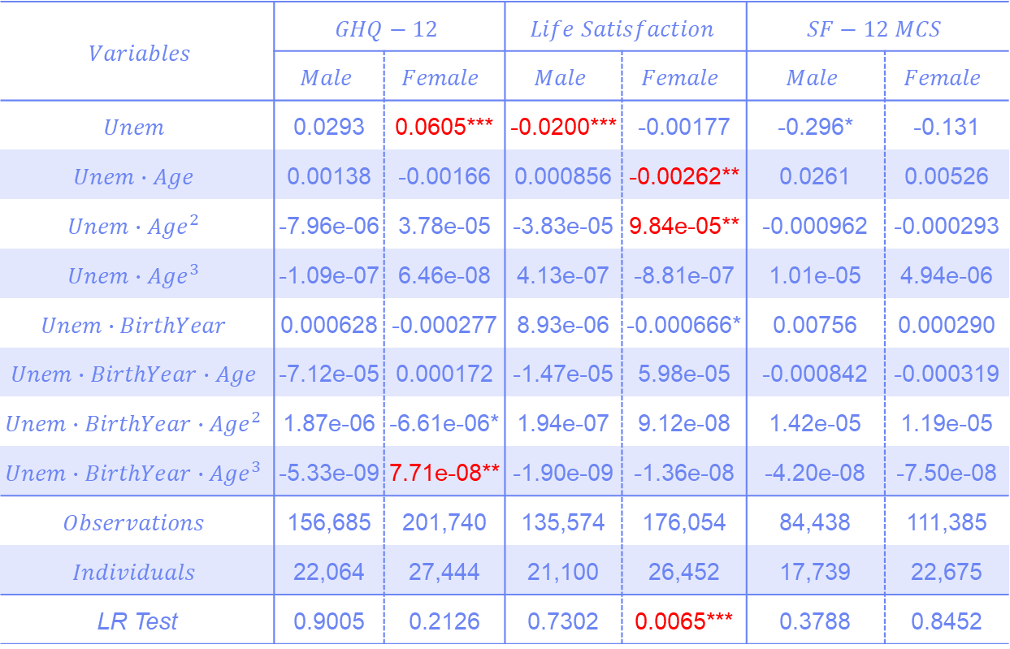
Results (II)
$Variables$ | $$GHQ−12$$ |  | $$Life Satisfaction$$ |  | $$SF−12 MCS$$
 | $$Male$$ | $$Female$$ | $$Male$$ | $$Female$$ | $$Male$$ | $$Female$$
$$Unem$$ | 0.0293 | 0.0605*** | -0.0200*** | -0.00177 | -0.296* | -0.131
$$Unem∙Age$$ | 0.00138 | -0.00166 | 0.000856 | -0.00262** | 0.0261 | 0.00526
$${Unem∙Age}^{2}$$ | -7.96e-06 | 3.78e-05 | -3.83e-05 | 9.84e-05** | -0.000962 | -0.000293
$${Unem∙Age}^{3}$$ | -1.09e-07 | 6.46e-08 | 4.13e-07 | -8.81e-07 | 1.01e-05 | 4.94e-06
$$Unem∙BirthYear$$ | 0.000628 | -0.000277 | 8.93e-06 | -0.000666* | 0.00756 | 0.000290
$$Unem∙BirthYear∙Age$$ | -7.12e-05 | 0.000172 | -1.47e-05 | 5.98e-05 | -0.000842 | -0.000319
$${Unem∙BirthYear∙Age}^{2}$$ | 1.87e-06 | -6.61e-06* | 1.94e-07 | 9.12e-08 | 1.42e-05 | 1.19e-05
$${Unem∙BirthYear∙Age}^{3}$$ | -5.33e-09 | 7.71e-08** | -1.90e-09 | -1.36e-08 | -4.20e-08 | -7.50e-08
$$Observations$$ | 156,685 | 201,740 | 135,574 | 176,054 | 84,438 | 111,385
$$Individuals$$ | 22,064 | 27,444 | 21,100 | 26,452 | 17,739 | 22,675
LR Test | 0.9005 | 0.2126 | 0.7302 | 0.0065*** | 0.3788 | 0.8452
$$∗∗∗ p<0.01, ∗∗ p<0.05, ∗ p<0.1$$

Slide 21


Results (II): GHQ-12
Research Question:
Is the association different between genders? Is it changing by year of birth, and is it changing by year of birth differently by gender?
$$Male$$
$$Female$$

Slide 22
Results (II): Life Satisfaction
Research Question:
Is the association different between genders? Is it changing by year of birth, and is it changing by year of birth differently by gender?
$$Male$$
$$Female$$

Slide 23
Results (II): SF-12 MCS
Research Question:
Is the association different between genders? Is it changing by year of birth, and is it changing by year of birth differently by gender?
$$Male$$
$$Female$$

Slide 24
Results (III)
Research Question:
Is the association moderated by economy-wide unemployment rates?

Slide 25
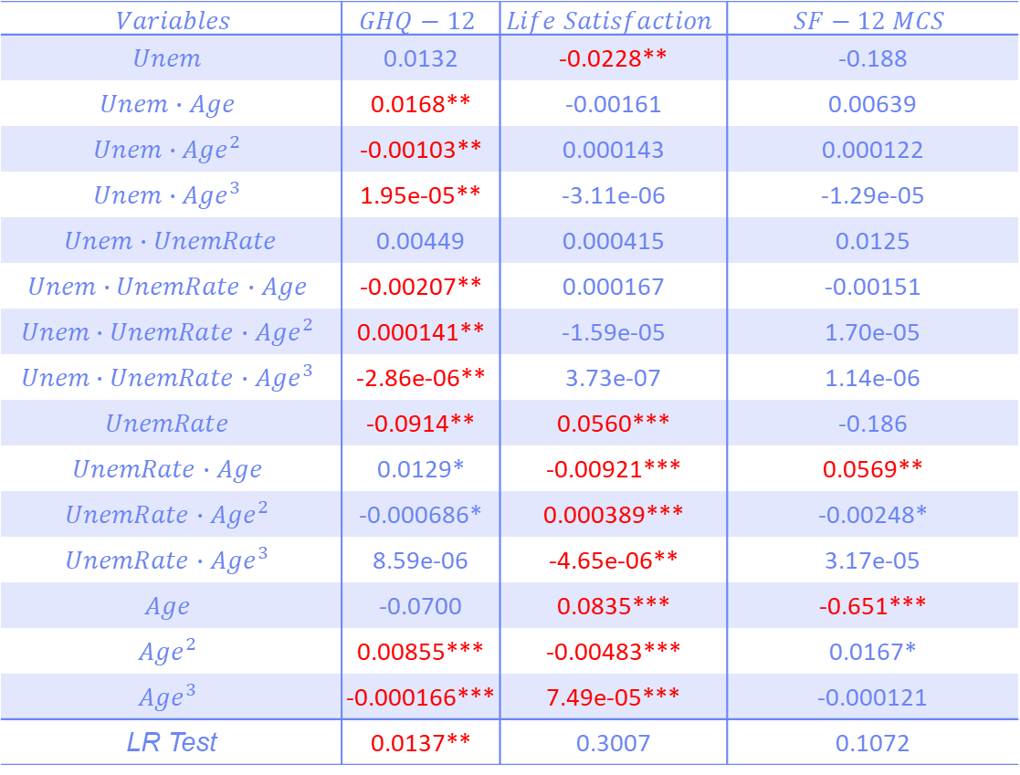
Results (III)
$Variables$ | $$GHQ−12$$ | $$Life Satisfaction$$ | $$SF−12 MCS$$
$$Unem$$ | 0.0132 | -0.0228** | -0.188
$$Unem∙Age$$ | 0.0168** | -0.00161 | 0.00639
$${Unem∙Age}^{2}$$ | -0.00103** | 0.000143 | 0.000122
$${Unem∙Age}^{3}$$ | 1.95e-05** | -3.11e-06 | -1.29e-05
$Unem∙UnemRate$ | 0.00449 | 0.000415 | 0.0125
$$Unem∙UnemRate∙Age$$ | -0.00207** | 0.000167 | -0.00151
$${Unem∙UnemRate∙Age}^{2}$$ | 0.000141** | -1.59e-05 | 1.70e-05
$${Unem∙UnemRate∙Age}^{3}$$ | -2.86e-06** | 3.73e-07 | 1.14e-06
$$UnemRate$$ | -0.0914** | 0.0560*** | -0.186
$$UnemRate∙Age$$ | 0.0129* | -0.00921*** | 0.0569**
$${UnemRate∙Age}^{2}$$ | -0.000686* | 0.000389*** | -0.00248*
$${UnemRate∙Age}^{3}$$ | 8.59e-06 | -4.65e-06** | 3.17e-05
$$Age$$ | -0.0700 | 0.0835*** | -0.651***
$${Age}^{2}$$ | 0.00855*** | -0.00483*** | 0.0167*
$${Age}^{3}$$ | -0.000166*** | 7.49e-05*** | -0.000121
LR Test | 0.0137** | 0.3007 | 0.1072
$$∗∗∗ p<0.01, ∗∗ p<0.05, ∗ p<0.1$$

Slide 26


Results (III): GHQ-12
Research Question:
Is the association moderated by economy-wide unemployment rates?
$$10th Percentile Unemployment \\ Rate$$
$$90th Percentile Unemployment$$
$$Rate$$

Slide 27
Results (III): GHQ-12
Research Question:
Is the association moderated by economy-wide unemployment rates?
$$10th Percentile Unemployment \\ Rate$$
$$90th Percentile Unemployment$$
$$Rate$$

Slide 28
Results (III): GHQ-12
Research Question:
Is the association moderated by economy-wide unemployment rates?

Slide 29
Results (III): GHQ-12
Research Question:
Is the association moderated by economy-wide unemployment rates?

Slide 30
Results (III): Life Satisfaction
Research Question:
Is the association moderated by economy-wide unemployment rates?
$$10th Percentile Unemployment \\ Rate$$
$$90th Percentile Unemployment$$
$$Rate$$

Slide 31
Results (III): Life Satisfaction
Research Question:
Is the association moderated by economy-wide unemployment rates?
$$10th Percentile Unemployment \\ Rate$$
$$90th Percentile Unemployment$$
$$Rate$$

Slide 32
Results (III): Life Satisfaction
Research Question:
Is the association moderated by economy-wide unemployment rates?

Slide 33
Results (III): Life Satisfaction
Research Question:
Is the association moderated by economy-wide unemployment rates?

Slide 34
Results (III): SF-12 MCS
Research Question:
Is the association moderated by economy-wide unemployment rates?
$$10th Percentile Unemployment \\ Rate$$
$$90th Percentile Unemployment$$
$$Rate$$
Notes:
XX-HOW MUCH OF THE ICC DOES THIS EXPLAIN. HOW BIG IS THE EFFECT, RELATIVE TO RANDOM EFFECT.

Slide 35
Results (III): SF-12 MCS
Research Question:
Is the association moderated by economy-wide unemployment rates?
$$10th Percentile Unemployment \\ Rate$$
$$90th Percentile Unemployment$$
$$Rate$$

Slide 36
Results (III): SF-12 MCS
Research Question:
Is the association moderated by economy-wide unemployment rates?

Slide 37
Results (III): SF-12 MCS
Research Question:
Is the association moderated by economy-wide unemployment rates?

Slide 38
Summary
On average, difference in GHQ-12 and life satisfaction trajectories between those with experience of youth unemployment and those without grows in the short-term before converging in late age. This may be explained by attrition. Significant difference between the unemployed and non-unemployment remains when outcomes at age 17 included in models.
Evidence that mental health and life satisfaction is worse in later cohorts across both genders, though this is not consistent across each outcome. Little evidence that the difference between the those with youth unemployment experience and those without is also larger in later cohorts.
Trajectories in mental health and life satisfaction appear worse following low unemployment periods. The difference between those with youth unemployment experience and those without is larger following low unemployment periods. This may be explained by selection effects.

Slide 39
Future Work
Missing Data
Local Area Unemployment Rates
Structural Equation Modelling

Slide 40


Acknowledgements
Thanks to:
Professor Jenny Head, and Dr. Stephen Jivraj
UBEL DTP and the ESRC
The Institute for Social and Economic Research, University of Essex
David Maré, Motu

Slide 41
References
Bell, D. N. F., & Blanchflower, D. G. (2011). Young people and the great recession. Oxford Review of Economic Policy, 27(2), 241–267. https://doi.org/10.1093/oxrep/grr011
Brydsten, A., Hammarström, A., Strandh, M., & Johansson, K. (2015). Youth unemployment and functional somatic symptoms in adulthood: Results from the Northern Swedish cohort. European Journal of Public Health, 25(5), 796–800. https://doi.org/10.1093/eurpub/ckv038
Bynner, J., & Parsons, S. (2002). Social exclusion and the transition from school to work: The case of young people not in education, employment, or training (NEET). Journal of Vocational Behavior, 60(2), 289–309. https://doi.org/10.1006/jvbe.2001.1868
Gregg, P., & Tominey, E. (2005). The wage scar from male youth unemployment. Labour Economics, 12(4), 487–509. https://doi.org/10.1016/j.labeco.2005.05.004
Jann, B. (2014). Plotting regression coefficients and other estimates. The Stata Journal 14(4): 708-737.
Lersch, P. M., Jacob, M., & Hank, K. (2018). Long-term Health Consequences of Adverse Labor Market Conditions at Time of Leaving Education: Evidence from West German Panel Data. Journal of Health and Social Behavior, 59(1), 002214651774984. https://doi.org/10.1177/0022146517749848
McQuaid, R., Raeside, R., Egdell, V., & Graham, H. (2014). Multiple scarring effects of youth unemployment in the UK, (April), 1–23. Retrieved from http://www.uni-salzburg.at/fileadmin/multimedia/SOWI/documents/VWL/FOSEM/FOSEM_SS_2014/mcquaid_paper.pdf
Mossakowski, K. N. (2008). Is the duration of poverty and unemployment a risk factor for heavy drinking? Social Science and Medicine, 67(6), 947–955. https://doi.org/10.1016/j.socscimed.2008.05.019
Nygren, K., Gong, W., & Hammarström, A. (2015). Is hypertension in adult age related to unemployment at a young age? Results from the Northern Swedish Cohort. Scandinavian Journal of Public Health, 43(1), 52–58. https://doi.org/10.1177/1403494814560845
Voßemer, J., Gebel, M., Nizalova, O., & Nikolaieva, O. (2018). The effect of an early-career involuntary job loss on later life health in Europe. Advances in Life Course Research, 35, 69–76. https://doi.org/10.1016/j.alcr.2018.01.001

Slide 42
Thank you
Questions?
Email: liam.wright.17@ucl.ac.uk

