Slide 1


Chapter 7
Wireless and
Mobile Networks
A note on the use of these Powerpoint slides:
We’re making these slides freely available to all (faculty, students, readers). They’re in PowerPoint form so you see the animations; and can add, modify, and delete slides (including this one) and slide content to suit your needs. They obviously represent a lot of work on our part. In return for use, we only ask the following:
Computer Networking: A Top Down Approach
If you use these slides (e.g., in a class) that you mention their source (after all, we’d like people to use our book!)
If you post any slides on a www site, that you note that they are adapted from (or perhaps identical to) our slides, and note our copyright of this material.
Thanks and enjoy! JFK/KWR
All material copyright 1996-2016
J.F Kurose and K.W. Ross, All Rights Reserved
7th edition
Jim Kurose, Keith Ross
Pearson/Addison Wesley
April 2016

Slide 2
Ch. 6: Wireless and Mobile Networks
Background:
# wireless (mobile) phone subscribers now exceeds # wired phone subscribers (5-to-1)!
# wireless Internet-connected devices equals # wireline Internet-connected devices
  laptops, Internet-enabled phones promise anytime untethered Internet access
two important (but different) challenges
  wireless: communication over wireless link
  mobility: handling the mobile user who changes point of attachment to network

Slide 3
Chapter 7 outline
7.1 Introduction
Wireless
7.2 Wireless links, characteristics
  CDMA
7.3 IEEE 802.11 wireless LANs (“Wi-Fi”)
7.4 Cellular Internet Access
  architecture
  standards (e.g., 3G, LTE)
Mobility
7.5 Principles: addressing and routing to mobile users
7.6 Mobile IP
7.7 Handling mobility in cellular networks
7.8 Mobility and higher-layer protocols

Slide 4



















Elements of a wireless network
network
infrastructure

Slide 5



Elements of a wireless network
wireless hosts
laptop, smartphone
run applications
may be stationary (non-mobile) or mobile
  wireless does not always mean mobility
network
infrastructure

Slide 6

Elements of a wireless network
base station
typically connected to wired network
relay - responsible for sending packets between wired network and wireless host(s) in its “area”
  e.g., cell towers, 802.11 access points
network
infrastructure

Slide 7
Elements of a wireless network
wireless link
typically used to connect mobile(s) to base station
also used as backbone link
multiple access protocol coordinates link access
various data rates, transmission distance
network
infrastructure

Slide 8
Characteristics of selected wireless links
1300
802.11 ac
450
802.11n
54
802.11a,g
802.11a,g point-to-point
5-11
802.11b
4G: LTWE WIMAX
4
3G: UMTS/WCDMA-HSPDA, CDMA2000-1xEVDO
Data rate (Mbps)
1
802.15
.384
2.5G: UMTS/WCDMA, CDMA2000
.056
2G: IS-95, CDMA, GSM
Indoor
10-30m
Outdoor
50-200m
Mid-range
outdoor
200m – 4 Km
Long-range
outdoor
5Km – 20 Km

Slide 9
Elements of a wireless network
infrastructure mode
base station connects mobiles into wired network
handoff: mobile changes base station providing connection into wired network
network
infrastructure

Slide 10
Elements of a wireless network
ad hoc mode
no base stations
nodes can only transmit to other nodes within link coverage
nodes organize themselves into a network: route among themselves

Slide 11
Wireless network taxonomy
single hop
multiple hops
host connects to
base station (WiFi,
WiMAX, cellular)
which connects to
larger Internet
host may have to
relay through several
wireless nodes to
connect to larger
Internet: mesh net
infrastructure
(e.g., APs)
no base station, no
connection to larger
Internet. May have to
relay to reach other
a given wireless node
MANET, VANET
no
infrastructure
no base station, no
connection to larger
Internet (Bluetooth,
ad hoc nets)

Slide 12
Chapter 7 outline
7.1 Introduction
Wireless
7.2 Wireless links, characteristics
  CDMA
7.3 IEEE 802.11 wireless LANs (“Wi-Fi”)
7.4 Cellular Internet Access
  architecture
  standards (e.g., 3G, LTE)
Mobility
7.5 Principles: addressing and routing to mobile users
7.6 Mobile IP
7.7 Handling mobility in cellular networks
7.8 Mobility and higher-layer protocols

Slide 13
Wireless Link Characteristics (1)
important differences from wired link ….
  decreased signal strength: radio signal attenuates as it propagates through matter (path loss)
  interference from other sources: standardized wireless network frequencies (e.g., 2.4 GHz) shared by other devices (e.g., phone); devices (motors) interfere as well
  multipath propagation: radio signal reflects off objects ground, arriving ad destination at slightly different times
…. make communication across (even a point to point) wireless link much more “difficult”

Slide 14

Wireless Link Characteristics (2)
SNR: signal-to-noise ratio
  larger SNR – easier to extract signal from noise (a “good thing”)
SNR versus BER tradeoffs
  given physical layer: increase power -> increase SNR->decrease BER
  given SNR: choose physical layer that meets BER requirement, giving highest thruput
    SNR may change with mobility: dynamically adapt physical layer (modulation technique, rate)
10⁻¹
10⁻²
10⁻³
BER
10⁻⁴
10⁻⁵
10⁻⁶
10⁻⁷
10
20
30
40
SNR(dB)
QAM256 (8 Mbps)
QAM16 (4 Mbps)
BPSK (1 Mbps)

Slide 15

Wireless network characteristics
Multiple wireless senders and receivers create additional problems (beyond multiple access):
A
B
C
C
A’s signal
strength
C’s signal
strength
B
A
Hidden terminal problem
B, A hear each other
B, C hear each other
A, C can not hear each other means A, C unaware of their interference at B
space
Signal attenuation:
B, A hear each other
B, C hear each other
A, C can not hear each other interfering at B
CSMA/CD not work!

Slide 16
Code Division Multiple Access (CDMA)
unique “code” assigned to each user; i.e., code set partitioning
  all users share same frequency, but each user has own “chipping” sequence (i.e., CDMA code) to encode data
  allows multiple users to “coexist” and transmit simultaneously with minimal interference (if codes are “orthogonal”)
encoded signal = (original data) X (CDMA code)
decoding: inner-product of encoded signal and CDMA code

Slide 17
CDMA encode/decode
channel output Z_{i,m}
Z_{i,m}= d_{i}.c_{m}
data
bits
d₀ = 1
1
1
1
1
1
d₁ = -1
1
1
1
-
-
-
-
1
-
-
-
1
-
1
1
1
1
1
sender
1
1
slot 1
channel
output
slot 0
channel
output
1
1
1
1
1
code
1
1
-
-
-
1
-
1
1
1
-
-
-
1
-
1
1
1
slot 1
slot 0
M
D_{i} = Σ Z_{i,m}.c_{m}
m=1
M
received
input
1
1
1
1
1
1
1
1
d₀ = 1
-
-
-
-
1
-
-
-
1
-
1
1
1
1
1
1
d₁ = -1
1
slot 1
channel
output
slot 0
channel
output
1
1
1
1
1
code
1
1
-
-
-
1
-
1
1
1
-
-
-
1
-
1
1
1
receiver
slot 1
slot 0

Slide 18



CDMA encode/decode
Formally, sender’s CDMA code consists of a sequence of M values
  (1,1,1,-1,1,-1,-1,-1)
Encode
  1,1,1,-1,1,-1,-1,-1,-1,-1,-1,1,-1,1,1,1
Decode
  (1,1,1,-1,1,-1,-1,-1)(1,1,1,-1,1,-1,-1,-1)/8=1
  (-1,-1,-1,1,-1,1,1,1) (1,1,1,-1,1,-1,-1,-1)/8=-1

Slide 19

CDMA: two-sender interference
channel sums together transmissions by sender 1 and 2
Sender 1
Sender 2
using same code as sender 1, receiver recovers sender 1’s original data from summed channel data!

Slide 20
CDMA: two-sender interference
Sender 1:
  CDMA code: (1,1,1,-1,1,-1,-1,-1)
  Encode (1,-1) as (1,1,1,-1,1,-1,-1,-1,-1,-1,-1,1,-1,1,1,1)
Sender 2:
  CDMA code: (1,-1,1,1,1,-1,1,1)
  Encode (1,1) as (1,-1,1,1,1,-1,1,1,1,-1,1,1,1,-1,1,1)
Sum up
  (2,0,2,0,2,-2,0,0,0,-2,0,2,0,0,2,2)
Receiver 1:
  (2,0,2,0,2,-2,0,0)(1,1,1,-1,1,-1,-1,-1)/8=1
  (0,-2,0,2,0,0,2,2)(1,1,1,-1,1,-1,-1,-1)/8=-1
Receiver 2:
  (2,0,2,0,2,-2,0,0)(1,-1,1,1,1,-1,1,1)/8=1
  (0,-2,0,2,0,0,2,2)(1,-1,1,1,1,-1,1,1)/8=1
Receiver 1 and 2’s codes are orthogonal

Slide 21
Chapter 7 outline
7.1 Introduction
Wireless
7.2 Wireless links, characteristics
  CDMA
7.3 IEEE 802.11 wireless LANs (“Wi-Fi”)
7.4 Cellular Internet Access
  architecture
  standards (e.g., 3G, LTE)
Mobility
7.5 Principles: addressing and routing to mobile users
7.6 Mobile IP
7.7 Handling mobility in cellular networks
7.8 Mobility and higher-layer protocols

Slide 22
IEEE 802.11 Wireless LAN
802.11b
2.4-5 GHz unlicensed spectrum
up to 11 Mbps
direct sequence spread spectrum (DSSS) in physical layer
  all hosts connecting to a same base station use same CDMA code
802.11a
  5-6 GHz range
  up to 54 Mbps
802.11g
  2.4-5 GHz range
  up to 54 Mbps
802.11n: multiple antennae
  2.4-5 GHz range
  up to 200 Mbps
802.11 ax (WiFi 6)
  up to 9.6 Gbps
all use CSMA/CA for multiple access
all have base-station and ad-hoc network versions

Slide 23




802.11 LAN architecture
wireless host communicates with base station
  base station = access point (AP)
Basic Service Set (BSS) (aka “cell”) in infrastructure mode contains:
  wireless hosts
  access point (AP): base station
  ad hoc mode: hosts only
Internet
hub, switch
or router
BSS 1
BSS 2

Slide 24
802.11: Channels, association
802.11b: 2.4GHz-2.485GHz spectrum divided into 11 channels at different frequencies
  AP admin chooses frequency for AP
  interference possible: channel can be same as that chosen by neighboring AP!
host: must associate with an AP
  scans channels, listening for beacon frames containing AP’s name (SSID) and MAC address
  selects AP to associate with
  may perform authentication [Chapter 8]
  will typically run DHCP to get IP address in AP’s subnet

Slide 25
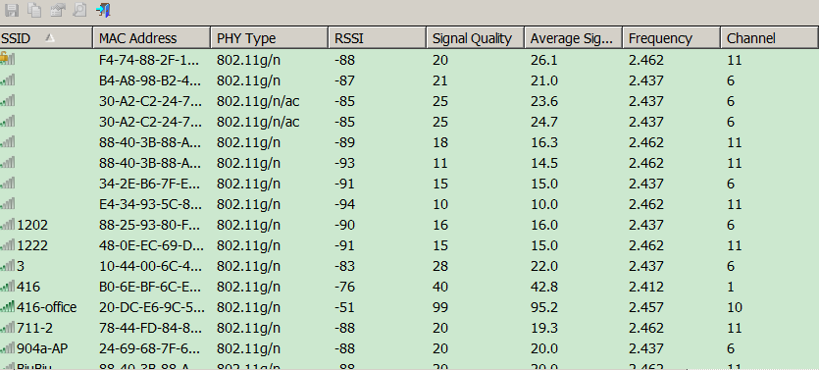
WifiInfoView

Slide 26
802.11: passive/active scanning
BBS 1
BBS 2
BBS 1
BBS 2
1
AP 2
AP 1
1
1
AP 2
AP 1
2
2
2
3
3
4
H1
H1
passive scanning:
beacon frames sent from APs
association Request frame sent: H1 to selected AP
association Response frame sent from selected AP to H1
active scanning:
Probe Request frame broadcast from H1
Probe Response frames sent from APs
Association Request frame sent: H1 to selected AP
Association Response frame sent from selected AP to H1

Slide 27




IEEE 802.11: multiple access
avoid collisions: 2⁺ nodes transmitting at same time
802.11: CSMA - sense before transmitting
  don’t collide with ongoing transmission by other node
802.11: no collision detection!
  difficult to receive (sense collisions) when transmitting due to weak received signals (fading)
  can’t sense all collisions in any case: hidden terminal, fading
  goal: avoid collisions: CSMA/C(ollision)A(voidance)
A
B
C
C
B
A’s signal
strength
C’s signal
strength
A
space

Slide 28
IEEE 802.11 MAC Protocol: CSMA/CA
802.11 sender
1 if sense channel idle for DIFS then
  transmit entire frame (no CD)
2 if sense channel busy then
  start random backoff timer value using binary exponential backoff (as in 802.3)
  timer counts down while channel idle / freeze while channel busy
3 if timer reach zero
  transmit and wait for ACK
4 if no ACK
  increase random backoff interval, repeat 2
802.11 receiver
- if frame received OK
return ACK after SIFS (ACK needed due to hidden terminal problem)
sender
receiver
DIFS
data
SIFS
ACK

Slide 29
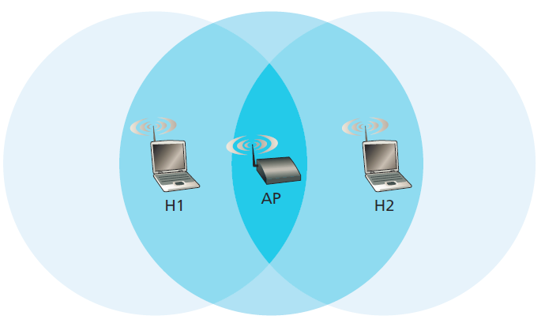
IEEE 802.11 MAC Protocol: CSMA/CA
Why link-layer ACK?
  Hard to detect collision. The station can not abort.
  The receiver acknowledges the frame in case of no collision.
Can link-layer ACK avoids collision? NO
  Two stations are hidden station to each other
  Two stations choose random backoff values that are close to each other

Slide 30
Avoiding collisions (more)
idea: allow sender to “reserve” channel rather than random access of data frames: avoid collisions of long data frames
sender first transmits small request-to-send (RTS) packets to BS using CSMA
  RTSs may still collide with each other (but they’re short)
BS broadcasts clear-to-send CTS in response to RTS
CTS heard by all nodes
  sender transmits data frame
  other stations defer transmissions
avoid data frame collisions completely
using small reservation packets!

Slide 31

Collision Avoidance: RTS-CTS exchange
A
B
AP
RTS(B)
RTS(A)
reservation collision
RTS(A)
CTS(A)
CTS(A)
DATA (A)
defer
time
ACK(A)
ACK(A)

Slide 32
Collision Avoidance: RTS-CTS
Avoid data frame collisions completely
  The hidden station problem is mitigated, since a long DATA frame is transmitted only after the channel has been reserved.
  A collision involving an RTS or CTS frame will last only for the duration of the short RTS or CTS frame. Once the RTS and CTS frames are correctly transmitted, the following DATA and ACK frames should be transmitted without collisions.
RTS/CTS is only used when transmitting long DATA frame

Slide 33
802.11 frame: addressing
2
2
6
6
6
2
6
0 - 2312
4
frame
control
duration
address
1
address
2
address
3
seq
control
address
4
payload
CRC
Address 4: used only in ad hoc mode
Address 1: MAC address
of wireless host or AP
to receive this frame
Address 3: MAC address
of router interface to which AP is attached
Address 2: MAC address
of wireless host or AP
transmitting this frame

Slide 34
802.11 frame: addressing
Internet
H1
R1
router
R1 MAC addr H1 MAC addr
dest. address
source address
802.3 frame
AP MAC addr H1 MAC addr R1 MAC addr
address 1
address 2
address 3
802.11 frame

Slide 35
802.11 frame: addressing
R1 knows IP address of H1, use ARP to determine H1’s MAC address, encapsulate 802.3 frame with H1 as dst_addr, R1 as src_addr.
Frame reaches to AP, AP converts it to 802.11 frame, with H1 as address 1, AP as address 2, R1 as address 3.
H1 responds, encapsulate 802.11 frame with AP and H1 as address 1 and address 2, R1 as address 3.
Frame reaches to AP, AP converts it to 802.3 frame, with H1 as src_addr, R1 as dst_addr.

Slide 36
802.11 frame: more
frame seq #
(for RDT)
duration of reserved
transmission time (RTS/CTS)
2
2
6
6
6
2
6
0 - 2312
4
frame
control
duration
address
1
address
2
address
3
seq
control
address
4
payload
CRC
2
2
4
1
1
1
1
1
1
1
1
Protocol
version
Type
Subtype
To
AP
From
AP
More
frag
Retry
Power
mgt
More
data
WEP
Rsvd
frame type
(RTS, CTS, ACK, data)
Whether encryption
is used or not

Slide 37

802.11: mobility within same subnet
H1 remains in same IP subnet: IP address can remain same
switch: which AP is associated with H1?
  self-learning (Ch. 5): switch will see frame from H1 and “remember” which switch port can be used to reach H1
BBS 1
H1
BBS 2
H1 may keep its IP address and all of its ongoing TCP connections.

Slide 38
802.11: mobility within same subnet
H1 in different IP subnet: IP address will change (if no mobile IP)
DHCP
H1
BBS 1
BBS 2

Slide 39
802.11: advanced capabilities
Rate adaptation
base station, mobile dynamically change transmission rate (physical layer modulation technique) as mobile moves, SNR varies
  Two frames without ack, fall back to next lower rate
  10 frames acked, or timeout since last fallback, promote to next higher level
10⁻¹
10⁻²
10⁻³
QAM256 (8 Mbps)
BER
10⁻⁴
QAM16 (4 Mbps)
BPSK (1 Mbps)
10⁻⁵
operating point
10⁻⁶
10⁻⁷
10
20
30
40
SNR(dB)
1. SNR decreases, BER increase as node moves away from base station
2. When BER becomes too high, switch to lower transmission rate but with lower BER

Slide 40
802.11: advanced capabilities
power management
node-to-AP: “I am going to sleep until next beacon frame”
  AP knows not to transmit frames to this node
  node wakes up before next beacon frame
beacon frame: contains list of mobiles with AP-to-mobile frames waiting to be sent
  node will stay awake if AP-to-mobile frames to be sent; otherwise sleep again until next beacon frame

Slide 41
802.15: personal area network
less than 10 m diameter
replacement for cables (mouse, keyboard, headphones)
ad hoc: no infrastructure
master/slaves:
  slaves request permission to send (to master)
  master grants requests
802.15: evolved from Bluetooth specification
  2.4-2.5 GHz radio band
  up to 721 kbps
S
P
P
radius of
coverage
M
S
S
P
P
M
Master device
Slave device
Parked device (inactive)
S
P

Slide 42
Chapter 7 outline
7.1 Introduction
Wireless
7.2 Wireless links, characteristics
  CDMA
7.3 IEEE 802.11 wireless LANs (“Wi-Fi”)
7.4 Cellular Internet access
  architecture
  standards (e.g., 3G, LTE)
Mobility
7.5 Principles: addressing and routing to mobile users
7.6 Mobile IP
7.7 Handling mobility in cellular networks
7.8 Mobility and higher-layer protocols

Slide 43

Components of cellular network architecture
MSC
connects cells to wired tel. net.
manages call setup (more later!)
handles mobility (more later!)
cell
covers geographical region
base station (BS) analogous to 802.11 AP
mobile users attach to network through BS
air-interface: physical and link layer protocol between mobile and BS
Mobile
Switching
Center
Public telephone
network
Mobile
Switching
Center
wired network

Slide 44
Cellular networks: the first hop
Two techniques for sharing mobile-to-BS radio spectrum
combined FDMA/TDMA: divide spectrum in frequency channels, divide each channel into time slots
CDMA: code division multiple access
time slots
frequency
bands

Slide 45
2G (voice) network architecture
Base station system (BSS)
MSC
BTS
BSC
G
Public
telephone
network
Gateway
MSC
Legend
Base transceiver station (BTS)
Base station controller (BSC)
Mobile Switching Center (MSC)
Mobile subscribers

Slide 46
3G (voice+data) network architecture
MSC
G
Public
telephone
network
radio
network
controller
Gateway
MSC
G
Public
Internet
SGSN
Key insight: new cellular data
network operates in parallel
(except at edge) with existing
cellular voice network
voice network unchanged in core
data network operates in parallel
GGSN
Serving GPRS Support Node (SGSN)
Gateway GPRS Support Node (GGSN)

Slide 47
3G (voice+data) network architecture
MSC
G
Public
telephone
network
radio
network
controller
Gateway
MSC
G
Public
Internet
SGSN
GGSN
radio interface
(WCDMA, HSPA)
radio access network
Universal Terrestrial Radio
Access Network (UTRAN)
core network
General Packet Radio Service
(GPRS) Core Network
public
Internet

Slide 48
3G versus 4G LTE network architecture
MSC
G
Public
telephone
network
3G
radio
network
controller
Gateway
MSC
G
Public
Internet
SGSN
GGSN
4G-LTE
HSS
MME
G
G
Public
Internet
S-GW
P-GW
radio access network
Universal Terrestrial Radio
Access Network (UTRAN)
Evolved Packet Core
(EPC)

Slide 49
4G: differences from 3G
all IP core: IP packets tunneled (through core IP network) from base station to gateway
no separation between voice and data – all traffic carried over IP core to gateway
Mobility
Management
Entity (MME)
Home Subscriber
Server(HSS)
(like HLR+VLR)
Serving
Gateway
(S-GW)
Packet data
network
Gateway
(P-GW)
UE
(user element)
eNodeB
(base station)
HSS
MME
control
G
G
Public
Internet
data
S-GW
P-GW
radio access network
Universal Terrestrial Radio
Access Network (UTRAN)
Evolved Packet Core
(EPC)

Slide 50

Functional split of major LTE components
handles idle/active UE transitions
pages UE
sets up eNodeB-PGW tunnel (aka bearer)
holds idle UE info
QoS enforcement

Slide 51

Radio+Tunneling: UE – eNodeB – PGW
IP packet from UE encapsulated in GPRS Tunneling Protocol (GTP) message at ENodeB
GTP message encapsulated in UDP, then encapsulated in IP. large IP packet addressed to SGW
G
G
UE
eNodeB
S-GW
P-GW
tunnel
link-layer radio net

Slide 52

Quality of Service in LTE
QoS from eNodeB to SGW: min and max guaranteed bit rate
QoS in radio access network: one of 12 QCI values

Slide 53
Chapter 7 outline
7.1 Introduction
Wireless
7.2 Wireless links, characteristics
  CDMA
7.3 IEEE 802.11 wireless LANs (“Wi-Fi”)
7.4 Cellular Internet Access
  architecture
  standards (e.g., 3G, LTE)
Mobility
7.5 Principles: addressing and routing to mobile users
7.6 Mobile IP
7.7 Handling mobility in cellular networks
7.8 Mobility and higher-layer protocols

Slide 54
What is mobility?
spectrum of mobility, from the network perspective:
no mobility
high mobility
mobile wireless user,
using same access
point
mobile user, connecting/ disconnecting from network using DHCP.
mobile user, passing through multiple access point while maintaining ongoing connections (like cell phone)

Slide 55



Mobility: vocabulary
home network: permanent “home” of mobile
(e.g., 128.119.40/24)
home agent: entity that will perform mobility functions on behalf of mobile, when mobile is remote
wide area network
permanent address: address in home network, can always be used to reach mobile
e.g., 128.119.40.186

Slide 56
Mobility: more vocabulary
permanent address: remains constant (e.g., 128.119.40.186)
visited network: network in which mobile currently resides (e.g., 79.129.13/24)
care-of-address（转交地址）: address in visited network.
(e.g., 79,129.13.2)
wide area network
foreign agent: entity in visited network that performs mobility functions on behalf of mobile.
correspondent: wants to communicate with mobile

Slide 57



How do you contact a mobile friend:
Consider friend frequently changing addresses, how do you find her?
I wonder where Alice moved to?
search all phone books?
call her parents?
expect her to let you know where he/she is?
Facebook!

Slide 58
Mobility: approaches
let routing handle it: routers advertise permanent address of mobile-nodes-in-residence via usual routing table exchange.
  routing tables indicate where each mobile located
  no changes to end-systems
let end-systems handle it:
  indirect routing: communication from correspondent to mobile goes through home agent, then forwarded to remote
  direct routing: correspondent gets foreign address of mobile, sends directly to mobile

Slide 59
Mobility: approaches
let routing handle it: routers advertise permanent address of mobile-nodes-in-residence via usual routing table exchange.
  routing tables indicate where each mobile located
  no changes to end-systems
let end-systems handle it:
  indirect routing: communication from correspondent to mobile goes through home agent, then forwarded to remote
  direct routing: correspondent gets foreign address of mobile, sends directly to mobile
not
scalable
to millions of
mobiles

Slide 60
Mobility: registration
visited network
home network
1
2
wide area network
mobile contacts foreign agent on entering visited network
foreign agent contacts home agent home: “this mobile is resident in my network”
end result:
foreign agent knows about mobile
home agent knows location of mobile

Slide 61
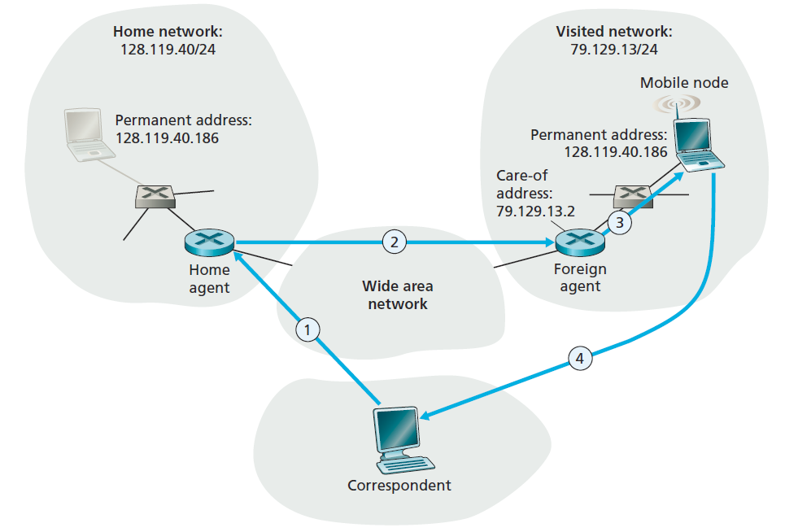
Mobility via indirect routing
foreign agent receives packets, forwards to mobile
home agent intercepts packets, forwards to foreign agent
correspondent addresses packets using home address of mobile
mobile replies directly to correspondent

Slide 62
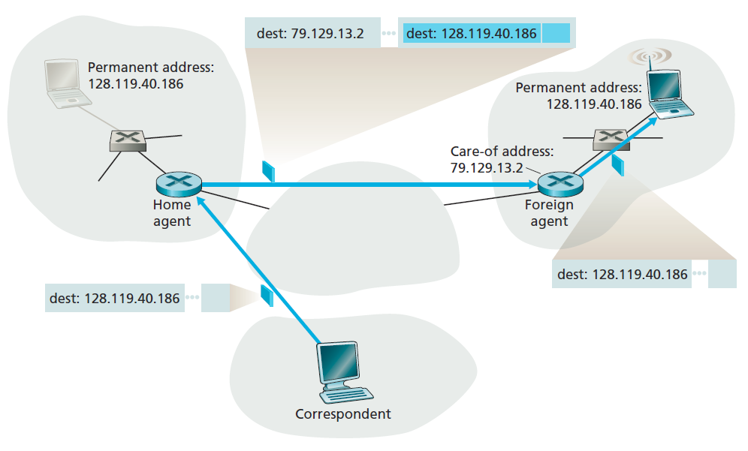
Datagram forwarding

Slide 63
Datagram forwarding
Home agent encapsulate the correspondent’s original complete datagram within a new (larger) datagram, delivered to the mobile node’s COA
  Route the datagram to foreign network
  Keep the correspondent’s datagram intact
Foreign agent receives and decapsulates the datagram and forward the original datagram to the mobile node.

Slide 64



Indirect Routing: comments
mobile uses two addresses:
  permanent address: used by correspondent (hence mobile location is transparent to correspondent)
  care-of-address: used by home agent to forward datagrams to mobile
foreign agent functions may be done by mobile itself
triangle routing: correspondent-home-network-mobile
  inefficient when
  correspondent, mobile
  are in same network

Slide 65
Indirect routing: moving between networks
suppose mobile user moves to another network
  registers with new foreign agent
  new foreign agent registers with home agent
  home agent update care-of-address for mobile
  packets continue to be forwarded to mobile (but with new care-of-address)
mobility, changing foreign networks transparent: on going connections can be maintained!
  Correspondent always communicate with permanent address.

Slide 66



Mobility via direct routing
foreign agent receives packets, decapsulate, forwards to mobile
correspondent tunnels to foreign agent
visited
network
home
network
3
1
2
4
correspondent requests, receives foreign address of mobile
mobile replies directly to correspondent

Slide 67




Mobility via direct routing: comments
Correspondent learns mobile node’s COA
Correspondent tunnels to mobile node’s COA
overcome triangle routing problem
non-transparent to correspondent: correspondent must get care-of-address from home agent
  what if mobile changes visited network?
3
1
2
4

Slide 68
Accommodating mobility with direct routing
Identify the foreign agent in that foreign network where the mobile node was first found as the anchor foreign agent.
Session starts before node moves (step 1)
When the mobile node moves to a new foreign network (step 2), the mobile node registers with the new foreign agent (step 3), and the new foreign agent provides the anchor foreign agent with the mobile node’s new COA (step 4).
When the anchor foreign agent receives an encapsulated datagram for a departed mobile node, it can then re-encapsulate the datagram and forward it to the mobile node using the new COA (step 5).

Slide 69
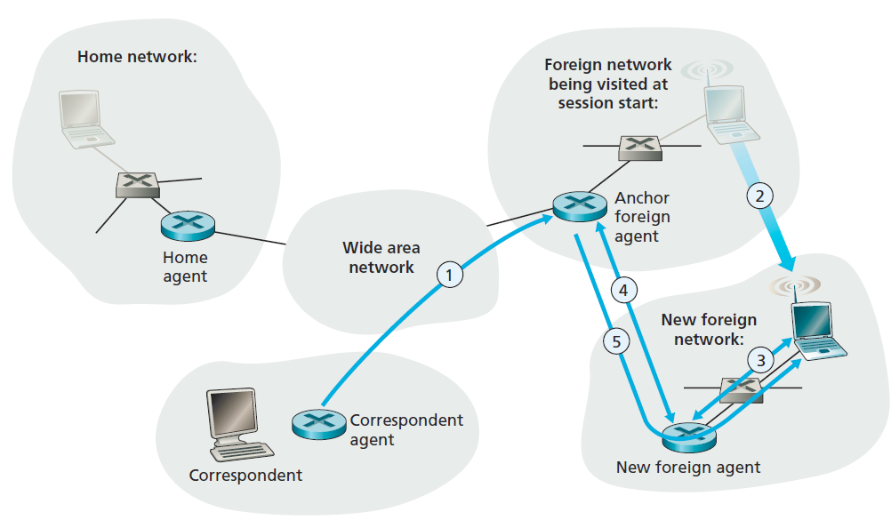
Accommodating mobility with direct routing

Slide 70
Indirect routing vs. direct routing
Transparent to correspondent
  Indirect: yes, only need to know permanent address
  Direct: no, need to tunnel.
Efficiency:
  Indirect: low, triangle routing
  Direct: high
Mobility within session:
  Indirect： Simple, just update home agent with new COA
  Direct: Complicated

Slide 71
Mobile IP
RFC 3344
has many features we’ve seen:
  home agents, foreign agents, foreign-agent registration, care-of-addresses, encapsulation (packet-within-a-packet)
three components to standard:
  indirect routing of datagrams
  agent discovery
  registration with home agent

Slide 72

Mobile IP: indirect routing
foreign-agent-to-mobile packet
packet sent by home agent to foreign agent: a packet within a packet
dest: 128.119.40.186
dest: 79.129.13.2
dest: 128.119.40.186
Permanent address: 128.119.40.186
Care-of address: 79.129.13.2
dest: 128.119.40.186
packet sent by correspondent

Slide 73
Mobile IP: agent discovery
agent advertisement: foreign/home agents advertise service by broadcasting ICMP messages (typefield = 9)
H,F bits: home and/or foreign agent
R bit: registration required
COAs provided by this foreign agent

Slide 74
Mobile IP: registration example
visited network: 79.129.13/24
home agent
HA: 128.119.40.7
foreign agent
care-of-addr: 79.129.13.2
mobile agent
MA (permanent addr. ):
128.119.40.186
ICMP agent adv.
COA: 79.129.13.2
….
registration req.
Permanent addr.:
Registration messages are in UPD, sent to port 434
registration req.
COA: 79.129.13.2
HA: 128.119.40.7
MA: 128.119.40.186
Lifetime: 9999
identification: 714
encapsulation format
….
COA: 79.129.13.2
HA: 128.119.40.7
MA: 128.119.40.186
Lifetime: 9999
identification:714
….
registration reply
HA: 128.119.40.7
MA: 128.119.40.186
Lifetime: 4999
Identification: 714
encapsulation format
….
registration reply
HA: 128.119.40.7
MA: 128.119.40.186
Lifetime: 4999
Identification: 714
….
time

Slide 75
Chapter 7 outline
7.1 Introduction
Wireless
7.2 Wireless links, characteristics
  CDMA
7.3 IEEE 802.11 wireless LANs (“Wi-Fi”)
7.4 Cellular Internet Access
  architecture
  standards (e.g., 3G, LTE)
Mobility
7.5 Principles: addressing and routing to mobile users
7.6 Mobile IP
7.7 Handling mobility in cellular networks
7.8 Mobility and higher-layer protocols

Slide 76
Components of cellular network architecture
recall:
correspondent
wired public telephone
network
MSC
MSC
MSC
MSC
MSC
different cellular networks,
operated by different providers

Slide 77
Handling mobility in cellular networks
home network: network of cellular provider you subscribe to (e.g., Sprint PCS, Verizon)
  home location register (HLR): database in home network containing permanent cell phone #, profile information (services, preferences, billing), information about current location (could be in another network)
visited network: network in which mobile currently resides
  visitor location register (VLR): database with entry for each user currently in network
  could be home network

Slide 78
GSM: indirect routing to mobile
HLR
home
network
2
correspondent
home
Mobile
Switching
Center
home MSC consults HLR,
gets roaming number of
mobile in visited network
1
call routed
to home network
3
Public switched
telephone
network
VLR
Mobile
Switching
Center
4
home MSC sets up 2nd leg of call
to MSC in visited network
mobile
user
MSC in visited network completes
call through base station to mobile
visited
network

Slide 79
GSM: handoff with common MSC
handoff goal: route call via new base station (without interruption)
reasons for handoff:
  stronger signal to/from new BSS (continuing connectivity, less battery drain)
  load balance: free up channel in current BSS
  GSM doesn't mandate why to perform handoff (policy), only how (mechanism)
handoff initiated by old BSS
VLR
Mobile
Switching
Center
old
routing
new
routing
old BSS
new BSS

Slide 80
GSM: handoff with common MSC
1. old BSS informs MSC of impending handoff, provides list of 1⁺ new BSSs
2. MSC sets up path (allocates resources) to new BSS
3. new BSS allocates radio channel for use by mobile
4. new BSS signals MSC, old BSS: ready
5. old BSS tells mobile: perform handoff to new BSS
6. mobile, new BSS signal to activate new channel
7. mobile signals via new BSS to MSC: handoff complete. MSC reroutes call
8 MSC-old-BSS resources released
VLR
Mobile
Switching
Center
4
2
1
8
7
3
old BSS
5
6
new BSS

Slide 81
GSM: handoff between MSCs
anchor MSC: first MSC visited during call
  call remains routed through anchor MSC
new MSCs add on to end of MSC chain as mobile moves to new MSC
optional path minimization step to shorten multi-MSC chain
home network
correspondent
Home MSC
anchor MSC
PSTN
MSC
MSC
MSC
(a) before handoff

Slide 82
GSM: handoff between MSCs
anchor MSC: first MSC visited during call
  call remains routed through anchor MSC
new MSCs add on to end of MSC chain as mobile moves to new MSC
optional path minimization step to shorten multi-MSC chain
home network
correspondent
Home MSC
anchor MSC
PSTN
MSC
MSC
MSC
(b) after handoff

Slide 83
Handling Mobility in LTE
Paging: idle UE may move from cell to cell: network does not know where the idle UE is resident
  paging message from MME broadcast by all eNodeB to locate UE
handoff: similar to 3G:
  preparation phase
  execution phase
  completion phase
source
MME
P-GW
target
MME
old
routing
new
routing
old
eNodeB
new
eNodeB

Slide 84
Mobility: cellular versus Mobile IP
cellular element |  | Comment on cellular element | Mobile IP element
Home system | Network to which mobile user’s permanent phone number belongs |  |  | Home network
Gateway Mobile Switching Center, or “home MSC”. Home Location Register (HLR) | Home MSC: point of contact to obtain routable address of mobile user. HLR: database in home system containing permanent phone number, profile information, current location of mobile user, subscription information |  |  | Home agent
Visited System | Network other than home system where mobile user is currently residing |  |  | Visited network
Visited Mobile services Switching Center. Visitor Location Record (VLR) | Visited MSC: responsible for setting up calls to/from mobile nodes in cells associated with MSC. VLR: temporary database entry in visited system, containing subscription information for each visiting mobile user |  |  | Foreign agent
Mobile Station Roaming Number (MSRN), or “roaming number” | Routable address for telephone call segment between home MSC and visited MSC, visible to neither the mobile nor the correspondent. |  |  | Care-of-address

Slide 85
Chapter 7 outline
7.1 Introduction
Wireless
7.2 Wireless links, characteristics
  CDMA
7.3 IEEE 802.11 wireless LANs (“Wi-Fi”)
7.4 Cellular Internet Access
  architecture
  standards (e.g., 3G, LTE)
Mobility
7.5 Principles: addressing and routing to mobile users
7.6 Mobile IP
7.7 Handling mobility in cellular networks
7.8 Mobility and higher-layer protocols

Slide 86
Wireless, mobility: impact on higher layer protocols
logically, impact should be minimal …
  best effort service model remains unchanged
  TCP and UDP can (and do) run over wireless, mobile
… but performance-wise:
  packet loss/delay due to bit-errors (discarded packets, delays for link-layer retransmissions), and handoff
  TCP interprets loss as congestion, will decrease congestion window un-necessarily
  delay impairments for real-time traffic
  limited bandwidth of wireless links

Slide 87
Chapter 7 summary
Wireless
wireless links:
  capacity, distance
  channel impairments
  CDMA
IEEE 802.11 (“Wi-Fi”)
  CSMA/CA reflects wireless channel characteristics
cellular access
  architecture
  standards (e.g., 3G, 4G LTE)
Mobility
principles: addressing, routing to mobile users
  home, visited networks
  direct, indirect routing
  care-of-addresses
case studies
  mobile IP
  mobility in GSM, LTE
impact on higher-layer protocols

