Slide 1


Chapter 8 Security
A note on the use of these Powerpoint slides:
We’re making these slides freely available to all (faculty, students, readers). They’re in PowerPoint form so you see the animations; and can add, modify, and delete slides (including this one) and slide content to suit your needs. They obviously represent a lot of work on our part. In return for use, we only ask the following:
Computer Networking: A Top Down Approach
If you use these slides (e.g., in a class) that you mention their source (after all, we’d like people to use our book!)
If you post any slides on a www site, that you note that they are adapted from (or perhaps identical to) our slides, and note our copyright of this material.
Thanks and enjoy! JFK/KWR
All material copyright 1996-2016
J.F Kurose and K.W. Ross, All Rights Reserved
7th edition Jim Kurose, Keith Ross Pearson/Addison Wesley April 2016

Slide 2
Chapter 8: Network Security
Chapter goals:
understand principles of network security:
cryptography and its many uses beyond “confidentiality” （保密）
authentication（真实）
message integrity（完整）
security in practice:
firewalls and intrusion detection systems
security in application, transport, network, link layers
8-2

Slide 3
Chapter 8 roadmap
8.1 What is network security?
8.2 Principles of cryptography
8.3 Message integrity, authentication
8.4 Securing e-mail
8.5 Securing TCP connections: SSL
8.6 Network layer security: IPsec
8.7 Securing wireless LANs
8.8 Operational security: firewalls and IDS
8-3

Slide 4
What is network security?
Confidentiality: only sender, intended receiver should “understand” message contents
sender encrypts message
receiver decrypts message
authentication: sender, receiver want to confirm identity of each other
message integrity: sender, receiver want to ensure message not altered (in transit, or afterwards) without detection
access and availability: services must be accessible and available to users
8-4

Slide 5



Friends and enemies: Alice, Bob, Trudy
well-known in network security world
Bob, Alice (lovers!) want to communicate “securely”
Trudy (intruder) may intercept, delete, add messages
Alice
Bob
channel
data, control messages
secure
sender
s
data
secure
receiver
data
Trudy
8-5

Slide 6
Who might Bob, Alice be?
… well, real-life Bobs and Alices!
Web browser/server for electronic transactions (e.g., on-line purchases)
on-line banking client/server
DNS servers
routers exchanging routing table updates
other examples?
8-6

Slide 7
There are bad guys (and girls) out there!
Q: What can a “bad guy” do?
A: A lot! See section 1.6
eavesdrop: intercept messages
actively insert messages into connection
impersonation: can fake (spoof) source address in packet (or any field in packet)
hijacking: “take over” ongoing connection by removing sender or receiver, inserting himself in place
denial of service: prevent service from being used by others (e.g., by overloading resources)
8-7

Slide 8
Chapter 8 roadmap
8.1 What is network security?
8.2 Principles of cryptography
8.3 Message integrity, authentication
8.4 Securing e-mail
8.5 Securing TCP connections: SSL
8.6 Network layer security: IPsec
8.7 Securing wireless LANs
8.8 Operational security: firewalls and IDS
8-8

Slide 9
The language of cryptography
Alice’s
encryption
key
Bob’s
decryption
key
K
K
A
B
plaintext
encryption
algorithm
ciphertext
decryption
algorithm
plaintext
m plaintext message
K_{A}(m) ciphertext, encrypted with key K_{A}
m = K_{B}(K_{A}(m))
8-9

Slide 10
Breaking an encryption scheme
cipher-text only attack: Trudy has ciphertext she can analyze
two approaches:
brute force: search through all keys
statistical analysis
known-plaintext attack: Trudy has plaintext corresponding to ciphertext
e.g., in monoalphabetic cipher, Trudy determines pairings for a,l,i,c,e,b,o,
chosen-plaintext attack: Trudy can get ciphertext for chosen plaintext
8-10

Slide 11
Symmetric key cryptography
K
K
S
S
plaintext
message, m
encryption
algorithm
ciphertext
decryption
algorithm
plaintext
K (m)
m = K_{S}(K_{S}(m))
S
symmetric key crypto: Bob and Alice share same (symmetric) key: K
e.g., key is knowing substitution pattern in mono alphabetic substitution cipher
Q: how do Bob and Alice agree on key value?
S
8-11

Slide 12
Simple encryption scheme
substitution cipher: substituting one thing for another
monoalphabetic cipher: substitute one letter for another (Caesar cipher)
plaintext: abcdefghijklmnopqrstuvwxyz
letter after 12 letters
ciphertext: mnbvcxzasdfghjklpoiuytrewq
e.g.:
Plaintext: bob. i love you. alice
ciphertext: nkn. s gktc wky. mgsbc
Encryption key: mapping from set of 26 letters
to set of 26 letters

Slide 13
A more sophisticated encryption approach
n substitution ciphers, M₁,M₂,…,M_{n}
cycling pattern:
e.g., n=4: M₁,M₃,M₄,M₃,M₂; M₁,M₃,M₄,M₃,M₂; ..
for each new plaintext symbol, use subsequent substitution pattern in cyclic pattern
dog: d from M₁, o from M₃, g from M₄
Encryption key: n substitution ciphers, and cyclic pattern
key need not be just n-bit pattern

Slide 14
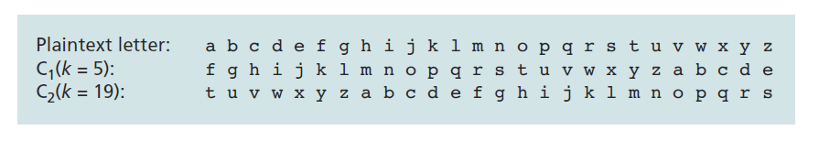
Polyalphabetic encryption
Using two Caesar ciphers
Repeating pattern: C₁, C₂, C₂, C₁, C₂
Plaintext: bob. i love you.
ciphertext: ghu. n etox dhz.

Slide 15
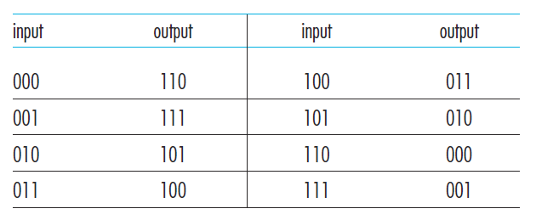
Block cipher
Message is encrypted in blocks of k bits.
Large k values against brute-force attack
2^{k} possible mapping
E.g, k=1024
Problem: maintaining a table of 2^{k} input values
Hard to maintain and update
k=3

Slide 16
Block cipher
Example: K=64
Break a 64-bit block into 8 chunks, each 8-bit chunk is processed by an 8-bit to 8-bit table
The 8 output chunks are reassembled into a 64-bit block.
The positions of the 64 bits in the block are then scrambled (permuted) to produce a 64-bit output.
This output is fed back to the 64-bit input, where another cycle begins.
After n cycles, the function provides a 64-bit block of ciphertext.
The key for this block cipher algorithm would be the eight permutation tables
scramble function is publicly known

Slide 17
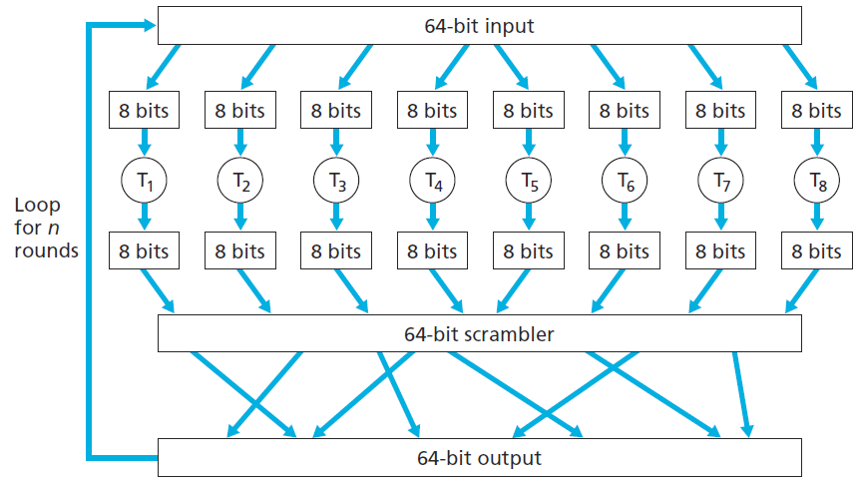
Block cipher

Slide 18
Cipher-block chaining
Problem of block cipher: two or more of the cleartext blocks can be identical.
E.g., 200 OK
The sender creates a random k-bit number r(i) for the ith block and calculates c(i) = K_{S}(m(i)⊕r(i)). (⊕ means exclusive or （异或）)
A new k-bit random number is chosen for each block.
Receiver receives c(i) and r(i), it can recover each block of the plaintext by computing m(i)=K_{S}(c(i))⊕r(i).
Example:
k=3, plain text 010 010 010
r(1)=001 r(2)=111 r(3)=100
Produce different ciphertext for same plaintext

Slide 19
Cipher-block chaining
Problem: need to transmit r(i) from sender to receiver
Transmit twice as many bits as before
Cipher-block chaining (CBC)
Sender generates a k-bit string, Initialization Vector (IV), denoted as c(0), sent IV to receiver.
Runs block cipher algorithm c(1)=K_{s}(m(1)⊕c(0)), send c(1) to receiver.
c(i)=K_{s}(m(i)⊕c(i-1))
Receiver: knows c(i-1), obtain m(i)=K_{s}(c(i))⊕c(i-1)

Slide 20
Cipher-block chaining: example
plain text 010 010 010
r(0)=001
c(1)=K_{s}(010⊕001)=K_{s}(011)=100
c(2)=K_{s}(010⊕100)=K_{s}(110)=000
c(3)=K_{s}(010⊕000)=K_{s}(010)=101

Slide 21
Block cipher
Standards
Use functions rather than tables
Use a string of bits as key: determines table mappings, permutations, and loops.
DES uses 64-bit blocks with a 56-bit key.
AES uses 128-bit blocks and can operate with keys that are 128, 192, and 256 bits long.

Slide 22
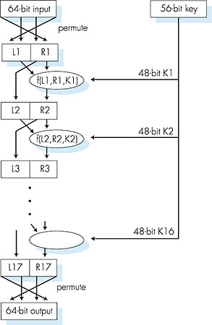
Symmetric key crypto: DES
DES: Data Encryption Standard
US encryption standard [NIST 1993]
56-bit symmetric key, 64-bit plaintext input
block cipher with cipher block chaining
how secure is DES?
DES Challenge: 56-bit-key-encrypted phrase decrypted (brute force) in less than a day
no known good analytic attack
making DES more secure:
3DES: encrypt 3 times with 3 different keys
8-22

Slide 23
AES: Advanced Encryption Standard
symmetric-key NIST standard, replaced DES (Nov 2001)
processes data in 128 bit blocks
128, 192, or 256 bit keys
brute force decryption (try each key) taking 1 sec on DES, takes 149 trillion years for AES
8-23

Slide 24
Public Key Cryptography
symmetric key crypto
requires sender, receiver know shared secret key
Q: how to agree on key in first place (particularly if never “met”)?
public key crypto
radically different approach [Diffie-Hellman76, RSA78]
sender, receiver do not share secret key
public encryption key known to all
private decryption key known only to receiver
8-24

Slide 25
Public key cryptography
+
Bob’s public
key
K
B
-
Bob’s private
key
K
B
plaintext
message, m
encryption
algorithm
ciphertext
decryption
algorithm
plaintext
message
+
K (m)
-
+
B
m = K (K (m))
B
B
8-25

Slide 26
Public key encryption algorithms
requirements:
+
.
-
.
1
need K ( ) and K ( ) such that
B
B
-
+
K (K (m)) = m
B
B
2
+
given public key K , it should be impossible to compute private key K
B
-
B
RSA: Rivest, Shamir, Adelson algorithm
8-26

Slide 27
Prerequisite: modular arithmetic
x mod n = remainder of x when divide by n
facts:
[(a mod n) + (b mod n)] mod n = (a+b) mod n
[(a mod n) - (b mod n)] mod n = (a-b) mod n
[(a mod n) * (b mod n)] mod n = (a*b) mod n
thus
(a mod n)^{d} mod n = a^{d} mod n
example: x=14, n=10, d=2: (x mod n)^{d} mod n = 4² mod 10 = 6 x^{d} = 14² = 196 x^{d} mod 10 = 6
8-27

Slide 28
RSA: getting ready
message: just a bit pattern
bit pattern can be uniquely represented by an integer number
thus, encrypting a message is equivalent to encrypting a number
example:
m= 10010001 . This message is uniquely represented by the decimal number 145.
to encrypt m, we encrypt the corresponding number, which gives a new number (the ciphertext).
8-28

Slide 29
RSA: Creating public/private key pair
1. choose two large prime numbers（质数） p, q.
(e.g., 1024 bits each)
2. compute n = pq, z = (p-1)(q-1)
3. choose e (with e<n) that has no common factors
with z (e, z are “relatively prime（互质）”).
4. choose d such that ed-1 is exactly divisible by z.
(in other words: ed mod z = 1 ).
5. public key is (n,e). private key is (n,d).
+
-
K
K
B
B
8-29

Slide 30
RSA: encryption, decryption
0. given (n,e) and (n,d) as computed above
1. to encrypt message m (<n), compute
e
c = m mod n
2. to decrypt received bit pattern, c, compute
d
m = c mod n
magic
happens!
e
d
m = (m mod n)
mod n
c
8-30

Slide 31
RSA example:
Bob chooses p=5, q=7. Then n=35, z=24.
e=5 (so e, z relatively prime).
d=29 (so ed-1 exactly divisible by z).
encrypting 8-bit messages.
m
e
e
bit pattern
m
c = m mod n
encrypt:
0000l000
12
24832
17
d
d
c
c
m = c mod n
decrypt:
17
481968572106750915091411825223071697
12
8-31

Slide 32
Why does RSA work?
must show that c^{d} mod n = m where c = m^{e} mod n
fact: for any x and y: x^{y} mod n = x^{(y mod z)} mod n
where n= pq and z = (p-1)(q-1)
thus, c^{d} mod n = (m^{e} mod n)^{d} mod n
= m^{ed} mod n
= m^{(ed mod z)} mod n
= m¹ mod n
= m
8-32

Slide 33
RSA: another important property
The following property will be very useful later:
-
+
+
-
K (K (m)) = m
=
K (K (m))
B
B
B
B
use public key first, followed by private key
use private key first, followed by public key
result is the same!
8-33

Slide 34
Why
-
+
+
-
K (K (m)) = m
?
=
K (K (m))
B
B
B
B
follows directly from modular arithmetic:
(m^{e} mod n)^{d} mod n = m^{ed} mod n
= m^{de} mod n
= (m^{d} mod n)^{e} mod n
8-34

Slide 35
Why is RSA secure?
suppose you know Bob’s public key (n,e). How hard is it to determine d?
essentially need to find factors of n without knowing the two factors p and q
If p and q is known, can get z=(p-1)(q-1)
given e, can find d=e⁻¹mod z
fact: factoring a big number is hard
8-35

Slide 36
RSA in practice: session keys
exponentiation in RSA is computationally intensive
DES is at least 100 times faster than RSA
use public key crypto to establish secure connection, then establish second key – symmetric session key – for encrypting data
session key, K_{S}
Bob and Alice use RSA to exchange a symmetric key K_{S}
Sender computes c=(K_{S})^{e} mod n, receiver obtain K_{S}
once both have K_{S}, they use symmetric key cryptography
8-36

Slide 37
Chapter 8 roadmap
8.1 What is network security?
8.2 Principles of cryptography
8.3 Message integrity, authentication
8.4 Securing e-mail
8.5 Securing TCP connections: SSL
8.6 Network layer security: IPsec
8.7 Securing wireless LANs
8.8 Operational security: firewalls and IDS
8-37

Slide 38
Authentication
Goal: Bob wants Alice to “prove” her identity to him
Protocol ap1.0: Alice says “I am Alice”
“I am Alice”
Failure scenario??
8-38

Slide 39
Authentication
Goal: Bob wants Alice to “prove” her identity to him
Protocol ap1.0: Alice says “I am Alice”
in a network,
Bob can not “see” Alice, so Trudy simply declares
herself to be Alice
“I am Alice”
8-39

Slide 40
Authentication: another try
Protocol ap2.0: Alice says “I am Alice” in an IP packet
containing her source IP address
Alice’s
IP address
“I am Alice”
Failure scenario??
8-40

Slide 41
Authentication: another try
Protocol ap2.0: Alice says “I am Alice” in an IP packet
containing her source IP address
Trudy can create
a packet “spoofing”
Alice’s address
Alice’s
IP address
“I am Alice”
8-41

Slide 42
Authentication: another try
Protocol ap3.0: Alice says “I am Alice” and sends her
secret password to “prove” it.
Alice’s
IP addr
Alice’s
password
“I’m Alice”
Failure scenario??
Alice’s
IP addr
OK
8-42

Slide 43
Authentication: another try
Protocol ap3.0: Alice says “I am Alice” and sends her
secret password to “prove” it.
Alice’s
IP addr
Alice’s
password
“I’m Alice”
playback attack: Trudy records Alice’s packet
and later
plays it back to Bob
Alice’s
IP addr
OK
Alice’s
IP addr
Alice’s
password
“I’m Alice”
8-43

Slide 44
Authentication: yet another try
Protocol ap3.1: Alice says “I am Alice” and sends her
encrypted secret password to “prove” it.
Alice’s
IP addr
encrypted
password
“I’m Alice”
Failure scenario??
Alice’s
IP addr
OK
8-44

Slide 45
Authentication: yet another try
Protocol ap3.1: Alice says “I am Alice” and sends her
encrypted secret password to “prove” it.
Alice’s
IP addr
encrypted
password
“I’m Alice”
record
and
playback
still works!
Alice’s
IP addr
OK
Alice’s
IP addr
encrypted
password
“I’m Alice”
8-45

Slide 46
Authentication: yet another try
Goal: avoid playback attack
nonce: number (R) used only once-in-a-lifetime
ap4.0: to prove Alice “live”, Bob sends Alice nonce, R. Alice
must return R, encrypted with shared secret key
“I am Alice”
R
K (R)
Alice is live, and only Alice knows key to encrypt nonce, so it must be Alice!
A-B
Failures, drawbacks?
8-46

Slide 47
Authentication: ap5.0
ap4.0 requires shared symmetric key
can we authenticate using public key techniques?
ap5.0: use nonce, public key cryptography
“I am Alice”
Bob computes
R
+
-
-
K
(K (R)) = R
K (R)
A
A
A
and knows only Alice could have the private key, that encrypted R such that
“send me your public key”
+
K
A
+
-
K
(K (R)) = R
A
A
8-47

Slide 48
ap5.0: security hole
man (or woman) in the middle attack: Trudy poses as Alice (to Bob) and as Bob (to Alice)
I am Alice
I am Alice
R
R
-
-
K (R)
K (R)
A
T
Send me your public key
Send me your public key
+
+
K
K
A
T
+
Trudy gets
+
K (m)
-
+
K (m)
A
m = K (K (m))
T
-
+
T
T
m = K (K (m))
sends m to Alice encrypted with Alice’s public key
A
A

Slide 49
ap5.0: security hole
man (or woman) in the middle attack: Trudy poses as Alice (to Bob) and as Bob (to Alice)
difficult to detect:
Bob receives everything that Alice sends, and vice versa. (e.g., so Bob, Alice can meet one week later and recall conversation!)
problem is that Trudy receives all messages as well!
未完待续
8-49

Slide 50
Chapter 8 roadmap
8.1 What is network security?
8.2 Principles of cryptography
8.3 Message integrity, authentication
8.4 Securing e-mail
8.5 Securing TCP connections: SSL
8.6 Network layer security: IPsec
8.7 Securing wireless LANs
8.8 Operational security: firewalls and IDS
8-50

Slide 51
Message digests
large
message
m
H: Hash
Function
computationally expensive to public-key-encrypt long messages
goal: fixed-length, easy- to-compute digital “fingerprint”
apply hash function H to m, get fixed size message digest（报文摘要）, H(m).
H(m)
Hash function properties:
many-to-1
produces fixed-size msg digest (fingerprint)
given message digest x, computationally infeasible to find m such that x = H(m)
8-51

Slide 52
Internet checksum: poor crypto hash function
Internet checksum has some properties of hash function:
produces fixed length digest (16-bit sum) of message
is many-to-one
But given message with given hash value, it is easy to find another message with same hash value:
message
ASCII format
message
ASCII format
I O U 1
0 0 . 9
9 B O B
49 4F 55 31
30 30 2E 39
39 42 D2 42
I O U 9
0 0 . 1
9 B O B
49 4F 55 39
30 30 2E 31
39 42 D2 42
B2 C1 D2 AC
different messages
but identical checksums!
B2 C1 D2 AC
8-52

Slide 53
Hash function algorithms
MD5 hash function widely used (RFC 1321)
computes 128-bit message digest in 4-step process.
arbitrary 128-bit string x, appears difficult to construct msg m whose MD5 hash is equal to x
SHA-1 is also used
US standard [NIST, FIPS PUB 180-1]
160-bit message digest
8-53

Slide 54
Message authentication code
A flawed approach for protecting message integrity
Alice creates message m and calculates the hash H(m) (for example with SHA-1).
Alice then appends H(m) to the message m, creating an extended message (m, H(m)), and sends the extended message to Bob.
Bob receives an extended message (m, h) and calculates H(m). If H(m) = h,
Bob concludes that everything is fine.
Trudy can create a bogus message m′ in which she says she is Alice, calculate H(m′), and send Bob (m′, H(m′)).

Slide 55
Message authentication code
Alice and Bob will need a shared secret s, called the authentication key.
Alice concatenates s with m to create m + s, and calculates the hash H(m + s) (for example with SHA-1).
H(m + s) is called the message authentication code (MAC).
Alice then appends the MAC to the message m, creating an extended message (m, H(m + s)), and sends to Bob.
Bob receives an extended message (m, h) and knowing s, calculates the MAC H(m + s).
If H(m + s) = h, Bob concludes that everything is fine.

Slide 56
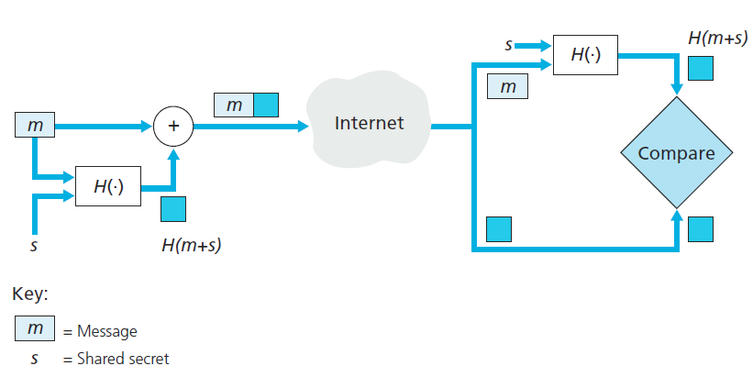
Message authentication code
Question: how to distributed authentication key?
Manual config
Public key

Slide 57
Digital signatures
cryptographic technique analogous to hand-written signatures:
sender (Bob) digitally signs document, establishing he is document owner/creator.
verifiable, nonforgeable: recipient (Alice) can prove to someone that Bob, and no one else (including Alice), must have signed document
8-57

Slide 58
Digital signatures
simple digital signature for message m:
Bob signs m by encrypting with his private key K_{B}, creating “signed” message, K_{B}(m)
-
-
Bob’s message, m
-
Bob’s private
key
-
K
m,K
(m)
B
B
Dear Alice
Oh, how I have missed you. I think of you all the time! …(blah blah blah)
Bob
Bob’s message, m, signed (encrypted) with his private key
Public key
encryption
algorithm
8-58

Slide 59
Digital signatures
-
suppose Alice receives msg m, with signature: m, K_{B}(m)
Alice verifies m signed by Bob by applying Bob’s public key K_{B} to K_{B}(m) then checks K_{B}(K_{B}(m) ) = m.
If K_{B}(K_{B}(m) ) = m, whoever signed m must have used Bob’s private key.
+
-
+
-
+
-
Alice thus verifies that:
Bob signed m
no one else signed m
Bob signed m and not m‘
non-deniable:
Alice can take m, and signature K_{B}(m) to court and prove that Bob signed m
-
8-59

Slide 60
Digital signature = signed message digest
Bob sends digitally signed message:
Alice verifies signature, integrity of digitally signed message:
large
message
m
H: Hash
function
H(m)
encrypted
msg digest
-
K_{B}(H(m))
Bob’s
private
key
digital
signature
(encrypt)
large
message
m
-
Bob’s
public
key
digital
signature
(decrypt)
K
B
+
H: Hash
function
K
encrypted
msg digest
B
+
-
K_{B}(H(m))
H(m)
H(m)
equal
?
8-60

Slide 61
Recall ap5.0: security hole
man (or woman) in the middle attack: Trudy poses as Alice (to Bob) and as Bob (to Alice)
I am Alice
I am Alice
R
R
-
-
K (R)
K (R)
A
T
Send me your public key
Send me your public key
+
+
K
K
A
T
+
Trudy gets
+
K (m)
-
+
K (m)
A
m = K (K (m))
T
-
+
T
T
m = K (K (m))
sends m to Alice encrypted with Alice’s public key
A
A

Slide 62
Public-key certification
motivation: Trudy plays pizza prank on Bob
Trudy creates e-mail order: Dear Pizza Store, Please deliver to me four pepperoni pizzas. Thank you, Bob
Trudy signs order with her private key
Trudy sends order to Pizza Store
Trudy sends to Pizza Store her public key, but says it’s Bob’s public key
Pizza Store verifies signature; then delivers four pepperoni pizzas to Bob
Bob doesn’t even like pepperoni
8-62

Slide 63
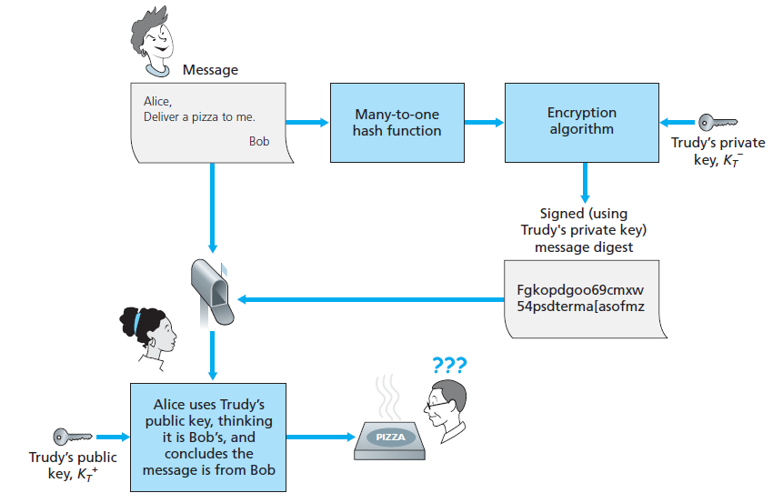

Slide 64
Certification authorities
certification authority (CA): binds public key to particular entity, E.
E (person, router) registers its public key with CA.
E provides “proof of identity” to CA.
CA creates certificate binding E to its public key.
certificate containing E’s public key digitally signed by CA – CA says “this is E’s public key”
Bob’s
public
key
digital
signature
(encrypt)
+
K
+
B
K
B
CA
private
key
certificate for Bob’s public key, signed by CA
-
Bob’s
identifying information
K
CA
8-64

Slide 65
Certification authorities
when Alice wants Bob’s public key:
gets Bob’s certificate (Bob or elsewhere).
apply CA’s public key to Bob’s certificate, get Bob’s public key
+
digital
signature
(decrypt)
Bob’s
public
key
K
B
+
K
B
CA
public
key
+
K
CA
8-65

Slide 66
RSA in Linux
Create RSA key pair
Upload the public key on a server
or
root@server1:~# ssh-keygen -t rsa Generating public/private rsa key pair. Enter file in which to save the key (/root/.ssh/id_rsa): Enter passphrase (empty for no passphrase): Enter same passphrase again: Your identification has been saved in /root/.ssh/id_rsa.
ssh-copy-id user@192.168.0.100
cat ~/.ssh/id_rsa.pub | ssh user@192.168.0.100 "cat >> ~/.ssh/authorized_keys"

Slide 67
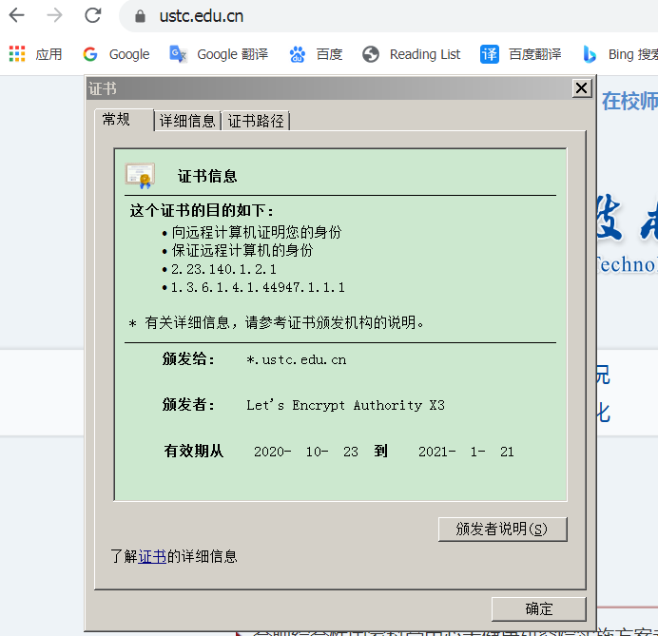
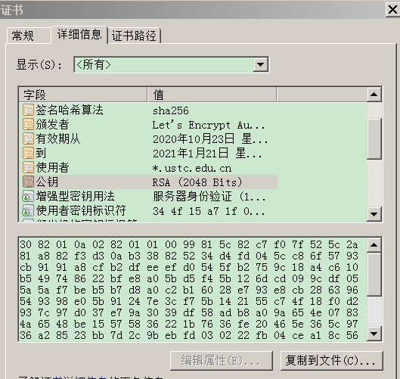
CA in practice
Let’s Encrypt作为CA颁发给ustc.edu.cn的证书

Slide 68
Summary
Objective：message encryption
Solution: block cipher,
cipher block chaining
Require: shared secret key (symmetric key)
Requirement: negotiate shared secret key
Solution: public key cryptography
Require: how to know someone’s public key?
m = K_{S}(K_{S}(m))
c(i)=K_{s}(m(i)⊕c(i-1))
m(i)=K_{s}(c(i))⊕c(i-1)
-
+
K (K (m)) = m
B
B

Slide 69
Summary
Objective：authentication (Alice proves she is Alice to Bob)
Solution: nonce, CA
Objective: Integrity
Solution: MAC using hash function and authentication key
Digital signature:
+
-
+
-
+
K
(K (R)) = R
K_{CA}(K_{CA}(K_{A}))
A
A
H(m + s)
+
-
K_{A}(K_{A}(H(m)))

Slide 70
Chapter 8 roadmap
8.1 What is network security?
8.2 Principles of cryptography
8.3 Message integrity, authentication
8.4 Securing e-mail
8.5 Securing TCP connections: SSL
8.6 Network layer security: IPsec
8.7 Securing wireless LANs
8.8 Operational security: firewalls and IDS
8-70

Slide 71
Secure e-mail
Alice wants to send confidential e-mail, m, to Bob.
K_{S}
.
K_{S}(m )
K_{S}(m )
.
m
K_{S}( )
K_{S}( )
m
+
-
Internet
K_{S}
.
.
+
-
K_{S}
K_{B}( )
+
+
K_{B}( )
K_{B}(K_{S} )
K_{B}(K_{S} )
+
-
K_{B}
K_{B}
Alice:
generates random symmetric private key, K_{S}
encrypts message with K_{S} (for efficiency)
also encrypts K_{S} with Bob’s public key
sends both K_{S}(m) and K_{B}(K_{S}) to Bob
8-71

Slide 72
Secure e-mail
Alice wants to send confidential e-mail, m, to Bob.
K_{S}
.
K_{S}(m )
K_{S}(m )
.
m
K_{S}( )
K_{S}( )
m
+
-
Internet
K_{S}
.
.
+
-
K_{S}
K_{B}( )
+
+
K_{B}( )
K_{B}(K_{S} )
K_{B}(K_{S} )
+
-
K_{B}
K_{B}
Bob:
uses his private key to decrypt and recover K_{S}
uses K_{S} to decrypt K_{S}(m) to recover m
8-72

Slide 73
Secure e-mail (continued)
Alice wants to provide sender authentication and message integrity
-
+
K_{A}
K_{A}
.
.
-
-
.
-
K_{A}(H(m))
K_{A}(H(m))
+
H(m )
m
H( )
K_{A}( )
K_{A}( )
+
-
compare
Internet
.
m
H( )
H(m )
m
Alice digitally signs message
sends both message (in the clear) and digital signature
8-73

Slide 74
Secure e-mail (continued)
Alice wants to provide secrecy, sender authentication, message integrity.
-
K_{A}
.
.
-
-
K_{A}(H(m))
K_{S}
m
H( )
K_{A}( )
.
-
+
K_{S}(m, K_{A}(H(m)))
K_{S}( )
m
+
Internet
.
+
K_{S}
K_{B}( )
+
K_{B}(K_{S} )
+
K_{B}
Alice uses three keys: her private key, Bob’s public key, newly created symmetric key
8-74

Slide 75
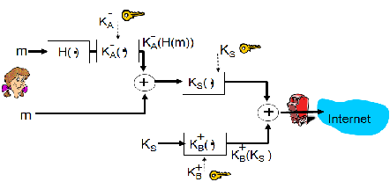
Secure e-mail (continued)
PGP (Pretty Good Privacy)
De facto standard
Essentially same as the previous slide
Software generate public key pair, choose MD5 or SHA for hashing

Slide 76
Chapter 8 roadmap
8.1 What is network security?
8.2 Principles of cryptography
8.3 Message integrity
8.4 Securing e-mail
8.5 Securing TCP connections: SSL
8.6 Network layer security: IPsec
8.7 Securing wireless LANs
8.8 Operational security: firewalls and IDS
8-76

Slide 77
SSL: Secure Sockets Layer
widely deployed security protocol
supported by almost all browsers, web servers
https
billions $/year over SSL
mechanisms: [Woo 1994], implementation: Netscape
variation -TLS: transport layer security, RFC 2246
provides
confidentiality
integrity
authentication
original goals:
Web e-commerce transactions
encryption (especially credit-card numbers)
Web-server authentication
optional client authentication
minimum hassle in doing business with new merchant
available to all TCP applications
secure socket interface
8-77

Slide 78
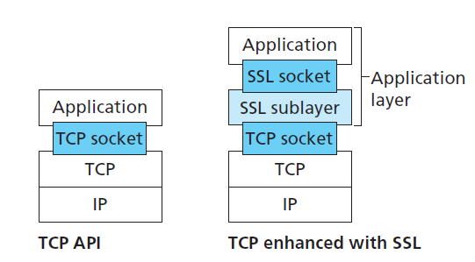
SSL and TCP/IP
SSL provides application programming interface (API) to applications
C and Java SSL libraries/classes readily available
8-78

Slide 79
Could do something like PGP:
-
K_{A}
.
.
-
-
K_{A}(H(m))
K_{S}
m
H( )
K_{A}( )
.
+
K_{S}( )
m
+
Internet
.
+
K_{S}
K_{B}( )
+
K_{B}(K_{S} )
+
K_{B}
but want to send byte streams & interactive data
want set of secret keys for entire connection
want certificate exchange as part of protocol: handshake phase
8-79

Slide 80
Toy SSL: a simple secure channel
handshake: Alice and Bob use their certificates, private keys to authenticate each other and exchange shared secret
key derivation: Alice and Bob use shared secret to derive set of keys
data transfer: data to be transferred is broken up into series of records
connection closure: special messages to securely close connection
8-80

Slide 81
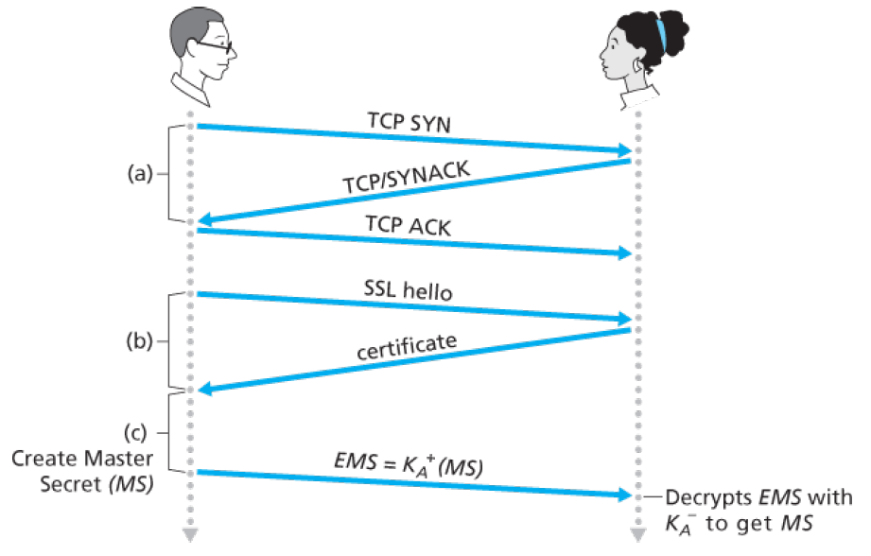
Toy: a simple handshake
MS: master secret
EMS: encrypted master secret
8-81

Slide 82
Toy: key derivation
considered bad to use same key for more than one cryptographic operation
use different keys for message authentication code (MAC) and encryption
four keys:
E_{B} = encryption key for data sent from Bob to Alice
M_{B} = MAC key for data sent from Bob to Alice
E_{A} = encryption key for data sent from Alice to Bob
M_{A} = MAC key for data sent from Alice to Bob
keys derived from the MS, using key derivation function (KDF)
Example: simply slicing the MS into four keys
8-82

Slide 83
Toy: data records
why not encrypt data in constant stream as we write it to TCP?
where would we put the MAC? If at end, no message integrity until all data processed.
e.g., with instant messaging, how can we do integrity check over all bytes sent before displaying?
instead, break stream in series of records
each record carries a MAC
receiver can act on each record as it arrives
issue: in record, receiver needs to distinguish MAC from data
want to use variable-length records
length
data
MAC
8-83

Slide 84
Toy: sequence numbers
problem: attacker can capture and replay record or re-order records
solution: put sequence number into MAC:
MAC = Hash(M_{x}, sequence||data)
note: send maintains a sequence number locally, no sequence number field in the record
problem: attacker could replay all records
solution: use nonce
8-84

Slide 85
Toy: control information
problem: truncation attack:
attacker forges TCP connection close segment
one or both sides thinks there is less data than there actually is.
solution: record types, with one type for closure
type 0 for data; type 1 for closure
MAC = Hash(M_{x}, sequence||type||data)
length
type
data
MAC
8-85

Slide 86
Toy SSL: summary
hello
certificate, nonce
K_{B}⁺(MS) = EMS
type 0, seq 1, data
bob.com
type 0, seq 2, data
type 0, seq 1, data
encrypted
type 0, seq 3, data
type 1, seq 4, close
type 1, seq 2, close
8-86

Slide 87
Toy SSL isn’t complete
how long are fields?
which encryption protocols?
want negotiation?
allow client and server to support different encryption algorithms
allow client and server to choose together specific algorithm before data transfer
8-87

Slide 88
SSL cipher suite
cipher suite
public-key algorithm
symmetric encryption algorithm
MAC algorithm
SSL supports several cipher suites
negotiation: client, server agree on cipher suite
client offers choice
server picks one
common SSL symmetric ciphers
DES – Data Encryption Standard: block
3DES – Triple strength: block
RC2 – Rivest Cipher 2: block
RC4 – Rivest Cipher 4: stream
SSL Public key encryption
RSA
8-88

Slide 89
Real SSL: handshake (1)
Purpose
server authentication
negotiation: agree on crypto algorithms
establish keys
client authentication (optional)
8-89

Slide 90
Real SSL: handshake (2)
client sends list of algorithms it supports, along with client nonce
server chooses algorithms from list; sends back: choice + certificate + server nonce
client verifies certificate, extracts server’s public key, generates pre_master_secret, encrypts with server’s public key, sends to server
client and server independently compute encryption and MAC keys from pre_master_secret and nonces
client sends a MAC of all the handshake messages
server sends a MAC of all the handshake messages
8-90

Slide 91
Real SSL: handshaking (3)
last 2 steps protect handshake from tampering
client typically offers range of algorithms, some strong, some weak
man-in-the middle could delete stronger algorithms from list
last 2 steps prevent this
last two messages are encrypted
8-91

Slide 92
Real SSL: handshaking (4)
why two random nonces?
suppose Trudy sniffs all messages between Alice & Bob
next day, Trudy sets up TCP connection with Bob, sends exact same sequence of records
Bob (Amazon) thinks Alice made two separate orders for the same thing
solution: Bob sends different random nonce for each connection. This causes encryption keys to be different on the two days
Trudy’s messages will fail Bob’s integrity check
8-92

Slide 93
SSL record protocol
data
data
fragment
MAC
data
fragment
MAC
record
header
encrypted
data and MAC
record
header
encrypted
data and MAC
record header: content type; version; length
MAC: includes sequence number, MAC key M_{x}
fragment: each SSL fragment 2¹⁴ bytes (~16 Kbytes)
8-93

Slide 94
SSL record format
1 byte
2 bytes
3 bytes
content
type
length
SSL version
data
MAC
data and MAC encrypted (symmetric algorithm)
8-94

Slide 95
Chapter 8 roadmap
8.1 What is network security?
8.2 Principles of cryptography
8.3 Message integrity
8.4 Securing e-mail
8.5 Securing TCP connections: SSL
8.6 Network layer security: IPsec
8.7 Securing wireless LANs
8.8 Operational security: firewalls and IDS
8-95

Slide 96
What is network-layer confidentiality ?
between two network entities:
sending entity encrypts datagram payload, payload could be:
TCP or UDP segment, ICMP message, OSPF message ….
all data sent from one entity to other would be hidden:
web pages, e-mail, P2P file transfers, TCP SYN packets …
“blanket coverage”
8-96

Slide 97
Virtual Private Networks (VPNs)
motivation:
institutions often want private networks for security.
costly: separate routers, links, DNS infrastructure.
VPN: institution’s inter-office traffic is sent over public Internet instead
encrypted before entering public Internet
logically separate from other traffic
USTC VPN
Connect to USTC router from outside USTC
Access resources (e.g., digital library) as if the host is within the USTC network.
8-97

Slide 98



Virtual Private Networks (VPNs)
public Internet
laptop
w/ IPsec
IP
header
IPsec
header
Secure
payload
salesperson in hotel
IP
header
IPsec
header
Secure
payload
IP
header
IPsec
header
Secure
payload
router w/
IPv4 and IPsec
router w/
IPv4 and IPsec
IP
header
payload
IP
header
payload
branch office
headquarters

Slide 99
IPsec services
data integrity
origin authentication
replay attack prevention
confidentiality
two protocols providing different service models:
Authentication Header (AH) protocol: provides source authentication & data integrity but not confidentiality
Encapsulation Security Protocol (ESP): provides source authentication, data integrity, and confidentiality
more widely used than AH
8-99

Slide 100
IPsec transport mode
IPsec
IPsec
IPsec datagram emitted and received by end-system
protects upper level protocols
Retain the original IP header unprotected, only protect the payload.
8-100

Slide 101
IPsec – tunneling mode
IPsec
IPsec
IPsec
IPsec
edge routers IPsec-aware
hosts IPsec-aware
Host connect to router
Protect the entire original IP packet by encapsulate it as payload of a new IP packet
8-101

Slide 102
Four combinations are possible!
Transport mode with AH | Transport mode with ESP
Tunnel mode with AH | Tunnel mode with ESP
most common and most important
8-102

Slide 103
Security associations (SAs)
before sending data, set up a logical connection called “security association (SA)” from sending to receiving entity
SAs are simplex（单向）: for only one direction
ending, receiving entitles maintain state information about SA
recall: TCP endpoints also maintain state info
IP is connectionless; IPsec is connection-oriented!
how many SAs in VPN w/ headquarters, branch office, and n traveling salespeople?
8-103

Slide 104
Example SA from R1 to R2
headquarters
Internet
branch office
200.168.1.100
193.68.2.23
R1
security association
R2
172.16.1/24
172.16.2/24
R1 stores for SA:
32-bit SA identifier: Security Parameter Index (SPI)
origin SA interface (200.168.1.100)
destination SA interface (193.68.2.23)
type of encryption used (e.g., 3DES with CBC)
encryption key
type of integrity check used (e.g., HMAC with MD5)
authentication key
8-104

Slide 105
Security Association Database (SAD)
endpoint holds SA state in security association database (SAD), where it can locate them during processing.
with n salespersons, 2 + 2n SAs in R1’s SAD
2n for n salespersons and 2 for the branch.
when sending IPsec datagram, R1 accesses SAD to determine how to process datagram.
when IPsec datagram arrives to R2, R2 examines SPI in IPsec datagram, indexes SAD with SPI, and processes datagram accordingly.
8-105

Slide 106
IPsec datagram
focus for now on tunnel mode with ESP
“enchilada” authenticated
encrypted
new IP header
ESP
hdr
original IP hdr
Original IP
datagram payload
ESP
trl
ESP
auth
SPI
Seq
#
padding
pad length
next header
8-106

Slide 107
What happens?
headquarters
Internet
branch office
200.168.1.100
193.68.2.23
R1
security association
R2
172.16.1/24
172.16.2/24
Padding: to ensure the data for encryption is times of block size
“enchilada” authenticated
encrypted
new IP header
ESP
hdr
original IP hdr
Original IP
datagram payload
ESP
trl
ESP
auth
SPI
Seq
#
padding
pad length
next header
next header: UDP or TCP?
8-107

Slide 108
R1: convert original datagram to IPsec datagram
appends to back of original datagram (which includes original header fields!) an “ESP trailer” field.
encrypts result using algorithm & key specified by SA.
appends to front of this encrypted quantity the “ESP header”, creating “enchilada”.
creates authentication MAC over the whole enchilada, using algorithm and key specified in SA;
appends MAC to back of enchilada, forming payload;
creates brand new IP header, with all the classic IPv4 header fields, which it appends before payload
8-108

Slide 109
Inside the enchilada:
“enchilada” authenticated
encrypted
new IP header
ESP
hdr
original IP hdr
Original IP
datagram payload
ESP
trl
ESP
auth
SPI
Seq
#
padding
pad length
next header
ESP trailer: Padding for block ciphers
ESP header:
SPI, so receiving entity knows what to do
Sequence number, to thwart replay attacks
MAC in ESP auth field is created with shared authentication key
8-109

Slide 110
IPsec sequence numbers
for new SA, sender initializes seq. # to 0
each time datagram is sent on SA:
sender increments seq # counter
places value in seq # field
goal:
prevent attacker from sniffing and replaying a packet
receipt of duplicate, authenticated IP packets may disrupt service
8-110

Slide 111
Security Policy Database (SPD)
policy: For a given datagram, sending entity needs to know if it should use IPsec (or direct send it out)
needs also to know which SA to use
may use: source and destination IP address; protocol number
info in SPD indicates “what” to do with arriving datagram
info in SAD indicates “how” to do it
8-111

Slide 112
Summary: IPsec services
new IP header
ESP
hdr
original IP hdr
Original IP
datagram payload
ESP
trl
ESP
auth
suppose Trudy sits somewhere between R1 and R2. she doesn’t know the keys.
will Trudy be able to see original contents of datagram? How about source, dest IP address, transport protocol, application port? Not be able to see encrypted part.
flip bits without detection? Fail integrity check using MAC
masquerade as R1 using R1’s IP address? Fail integrity check at R2
replay a datagram? Fail with wrong sequence number
8-112

Slide 113
IKE: Internet Key Exchange
previous examples: manual establishment of IPsec SAs in IPsec endpoints:
Example SA
SPI: 12345
Source IP: 200.168.1.100
Dest IP: 193.68.2.23
Protocol: ESP
Encryption algorithm: 3DES-cbc
HMAC algorithm: MD5
Encryption key: 0x7aeaca…
HMAC key:0xc0291f…
manual keying is impractical for VPN with 100s of endpoints
instead use IPsec IKE (Internet Key Exchange)
8-113

Slide 114
IKE phases
IKE has two phases
phase 1: establish bi-directional IKE SA
note: IKE SA different from IPsec SA
aka ISAKMP security association
phase 2: ISAKMP is used to securely negotiate IPsec pair of SAs
phase 1 has two modes: aggressive mode and main mode
aggressive mode uses fewer messages
main mode provides identity protection and is more flexible
8-114

Slide 115
IPsec summary
IKE message exchange for algorithms, secret keys, SPI numbers
either AH or ESP protocol (or both)
AH provides integrity, source authentication
ESP protocol (with AH) additionally provides encryption
IPsec peers can be two end systems, two routers/firewalls, or a router/firewall and an end system
8-115

Slide 116
Chapter 8 roadmap
8.1 What is network security?
8.2 Principles of cryptography
8.3 Message integrity
8.4 Securing e-mail
8.5 Securing TCP connections: SSL
8.6 Network layer security: IPsec
8.7 Securing wireless LANs
8.8 Operational security: firewalls and IDS
8-116

Slide 117



WEP design goals
symmetric key crypto
confidentiality
end host authorization
data integrity
self-synchronizing: each packet separately encrypted
given encrypted packet and key, can decrypt; can continue to decrypt packets when preceding packet was lost (unlike Cipher Block Chaining (CBC) in block ciphers)
Efficient
implementable in hardware or software
8-117

Slide 118
Review: symmetric stream ciphers
keystream
generator
key
keystream
combine each byte of keystream with byte of plaintext to get ciphertext:
m(i) = ith unit of message
ks(i) = ith unit of keystream
c(i) = ith unit of ciphertext
c(i) = ks(i) ⊕ m(i) (⊕ = exclusive or)
m(i) = ks(i) ⊕ c(i)
WEP uses RC4
8-118

Slide 119
Stream cipher and packet independence
recall design goal: each packet separately encrypted
if for frame n+1, use keystream from where we left off for frame n, then each frame is not separately encrypted
need to know where we left off for packet n
WEP approach: initialize keystream with key + new IV for each packet:
keystream
generator
Key+IV_{packet}
keystream_{packet}
8-119

Slide 120
WEP encryption (1)
sender calculates Integrity Check Value (ICV, four-byte hash/CRC over data
each side has 104-bit shared key
sender creates 24-bit initialization vector (IV), appends to key: gives 128-bit key
sender also appends keyID (in 8-bit field)
128-bit key inputted into pseudo random number generator to get keystream
data in frame + ICV is encrypted with RC4:
bytes of keystream are XORed with bytes of data & ICV
IV & keyID are appended to encrypted data to create payload
payload inserted into 802.11 frame
encrypted
IV
Key ID
data
ICV
MAC payload
8-120

Slide 121
WEP encryption (2)
new IV for each frame
8-121

Slide 122
WEP decryption overview
encrypted
IV
Key ID
data
ICV
MAC payload
receiver extracts IV
inputs IV, shared secret key into pseudo random generator, gets keystream
XORs keystream with encrypted data to decrypt data + ICV
verifies integrity of data with ICV
note: message integrity approach used here is different from MAC (message authentication code) and signatures (using PKI).
8-122

Slide 123
Breaking 802.11 WEP encryption
security hole:
24-bit IV, one IV per frame, -> IV’s eventually reused
IV transmitted in plaintext -> IV reuse detected
attack:
Trudy causes Alice to encrypt known plaintext d₁ d₂ d₃ d₄ …
Trudy sees: c_{i} = d_{i} XOR k_{i}^{IV}
Trudy knows c_{i} d_{i}, so can compute k_{i}^{IV}
Trudy knows encrypting key sequence k₁^{IV} k₂^{IV} k₃^{IV} …
Next time Trudy finds that IV is used, Trudy can decrypt with k₁^{IV} k₂^{IV} k₃^{IV} …
WEP is replaced by WPA and WPA2.
8-123

Slide 124
End-point authentication w/ nonce
Nonce: number (R) used only once –in-a-lifetime
How to prove Alice “live”: Bob sends Alice nonce, R. Alice
must return R, encrypted with shared secret key
“I am Alice”
R
K (R)
Alice is live, and only Alice knows key to encrypt nonce, so it must be Alice!
A-B
8-124

Slide 125
WEP authentication
authentication request
nonce (128 bytes)
nonce encrypted shared key
success if decrypted value equals nonce
Notes:
not all APs do it, even if WEP is being used
AP indicates if authentication is necessary in beacon frame
done before association
8-125

Slide 126
802.11i: improved security
numerous (stronger) forms of encryption possible
provides key distribution
uses authentication server separate from access point
8-126

Slide 127

802.11i: four phases of operation
AP: access point
STA:
client station
AS:
Authentication
server
wired
network
1 Discovery of
security capabilities
2
STA and AS mutually authenticate, together
generate Master Key (MK). AP serves as “pass through”
3
STA derives
Pairwise Master
Key (PMK)
AS derives
same PMK,
sends to AP
3
4
STA, AP use PMK to derive
Temporal Key (TK) used for message
encryption, integrity
8-127

Slide 128
EAP: extensible authentication protocol
EAP: end-end client (mobile) to authentication server protocol
EAP sent over separate “links”
mobile-to-AP (EAP over LAN)
AP to authentication server (RADIUS over UDP)
wired
network
EAP TLS
EAP
EAP over LAN (EAPoL)
RADIUS
IEEE 802.11
UDP/IP
8-128

Slide 129
Chapter 8 roadmap
8.1 What is network security?
8.2 Principles of cryptography
8.3 Message integrity
8.4 Securing e-mail
8.5 Securing TCP connections: SSL
8.6 Network layer security: IPsec
8.7 Securing wireless LANs
8.8 Operational security: firewalls and IDS
8-129

Slide 130


Firewalls
firewall
isolates organization’s internal net from larger Internet, allowing some packets to pass, blocking others
administered
network
public
Internet
trusted “good guys”
untrusted “bad guys”
firewall
8-130

Slide 131
Firewalls: why
prevent denial of service attacks:
SYN flooding: attacker establishes many bogus TCP connections, no resources left for “real” connections
prevent illegal modification/access of internal data
e.g., attacker replaces CIA’s homepage with something else
allow only authorized access to inside network
set of authenticated users/hosts
three types of firewalls:
stateless packet filters
stateful packet filters
application gateways
8-131

Slide 132
Stateless packet filtering
Should arriving packet be allowed in? Departing packet let out?
internal network connected to Internet via router firewall
router filters packet-by-packet, decision to forward/drop packet based on:
source IP address, destination IP address
TCP/UDP source and destination port numbers
ICMP message type
TCP SYN and ACK bits
8-132

Slide 133
Stateless packet filtering: example
example 1: block incoming and outgoing datagrams with IP protocol field = 17 and with either source or dest port = 23
result: all incoming, outgoing UDP flows and telnet connections are blocked
example 2: block inbound TCP segments with ACK=0.
result: prevents external clients from making TCP connections with internal clients, but allows internal clients to connect to outside.
8-133

Slide 134
Stateless packet filtering: more examples
Policy | Firewall Setting
No outside Web access. | Drop all outgoing packets to any IP address, port 80
No incoming TCP connections, except those for institution’s public Web server only. | Drop all incoming TCP SYN packets to any IP except 130.207.244.203, port 80
Prevent Web-radios from eating up the available bandwidth. | Drop all incoming UDP packets - except DNS and router broadcasts.
Prevent your network from being used for a smurf DoS attack. | Drop all ICMP packets going to a “broadcast” address (e.g. 130.207.255.255).
Prevent your network from being tracerouted | Drop all outgoing ICMP TTL expired traffic
8-134

Slide 135
Access Control Lists
ACL: table of rules, applied top to bottom to incoming packets: (action, condition) pairs: looks like OpenFlow forwarding (Ch. 4)!
action | source address | dest address | protocol | source port | dest port | flag bit
allow | 222.22/16 | outside of 222.22/16 | TCP | > 1023 | 80 | any
allow | outside of 222.22/16 | 222.22/16 | TCP | 80 | > 1023 | ACK
allow | 222.22/16 | outside of 222.22/16 | UDP | > 1023 | 53 | ---
allow | outside of 222.22/16 | 222.22/16 | UDP | 53 | > 1023 | ----
deny | all | all | all | all | all | all
8-135

Slide 136
Stateful packet filtering
stateless packet filter: heavy handed tool
admits packets that “make no sense,” e.g., dest port = 80, ACK bit set, even though no TCP connection established:
action | source address | dest address | protocol | source port | dest port | flag bit
allow | outside of 222.22/16 | 222.22/16 | TCP | 80 | > 1023 | ACK
stateful packet filter: track status of every TCP connection
track connection setup (SYN), teardown (FIN): determine whether incoming, outgoing packets “makes sense”
timeout inactive connections at firewall: no longer admit packets
8-136

Slide 137
Stateful packet filtering
ACL augmented to indicate need to check connection state table before admitting packet
action | source address | dest address | proto | source port | dest port | flag bit | check conxion
allow | 222.22/16 | outside of 222.22/16 | TCP | > 1023 | 80 | any
allow | outside of 222.22/16 | 222.22/16 | TCP | 80 | > 1023 | ACK | x
allow | 222.22/16 | outside of 222.22/16 | UDP | > 1023 | 53 | ---
allow | outside of 222.22/16 | 222.22/16 | UDP | 53 | > 1023 | ---- | x
deny | all | all | all | all | all | all
是否有连接？
是否有DNS query？
8-137

Slide 138
Application gateways
filter packets on application data as well as on IP/TCP/UDP fields.
example: allow select internal users to telnet outside
host-to-gateway
telnet session
application
gateway
router and filter
gateway-to-remote
host telnet session
1. require all telnet users to telnet through gateway.
2. for authorized users, gateway sets up telnet connection to dest host. Gateway relays data between 2 connections
3. router filter blocks all telnet connections not originating from gateway.
8-138

Slide 139
Limitations of firewalls, gateways
IP spoofing: router can’t know if data “really” comes from claimed source
if multiple app’s. need special treatment, each has own app. gateway
client software must know how to contact gateway.
e.g., must set IP address of proxy in Web browser
filters often use all or nothing policy for UDP
tradeoff: degree of communication with outside world, level of security
many highly protected sites still suffer from attacks
8-139

Slide 140
Intrusion detection systems
packet filtering:
operates on TCP/IP headers only
no correlation check among sessions
IDS: intrusion detection system
deep packet inspection: look at packet contents (e.g., check character strings in packet against database of known virus, attack strings)
examine correlation among multiple packets
port scanning
network mapping
DoS attack
8-140

Slide 141
Intrusion detection systems
multiple IDSs: different types of checking at different locations
firewall
internal
network
Internet
IDS
sensors
Web
server
DNS
server
FTP
server
demilitarized
zone
8-141

Slide 142
Network Security (summary)
basic techniques…...
cryptography (symmetric and public)
message integrity
end-point authentication
…. used in many different security scenarios
secure email
secure transport (SSL)
IP sec
802.11
operational security: firewalls and IDS
8-142

