Slide 1
AIDD8122 — Advanced Topics in Artificial Intelligence & Drug Discovery
Molecular representations, model families and
evaluation protocols for predicting BACE-1 inhibition
A systematic benchmark against graph neural networks
Jiayang Li · P2600332
Faculty of Applied Sciences · Macao Polytechnic University

Slide 2
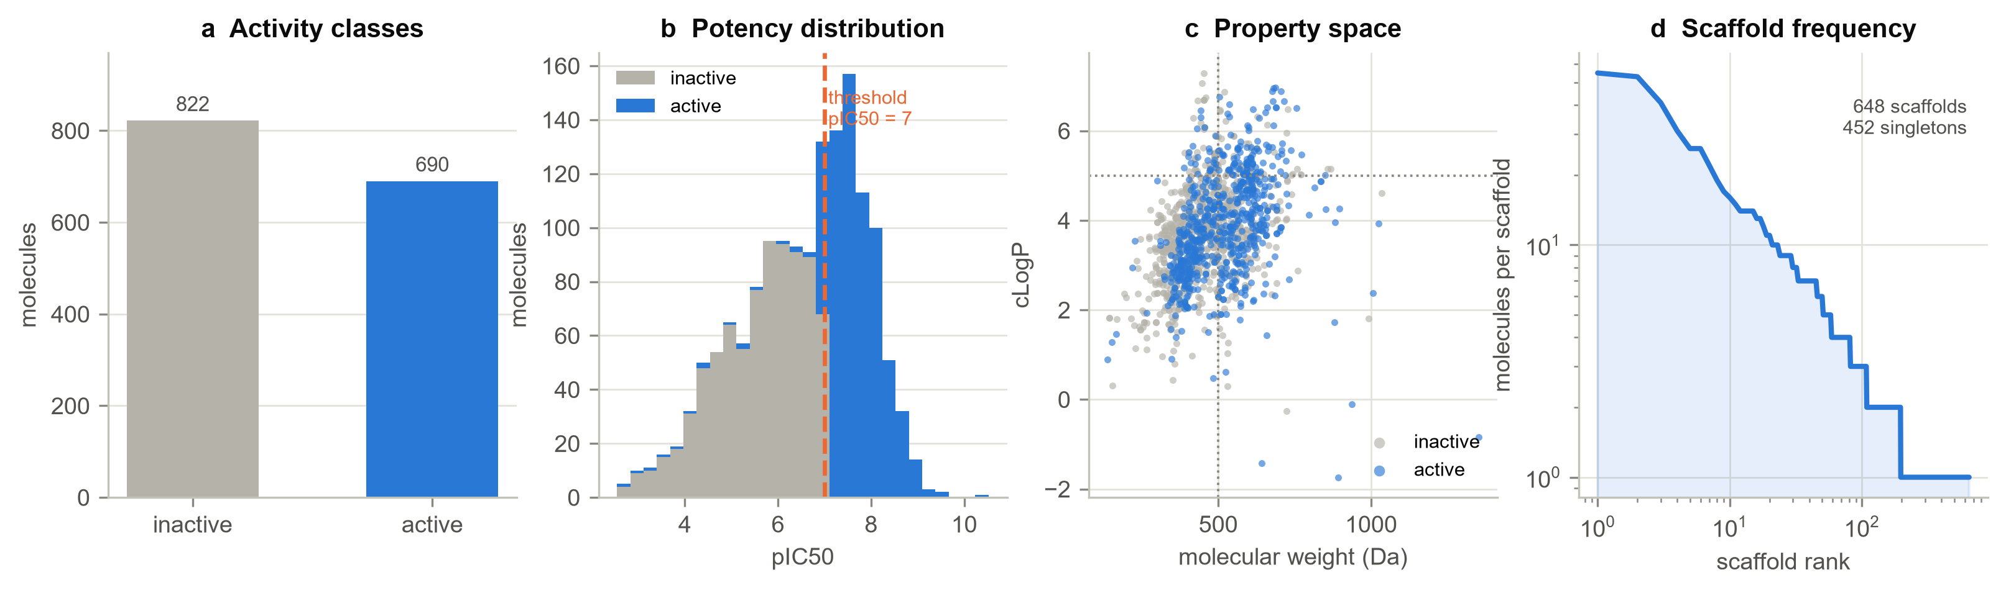
MOTIVATION
BACE-1: a well-studied target that keeps failing
— Alzheimer's disease: 55 million people, no reliable disease-modifying therapy. BACE-1 performs the first, rate-limiting cut that releases amyloid-beta.
— Four clinical candidates reached late-stage trials; all were discontinued — but two decades of chemistry left a rich, well-annotated dataset.
→ An ideal testbed for asking what actually drives predictive accuracy.
1,512 curated molecules · 690 active · 648 Bemis-Murcko scaffolds · median MW 464 Da

Slide 3
RESEARCH QUESTIONS
Three choices decide what a model appears to be worth
Every QSAR study makes these choices — usually implicitly. This project makes them the object of study.
RQ1
RQ2
RQ3
RQ4
Representation vs model
Random vs scaffold split
Learned vs fixed features
Accuracy vs reliability
Which choice buys more accuracy for the same effort?
How optimistic is a random split, in numbers?
Does a graph network beat fingerprints at this scale?
Can we say where the model should be trusted?

Slide 4
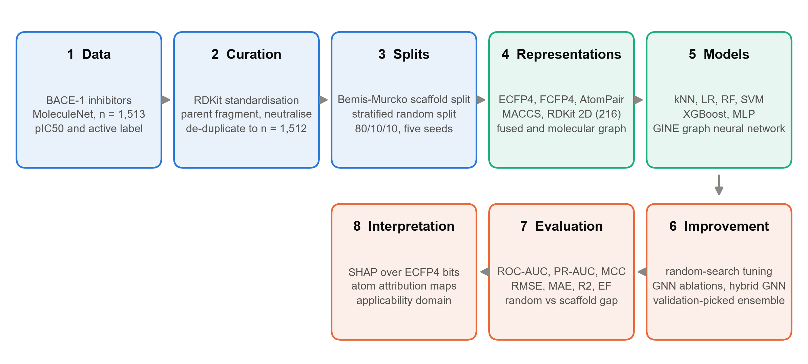
METHODS
One dataset, one protocol, everything else varied
— 6 representations × 6 model families × 2 tasks × 2 splits × 5 seeds, plus a GINE graph network written from scratch in PyTorch.
— Every selection decision — hyperparameters, early stopping, ensemble membership — made on validation data only.

Slide 5
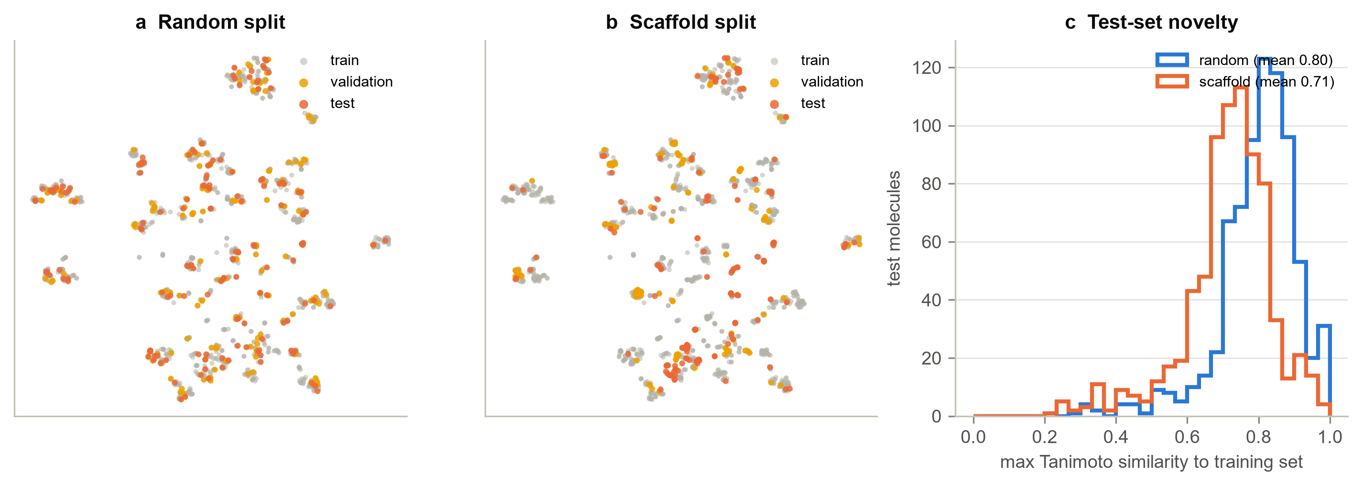
EVALUATION DESIGN
Scaffold splitting genuinely hides chemistry from the model
0.80
0.71
648
mean max Tanimoto similarity,
random split
mean max Tanimoto similarity,
scaffold split
distinct Bemis-Murcko
scaffolds

Slide 6
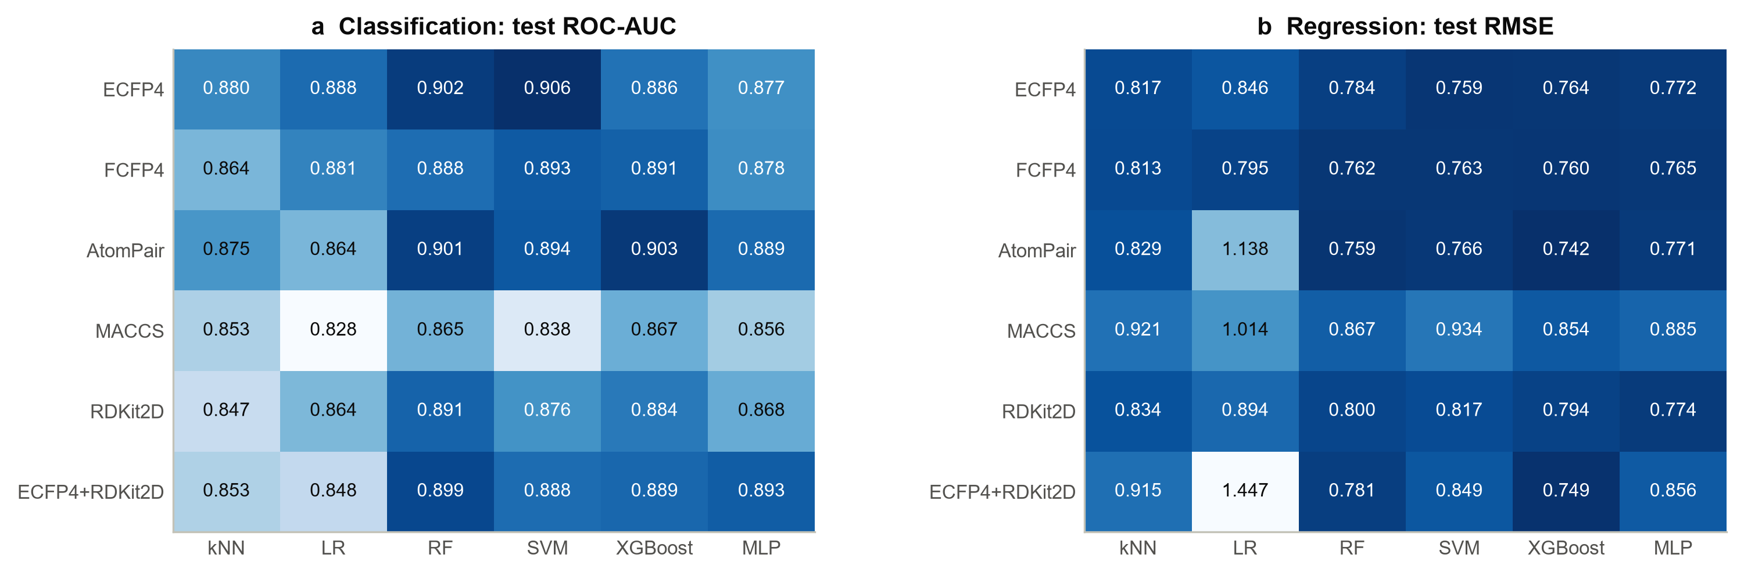
RESULT · RQ1
Representation matters at least as much as the model
— Spread between best and worst representation: 0.039 ROC-AUC. Between best and worst model family: 0.029.
— Best classifier ECFP4 + SVM (0.906); best regressor AtomPair + XGBoost (0.742 RMSE).
— Naive fusion of fingerprints and descriptors did not help — it hurt the linear model.

Slide 7
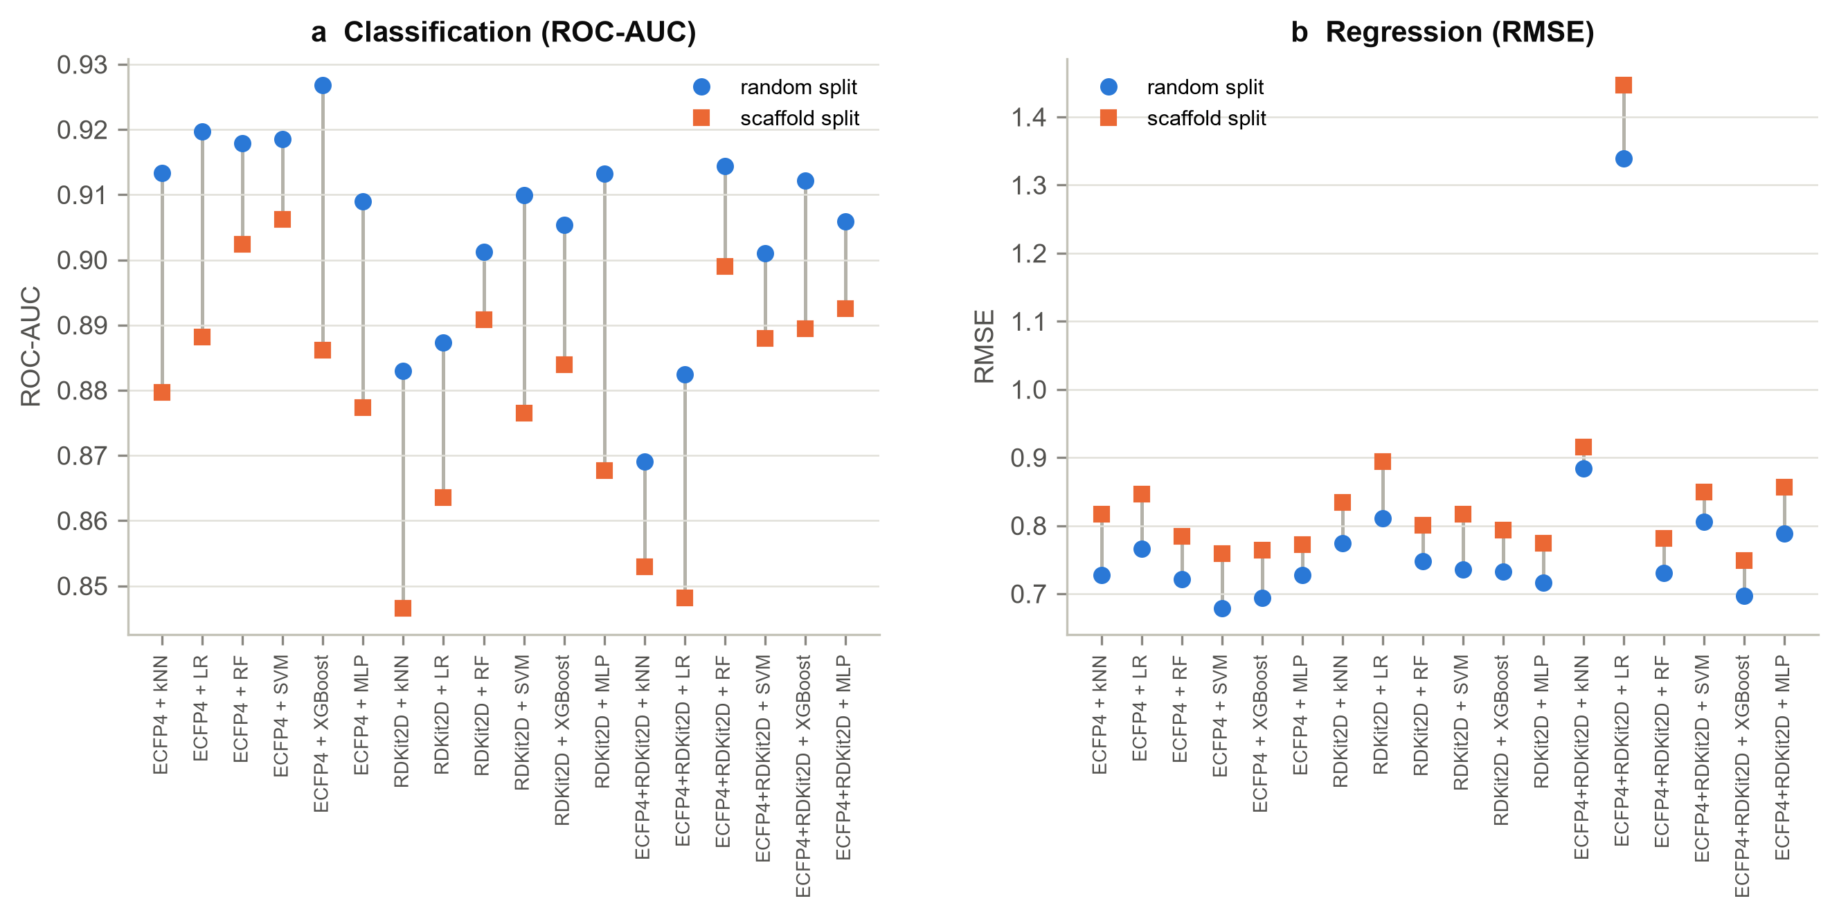
RESULT · RQ2
A random split flatters every single model
18/18
+0.025
−0.065
configurations scored better
under random splitting
mean ROC-AUC
inflation
mean RMSE understatement
(log units)

Slide 8
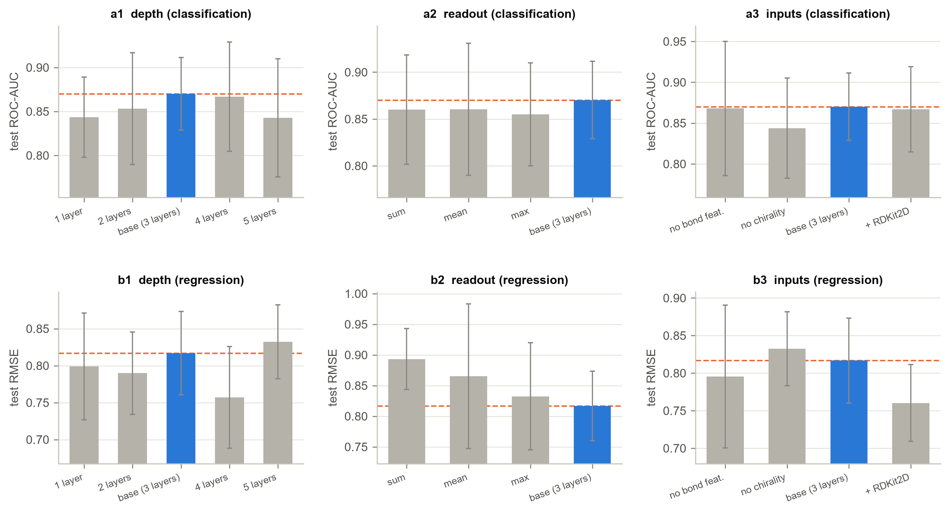
RESULT · RQ3
The graph network does not win at 1,200 molecules
— GNN reaches 0.870 ROC-AUC and 0.817 RMSE — behind the best fingerprint models (0.906 / 0.742).
— Ablations behave as theory predicts: depth peaks at three layers (over-smoothing beyond), concatenated readout beats any single pooling.
— Removing stereochemistry costs 0.026 ROC-AUC — chemically sensible for transition-state isosteres.

Slide 9
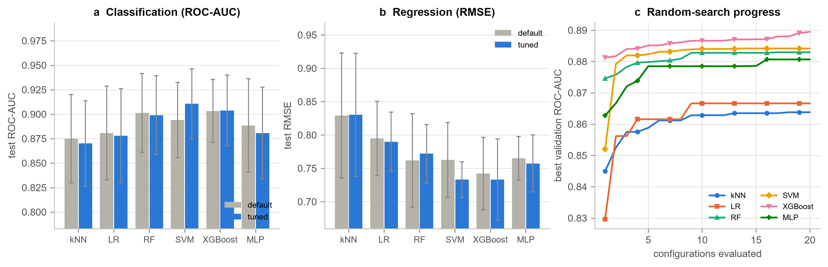
RESULT · RQ4A
Tuning buys little; ensembling helps only regression
— 20 random configurations per model, task and seed: mean change -0.0001 ROC-AUC, only 2 of 6 families improved.
— With ~150 validation molecules, the best of twenty captures noise as readily as signal: validation keeps rising, test does not follow.
— Ensembling: no gain for classification, but the best overall regression result (0.707 RMSE).

Slide 10
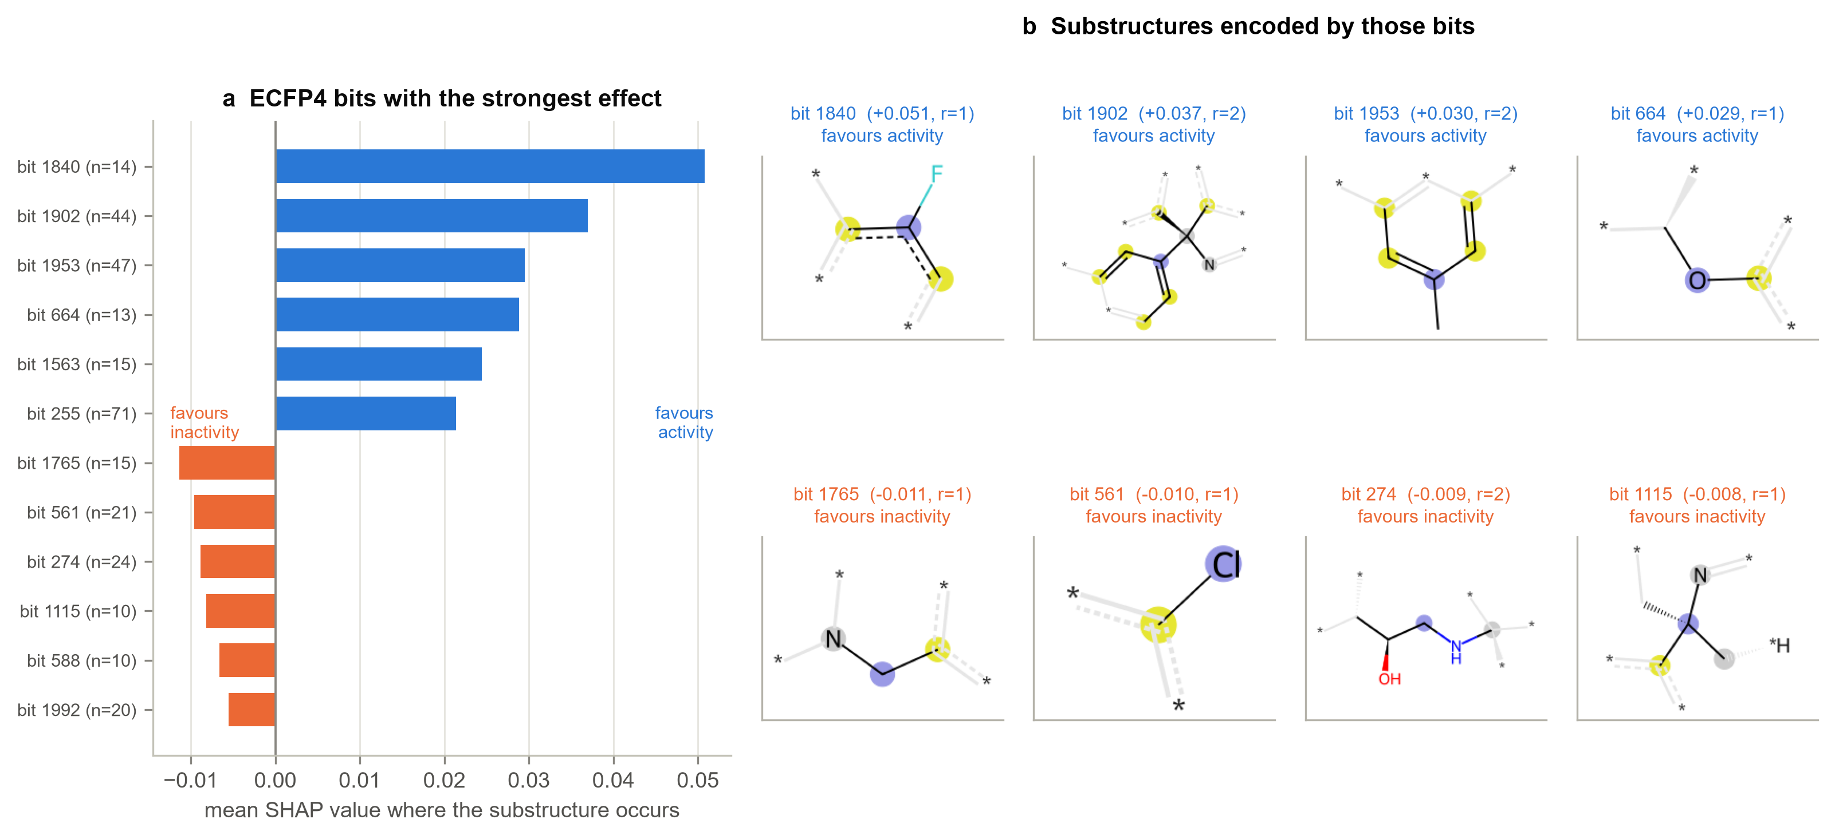
RESULT · RQ4B
The model's reasoning is chemically legible
— SHAP over ECFP4 bits maps each contribution back to a concrete substructure: fluorinated and aromatic-nitrogen environments raise predicted activity.
— Presence of a substructure is informative; absence is not — a direct consequence of how fingerprints encode molecules.

Slide 11
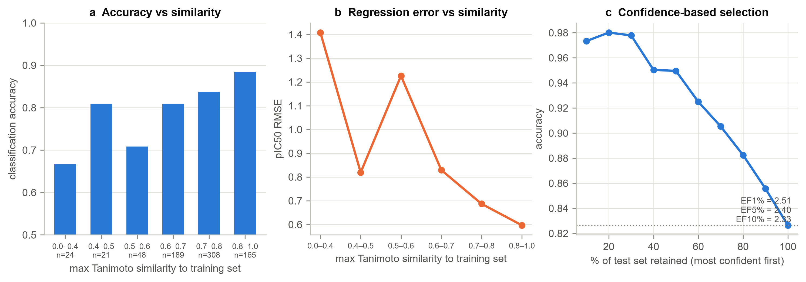
RESULT · RQ4C — THE PRACTICAL FINDING
A single accuracy number hides a twofold difference in reliability
67% → 88%
1.41 → 0.60
97%
accuracy, least to most similar
to the training set
pIC50 RMSE over the
same range
accuracy on the most
confident 10%

Slide 12
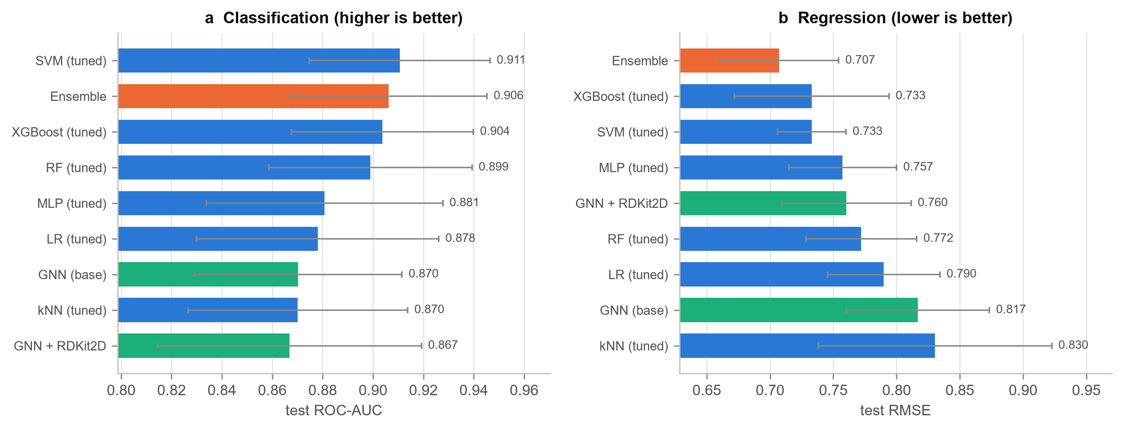
SUMMARY OF RESULTS
Everything side by side
Scaffold-split test performance, mean ± SD over five seeds. Blue: classical models. Green: graph networks. Orange: ensemble.

Slide 13
CONCLUSIONS
What to take away
1 Spend effort on the representation before the model — it explains as much or more of the variation.
2 Report scaffold-split numbers. A random split inflated every configuration here, by 0.025 ROC-AUC on average.
3 At ~1,200 molecules a learned graph representation does not beat well-designed fingerprints; descriptors recover part of its gap.
4 Tuning and ensembling give little on a small validation set — the noise floor is reached quickly.
5 Always publish an applicability domain: reliability varied twofold with similarity to the training set, and confidence tracked it closely enough to triage.

Slide 14
Thank you
Questions welcome
Code, cached splits, per-molecule predictions and figure scripts:
https://github.com/ljyhh0826-coder/AIDD8122-BACE1-ML

