Slide 1
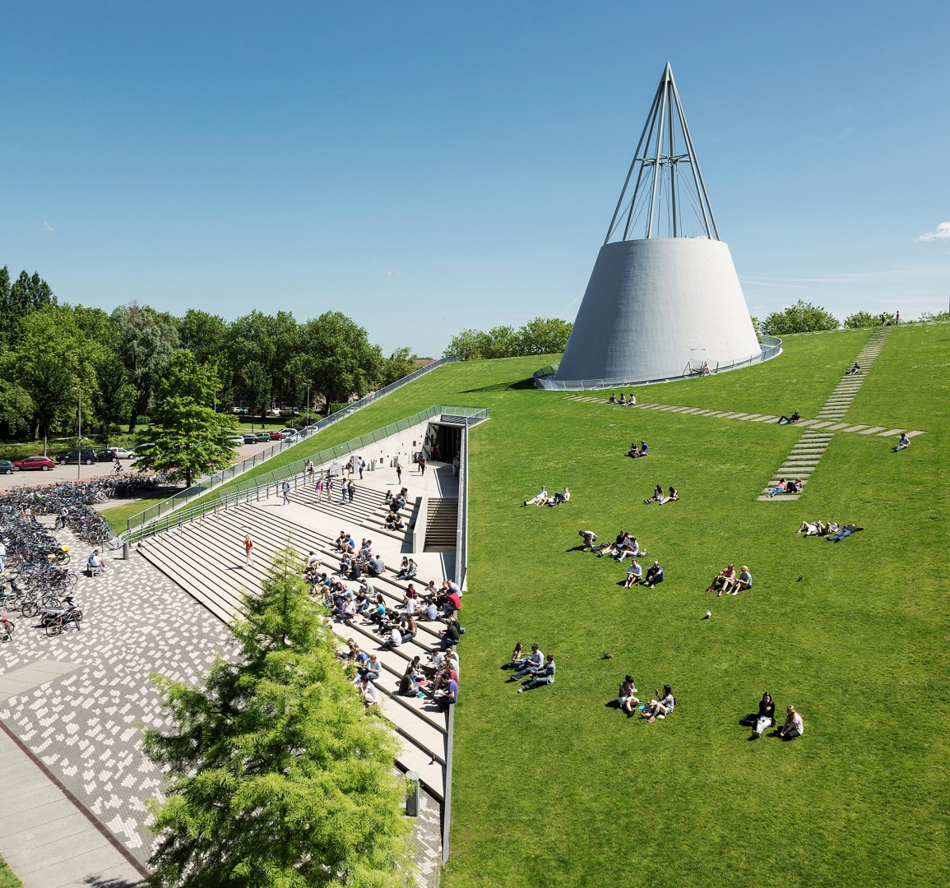
Web-scale Data Management
Group 6
Daniel van den Akker
Jingyu Li
Lang Feng
Xueyuan Chen
Zhiheng Wang

Slide 2
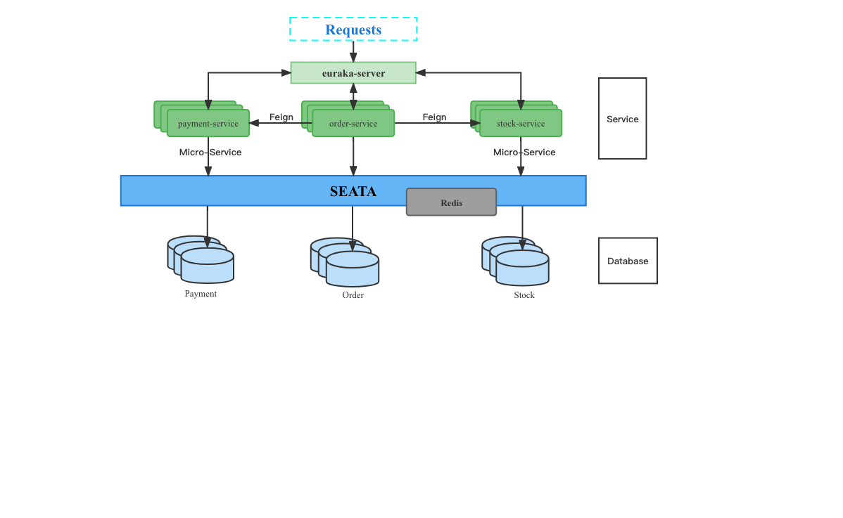
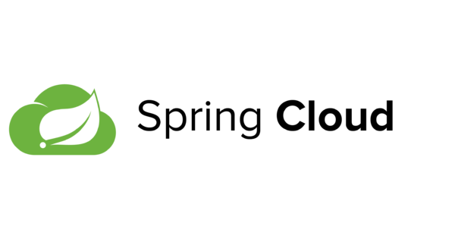



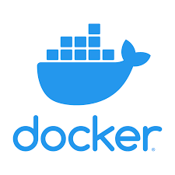
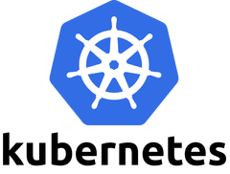
Overall Design Architecture Diagram

Slide 3
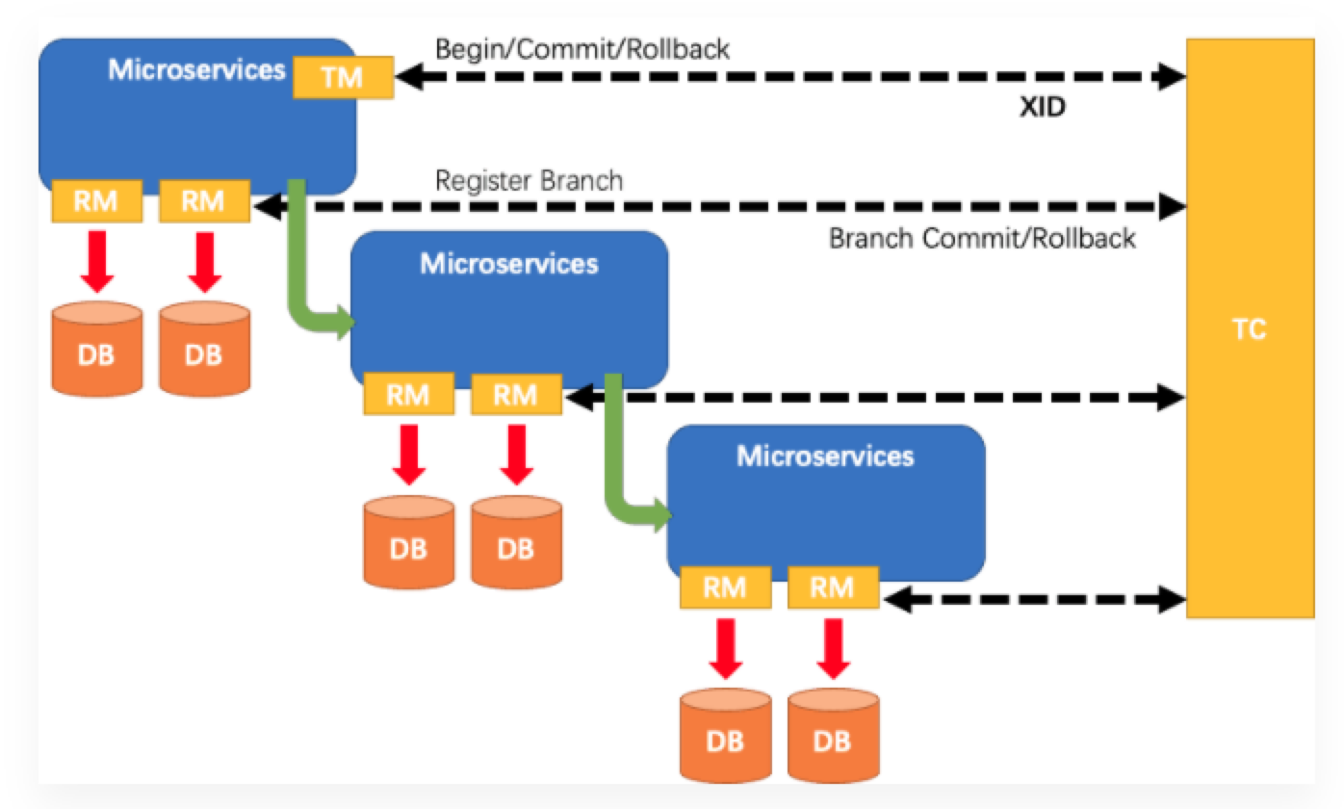
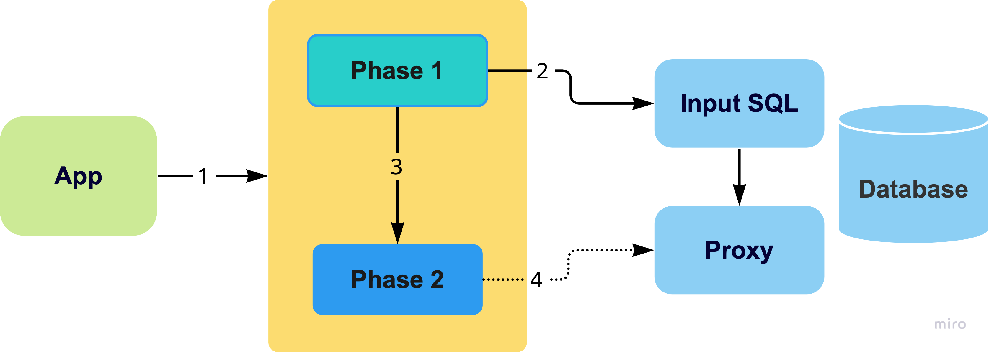
Life cycle of transactions in Seata

Slide 4
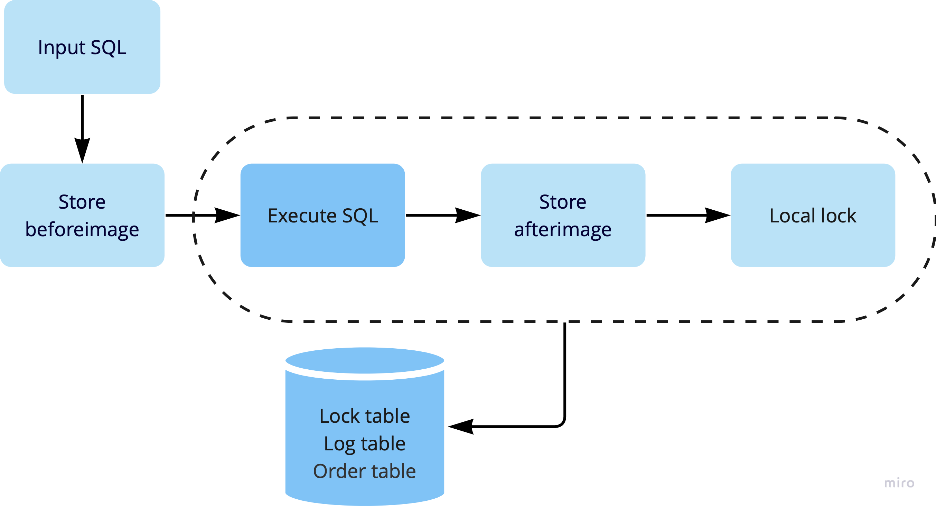
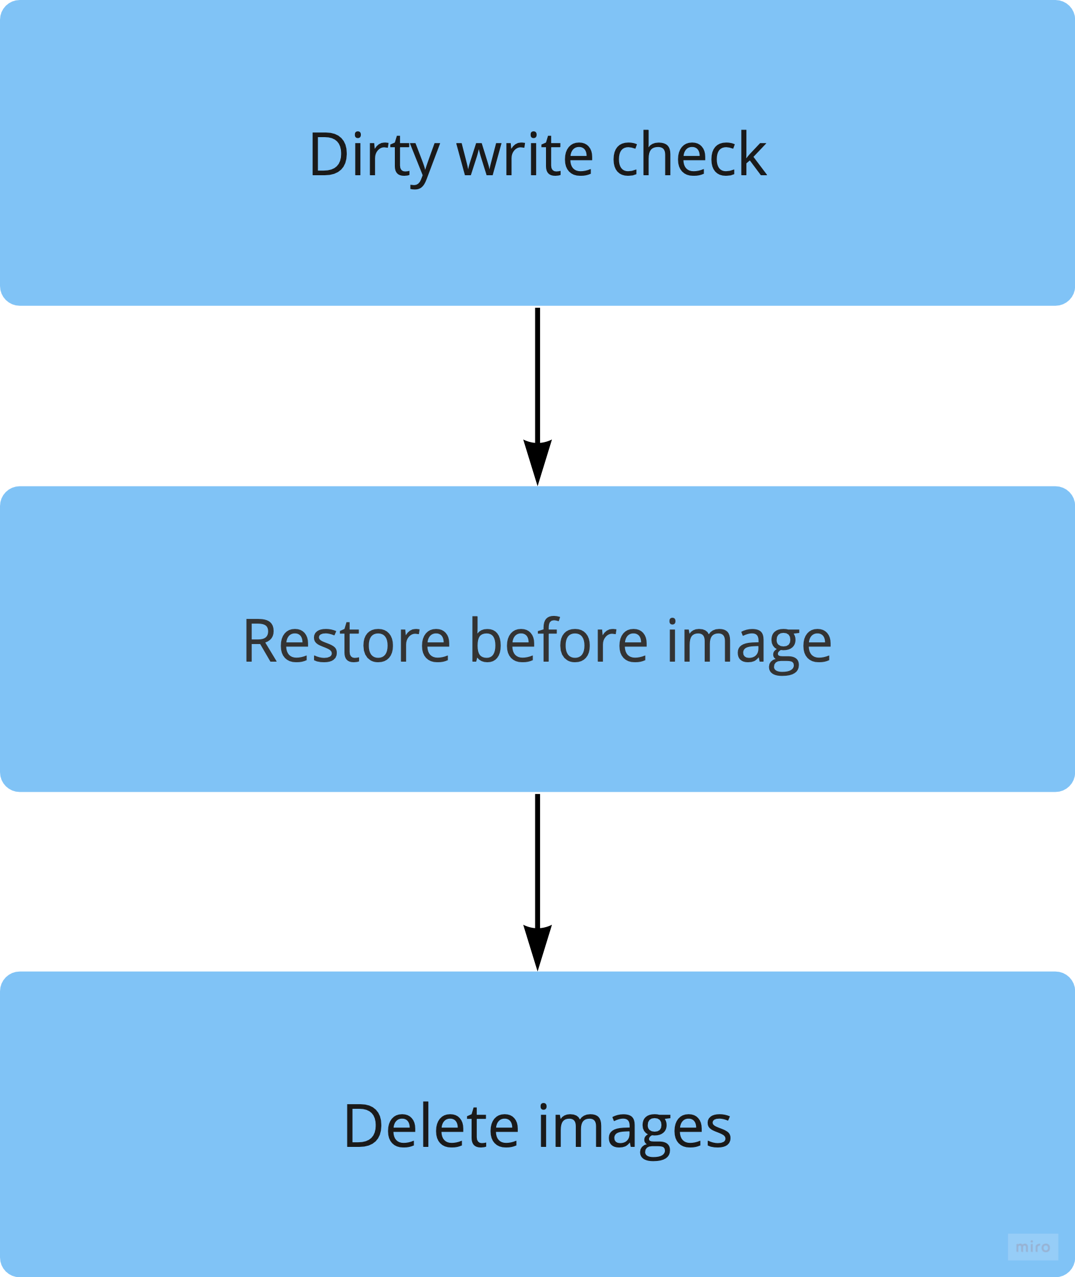
Phase 1
Seata AT mode
Phase 1：commit business data and rollback log in the same local transaction, then release local lock and connection resources.
Phase 2：
for commit case, do the work asynchronously and quickly.
for rollback case, do compensation, base on the rollback log created in the phase 1.
Phase 2

Slide 5
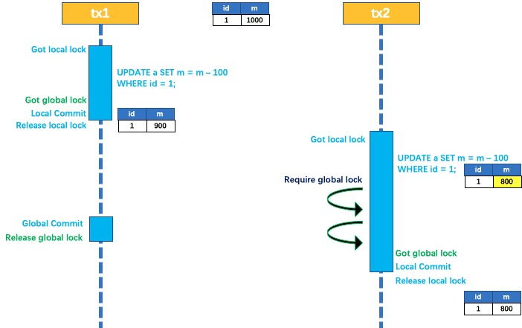
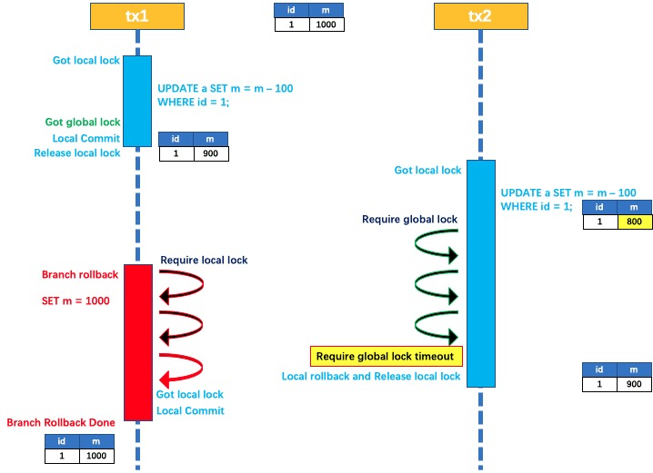
Method of transaction execution

Slide 6
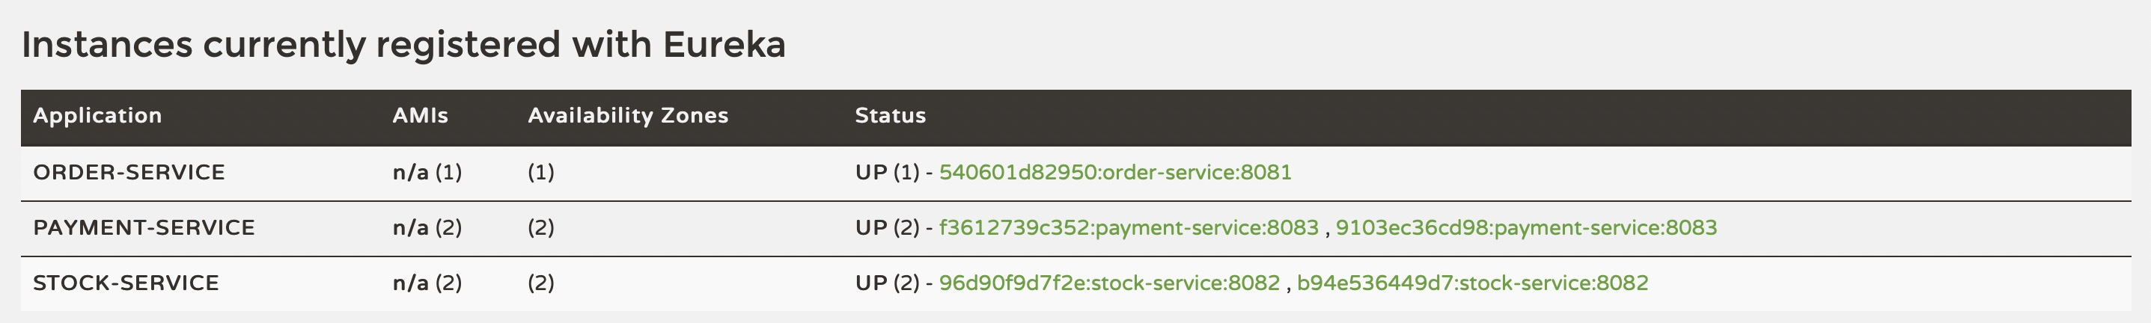
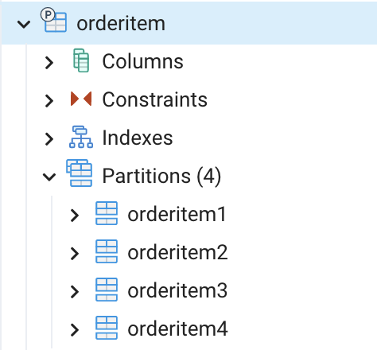
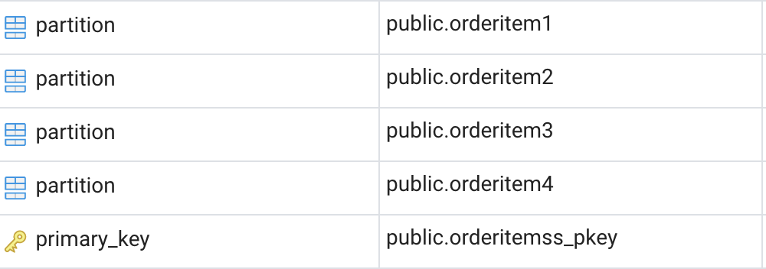
Multiple Eurake & Micro-services
Read Scalability- Database Replica
Add additional databases
Write Scalability- Table Partitioning
Divide each table into four sub-tables.
Method of scalability & fault-tolerance
09-10-2020
Notes:
(The sub-table keep consistent with the parent table, and only provides readable functions)

Slide 7
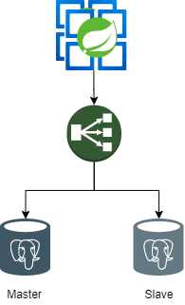
Pgpool-II manages Postgresql service instances and provides connection pooling, load balancing, automated failover, and replication.
Seata, Eureka and Databases are deployed as K8s StatefulSets
Scaling up by updating K8s replica configurations
Method of scalability & fault-tolerance
09-10-2020
Notes:
(The sub-table keep consistent with the parent table, and only provides readable functions)

Slide 8
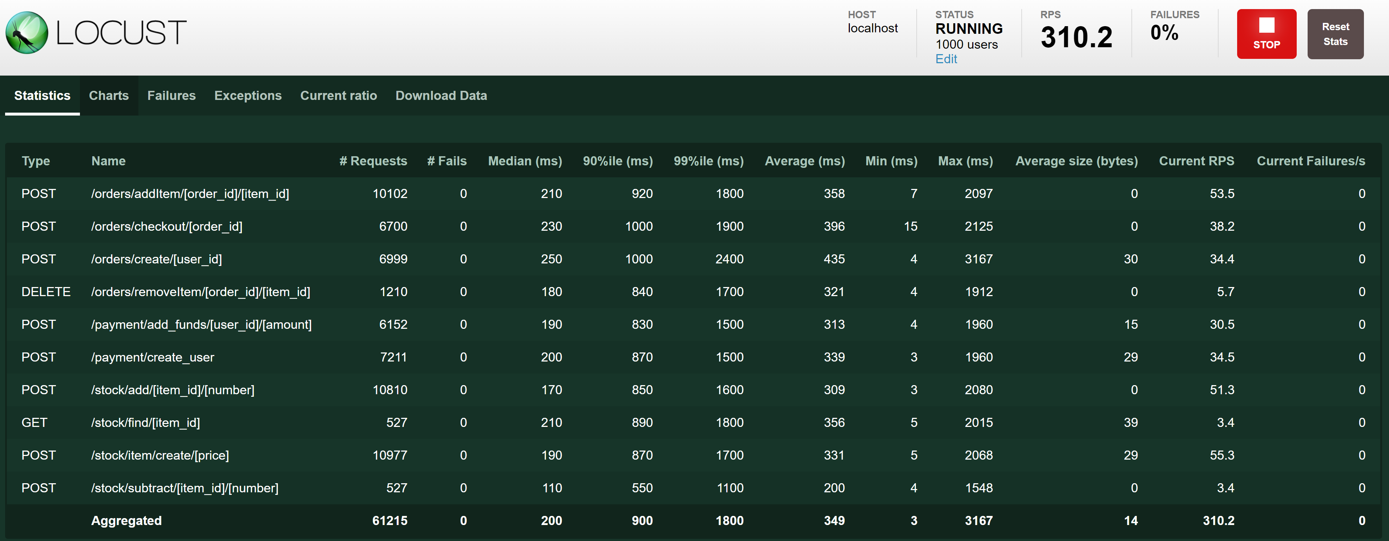
Results
- Consistency test passed with 0 inconsistencies in payment and stock log and databases
-
09-10-2020

Slide 9
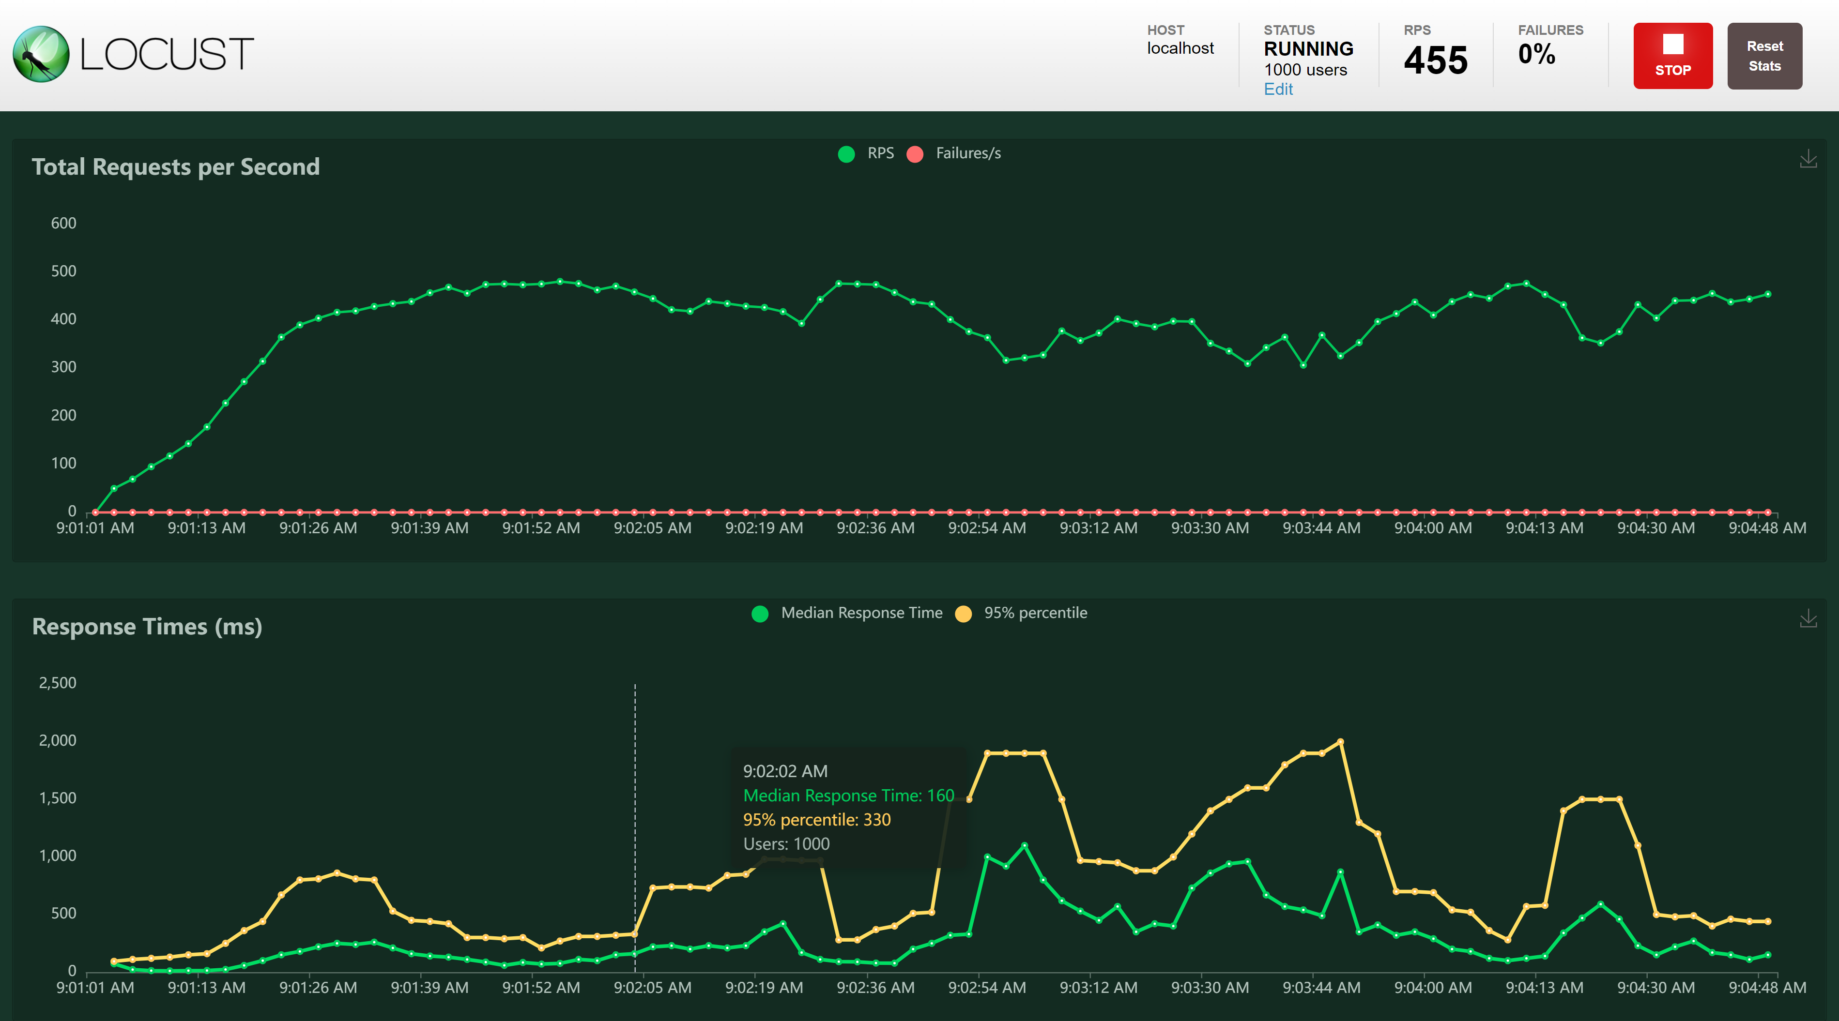
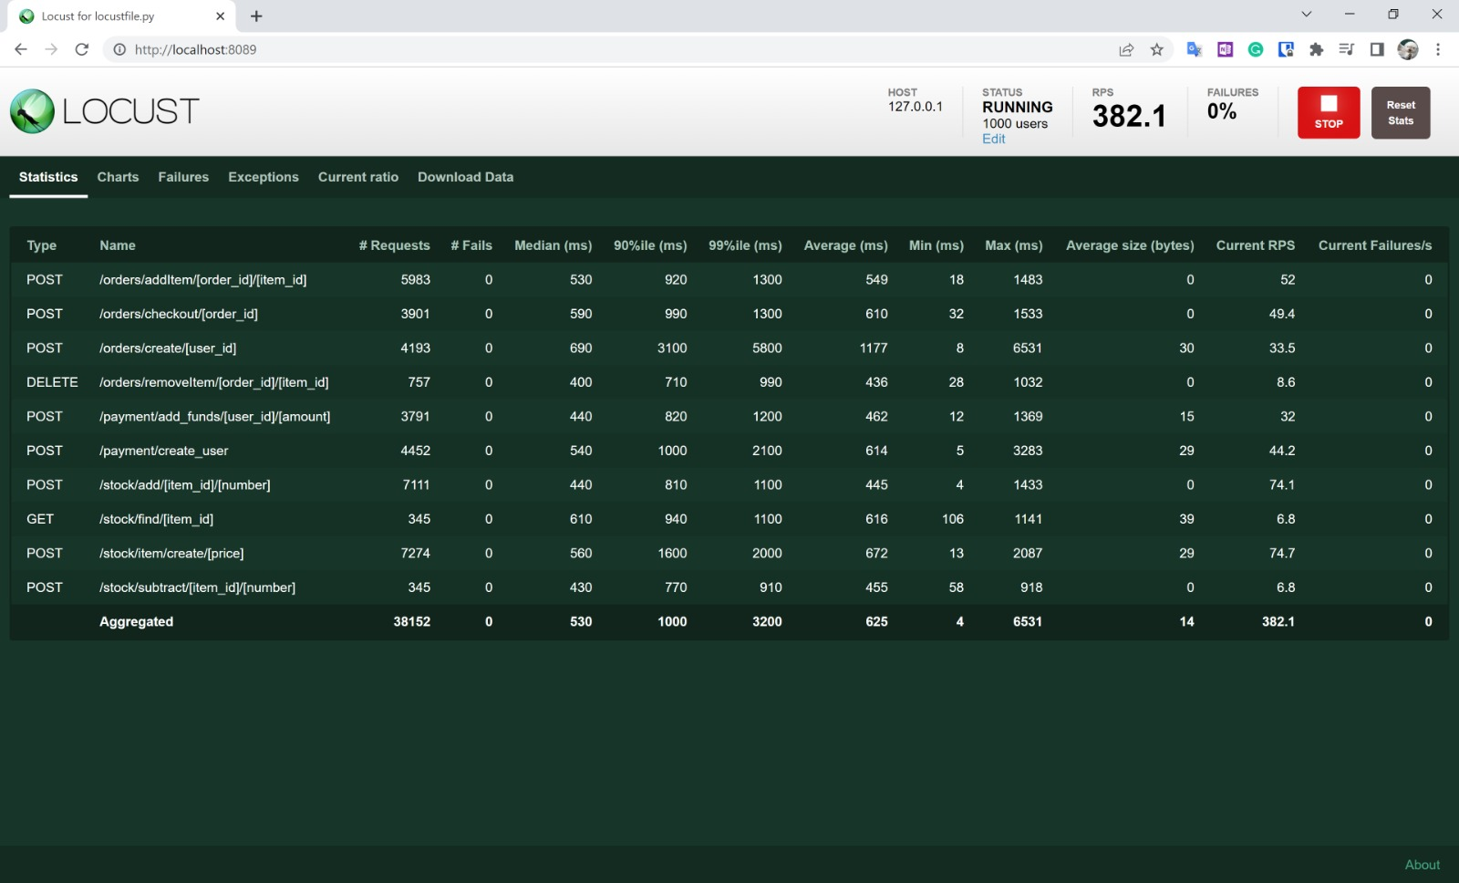
Results
09-10-2020

Slide 10
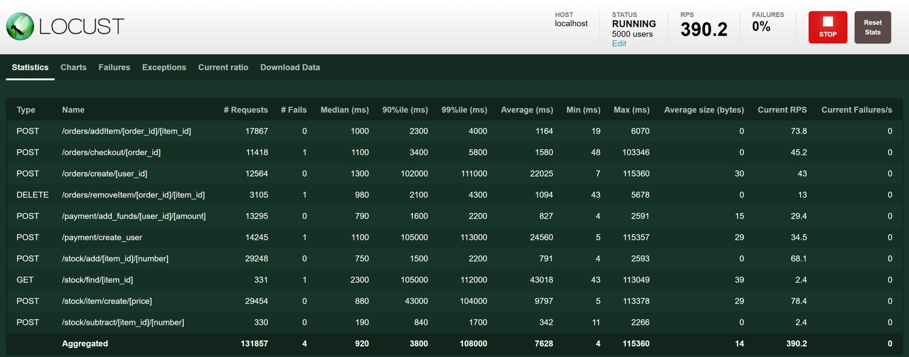
Results
09-10-2020

Slide 11
Q&A

