Slide 1


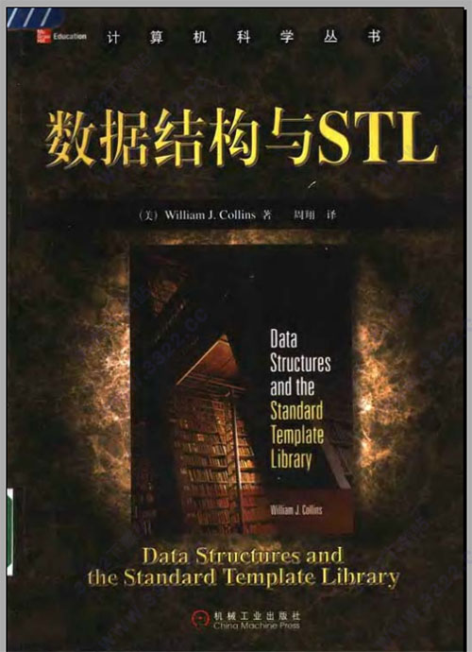
This Course is intended for studying Data Structures and algorithms using C++ and STL.
Textbook: William J. Collins. Data Structure and the Standard Template Library（影印版）. 北京:机械工业出版社. 2003年3月.
References:
[1] William J. Collins，数据结构与STL（中文版），机械工业出版社. 2003.
[2] Mark Allen Weiss, 数据结构与算法分析:Java语言描述, 机械工业出版社, 2016.
[3] 迈克尔 T. 古德里奇，罗伯特·塔马, 数据结构与算法：Python语言实现, 机械工业出版社, 2018.
[4]Michael Main, Walter Savitch, Data Structures and Other Objects Using C++，科学出版社，2012.
[5] Matthew H.Austern. 泛型编程与STL（影印版）,中国电力出版社, 2003年11月

Slide 2

目标1（工程知识）： 掌握数据结构的基本概念和基本原理，深刻理解数据逻辑结构、存储结构和运算算法设计之间的关系，能够从求解问题中提炼出数据模型并准确采用抽象数据类型进行描述。
目标2（问题分析）： 掌握常用数据结构的实现过程及应用，针对逻辑结构特点设计相应的存储结构和高效算法。在求解复杂工程问题时，能选择合适的数据结构和标准库的容器类，用以表达和构建软件，具备基本的数据表示和数据处理能力。
目标3（研究）： 基于专业知识，在理论上能够对算法进行时间和空间复杂度分析，能够判断在实际问题中数据结构和算法的适用性。掌握数据结构的实验方法，能够根据需要开展实验研究，正确描述数据、组织数据和实现算法，分析实验结果并获得合理有效的结论。

Slide 3
Labs: 20%
Usual grade: 10%
Final Test: 70%

Slide 4
What is Data Structure?
Data structure refers to a collection of data elements with interrelationships and structures, including data logical structure, data storage structure, and data operation.

Slide 5


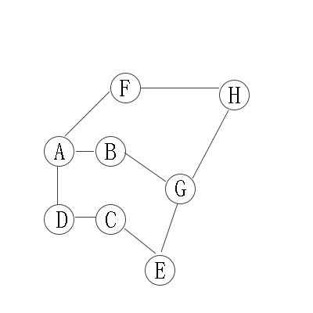
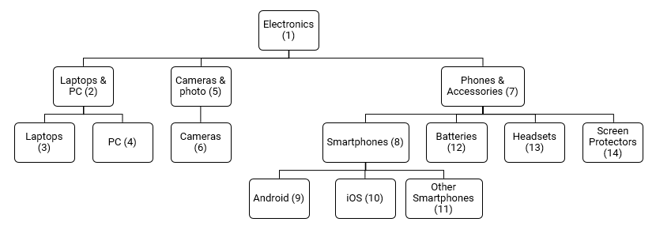
Data logical structure
Set
Linear structure
Tree structure
Graph structure

Slide 6
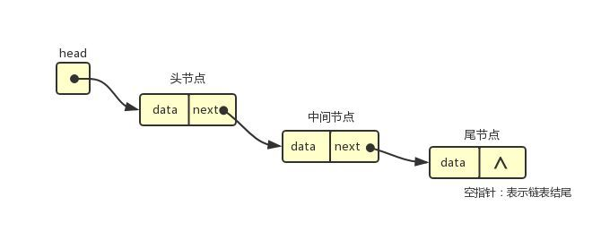
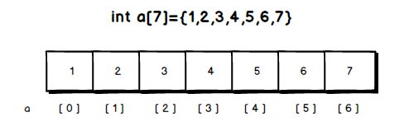
Data Storage Structure
struct person{
string Name;
string Email;
int Age;
bool Status;
};
struct node{
float data;
node* next;
};
node *head;

Slide 7
Data Operation
The purpose of storing data in a computer is to implement one or more operations.
The operations are also called algorithms.

Slide 8
Why data structures is important?
Programs = data structures + algorithms
Software = data structures + algorithms + documents
For each data structure, understand its data logical structure, data storage structure, and data operation.

Slide 9
How to learn this course well?
Read the text book carefully and be able to read other English technical materials.
Try to verify the code in the textbook.
Try to complete the lab on your own.
Love the programming and get used to think in programming logic.
Books for extended reading:
[1] Bruce Eckel, Chuck Allison, Think in C++(C++编程思想), 机械工业出版社，2011 (Think in Java/C#....)
[2] Scott Meyers, Effective C++:改善程序与设计的55个具体做法(第3版), 电子工业出版社, 2011 (Effective Java....)

Slide 10
Some important issues in learning C++:
Execute Sequence for whole program, constructor, destructor etc.
What happens in initializing the class?
The above issues are more complicated if we consider the inheritance case.
Using operators and expressions in C++.
Using pointer to implement dynamic memory allocation in C++.

Slide 11
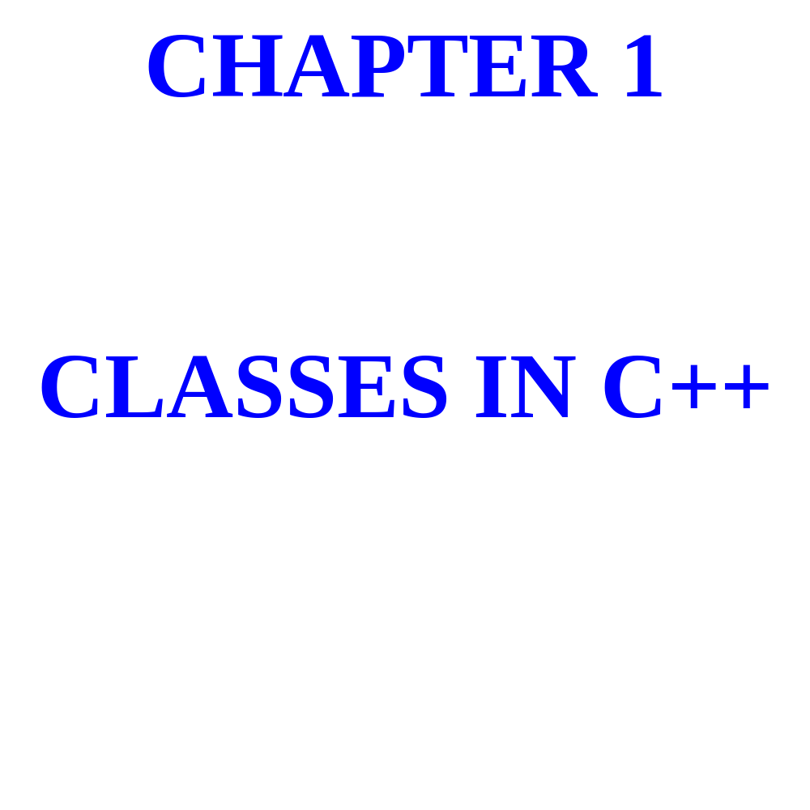

Slide 12
A class consists of variables,
Called fields, together with
Functions, called methods,
That act on those fields.

Slide 13
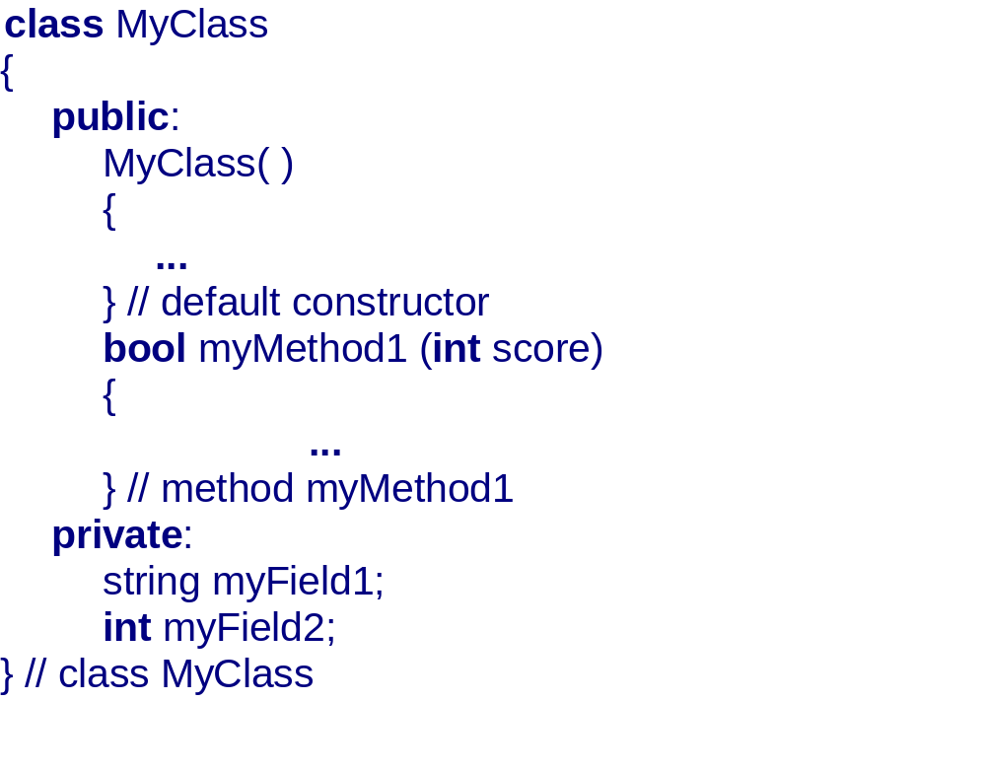

Slide 14
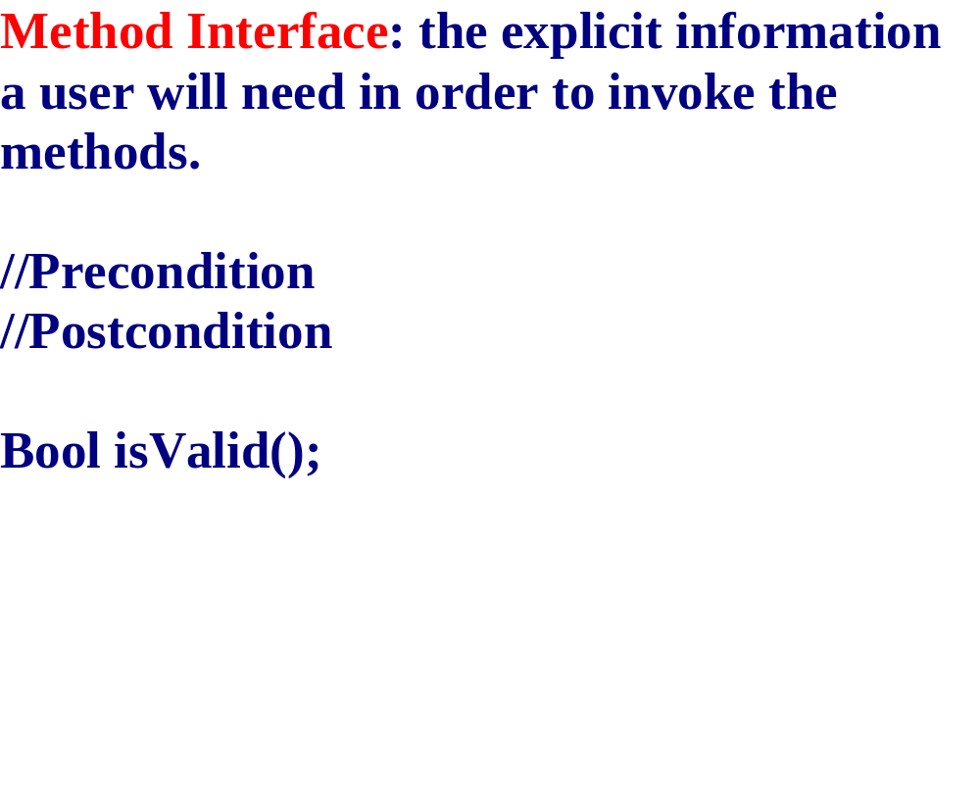

Slide 15
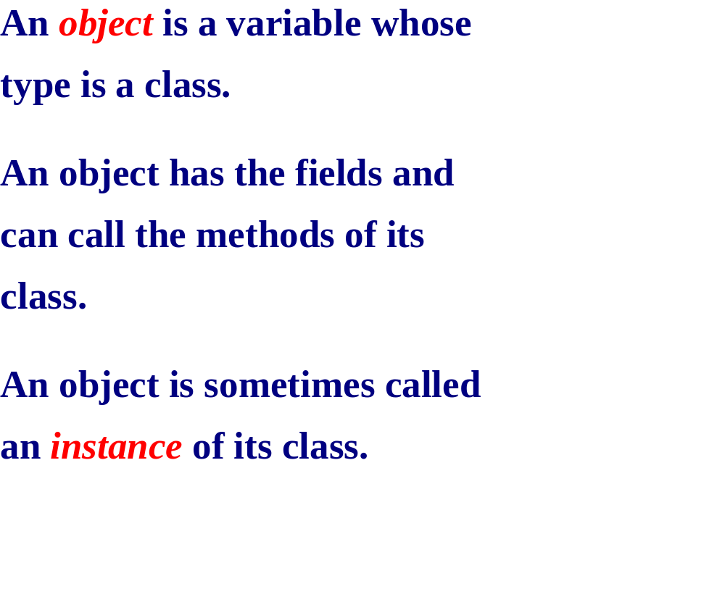

Slide 16
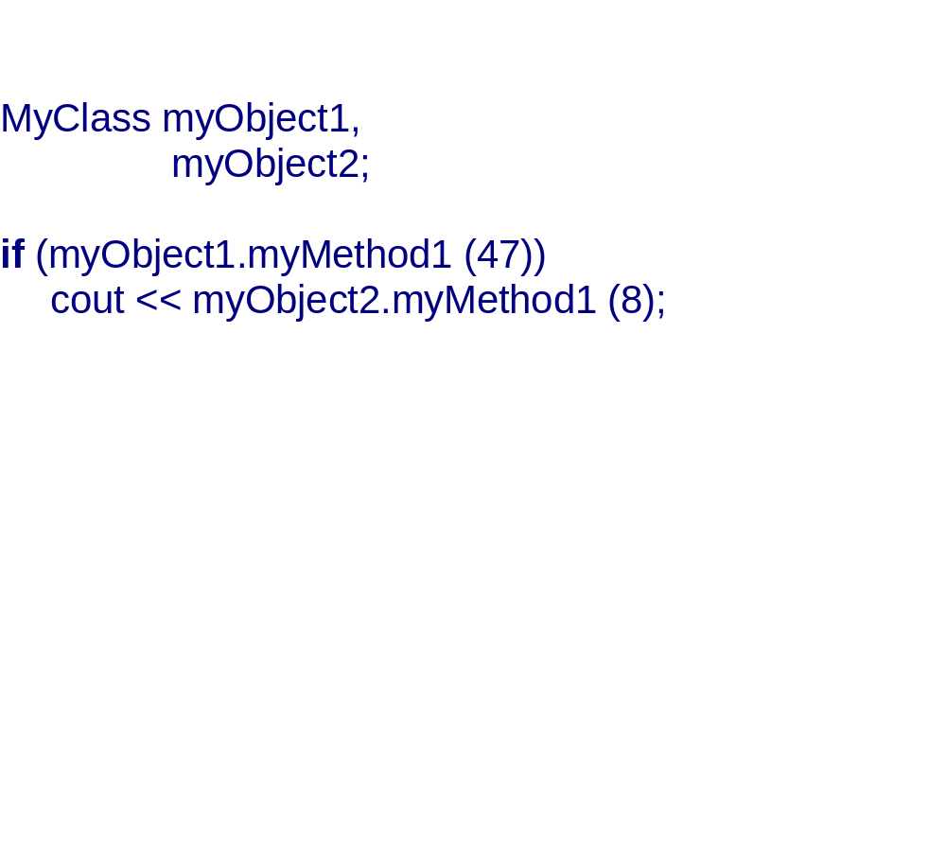

Slide 17

USER’S VIEW OF A CLASS:
METHOD INTERFACES
(= PRECONDITION + POSTCONDITION
+ METHOD HEADING)
DEVELOPER’S VIEW OF A CLASS:
FIELDS AND METHOD DEFINITIONS

Slide 18
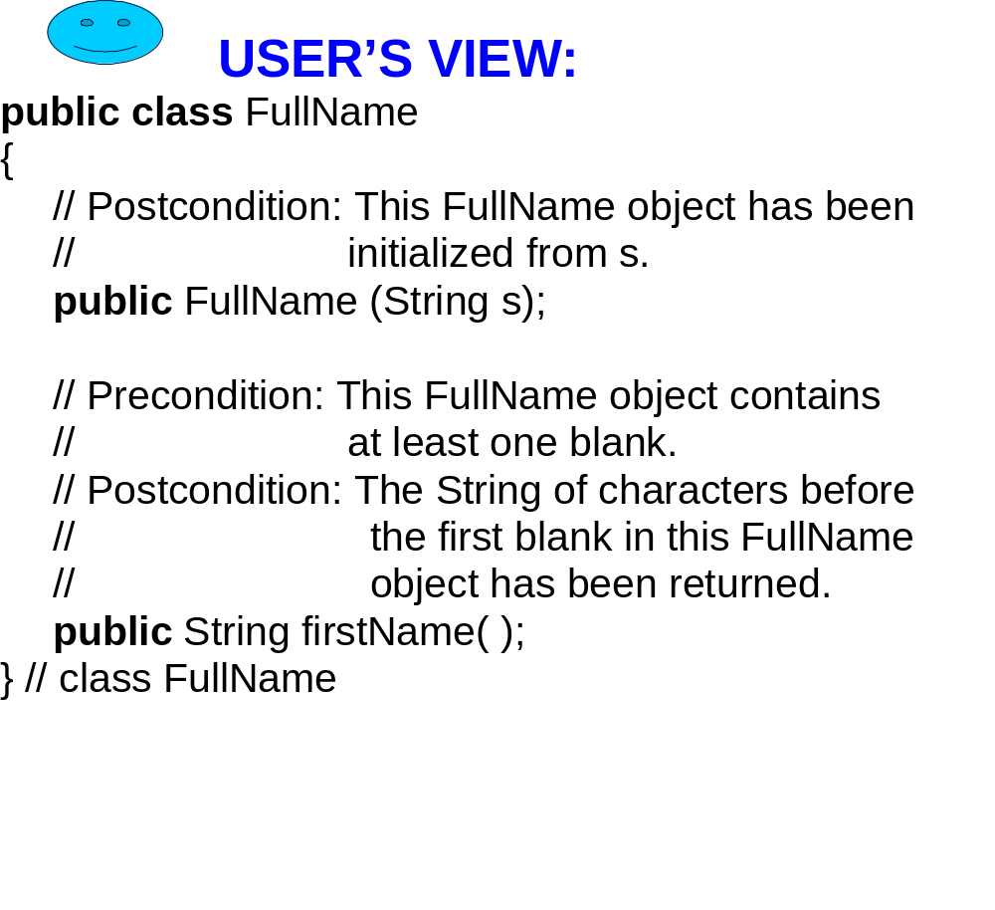

Slide 19
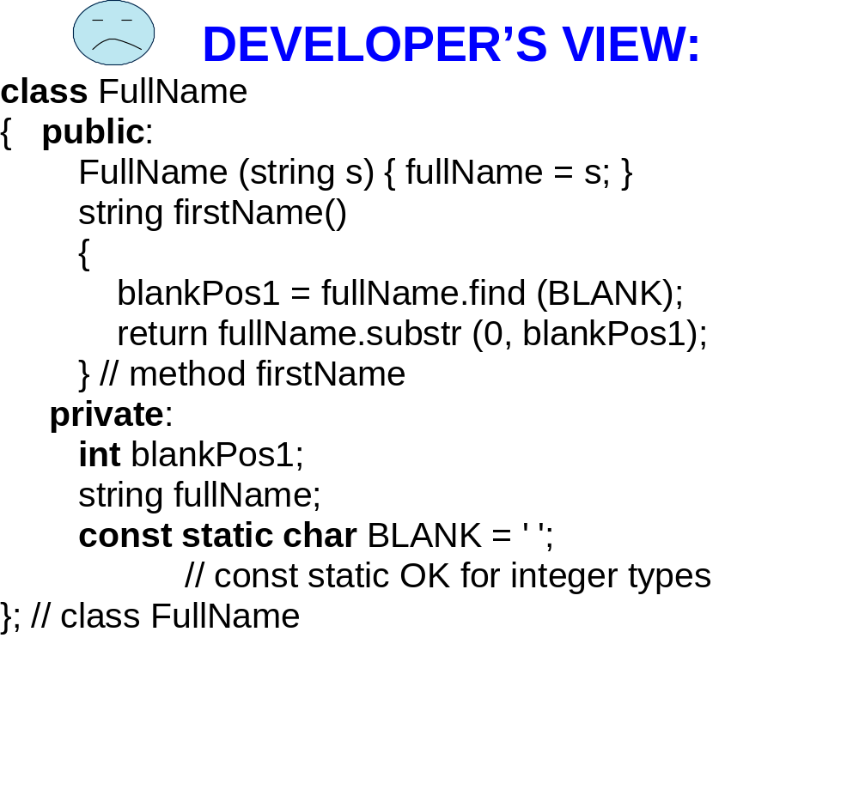

Slide 20
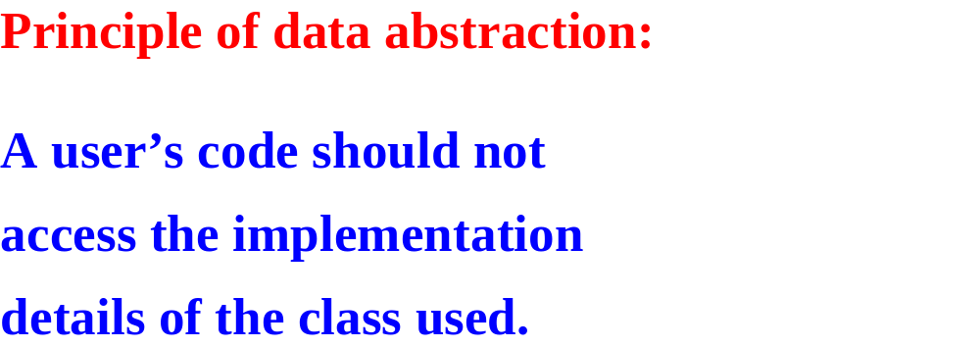

Slide 21
BEST-PAID EMPLOYEE IN A COMPANY?
CREATE A CLASS CALLED Employee.
THE INFORMATION AVAILABLE ON EACH EMPLOYEE CONSISTS OF THE EMPLOYEE’S NAME AND GROSS PAY.

Slide 22
THE Employee CLASS
USER’S VIEW

Slide 23
THE Employee CLASS: USER’S VIEW
// Postcondition: this Employee's name has been set to
// “” and gross pay to 0.00.
Employee( );

Slide 24
THE Employee CLASS: USER’S VIEW
// Postcondition: This Employee's name has been set to
// “” and gross pay to 0.00.
Employee( );
NOTE: In the above postcondition, and in
The postconditions that follow, “this
Employee” refers to the calling object: the
Object that called the method.

Slide 25
THE Employee CLASS: USER’S VIEW
// Postcondition: The name and gross pay of this
// Employee been read in.
void readInto( );

Slide 26
THE Employee CLASS: USER’S VIEW
// Postcondition: true has been returned if this
// Employee is the sentinel. Otherwise, // false has been returned.
bool isSentinel( ) const;
NOTE: the reserved word const at the end
of the method heading means that the
definition of the method is not allowed
to modify the calling object.

Slide 27
THE Employee CLASS: USER’S VIEW
// Postcondition: true has been returned if this
// Employee's gross pay is greater than
// that of otherEmployee. Otherwise, false
// has been returned.
bool makesMoreThan (const Employee&
otherEmployee) const;

Slide 28
THE Employee CLASS: USER’S VIEW
// Postcondition: true has been returned if this
// Employee's gross pay is greater than
// that of otherEmployee. Otherwise, false
// has been returned.
bool makesMoreThan (const Employee&
otherEmployee) const;
DEFINITION NOT ADDRESS OF ARGUMENT ALLOWED TO MODIFY SENT, NOT A COPY
ARGUMENT OF ARGUMENT
(PROVIDES SECURITY) (SAVES TIME AND SPACE)

Slide 29
THE Employee CLASS: USER’S VIEW
// Postcondition: this Employee contains a copy of
// otherEmployee.
void getCopyOf (const Employee& otherEmployee);
// Postcondition: this Employee's name and gross pay
// have been written out.
void printOut( ) const;

Slide 30
Employee OBJECTS
Employee employee1,
employee2;
employee1.readInto( );
employee2.readInto( );
if (employee1.makesMoreThan (employee2))
employee1.printOut( );
else
employee2.printOut( );

Slide 31
THE Employee CLASS:
DEVELOPER’S VIEW employee1.h (THE HEADER FILE)
#ifndef EMPLOYEE
#define EMPLOYEE
#include <string> // declares string class using namespace std; class Employee
{

Slide 32
THE Employee CLASS:
DEVELOPER’S VIEW employee1.h (continued) public:
// Postcondition: this employee's name has
// been set to "" and gross pay
// to 0.00.
Employee( );
// method interfaces for other methods

Slide 33
THE Employee CLASS:
DEVELOPER’S VIEW employee1.h (continued) private: string name; double grossPay; const static double GROSS_PAY_SENTINEL; const static string EMPTY_STRING; const static string NAME_SENTINEL;
}; // Employee
#endif

Slide 34
THE Employee CLASS:
DEVELOPER’S VIEW employee1.cpp (THE SOURCE FILE )
#include <iostream>
#include <iomanip> // declares output formatting objects
#include "employee1.h" // declares Employee class

Slide 35
THE Employee CLASS:
DEVELOPER’S VIEW employee1.cpp (continued )
Employee::Employee( )
{ name = EMPTY_STRING; grossPay = 0.00;
} // default constructor

Slide 36
scope-resolution employee1.cpp (continued ) operator (the readInto method in void Employee::readInto( ) the Employee class)
{ const string NAME_AND_PAY_PROMPT =
"Please enter a name and gross pay, to quit, enter "; cout << NAME_AND_PAY_PROMPT
<< NAME_SENTINEL << " "
<< GROSS_PAY_SENTINEL; cin >> name >> grossPay;
} // readInto

Slide 37
employee1.cpp (continued )
// definitions of other employee methods
... const string Employee::EMPTY_STRING = ""; const string Employee::NAME_SENTINEL = "*"; const double Employee::GROSS_PAY_SENTINEL =
-1.0;

Slide 38
APPLICATION:
FIND THE BEST PAID EMPLOYEE
IN A COMPANY.

Slide 39
The Company Class: User’s View
// Postcondition: this Company has been initialized.
Company( );
// Postcondition: this Company’s best‑paid employee
// has been determined.
void findBestPaid( );
// Postcondition: this Company’s best‑paid employee
// has been printed out.
void printBestPaid( ) const;

Slide 40
THE Company CLASS: DEVELOPER’S VIEW
SEE LAB 1

Slide 41
EXERCISE: To get things started,
The main function must define a
Company object. Provide that
Definition. WHAT FILE (employee1.H,
Employee1.Cpp, company1.H, company1.Cpp)
Must be included in the class that has the main function?

Slide 42
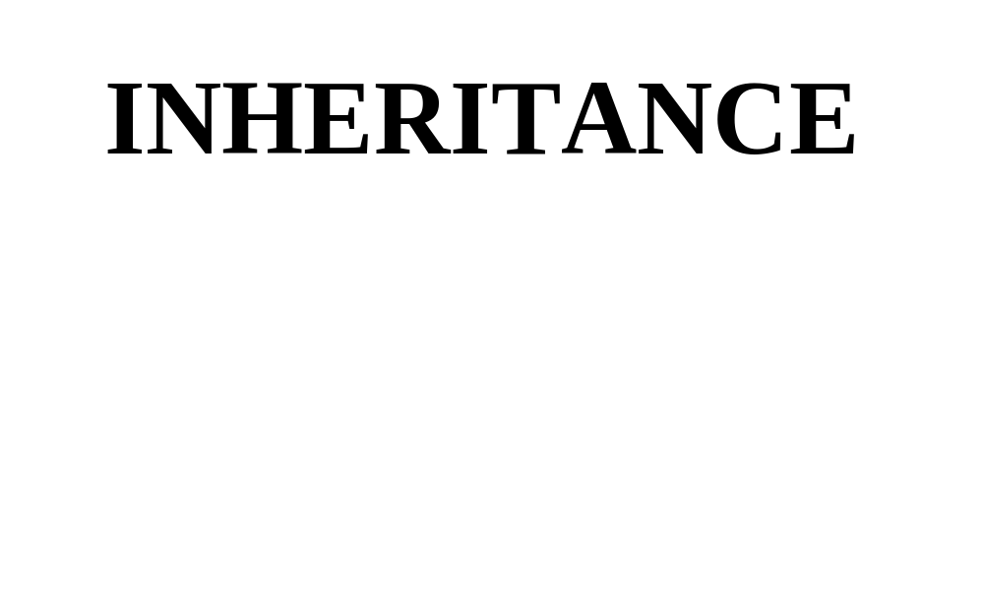

Slide 43
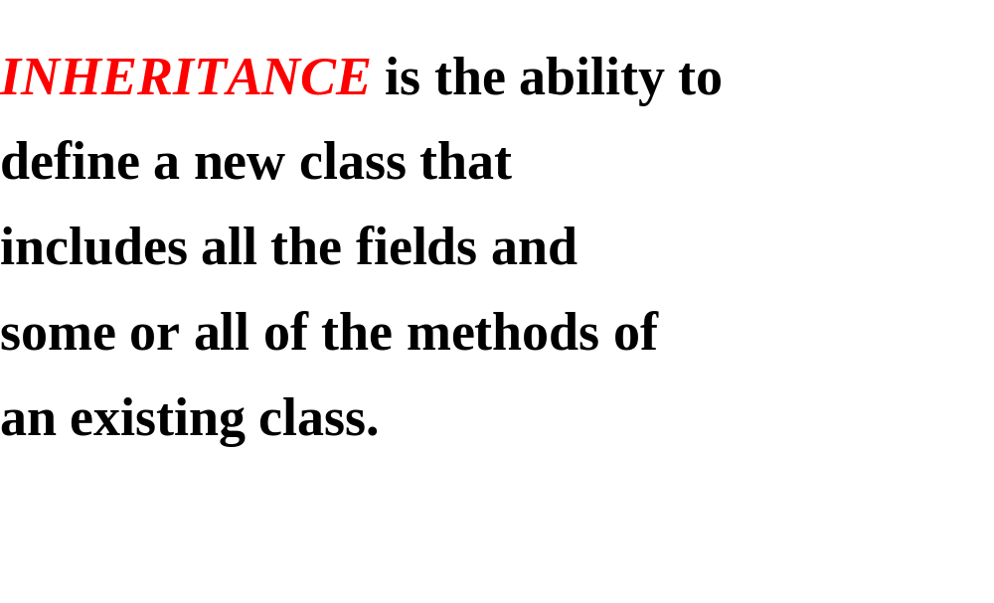

Slide 44
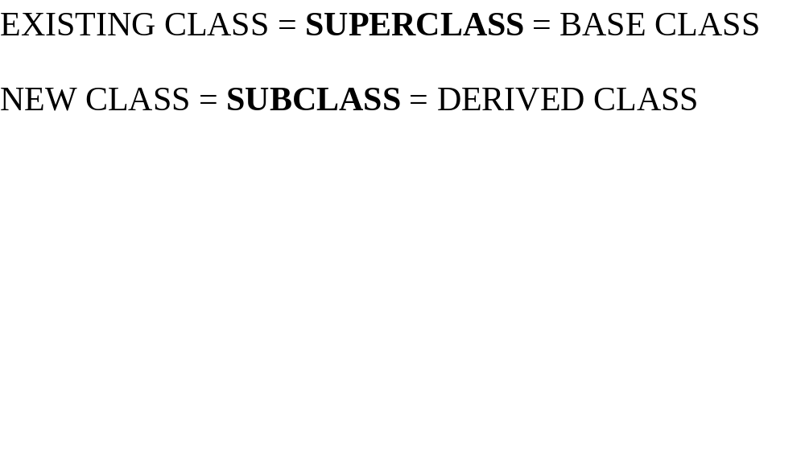
SUPERCLASS
SUBCLASS

Slide 45
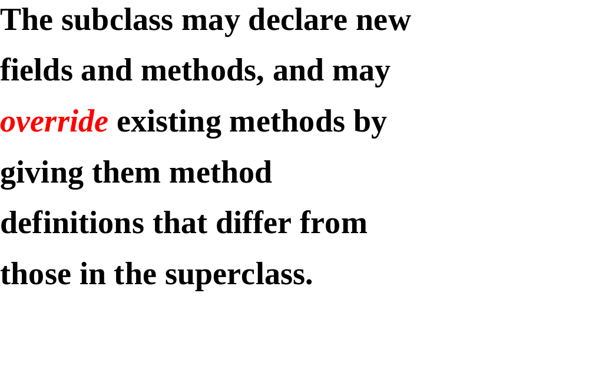

Slide 46
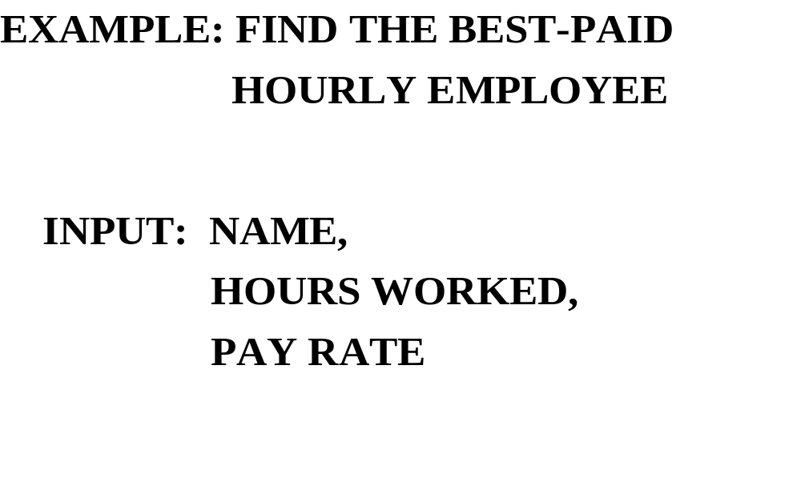

Slide 47
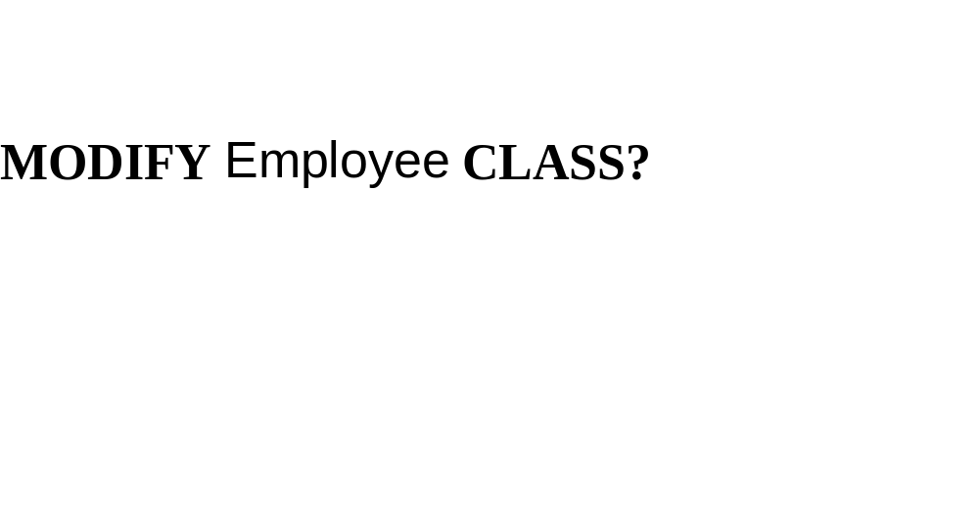

Slide 48
THE OPEN-CLOSED PRINCIPLE
EVERY CLASS SHOULD BE
OPEN: Extendible through inheritance
CLOSED: Stable for existing applications

Slide 49
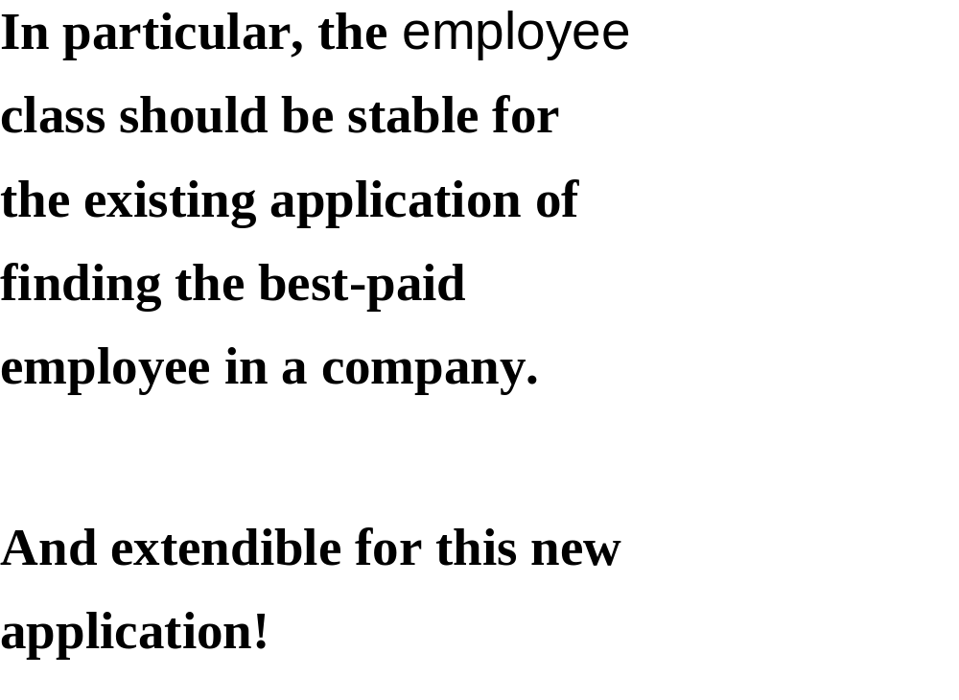

Slide 50
THE NEW CLASS WILL BE
HourlyEmployee
A SUBCLASS OF Employee. WHICH
Employee METHODS WILL BE
OVERRIDDEN?

Slide 51
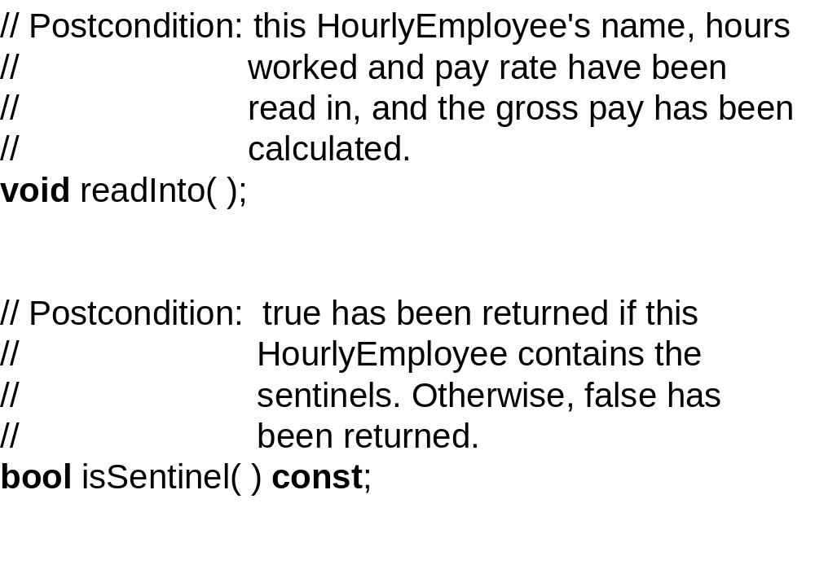

Slide 52
THE makesMoreThan, getCopyOf and
printOut methods are untouched,
and may be called as is by any
HourlyEmployee object
After all, an HourlyEmployee IS AN
Employee!

Slide 53
WHAT FIELDS?
for the new information:
hoursWorked, payRate

Slide 54
WHAT ABOUT name AND grossPay?
According to the definition
of inheritance, the HourlyEmployee
class automatically “inherits”
these two fields.
BUT HOW?

Slide 55
To allow subclass objects to
access superclass fields, those
fields should be given the
protected level of protection.
private IS TOO RESTRICTIVE (SUPERCLASS ONLY)
public IS TOO LAX (ANY CLASS’S CODE CAN ACCESS THE FIELD)

Slide 56
So, in the Employee class, we
change the protection level
for those two fields:
protected:
string name,
double grossPay;

Slide 57
Then those two fields can be
accessed in any Employee class
method, and in any method in any
subclass of Employee.
Here is the declaration of the
HourlyEmployee class (the post-
conditions were given above):

Slide 58
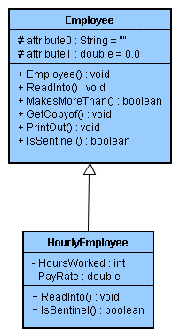

Slide 59
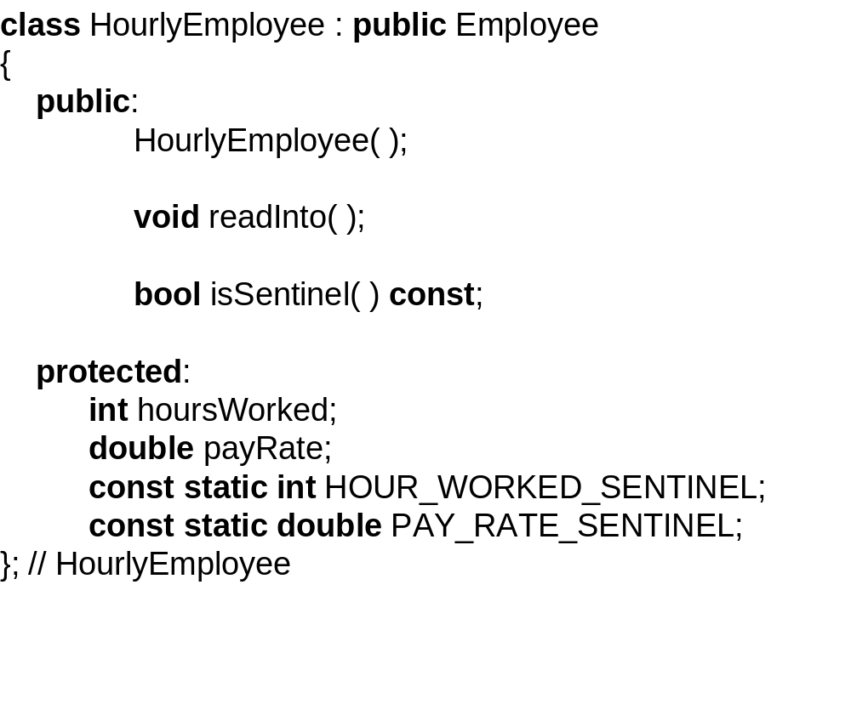

Slide 60
The method definitions are just
what you would expect. for
example, here is the definition
of isSentinel:

Slide 61
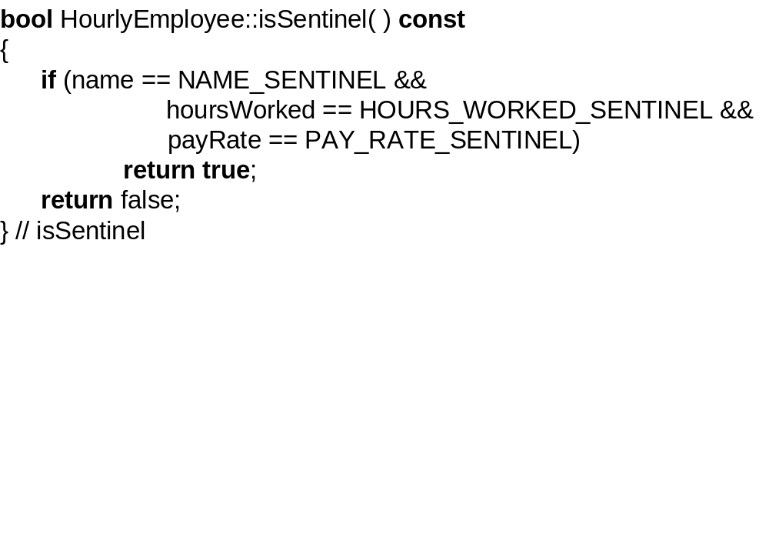

Slide 62
We created this HourlyEmployee
class for the application of
finding the best-paid hourly
employee in a company. can the
original company class use the
HourlyEmployee class for this
new application?

Slide 63
No, because the Company class
makes no mention of an
HourlyEmployee object. so we will
define Company2, a subclass of
Company.
Here is the declaration of the
Company2 class:

Slide 64
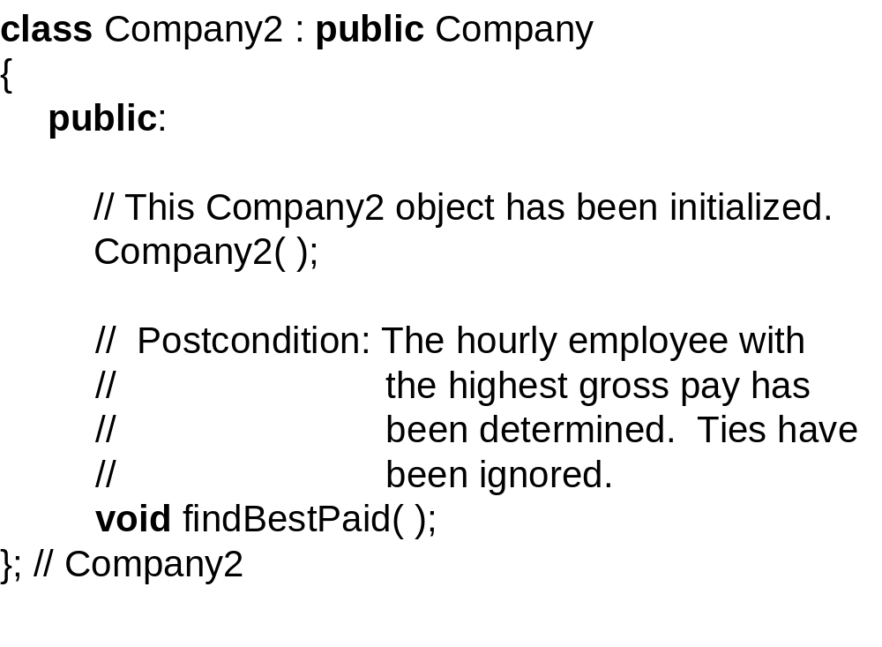

Slide 65
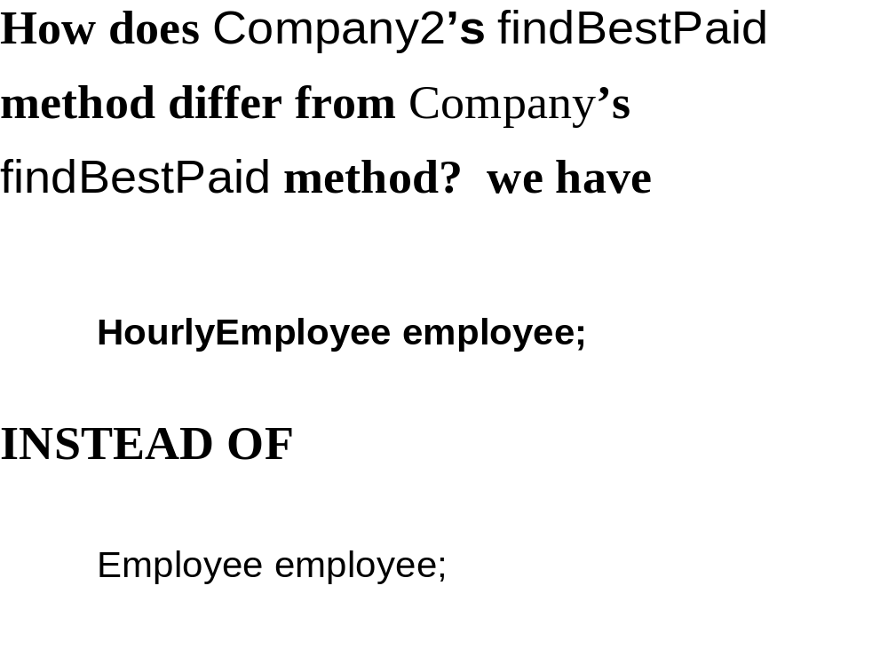

Slide 66
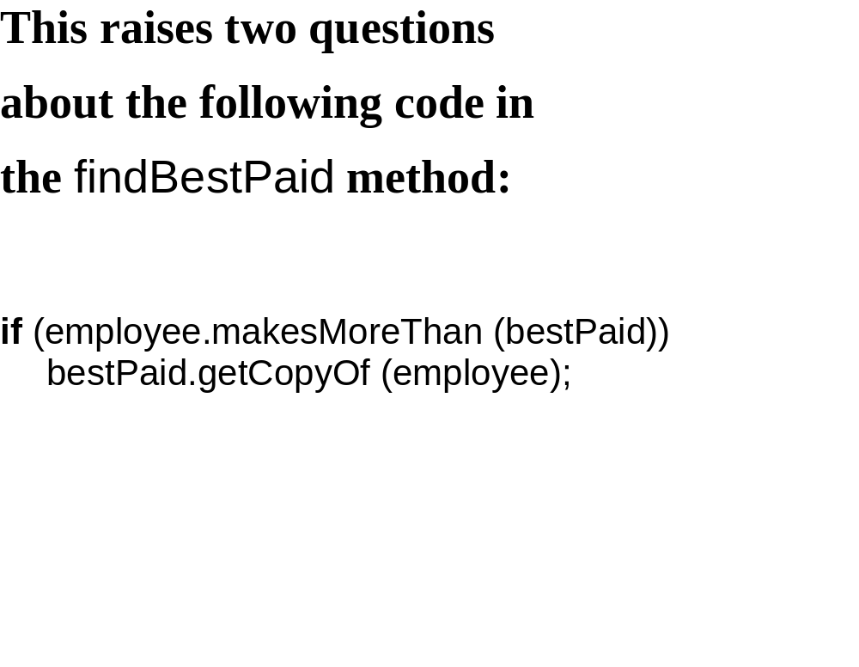

Slide 67
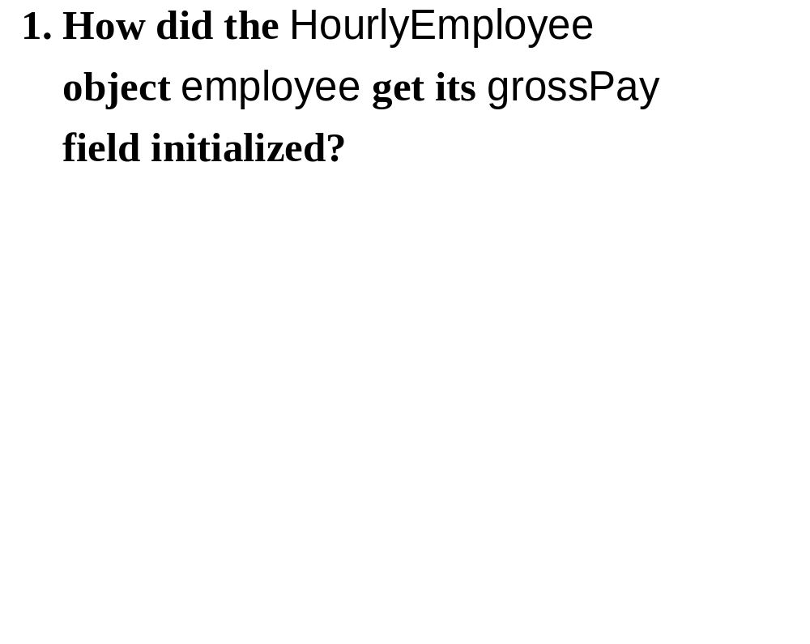

Slide 68
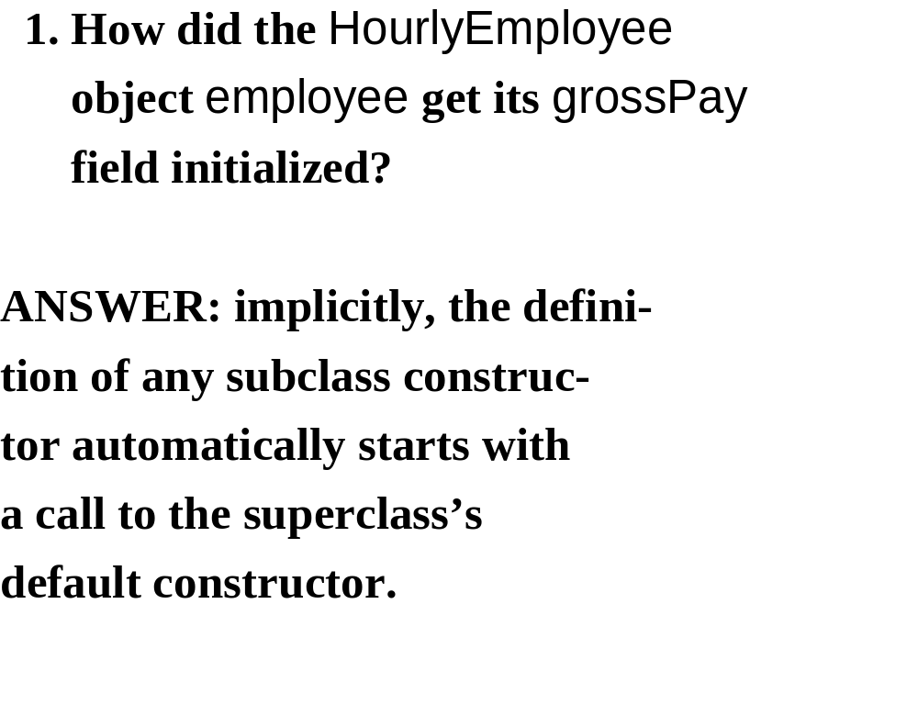

Slide 69
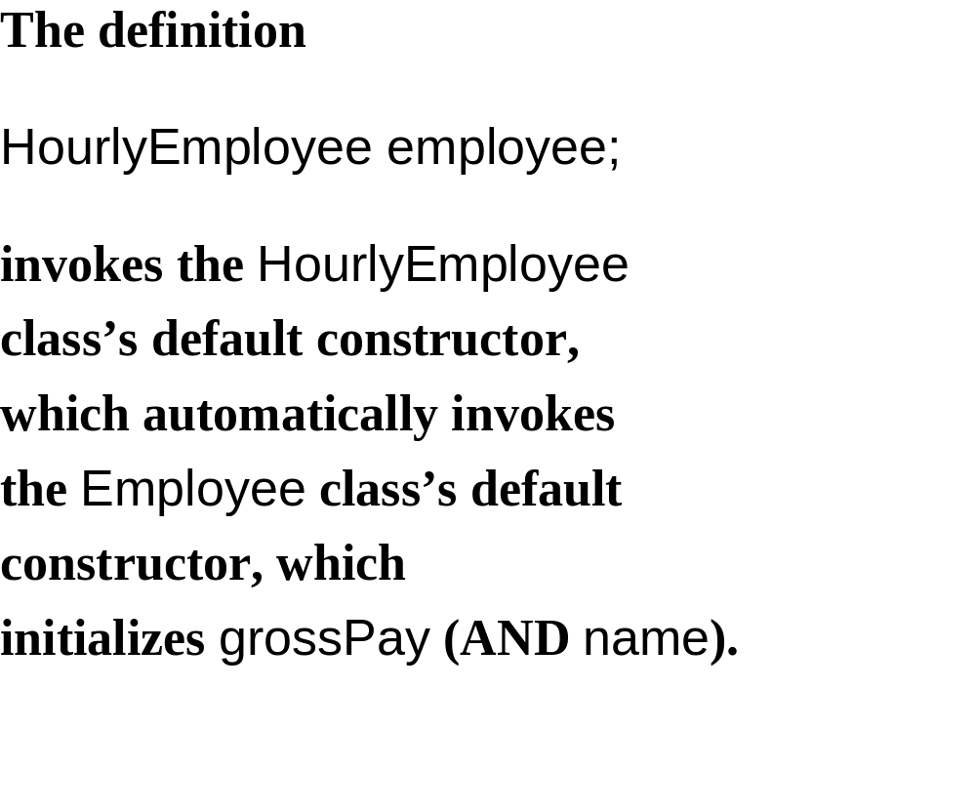

Slide 70
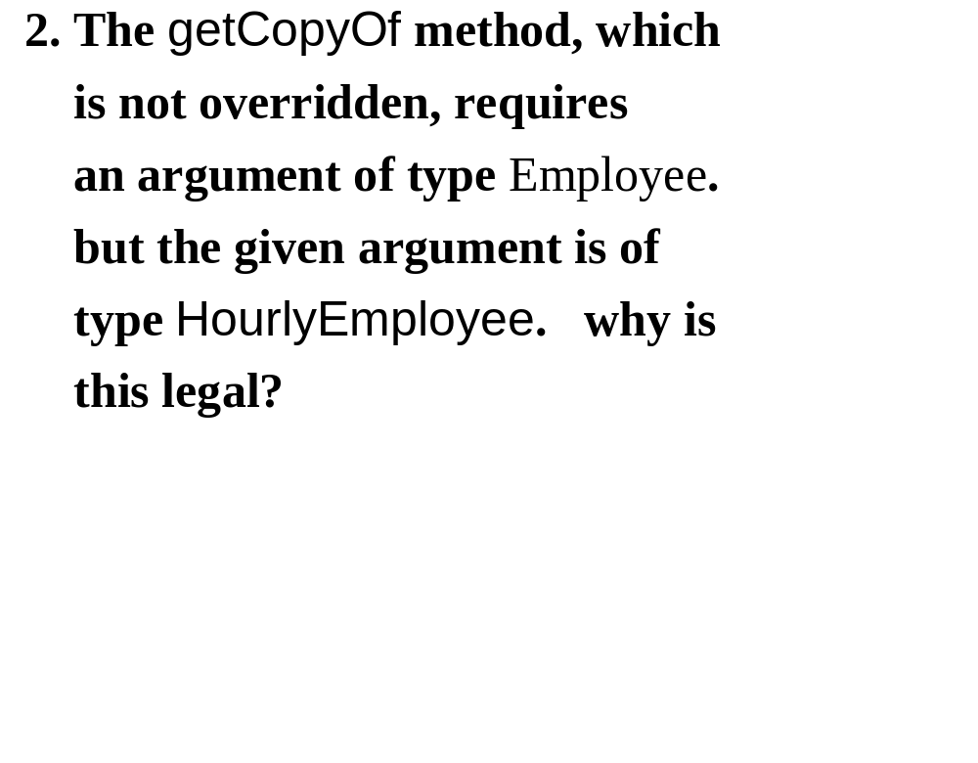

Slide 71
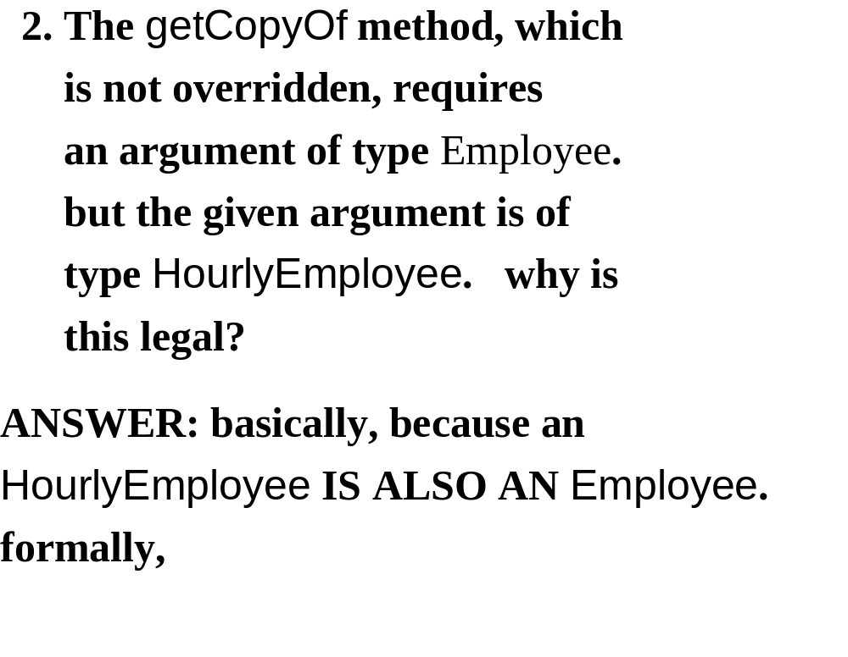

Slide 72
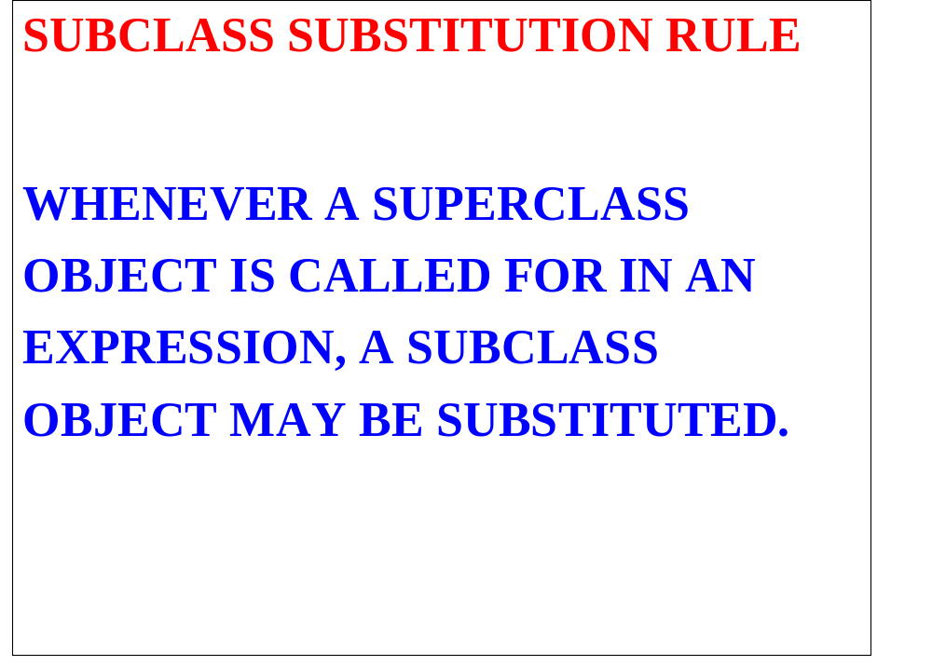

Slide 73
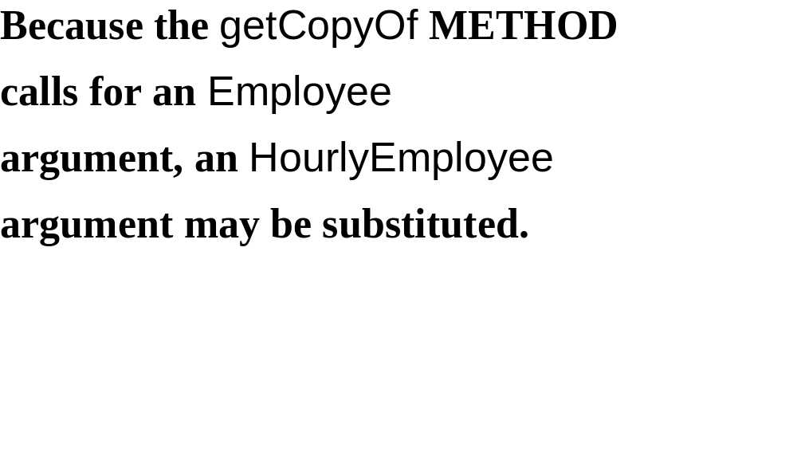

Slide 74


Slide 75
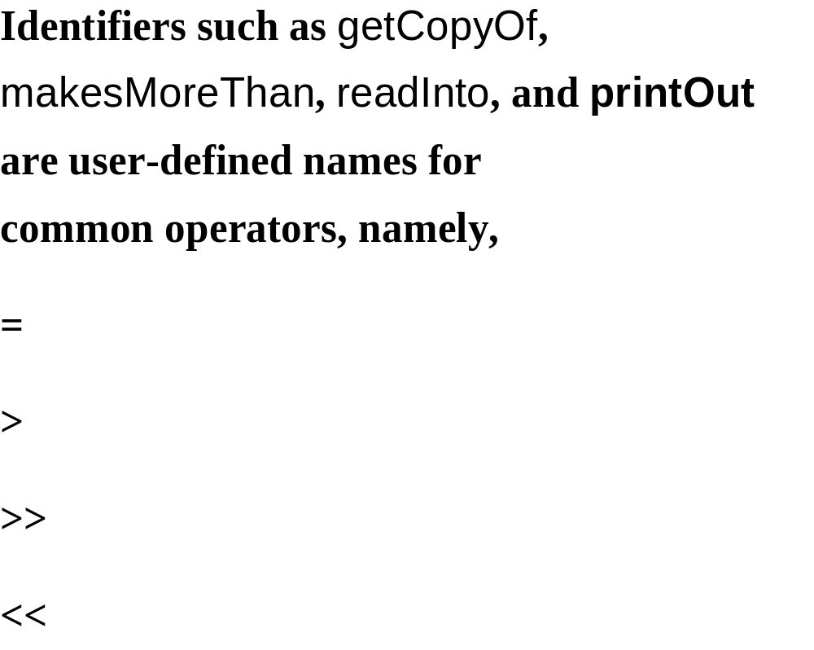

Slide 76
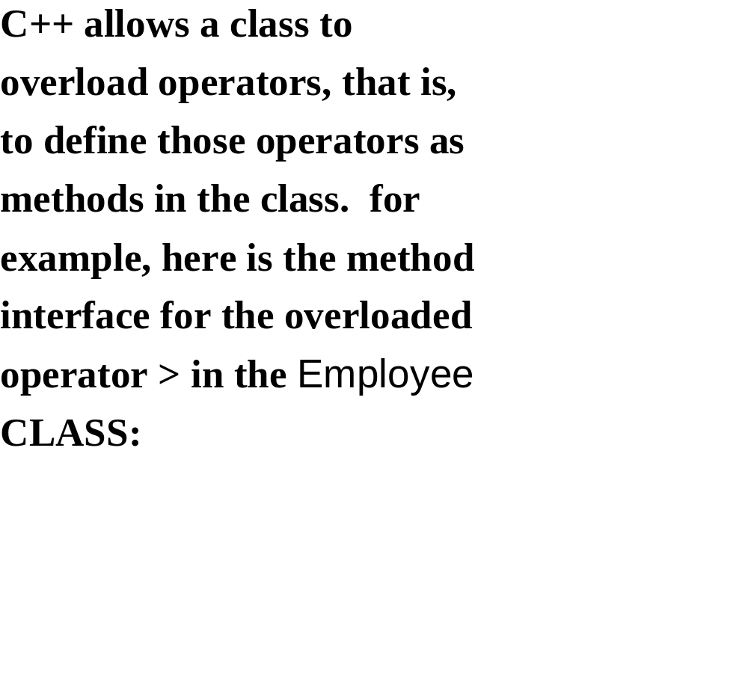

Slide 77
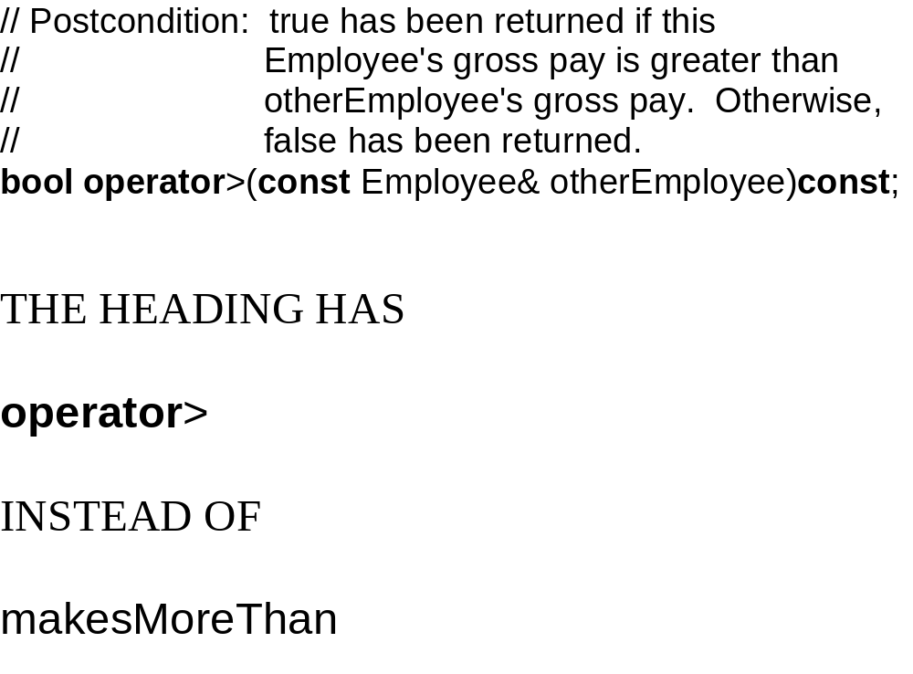

Slide 78
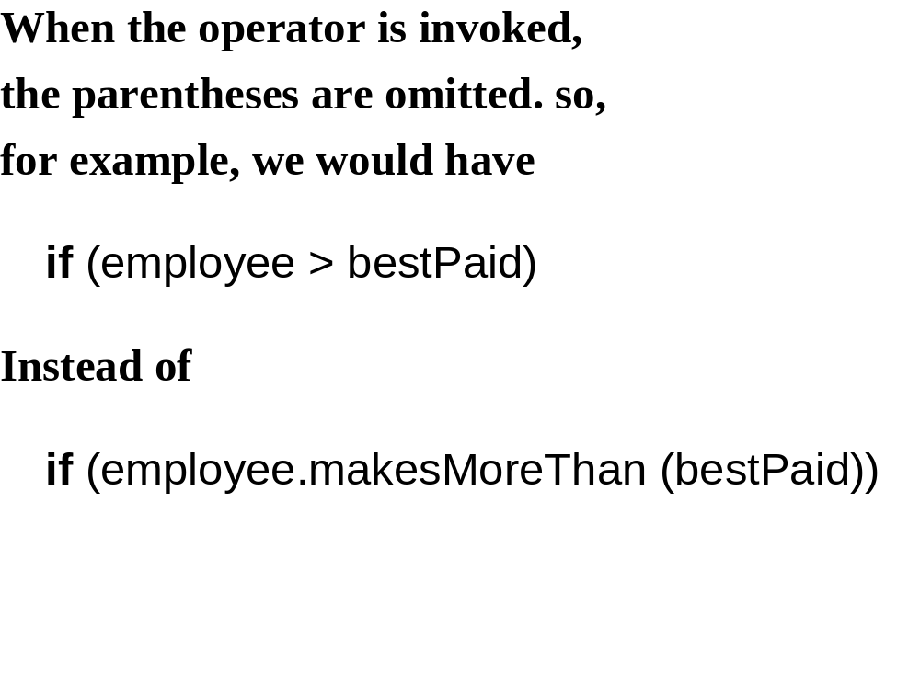

Slide 79
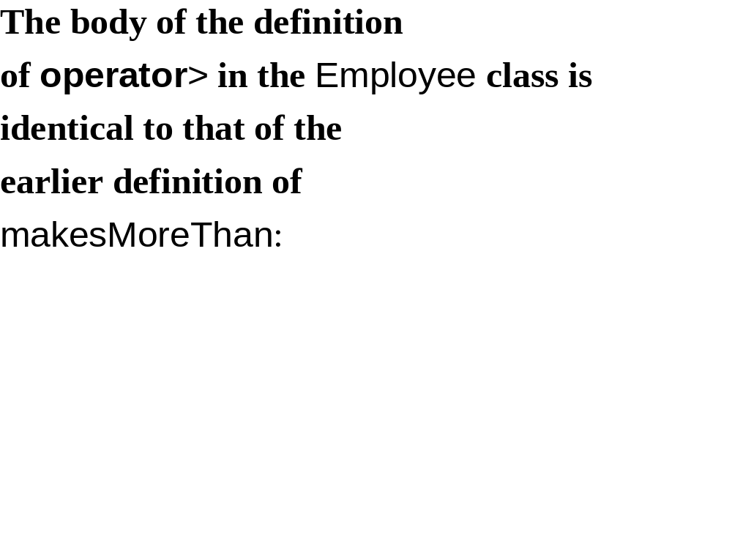
bool Employee:: (const Employee &otherEmployee) const
{
return grossPay > otherEmployee.grossPay;
}
makesMoreThan
operator >

Slide 80
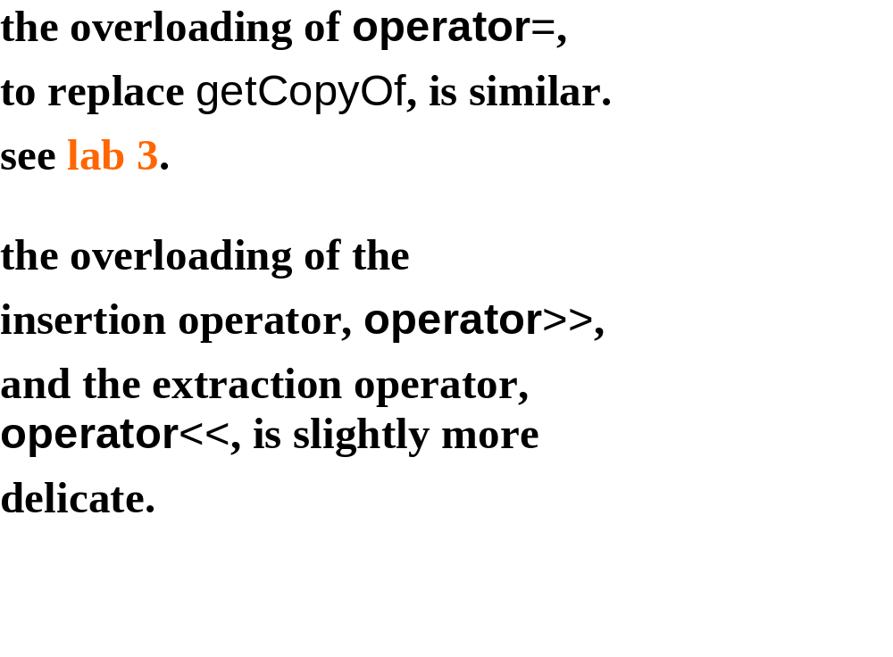

Slide 81
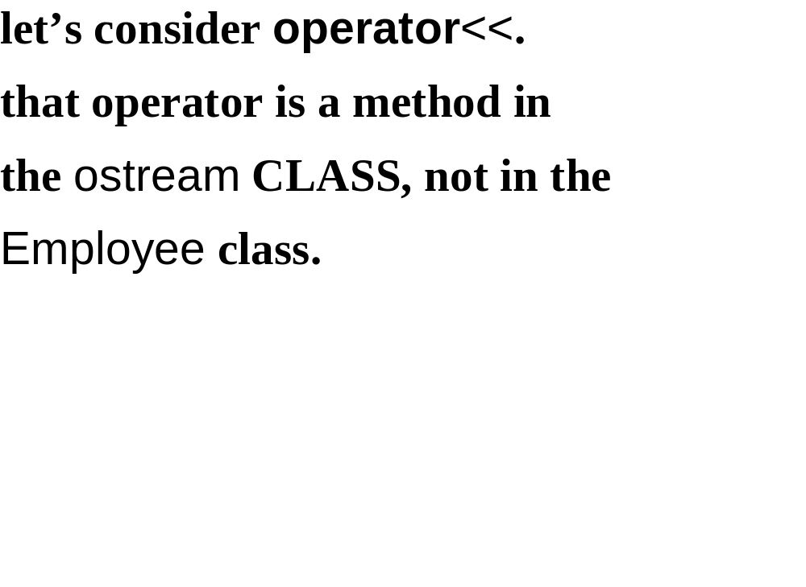

Slide 82
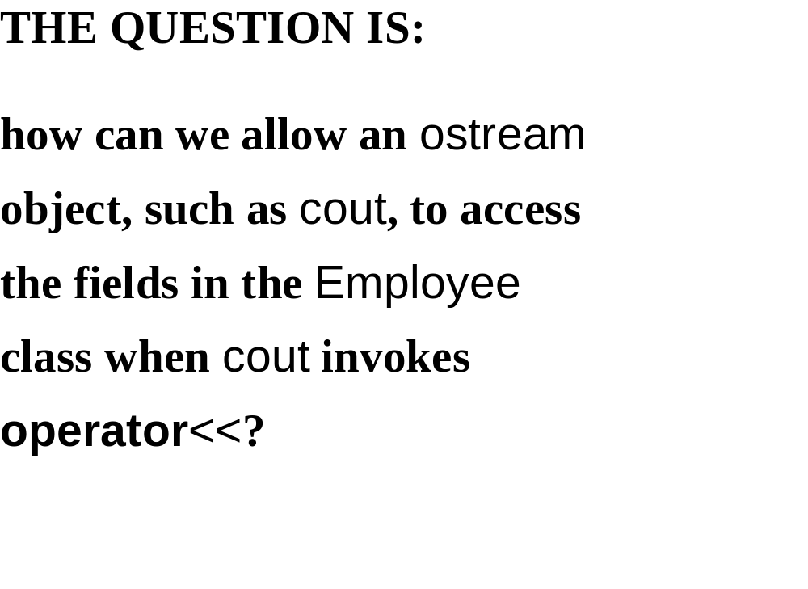

Slide 83
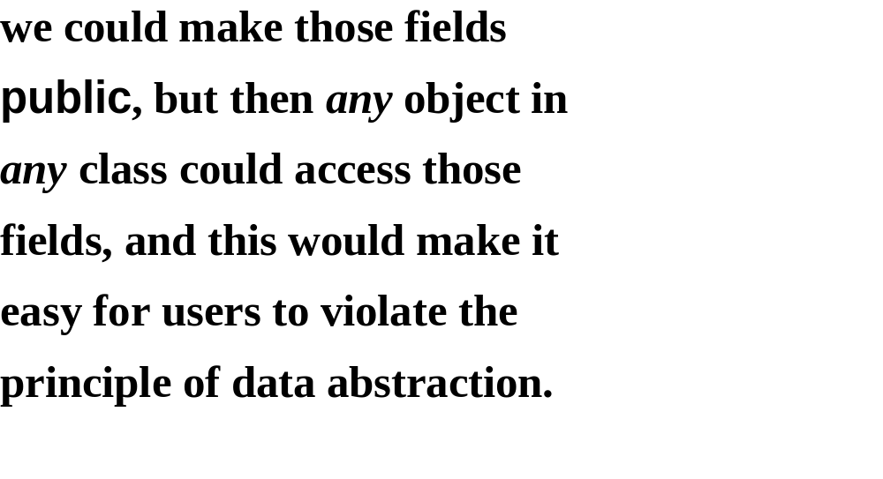

Slide 84
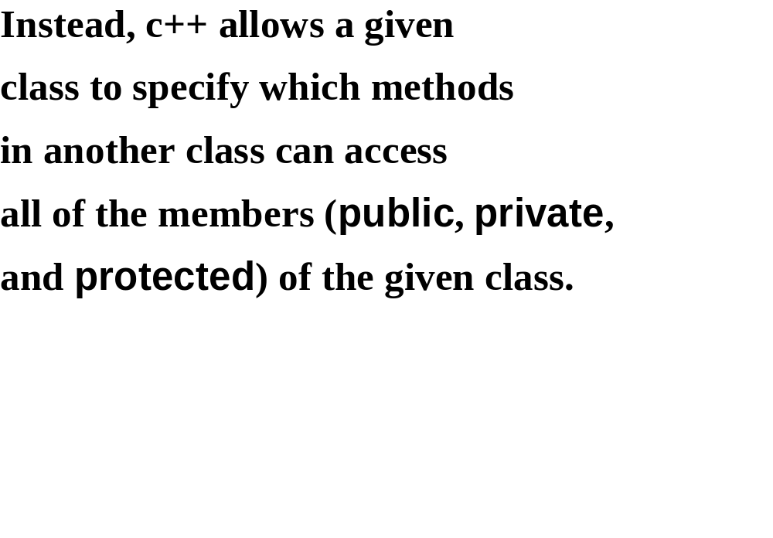

Slide 85
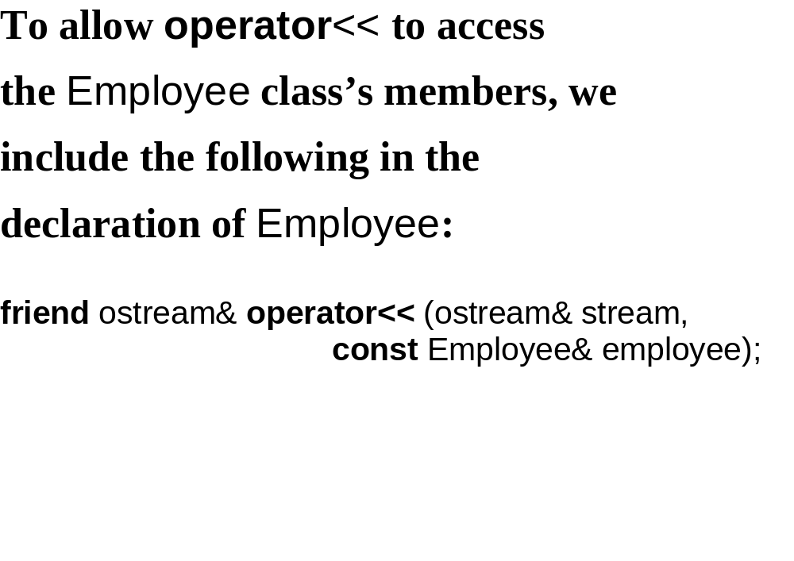

Slide 86
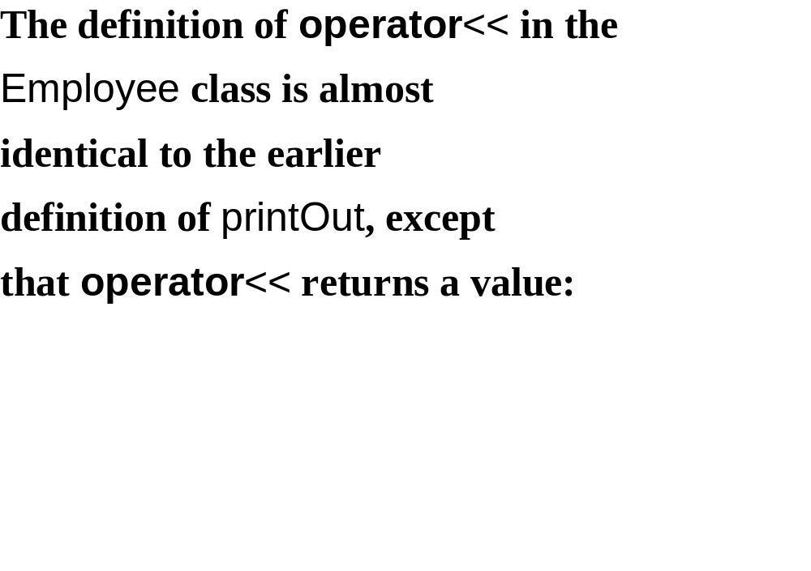

Slide 87
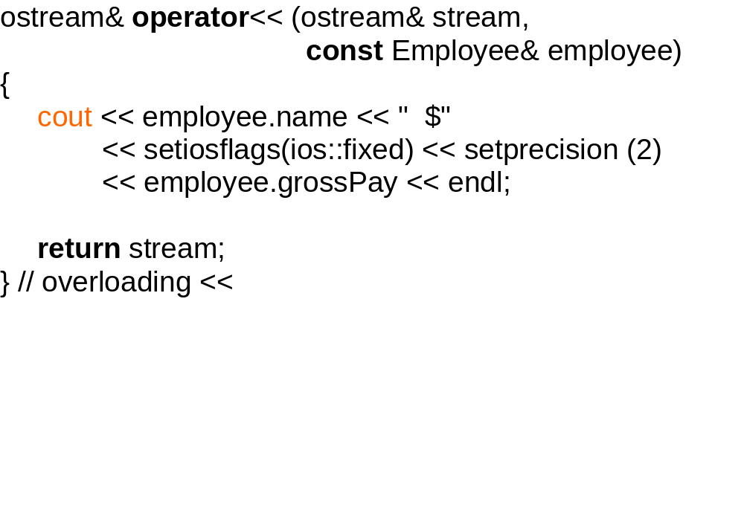
stream

Slide 88
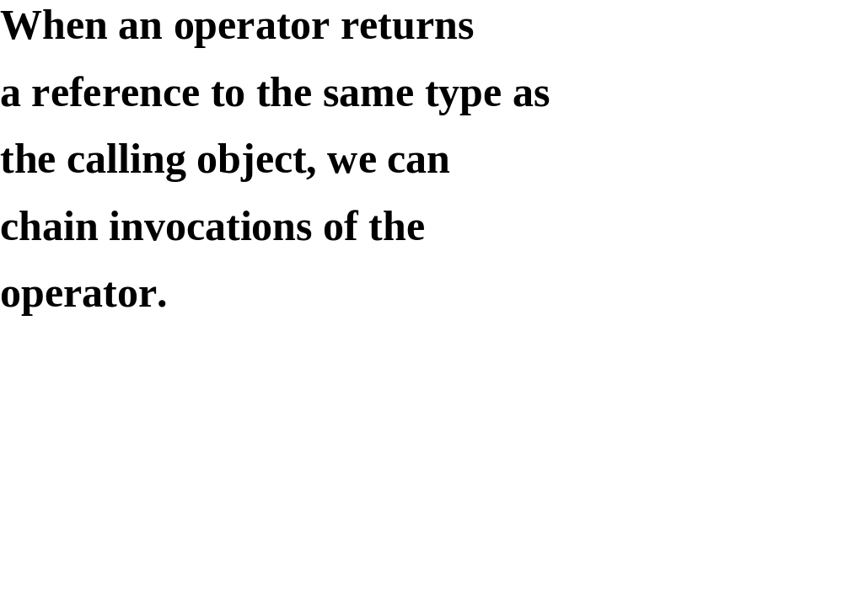

Slide 89
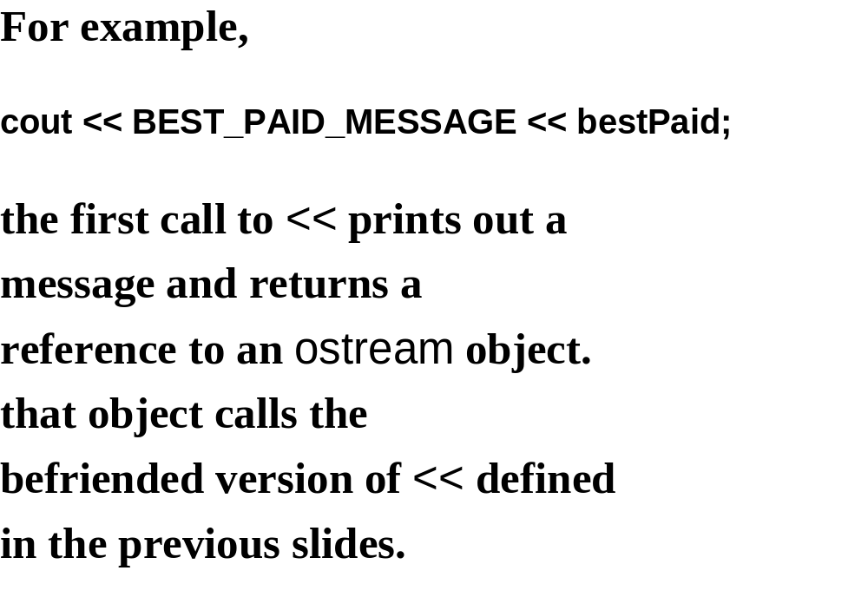

Slide 90
