Slide 1
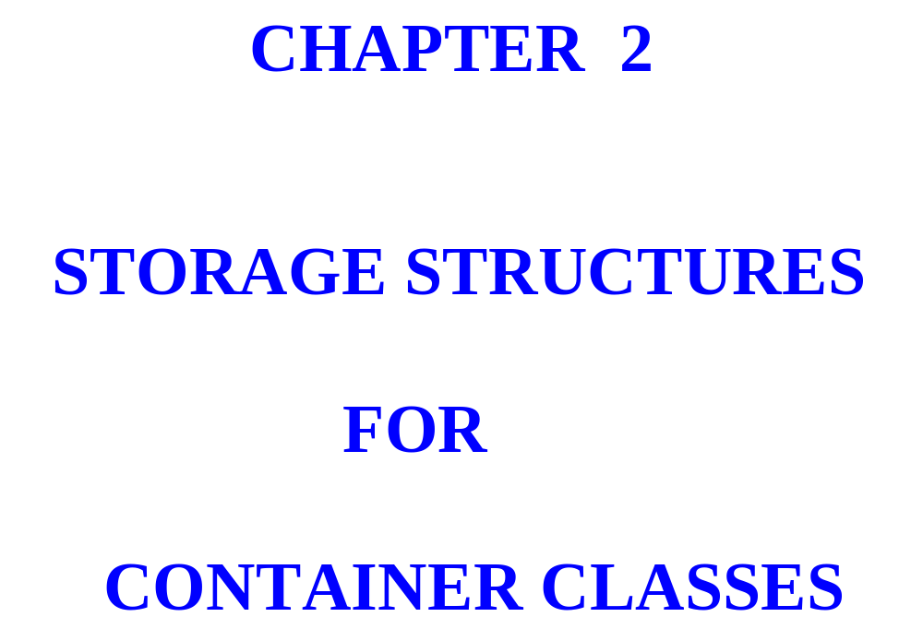

Slide 2
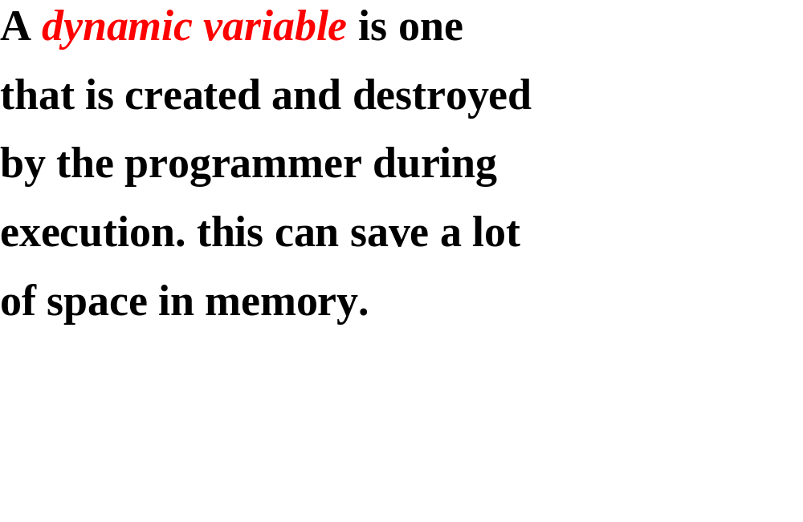

Slide 3
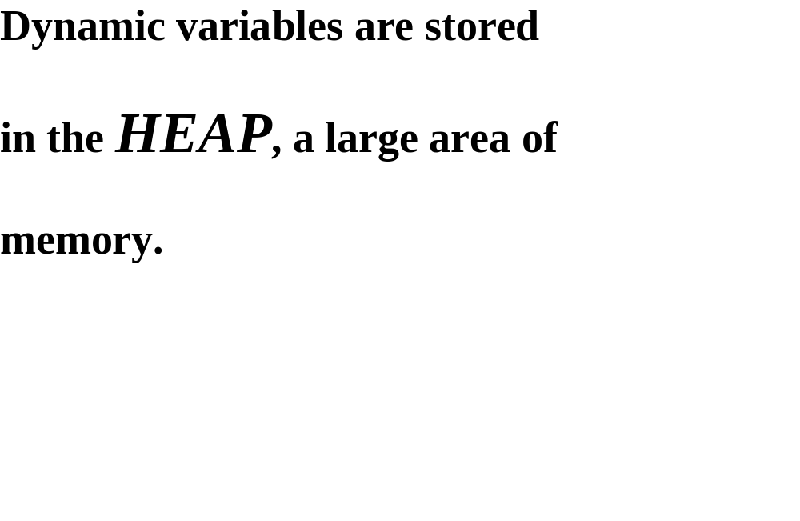

Slide 4
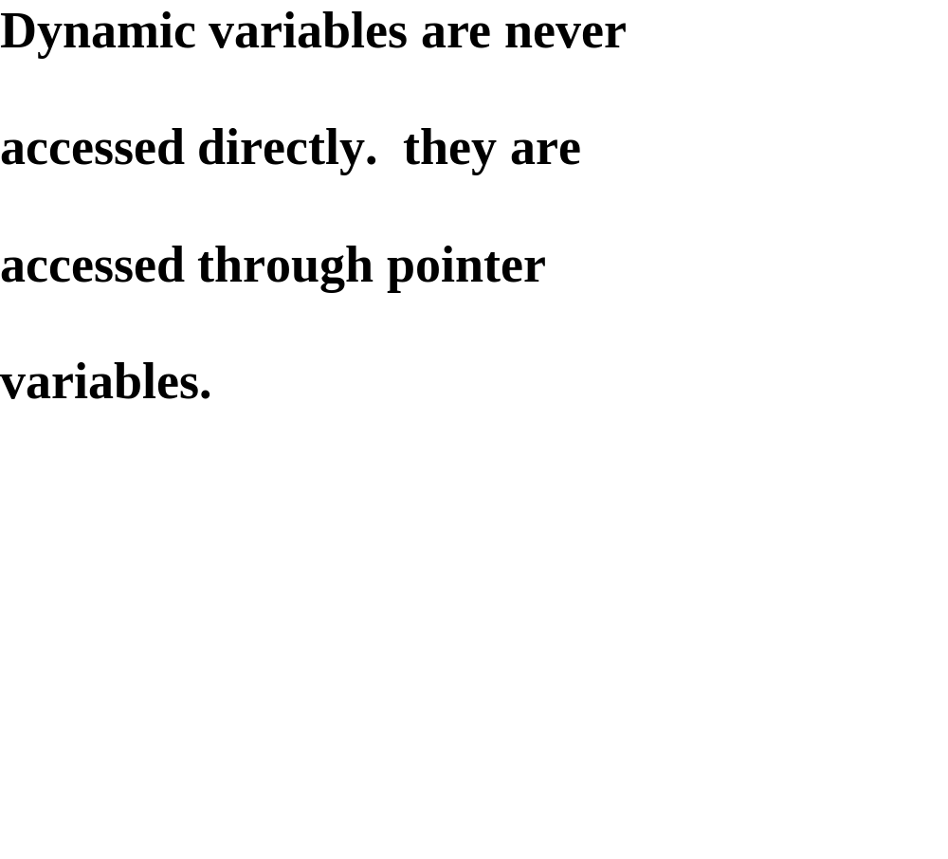

Slide 5
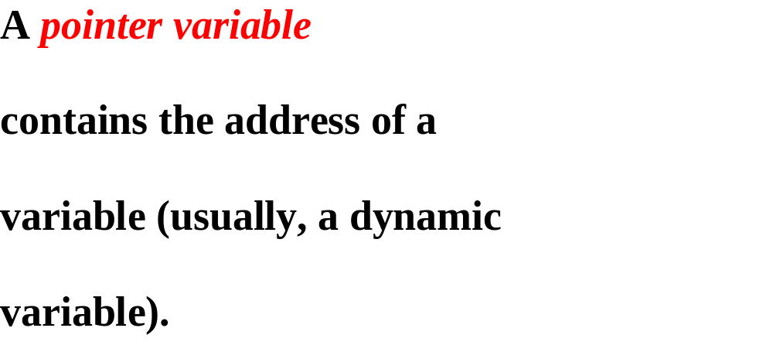


int x=10,*p;
p=&x;
P
0x4f00
0x4f00
x=10
*p is x, value of p is an address 0x4f00.

Slide 6
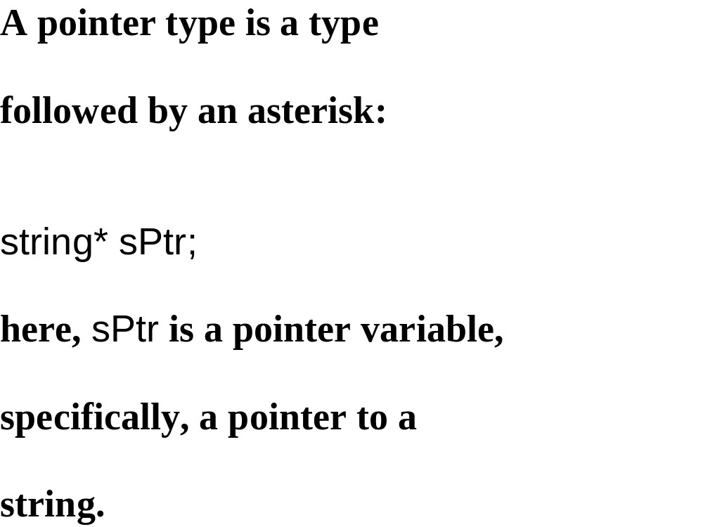

Slide 7
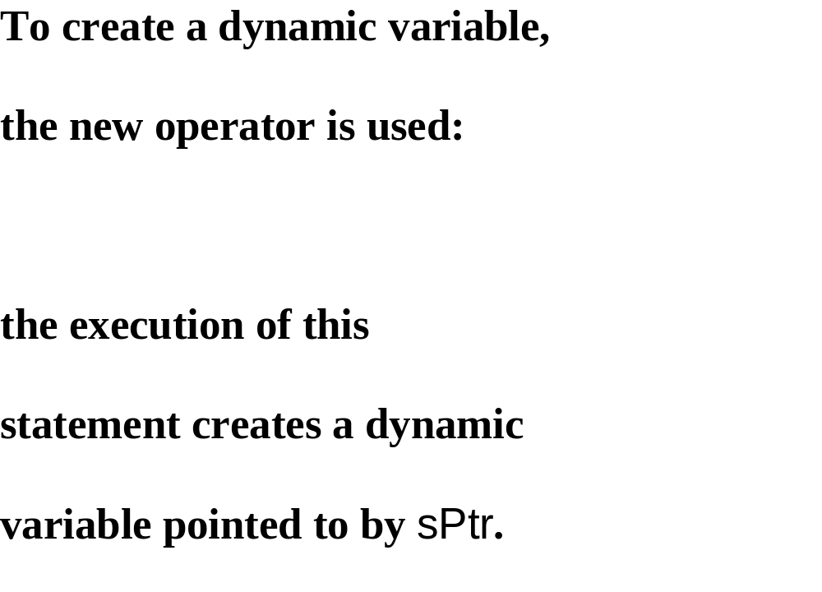
sPtr = new string;

Slide 8
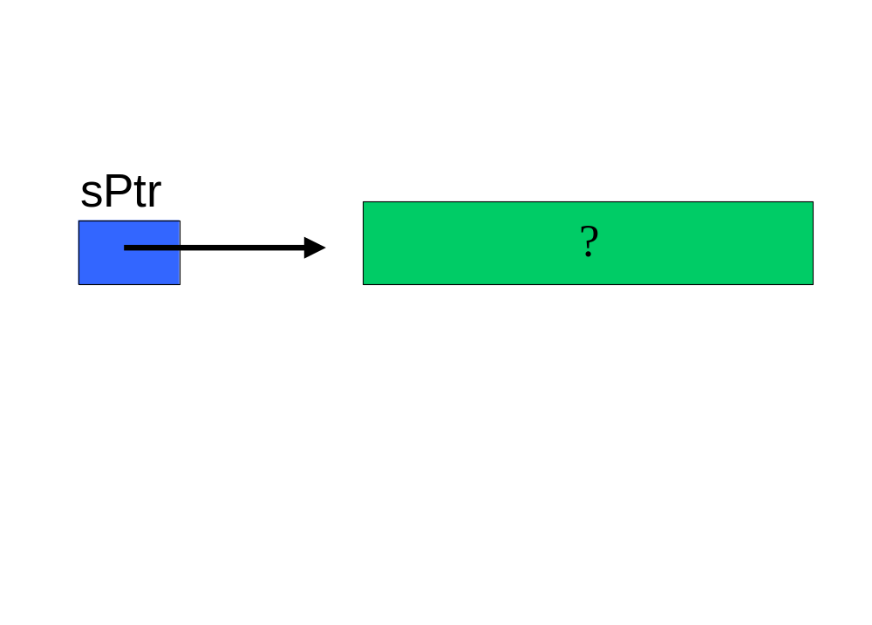

Slide 9
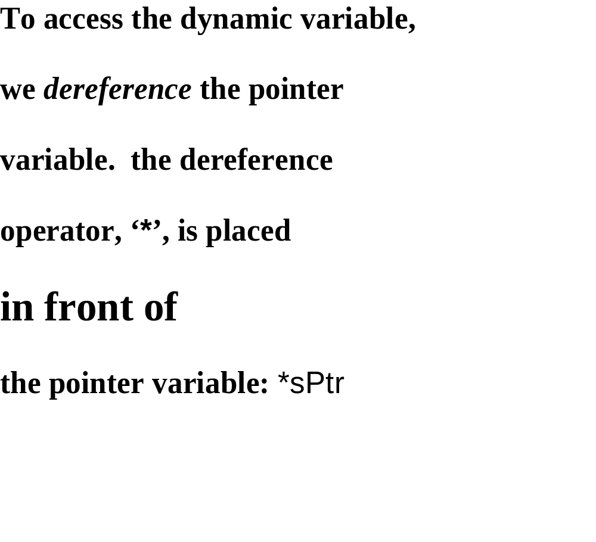

Slide 10
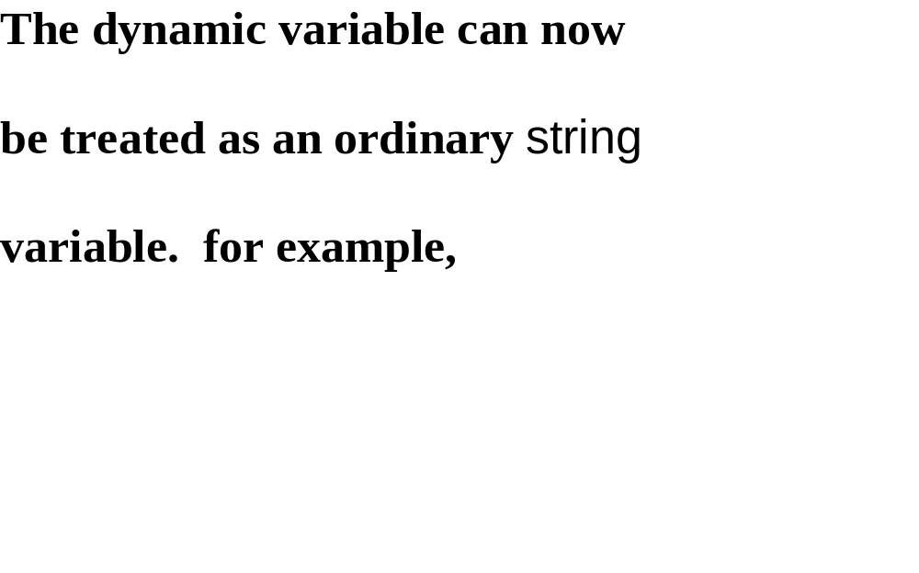
*sPtr = “serene”; // note ‘*’ to left of sPtr

Slide 11
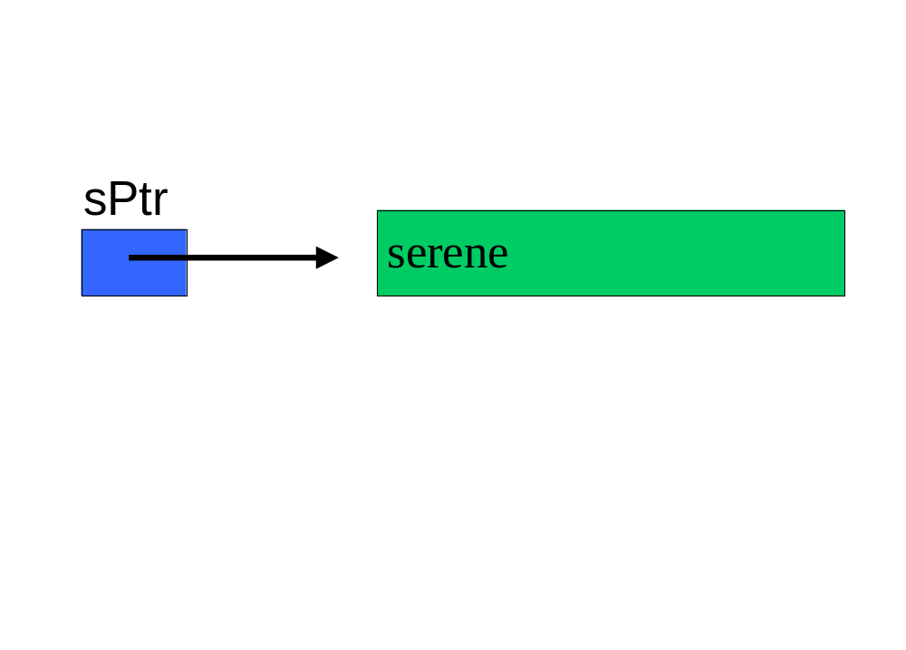

Slide 12
cin >> *sPtr;
while (*sPtr != "***")
{
if ((*sPtr).length() <= 6)
cout << *sPtr << " is a small word." << endl;
else
cout << *sPtr << " is not a small word." << endl;
cin >> *sPtr;
} // while

Slide 13
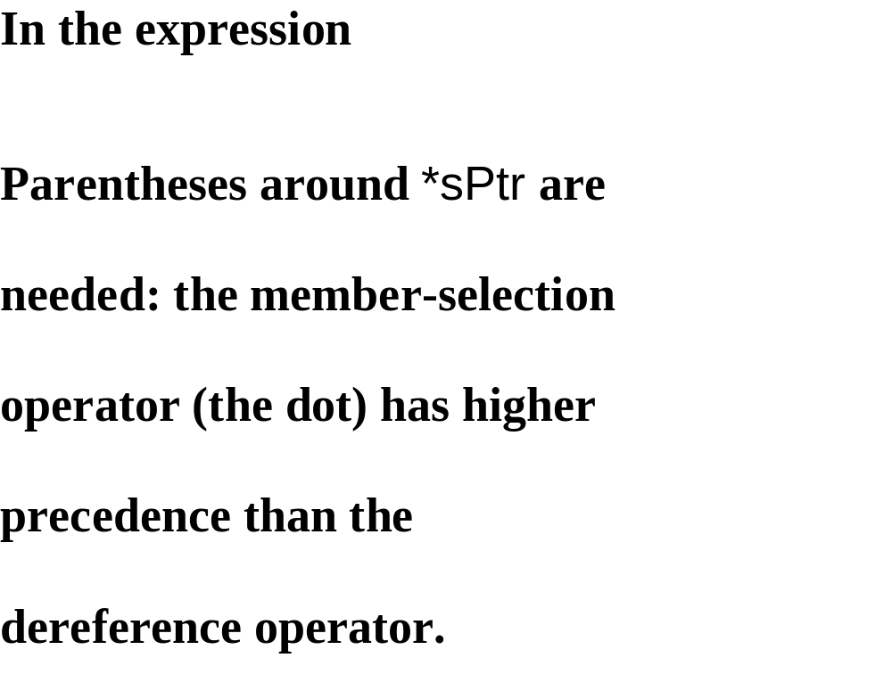
(*sPtr).length() <= 6

Slide 14
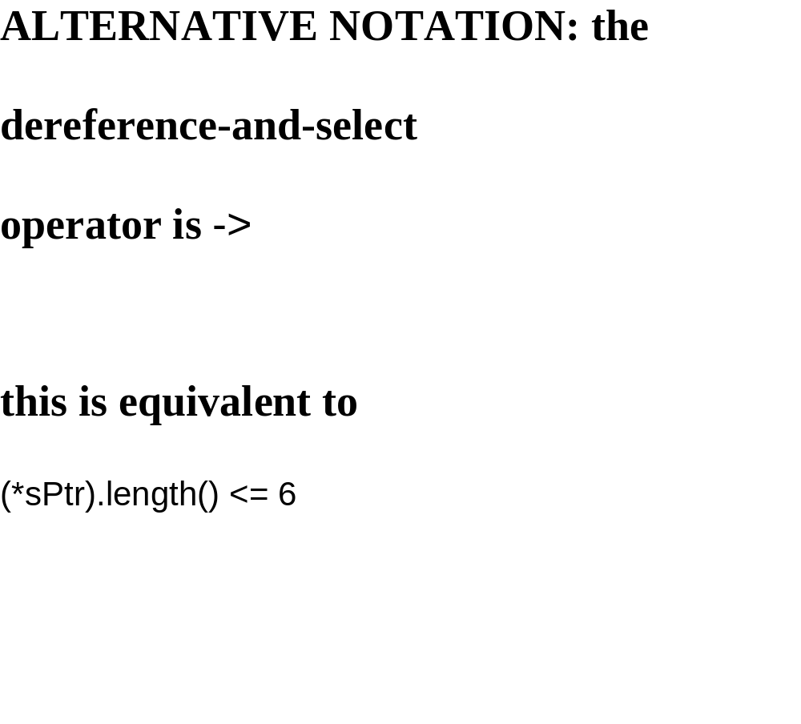
sPtr -> length() <= 6
(*sPtr).length() <= 6

Slide 15
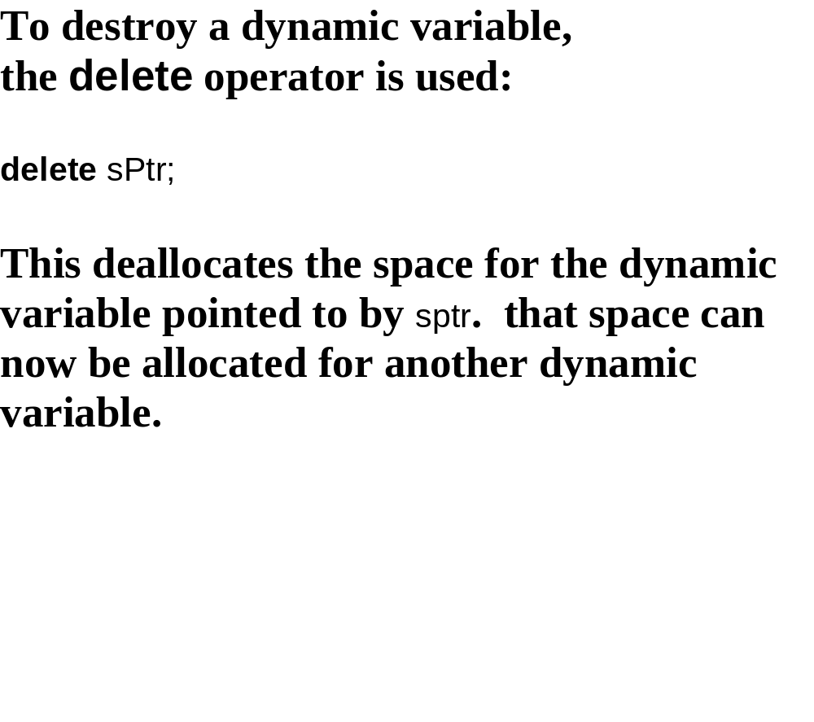
Delete sPtr;

Slide 16
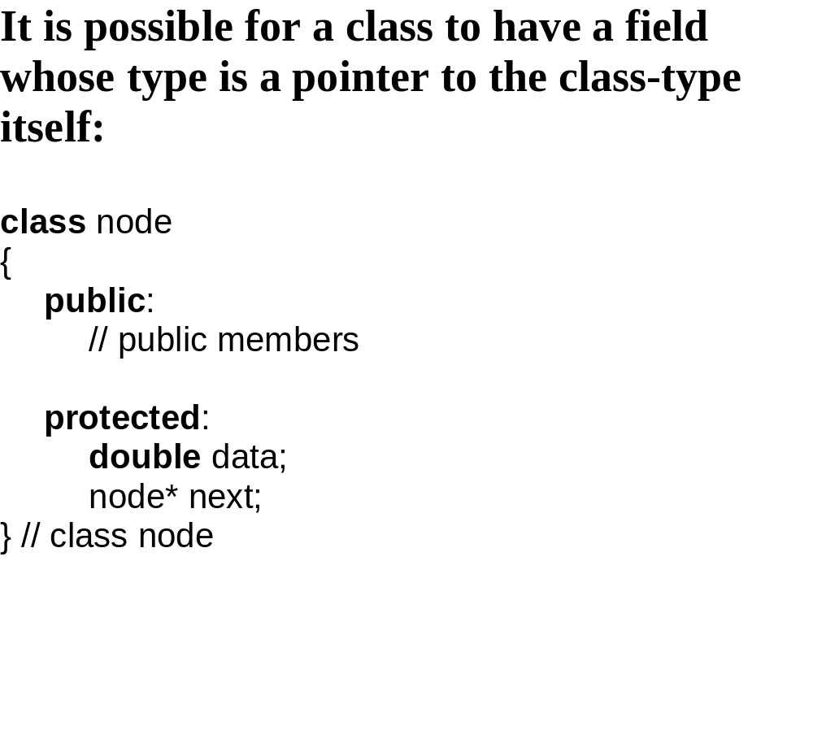
class node
{
public:
// public members
protected:
double data;
node* next;
} // class node

Slide 17
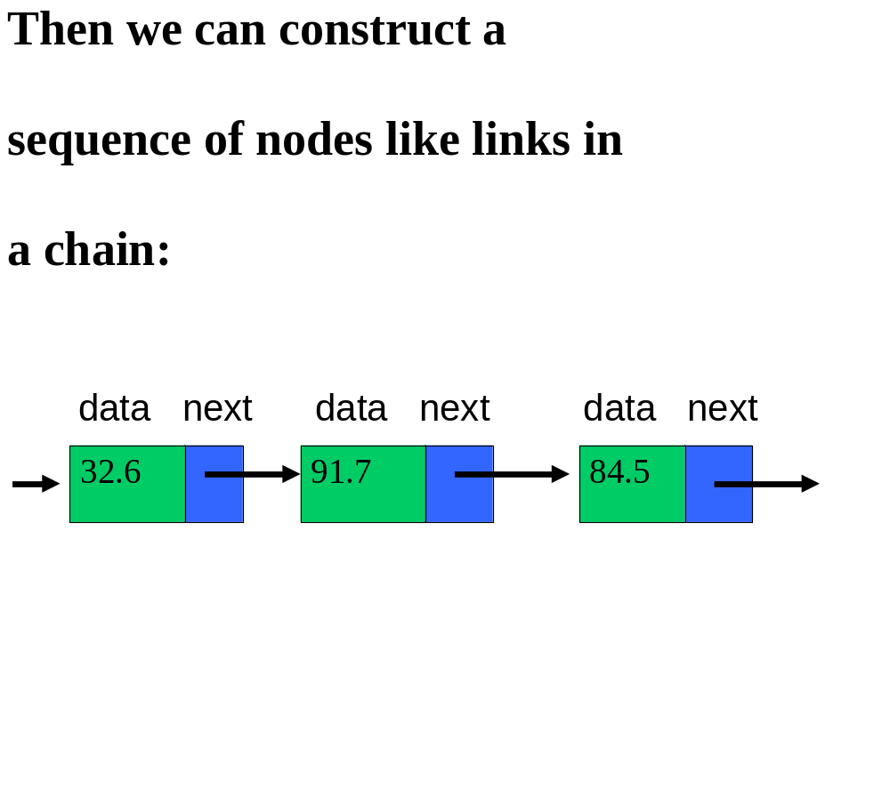

Slide 18


Slide 19
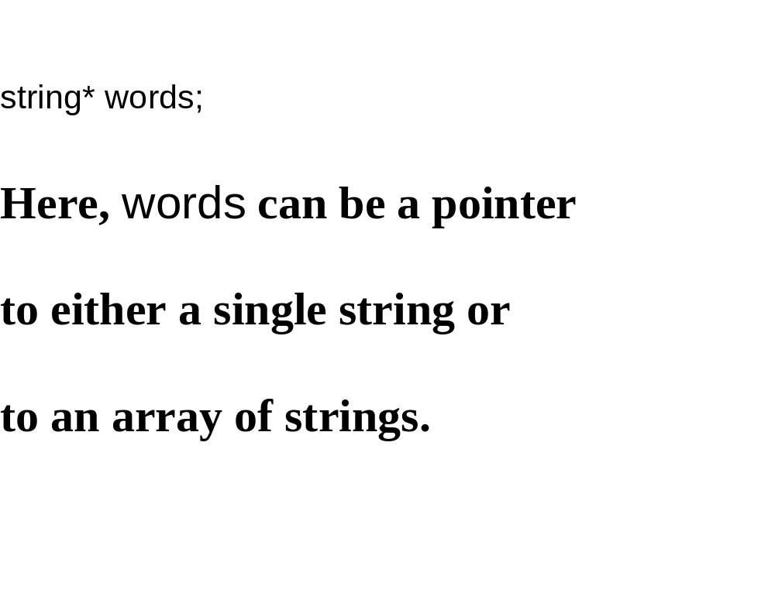
string * words;

Slide 20
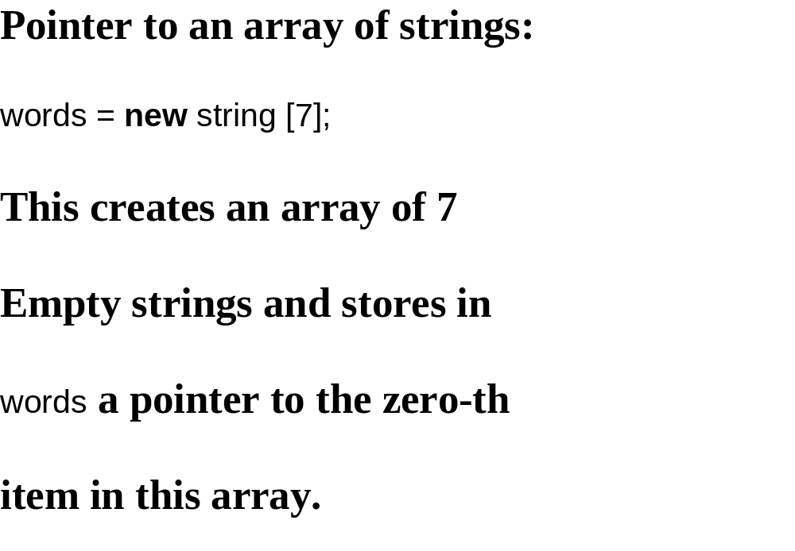
words = new string [7];

Slide 21
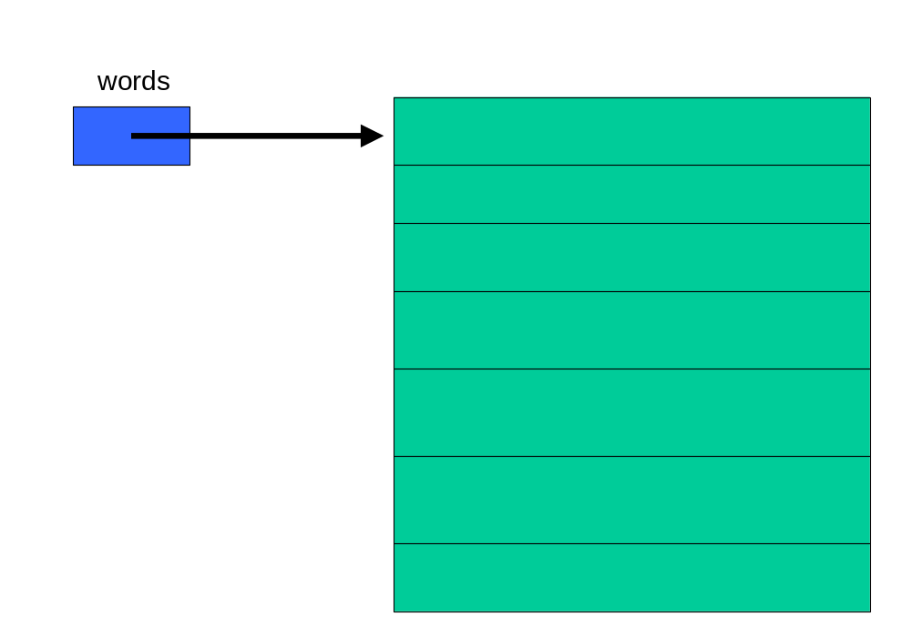

Slide 22
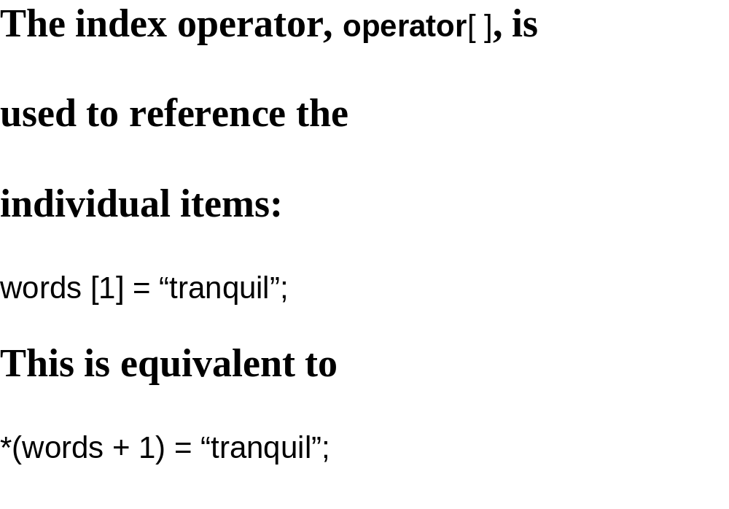
Words[1] = “tranquil”;
*(Words+1) = “tranquil”;

Slide 23
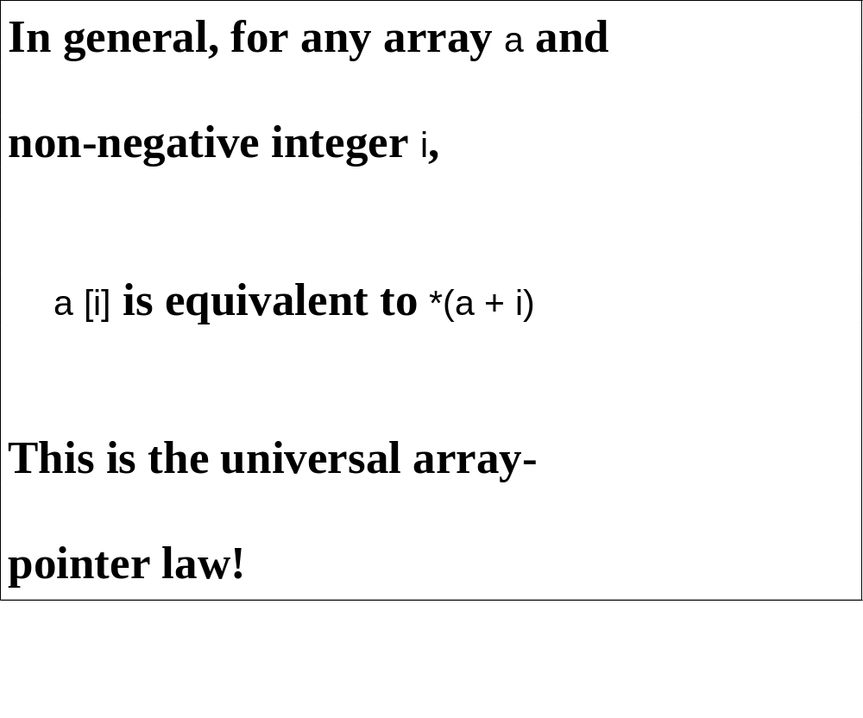

Slide 24
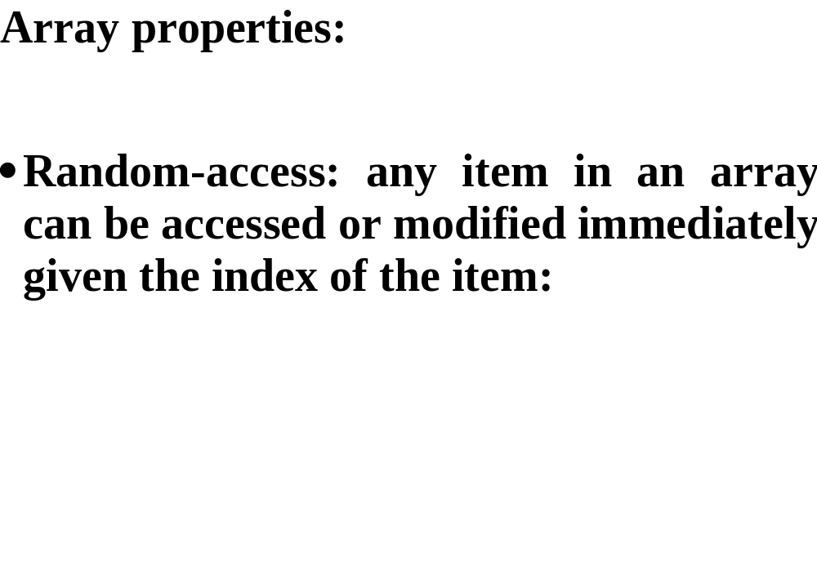
for (int j = 0; j < 7; j++)
cin >> words [j];

Slide 25
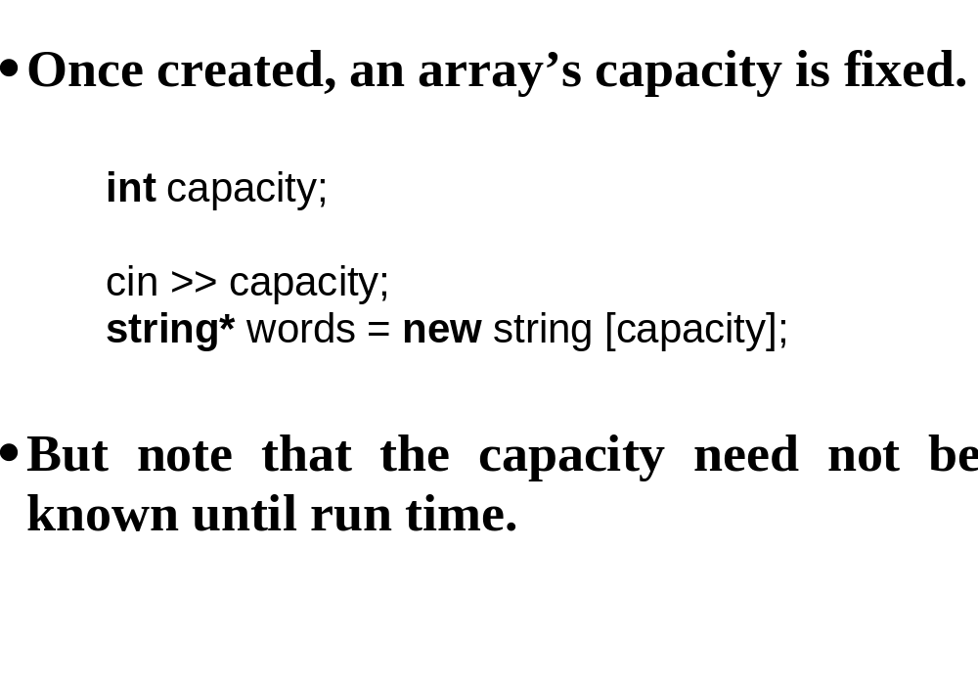
int capacity;
cin >> capacity;
string* words = new string [capacity];

Slide 26
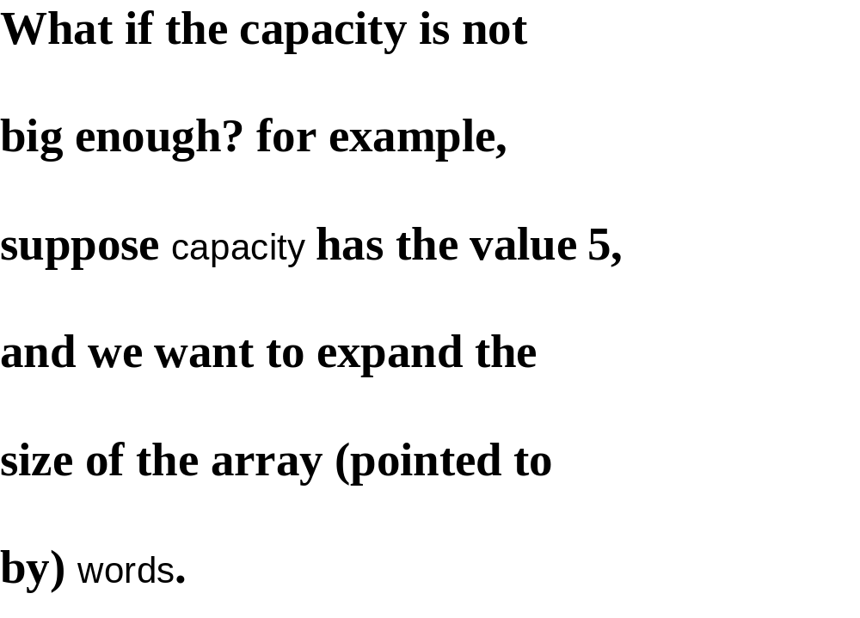

Slide 27
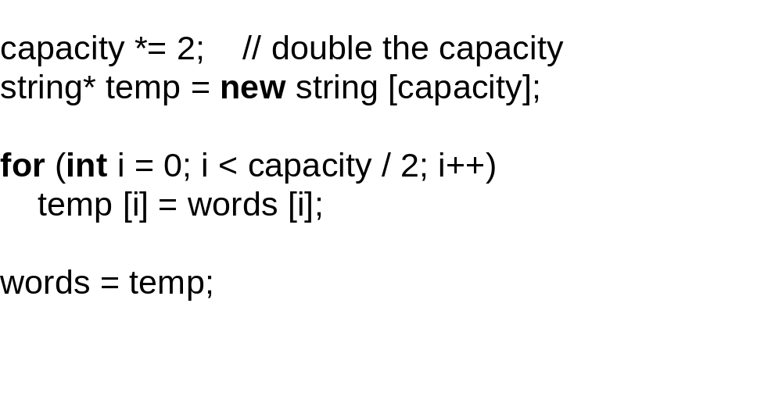

Slide 28
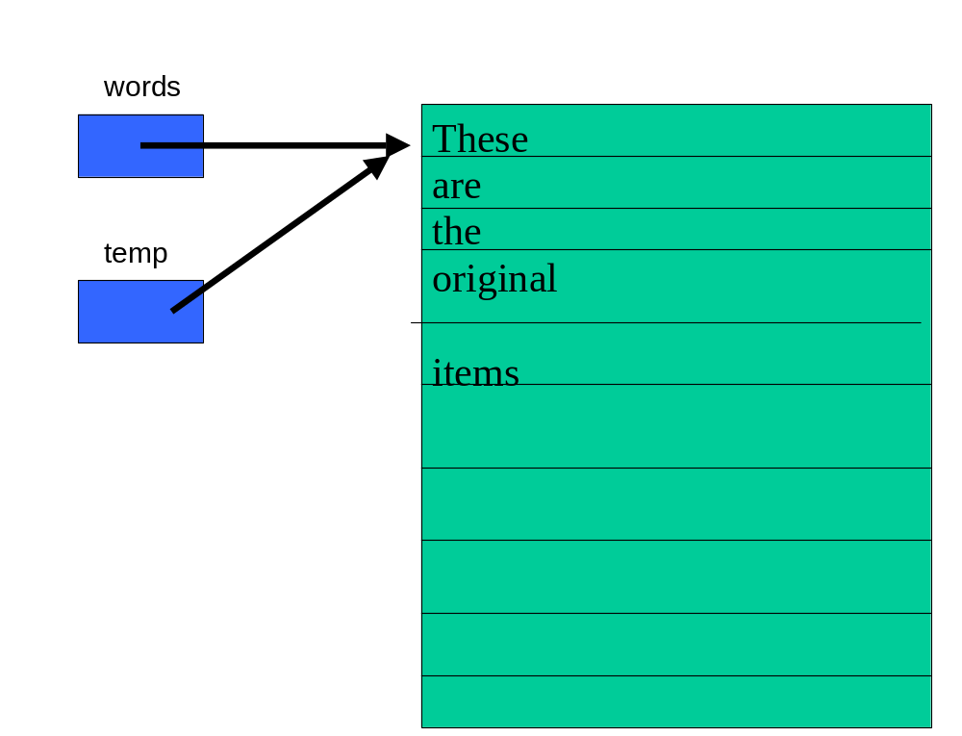

Slide 29
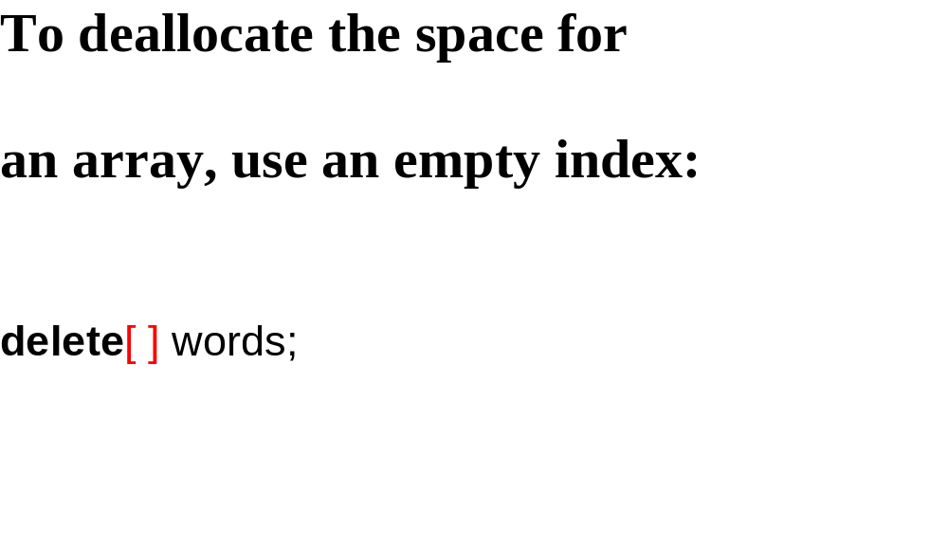

Slide 30
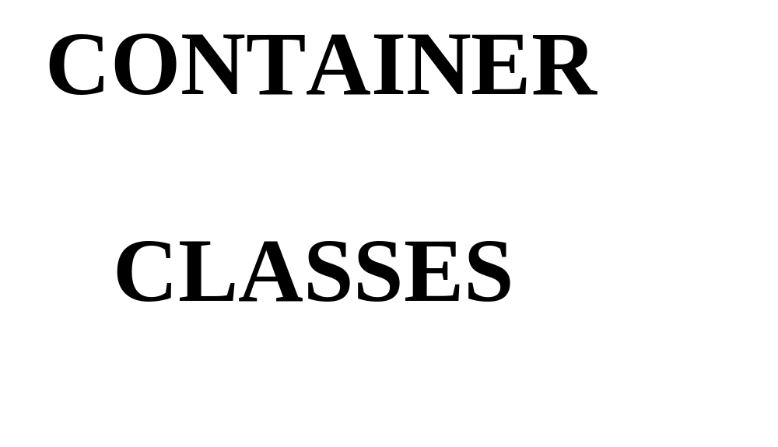

Slide 31
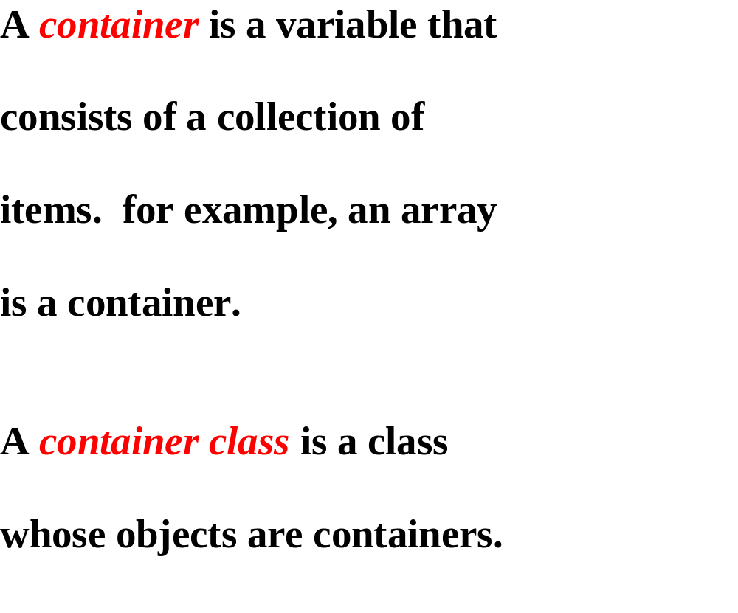

Slide 32
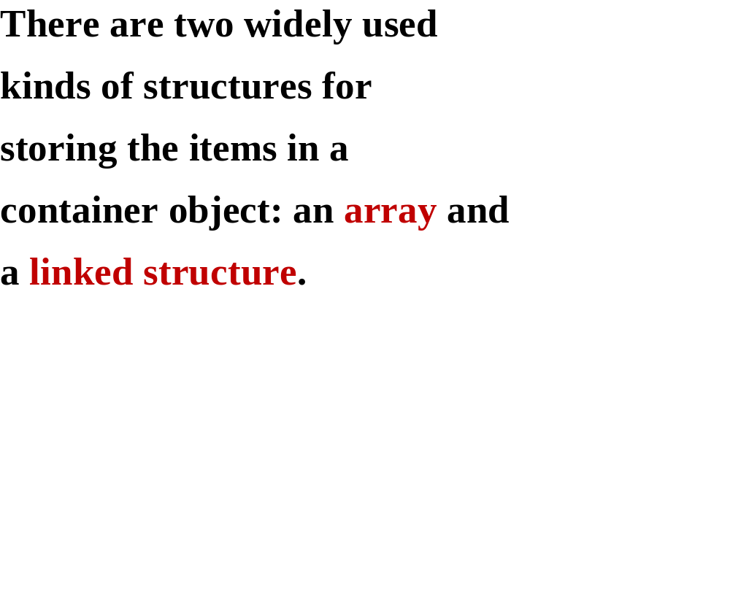

Slide 33
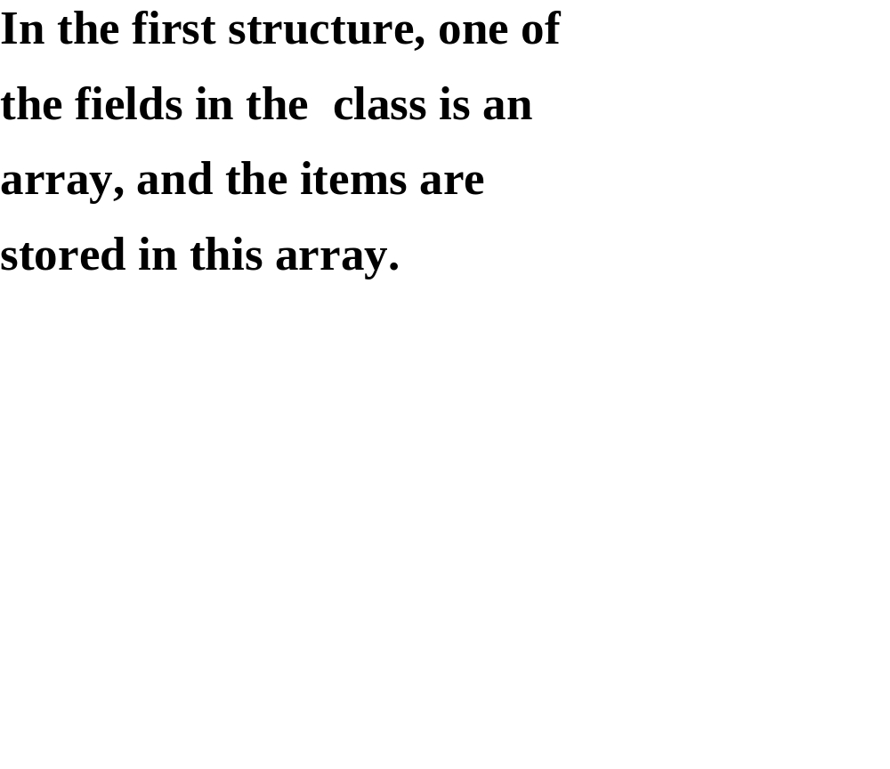

Slide 34
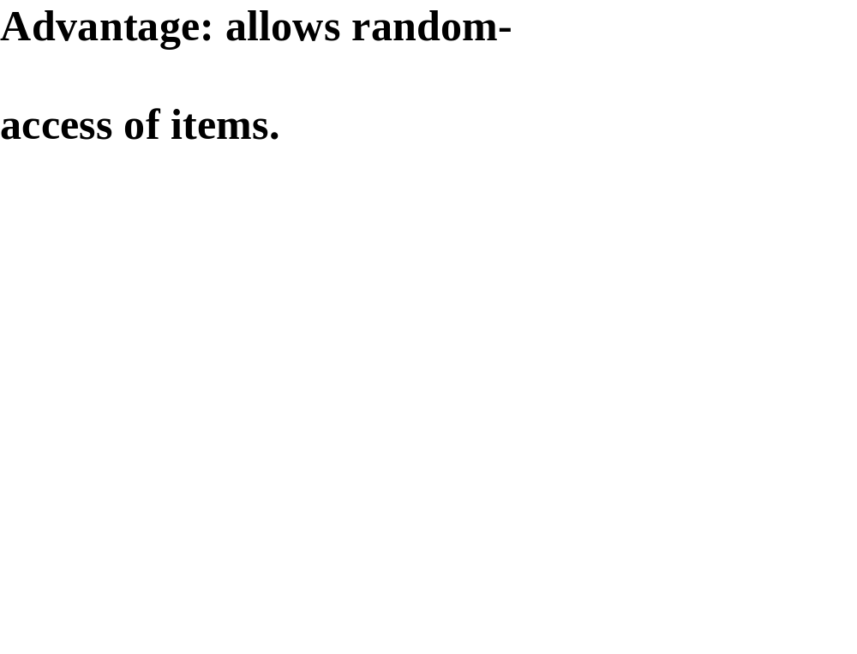

Slide 35
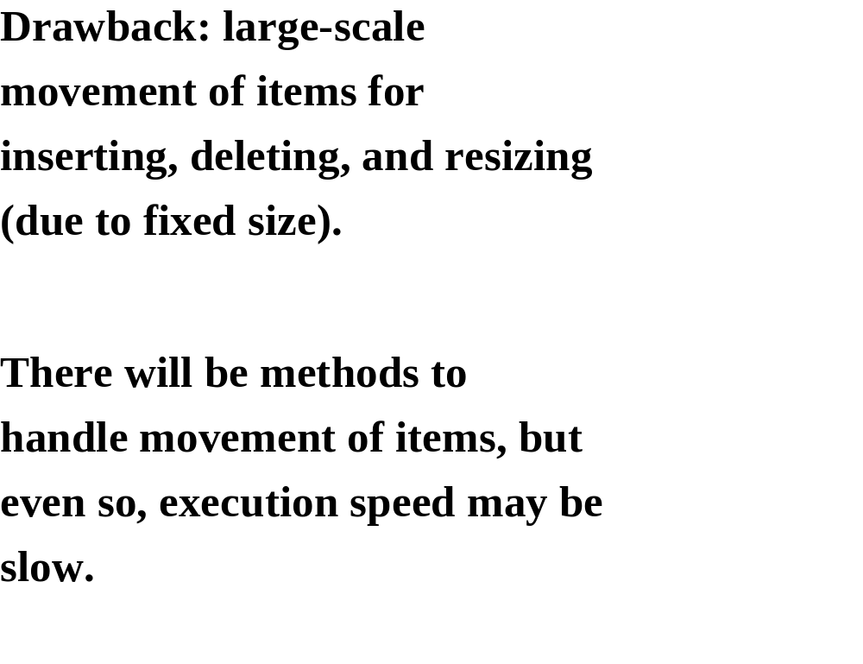

Slide 36
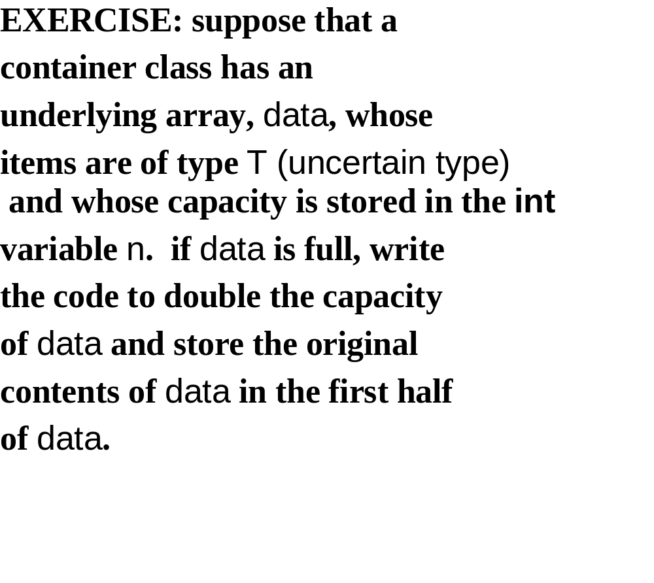

Slide 37
template <class T>
class Demo
{
protected:
T *data;
int n;
public:
Demo(int capacity)
{
data=new T[capacity];
}
void dblsize()
{
delete[] data;
n=n*2;
data= new T[n];
}
~Demo()
{
delete[] data;
}
};
n=capacity; //?
n=n*2;
T *temp=new T[n];
for (int i = 0; i < n / 2; i++)
temp [i] = data [i];
delete[] data;
data = temp;

Slide 38
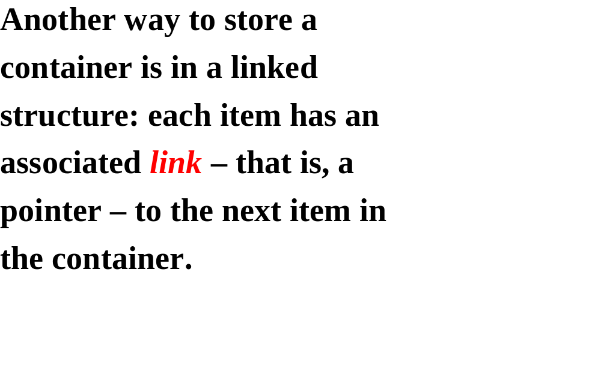

Slide 39
Here is the basic idea:
do
re
mi

Slide 40
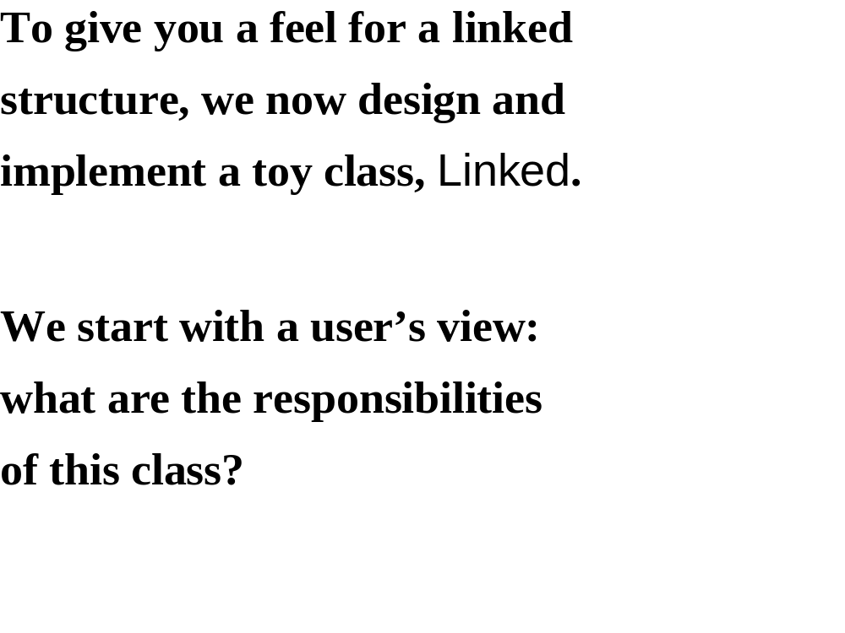

Slide 41
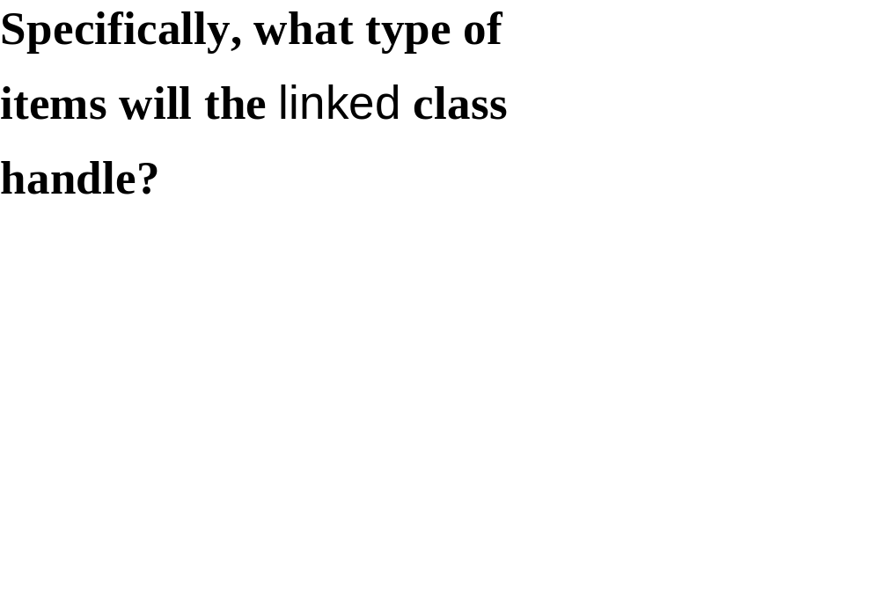

Slide 42
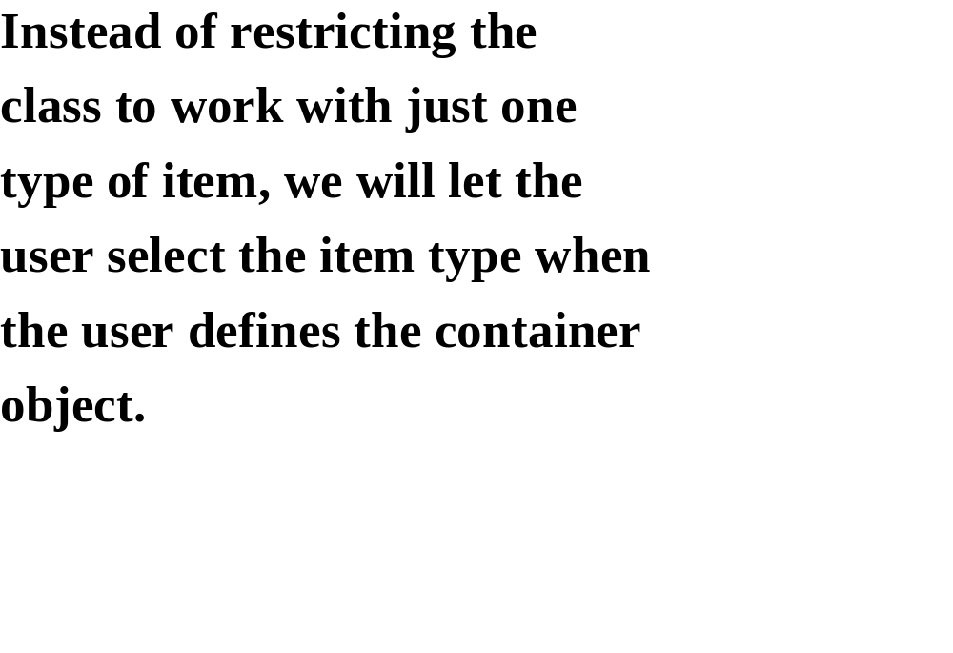

Slide 43
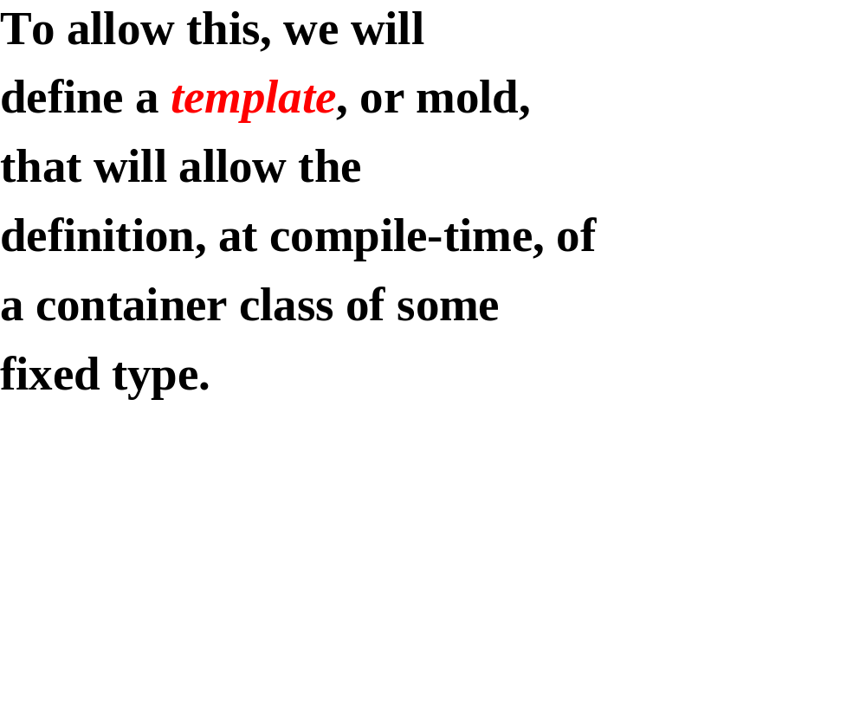

Slide 44
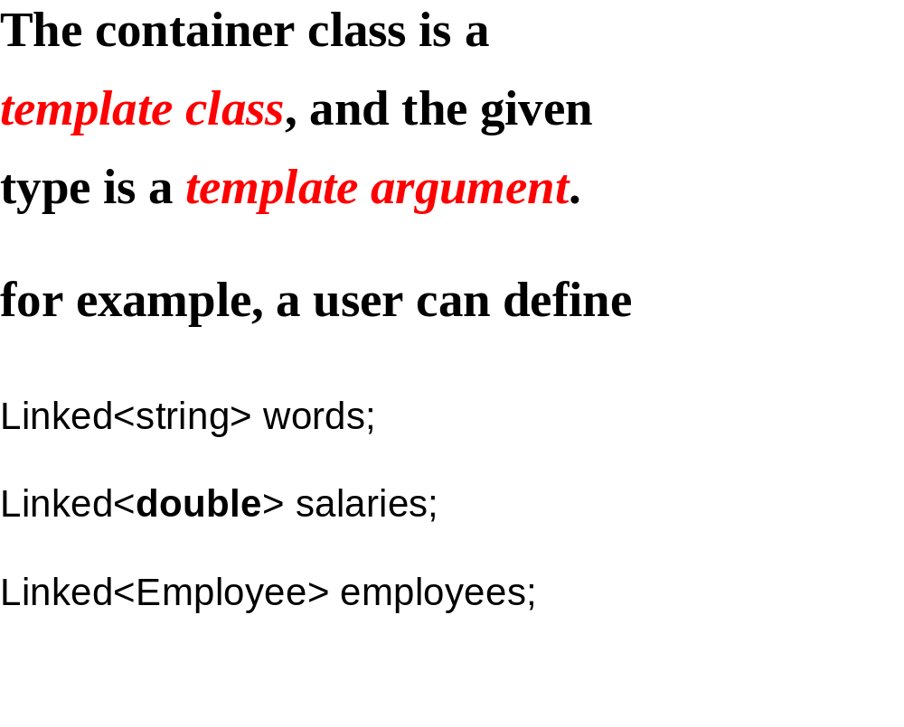

Slide 45
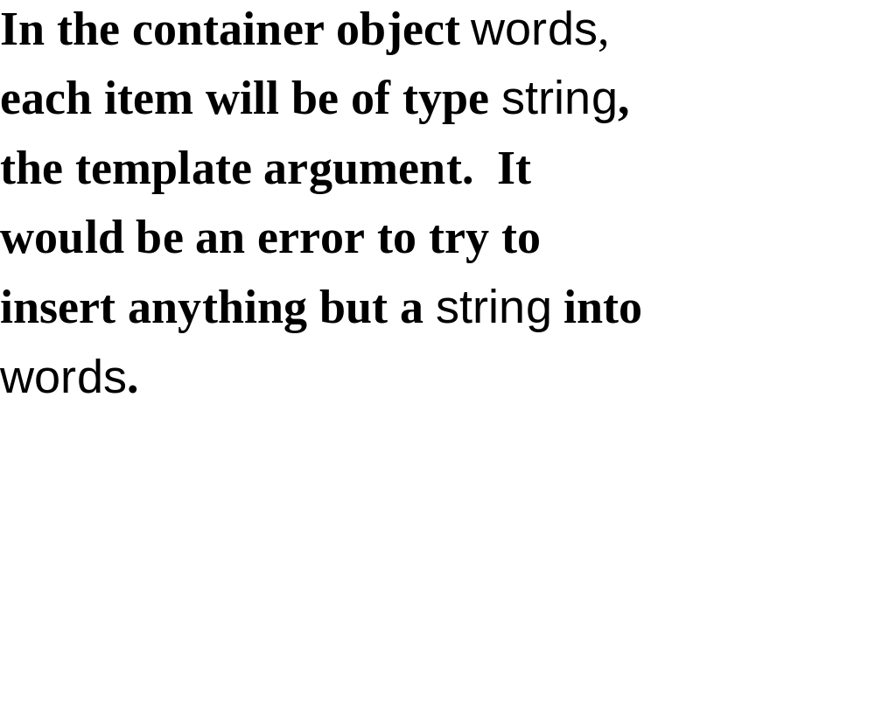

Slide 46
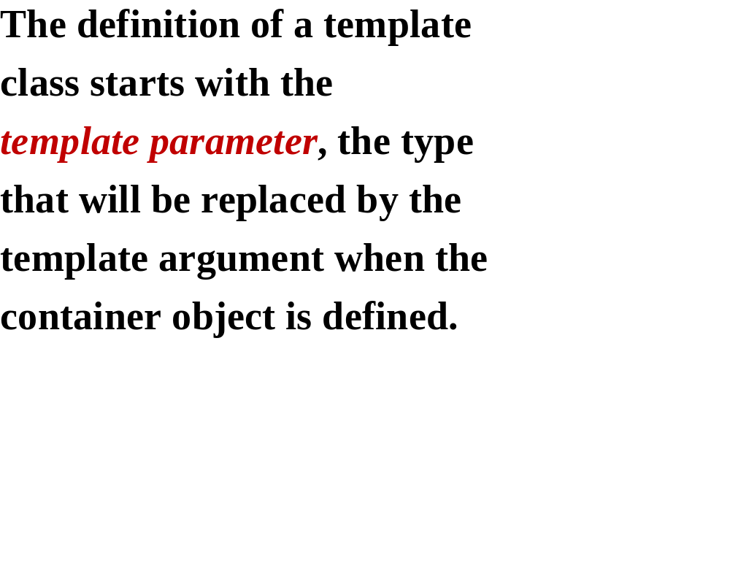

Slide 47
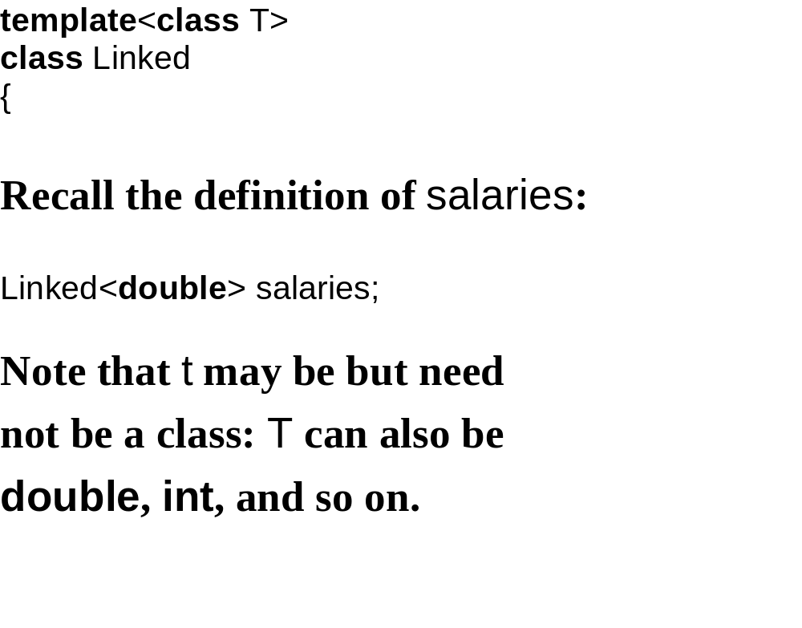

Slide 48
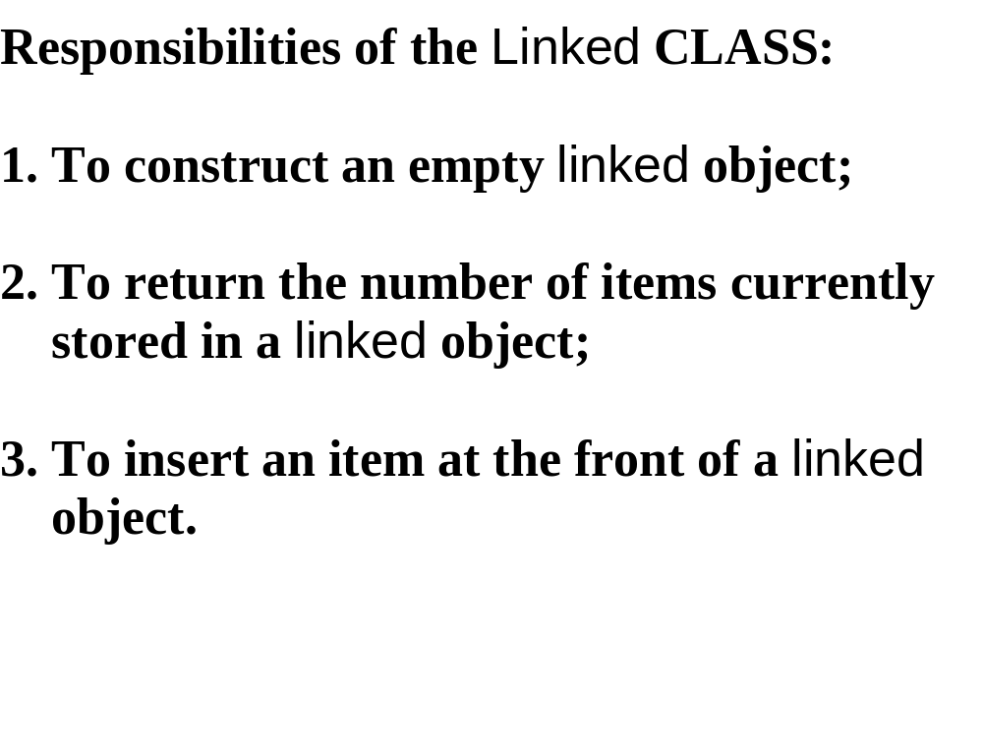

Slide 49
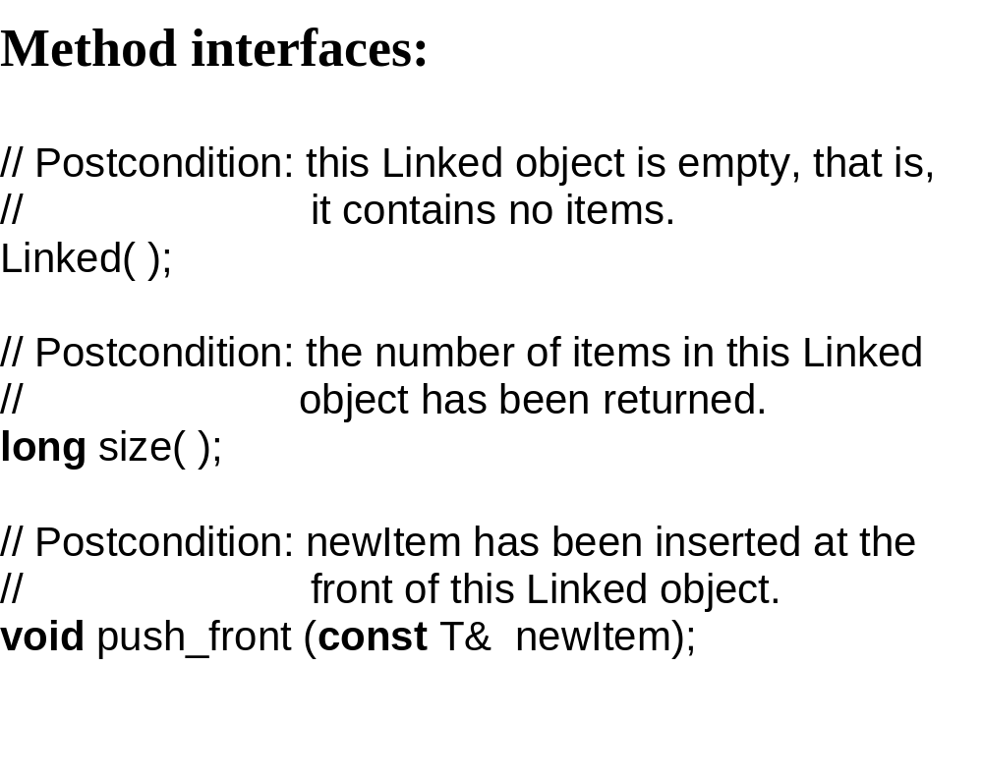

Slide 50
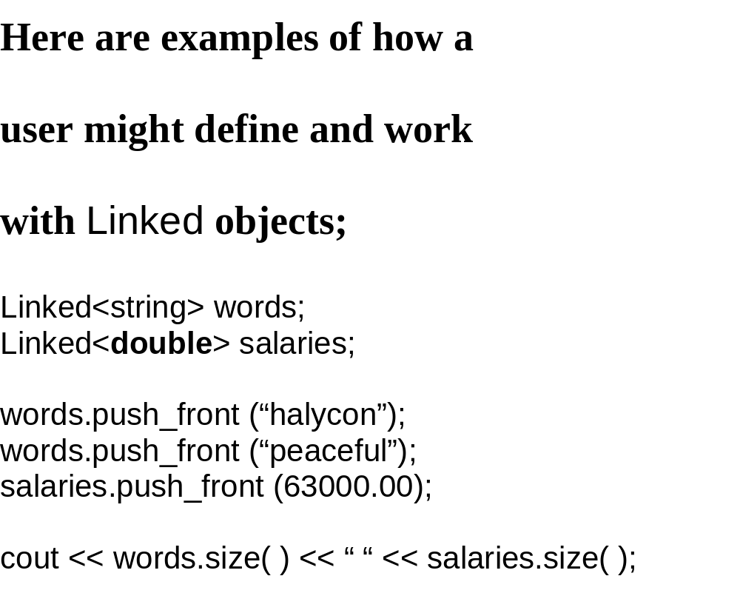

Slide 51
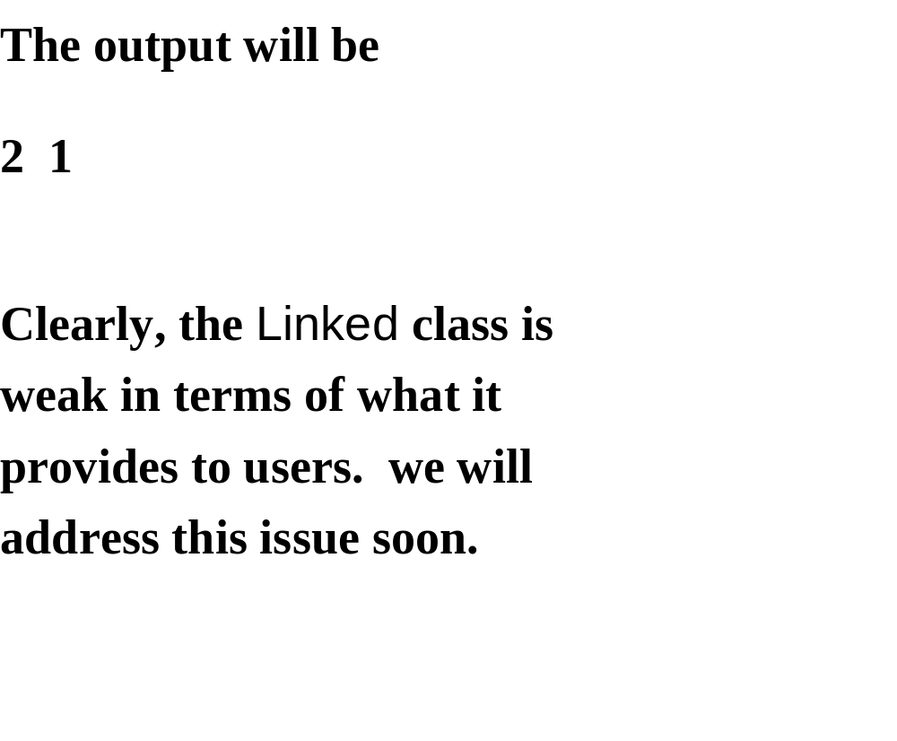

Slide 52
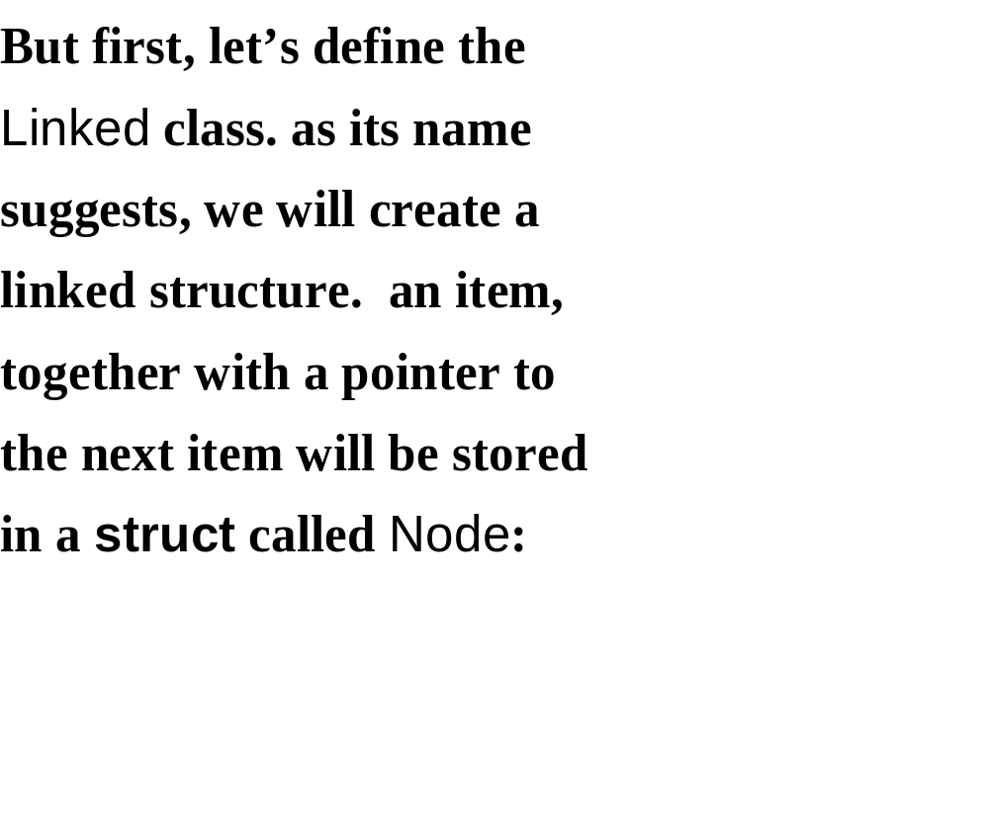

Slide 53
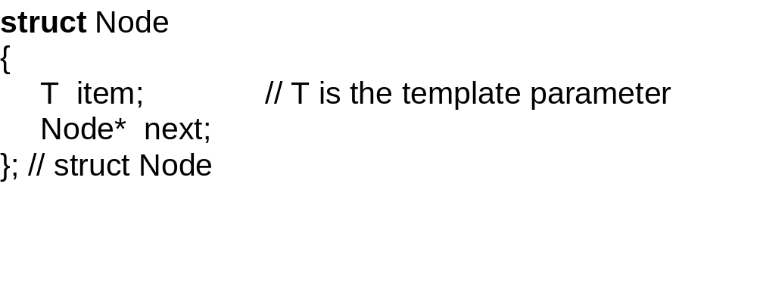

Slide 54
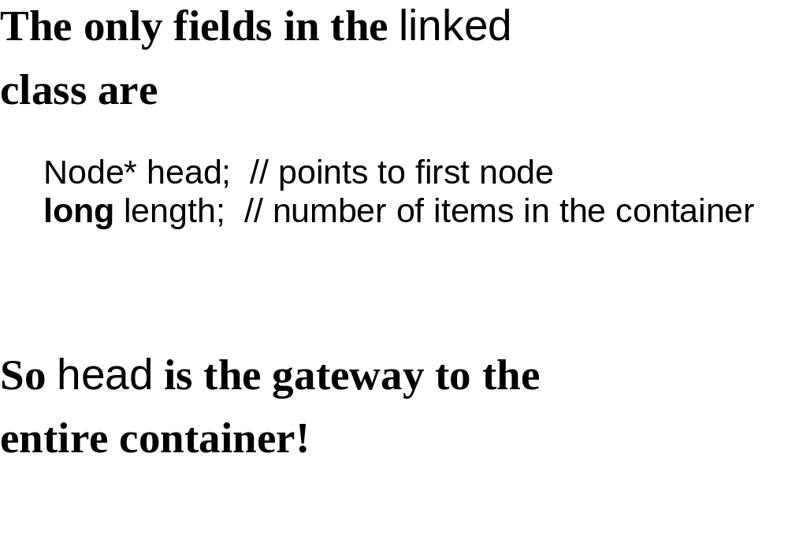

Slide 55


Slide 56


Slide 57


Slide 58


Slide 59


Slide 60


Slide 61
myLinked. myLinked.
head length
3
do
re
mi
NULL

Slide 62


Slide 63


Slide 64
myLinked. myLinked.
head length
newHead
3
?
?
do
re
mi
NULL

Slide 65


Slide 66
myLinked. myLinked.
head length
newHead
3
ti
?
do
re
mi
NULL

Slide 67


Slide 68
myLinked. myLinked.
head length
newHead
3
ti
do
re
mi
NULL

Slide 69


Slide 70
myLinked. myLinked.
head length
newHead
4
ti
do
re
mi
NULL

Slide 71


Slide 72


Slide 73


Slide 74


Slide 75


Slide 76


Slide 77
#include "stdafx.h"
class A
{
int a;
public:
class B
{
int b;
public:
B(int y){ b=y;}
int getb(){return b;}
};
B set(){ return B(4);}
};
int main(int argc, char* argv[])
{
A x;
A::B y(3);
printf("Hello World!%d\n %d", x.set().getb(), y.getb());
return 0;
}

Slide 78
#include "stdafx.h"
#include <iostream>
using namespace std;
class A
{
int a;
int c;
public:
class B
{
friend class A;
int b;
private:
B(int y){ b=y;}
public:
int getb(){return b;}
};
B set(){ return B(4);}
};
int main(int argc, char* argv[])
{
A x;
A::B y(3);
printf("%d\n", x.set().getb());
return 0;
}

Slide 79
Constructor of class A::B is private, statement A::B y(3) will cause an access violation. In the term of declaring A is a friend class of B, x.set().getb() will return the result.

Slide 80
An iterator is an object that
enables a user to loop through
a container without violating
the principle of data
abstraction.

Slide 81


Slide 82


Slide 83


Slide 84


Slide 85


Slide 86


Slide 87


Slide 88
template<class T>
class Linked
{
protected:
struct Node { T item; Node* next; }
Node* head;
long length;
public:
class Iterator
{
friend class Linked<T>;
protected:
public:
} // class Iterator
…
} // class Linked

Slide 89


Slide 90


Slide 91


Slide 92


Slide 93


Slide 94


Slide 95


Slide 96
Note：these methods of Linked
Iterator begin()
{
return Iterator (head);
} // begin
Iterator end()
{
return Iterator (NULL);
} // end

Slide 97


Slide 98


Slide 99


Slide 100


Slide 101


Slide 102


Slide 103


Slide 104


Slide 105


Slide 106


Slide 107


Slide 108


Slide 109


Slide 110


Slide 111


Slide 112


Slide 113


Slide 114


Slide 115


Slide 116


Slide 117


Slide 118


Slide 119
Linked<string> words;
words.push_front ("mellow");
words.push_front ("placid");
words.push_front ("serene");
Linked<string>::Iterator itr;
itr = find (words.begin( ), words.end( ), "placid");
if (itr == words.end( ))
cout << "word not found" << endl;
else
cout << "word found" << endl;

Slide 120
int scores [5];
for (int i = 0; i < 5; i++)
scores [i] = 20 * i;
if (find (scores, scores + 5, 35) == scores + 5)
cout << "score not found" << endl;
else
cout << "score found" << endl;

Slide 121


Slide 122


Slide 123


Slide 124
template <class InputIterator1, class InputIterator2>
bool equal (InputIterator1 first1, InputIterator1 last1,
InputIterator2 first2)
{
InputIterator1 itr1;
InputIterator2 itr2;
for(itr1=first1,itr2=first2;
itr1!=last1&&*itr1==*itr2; itr1++,itr2++) ;
return itr1==last1;
}

