Slide 1
CHAPTER 4
RECURSION

Slide 2
Basically, a function is
recursive if it includes a call to
itself.

Slide 3
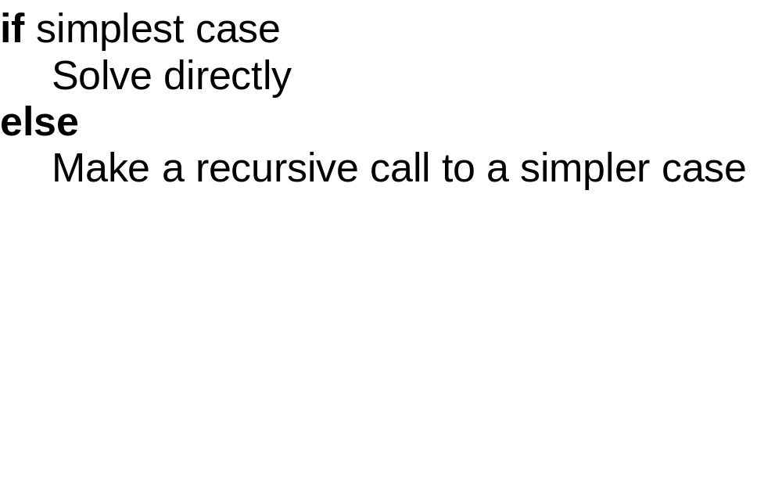

Slide 4
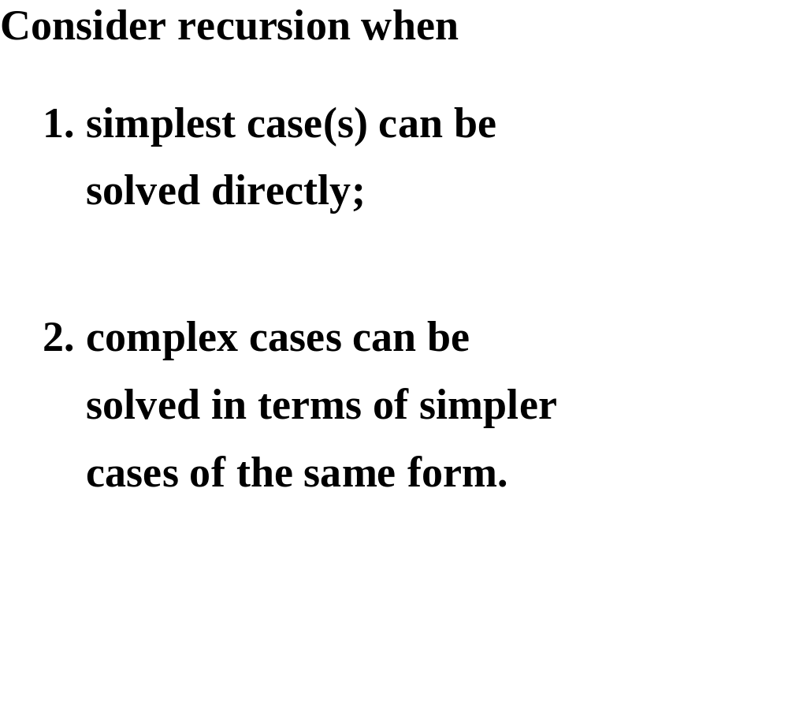

Slide 5
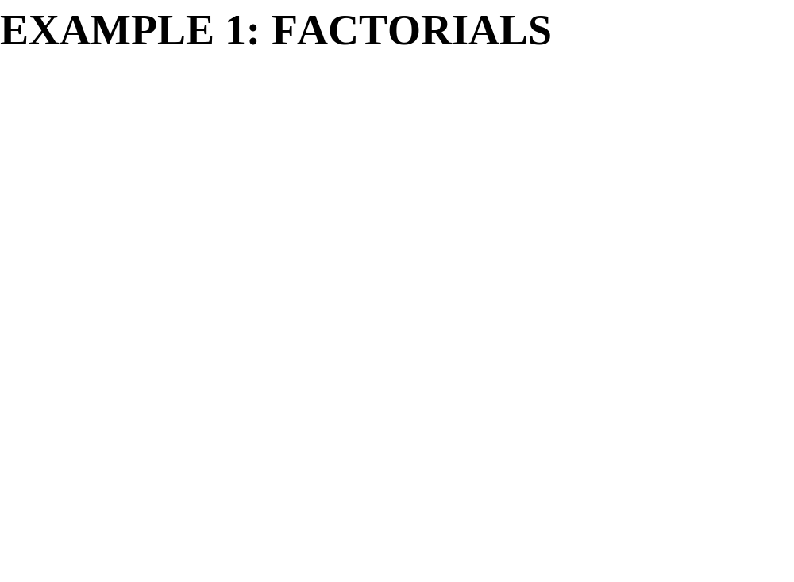

Slide 6
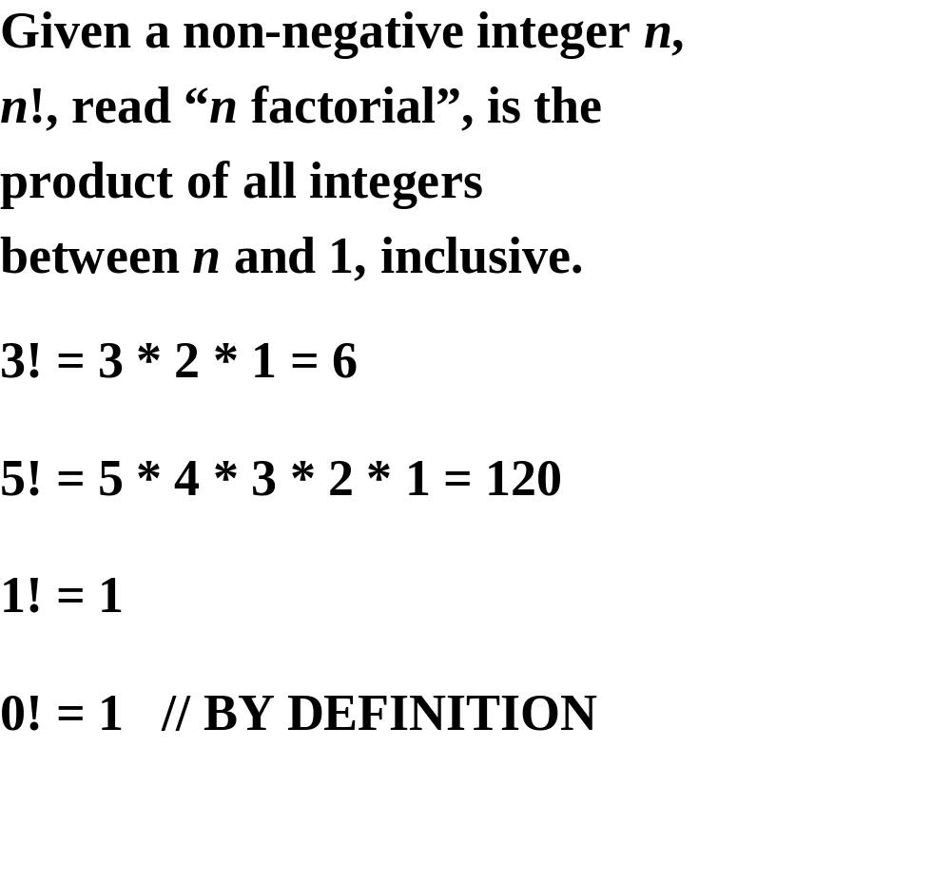

Slide 7
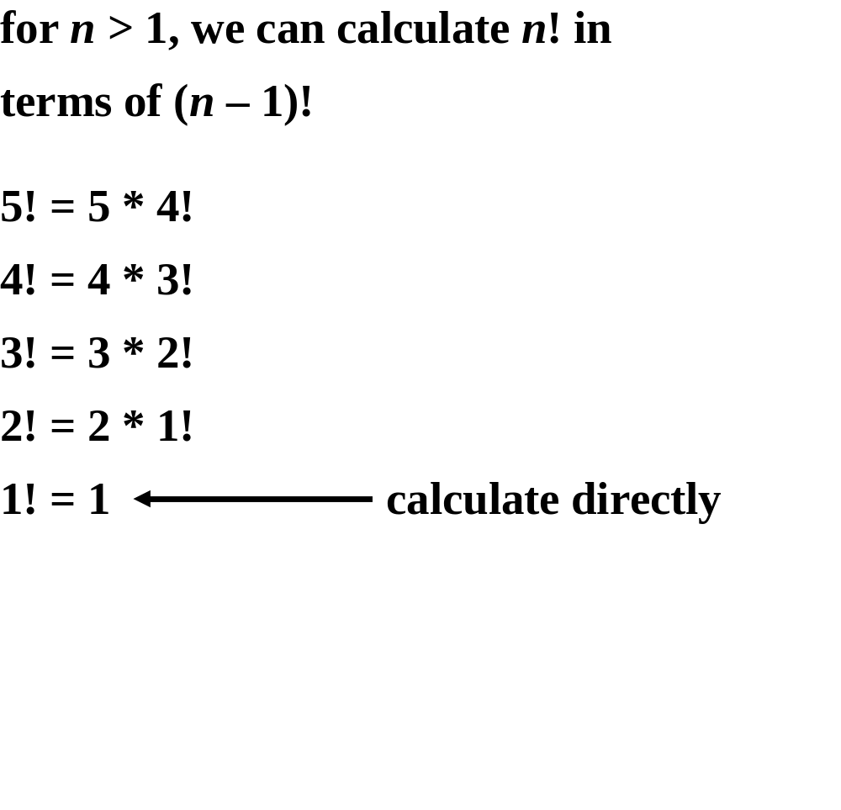

Slide 8
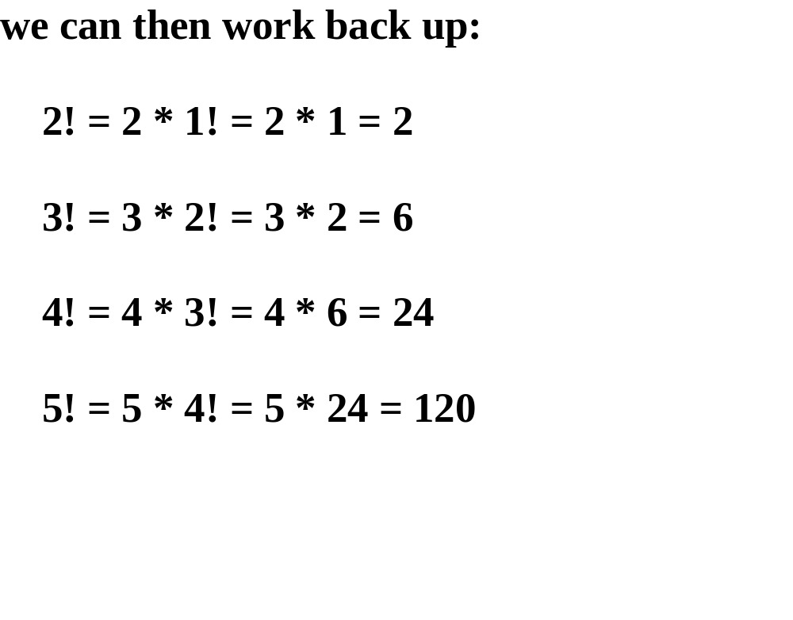

Slide 9
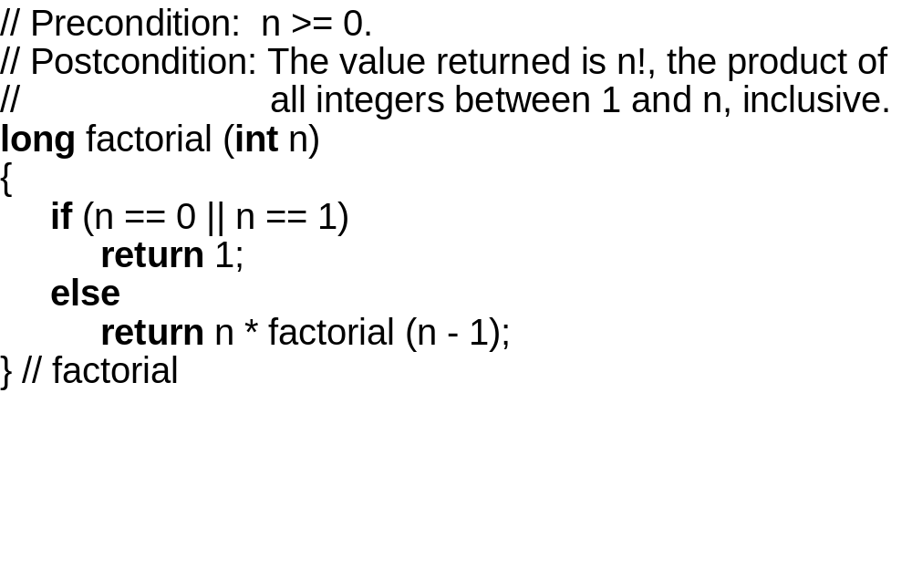

Slide 10
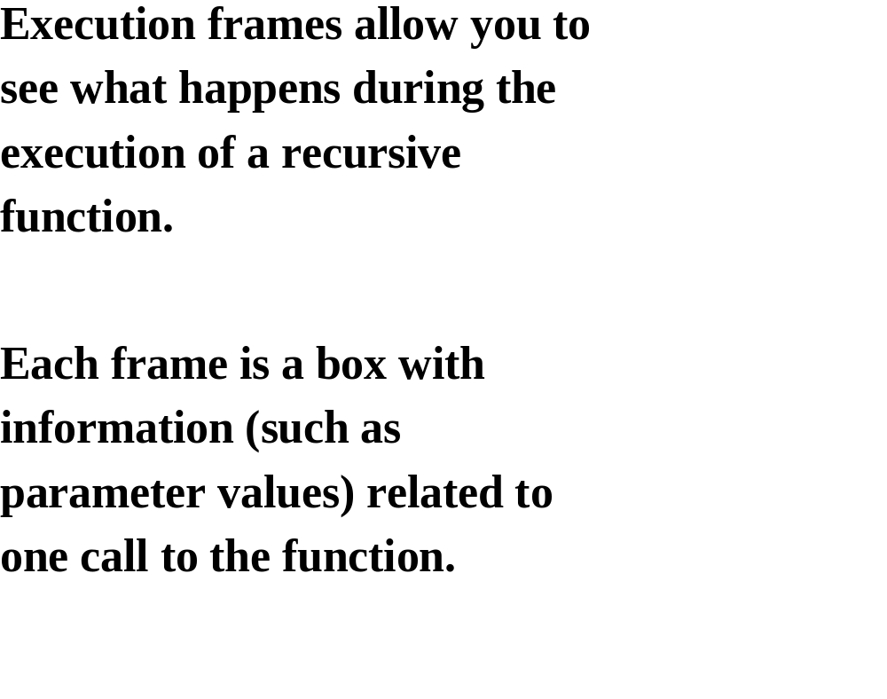

Slide 11
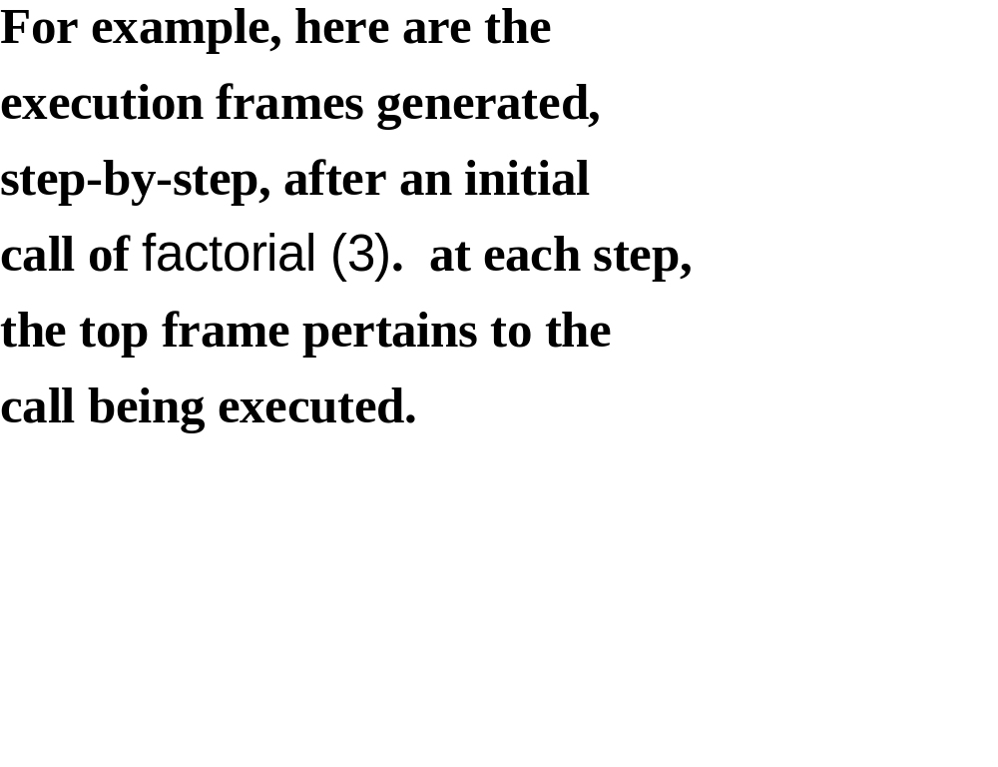

Slide 12
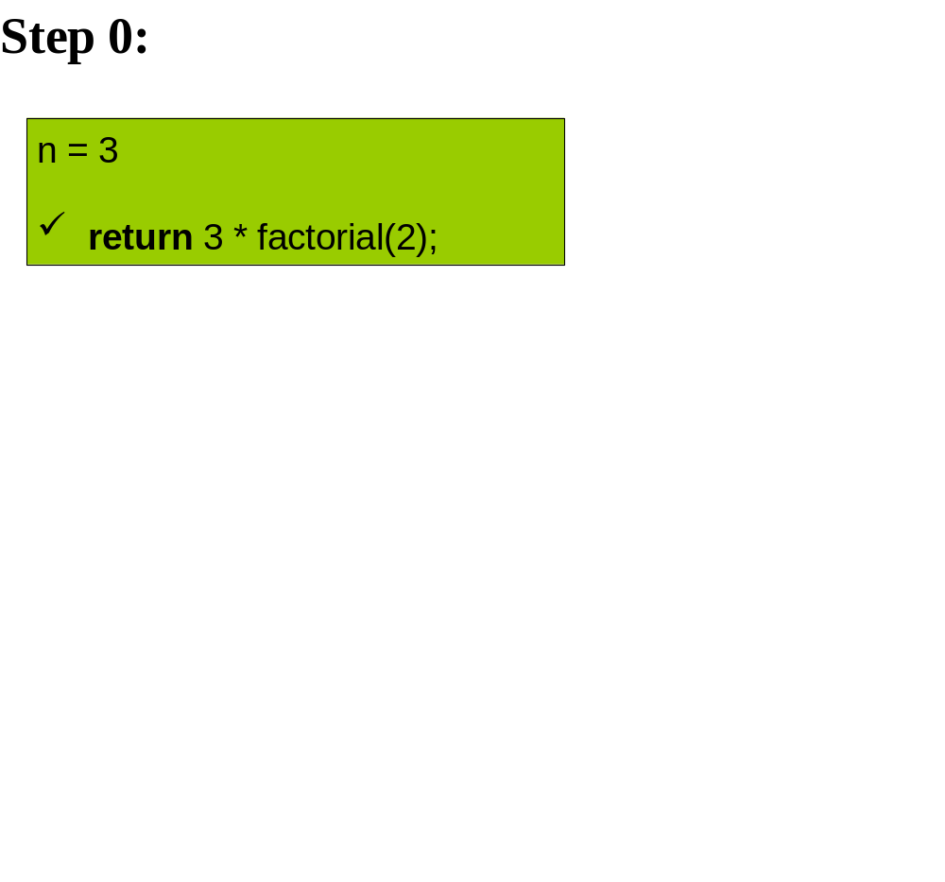

Slide 13
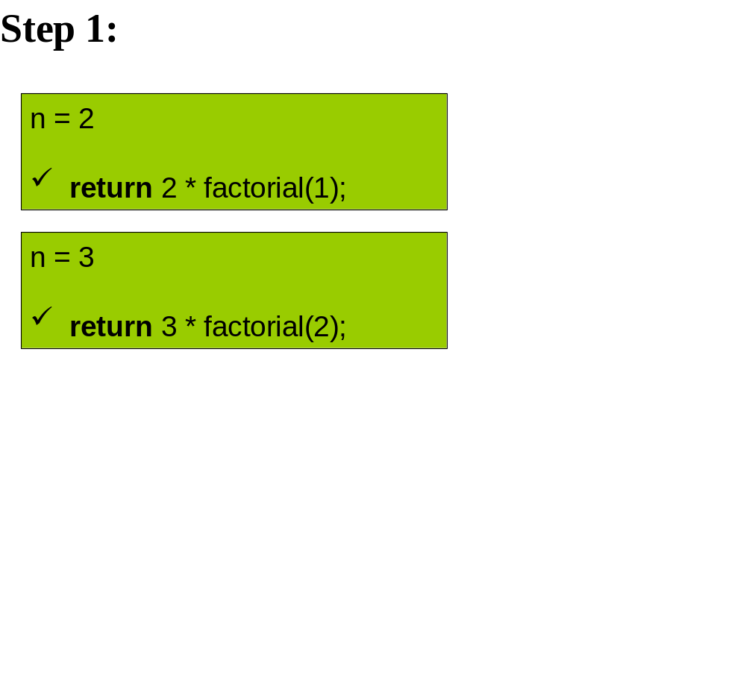

Slide 14
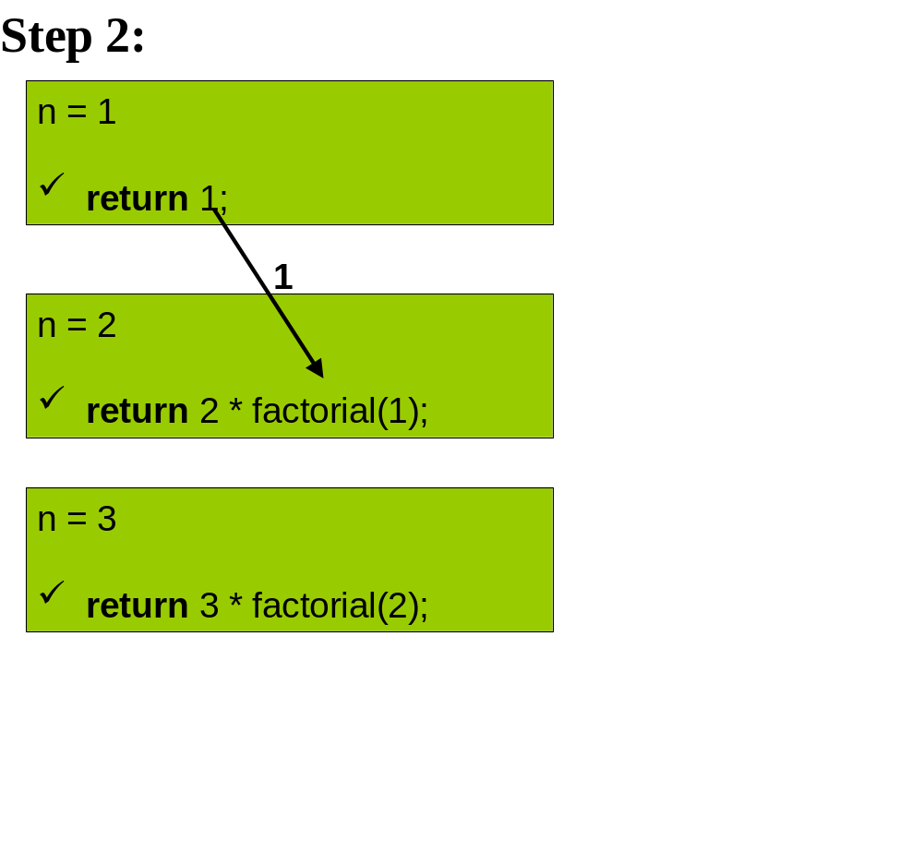

Slide 15
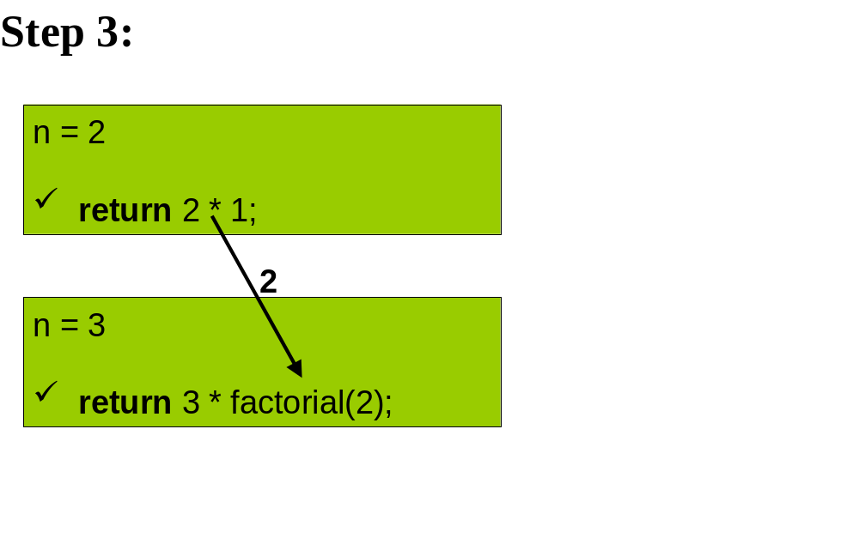

Slide 16
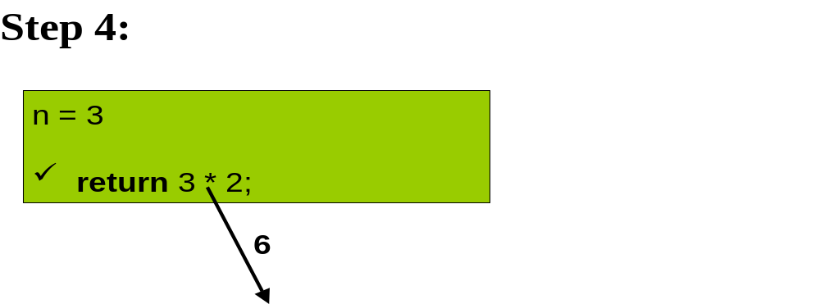

Slide 17
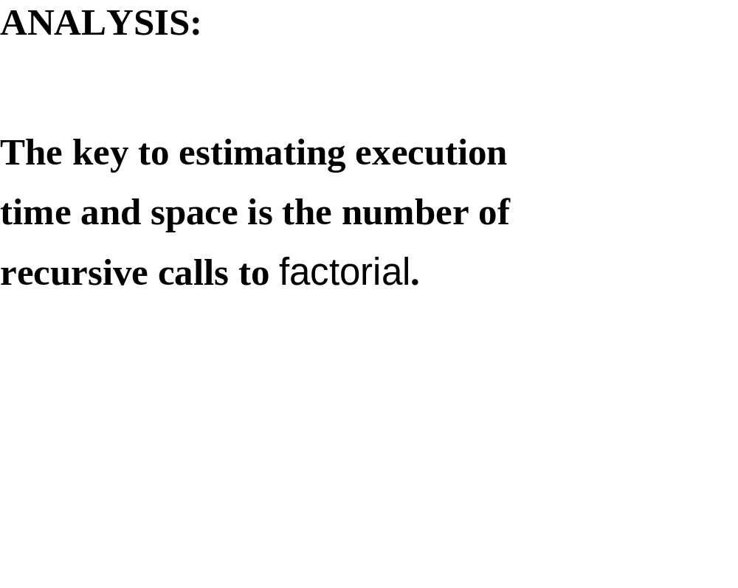

Slide 18
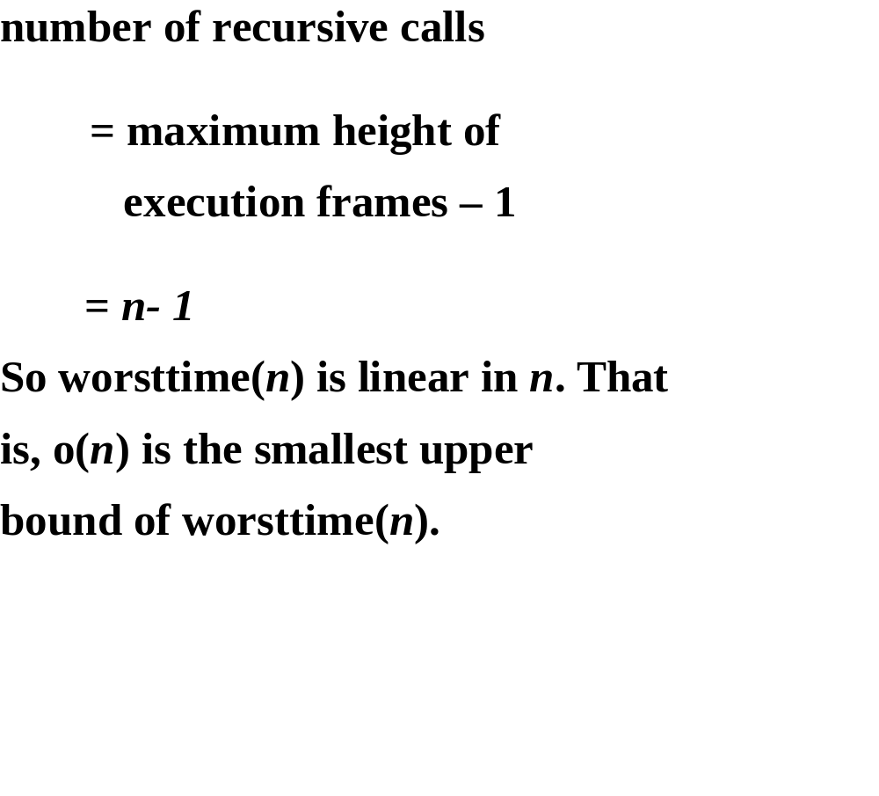

Slide 19
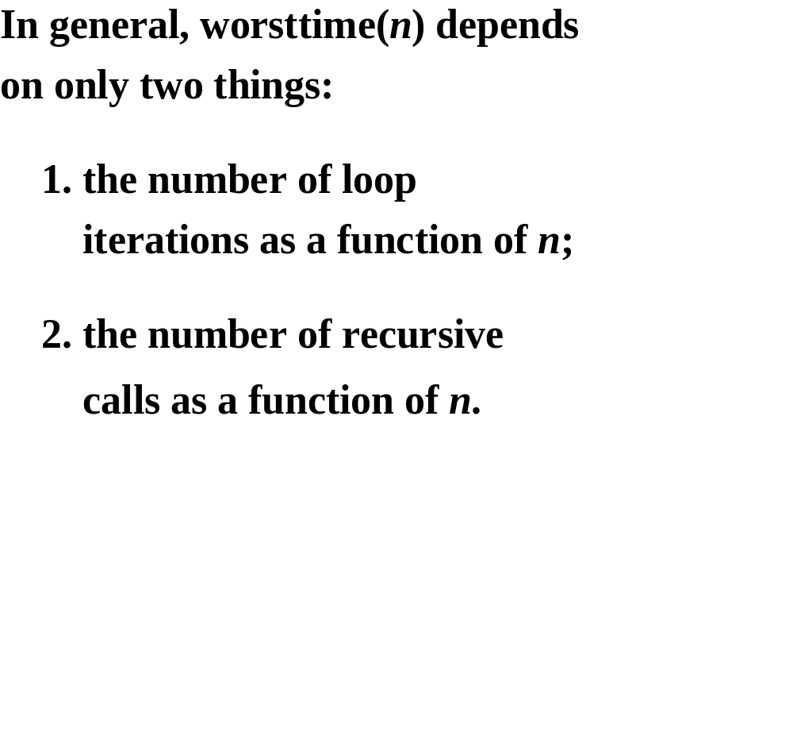

Slide 20
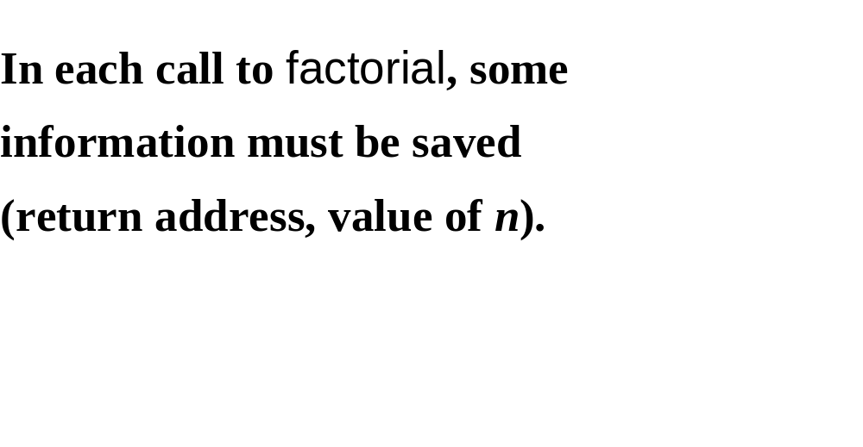

Slide 21
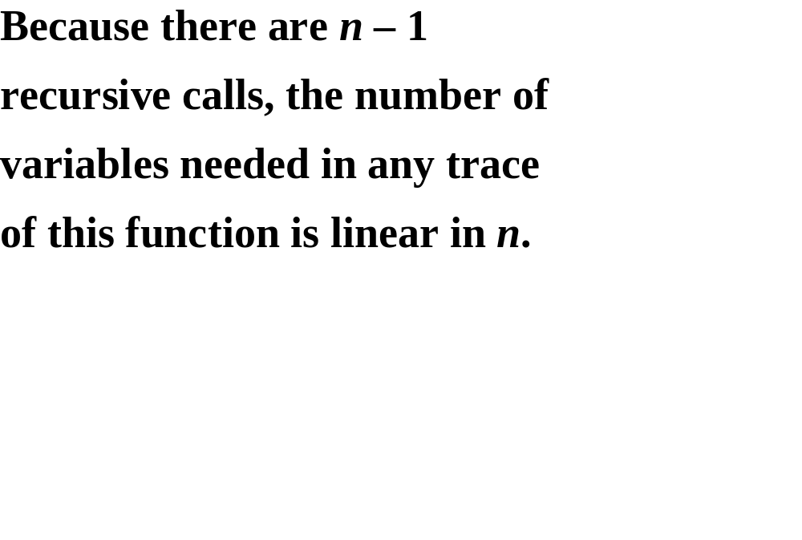

Slide 22
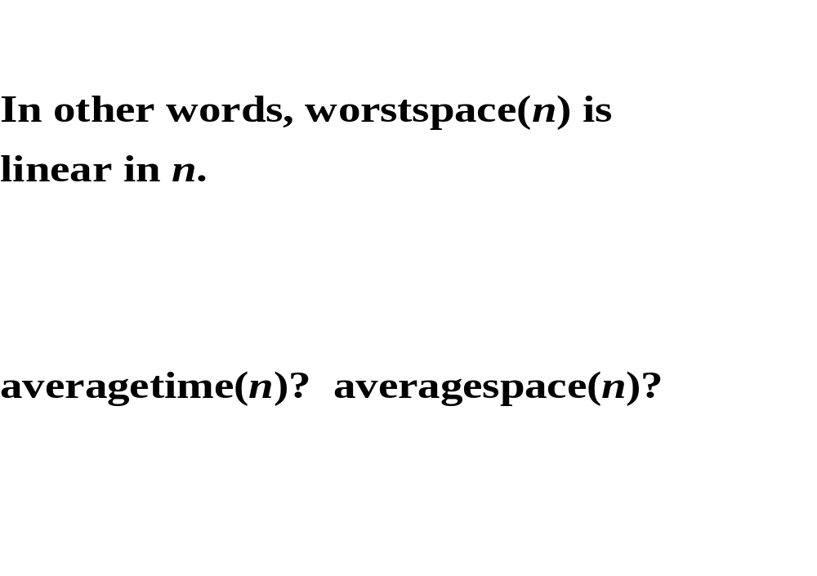

Slide 23
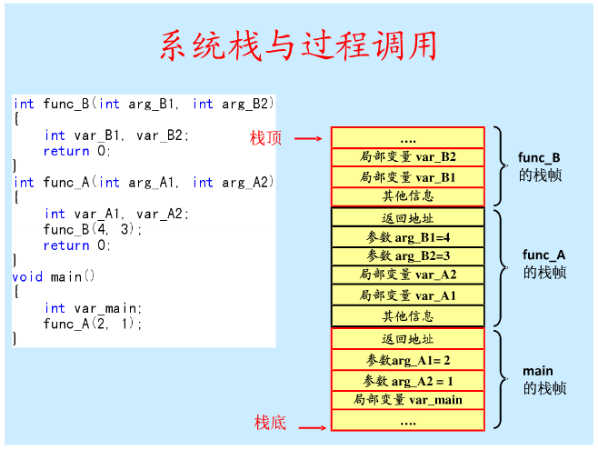

Slide 24
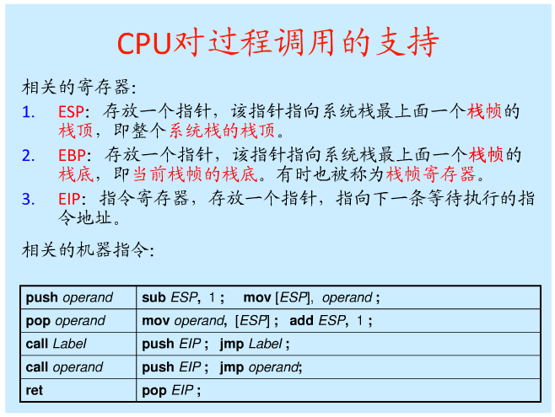

Slide 25
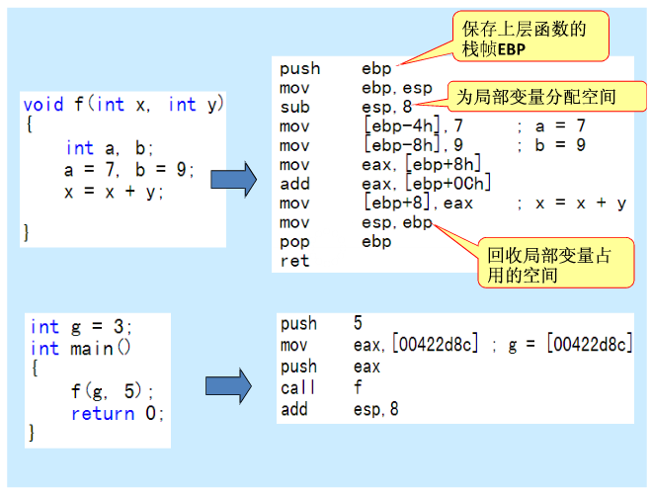

Slide 26
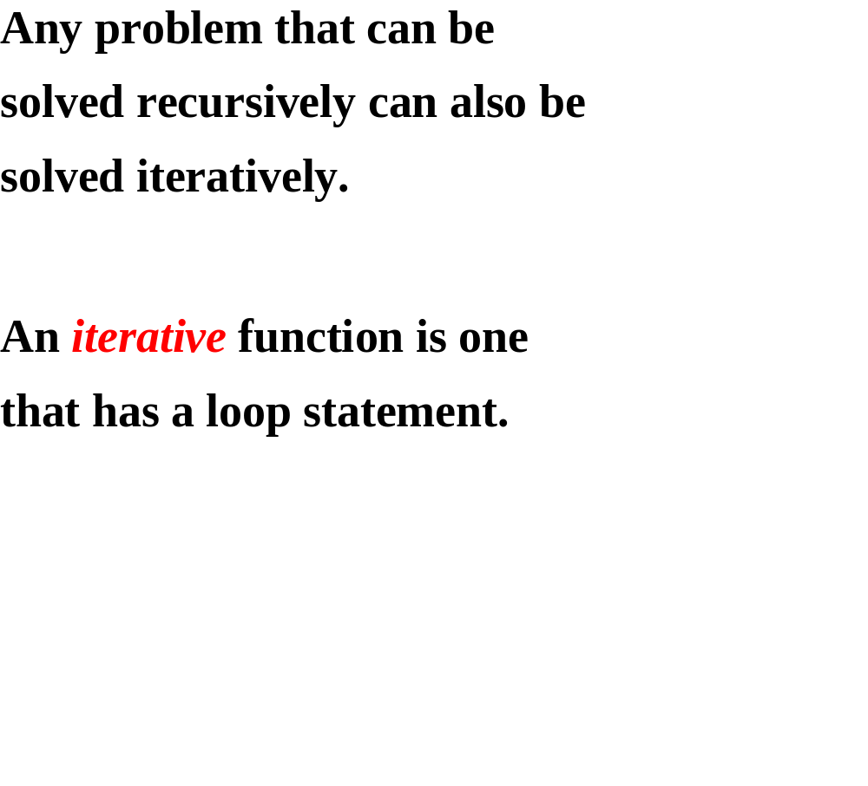

Slide 27
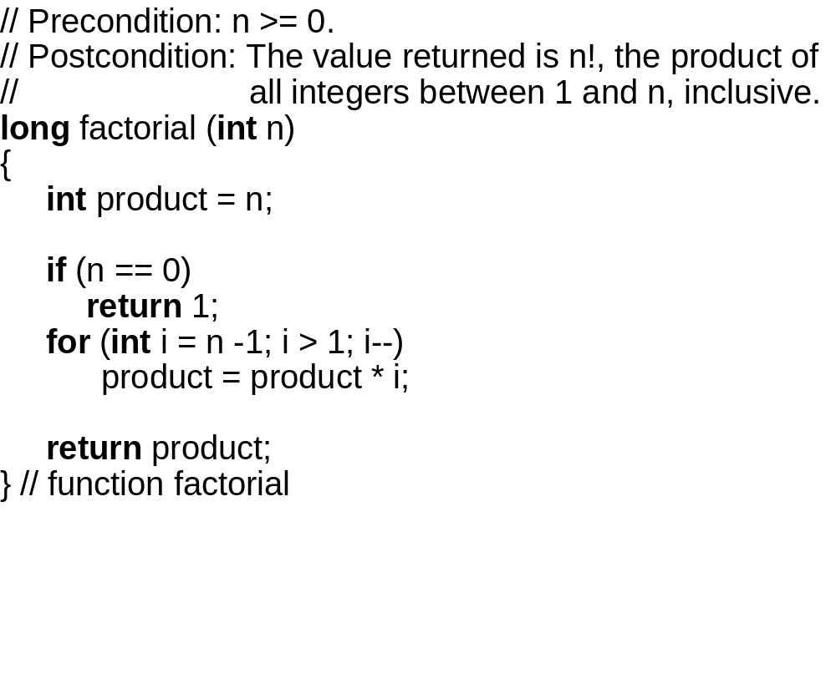

Slide 28
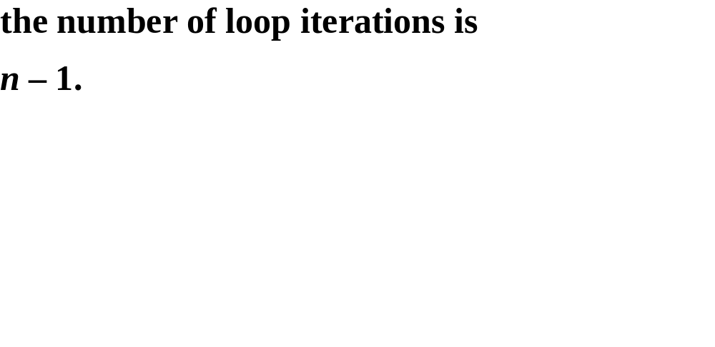

Slide 30
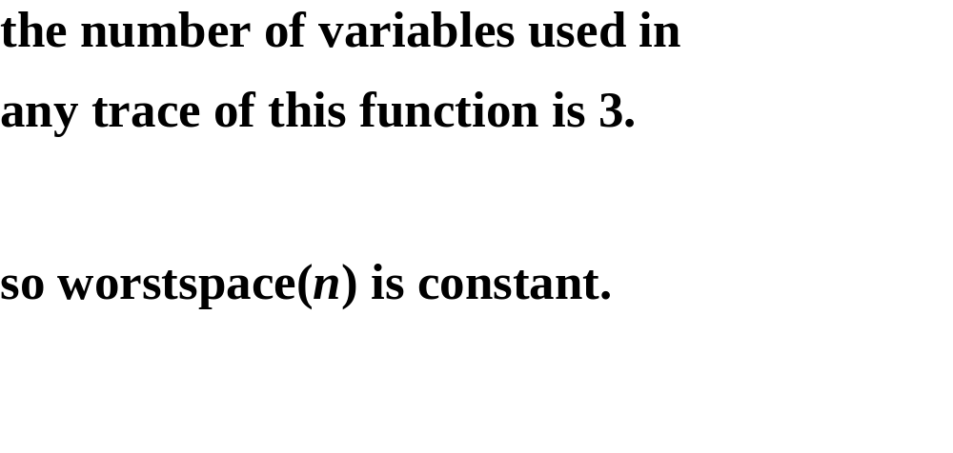

Slide 31
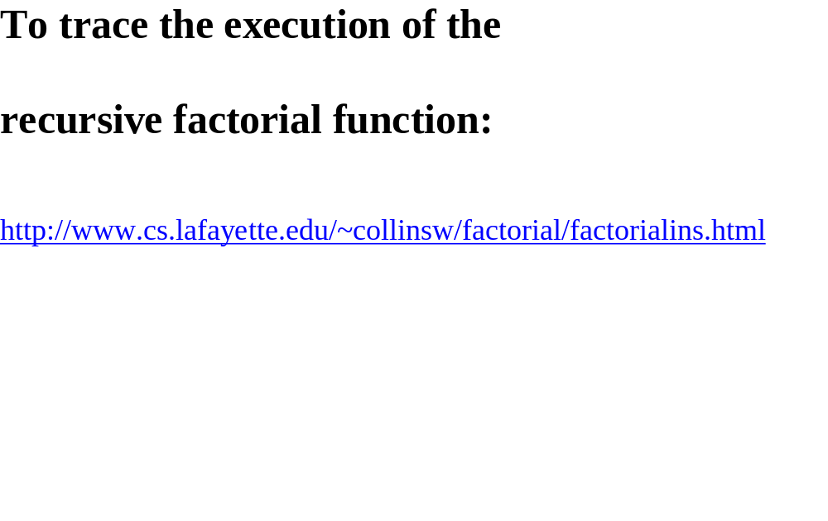

Slide 32
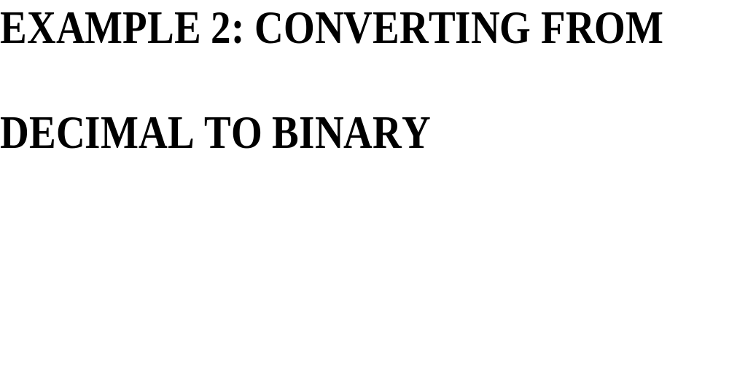

Slide 33
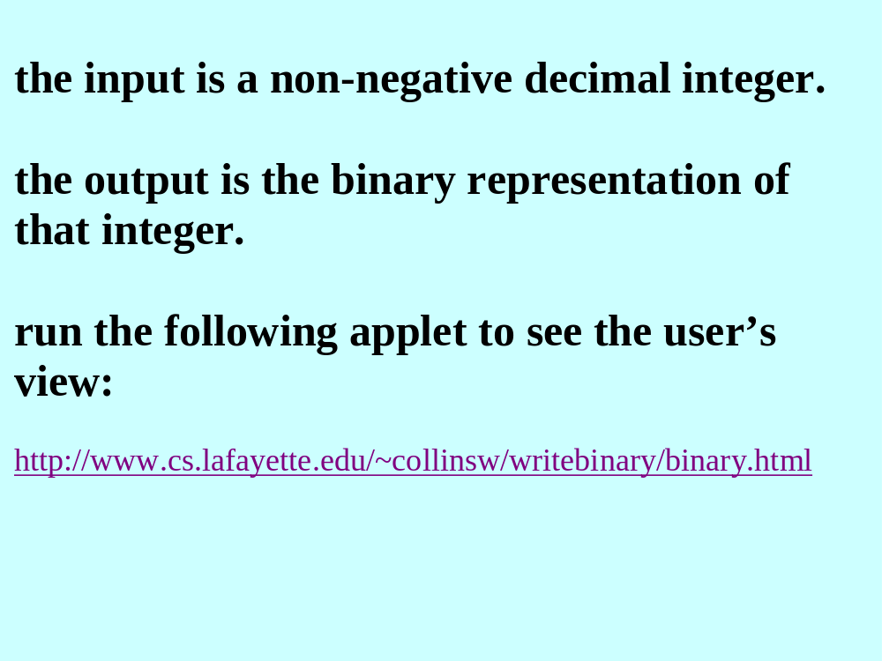

Slide 34
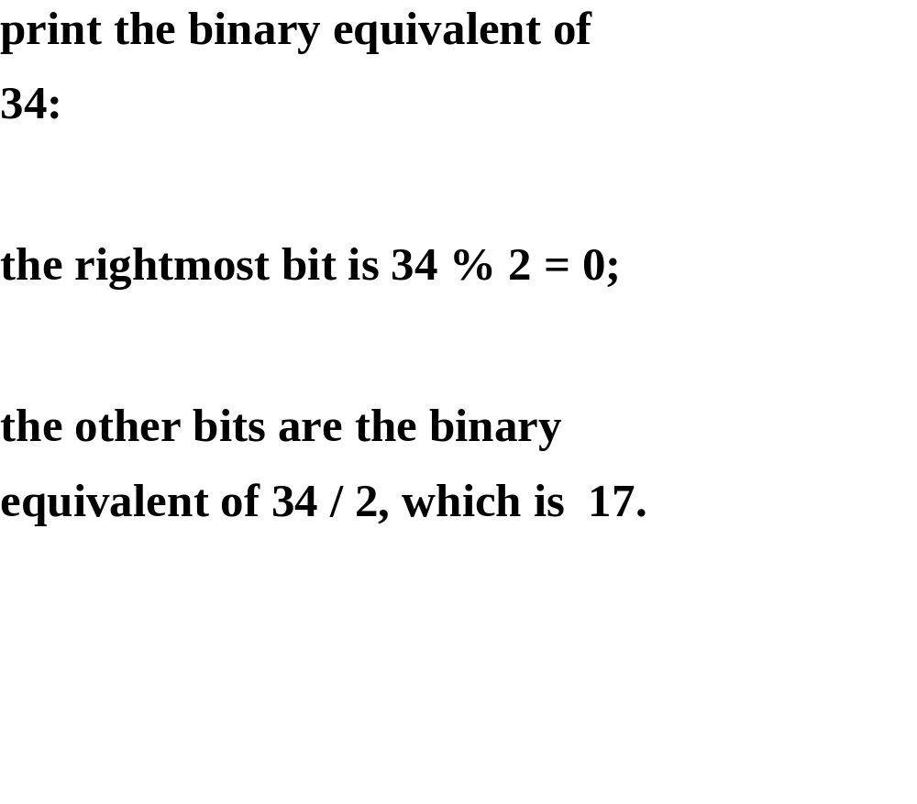

Slide 35
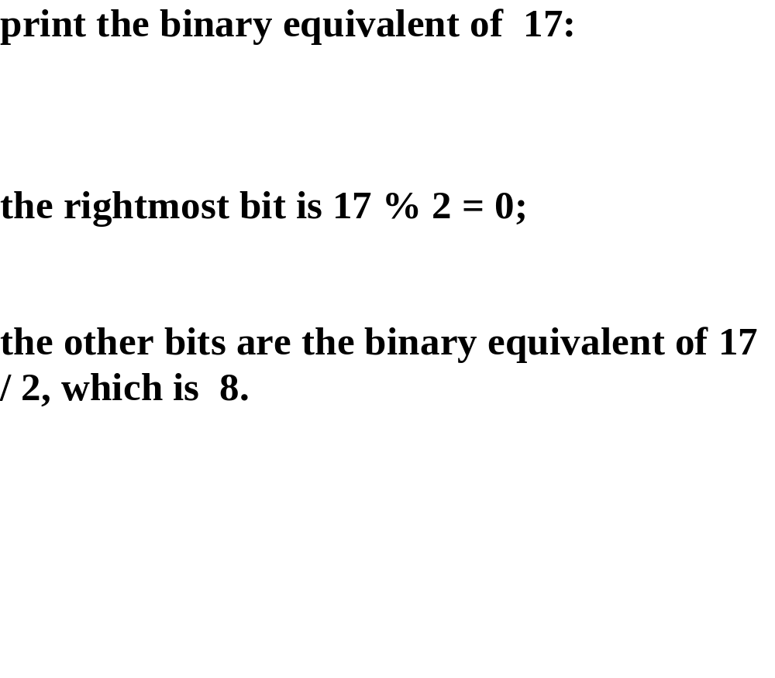

Slide 36
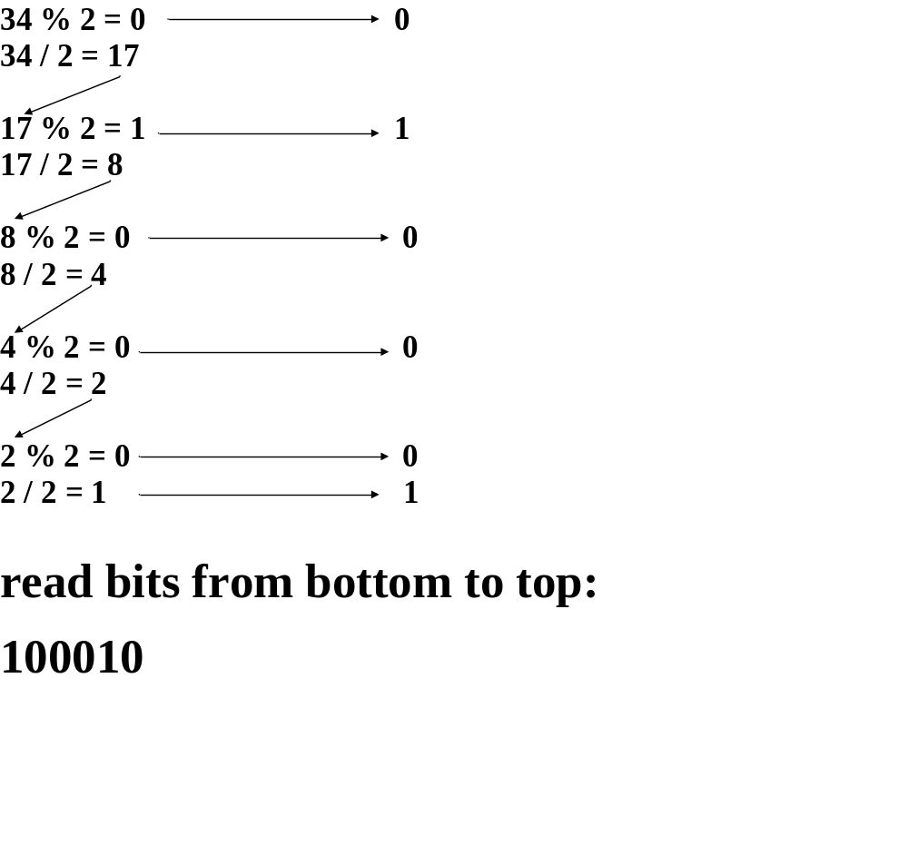

Slide 37
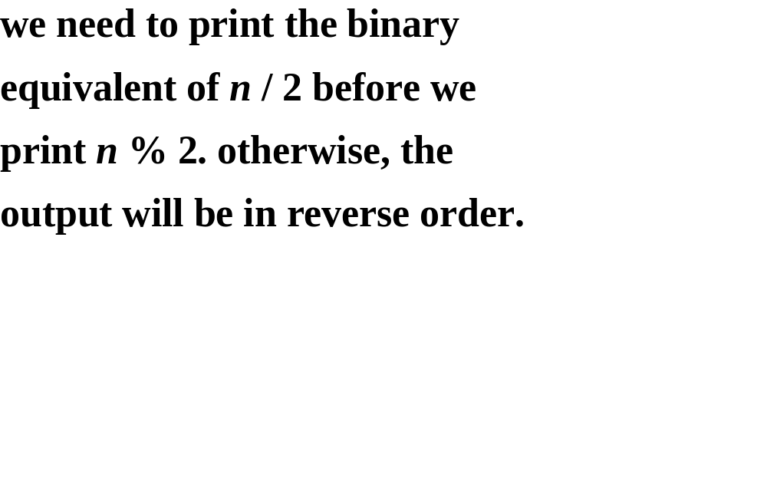

Slide 38
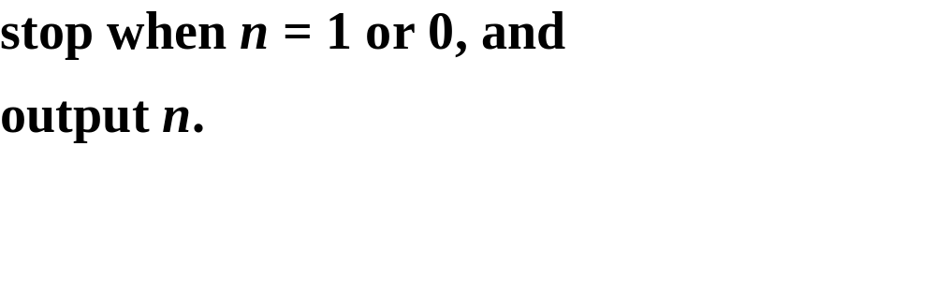

Slide 39
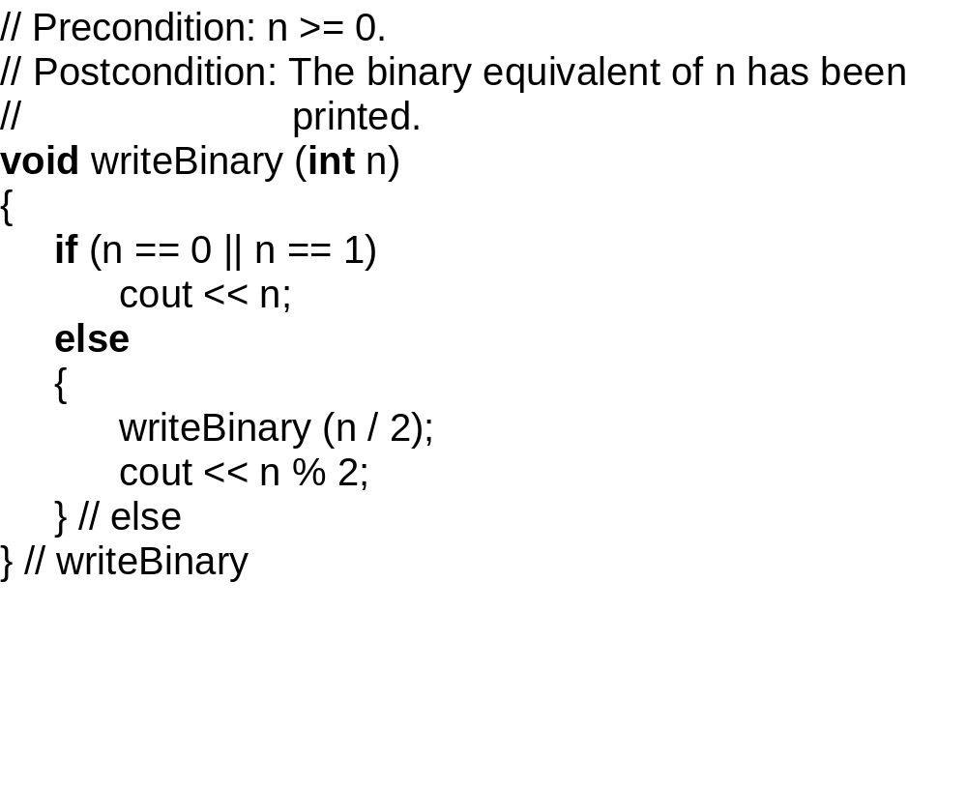

Slide 40
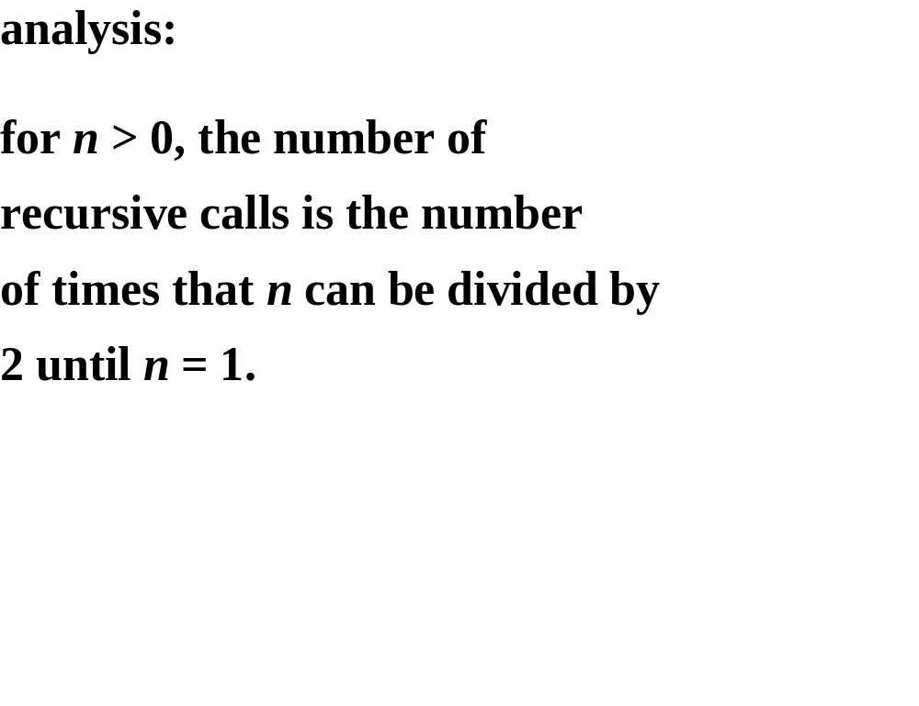

Slide 41
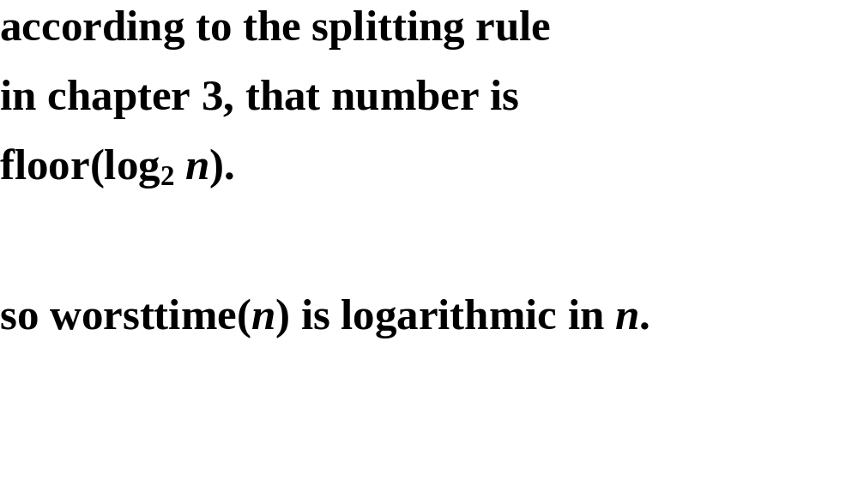

Slide 42


Slide 43
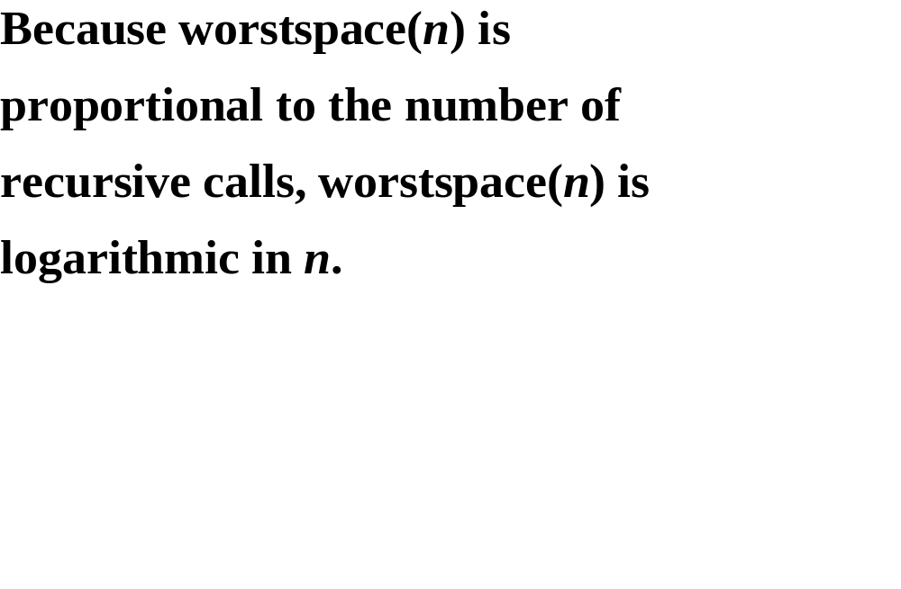

Slide 44
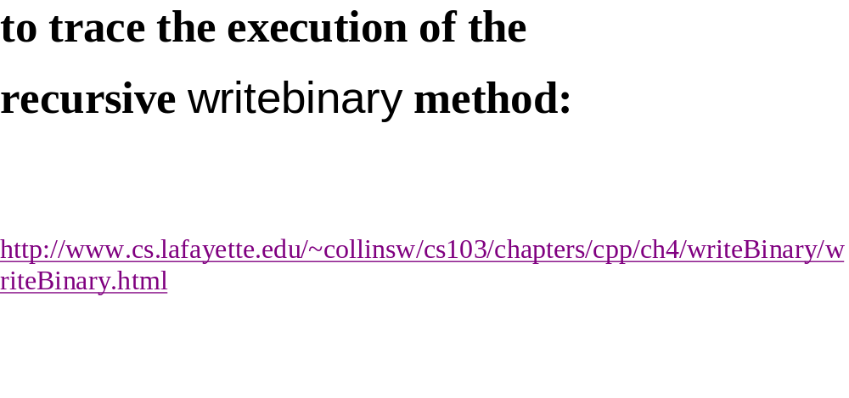

Slide 45
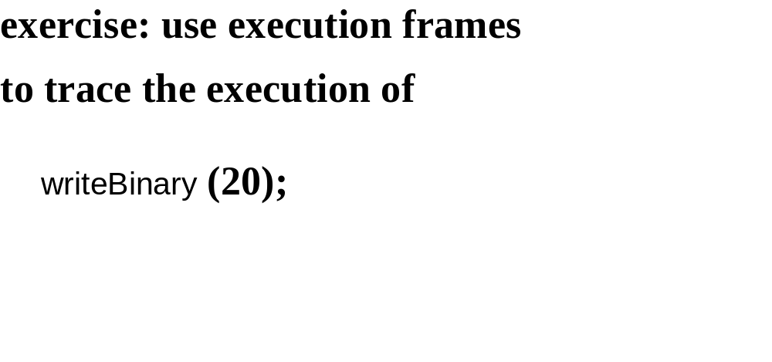

Slide 46
EXAMPLE 3: TOWERS OF HANOI

Slide 47
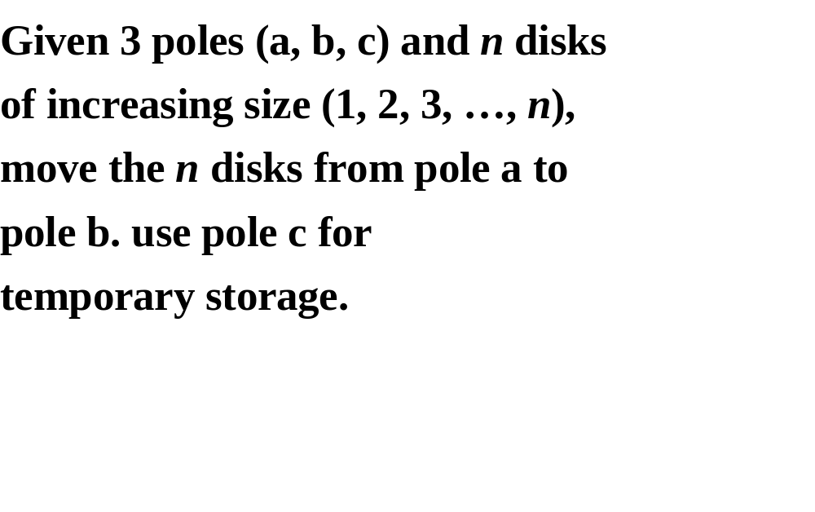

Slide 48
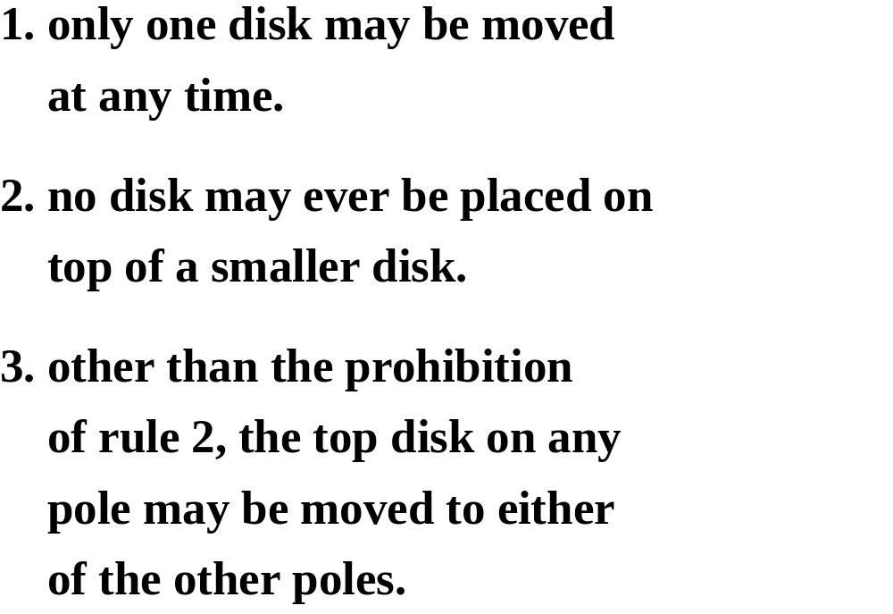

Slide 49
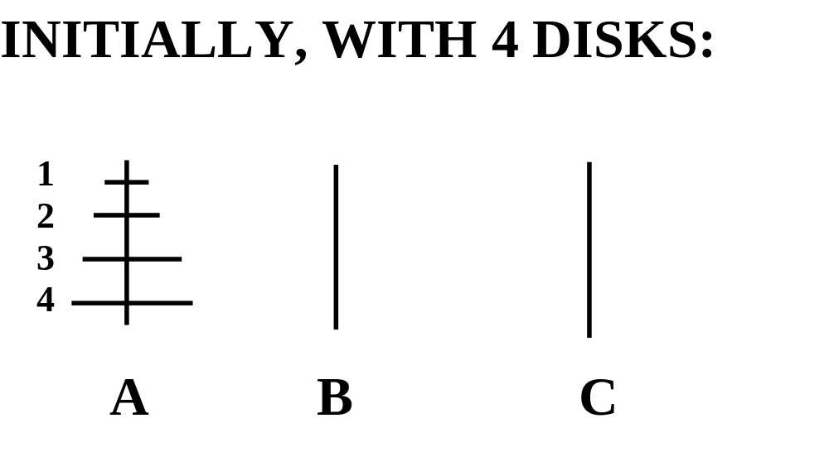

Slide 50
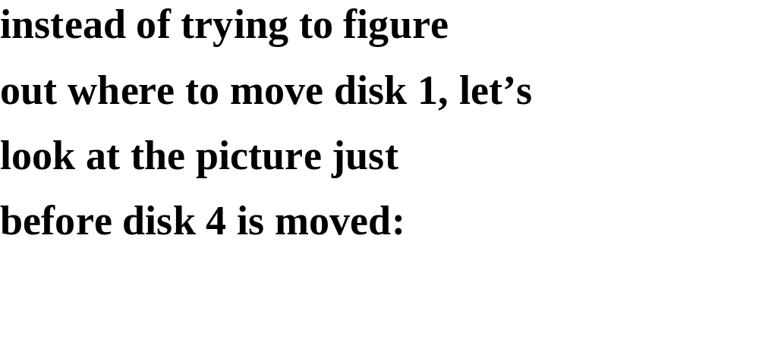

Slide 51
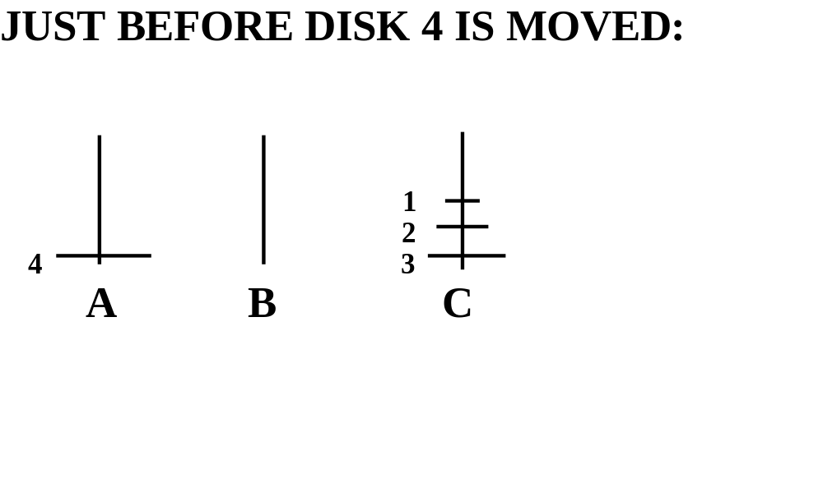

Slide 52
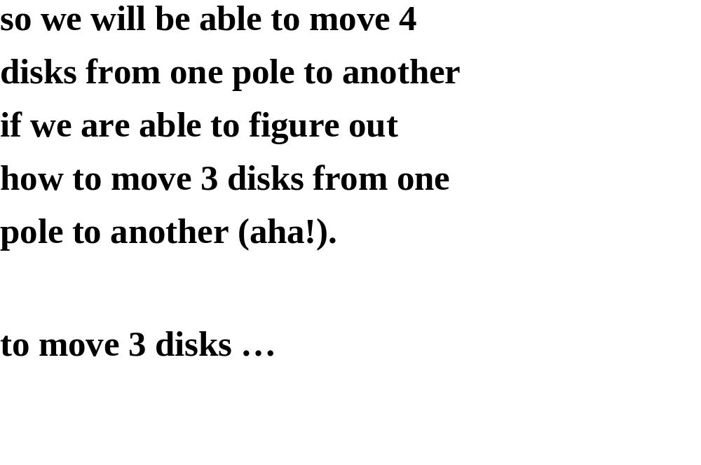

Slide 53
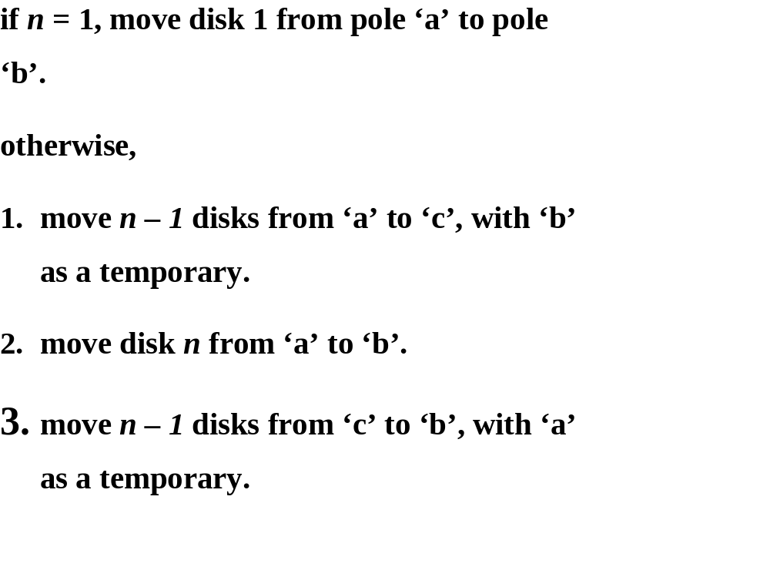

Slide 54
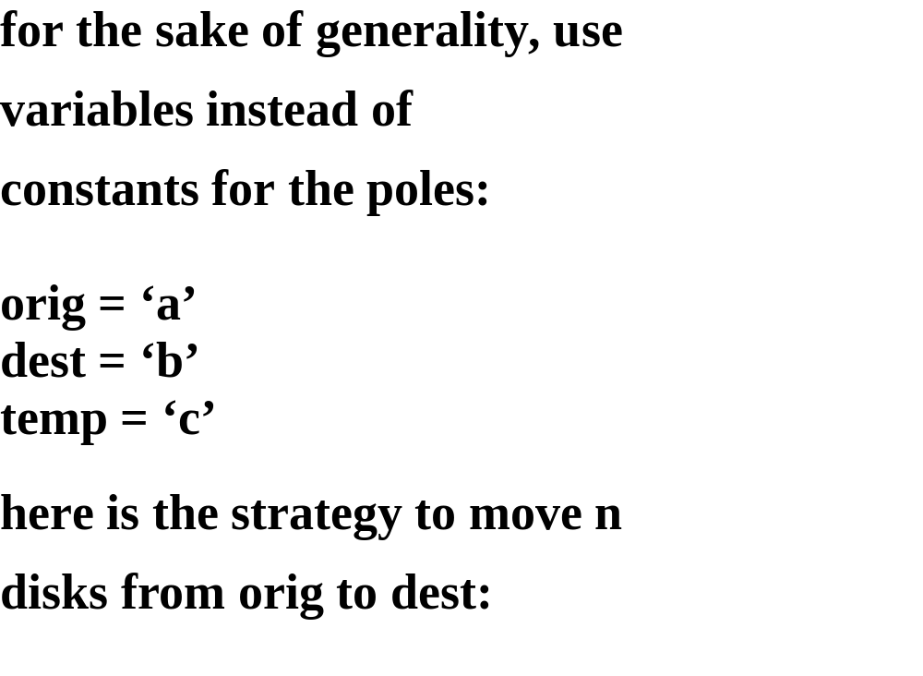

Slide 55
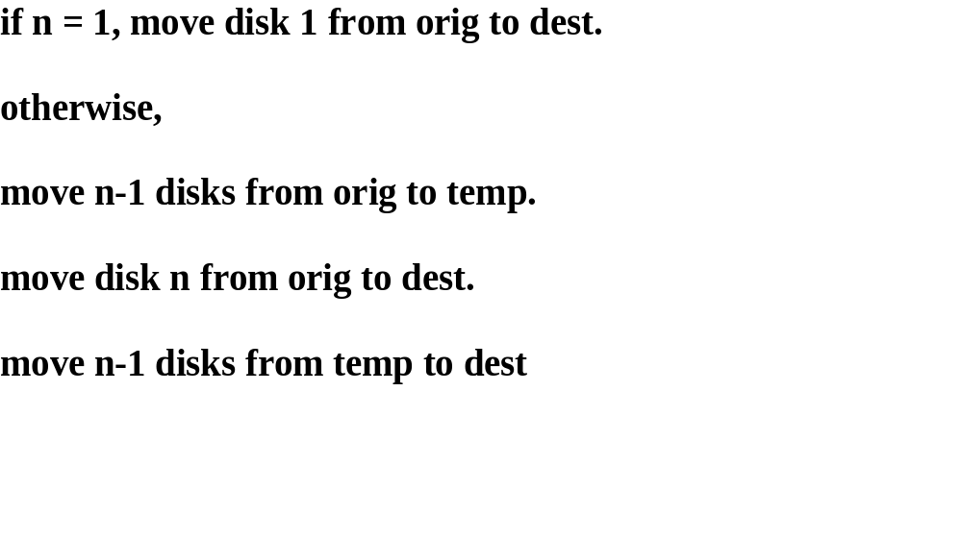

Slide 56
// Precondition: n > 0.
// Postcondition: The steps needed to move n disks from pole orig
// to pole dest have been written out. Pole temp
// is used for temporary storage.
// The worstTime(n) is O(2 ^{n}).
void move (int n, char orig, char dest, char temp)
{
if (n == 1)
cout << "Move disk 1 from " << orig << " to "
<< dest << endl;
else
{
move (n ‑ 1, orig, temp, dest);
cout << "Move disk " << n << " from " << orig
<< " to " << dest << endl;
move (n ‑ 1, temp, dest, orig) ;
} // else
} // move

Slide 57


Slide 58


Slide 59


Slide 60
the total number of calls to move is:
n-1
1 + 2 + 4 + … + 2 ^{n-1} = ∑ 2^{i}
i=0

Slide 61
n-1
∑ 2^{i} = 2^{n} - 1
i=0
see example 6 of appendix 1 for a
proof by mathematical
induction.

Slide 62
we conclude that worsttime(n) is
o(2^{n}), and, because 2^{n} - 1 disks must
be moved, o(2^{n}) is the smallest
upper bound of worsttime(n).

Slide 63


Slide 64


Slide 65
EXAMPLE 4:
BACKTRACKING

Slide 66
Backtracking is the strategy
of trying to reach a goal by a
sequence of chosen positions,
with re-tracing in reverse
order of positions that
cannot lead to the goal.

Slide 67
STRATEGY: try to go west; if unable to go west,
try to go south; if unable to go south,
backtrack (until you can go south). The goal is
either G1 or G2.
P3 P2 P1
P4 P5
G2 P7 P6
G1

Slide 68
When a position is visited, it is
marked as (potentially) being on
a path to the goal. If we
discover otherwise, the
marking must be undone, so that
position will never again be
visited.

Slide 69
We will solve this maze-search
problem within the general
framework of backtracking,
which can easily be utilized in
other applications.

Slide 70
ALREADY PROVIDED:
Application.h (methods such as valid,
record, done, undo)
GENERAL-PURPOSE Backtrack CLASS;
main FUNCTION;
USER SUPPLIES:
A source file that implements
the header file application.h;
a position class

Slide 71


Slide 72


Slide 73


Slide 74


Slide 75


Slide 76


Slide 77


Slide 78


Slide 79


Slide 80

Two very important things:
1.It’s a post-increment, but a new position should be returned?
2. What is the position pointed by itr after post-increment?
Recursive call and return here!

Slide 81


Slide 82


Slide 83
MAZE SEARCHING: 1 = CORRIDOR;
0 = WALL
start 1 1 1 0 1 1 0 0 0 1 1 1 1
        1 0 1 1 1 0 1 1 1 1 1 0 1
        1 0 0 0 1 0 1 0 1 0 1 0 1
        1 0 0 0 1 1 1 0 1 0 1 1 1
        1 1 1 1 1 0 0 0 0 1 0 0 0
        0 0 0 0 1 0 0 0 0 0 0 0 0
        0 0 0 0 1 1 1 1 1 1 1 1 1 finish
Iterator choices: north, east, south, west

Slide 84


Slide 85
SOLUTION: 9 = PATH; 2 = DEAD END
      9 9 9 0 2 2 0 0 0 2 2 2 2
      1 0 9 9 9 0 2 2 2 2 2 0 2
      1 0 0 0 9 0 2 0 2 0 2 0 2
      1 0 0 0 9 2 2 0 2 0 2 2 2
      1 1 1 1 9 0 0 0 0 1 0 0 0
      0 0 0 0 9 0 0 0 0 0 0 0 0
      0 0 0 0 9 9 9 9 9 9 9 9 9

Slide 86
All that need to be developed
are the position class and the
source file that implements
application.h.
For this application, a position is
simply a row and column, so:

Slide 87


Slide 88


Slide 89


Slide 90


Slide 91


Slide 92


Slide 93


Slide 94


Slide 95


Slide 96


Slide 97


Slide 98


Slide 99
exercise: recall the solution when the order was north, east, south, west:
9 9 9 0 2 2 0 0 0 2 2 2 2
      1 0 9 9 9 0 2 2 2 2 2 0 2
      1 0 0 0 9 0 2 0 2 0 2 0 2
      1 0 0 0 9 2 2 0 2 0 2 2 2
      1 1 1 1 9 0 0 0 0 1 0 0 0
      0 0 0 0 9 0 0 0 0 0 0 0 0
      0 0 0 0 9 9 9 9 9 9 9 9 9

Slide 100
re-solve with the order north, east, west, south:
start 1 1 1 0 1 1 0 0 0 1 1 1 1
        1 0 1 1 1 0 1 1 1 1 1 0 1
        1 0 0 0 1 0 1 0 1 0 1 0 1
        1 0 0 0 1 1 1 0 1 0 1 1 1
        1 1 1 1 1 0 0 0 0 1 0 0 0
        0 0 0 0 1 0 0 0 0 0 0 0 0
        0 0 0 0 1 1 1 1 1 1 1 1 1 finish
        HINT: ONLY ONE ‘1’ REMAINS.

Slide 101


Slide 102


Slide 103


Slide 104


Slide 105


Slide 106


Slide 107


Slide 108


Slide 109


Slide 110


Slide 111


Slide 112


Slide 113


Slide 114


Slide 115


Slide 116


Slide 117


Slide 118


Slide 119


Slide 120


Slide 121


Slide 122


Slide 123


Slide 124


Slide 125


Slide 126


Slide 127


Slide 128


Slide 129


Slide 130


Slide 131


Slide 132


Slide 133


Slide 134


Slide 135


Slide 136


Slide 137


Slide 138


Slide 139


Slide 140


Slide 141


Slide 142


Slide 143


Slide 144


Slide 145


Slide 146


Slide 147


Slide 148


Slide 149


Slide 150


