Slide 1
CHAPTER 5
VECTORS AND DEQUES

Slide 2
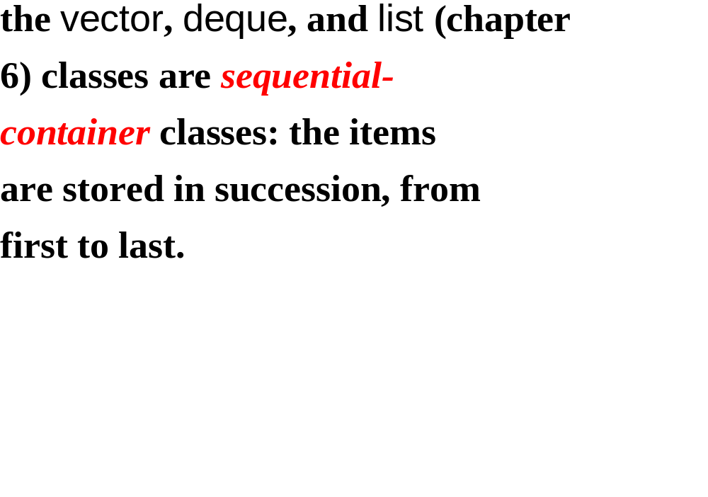

Slide 3
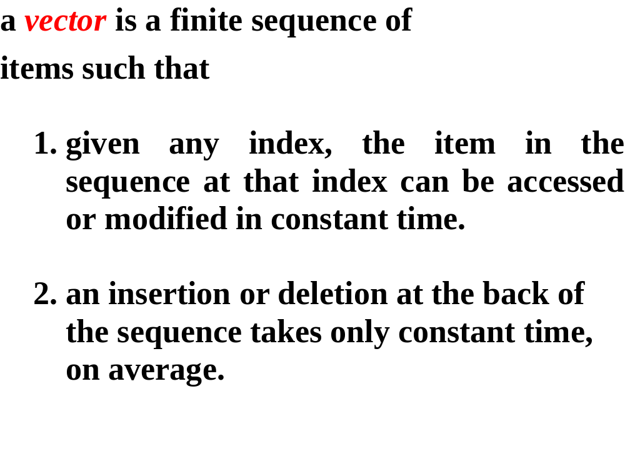

Slide 4
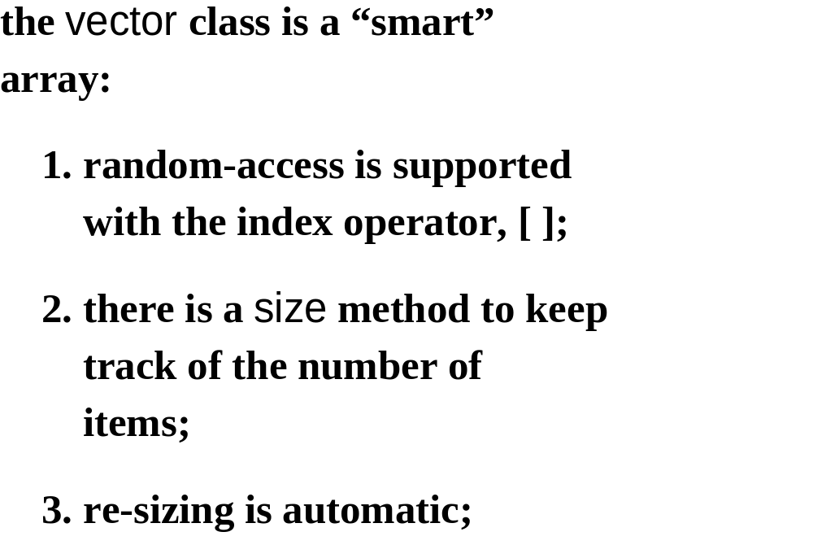

Slide 5
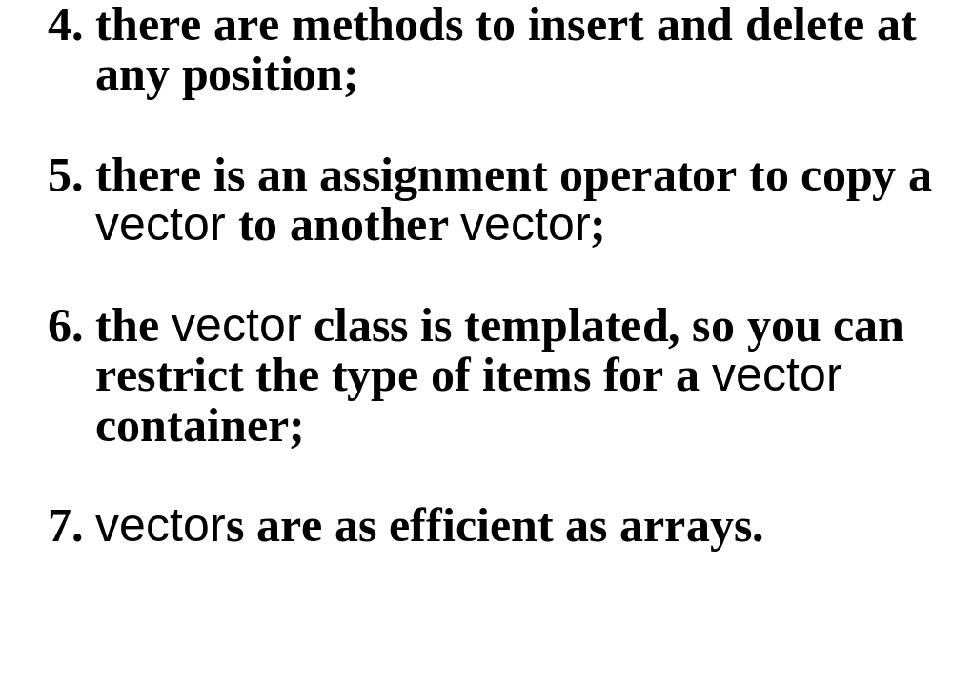

Slide 6


Slide 7
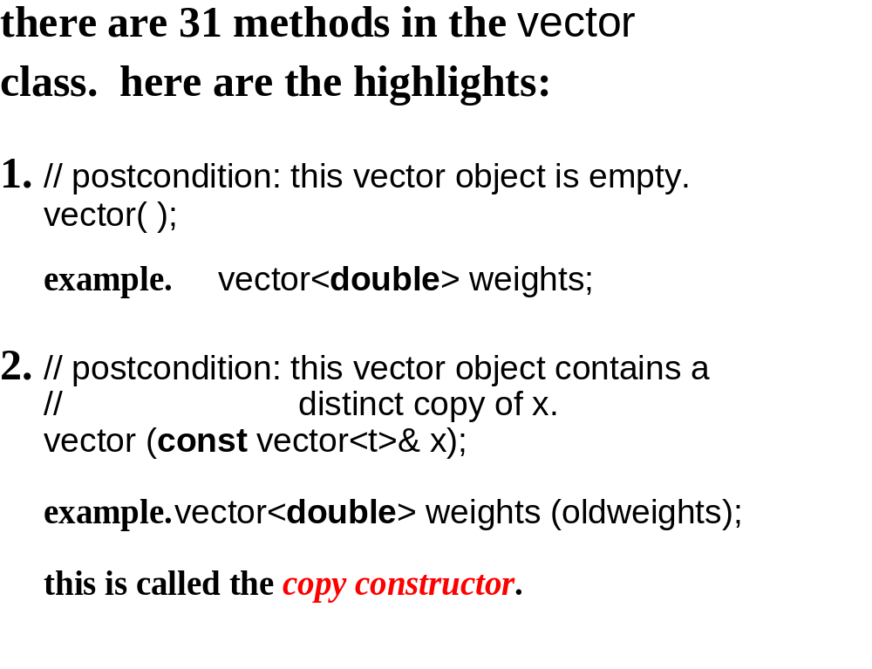

Slide 8
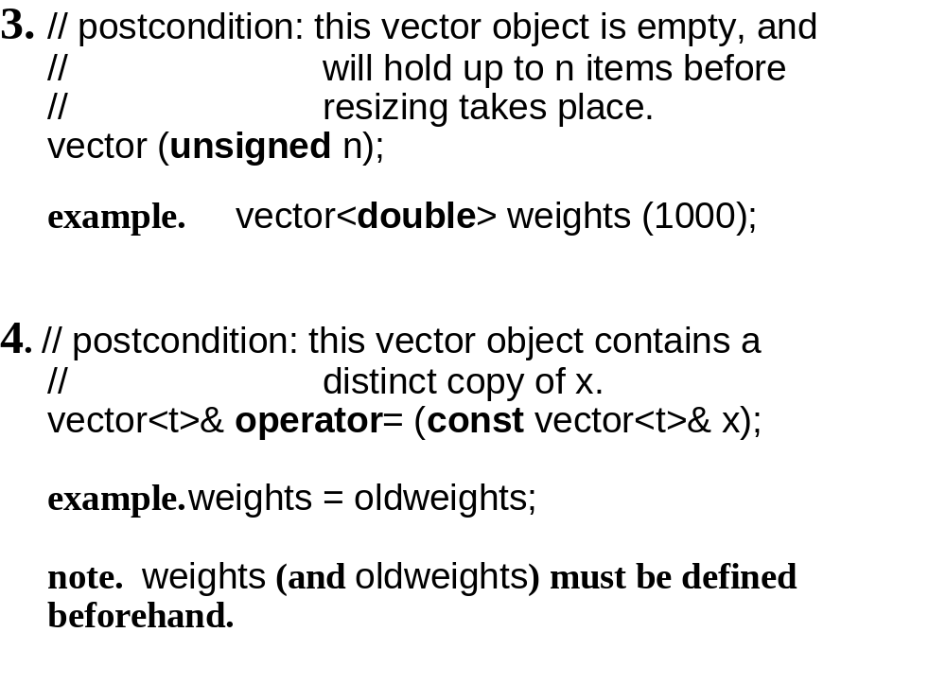

Slide 9
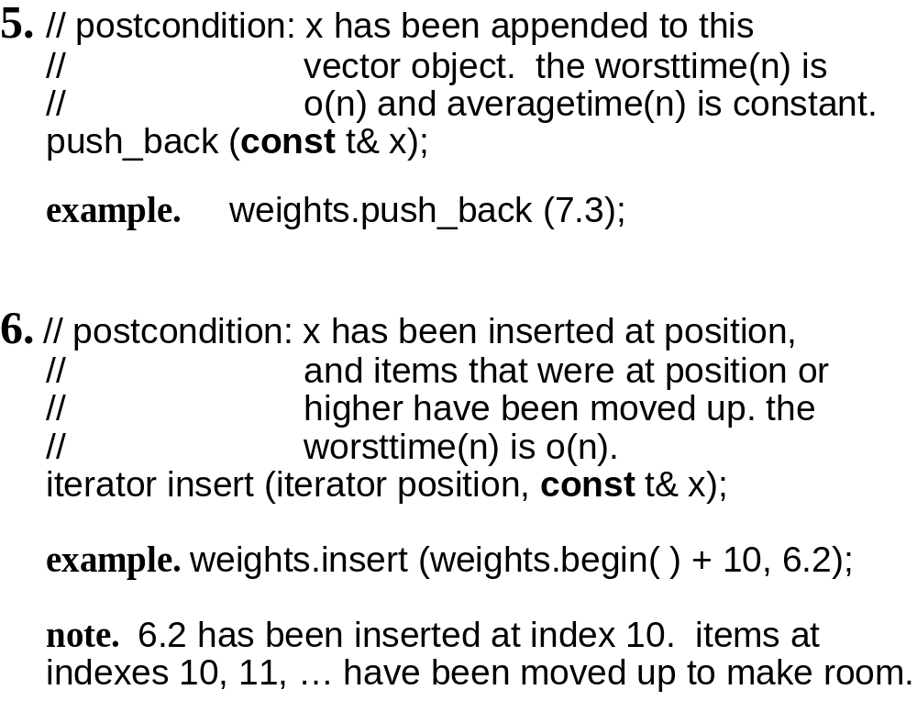

Slide 10
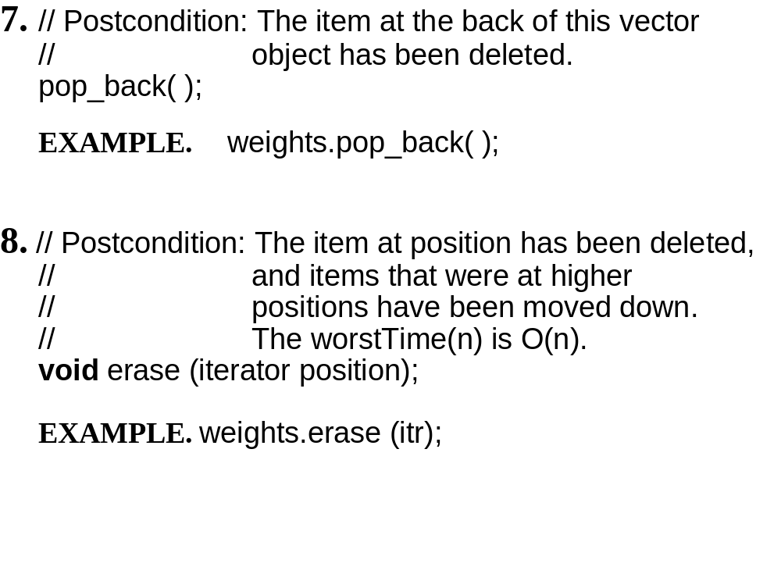

Slide 11
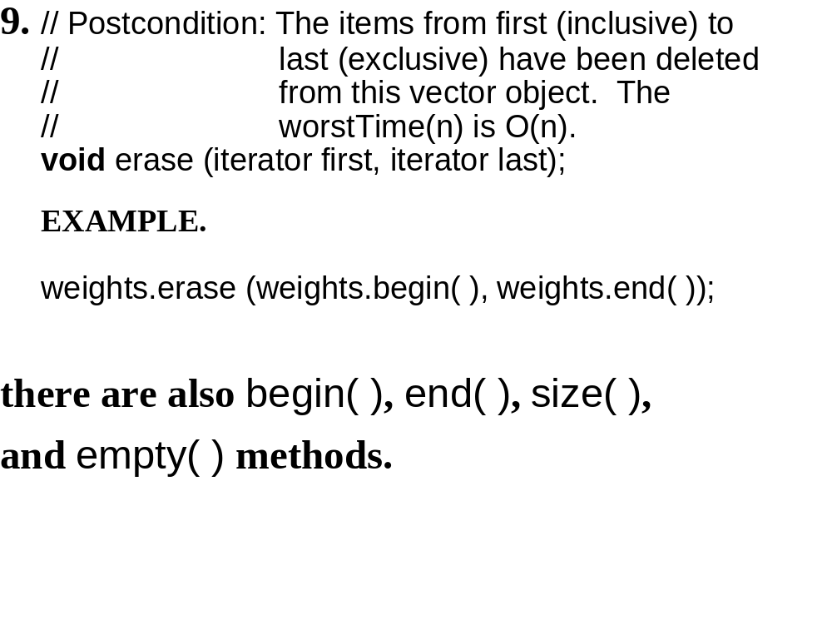

Slide 12
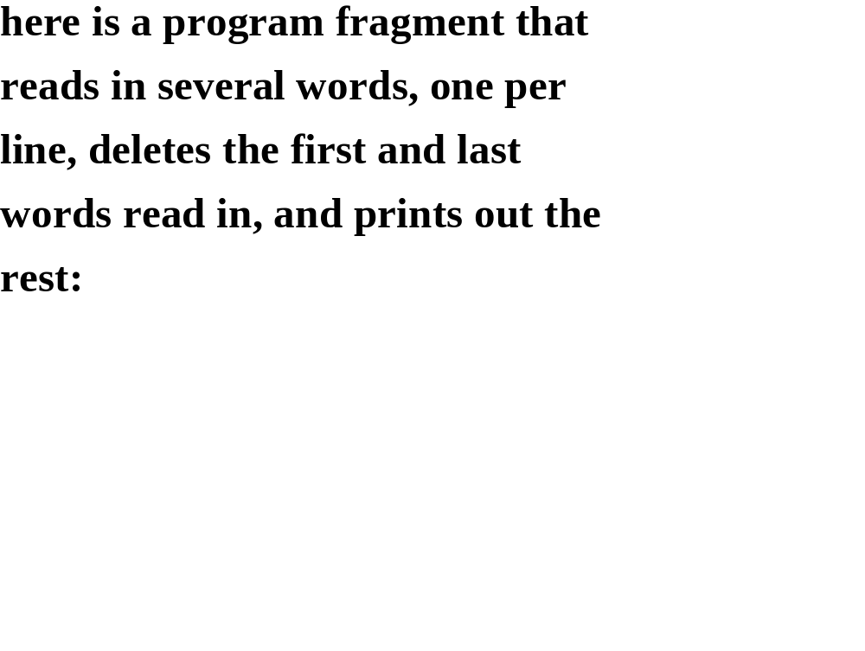

Slide 13
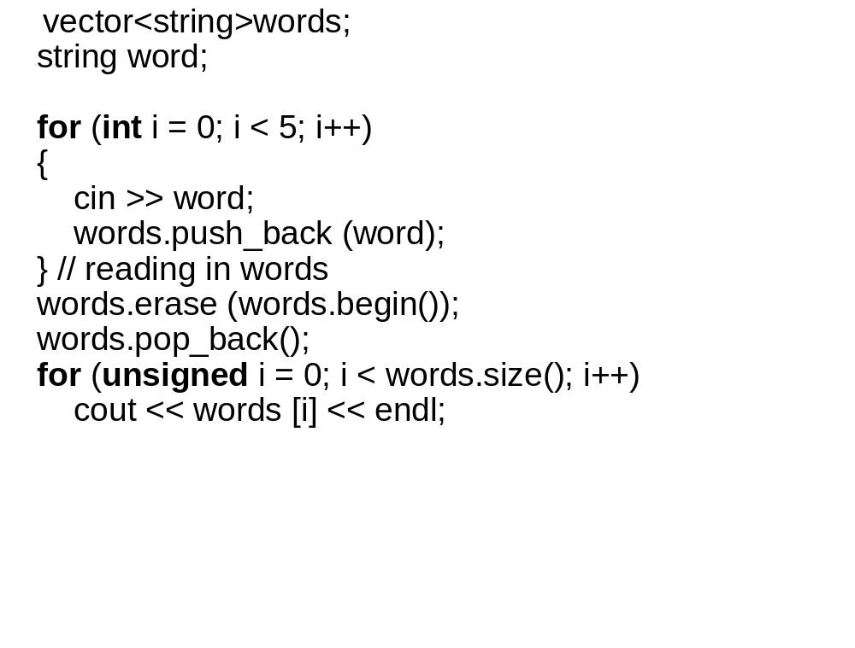

Slide 14
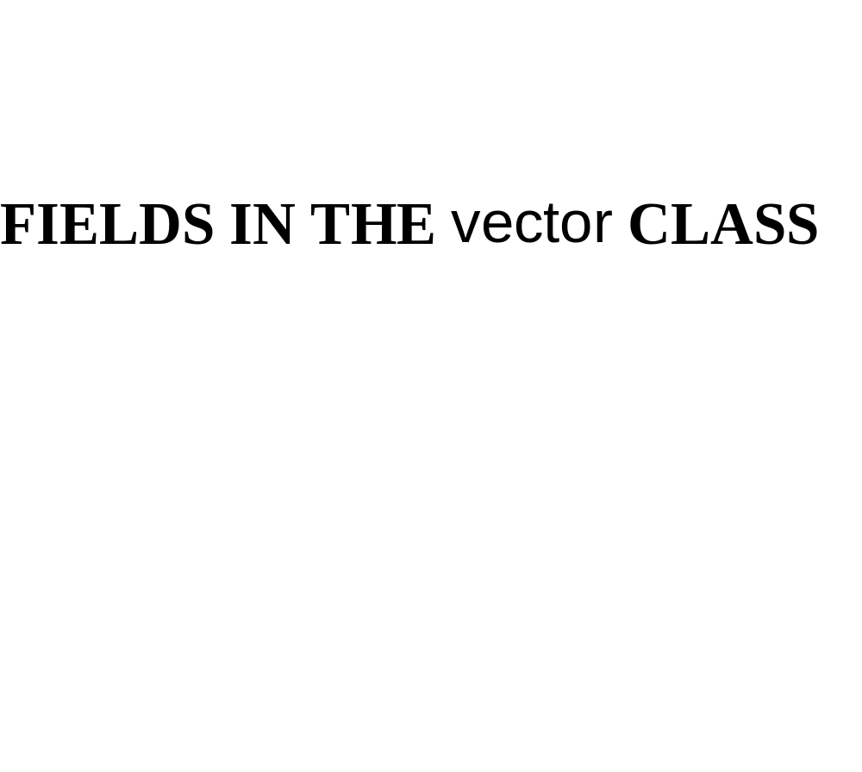

Slide 15
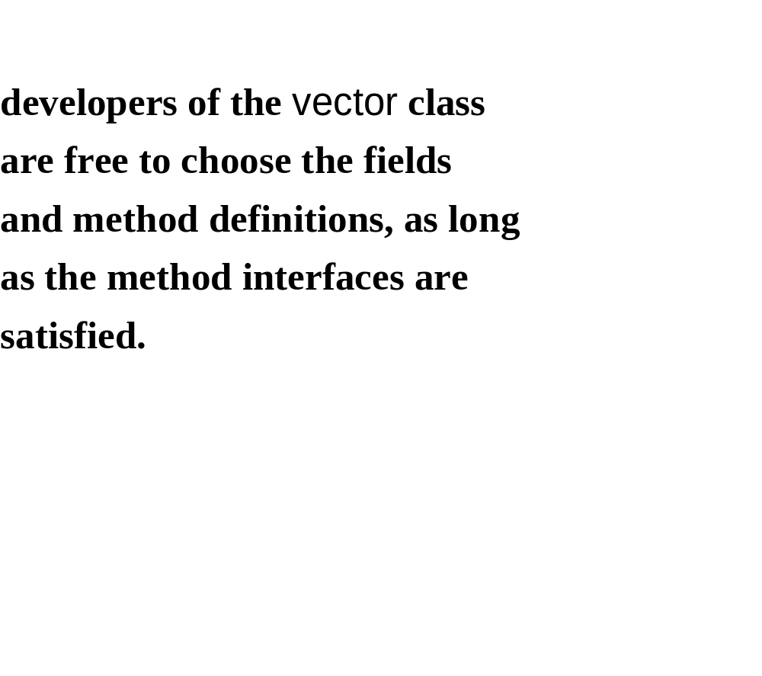

Slide 16
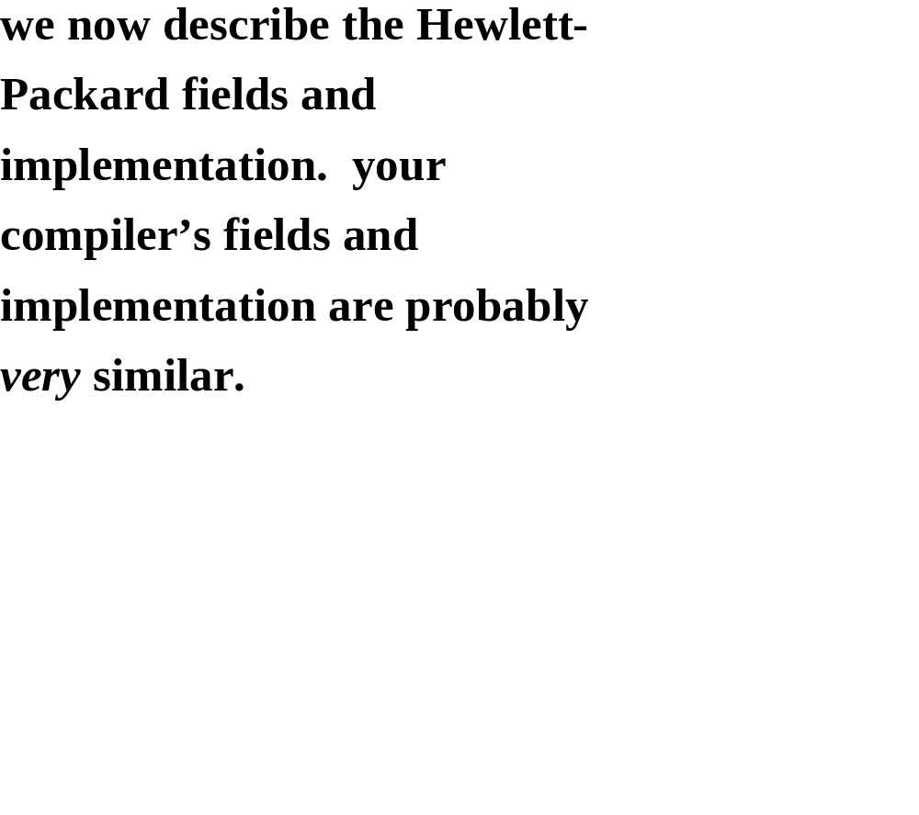

Slide 17
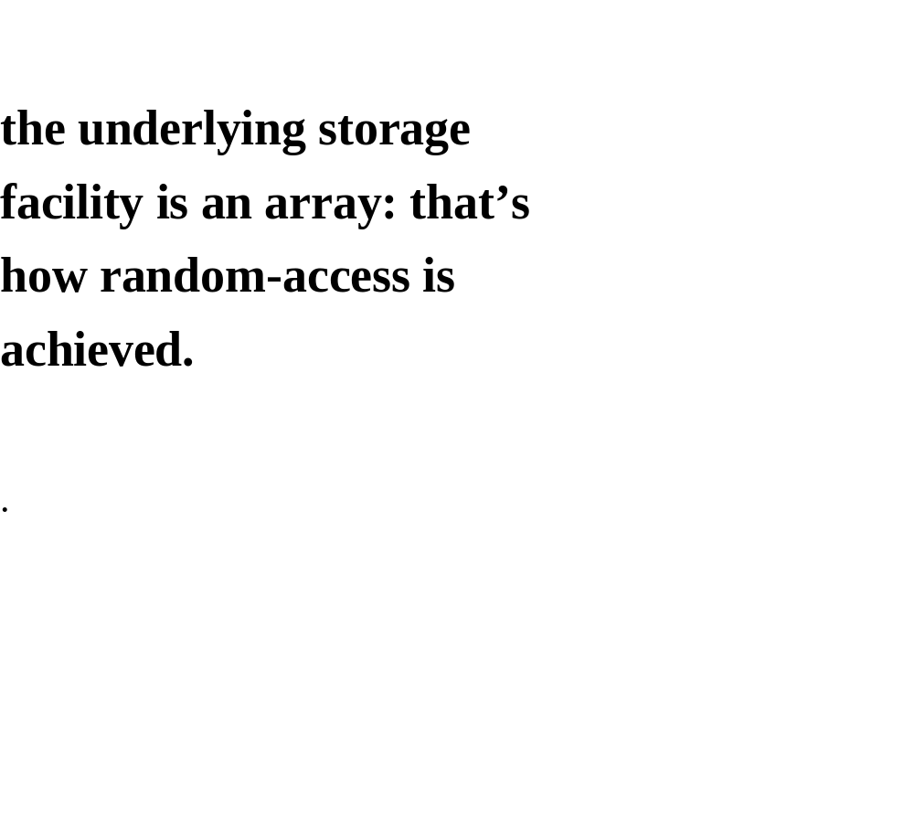

Slide 18
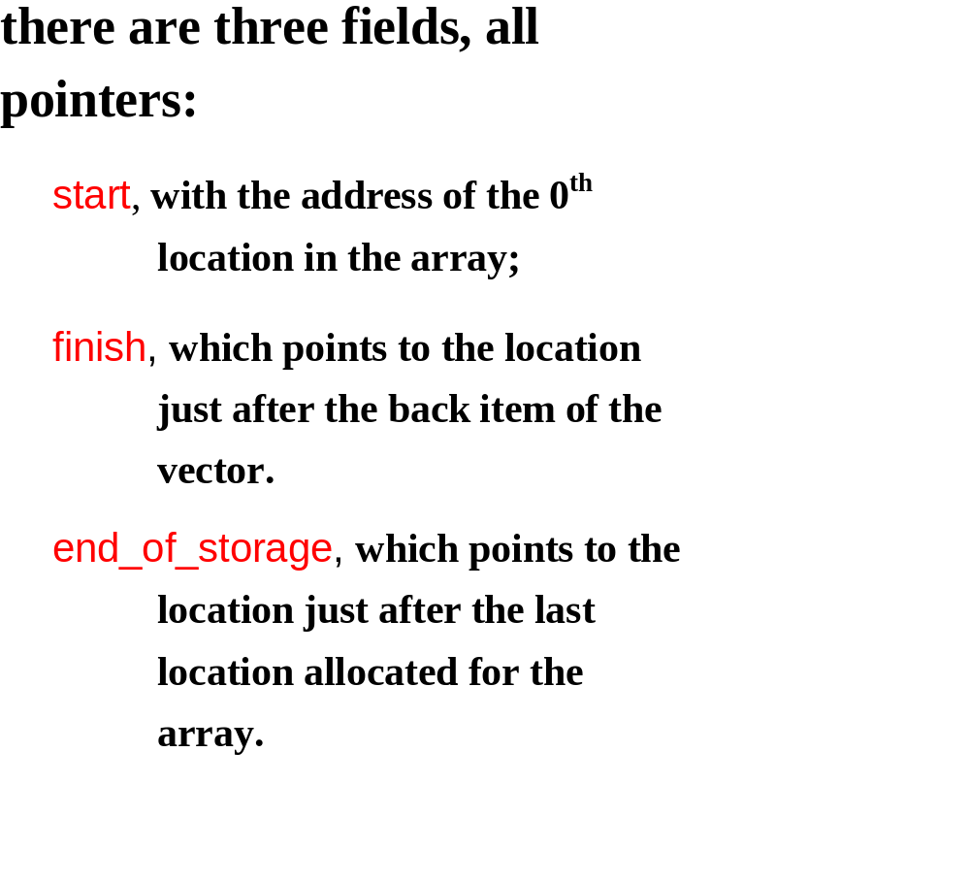

Slide 19
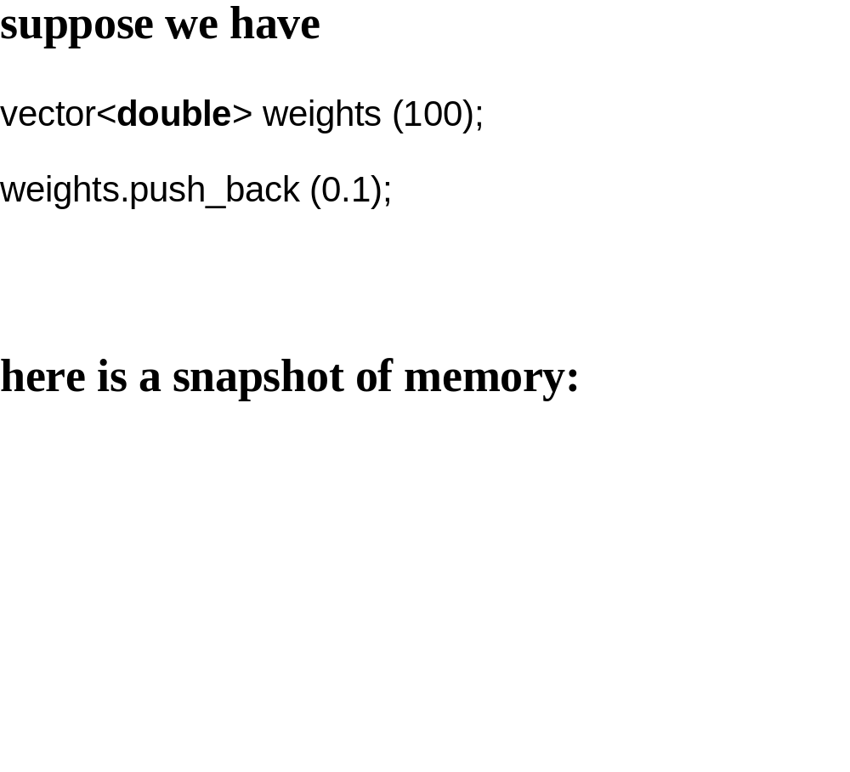

Slide 20
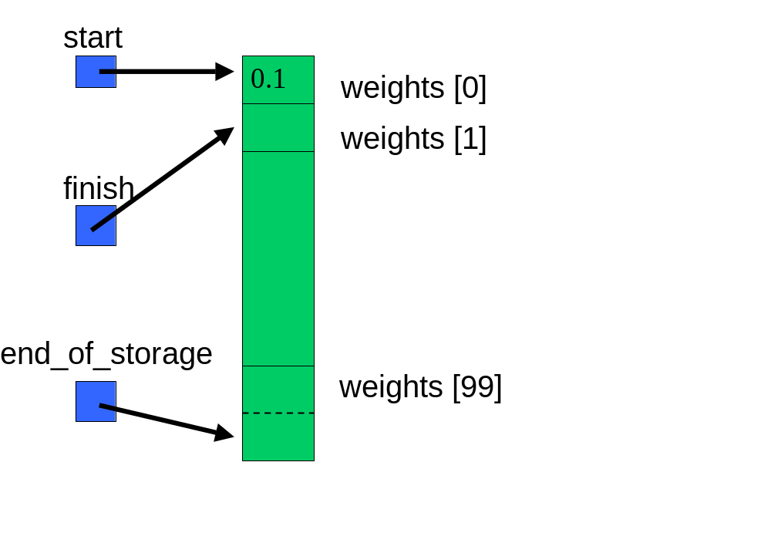

Slide 21
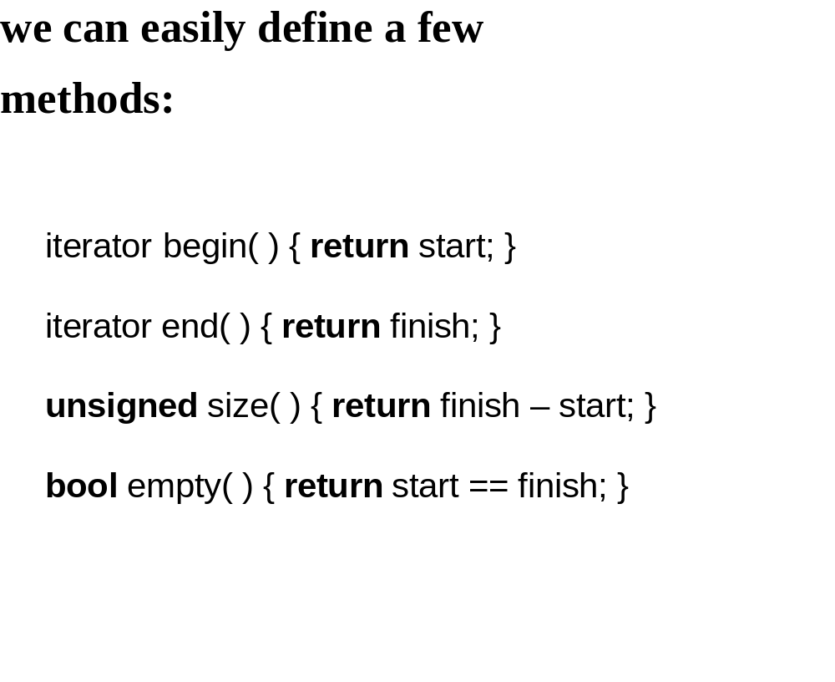

Slide 22
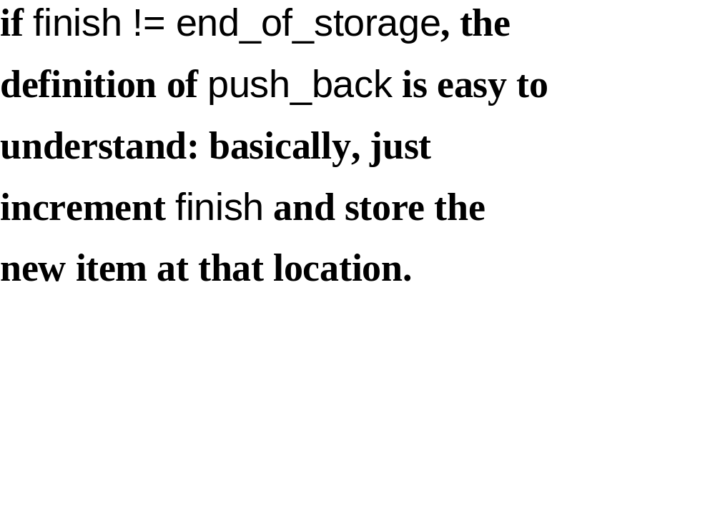

Slide 23
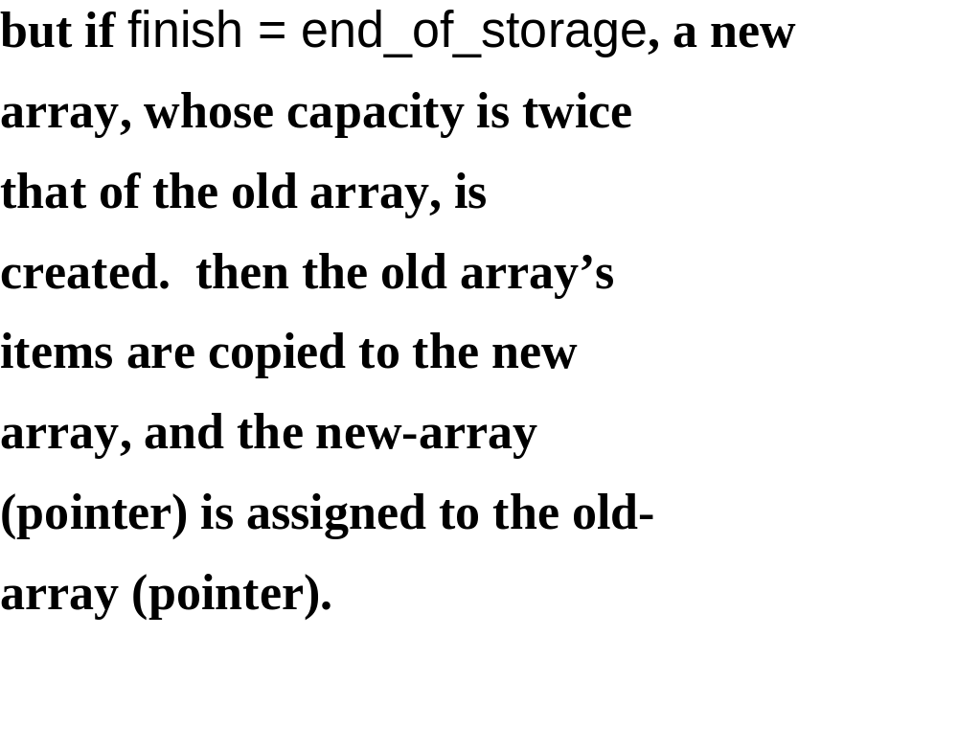

Slide 24
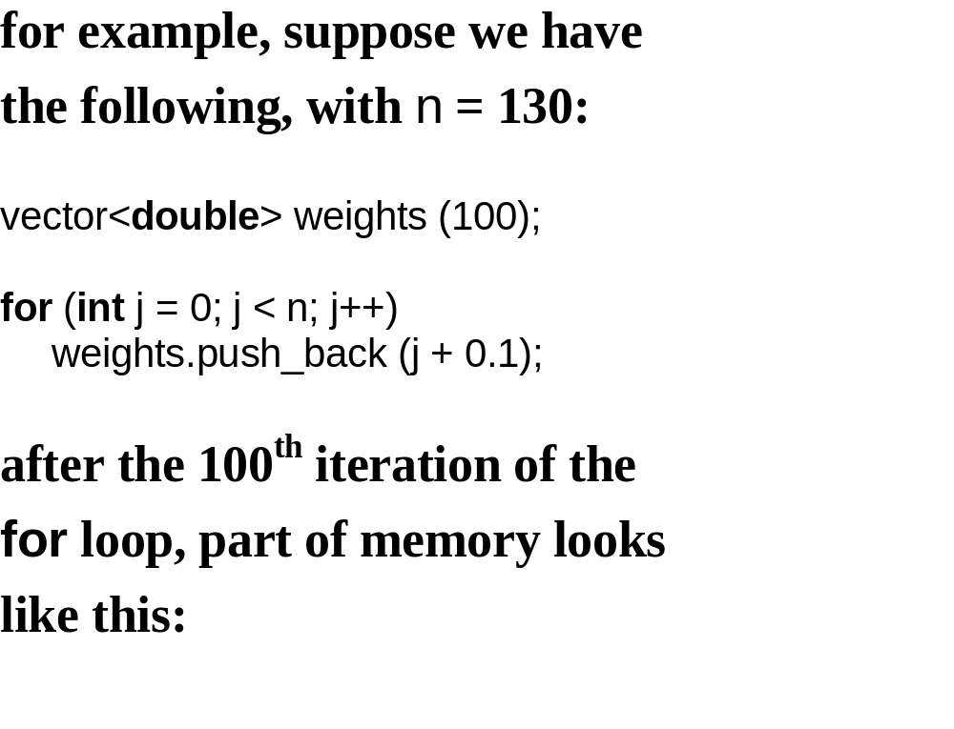

Slide 25
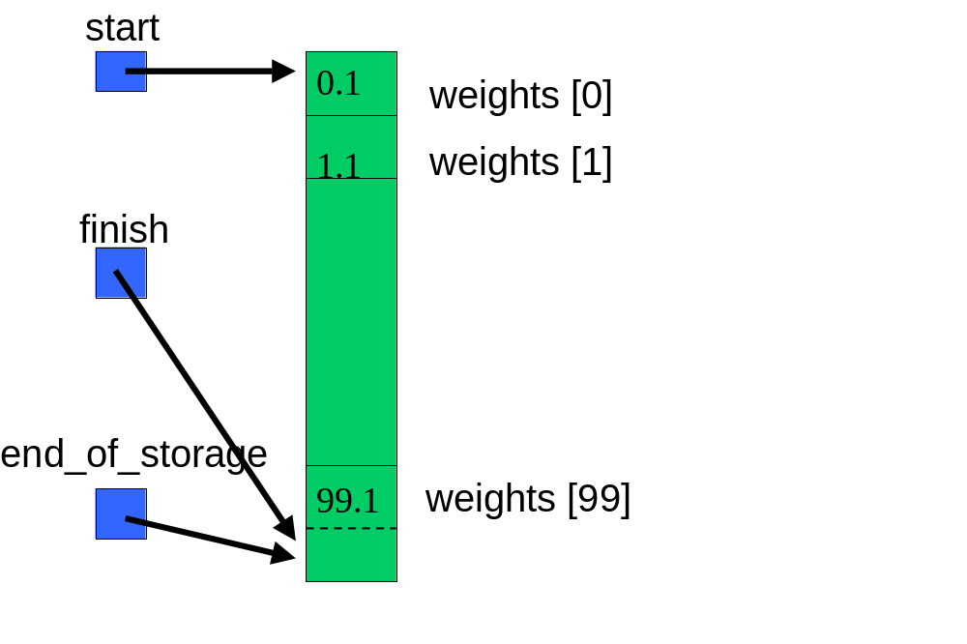

Slide 26
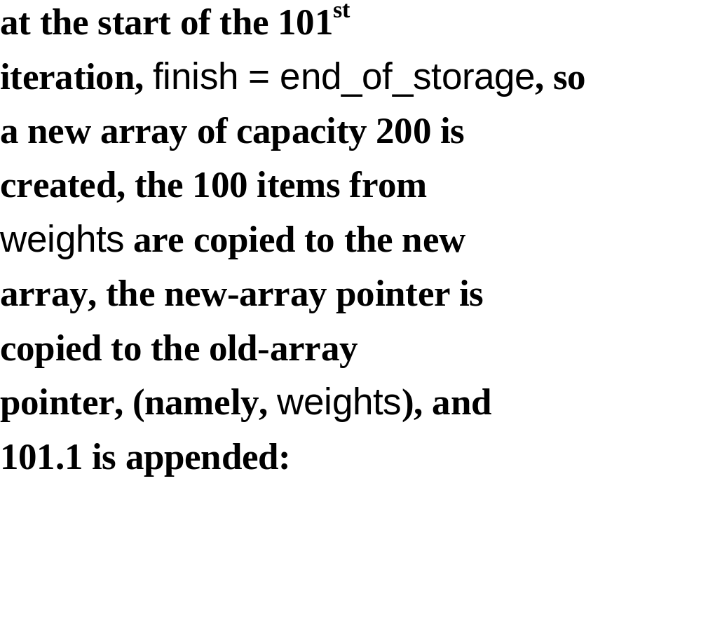

Slide 27
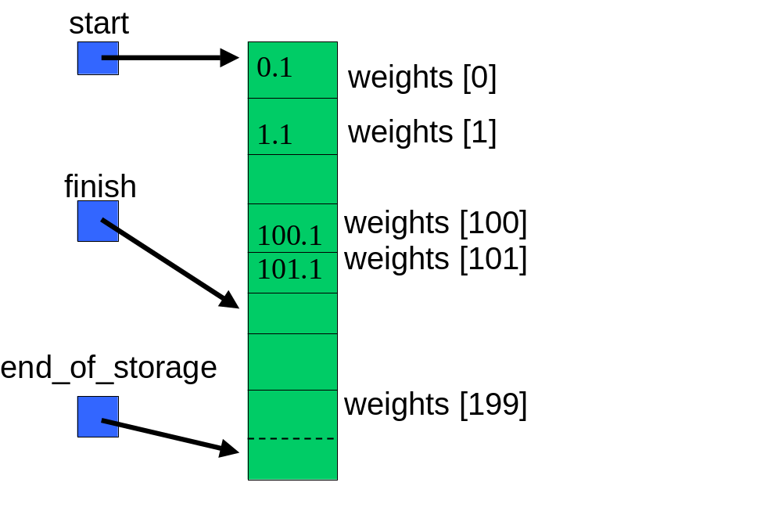

Slide 28
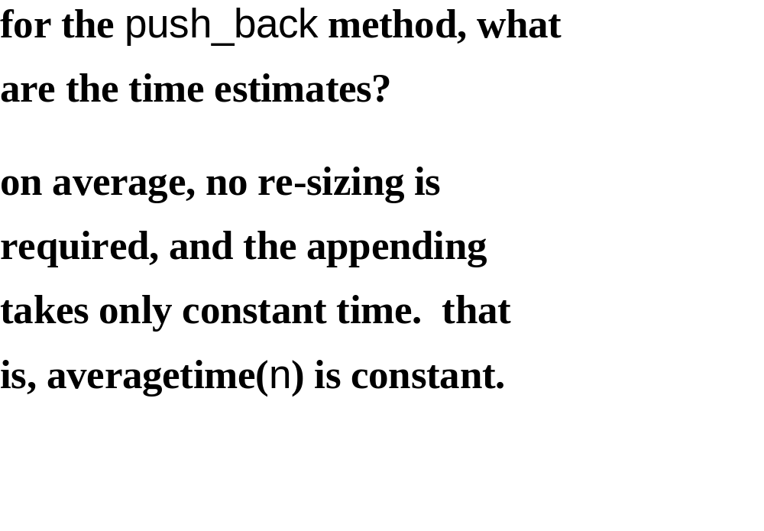

Slide 29
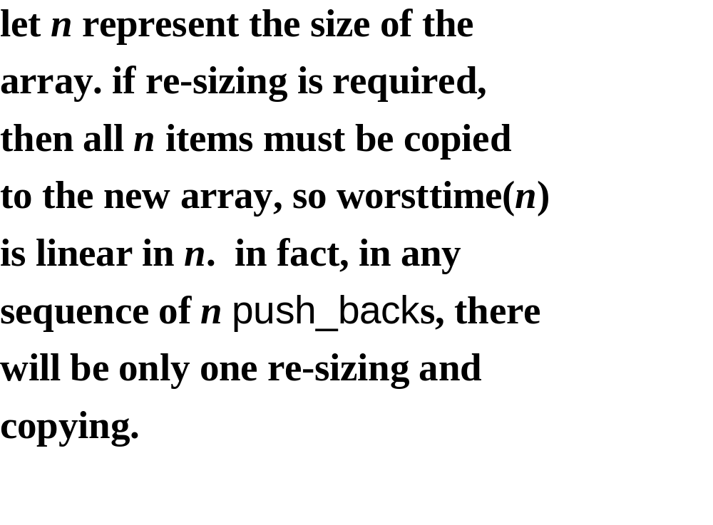

Slide 30
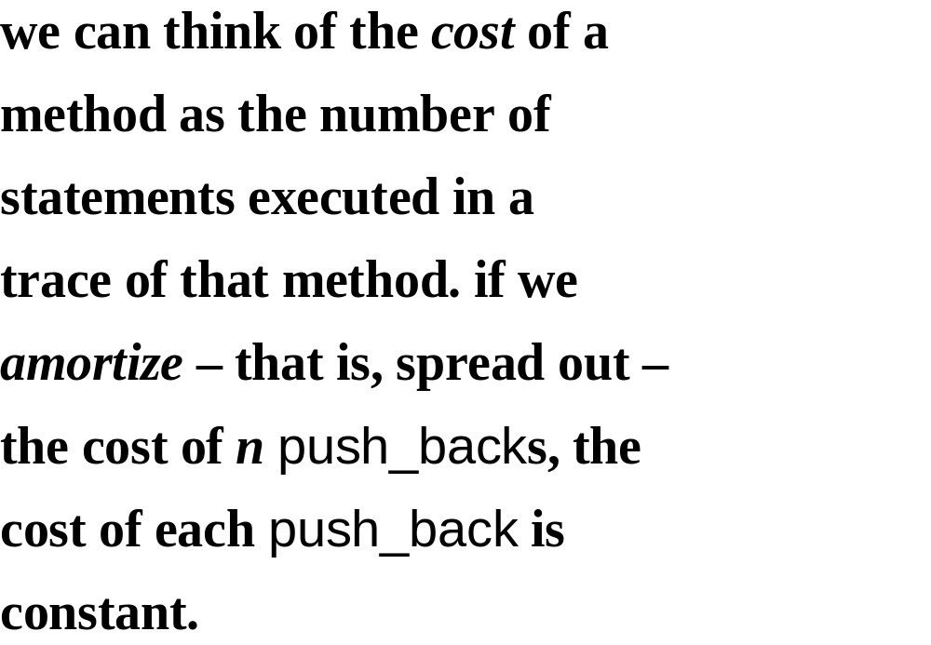

Slide 31
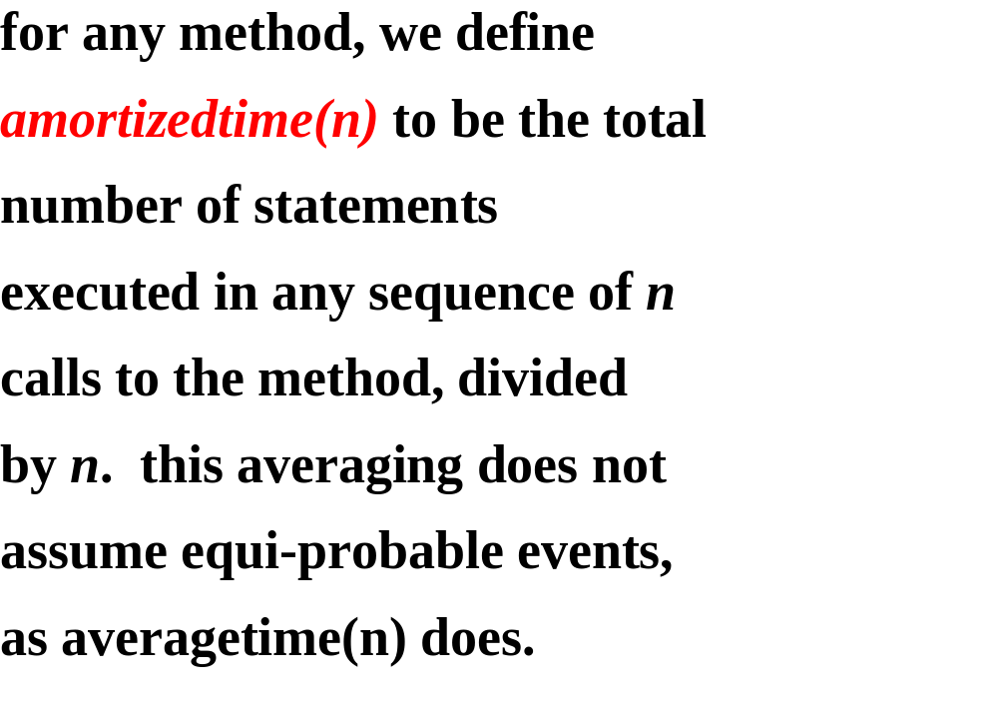

Slide 32
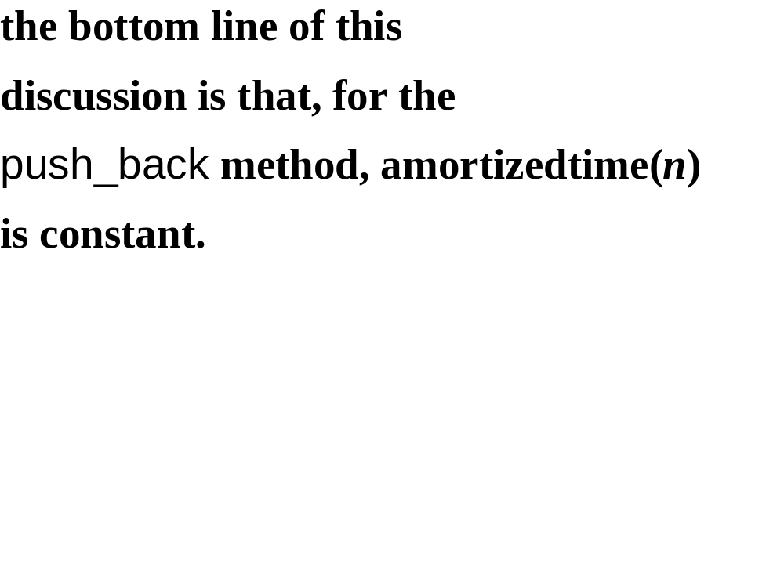

Slide 33
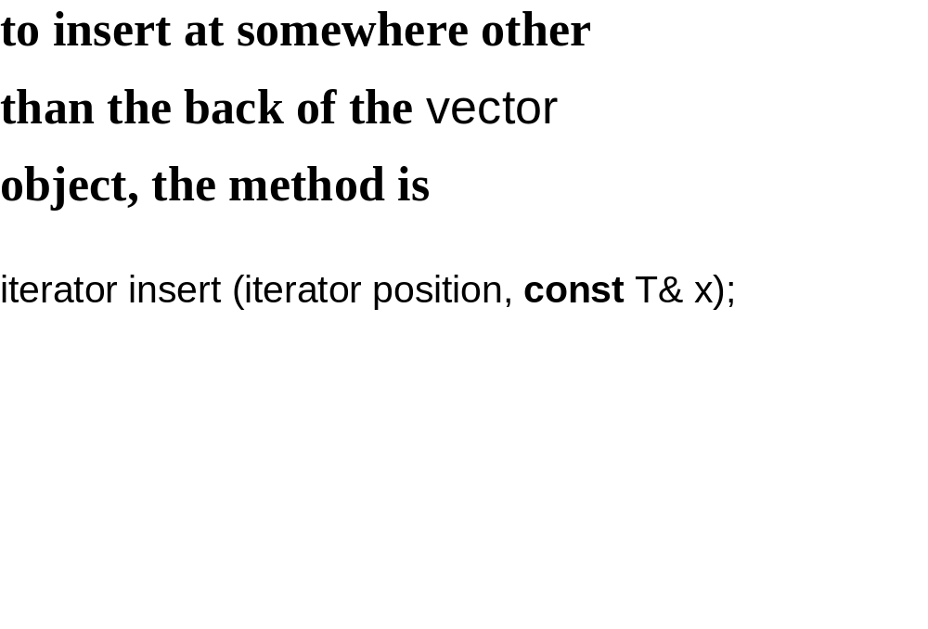

Slide 34
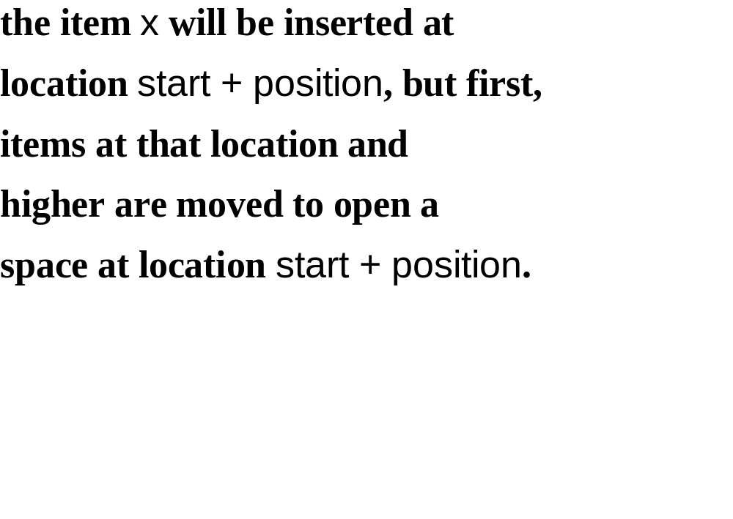

Slide 35
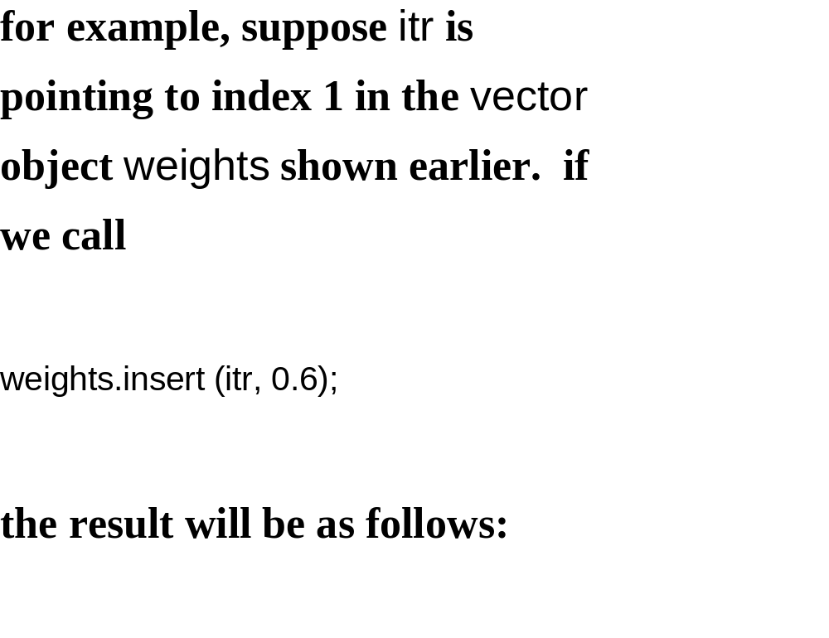

Slide 36
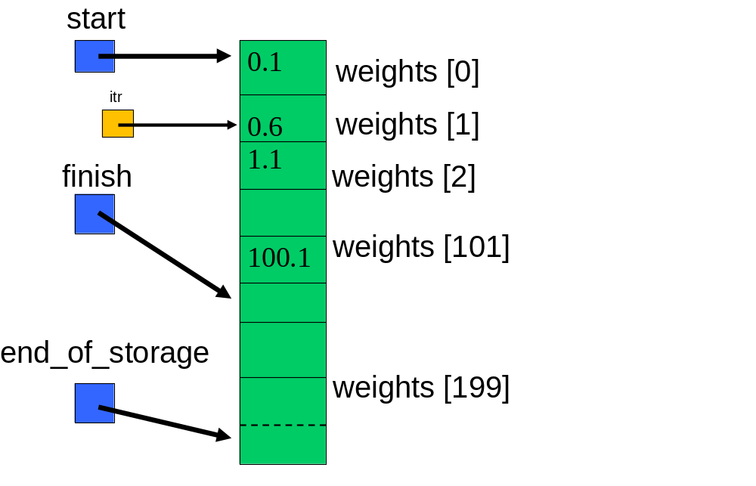

Slide 37
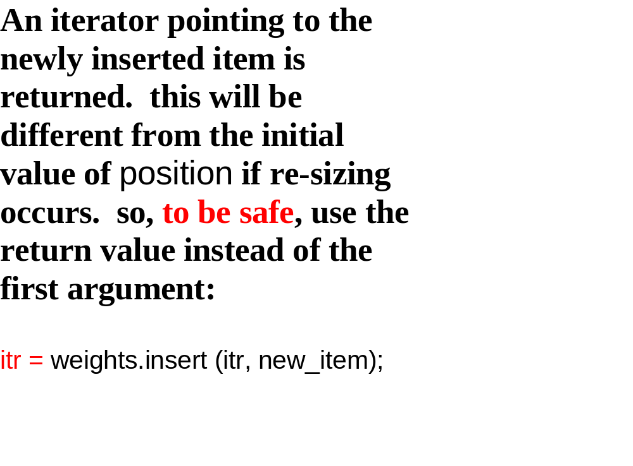

Slide 38
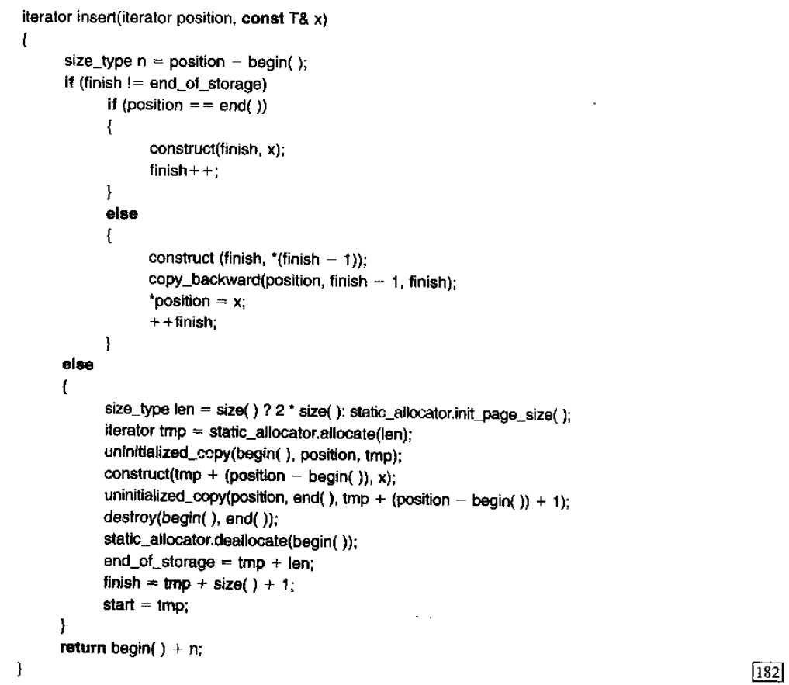

Slide 39
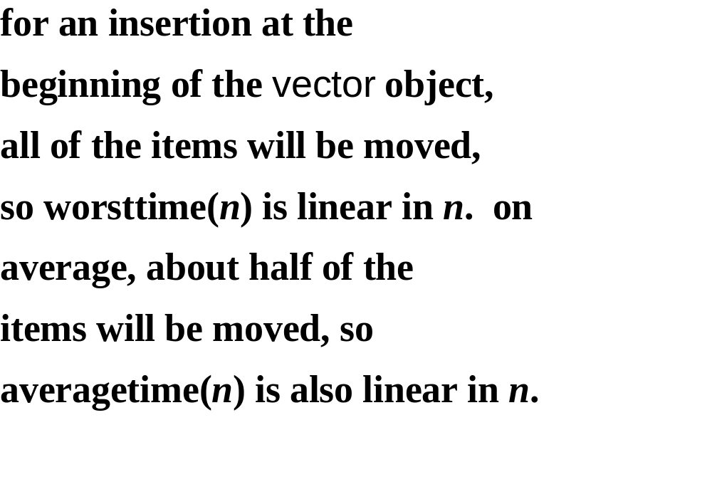

Slide 40
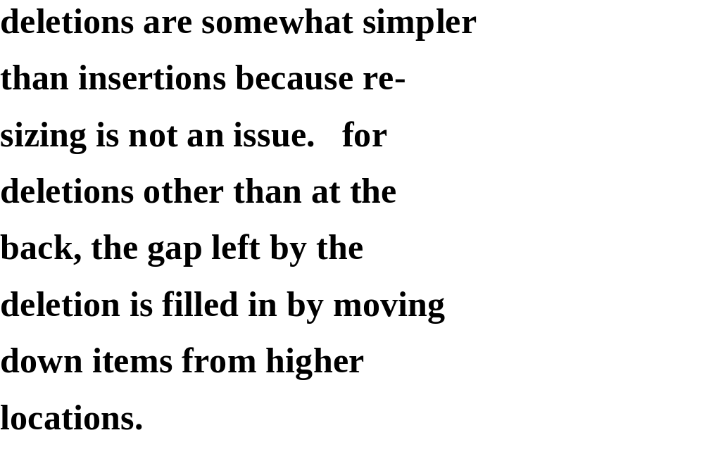

Slide 41
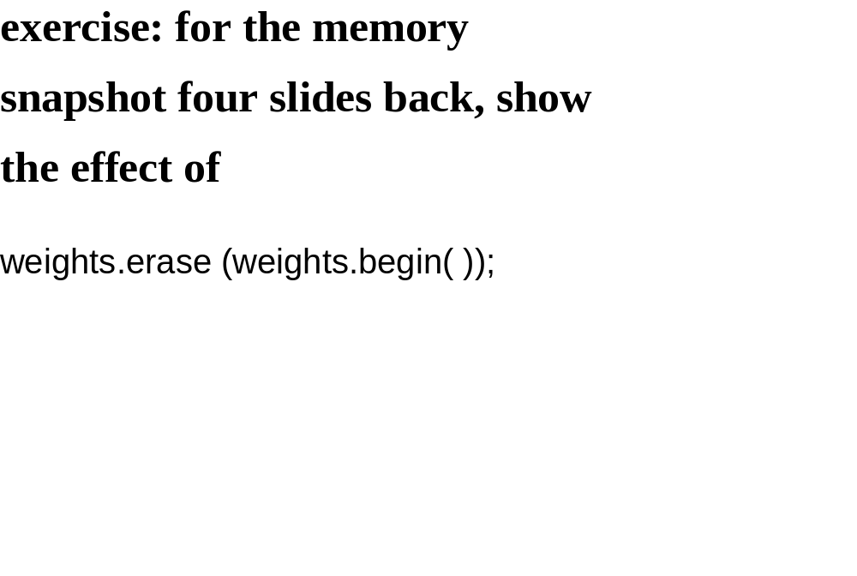

Slide 42
APPLICATION
HIGH-PRECISION ARITHMETIC

Slide 43
in public-key cryptography, the
integers are hundreds of digits
long.

Slide 44
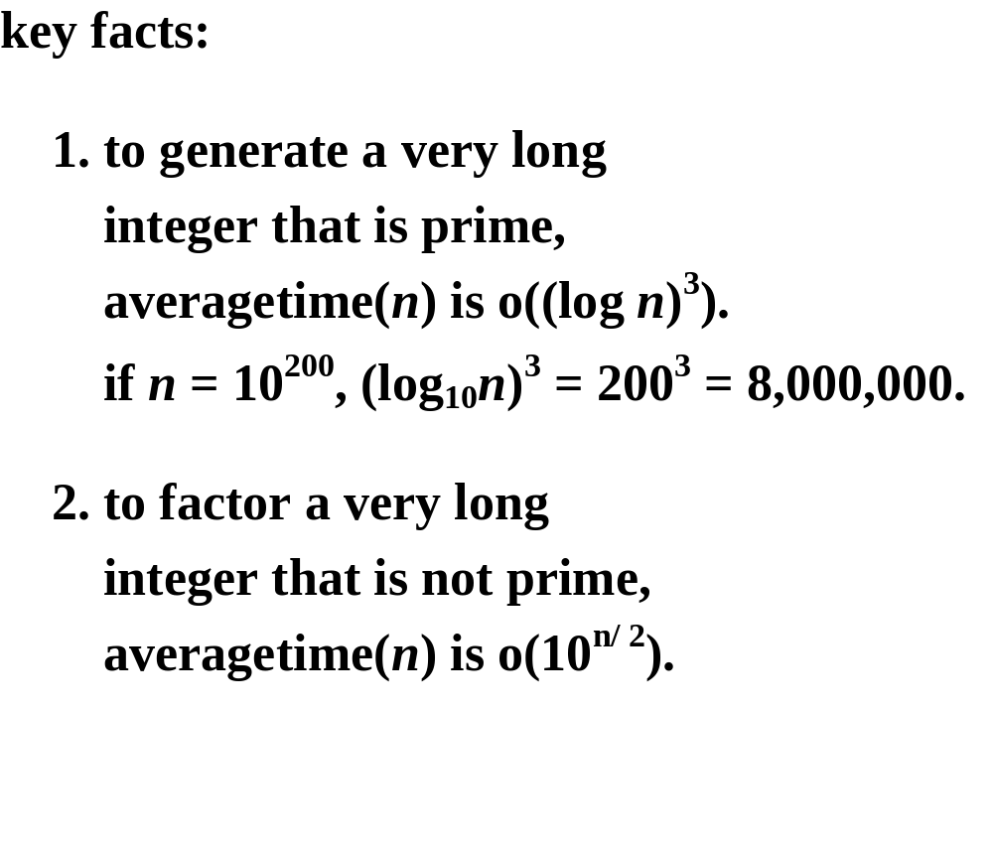

Slide 45
3. given primes p and q, (p – 1)(q – 1)
is used to encode a public
message.
4. to decode the message, p and
q must be known.

Slide 46
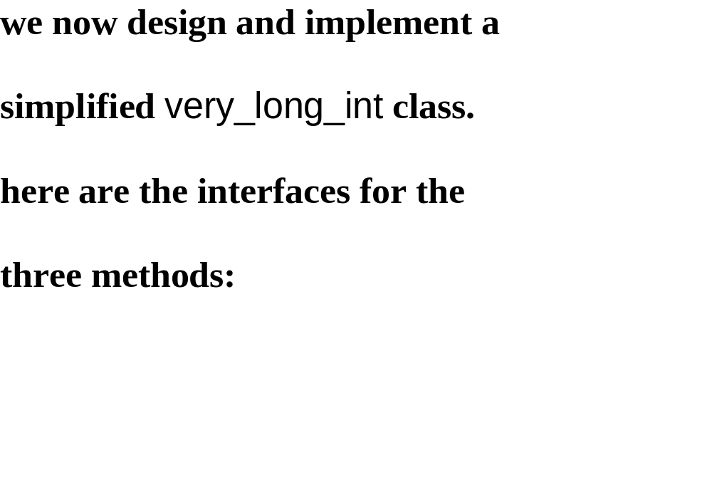

Slide 47
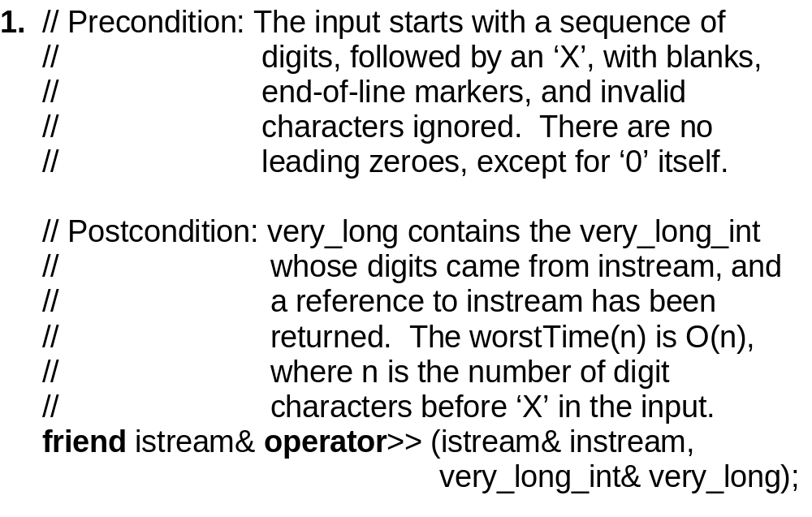

Slide 48
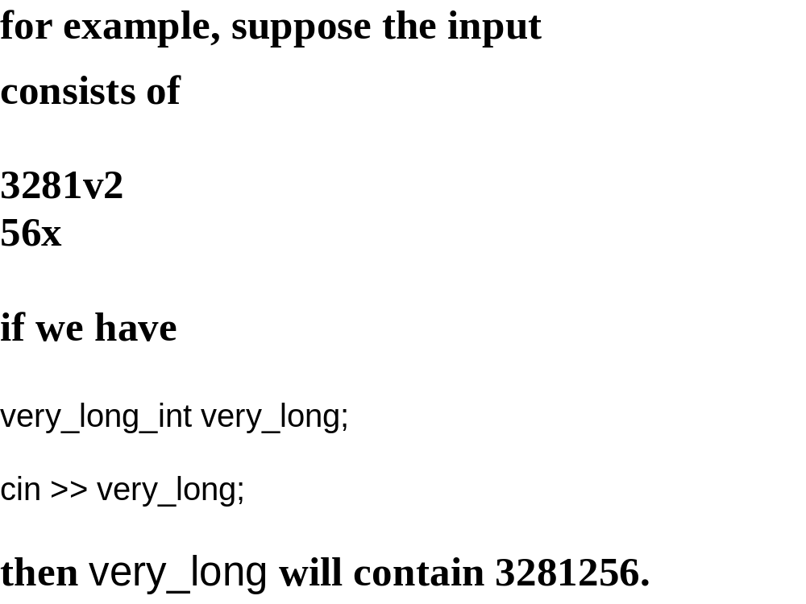

Slide 49
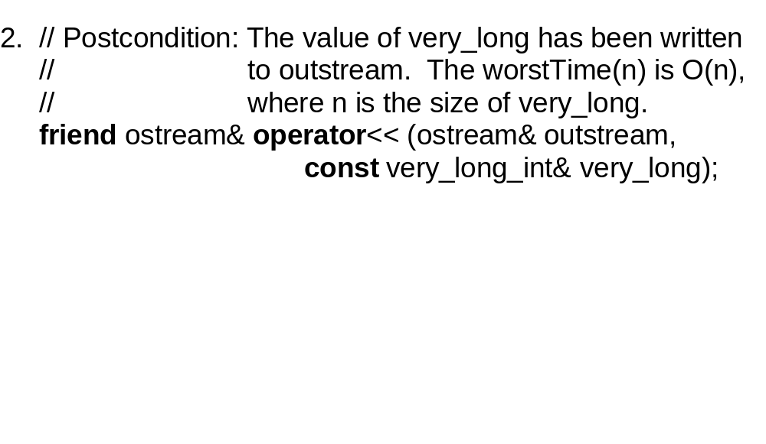

Slide 50
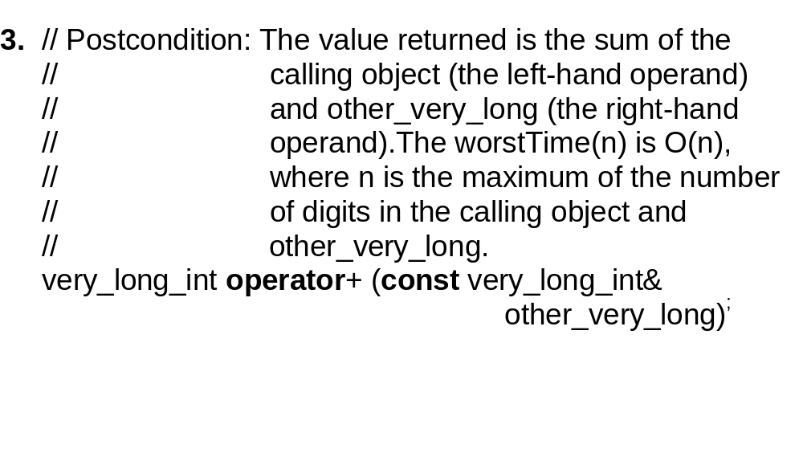

Slide 51
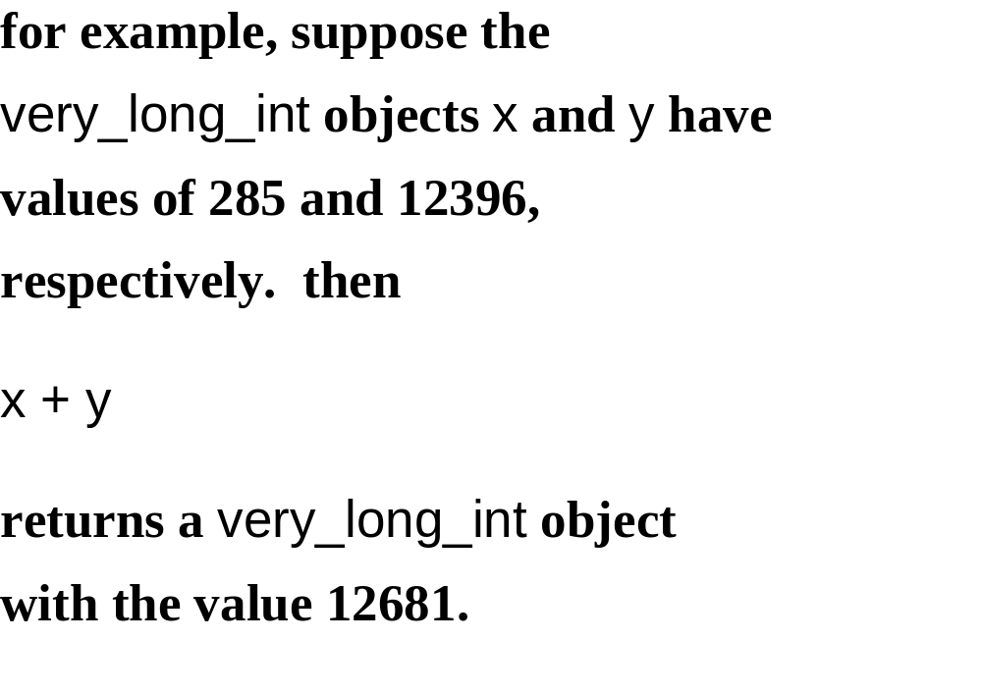

Slide 52
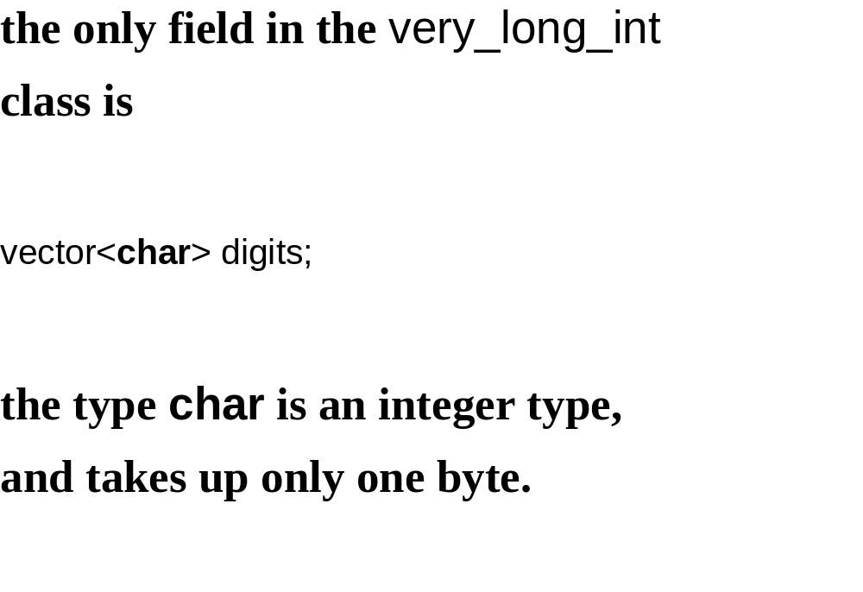

Slide 53
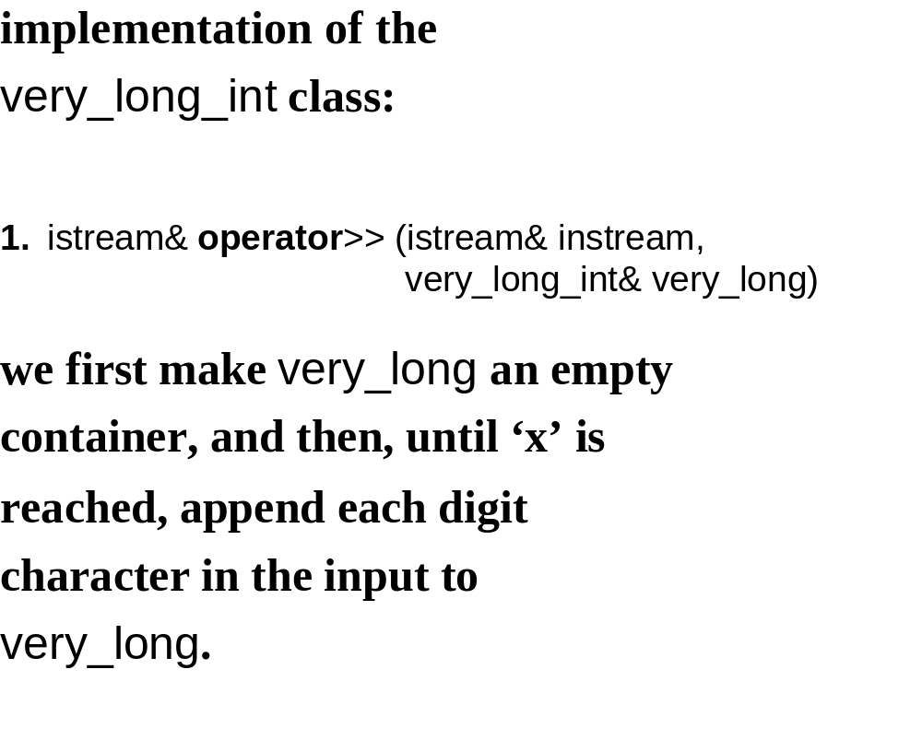

Slide 54
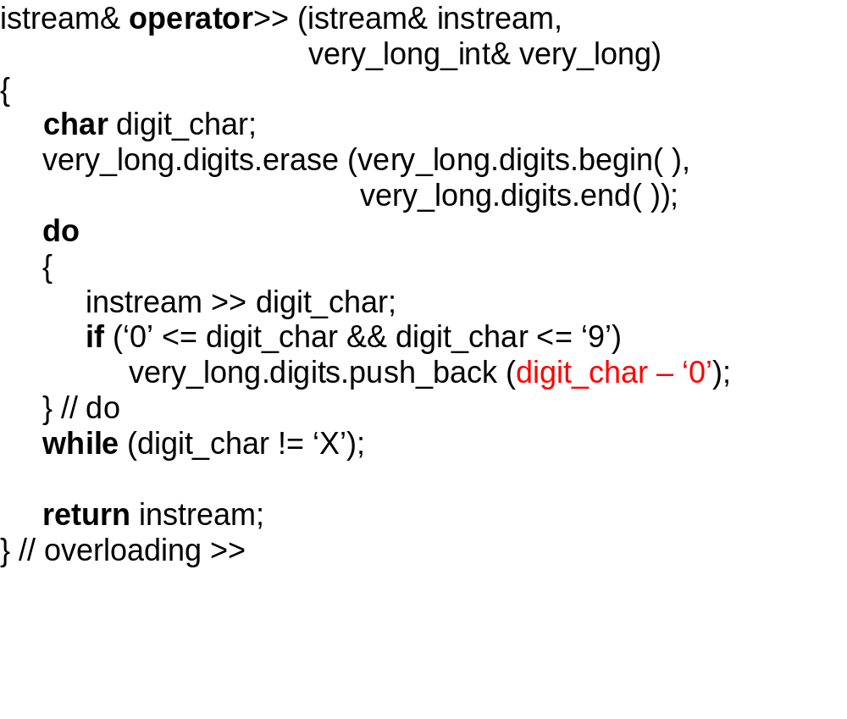

Slide 55
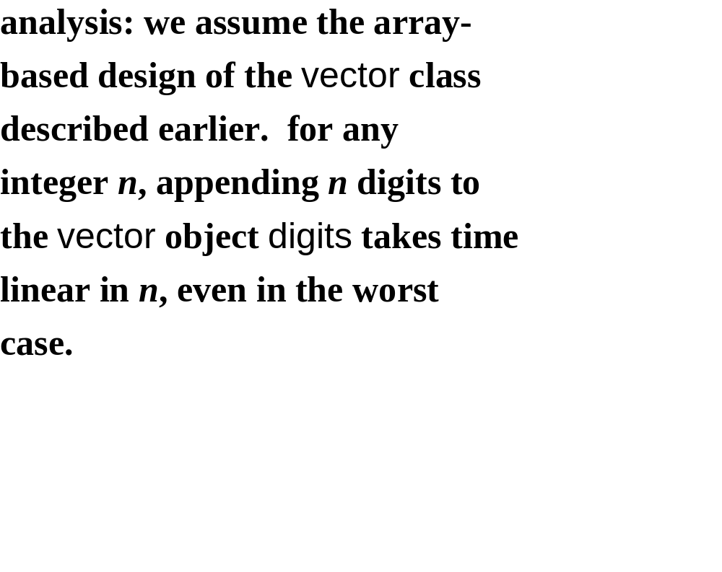

Slide 56


Slide 57


Slide 58


Slide 59


Slide 60


Slide 61


Slide 62


Slide 63


Slide 64


Slide 65


Slide 66


Slide 67
for example, suppose the
calling very_long_int object has
the value 13579. then
least (0) returns ‘9’
least (1) returns ‘7’
least (2) returns ‘5’
least (3) returns ‘3’
least (4) returns ‘1’
least (5) returns ‘0’
least (6) returns ‘0’

Slide 68


Slide 69


Slide 70


Slide 71


Slide 72


Slide 73


Slide 74


Slide 75


Slide 76


Slide 77


Slide 78


Slide 79


Slide 80


Slide 81


Slide 82


Slide 83


Slide 84


Slide 85


Slide 86


Slide 87


Slide 88


Slide 89


Slide 90


Slide 91


Slide 92


Slide 93


