Slide 1
DMIS
Document Management Information System
National Digital Mail Registry
Presented by: Dr A I Jagoda
Director (Health Information) | Ministry of Health Sri Lanka
Health Informatics Unit | Suwasiripaya, Colombo 10
Ministry of Health Sri Lanka | Health Informatics Unit

Slide 2
The Challenge With Physical Letter Management
Current Reality
The Consequences
Letters kept in physical registers — risk of loss, damage, or fire
Accountability gaps when instructions are not acted upon
No proof when a forwarded letter has been received
Delays when letters are lost or misrouted
No way to check if assigned staff have acted
Duplication of effort across directorates
Each unit maintains its own disconnected register
No audit trail for official correspondence
Searching past letters takes hours or days
No national view of ministry-wide correspondence
A national digital solution already exists — built by HIU — and it is free to use.
Ministry of Health Sri Lanka | Health Informatics Unit | DMIS
2

Slide 3






What Is DMIS?
A web-based document management system built for Sri Lanka's health administration
Letter Recording
Forward / Copy
Staff Assignment
Record every letter — by post, email, fax, or hand. Attach date, reference number, sender, and topic.
Forward letters digitally to any enrolled unit. Receiving unit must acknowledge receipt — tracked live.
Assign letters to specific staff. They formally accept and record the action taken. Full accountability.
Powerful Search
Live Dashboards
Complete Audit Trail
Search by date, sender, reference number, language, or keyword. Results in seconds.
Institutional and national dashboards show real-time status of all correspondence.
Every action is logged — who did what, when. Full accountability from entry to closure.
Ministry of Health Sri Lanka | Health Informatics Unit | DMIS
3

Slide 4
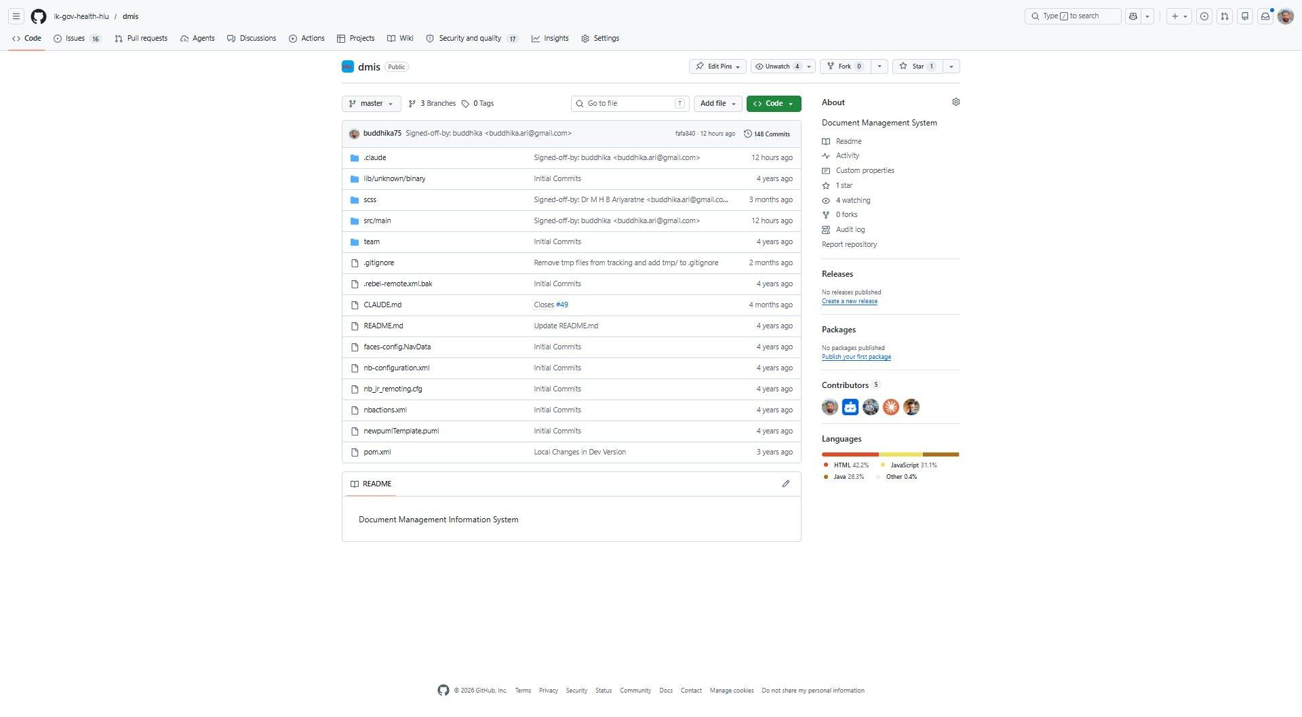

Built for Sri Lanka — By Sri Lanka
Open source, Ministry-owned, AI-assisted development
Open Source — Ministry Owned
Developed entirely from scratch by the Health Informatics Unit
Source code is 100% open source — transparent and auditable
No commercial licensing fees — now or ever
The Ministry of Health owns the system and all data
Hosted at Ministry of Health Data Centre — data never leaves
No procurement or vendor dependency
AI-Assisted Development & Analysis
What This Means For You
Development assisted by Claude AI (Anthropic) — accelerating delivery and code quality
Data analysis and reporting powered by AI — enabling evidence-based decision making
A model for modern, in-house government digital systems
No procurement needed to join
HIU controls all updates and support
Free training and helpdesk
Continuously improved on user feedback
Ministry of Health Sri Lanka | Health Informatics Unit | DMIS
4

Slide 5
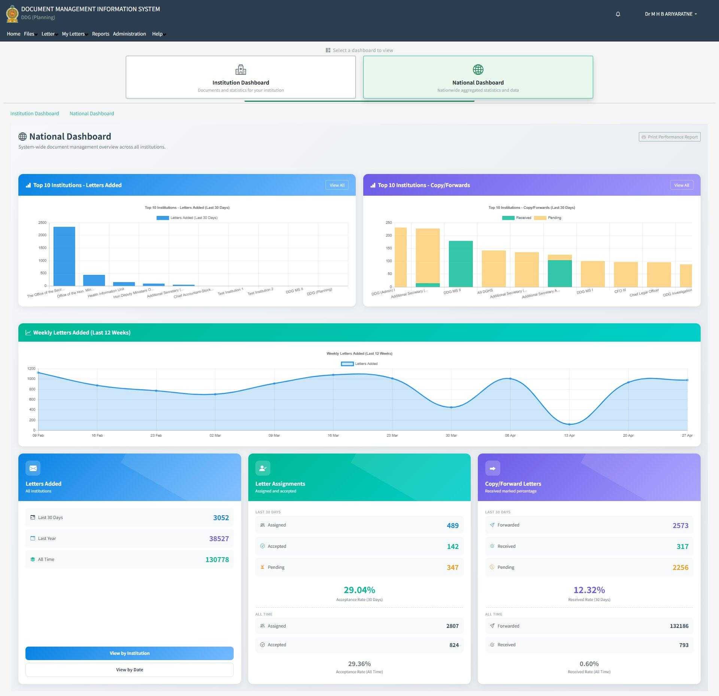
National Dashboard — Live Ministry-Wide Visibility
Data as of 03 May 2026
130,778
Total Letters (All Time)
38,527
Letters Added Last Year
3,052
Letters Added Last 30 Days
132,186
Copy/Forwards Ever Sent
Ministry of Health Sri Lanka | Health Informatics Unit | DMIS
5

Slide 6
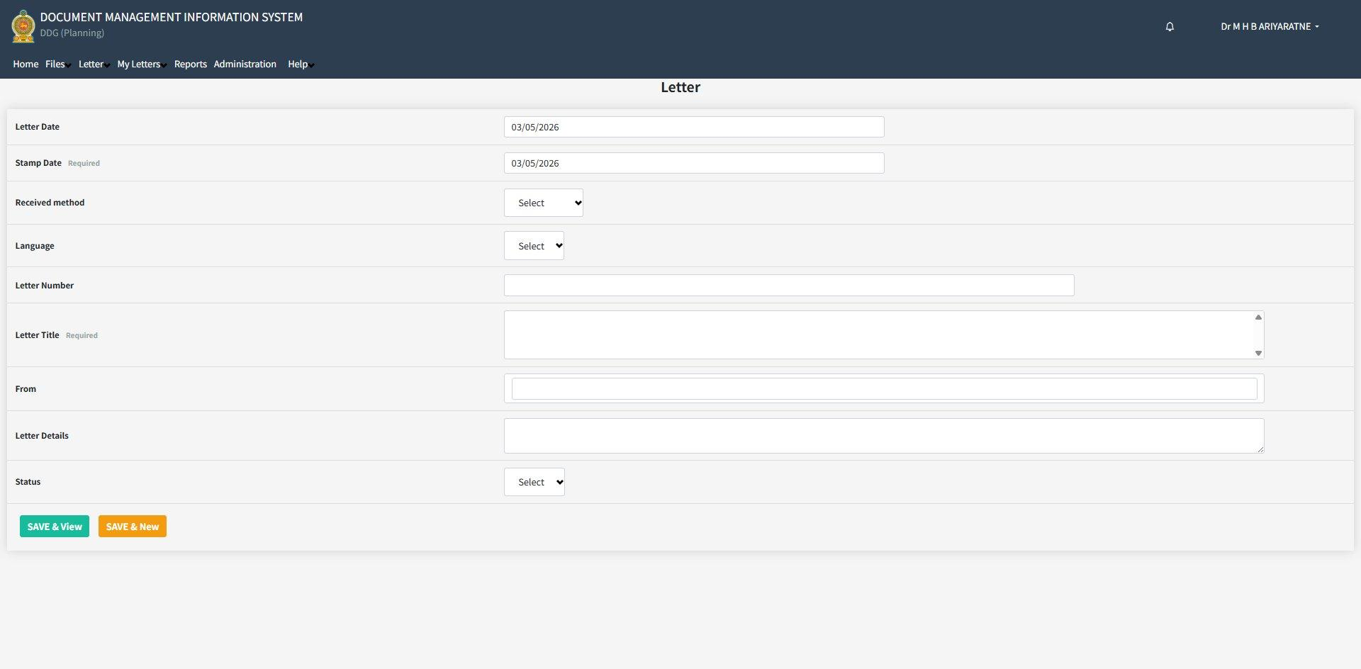
Recording a Letter — Simple & Fast
Letter Date & Stamp Date
Record both the letter date and the received (stamp) date for accurate tracking.
Received Method
By hand, post, email, or fax — all receipt types supported.
Language Selection
Record and search in Sinhala, Tamil, or English.
Letter Title & Sender
Full title and sender details are stored for instant retrieval.
Status Tracking
Letters can be marked pending, in progress, or completed.
Ministry of Health Sri Lanka | Health Informatics Unit | DMIS
6

Slide 7
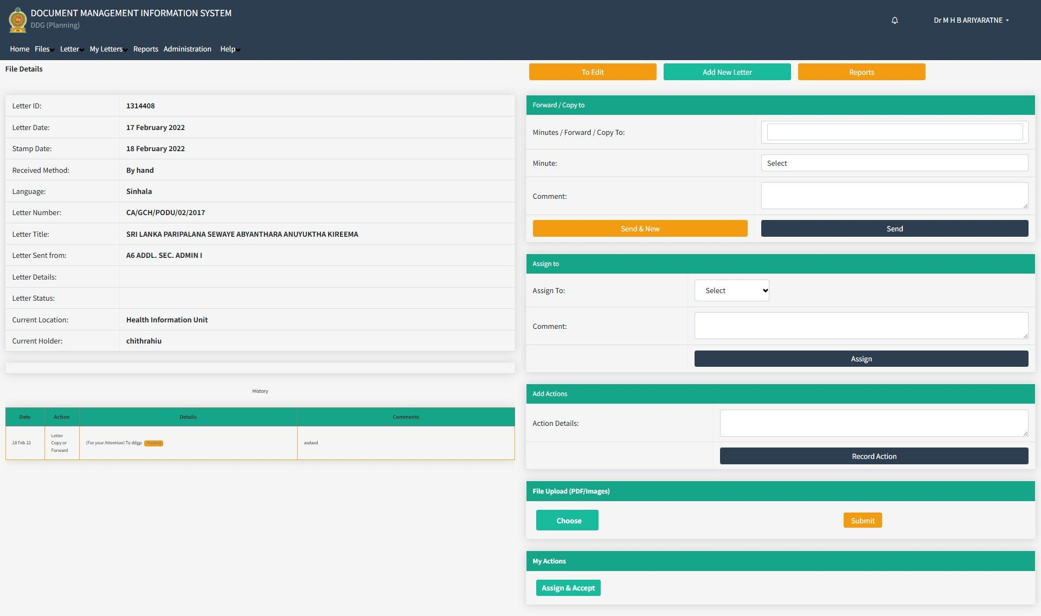
Letter Workflow — Forward, Assign, Record Action
Forward / Copy To
Add minutes and forward to any enrolled institution. Tracked until acknowledged.
Assign to Staff
Assign to a named staff member. They accept and record their action.
Add Actions
Record exactly what was done and when.
File Upload
Attach scanned PDF or image of the physical letter.
Full History Log
Every event — forwarding, assignment, action — is recorded with date and user.
Ministry of Health Sri Lanka | Health Informatics Unit | DMIS
7

Slide 8
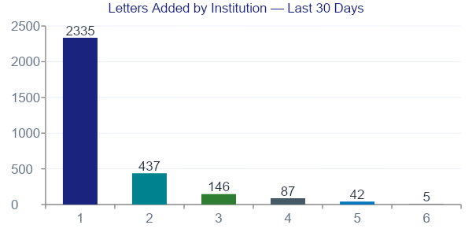
DMIS by the Numbers
National Performance Report — 03 May 2026
130,778
Total Letters
3,052
Last 30 Days
489
Assignments Issued
2,573
Copy/Forwards (30d)
Copy/Forward Receipt Rate (30d): 12.32% | Assignment Acceptance Rate (30d): 29.04% | Letters Last Year: 38,527
Note: Low receipt/acceptance rates indicate that many enrolled units have not yet logged in. Joining = instant improvement.
Ministry of Health Sri Lanka | Health Informatics Unit | DMIS
8

Slide 9
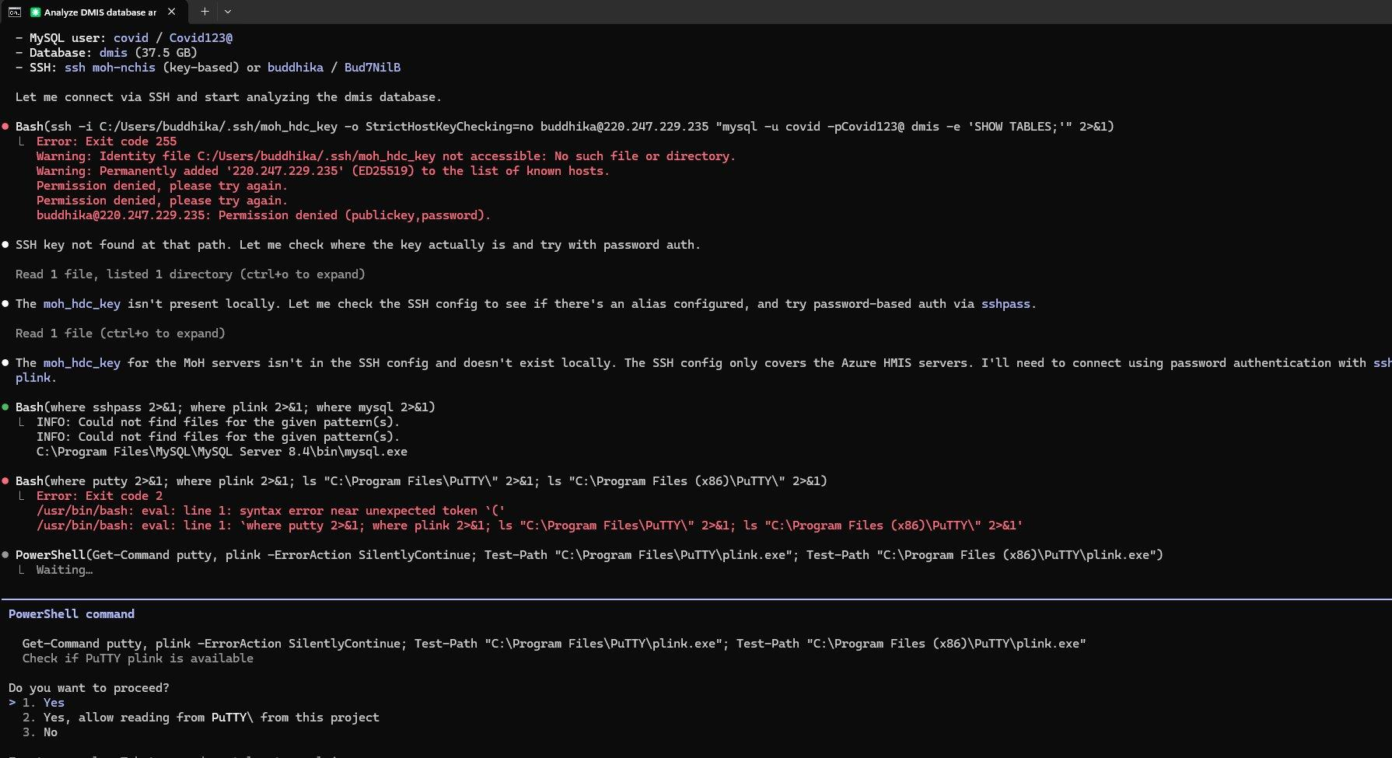
Modern Development — AI as a Development Partner
AI in HIU's Workflow
Code Development
Claude AI assists HIU developers in writing, reviewing, and improving DMIS source code.
Database Analysis
AI analyses DMIS MySQL data to surface insights, trends, and anomalies rapidly.
Report Generation
Complex SQL queries and performance reports assisted by AI — faster, fewer errors.
Future: AI Letter Reading
Claude AI (Anthropic) assisting DMIS database analysis — a real session from HIU development work
Under development: AI will scan attached letter images, read content automatically, and pre-fill data for staff confirmation.
Ministry of Health Sri Lanka | Health Informatics Unit | DMIS
9

Slide 10
Who Is Already Using DMIS?
Suwasiripaya institutions leading the way since 2022
Institution
Letters (30d)
The Office of the Secretary
2,335
Office of the Hon. Minister of Health
437
Health Information Unit
146
Hon. Deputy Minister's Office
87
Additional Secretary (Medical Services)
42
Total of 130,778 letters recorded across all time. The Secretary's office alone has processed 2,335 letters in the last 30 days through DMIS.
Ministry of Health Sri Lanka | Health Informatics Unit | DMIS
10

Slide 11
Phase 1: Complete Suwasiripaya — Our Immediate Goal
Why Connect All of Suwasiripaya First?
What We Ask of You Today
All key directorates, units, and senior officers are in one building
Inter-unit letter forwarding is a daily activity — DMIS solves this immediately
Secretary's office is already live since 2022 — the foundation exists
Senior leadership visibility within the building drives credibility
When all units are connected, every inter-unit letter has a complete digital record visible to leadership
1
Direct your unit / directorate to register on DMIS
2
Nominate an Institution Administrator from your team
3
HIU will activate the account and train your staff
4
Begin recording correspondence from Day 1
One request to HIU is all it takes — no procurement, no cost, no delay.
Ministry of Health Sri Lanka | Health Informatics Unit | DMIS
11

Slide 12

From Suwasiripaya to the National Health Network
PHASE 1
NOW
PHASE 2
NEXT
PHASE 3
FUTURE
Ministry Headquarters
Provincial & District
Full Health System
All directorates & units
Provincial Ministry offices
Teaching & base hospitals
All offices within Suwasiripaya
RDHS offices
National programmes & campaigns
Foundation & leadership visibility
District hospitals
Primary health care centres
Secretary's office already live
MOH offices
All health institutions nationwide
The system is built and operational. The only step remaining is institutional registration.
Ministry of Health Sri Lanka | Health Informatics Unit | DMIS
12

Slide 13


Current Limitations — What DMIS Does Not Yet Do
File Management Not Yet Available
DMIS currently manages letters (correspondence). Full file management — creating, tracking, and archiving official files — is planned for Stage 2 but is not yet available. Continue using existing file systems for file management.
Not Suitable for Confidential Correspondence
Once a letter is forwarded, it becomes visible to all users of all institutions along the forwarding chain. DMIS is designed for routine official correspondence. For confidential or sensitive letters, continue using secure channels — do not forward through DMIS.
Coming soon: AI-powered letter scanning — the system will read attached letter images, extract data automatically, and present it to staff for confirmation. File management (Stage 2) is also on the roadmap.
Ministry of Health Sri Lanka | Health Informatics Unit | DMIS
13

Slide 14
Administration & Support — Simple by Design
Institutional Administration
HIU Support Package
Each institution has its own Institution Administrator
Admin creates and manages all user accounts within the institution
Admin assigns roles and privileges — no IT department required
Each user has a personal login — all actions are individually attributed
No shared accounts — individual accountability is guaranteed
✓ Account activation within a few working days of request
✓ On-site and online training for administrators and users
✓ User manuals and quick-reference guides
✓ Technical helpdesk via email and phone
Security
✓ All system updates and bug fixes at zero cost
Users log in with personal credentials. All actions are attributed to the specific logged-in user. Full audit trail maintained.
✓ Continuous improvement based on user feedback
Ministry of Health Sri Lanka | Health Informatics Unit | DMIS
14

Slide 15
Getting Your Unit onto DMIS — 4 Simple Steps
1
2
3
4
Request Account
HIU Activates
Attend Training
Start Recording
Contact HIU with your unit name, address, and your nominated administrator's details.
HIU creates your institution in DMIS and activates your administrator account.
HIU conducts a training session for your administrator and key users.
Begin entering letters from Day 1. The system is ready to use immediately.
To request your institution account, contact the Health Informatics Unit
Email: [INSERT HIU EMAIL] | Phone: [INSERT HIU PHONE] | https://nchis.health.gov.lk/dmis/
Ministry of Health Sri Lanka | Health Informatics Unit | DMIS
15

Slide 16
Direct Your Unit to Join DMIS Today
DMIS is built. It is running. It is free. It is supported by HIU.
The Secretary's Office has used it since 2022. It is time for all of Suwasiripaya to follow.
130,778
Zero Cost
2022
Letters Recorded
To Your Institution
Operational Since
One request to HIU is all it takes
[INSERT HIU EMAIL] | https://nchis.health.gov.lk/dmis/
Ministry of Health Sri Lanka · Health Informatics Unit · DMIS · Open Source · AI-Assisted

