Slide 1

Crossfade
NEXT-MARKET RADAR FOR AFRICAN MUSIC
41%
Get ahead of where a rising song breaks next
of Crossfade's weekly top-10 song–market picks came true within 4 weeks
Best rule-based approach: 13%
Held-out 2025–26 data
DataNova 2026 · Problem statement DN-OP-01 Open Innovation
Solo entry · Lindokuhle Nyoka, Johannesburg
Notes:
Crossfade is a next-market radar for African music. It tells distributors and labels which country each rising song will chart in next, four weeks early, with the evidence. On 2025 and 2026 data the model never saw, 41% of its weekly top-ten picks came true; the best simple rule got 13%.

Slide 2
43 charts, a few slots a week
A distributor's marketing team can work a handful of markets a week. Which ones, for which songs?
AR
AT
AU
BE
BR
CA
CH
CL
CO
Today
Markets are picked by gut feel, by where the big labels go, or by where the artist is already big.
CZ
DE
DK
EE
ES
FI
FR
GB
IE
IS
IT
JP
KE
KR
LU
MX
NG
NL
The cost
Playlist pitches, PR and local content land in markets the song was never going to reach.
NO
NZ
PE
PL
PT
RO
RS
RU
SE
TR
TZ
UA
UG
US
ZA
ZW
The miss
The market the song was about to break in goes unworked.
43 national YouTube Top-100 charts. Orange: the three a team can actually work this week.
Notes:
There are 43 national charts in the data. A distributor's marketing team can work two or three markets per song per week. Today they choose by gut feel or by where the artist is already big, so effort lands in markets the song was never going to reach, and the market it was about to break in goes unworked.

Slide 3
Songs travel along corridors
Corridors say where. Momentum and the artist's track record say which songs.
Uganda
5.0%
Where each approach spends its weekly picks
66%
Corridor-only rule: on coordinated global launches, songs that need the least help
Kenya
4.0%
Nigeria
Zimbabwe
3.8%
25%
Crossfade: the rest go to emerging songs, a median of 6 different songs a week
Tanzania
3.0%
Share of songs entering each chart within 4 weeks of charting in Nigeria, latest quarter. Typical country pair: 1.3%.
Notes:
Songs do not spread at random. Songs charting in Nigeria enter Uganda's chart within four weeks 5% of the time, about four times a typical country pair. Corridors alone tell you where; but a corridor-only rule spends two thirds of its picks on big global launches. Crossfade adds momentum and the artist's history in each market, so it also picks which songs.

Slide 4
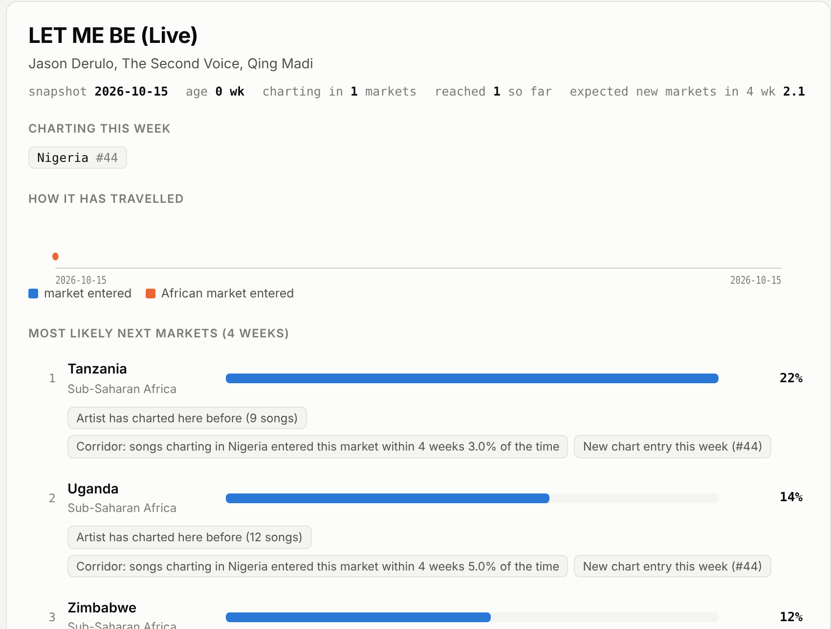
What a marketing lead sees on Monday
A live radar of rising songs, each with its most likely next markets and the evidence.
1
Open the radar
Filter to songs charting in Africa this week.
2
Read the picks
Each song's 8 likely next markets, a calibrated probability, and up to 3 evidence-backed reasons.
3
Act
Choose 2–3 markets; brief local playlist pitching, PR and content.
Open the live demo →
Notes:
Monday morning the marketing lead opens the radar on songs charting in Africa. Here, LET ME BE is charting only in Nigeria at number 44. Crossfade ranks Tanzania first at 22 percent, because Nigeria to Tanzania is an established corridor and the lead artist has charted there with nine earlier songs. They pick two or three markets and brief the local team. The demo link is on the slide.

Slide 5
How it works
Eight years of public chart history, a question asked every week, and nothing from the future.
01
02
03
04
Data
Songs
Questions
Model
YouTube weekly Top-100, 43 countries, May 2018 – Oct 2026
Video keys merged across remasters, live and featured-artist spellings
Every week × rising song × country not yet reached: will it chart there within 4 weeks?
LightGBM on 29 point-in-time features; exact TreeSHAP turned into plain reasons
1.94M rows · CC-BY 4.0
121,256 keys → 119,728 songs
30.2M rows · 0.23% yes
6 baselines on the same rows
No leakage, by construction
Time-only splits with a 4-week purge · every feature dated on or before the snapshot · corridor rates re-estimated each quarter from outcomes already finished · automated tests recompute labels and features from the raw charts
Notes:
The pipeline: verified Zenodo data, song identity normalisation, then one row per week, rising song and unreached country, labelled by whether the song entered that chart within four weeks. That is 30 million rows with a 0.23 percent positive rate. Every feature uses only data available at the time; corridor rates are recomputed each quarter from outcomes that had already finished; tests check this against the raw charts.

Slide 6
Proof: 3× more hits per pick
Each week every model picks its 10 best song–market pairs. Share that entered within 4 weeks, Jan 2025 – Sep 2026, never seen in training.
It holds when the slate is restricted
40.7% vs 18.6%
Emerging songs only (no global launches)
34.9% vs 13.2%
One pick per song, 10 different songs
28.1% vs 17.4%
Songs charting in Africa
Crossfade vs best baseline. Base rate of a random pick: 0.24%. 90 weeks, 900 picks per model.
Notes:
This is the result that matters for a budget. Each week, each model chooses its ten best song-market pairs. 41.2 percent of Crossfade's picks came true; the best baseline managed 13.3. It holds for emerging songs only, when each song gets a single pick, and for songs charting in Africa.

Slide 7
It ranks well, and it holds every year
Beat every baseline in 2022, 2023 and 2024 validation, then on the 2025–26 test, scored once.
61.0%
#1 pick was a market it entered
Best baseline 57.9%
89.9%
real next markets in its top 10
Best baseline 87.6% · random 28.8%
83.8%
top-5 recall, Africa-debut songs
Best baseline 77.8%
Notes:
On ranking each song's markets, Crossfade's first pick is right 61 percent of the time, and nine in ten real next markets are in its top ten. The gain over the strongest baseline is modest on this metric, a few points, but it is consistent: it won in every validation year and on the held-out test. The axis starts at zero, so the bars show the gain at its true size.

Slide 8
Every pick is explained and calibrated
Reasons come from exact TreeSHAP and are shown only when the data backs them.
Calibrated
2.05% → 2.15%
Top tenth of test candidates: predicted vs observed entry rate
Expected calibration error 0.019 percentage points. A 20% means about 20%, so teams can plan with the numbers.
Example reasons on the radar
“Corridor: songs charting in Nigeria entered this market within 4 weeks 3.0% of the time” · “Artist has charted here before (9 songs)”
Notes:
Every recommendation carries up to three reasons. They come from exact TreeSHAP contributions, but a reason is only shown if the underlying value supports it. The strongest drivers are corridor strength from markets the song is charting in now, the artist's history and view growth. The probabilities are calibrated: in the top tenth of candidates the model predicted 2.05 percent and 2.15 percent happened.

Slide 9
A growing market and an honest wedge
Analytics tools show where an artist already is. Crossfade forecasts where a song goes next.
US$120M
Product | Price (public) | What it does
Chartmetric | $40–150/mo; API from $350 | Where an artist is popular now
Soundcharts | $10–129/mo; API from $50 | Charts, radio and playlist monitoring
Crossfade | Team $99/mo · Distributor $750/mo (assumed) | Where each rising song charts next, with evidence
Sub-Saharan recorded music, 2025
+15.2% in a year (IFPI)
7,000+
artists at Africori alone
Owned by Warner Music Group
Bottom-up, Africa only (estimates)
40 distributors × $750/mo + 300 labels and managers × $99/mo ≈ US$0.7M a year. A good small business on its own; the venture case needs every corridor worldwide and adjacent decisions such as show booking.
Sources: Music In Africa (IFPI GMR 2026), NextBillion, chartmetric.com/pricing, soundcharts.com/pricing, accessed 5 Nov 2026.
Notes:
Sub-Saharan recorded music grew 15 percent to 120 million dollars in 2025, and a few large distributors each handle thousands of artists. Existing analytics tools show where an artist already is; Crossfade forecasts the next market. Honest sizing for Africa alone is about 0.7 million dollars a year, so Africa is the wedge, not the whole company.

Slide 10
What it does not do yet
Stated up front, each with the next step.
Forecasts organic spread, not uplift
A chart entry is visibility
It predicts where a song is heading, not what promotion adds.
It is not proof of a lasting audience.
Next: Randomised uplift test with a distributor partner
Next: Add repeat-listening data from licensed sources
YouTube only, 43 countries
Popularity bias
Much of Africa and Asia is missing from the charts.
Established artists carry more history.
Next: Licensed multi-platform chart data (APIs from $50/mo)
Next: Emerging-only results reported; artist history shown as an explicit reason
Notes:
Four limits, stated plainly. It forecasts organic spread, not what promotion adds; a chart entry shows visibility, not a lasting audience; it uses YouTube charts for 43 countries; and established artists have more history. Each has a concrete next step, the most important being an uplift test with a distributor.

Slide 11
Next 60 days, and the ask
From a validated model to a validated business.
The ask
A place in Round 2
Introductions to African distributors and labels for design partners
Weeks 1–2
Weeks 3–6
Weeks 7–8
10 conversations with distributor and label marketing leads
3 design partners get a free weekly top-10 slate by email
A randomised uplift test with one partner
Live demo https://claude.ai/artifact/VXQdETrTq3NujmWX2rM1ag
Lindokuhle Nyoka · lindokuhle.nyoka03@gmail.com · github.com/lk-nyoka
Notes:
Next: ten conversations with distributor and label marketing leads, three design partners on a free weekly slate, then a randomised uplift test. The ask: a place in round two, and introductions to African distributors and labels. Thank you.

