Slide 1

AUTOMATED EVALUATION OF THE REY-OSTERRIETH COMPLEX IMAGE TEST
Lucia Korbeľová

Slide 2
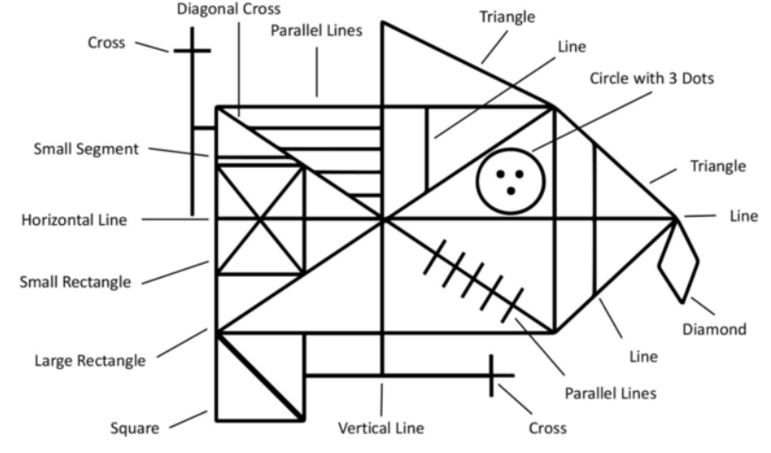
REY-OSTERRIETH COMPLEX Figure (ROCF) TEST
Visuospatial abilities and memory
The patient draws a copy of the ROCF figure either from a template or from memory
Consists of 18 geometrical elements, each scored from 0 to 2
Total score - from 0 to 36
Scoring is based on accuracy of the drawn elements and correctness of their placement

Slide 3
Objective of the thesis
Automated system to approximate ROCF drawing scores
Computer vision and artificial intelligence techniques
Getting closer to annotations done by experts
Based on a dataset used in two master’s theses from FEI STU: Iványi (2023) and Čobrda (2024)
First goal: replicating their results with more modern architectures
Simplified scoring system:
Scores were divided into four classes (Iványi, 2023)
Each class: interval of score values
Purpose: balanced class distribution
Class | Minimal total score | Maximal total score
1 | 0 | 14.5
2 | 15 | 22
3 | 22.5 | 30
4 | 30.5 | 36

Slide 4
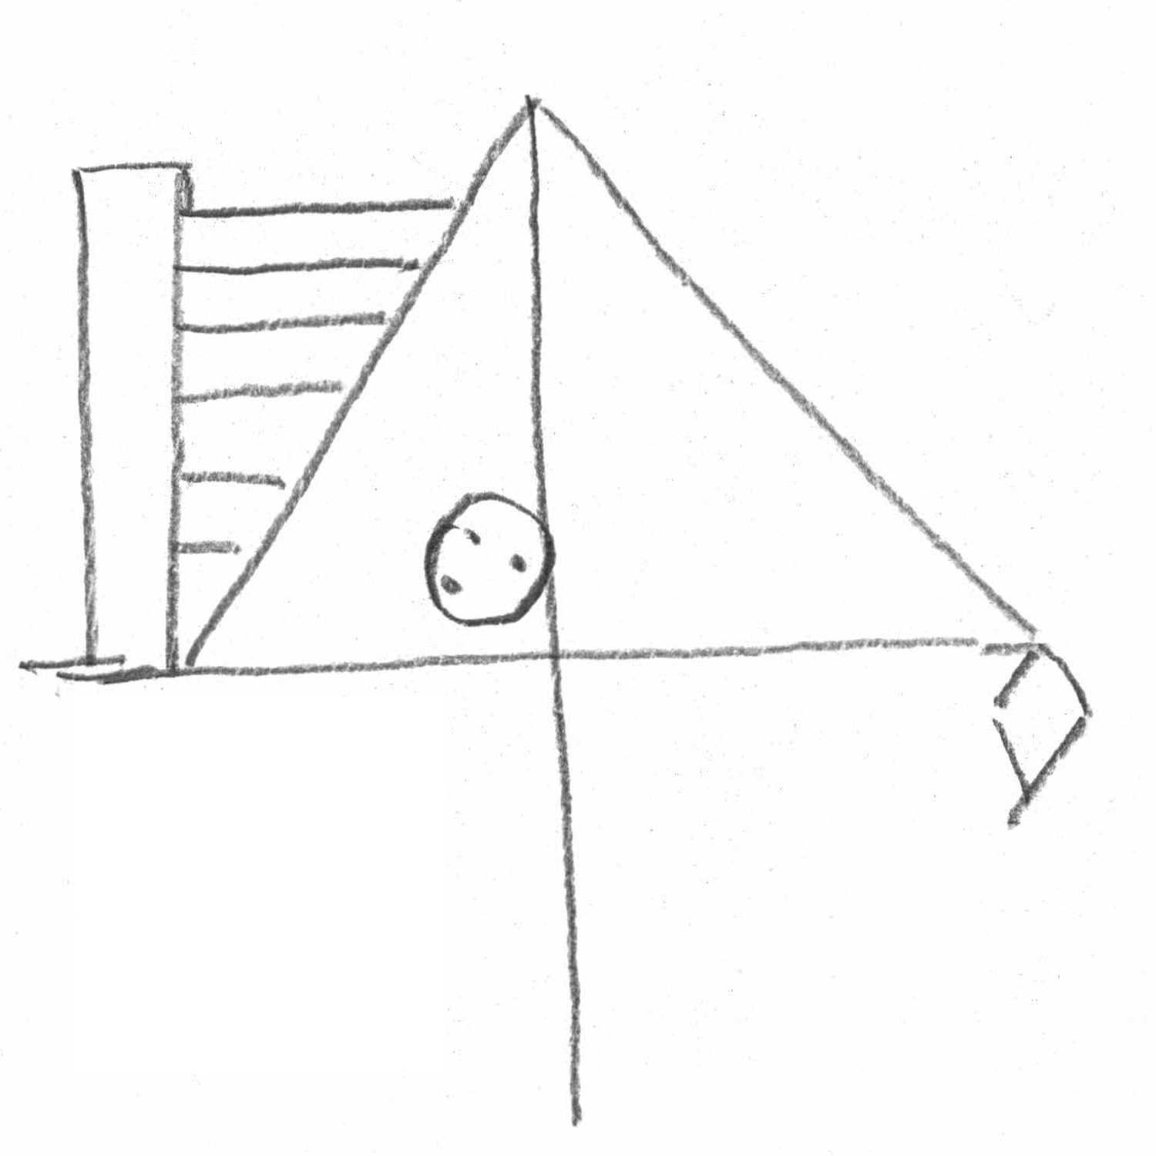
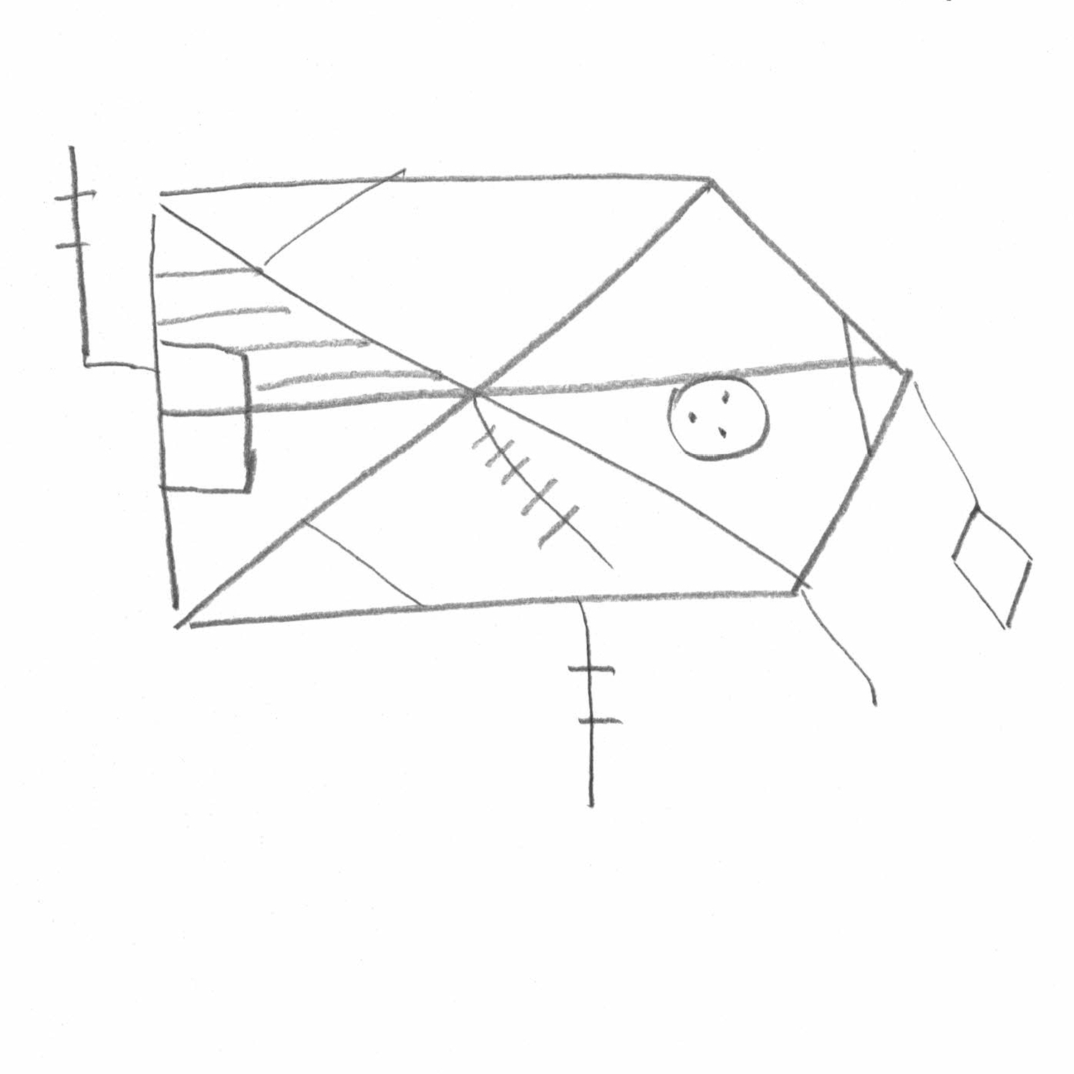
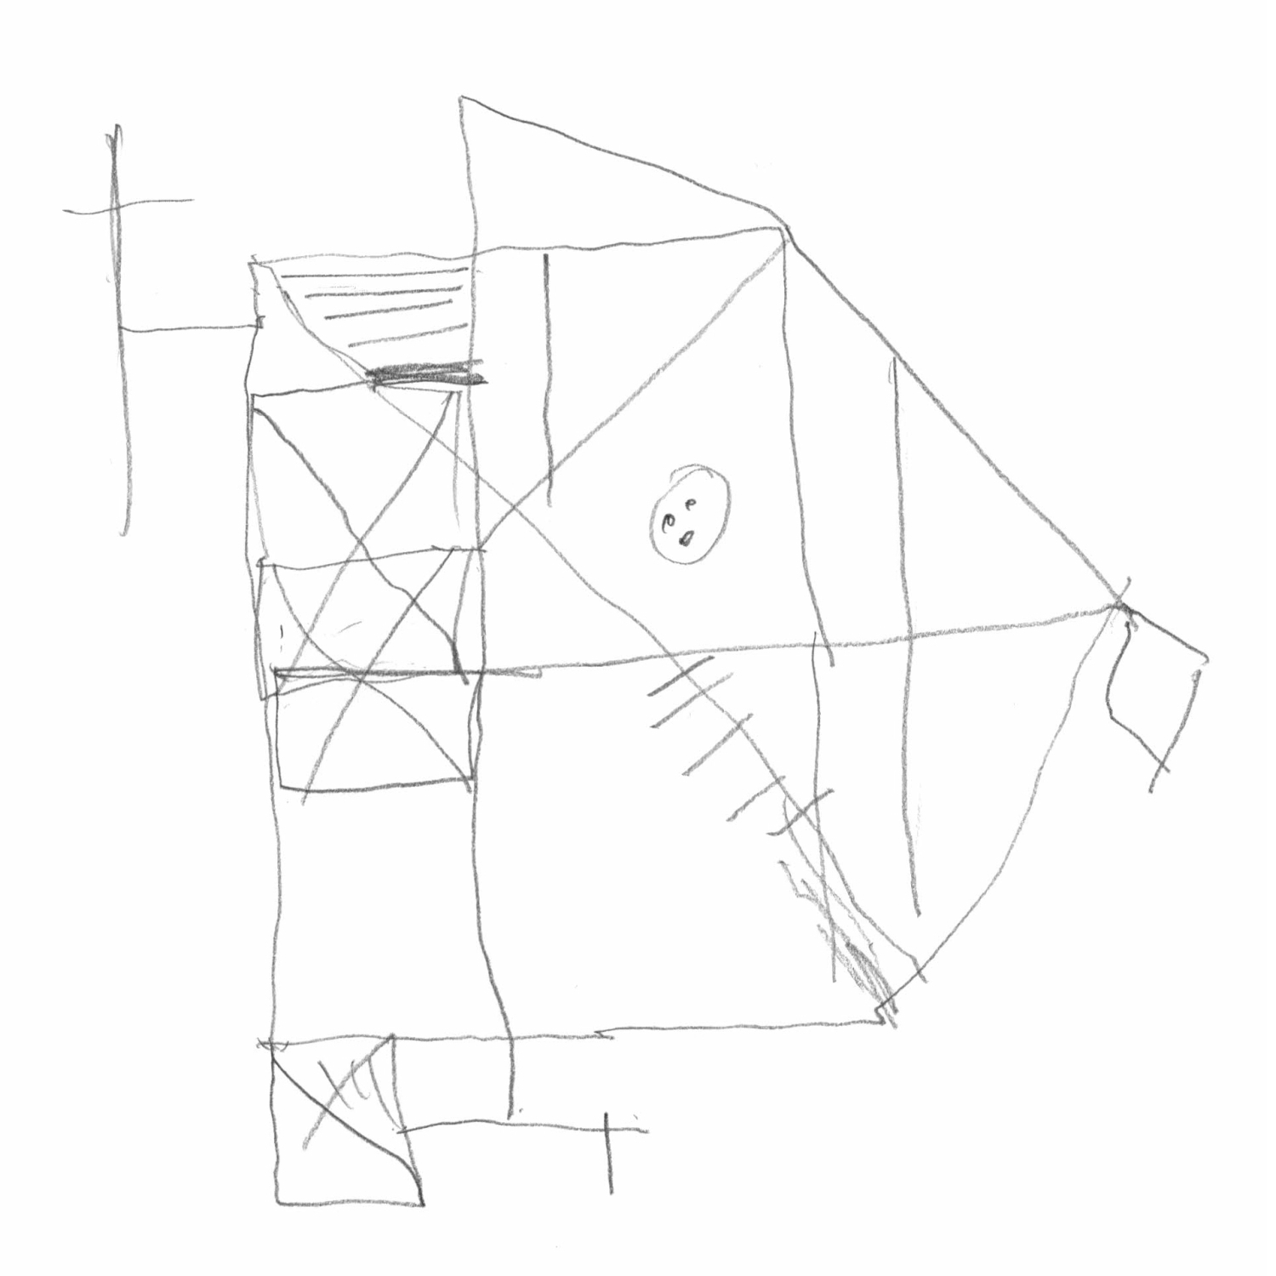
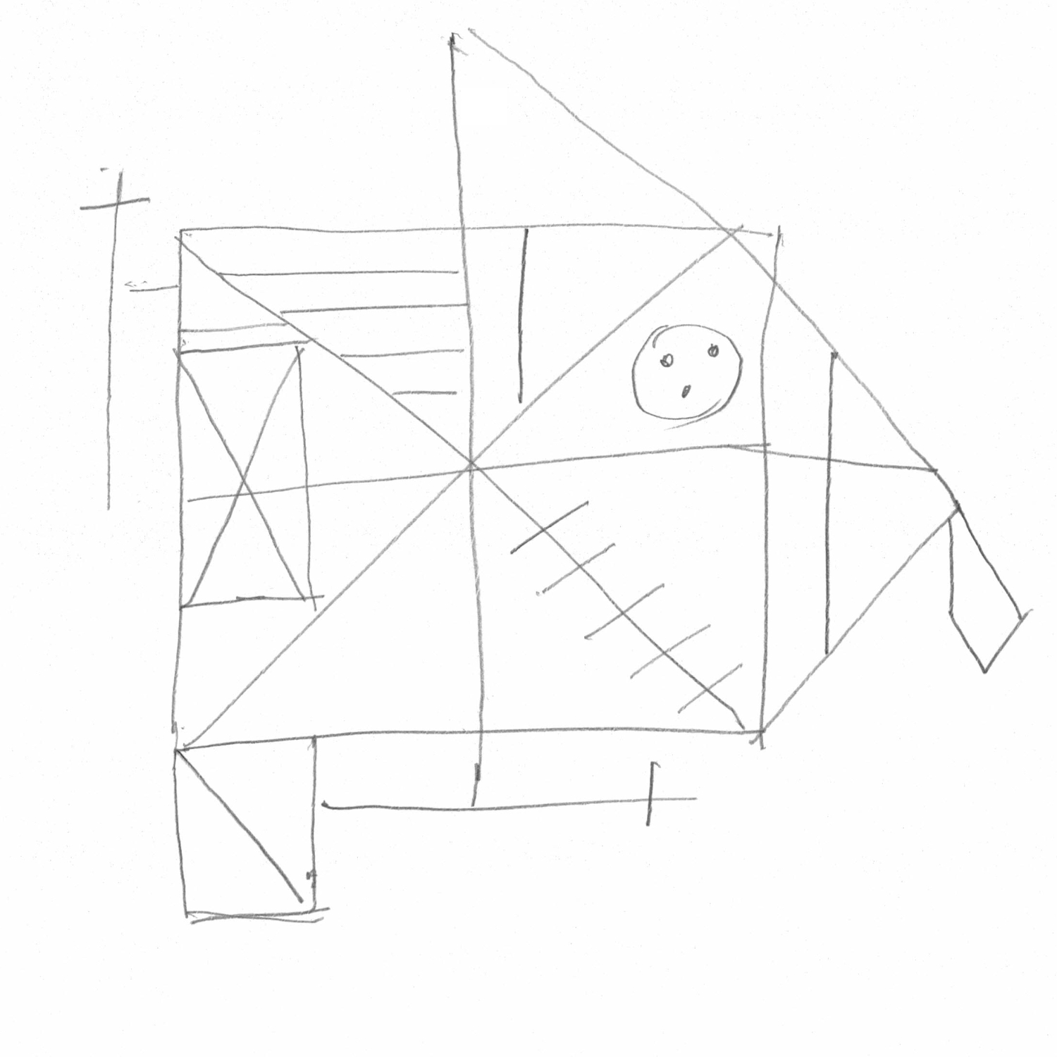
Dataset and libraries
1041 images
Training dataset: 842, Validation dataset: 94, Testing dataset: 105
Greyscale
Augmentations:
Color jittering – random change of brightness, contrast
Random translation
Random crop
Libraries: PyTorch (AI and ML), Matplotlib (graphs), NumPy (vectorized computation), OpenCV (image processing)
score 3 = class 1
score 15.5 = class 2
score 25 = class 3
score 32 = class 4

Slide 5
resnet-18 vs. swin transformer: model experiments
ResNet-18 Configuration
Two types of pooling layers between the final convolution and FCL:
Global average pooling
Average pooling with kernel size (2, 2)
Two learning rates:
0.001
0.0001
Swin Transformer Configuration
Two types of input data:
With pixel position embeddings: three channels – pixel intensities, pixel coordinates
Without pixel position embeddings: one channel – pixel intensities
Learning rate: 0.0001
Common Settings
ImageNet-pretrained weights
Four data augmentation techniques
Adam optimizer
L2 regularization
Batch size: 16
Learning rate scheduler

Slide 6
Validation accuracy of model predictions
 | Pool layer | Learning rate | Pixel position embedding | None | Color jittering | Translation | Resized crop
ResNet-18 | 2x2 | 0.001 | x | 73.4% | 54.3% | 81.9% | 75.5%
ResNet-18 | 2x2 | 0.0001 | x | 100.0% | 100.0% | 96.8% | 100.0%
ResNet-18 | global | 0.001 | x | 100.0% | 98.9% | 93.6% | 95.7%
ResNet-18 | global | 0.0001 | x | 100.0% | 97.9% | 96.8% | 98.9%
Swin transformer | x | 0.0001 | without | 95.74% | 91.49% | 89.36% | 100%
Swin transformer | x | 0.0001 | with | 98.94% | 93.62% | 85.11% | 100%

Slide 7
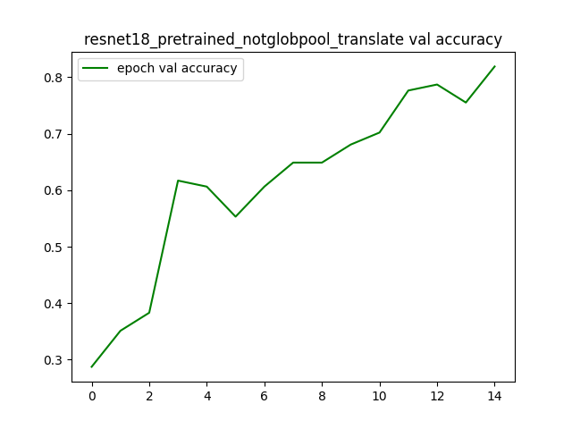
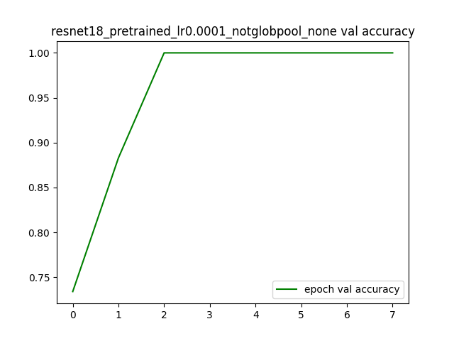
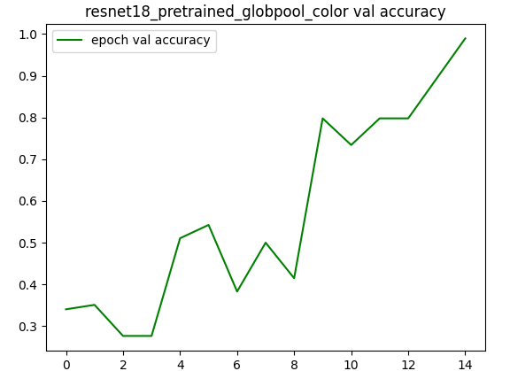
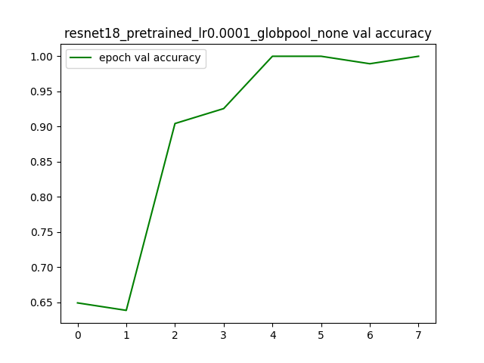
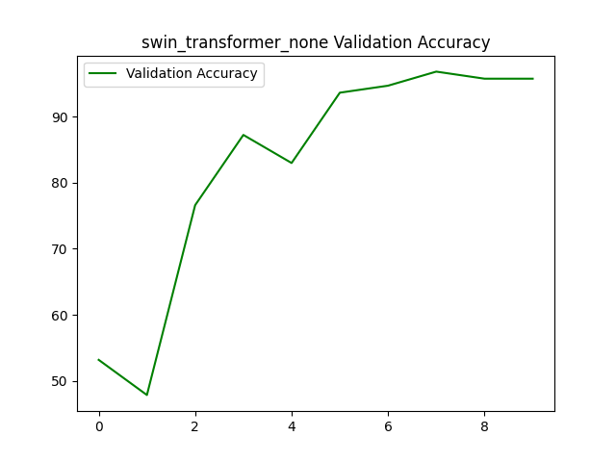
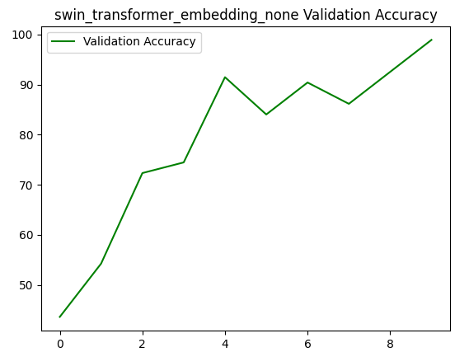
Validation Accuracy Curves of Selected Models Trained with Optimal Augmentation
Translation
No augmentation
Color jittering
ResNet-18, pool layer (2x2), LR=0.001
ResNet-18, pool layer (2x2), LR=0.0001
ResNet-18, global pool layer, LR=0.001
No augmentation
No augmentation
No augmentation
ResNet-18, global pool layer, LR=0.0001
Swin transformer without pix. pos. embedding
Swin transformer with pix. pos. embedding

Slide 8
Analysis of number of dark pixels
Nearly perfect accuracy on testing set – suspected overfitting
Explored correlation between number of dark pixels and four ROCF score classes
Computed various metrics based on the number of pixels corresponding to the drawing in binarized images
Founding: higher-scoring drawings tend to have more dark pixels
Model might rely on simple visual cues (density of dark pixels) rather than deeper understanding
 | Class 1 (0-14.5) | Class 2 (15-22) | Class 3 (22.5-30) | Class 4 (30.5-36)
Average | 9171 | 10817 | 12049 | 12728
Median | 9326 | 10799 | 11977 | 12688
Std | 1863 | 1593 | 1537 | 1376
3 points – class 1
32 points – class 4

Slide 9
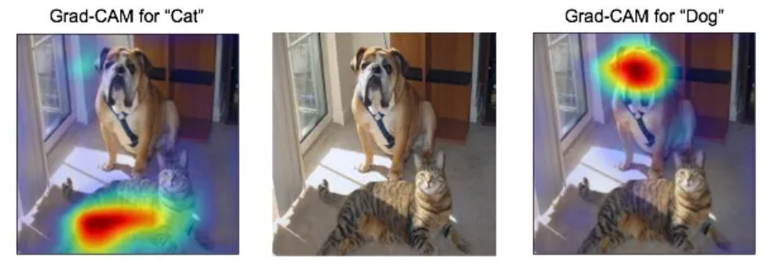
Future plans
Shift from 4-class classification to more precise prediction of total score
Train individual ResNet-18 models to estimate scores for each of the 18 ROCF elements separately
Focus the model’s attention on the expected location of each element using Gaussian weights on pixels
Use explainable AI techniques (e.g., Grad-CAM) to validate whether the model attends to relevant image areas during prediction
More interpretable and clinically useful automated scoring system

Slide 10
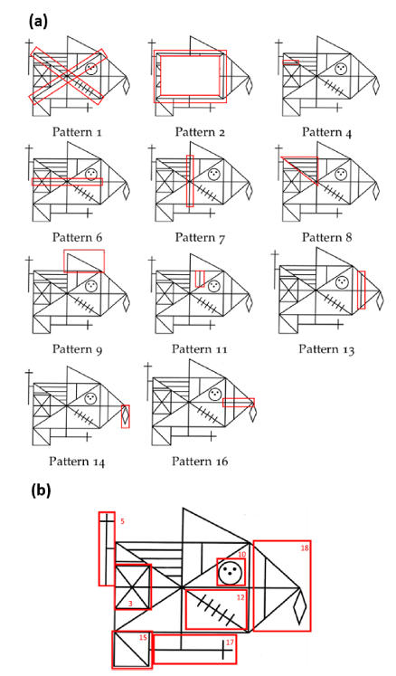
A decision support system for rey–osterrieth complex figure evaluation
18 ROCF elements - qualitative labels: omitted, distorted, misplaced, correct
Simple patterns (lines, rectangles) classified using Computer Vision techniques
Complex patterns classified using Deep Learning
Two SVM classifiers determine presence/absence and distinguish between correct and distorted elements.
Predicting the diagnosis (healthy, MCI, or dementia)
Labels from all 18 patterns - features for a CatBoost classifier
Explainable AI (SHAP) - which patterns most influenced the diagnosis prediction.

Slide 11
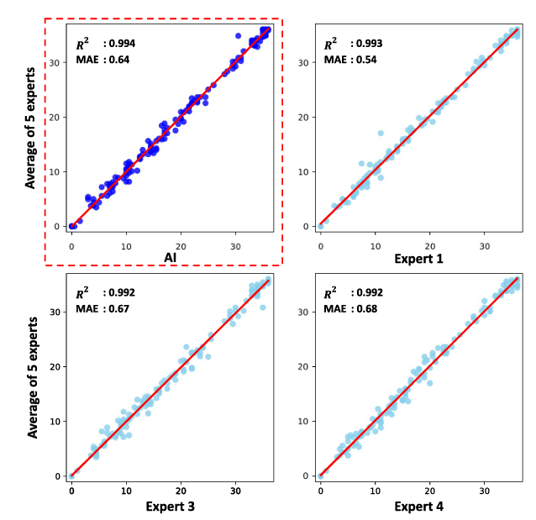
Automating Rey Complex Figure Test scoring using a deep learning-based approach: a potential large-scale screening tool for cognitive decline
Large dataset: 20 040 ROCF images
DenseNet-based convolutional neural network
Data quality enhancement: manual review and correction of scoring errors of images with prediction errors ≥5 points before final model training
Internal validation: 5-fold cross-validation – Mean Absolute Error = 0.95 points
External validation: comparing prediction of model and 5 human experts with testing set annotations
AI matched performance of human experts

Slide 12
references
https://www.researchgate.net/publication/360370646_Modeling_Users'_Cognitive_Performance_Using_Digital_Pen_Features
https://medium.com/@mohamedchetoui/grad-cam-gradient-weighted-class-activation-mapping-ffd72742243a
Peter Iványi. Automatizované hodnotenie neuropsychologického testu. Diplomová práca, Slovenská technická univerzita v Bratislave, Fakulta elektrotechniky a informatiky, Bratislava, 2023.
Miroslav Čobrda. Klasifikácia na základe reyových figúr. Diplomová práca, Slovenská technická univerzita v Bratislave, Fakulta elektrotechniky a informatiky, Bratislava, 2024.
Davide Di Febbo, Simona Ferrante, Marco Baratta, Matteo Luperto, Carlo Ab bate, Pietro Davide Trimarchi, Fabrizio Giunco, and Matteo Matteucci. A decision support system for rey–osterrieth complex figure evaluation. Expert Systems with Applications, 213:119226, 2023.
J. Y. Park, E. H. Seo, H. J. Yoon, and et al. Automating Rey Complex Figure Test scoring using a deep learning-based approach: a potential large-scale screening tool for cognitive decline. Alzheimer’s Research & Therapy, 15:145, 2023.

Slide 13
Master’s Thesis sources
Master’s Thesis web page: https://davinci.fmph.uniba.sk/~korbelova19/masters_thesis/masters_thesis_ROCF.html
Prototype of Master’s Thesis on github: https://github.com/lk0103/ROCF_score_classification/tree/main

Slide 14
Thank you for your attention

