Slide 1

AUTOMATED EVALUATION OF THE REY-OSTERRIETH COMPLEX IMAGE TEST
Author: Lucia Korbeľová
Supervisor: doc. RNDr. Zuzana Černeková, PhD.

Slide 2
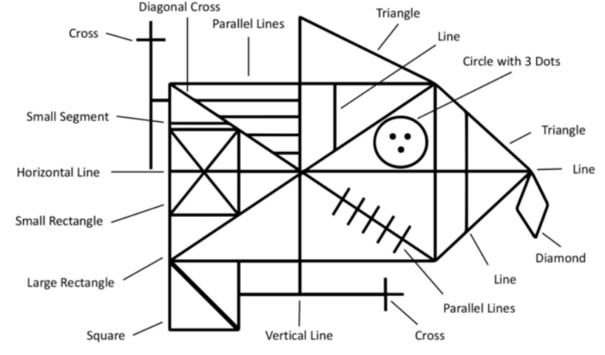
REY-OSTERRIETH COMPLEX Figure (ROCF) TEST
Visuospatial abilities and memory
The patient draws a copy of the ROCF figure either from a template or from memory
Consists of 18 geometrical elements, each scored from 0 to 2
Total score - from 0 to 36
Scoring is based on accuracy of the drawn elements and correctness of their placement

Slide 3
Objective of the thesis
Automated system to approximate ROCF drawing scores
Computer vision and artificial intelligence techniques
Getting closer to annotations done by experts
Same dataset used in two master’s theses from FEI STU: Iványi (2023) and Čobrda (2024)
Simplified scoring system:
Scores were divided into four classes (Iványi, 2023)
Each class: interval of score values
First goal: replicating their results with more modern architectures
Class | Minimal total score | Maximal total score
1 | 0 | 14.5
2 | 15 | 22
3 | 22.5 | 30
4 | 30.5 | 36

Slide 4
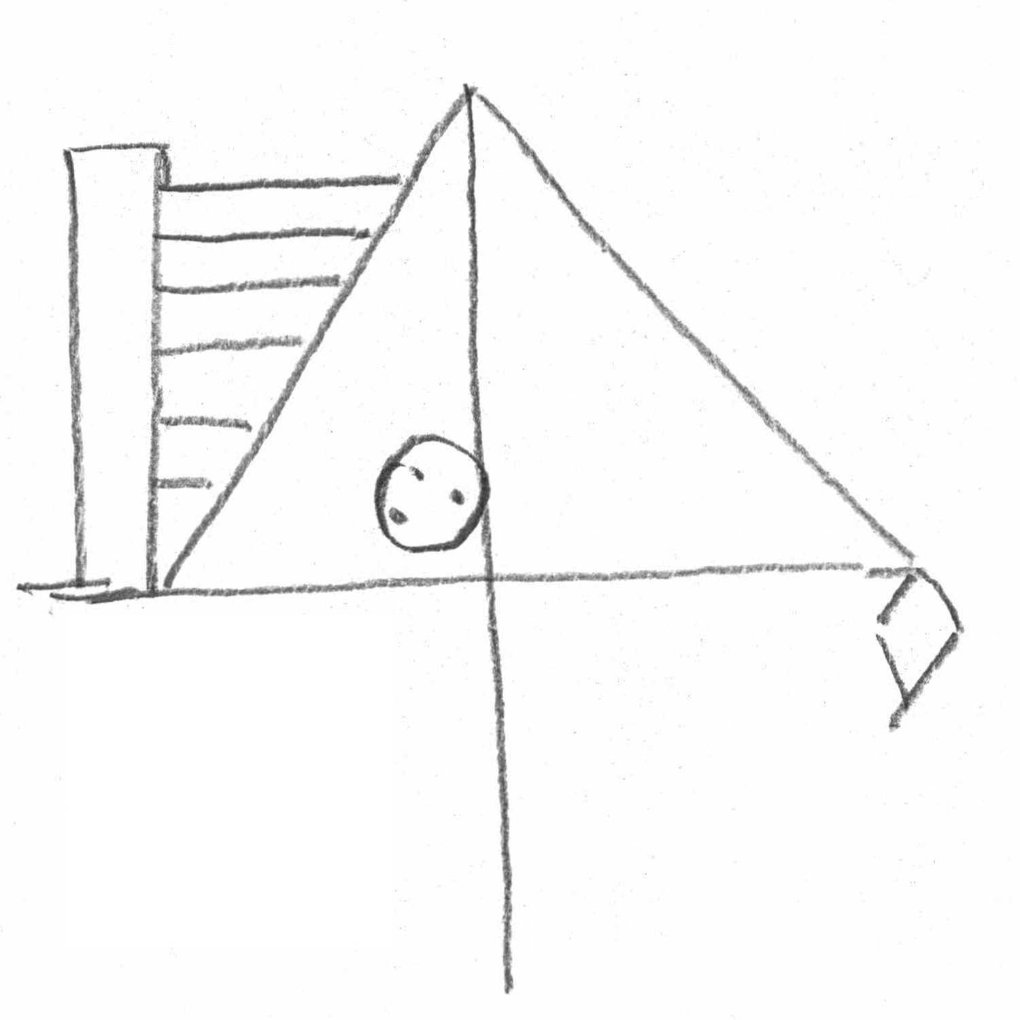
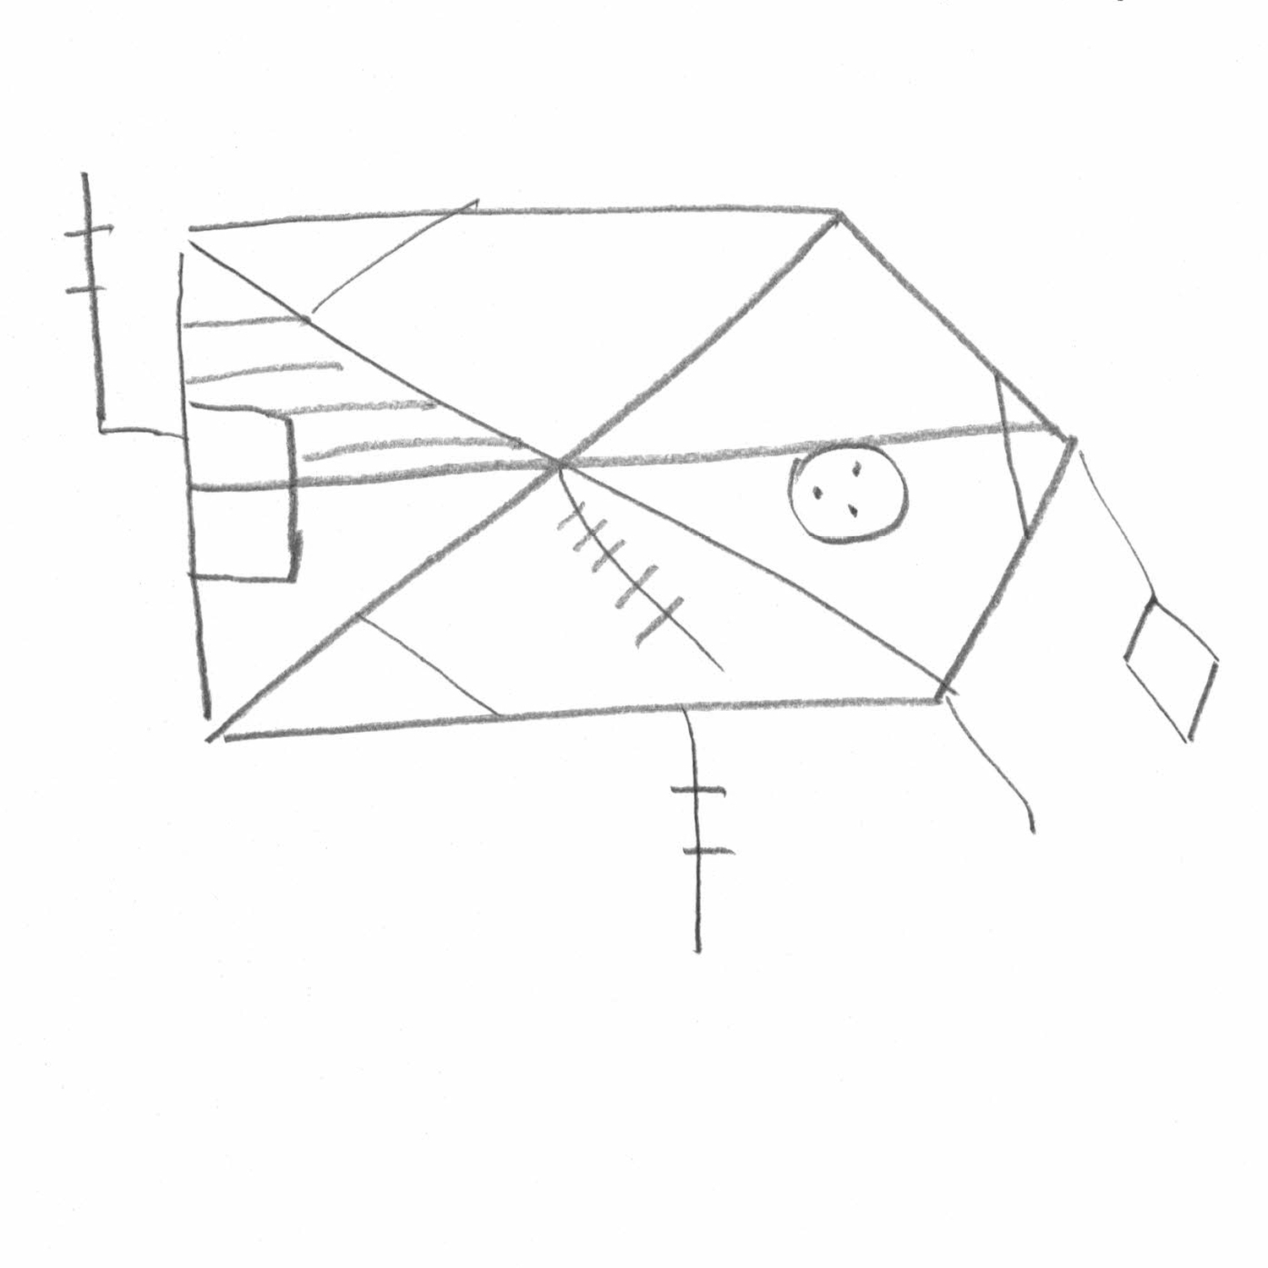
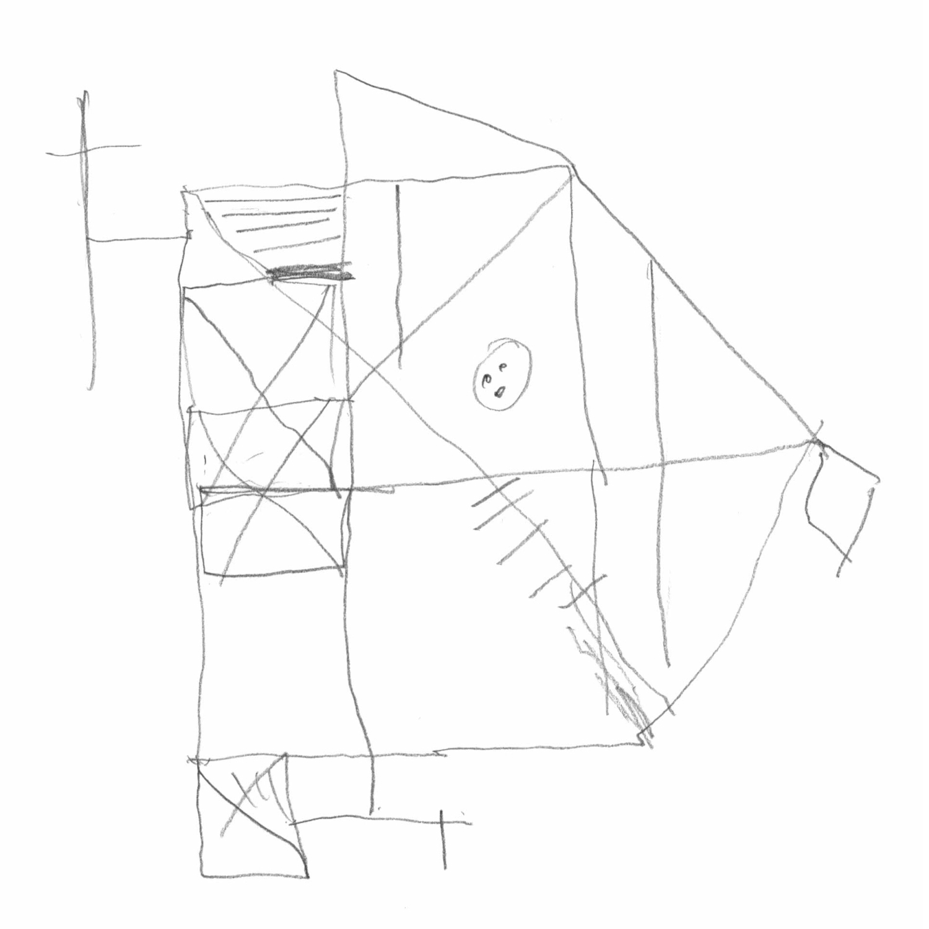
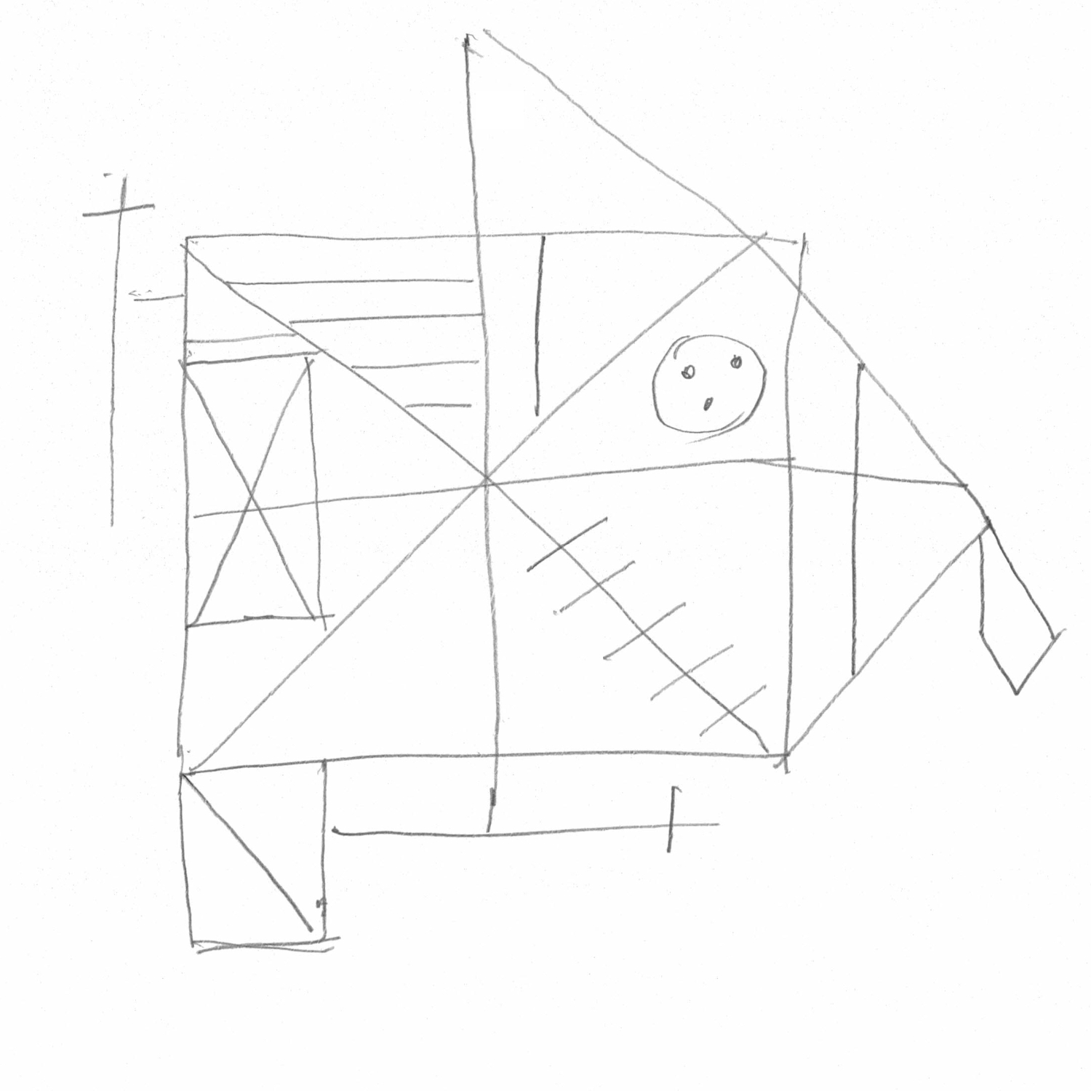
Dataset and libraries
1041 images
Training dataset: 842
Validation dataset: 94
Testing dataset: 105
Libraries:
PyTorch and scikit-learn (AI and ML)
Matplotlib (graphs)
NumPy (vectorized computation)
OpenCV (image processing)
score 3 = class 1
score 15.5 = class 2
score 25 = class 3
score 32 = cla44ss 4

Slide 5
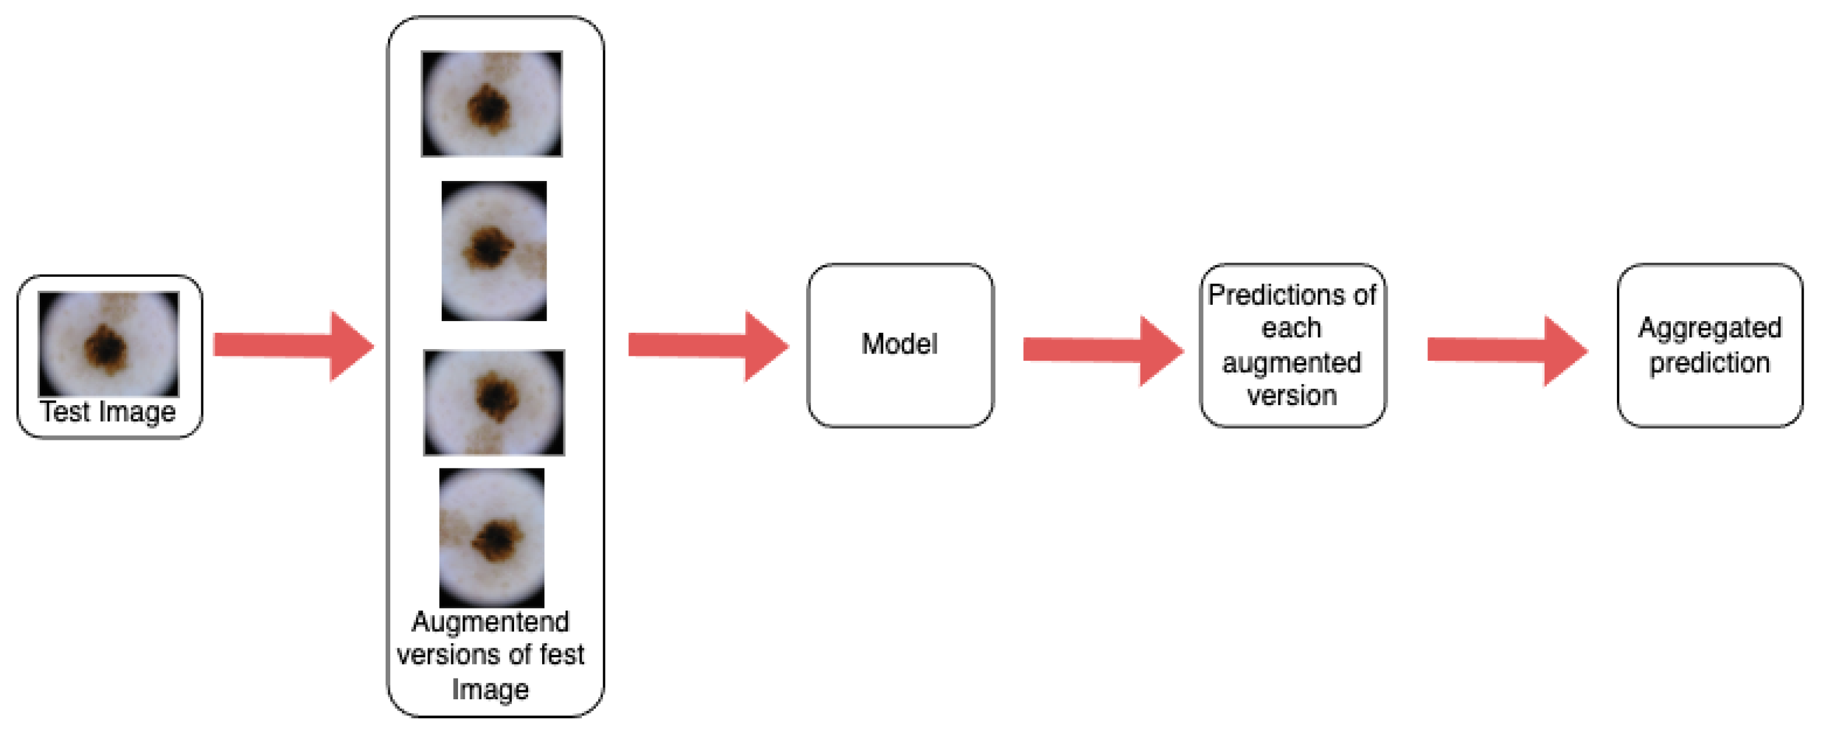
Evaluation method
Metrics: recall, precision, F1 score, mean absolute error (MAE), confusion matrix
Test-time augmentation to improve performance on testing set
Five versions of each image (original, rotated, translated, brightness/contrast adjusted, and a combined augmentation). Final prediction made by majority vote.
The model evaluated on the test set is the one from the epoch with the highest validation F1 score.
Comparison: testing recall is compared to a simple CNN baseline by Iványi (2023), which achieved 72.5% recall on the 4-class task.

Slide 6
Initial model and augmentation experiments
Goal: choose NN architecture and augmentation strategy
Simplified 4-class classification setup proposed by Iványi (2023)
Architectures tested: ResNet-18 and Swin Transformer
Augmentations tested: translation, rotation, crop, brightness/contrast change, and a combined augmentation (translation, rotation and brightness/contrast change)
Additional hyperparameters: whether to use global average pooling (ResNet-18), learning rates 0.001 vs. 0.0001, and different learning rate decay schedules
Common settings: LR 0.0001, ImageNet pretrained weights, Adam optimizer, L2 regularization, batch size 16, learning rate scheduler (patience 3 epochs)

Slide 7
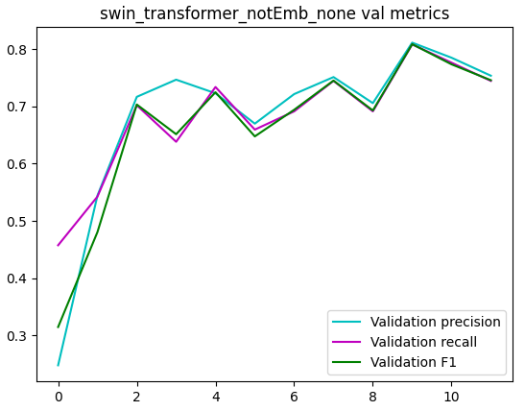
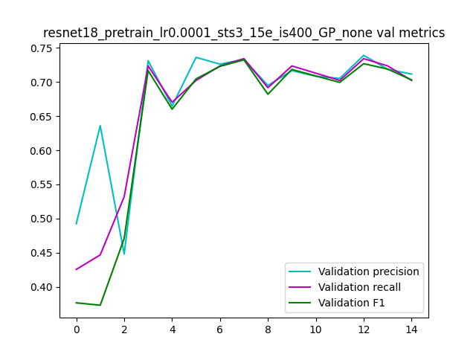
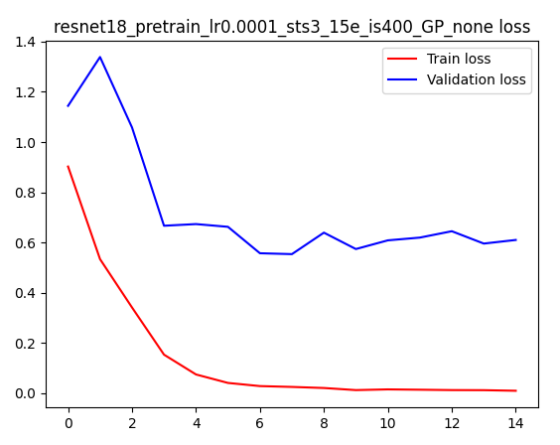
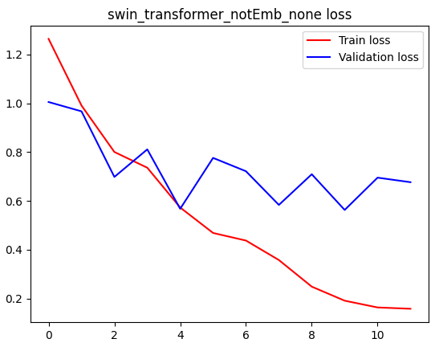
Model comparison without augmentations
Swin Transformer
ResNet-18
ResNet-18
Test metrics | CNN by Iványi | ResNet-18 | Swin Transformer
Recall | 72.5% | 71.43% | 68.57%
Precision | - | 72.14% | 68.61%
F1 score | - | 70.51% | 68.25%
Loss | - | 0.9951 | 1.0253
Swin Transformer

Slide 8
ResNet-18 augmentation test results
 | Augmentation type
TTA test metrics | no | contrast. brightness | translation | rotation | crop | contrast, brightness, translation, rotation
Recall | 71.43% | 72.38% | 73.33% | 73.33% | 50.48% | 77.14%
Precision | 72.14% | 72.69% | 73.51% | 73.37% | 53.43% | 77.61%
F1 score | 70.51% | 71.58% | 73.17% | 72.77% | 42.88% | 76.94%
Loss | 0.9951 | 0.8071 | 0.9922 | 0.9214 | 1.0312 | 0.6135

Slide 9
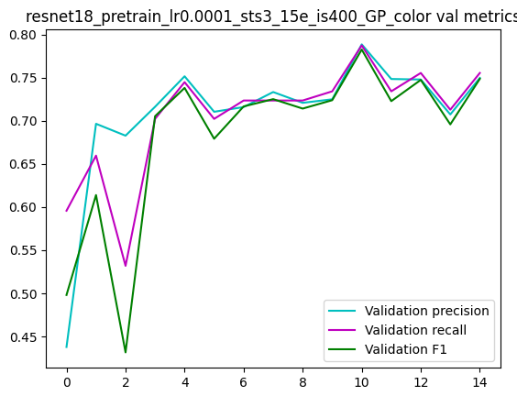
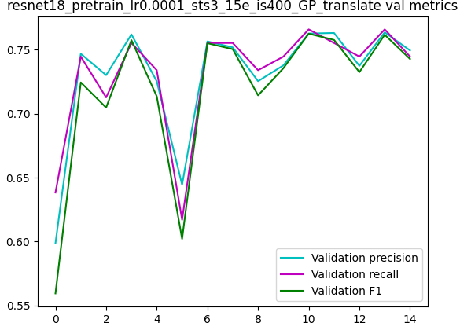
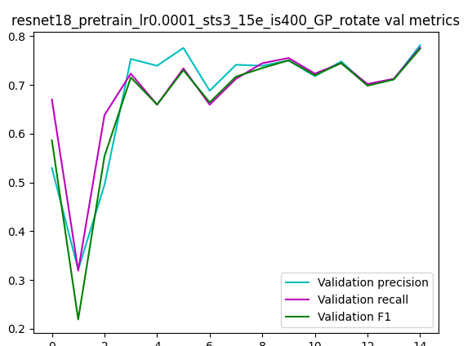
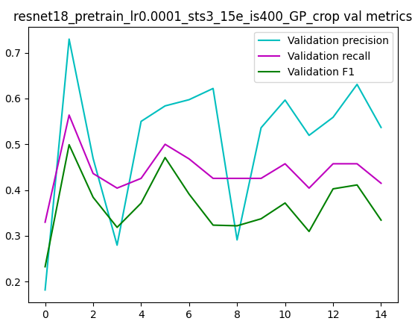
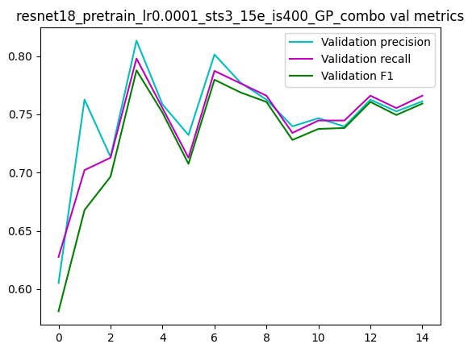
Validation Accuracy Curves of Resnet-18 models
No augmentation
Color jittering
Translation
Rotation
Crop
Combined augmentation

Slide 10
Swin transformer augmentation test results
 | Augmentation type
TTA test metrics | no | contrast. brightness | translation | rotation | crop | contrast, brightness, translation, rotation
Recall | 68.57% | 64.76% | 66.67% | 73.33% | 24.76% | 69.52%
Precision | 68.61% | 65.41% | 66.71% | 73.29% | 6.13% | 69.08%
F1 score | 68.25% | 64.98% | 66.57% | 72.23% | 9.83% | 68.85%
Loss | 1.0253 | 0.987 | 0.7173 | 0.7681 | 2.4093 | 0.7053

Slide 11
Future plans
Class | 1 | 2 | 3 | 4 | 5 | 6
Minimal total score | 0 | 6.5 | 12.5 | 18.5 | 24.5 | 30.5
Maximal total score | 6 | 12 | 18 | 24 | 30 | 36
Transition from 4-class classification to a 6-class setup, where each class represents a six-point score interval
Best performing model: ResNet-18
Best performing augmentation: combination of multiple augmentations
Preprocessing step: drawing reconstruction to remove background noise and enhance line visibility
Baseline model: ResNet-18 without any preprocessing or augmentation, compared against preprocessing only, augmentation only, and the combination of both

Slide 12
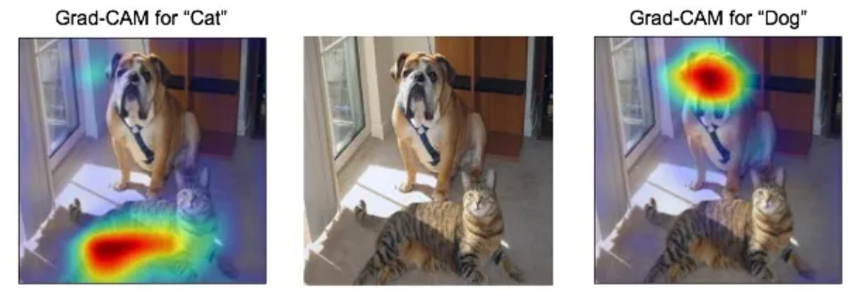
Future plans
An encoder–decoder model will also be trained: the encoder compresses each drawing into a low-level feature vector, and the decoder learns to reconstruct the original image from this vector.
The encoder’s feature vectors will feed a simple neural network for final classification
This encoder-based approach will be compared with the four ResNet-18 models from the 6-class experiment
Use explainable AI techniques (e.g., Grad-CAM) to validate whether the model attends to relevant image areas during prediction

Slide 13
Previous work
Automated scoring of a neuropsychological test: the Rey Osterrieth complex figure:
Detected basic shapes (rectangles, triangles) using classical computer vision
Represented lines as attributed relational graph and detected shapes using fuzzy spatial metrics inspired by Gestalt psychology
A decision support system for rey–osterrieth complex figure evaluation:
Simple elements classified into 4 qualitative classes with classical CV and complex elements handled by deep learning techniques
Predicted classes of 18 elements used to estimate the final diagnosis instead of score
Automating Rey Complex Figure Test scoring using a deep learning-based approach: a potential large-scale screening tool for cognitive decline:
Large dataset (~20 000 images) used to train DenseNet model
Model predicts the final ROCF score and reaches human-level performance

Slide 14
references
https://www.researchgate.net/publication/360370646_Modeling_Users'_Cognitive_Performance_Using_Digital_Pen_Features
https://medium.com/@mohamedchetoui/grad-cam-gradient-weighted-class-activation-mapping-ffd72742243a
https://www.mdpi.com/2313-433X/11/1/15
Peter Iványi. Automatizované hodnotenie neuropsychologického testu. Diplomová práca, Slovenská technická univerzita v Bratislave, Fakulta elektrotechniky a informatiky, Bratislava, 2023.
Miroslav Čobrda. Klasifikácia na základe reyových figúr. Diplomová práca, Slovenská technická univerzita v Bratislave, Fakulta elektrotechniky a informatiky, Bratislava, 2024.
R.O. Canham, S.L. Smith, and A.M. Tyrrell. Automated scoring of a neuropsy chological test: the rey osterrieth complex figure. In Proceedings of the 26th Euromicro Conference. EUROMICRO 2000. Informatics: Inventing the Future, volume 2, pages 406–413 vol.2, 2000.
Davide Di Febbo, Simona Ferrante, Marco Baratta, Matteo Luperto, Carlo Ab bate, Pietro Davide Trimarchi, Fabrizio Giunco, and Matteo Matteucci. A decision support system for rey–osterrieth complex figure evaluation. Expert Systems with Applications, 213:119226, 2023.
J. Y. Park, E. H. Seo, H. J. Yoon, and et al. Automating Rey Complex Figure Test scoring using a deep learning-based approach: a potential large-scale screening tool for cognitive decline. Alzheimer’s Research & Therapy, 15:145, 2023.

Slide 15
Master’s Thesis sources
Master’s Thesis web page: https://davinci.fmph.uniba.sk/~korbelova19/masters_thesis/masters_thesis_ROCF.html
Prototype of Master’s Thesis on github: https://github.com/lk0103/ROCF_score_classification/tree/main

Slide 16
Thank you for your attention

