Slide 1
Quote in minutes.
Never guess a price.
The chat-native quotation tracker for Malaysian SMEs.
TEAM SPARK SURGE · DOMAIN 2 · SDG 8 DECENT WORK AND ECONOMIC GROWTH
Universiti Tun Hussein Onn Malaysia (UTHM)
Harrish Govind · Larm Kai Xian · Kevinraj Gaunder · Teoh Yeong Boon · Muhammad Aqil
Notes:
[0:00 to 0:15] Hi, we are Spark Surge from UTHM, and this is LARIS, a chat-native quotation tracker for Malaysian SMEs. Our promise: quote in minutes, and never guess a price.

Slide 2



1. The Problem
ILLUSTRATIVE OWNER · 11 PM
1.07M
39.7%
She quotes from her phone, between jobs.
MSME establishments (DOSM, 2023)
of GDP comes from MSMEs (DOSM, 2025)
Enquiries arrive as Manglish voice notes
48.7%
61 days
Supplier prices sit in photos and PDFs
Quotes are priced from memory, then chased by hand
of national employment (DOSM, 2025)
average business payment delay (Experian, 2025)
Slow reply = lost job. Stale price = lost margin.
No Malaysian survey measures quote turnaround, so we are timing it with owners. Sources: DOSM MSME Performance 2025 and Economic Census 2023; Experian State of Credit 2025. The owner is an illustrative persona.
Notes:
[0:15 to 0:55] Meet a small shop owner. It is eleven at night, and she is quoting from her phone, between jobs. Enquiries arrive as Manglish voice notes. Supplier prices sit in photos and PDFs. So she prices from memory, then chases by hand. This is not a niche: Malaysia has about 1.07 million MSMEs, 39.7 percent of GDP, 48.7 percent of jobs, and businesses wait 61 days on average to be paid. A slow reply loses the job. A stale price loses the margin. Honestly, nobody has measured quote turnaround here, so we are timing it with owners.

Slide 3





2. Our Solution
Customers stay in chat. Owners stay in control.
01 ASK
02 UNDERSTAND
03 PRICE
04 APPROVE
05 TRACK
Customer asks on Telegram or WhatsApp, in text or a voice note.
ILMU turns the message into items and quantities.
Rules price it from the cost book and apply a margin floor.
The owner approves with one tap. Staff never see margins.
Quote is sent, tracked, exported and chased automatically.
The AI reads. Rules price. The owner approves.
Notes:
[0:55 to 1:29] LARIS keeps customers in chat and owners in control. One: the customer asks on Telegram or WhatsApp, by text or voice note. Two: ILMU turns the message into items and quantities. Three: rules, not AI, price it from the owner's cost book, with a margin floor. Four: the owner approves with one tap, and staff never see margins. Five: LARIS sends the quote, tracks it, exports it and chases it. The AI reads. Rules price. The owner approves.

Slide 4




3. What It Does
Chat and voice enquiries
Rule-based pricing
Catalog from a photo
Text or Manglish voice notes on Telegram, read into items.
Cost book, margin guard, stale-cost alerts. No AI price.
One shelf photo becomes reviewable items (Qwen2.5-VL on RunPod).
Availability and quote asks
Price lists in, quotes out
Owner control
Customers ask "is it available?" and "quote 50 kg".
PDF, photo, XLSX, DOCX, CSV in. PDF, XLSX, CSV out.
Approval step, roles, audit log, tracker and reminders.
Telegram is live. WhatsApp is built and waiting for Meta setup.
Notes:
[1:29 to 2:15] Six things matter. First, chat and voice enquiries, read into items. Second, rule-based pricing with a margin guard and stale-cost alerts, so no AI price. Third, a catalog from a photo: one shelf photo becomes reviewable items, read by Qwen2.5-VL on a RunPod GPU. Fourth, availability and quote asks: customers can ask is it available, and request a quote. Fifth, supplier price lists come in as PDF, photo, Excel, Word or CSV, and quotes go out as PDF, Excel or CSV. Sixth, owner control: approval, roles, audit log, tracker and reminders. Telegram is live, and WhatsApp is built and waiting for Meta setup.

Slide 5
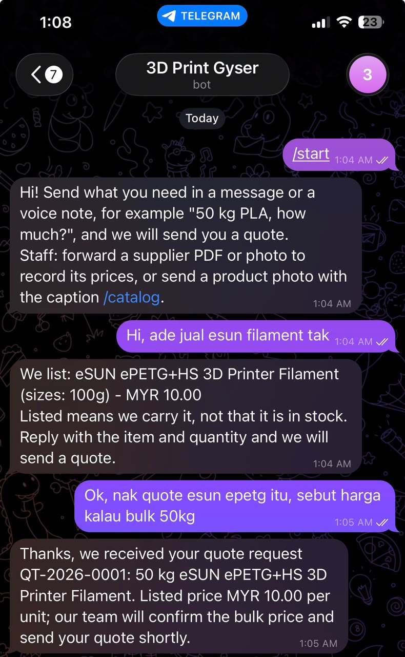
See It Work
Gyser 3D Print · @Gyser3DPrintBot
OWNER'S SCREEN
Draft QT-2026-0001
NEEDS REVIEW
Item
eSUN ePETG+HS 3D Printer Filament
Quantity
50 kg (customer asked in Malay)
Listed price
MYR 10.00 per unit (100g size)
Bulk price
Owner to confirm
Approve and send
Voice notes follow the same path
Left: real Telegram screenshot. Right: owner screen recreated. Synthetic sample data.
Notes:
[2:15 to 3:15] This is the real Telegram bot. The customer taps start and gets a short guide. Then asks, in Malay-English: do you sell eSUN filament? The bot answers only from the confirmed catalog: eSUN ePETG filament, ten ringgit for the 100 gram size. And it says listed means we carry it, not that it is in stock. We never claim stock we do not track. Then the customer asks for a quote on fifty kilos. LARIS does not promise a price. It creates draft QT-2026-0001 and tells the customer the owner will confirm the bulk price. On the right is what the owner sees: needs review, the item, the quantity, the listed price, and the bulk price waiting for the owner. One tap to approve and send. All of this is synthetic sample data.

Slide 6
4. Why LARIS
 | Chat and spreadsheet | Accounting / ERP | LARIS
Works inside the chats customers use | ✓ | ✗ | ✓
Reads voice-note enquiries | ✗ | ✗ | ✓
Price comes from rules, never AI | ✗ | ~ | ✓
Owner approval and audit trail | ✗ | ✓ | ✓
Reads supplier lists and shelf photos | ✗ | ~ | ✓
Ready without an IT team | ✓ | ✗ | ✓
✓ yes ~ partly ✗ no. A comparison of tool categories, not named products.
Notes:
[3:15 to 3:41] Why is this different? Chat and spreadsheets are where owners already are, but nothing checks the price. Accounting and ERP tools are not built for chat and need setup. LARIS lives in the chat, reads voice, lists and photos, and keeps the price in rules with the owner in control. This compares categories of tools, not named products.

Slide 7
5. Impact
SDG
Minutes from enquiry to sent quote
PHASE 2 TARGET
8
-50%
Baseline: owner timing sessions in progress
Enquiries answered within 1 hour
PHASE 2 TARGET
90%
Target 8.3: support growth of micro, small and medium enterprises
Baseline: being measured
Sent quotes on a stale cost with no warning
PHASE 2 TARGET
0
Today: nothing flags a moved price
RM0.006
1.07M
~500
ILMU speech for a 30 s voice note
MSMEs that could use it
automated tests on every commit
Targets are goals, not results. Speech price from the ILMU console (before SST).
Notes:
[3:41 to 4:23] Our impact target is SDG 8, target 8.3: helping micro, small and medium enterprises grow. We track three KPIs. Minutes from enquiry to sent quote, targeting minus fifty percent. Enquiries answered within an hour, targeting ninety percent. And sent quotes on a stale cost with no warning, targeting zero. The baselines come from owner timing sessions we are running now, so these are targets, not results. And it is cheap to run: a thirty second voice note costs about six tenths of a sen on ILMU.

Slide 8
6. Business Model
KEY PARTNERS
KEY ACTIVITIES
VALUE PROPOSITION
RELATIONSHIPS
CUSTOMER SEGMENTS
ILMU (YTL AI Labs): speech and extraction
RunPod: GPU for vision
Replit: hosting
Telegram and Meta: chat channels
Quote automation
Reading price lists and photos
Quote from chat in minutes
No guessed prices: rules price, AI reads
Owner approves, audit log keeps the record
Self-serve sign-up
Owner support in BM and English
Made-to-order micro and small firms
Signage, printing, 3D printing, fabrication, renovation
Owners who quote from chat
KEY RESOURCES
CHANNELS
Rules engine and cost book
Signed-licence system
Telegram and WhatsApp
Web app
Trade communities
COST STRUCTURE
REVENUE STREAMS
Speech and AI usage (ILMU, about RM0.0002 per second of audio)
GPU billed only while it runs, plus hosting and chat messages
Subscription per business with seats (signed licence, built). Illustrative: RM39 a month
Optional per-quote add-ons (price to be validated)
Notes:
[4:23 to 5:01] The business model. Customers are made-to-order micro and small firms, such as signage, printing, 3D printing and fabrication, who quote from chat. The value is a quote in minutes, no guessed prices, and an owner who approves. We reach them through Telegram, WhatsApp, the web app and trade communities. Revenue is a subscription per business with seats, already built as a signed licence, illustratively thirty-nine ringgit a month, plus optional per-quote add-ons. Costs are mostly usage. The next slide shows the numbers.

Slide 9
7. Revenue and ROI
ILLUSTRATIVE ASSUMPTIONS, TO VALIDATE WITH OWNERS
ASSUMPTIONS
OWNER ROI
OUR ECONOMICS
30 quotes a month per business
10 minutes saved per quote (the 50% target)
Time valued at the minimum wage, RM8.72 an hour
Price hypothesis: RM39 per business per month
RM43.60
~RM0.07
of time saved a month
variable cost per quote
vs RM39 subscription: covered even at the wage floor, before any margin protected.
Voice note RM0.006, chat message up to RM0.056, extraction under RM0.01 (est.). About 95% variable margin before hosting and GPU.
100 businesses = about RM46,800 a year 0.1% of MSMEs = about RM0.5M
Scenarios, not forecasts. Minimum wage RM8.72 an hour (Minimum Wages Order 2024). Voice and chat prices from the ILMU console and a chat-vendor page, before SST; extraction cost is our estimate. GPU US$0.59 an hour, only while running.
Notes:
[5:01 to 5:45] How does it pay? These are illustrative assumptions we still need to validate with owners. Say thirty quotes a month, with ten minutes saved on each. At the minimum wage of eight ringgit seventy-two an hour, that is worth forty-three ringgit sixty a month. Our price hypothesis is thirty-nine ringgit, so the owner is covered even at the wage floor. Our cost to serve is about seven sen a quote, roughly ninety-five percent variable margin. As a scenario, not a forecast: a hundred businesses is about forty-seven thousand ringgit a year.

Slide 10
8. How It Is Built
Telegram / WhatsApp
FastAPI on Replit
ILMU and RunPod AI
Rules engine and cost book
Owner web app
Replit
RunPod
ILMU
Hosts the app, API and PostgreSQL. All secrets live in Replit Secrets.
A GPU runs Qwen2.5-VL with vLLM and reads catalog photos. Stopped when idle.
Manglish speech-to-text and structured extraction through the ILMU API.
~500
Live
Synthetic
automated tests, green in CI
Telegram bot and web app
data only, PDPA-safe demo
Notes:
[5:45 to 6:13] Under the hood: chat messages reach FastAPI on Replit, which calls ILMU and RunPod, then the rules engine and cost book, then the owner web app. Replit hosts the app and PostgreSQL. A RunPod GPU runs Qwen2.5-VL and is stopped when idle. ILMU does Manglish speech and extraction. About five hundred automated tests run on every commit, on synthetic data.

Slide 11
Next, and who we are
NEXT
TEAM SPARK SURGE
Connect WhatsApp through Meta
Per-size prices and quantity tiers
Time real owners: manual vs LARIS
Stock levels for "in stock" answers
Harrish Govind Team Leader
Larm Kai Xian Full-stack developer
Kevinraj Gaunder Researcher, Tester
Teoh Yeong Boon Store and quotation dataset
Muhammad Aqil Deck designer, Tester
Try it now
Telegram @Gyser3DPrintBot
laris-malaysia.replit.app
Judge login (demo account, synthetic data): lkaixian91@gmail.com / sparksurge
Terima kasih. Thank you.
Notes:
[6:13 to 6:43] Next we will connect WhatsApp through Meta, add per-size prices and quantity tiers, time real owners, and add stock levels. This is team Spark Surge: Harrish, Larm Kai Xian, Kevinraj, Teoh Yeong Boon and Muhammad Aqil. You can try it now: message the Telegram bot Gyser 3D Print Bot, or open the web app. The judge login is on screen. Terima kasih, thank you.

