Slide 1
Designer can code
Lecture 2
by Tom Lau

Slide 2
Aims
Style.xml and drawable.xml
Basics Concept of Material Design
Animation
OnClickListener (Click Response)

Slide 3

Basic Knowledge of Android APP
Android APP
JAVA
(Logical Code)
Picture
(most likely PNG)
xml
(layout, graphic, animation….)

Slide 4
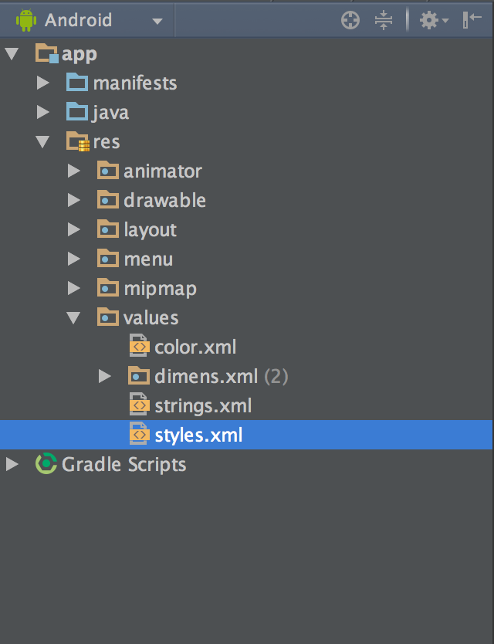
Styles.xml
Customize your theme here.

Slide 5
Theme
Hide ActionBar
Set Color Scheme
Default value of the property

Slide 6
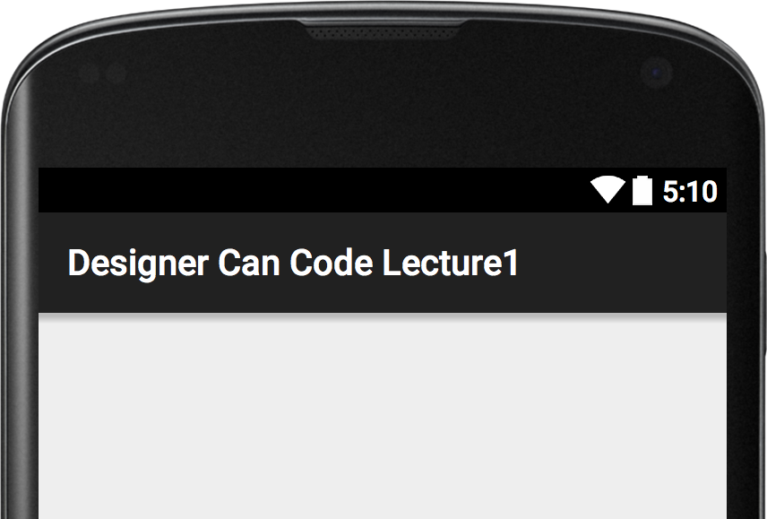
ActionBar
An limited control area

Slide 7
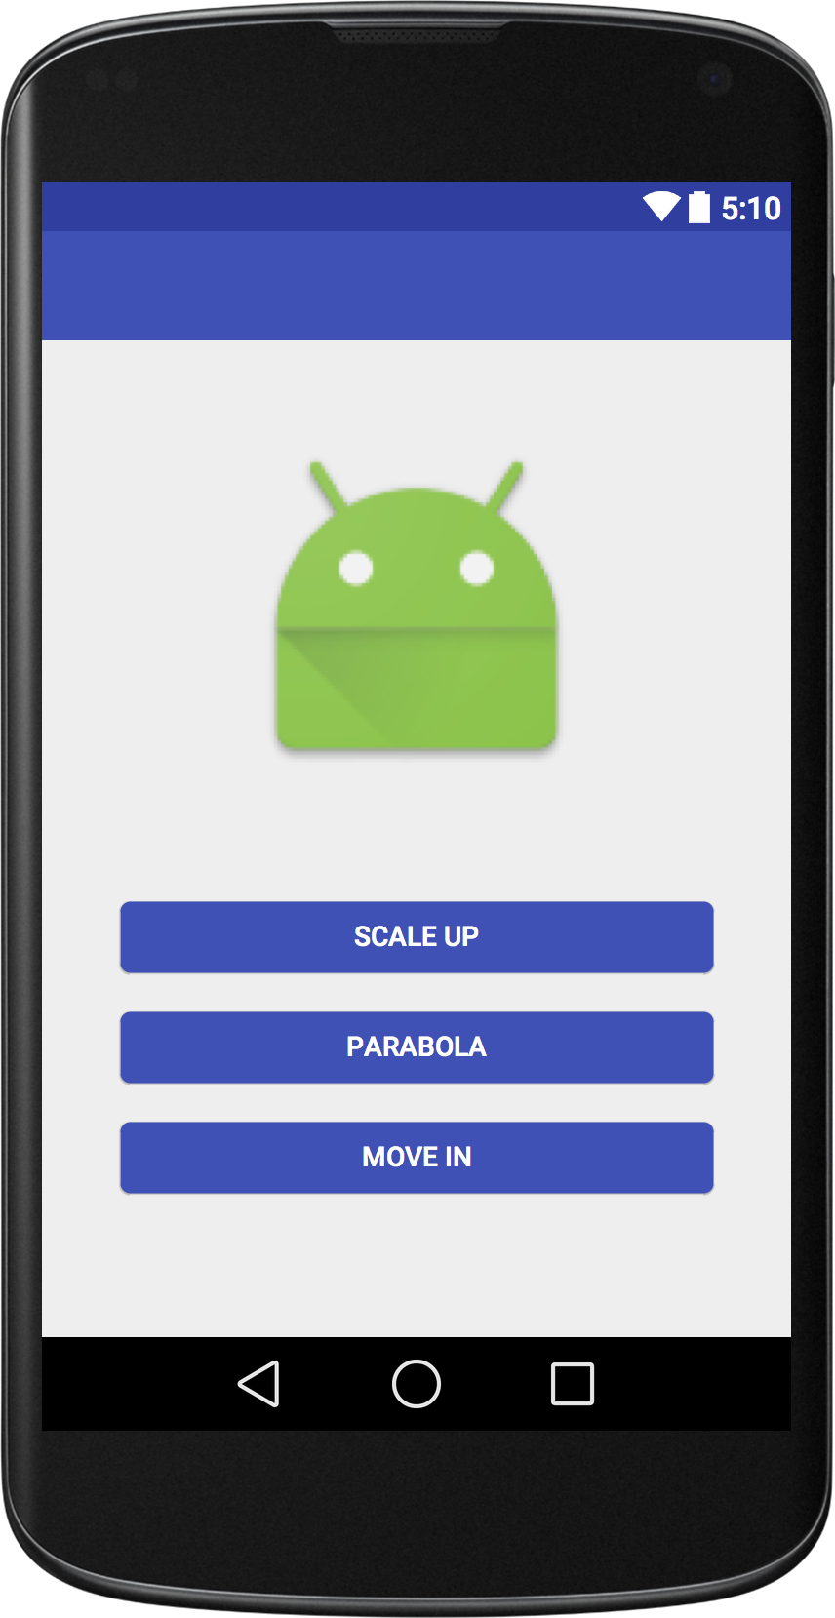
ToolBar
More controllable ActionBar

Slide 8
Material Design
Color Scheme

Slide 9
Material Design Button
It is not compatible with Android 5.0 below
but you can make it compatible like

Slide 10
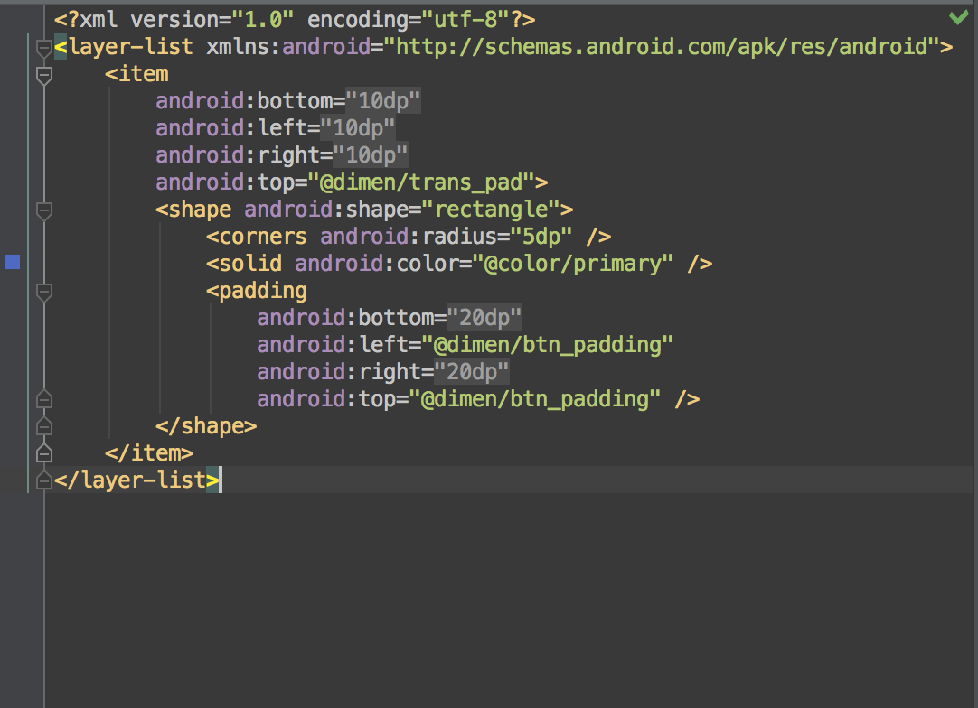
XML in Drawable
layer-list
selector
ripple

Slide 11
layer-list
It can contain many item by using layer approach
the top layer will be the bottom item at xml
it can use four properties, left, right, top and bottom, to item position

Slide 12
selector
the item in selector can have different state, like state_pressed, enable, long press
It is common to be used as a button background before Android 5.0

Slide 13
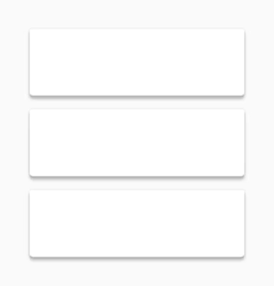
ripple
It only need to mention item drawable and set the color property
The animation will auto generated
Be careful, it only support Android 5.0 or above device, so create drawable-v21 folder please!!!!

Slide 14
OnClickListener
OnClickListener is a things on JAVA to handle the click event
Each Listener should to be set at at least one view in order to trigger event

Slide 15
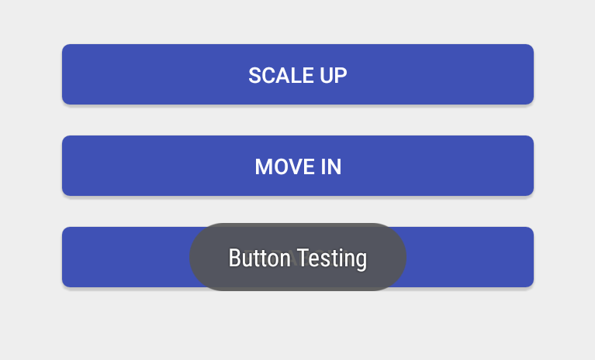
Toast
Toast is message dialog on the screen
it will disappear in a few second.

Slide 16
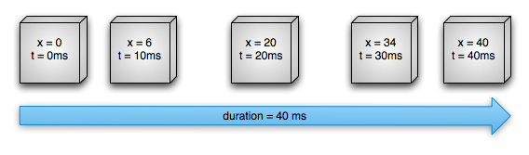
ObjectAnimator
A thing that keep changing a properties very fast

Slide 17
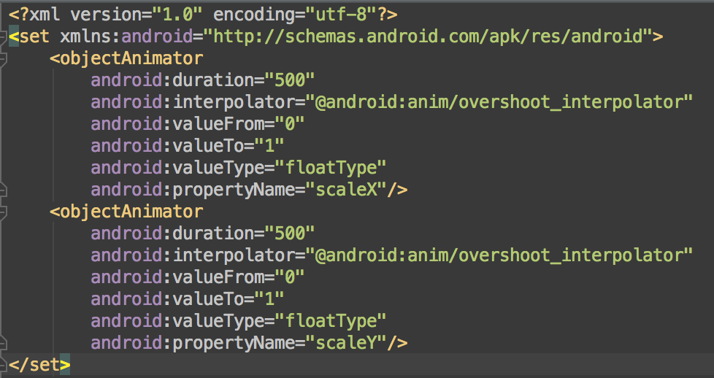
ObjectAnimator
ObjectAnimator can put in a set so that it can cooperate with other

Slide 18
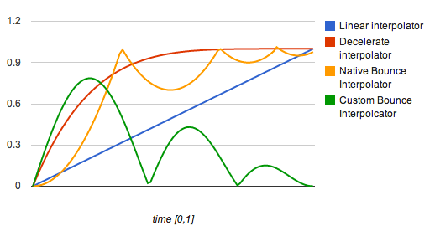
interpolator
It is a thing to mention how the value change

Slide 19
ObjectAnimator
Since ObjectAnimator is to change the properties of a View in order to have animation effect, a customise animation need to customise a View to have a new property to change

