Slide 1
Urban Hamster Clothing: Return Policy Case Study
Analysis & Business Recommendations
Presented by: Logan Kaliba

Slide 2
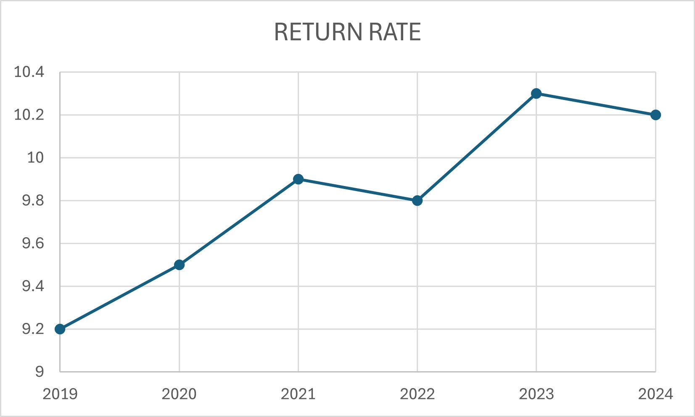
Urban Hamster Return Rate Overview
Overall Return Rate: 10.0%
Industry Average: 13.2% (Capital One Shopping, 2025)
Return rate 24% lower than the national average
Lost revenue due to returns: $1.09M

Slide 3
Return Trends & Product Categories
• Most returned categories:
1. Pants
2. Leggings
3. Socks & Hosiery
• Return rate rising since 2019 – gradual increase over time

Slide 4
Improving Policy, Boosting Trust
• Extend return window to 30 days
• Accept items in 'resalable condition'
• Cover return shipping & offer scannable barcodes
• Add online return request option
→ Improves buyer trust, satisfaction, and potential sales

