Slide 1

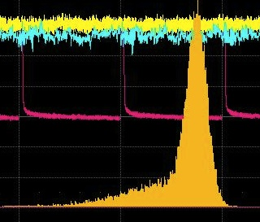
Optical fiber
LED
Generator
Channel 1
Channel 2
Splitter
PMT
Channel 1
(Signal)
Channel 2
(Trigger)
Dark box
High Voltage
supply
Oscilloscope
(LeCroy WavePro 725Zi)

