Slide 1
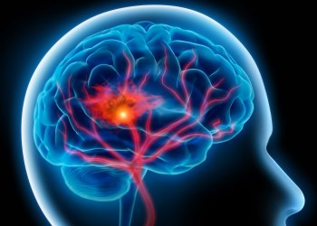
Predicting Strokes from Medical and Lifestyle data
Lukas Kania
DATA 1030 Fall 2021: Andras Zsom
Brown University - October 13, 2021
https://github.com/lkania1/data1030project
Notes:
The project I have been working on this semester works with medical and lifestyle data that is used to predict stroke outcomes of patients.

Slide 2

Project Motivation
World Health Organization states that Stroke is the second highest cause of death in the world (11% of deaths).
Goal is to predict stroke outcomes of patients
Classification (1 = had a stroke, 0 = did not have a stroke)
Accurate model could help provide insights to future patient’s health outcome.
Notes:
The motivation for this project is to better understand the factors that lead to a stroke from previous patients. This can then be used to predict the outcome of future patients. This problem is a classification problem that would predict if a patient had or will have a stroke or not. This is an important problem because the world health organization states that stroke is the second leading cause of death in the world.

Slide 3

The Dataset:
Kaggle dataset: https://www.kaggle.com/fedesoriano/stroke-prediction-dataset
5,110 patients, with 10 different feature columns
Target Variable: Stroke outcome
1 = Had a Stroke
0 = Did not have a Stroke
Problems: Missing values for feature columns (bmi)
Notes:
The dataset itself comes from Kaggle.com via the link shown. There are 5,110 patients or data points with 10 feature columns including heart dieseae, hypertension, work type, residence type, marital status that will be used to predict the target variable, which is stroke outcome. Having a stroke will be referred to as 1 and not having a stroke will be referred to as 0. Some of the issues that were presented within this data includes missing values within the bmi or body mass index feature column. The handling of this issue will be discussed later in the preprocessing section of this presentation.

Slide 4
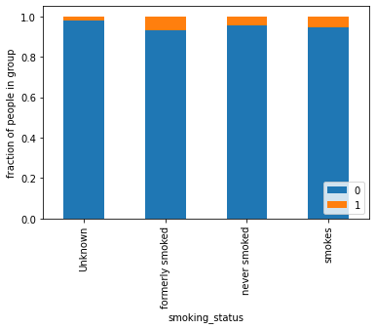
Stroke Outcome compared with Smoking Status
Is smoking a strong indicator of positive stroke outcome?
Expected to have stronger fractions for stroke positive patients.
“Unknown” status indicates information was not provided for given patient
Notes:
During EDA, the features were compared against the target variable in the univariate and bivariate plots as will be shown here. This stacked bar plot describes the relationship between smoking status of a patient and their stroke outcome. This was a feature column that I suspected would have a strong positive relationship between the two columns “former and current smokers” and stroke outcome. However, the fractions of patients does not vary through all four options for this categorical featureas I anticipated. A side note here is that “unknown” are not NaN values but instead the patient did not provide information about their smoking habits. These were not eliminated because they are a unique category within this feature as opposed to a Null value.

Slide 5
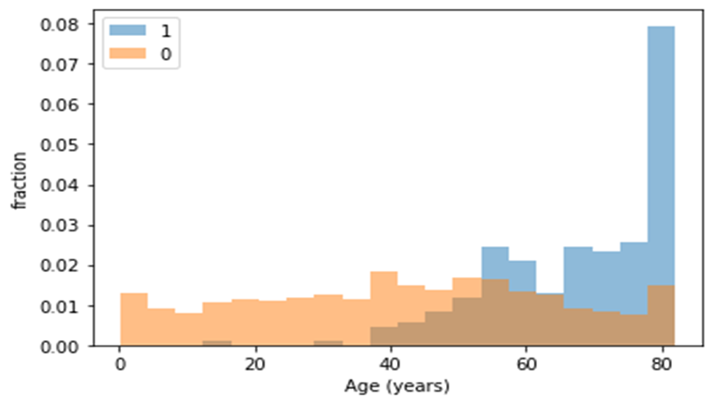
Patient compared to their risk of having a stroke
Does age play a role in the likelihood of having a stroke?
Age does play a role in having a stroke
Patients that did have a stroke are primarily above 40 years old.
Notes:
The next feature that was examined was age with stroke outcome. This overlayed histogram distinguishes the patients that had a stroke and those that did not and then they are binned according to their age. As seen here, Age does play a role in stroke outcome as the patients that did have a stroke are primarily over the age of 40.

Slide 6
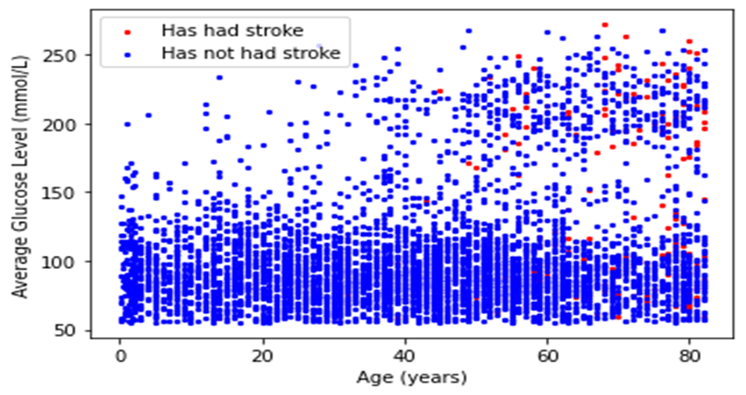
Age compared with Average Glucose Level with Stroke outcome distinguished
What does multiple features say about stroke outcome?
As discussed previously, age does impact stroke outcome.
Average Glucose level does not provide as strong of insights.
Notes:
The last plot that I would like to speak about is this scatter plot of age verses average glucose level. This scatter plot also makes a distinction between patients that had a stroke or did not have a stroke via red and blue points. Again, age clearly has an impact on stroke outcome, but average glucose level does not have quite as clear impaction on stroke outcome.

Slide 7
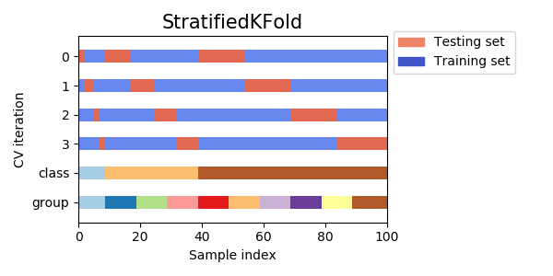
Splitting the Data:
Unbalanced data (209 Patients had a stroke. 4901 patients did not.)
Dataset is IID, therefore Stratified Kfold Split was utilized.
80/10/10 train/test/val split
Notes:
While formulating my pipeline, the splitting of this dataset was an important factor. This data is quite unbalanced, seeing that 209 patients had a stroke, and 4901 patients did not. This meant that a splitting method, such as stratified split would help to balance this data. Specifically, I chose a stratified k fold split, with an 80/10/10 train/test/validation set size split due to the size of the dataset. This will provide a larger sample to train on through the fold iterations.

Slide 8
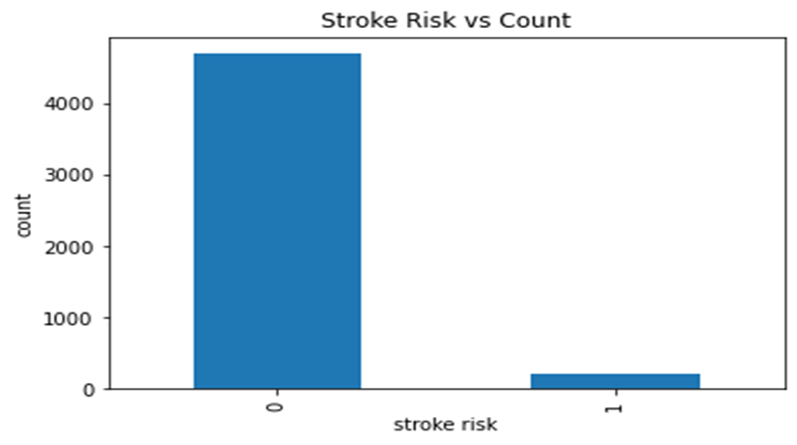
Data Preprocessing:
StandardScaler: Age
Continuous, roughly normally distributed
OneHotEncoder: work_type, smoking_status, gender, ever_married, and Residence_type
Categorical, unrankable values
Already Processed: Hypertension, Heart_Disease, Avg_glucose_level, Bmi
Boolean (1 or 0) values or Float values
Missing Data: Body Mass Index contained 201 missing values which were eliminated.
4.26% of dataset
Notes:
Finally, the preprocessing was performed as described here. I decided against ordinal encoder due to the categorical features not being able to be ranked. In addition to the two encoders here, 201 patients or rows were eliminated from the dataset because they did not have a value for body mass index. I did not want to impute medical data because this is sensitive data that could impact the accuracy of my model and thus the health outcome of a patient. This equated to only 4.26% of the dataset which quite small.

Slide 9
Questions?
Thank you!
Notes:
Are there any questions?

