Slide 1
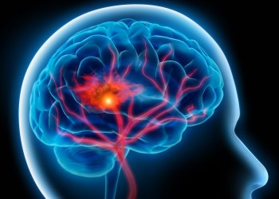
Predicting Strokes from Medical and Lifestyle data
Lukas Kania
DATA 1030 Fall 2021: Andras Zsom
Brown University – December 8th, 2021
https://github.com/lkania1/data1030project
Notes:
The project I have been working on this semester works with medical and lifestyle data that is used to predict stroke outcomes of patients.

Slide 2

Context
Classification Problem: predicting “stroke” (class 1) and “no stroke” (class 0) outcomes of patients to help predict future patients’ outcomes.
World Health Organization states that Stroke is the second highest cause of death in the world (11% of deaths).
Dataset comprised of 5,110 patients, with 11 different feature columns
Kaggle Data set
Notes:
The motivation for this project is to better understand the factors that lead to a stroke from previous patients. This can then be used to predict the outcome of future patients. This problem is a classification problem that would predict if a patient had or will have a stroke or not. This is an important problem because the world health organization states that stroke is the second leading cause of death in the world.

Slide 3
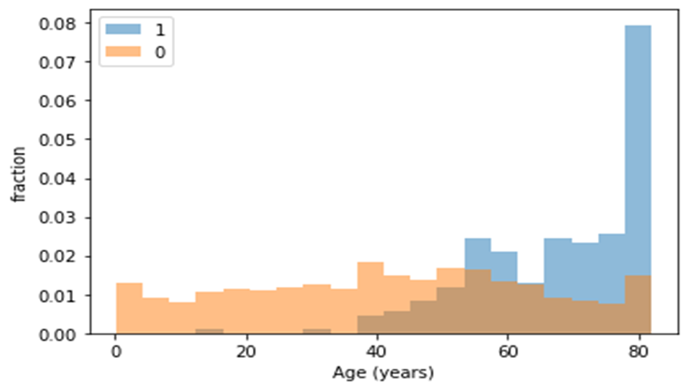
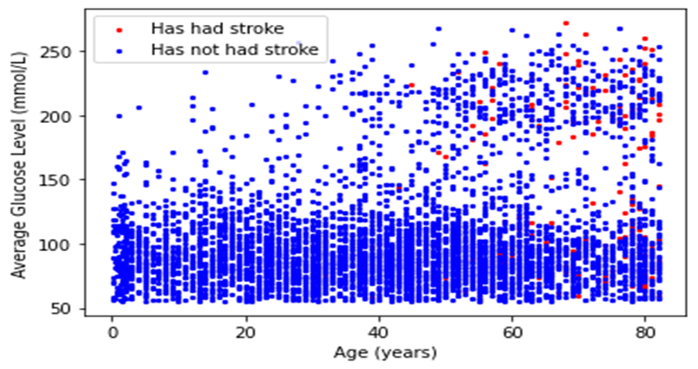
EDA and Preprocessing:
201 patients had missing data for BMI. These patients were dropped as to not impute health data, which could impact a person’s livelihood (4.26%).
Dataset is heavily unbalanced (class 1: 209 patients, class 2: 4901 patients)
60/20/20 training, testing, validating split utilizing Stratified K Fold with 4 folds.
11 features originally with 22 after preprocessing:
Age and average glucose level show promise as features for prediction of stroke.
Notes:
The dataset itself comes from Kaggle.com via the link shown. There are 5,110 patients or data points with 10 feature columns including heart dieseae, hypertension, work type, residence type, marital status that will be used to predict the target variable, which is stroke outcome. Having a stroke will be referred to as 1 and not having a stroke will be referred to as 0. Some of the issues that were presented within this data includes missing values within the bmi or body mass index feature column. The handling of this issue will be discussed later in the preprocessing section of this presentation.

Slide 4
Pipelines and Models:
Model | Logistic Regression | Random Forest | SVC | XGBoost
Reasoning | Processed features are binary, thus classification with Ridge regularization should work well. | Processed features are primarily binary, which work well for Random Forest Classifiers | Small number of features overall, many of which seem to be unrelated. | Powerful tree algorithm that routinely outperforms RFC and Logistic regression.
Tuning | Alpha (logspace) | Max depth (linspace) Max features (linspace) | Alpha (logspace) Gamma (logspace) | Learning rate (linspace) Column sample by tree (linspace) Sub sample (linspace)
Evaluation Metric: F1 score, with the goal of maximizing true positive and minimizing false positives.
Notes:
The dataset itself comes from Kaggle.com via the link shown. There are 5,110 patients or data points with 10 feature columns including heart dieseae, hypertension, work type, residence type, marital status that will be used to predict the target variable, which is stroke outcome. Having a stroke will be referred to as 1 and not having a stroke will be referred to as 0. Some of the issues that were presented within this data includes missing values within the bmi or body mass index feature column. The handling of this issue will be discussed later in the preprocessing section of this presentation.

Slide 5
Results: Cross Validation Scores
Model | Baseline | Logistic Regression | Random Forest | SVC | XGBoost
F1 Score | 8.17% | 1.152% | 3.0303% | 8.139% | 12.163%
Percent Change from baseline | 0.0% | -85.90% | -62.9% | -0.38% | 48.87%
F1 Standard Deviation | - | 0.01996 | 0.03329 | 0.03906 | 0.04916
Number of Std. Devs. From baseline | - | -3.5148 | -0.007206 | -1.5432 | 0.8127
Best Model: XGBoost performs best (highest number of standard deviations And positive percent change)
Parameters:
Learning Rate: 0.67
Column Sample by Tree: 1.0
Sub Sample: 0.2575
Notes:
The dataset itself comes from Kaggle.com via the link shown. There are 5,110 patients or data points with 10 feature columns including heart dieseae, hypertension, work type, residence type, marital status that will be used to predict the target variable, which is stroke outcome. Having a stroke will be referred to as 1 and not having a stroke will be referred to as 0. Some of the issues that were presented within this data includes missing values within the bmi or body mass index feature column. The handling of this issue will be discussed later in the preprocessing section of this presentation.

Slide 6
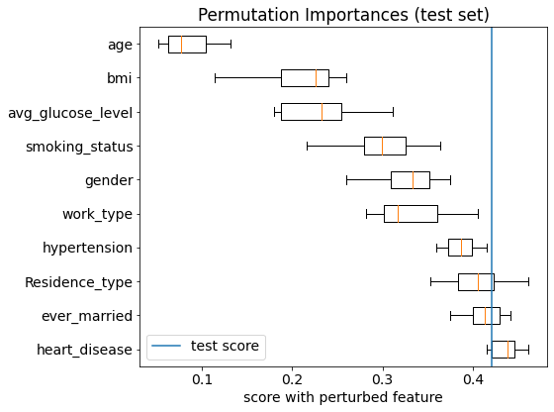
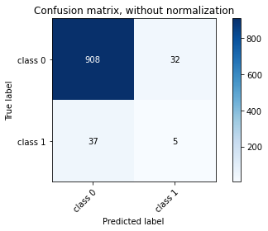
Results cont.:
Feature Importance: Age, BMI, and average glucose level all impact the outcome of a stroke the most.
Notes:
The dataset itself comes from Kaggle.com via the link shown. There are 5,110 patients or data points with 10 feature columns including heart dieseae, hypertension, work type, residence type, marital status that will be used to predict the target variable, which is stroke outcome. Having a stroke will be referred to as 1 and not having a stroke will be referred to as 0. Some of the issues that were presented within this data includes missing values within the bmi or body mass index feature column. The handling of this issue will be discussed later in the preprocessing section of this presentation.

Slide 7
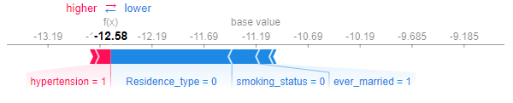
Results cont.:
SHAP: Depicts a single patient’s local feature importance.
Can show patient what is causing their classification
Residence type, smoking status and marriage push value left
Hypertension push value right
Notes:
The dataset itself comes from Kaggle.com via the link shown. There are 5,110 patients or data points with 10 feature columns including heart dieseae, hypertension, work type, residence type, marital status that will be used to predict the target variable, which is stroke outcome. Having a stroke will be referred to as 1 and not having a stroke will be referred to as 0. Some of the issues that were presented within this data includes missing values within the bmi or body mass index feature column. The handling of this issue will be discussed later in the preprocessing section of this presentation.

Slide 8
Outlook:
Need additional patient data to make predictions more accurate.
Additional stroke patients (4.26% to ~11%)
Possible Important Features:
Physical activity habits
MRI scan data
Blood health metrics
Implement KNN
Notes:
The dataset itself comes from Kaggle.com via the link shown. There are 5,110 patients or data points with 10 feature columns including heart dieseae, hypertension, work type, residence type, marital status that will be used to predict the target variable, which is stroke outcome. Having a stroke will be referred to as 1 and not having a stroke will be referred to as 0. Some of the issues that were presented within this data includes missing values within the bmi or body mass index feature column. The handling of this issue will be discussed later in the preprocessing section of this presentation.

Slide 9
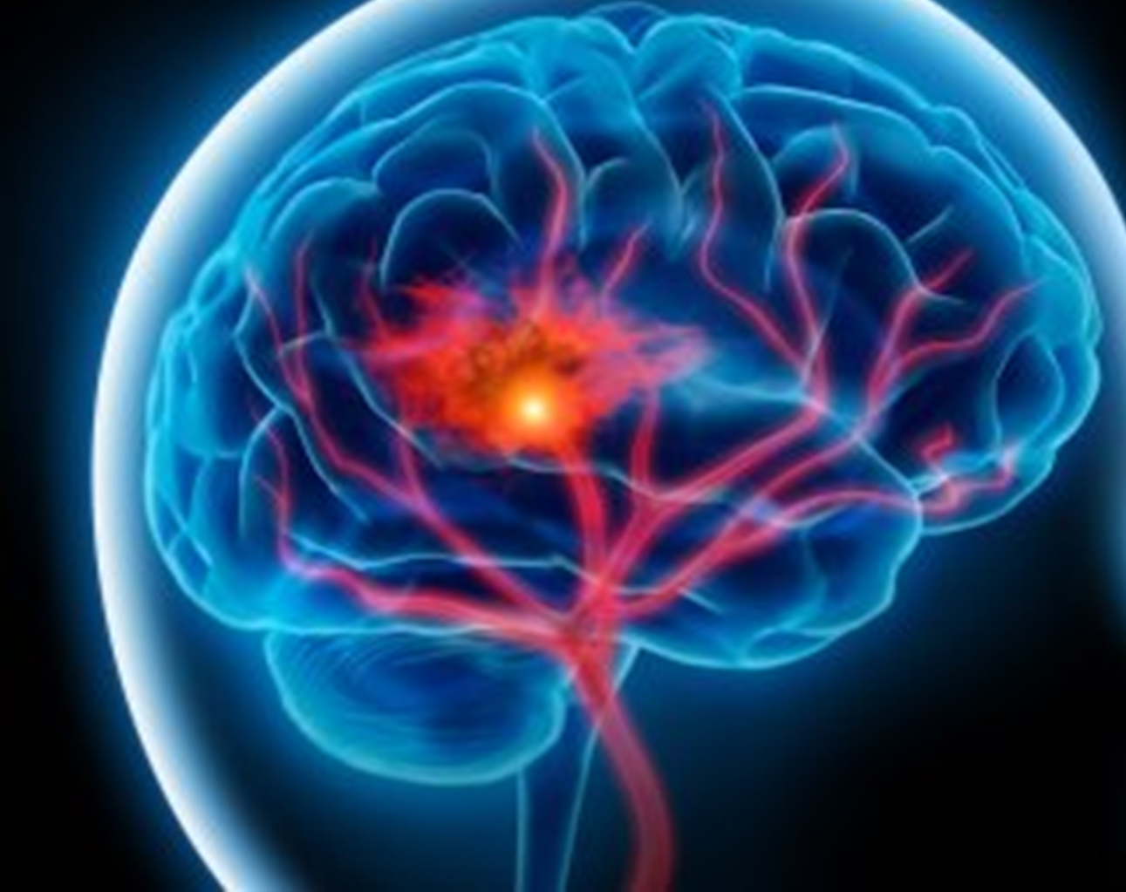
Questions?
Thank you!
Notes:
Are there any questions?

