Slide 1
OBJECTIVE
To develop a website for selling electronic appliances. The website should be easy to access ,look attractive and encorporates all the implementations that we have learnt throughout the course.

Slide 2
INTRODUCTION
Basically we have designed a website where the users can purchase electrical appliances and also explore variety of other electrical appliances. The users can either login or can access the website using guest login.

Slide 3
LANGUAGE USED
HTML
CSS for styling
JAVASCRIPT for making the website dynamic.

Slide 4
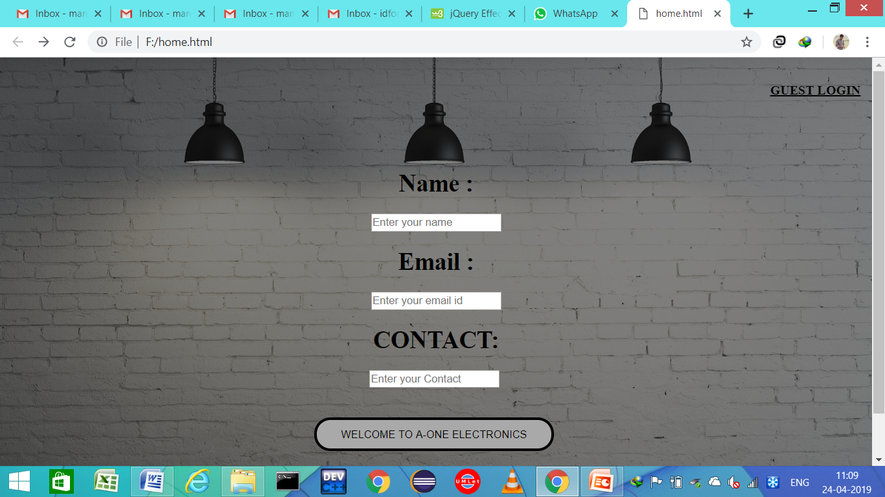
THE LOGIN PAGE

Slide 5
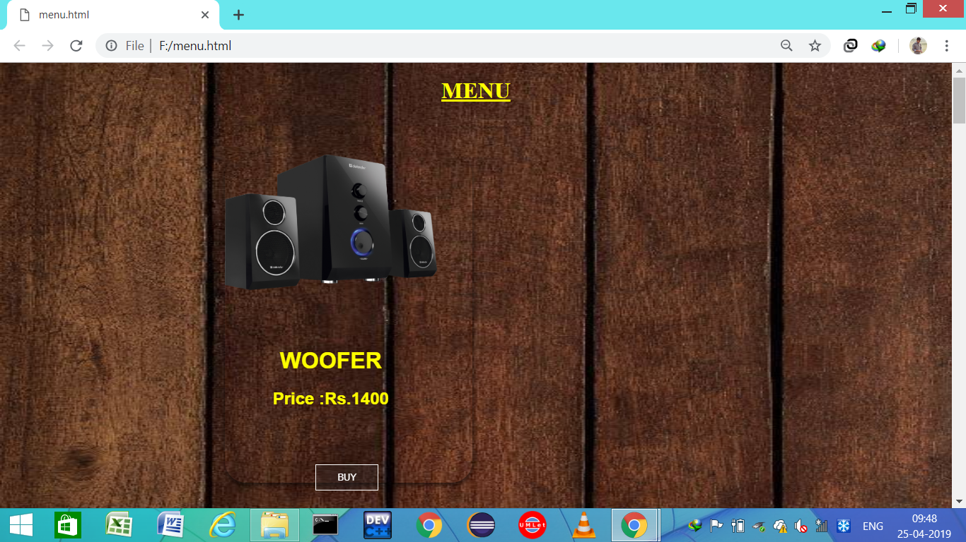
THE MENU PAGE

Slide 6
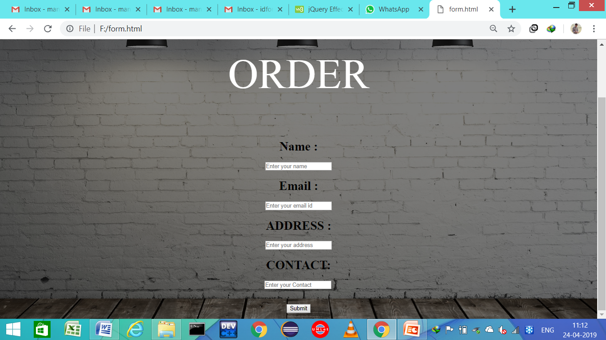
THE ORDER PAGE

Slide 7
CONCLUSION
We have made a website for the users so that they can make purchase of electronic appliances online in a convenient manner.

Slide 8
THANKS FOR WATCHING

