Slide 1
Data Science & Analytics Intern Series
Week 6: Model Building
Neural Networks, Random Forest, Gradient Boosting
July 27, 2023

Slide 2
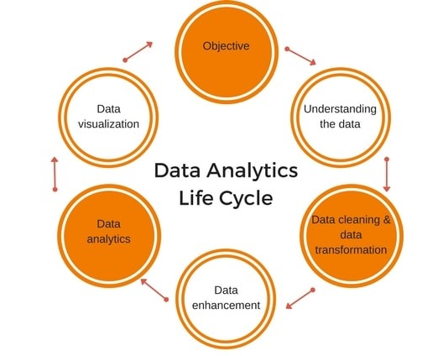
Analytics Life Cycle
Notes:
https://www.congrelate.com/17-data-analytics-life-cycle-phases-pictures/

Slide 3
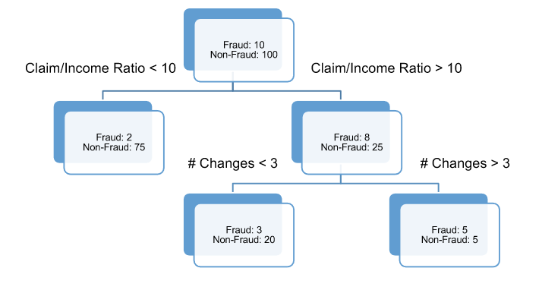
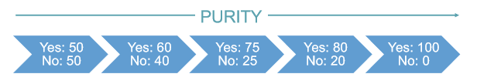
Tree-Based Models
Decision Tree: built by recursively splitting the data into successively purer subsets of data
Measurements of purity: Gini, entropy, misclassification error rate, Chi-square tests
Notes:
Decision Tree: splitting is done according to some condition
Purity? The more “pure” a leaf is, the less error we make in the predictions of that leaf.

Slide 4
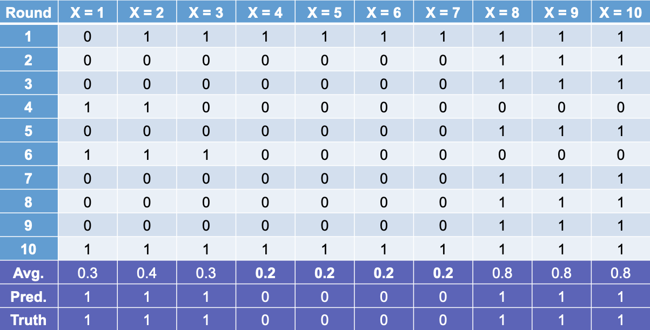
Ensemble Models
Bagging (Bootstrap Aggregating):
Take k bootstrap samples
For each of the k bootstrap samples, create a model using that sample as training data
Ensemble the k different models
Notes:
Bootstrap samples: random samples of your data with replacement that are the same size as the original dataset
Some observations will not be sampled (out-of bag observations)
It is valuable to ensemble the k different models because different models capture different signal in the data.
PICTURE:
Round of bagging on the y-axis, observation in the dataset across the x-axis
First row = values based on the first split decision (classification, fraud or not fraud) for the decision tree
Each row = values based on the split decision for that decision tree
Average the above 1s and 0s
Set a cutoff that optimizes the splits, in this case, we set our cutoff to be above 0.2 for being a 1 rather than a 0.

Slide 5
Ensemble Models – Random Forests
Random Forest: ensembles of decision trees
Parameters to tune:
# of trees
# of variables for each split (mtry)
Depth of tree (“Pruning”)
Notes:
The reason it’s important to know the math behind bagging is because Random Forests are ensembles of decision trees, sampled similarly to the bagging technique.
Don’t use bagging in the same way we mentioned previously, but they do use bootstrapped samples and random subsets of variables for each split and unpruned decision trees in each ensemble.
Results from the trees are ensembled together into one voting system.
Parameters:
Can have hundreds of trees in one model
This is the # of variables you allow each tree in the ensemble to use; aka, how many variables it is “trying”
Pruning: set the number of steps down the tree the model can build until it is forced to stop
Tree will build down until every observation is in its own leaf (“perfect prediction”, but overfit)

Slide 6
Random Forests Summary
Advantages | Disadvantages
Computationally fast (handles thousands of variables) | No “interpretability” other than variable importance
Trees trained simultaneously | Tuning parameters
Accurate classification model
Variable importance
Missing data is OK
Notes:
Random Forest models use all of the variables since they are average (as ensembles) across all trees used to build the model
Some methods to do variable selection, but out of scope for this presentation.
Trees can be trained in parallel
Accurate as a classification model, but also good at regression as well.
Missing can be handled as a category in RF models.

Slide 7
Bagging vs. Boosting
Boosting:
Draw a sample of observations from a dataset with replacement (like “bagging”).
Observations are NOT sampled randomly.
Assigns weight to each training observation and uses the weight as a sampling distribution
Weight is higher for observations that are harder to classify!
Notes:
Boosting: sampling technique similar to bagging
Take samples from a dataset with replacement, but the observations are NOT sampled randomly
Boosting assigns weight to each training observation and uses the weight as a sampling distribution.
Higher weighted observation is more likely to be drawn.
Adaptively change weight in each round.
Weight is higher for observations that are harder to classify.

Slide 8
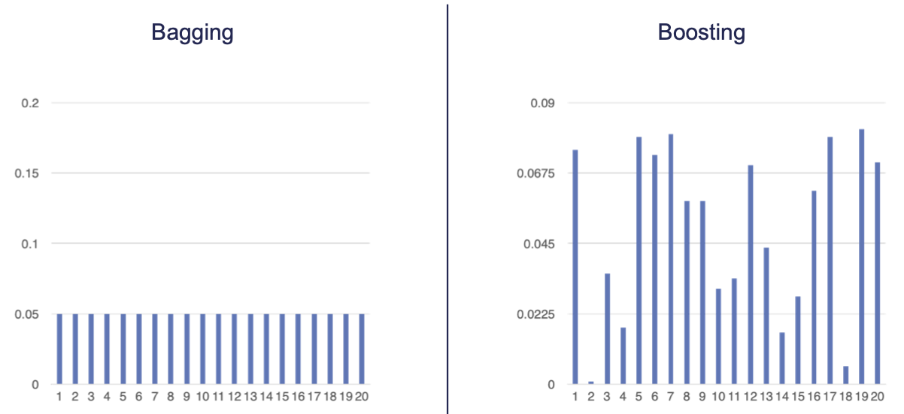
Bagging vs. Boosting
Probability of selecting an observation:
Notes:
In boosting, every observation in the dataset does NOT have an equal chance of being selected for the sample, unlike bagging.
This means that boosting models are NOT independent in observation selection.

Slide 9
Bagging vs. Boosting
Bagging | Boosting
Ensemble model built simultaneously → no time to evaluate accuracy. | Want a chance to improve predictions sequentially.
Notes:
This means that with boosted models, mistakes made in the analytics lifecycle are INFLATED.

Slide 10
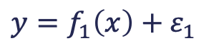
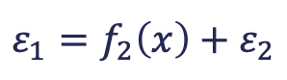
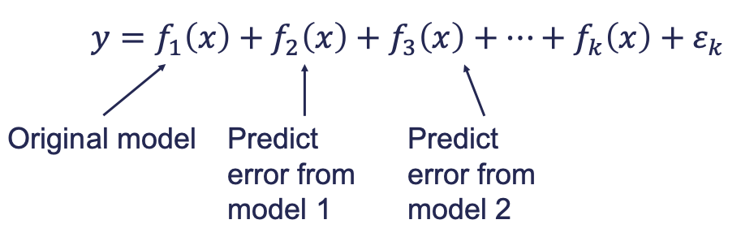
Additive Ensemble Models - Gradient Boosting
Build a SIMPLE model to predict target:
Try to predict the model error with another SIMPLE model:
Continue to add model after model, each one predicting the error:
Notes:
ADDITIVE ENSEMBLE MODELS
No voting or averaging of individual models
Predictions from each model are summed together for final prediction
Do this until there is REALLY SMALL ERROR.
Basically, you want to dramatically overfit your model.
Key to gradient boosting is using weak learners (SIMPLE MODELS)
Shallow regression/decision trees are the best
Additive fashion of the ensemble provides really good predictions

Slide 11
Gradient Boosting
Tune parameters to prevent overfitting:
Reduce weight of each of the error models for prediction.
# of trees (classifiers) used in the prediction.
Other parameters…
Notes:
How do you prevent overfitting is model is designed to overfit?
Smaller values of the weight coefficient in the model lead to less overfitting.
Larger number of trees = more prone to overfitting.
Tons of other parameters introduced over the years to help.

Slide 12
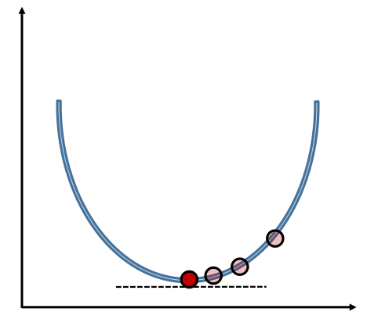
Gradient Boosting
Gradient descent: method that iteratively updates parameters in order to minimize a loss function (the errors) by moving in the direction of the steepest descent
Learning rate: step size, updated at each step to help with minimization
Notes:
Minimizes the loss function by taking iteratively smaller steps until it finds the minimum
Without the learning rate, we might take steps too big (miss the minimum) or too small (too long to optimize)
Starts at random points in the descent

Slide 13
Extreme Gradient Boosting (XGBoost)
Advantages
Additional regularization parameters to prevent overfitting
Settings to stop model assessment when adding more trees isn’t helpful
Supports parallel processing, but still must be trained sequentially
Variety of loss functions
Allows generalized linear models as well as tree-based models
Notes:
Additional parameters means more tuning..

Slide 14
Gradient Boosting Summary
Advantages | Disadvantages
Very accurate (if tuned properly) | Lacks “interpretability” beyond variable importance
Tend to outperform Random Forests when properly trained and tuned | Computationally slower than Random Forests
Variable importance provided | More tuning parameters than Random Forests
 | Harder to optimize
 | More sensitive to tuning parameters
Notes:
Computationally slower than RFs? → building sequentially.

Slide 15
Neural Networks
Organized in a network of neurons through layers.
The input variables are considered the neurons on the bottom layer.
The output variable is considered the neuron on the top layer.
The layers in between, called hidden layers, transform the input variables through non-linear methods to try and best model the output variable.

Slide 16
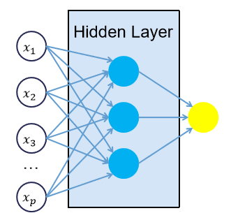
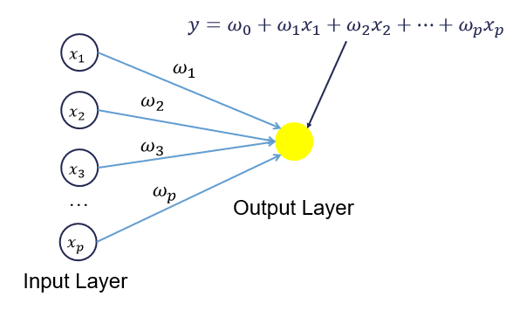
Neural Networks
Notes:
All of the nonlinearities and complication of the variables get added to the model in the hidden layers.

Slide 17
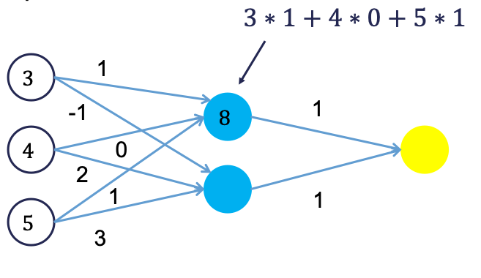
Neural Networks
Backpropagation Algorithm:
Forward phase:
Start with some initial weights.
Calculations passed through network.
Predicted value computed.
Backward phase:
Predicted value compared with actual value (error).
Work backwards through network to adjust weights to make the prediction better.
Notes:
Initial weights are often random
Repeat until some notion of convergence in the algorithm.

Slide 18
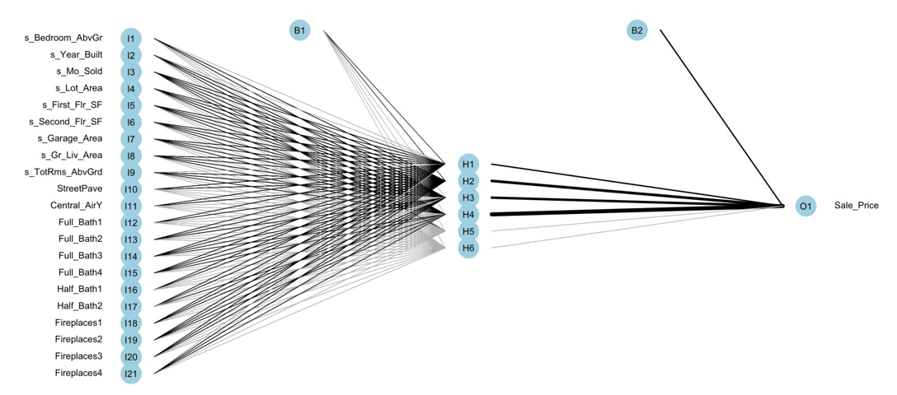
Neural Networks
Notes:
Initial weights are often random
Repeat until some notion of convergence in the algorithm.

Slide 19
Neural Network Summary
Advantages | Disadvantages
Used for categorical / numerical target variables. | No insights for variable importance.
Capable of modeling complex nonlinear patterns. | Extremely computationally intensive.
No assumptions about the data distributions. | Tuning of parameters.
 | Prone to overfitting training data.
Notes:
VERY SLOW TO TRAIN.

Slide 20
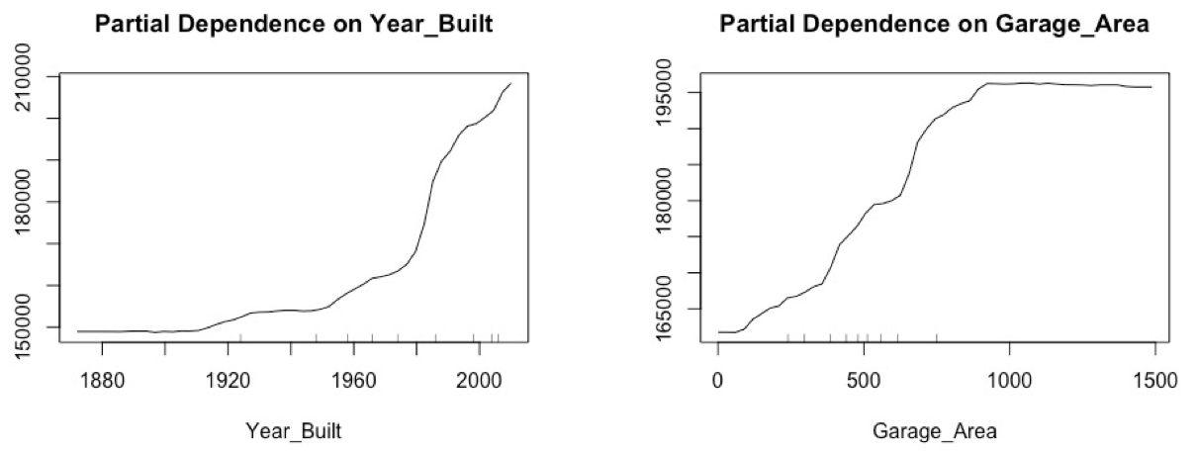
“Interpretability”
Most ML models are not interpretable in the classical sense
Relationships are not linear! They are complicated!
We can get a general idea of overall pattern for a predictor variable compared to a target variable
Partial Dependence Plots
Notes:
“Classical sense” – as one predictor variable increases, the target variable always does, etc.
PDPs – holding all else constant, how does Year_Built affect the target variable (Sale_Price)? Holding all else constant, how does Garage_Area affect the target variable?
- Narrow in on one relationship, holding everything else constant, to get a sense of the shape/trend of the relationship

Slide 21
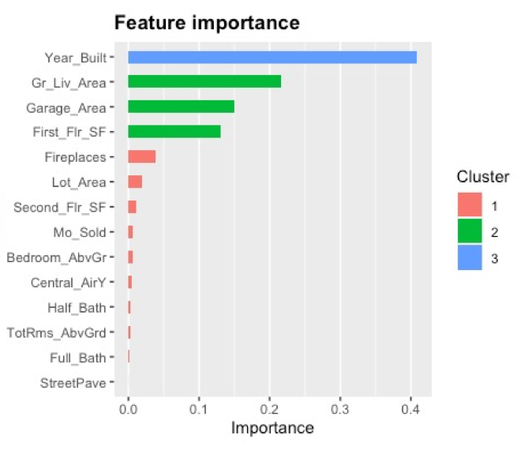
“Interpretability”
Variable Importance:
Gain
Coverage
Frequency
Notes:
Gain – equivalent metric in random forests
Coverage – measures the relative number of observations influenced by the variable
Frequency – percentage of splits in the whole ensemble that use this variable

