Slide 1

Final Presentation WordPress 3.0+
Leonard Bogdonoff 12/6/11 T. DEDONNO CIM225

Slide 2
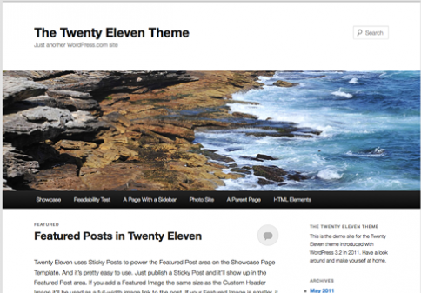
What is WordPress
"A semantic personal publishing platform with a focus on aesthetics, web standards, and usability.“
-WordPress.com

Slide 3
What is WordPress (cont.)
Open Source: Constant growth, support and versatility in application.
“well-architectured personal publishing system built on PHP and MySQL”
Web-standards: Search Engine Friendly

Slide 4

Who Uses WordPress?
Users
Individuals
Businesses
Developers
HTML
CSS
PHP
Javascript

Slide 6
Why Does WordPress Use PHP
Stores contents in Databases: posting, comments, settings, tags, categories
Website flexibility Header/Sidebar/Footer Template system The Loop Hooks Themes Plugins/Widgets

Slide 7
Header.php
Global file that displays headers and navigation. Loads first.
Title/Description
Image
Navigation Menu

Slide 8
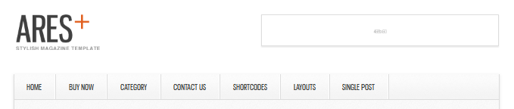
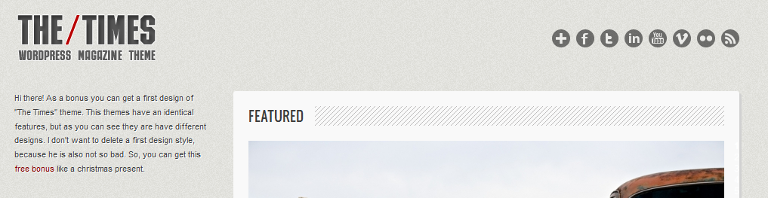
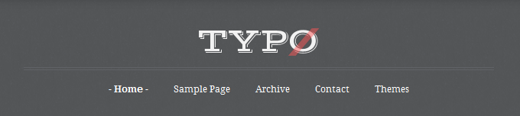
Header
Nav

Slide 9
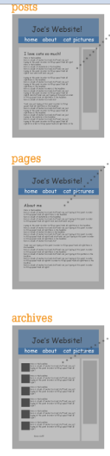
Templates
Designates how the page content loads.
Loads after Header.php
Controls “The Loop”
Decides where to load sidebars

Slide 10
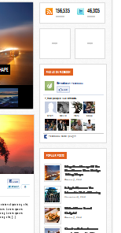
Sidebar.php
Multiple sidebars can be set up in functions.php, and contents of sidebar widgets are set up from the WordPress wp-admin panel.
Sidebar: Template Designated
Widget: Nested in Sidebar
wp-admin

Slide 11
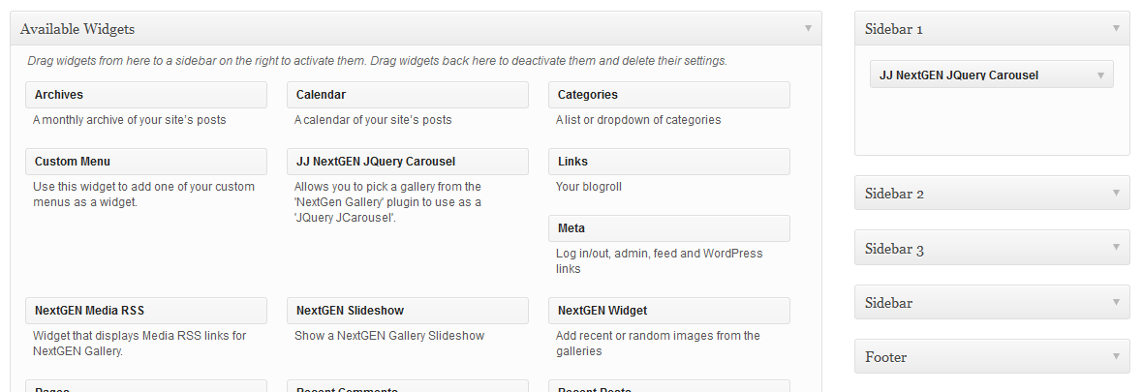
Sidebar.php
Place anywhere in the Template
Wp-admin UI

Slide 12
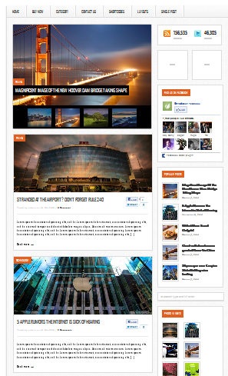
The Loop
Displays the main area of sites that are controlled by individual template.
Repeats specified content:
Title, Date, Content, Date, Links
Uses template:
Single, Full-width, Custom

Slide 13
The Loop
Query post or page
Start Loop
the_title (outputs the title of the post)
the_excerpt (outputs the post excerpt)
the_content (outputs the full post content)
the_category (outputs the post categories)
the_author (outputs the post author)
the_date (outputs the post date)
other tags (there is a variety of other tags you can use in the loop)
endwhile;
Exit the loop

Slide 14
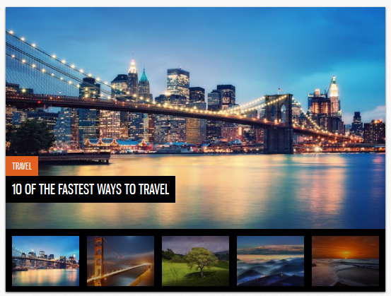
The Loop
Content:
Photos
Template:
Gallery

Slide 15

The Loop
Content:
No Loop
Template:
Emphasize Nav Menu

Slide 16
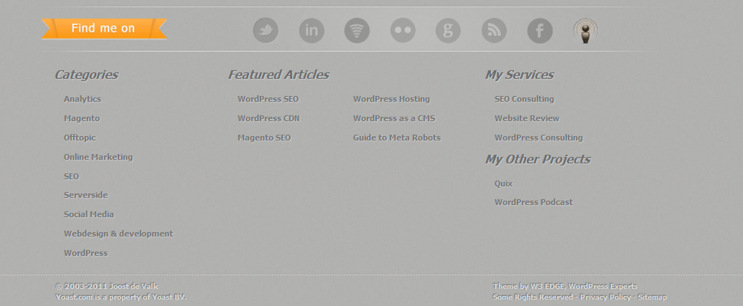
Footer.php
Loads Global footer instructions.

Slide 17
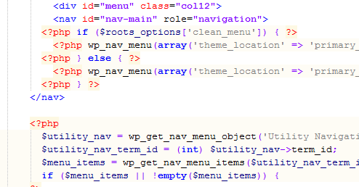
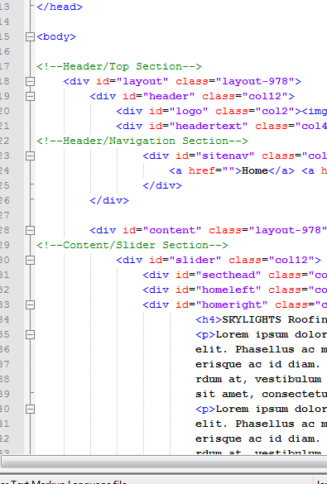
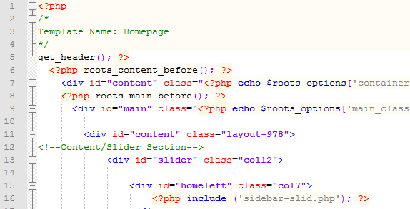
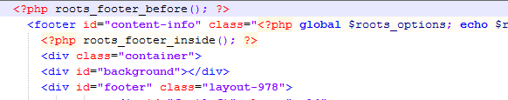
Index.html
Header.php
Template.php
Footer.php

Slide 18
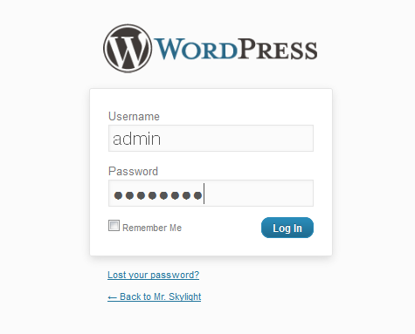
User/Admin User Interface
User
Wp-Admin: UI

Slide 19

1. Learn The Syntax
2. Buy A Theme/Plug-in
3. ???
4. Profit

