Slide 1
AI Use Identification Workflow by HexaCorp Ltd
Policy • Toolkit • Effort Rubric

Slide 2
Presentation Flow
PATEL
Patel – Introduction
Sabitha – Workflow Overview
Bibisha – Current AI Detection Methods & Limitations
Elliot – Evidence Supporting Methodology
Ricardo – Ethical & Legal Considerations
Jaime – Appendices Overview
Patel – Conclusion

Slide 3
Introduction
PATEL
Purpose: Build a fair AI Use Identification Workflow
Supports accurate and transparent assessment
Helps markers check authenticity consistently
Covers: workflow, methods, evidence, ethics, appendices

Slide 4
AI Use Policy
PATEL
What the policy covers:
Defines acceptable vs restricted AI use
Requires transparency in assessments
Outlines when disclosure is required
Supports academic integrity

Slide 5
Workflow Diagram – AI Use Identification
SABITHA
Start: Submission Received
Check References & Facts
Check Disclosure Form
Review Drafts / Git Logs
Review Writing/Code Consistency
Decision: Accept • Monitor • Escalate

Slide 6
Workflow Overview
SABITHA
Student submits work + disclosure
Marker checks writing consistency
Toolkit used for authenticity
Rubric applied
Outcome: Accept / Monitor / Escalate
These support fair identification of AI involvement.
Ensures transparency
Supports fair and consistent marking
Maintains academic integrity

Slide 7
Current Detection Methods
BIBISHA
Manual Methods
  Comparing past work and class performance
  Document history (Version Control, GitHub, Timestamps)
  Code demo
AI-Detecting Software
  Turnitin
  GPT Zero
  Originality.ai

Slide 8
Limitations
BIBISHA
Accuracy Issues (Turnitin)
  Stanford Study: 85% TPR
  False Positive Rate: 15-22%
Biasness
  International students¹
  Neurodivergent students²
Real consequences
  Moira Olmsted³
  Texas A&M’s Professor used ChatGPT to grade papers⁴

Slide 9
In Support of Our Methodology
ELLIOT
Inevitability of tech innovations in education⁵
Potential educational outcome benefits⁶
Will work to reduce false accusations
Fair for students⁷
Helps to uphold academic standards

Slide 10
Ethical Considerations
RICARDO
Fairness
Reducing bias
Protecting honest students
Encouraging transparency

Slide 11
Legal Considerations
RICARDO
GDPR
Privacy of drafts/logs
Clear communication
Consistent application

Slide 12
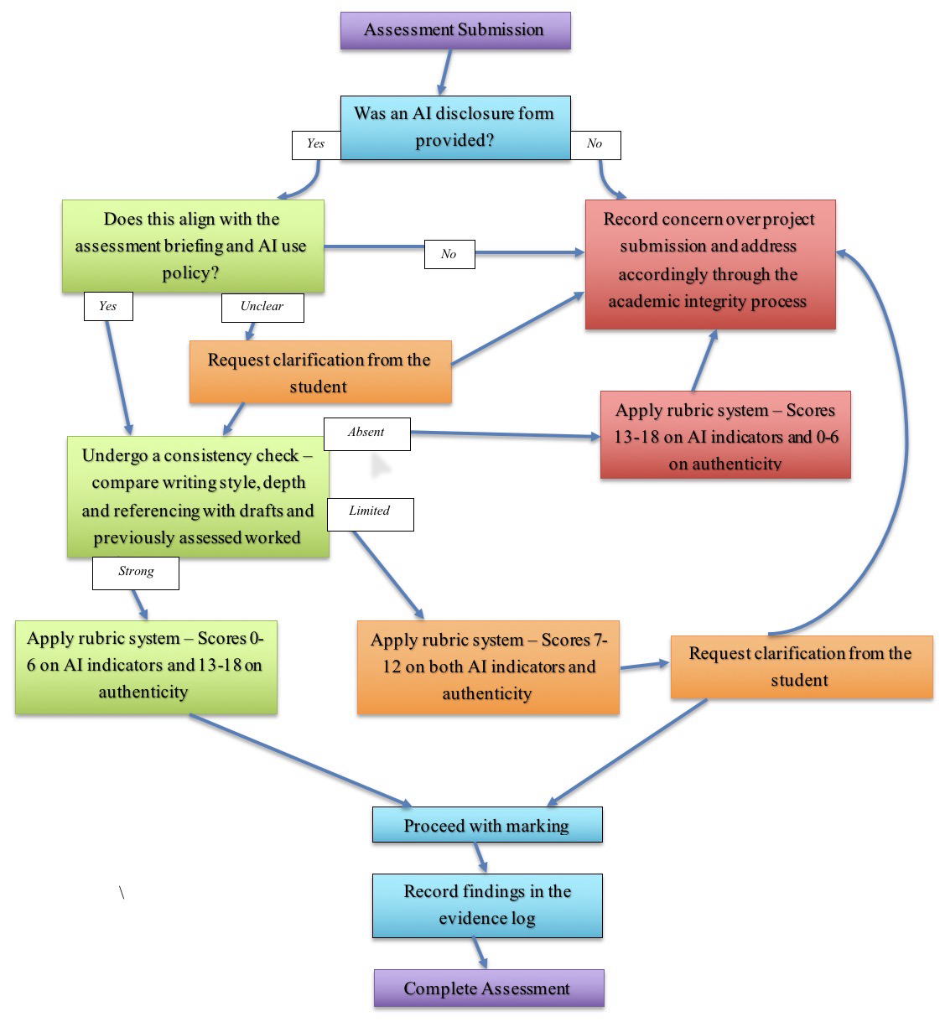
Appendices Overview – Part 1
JAMIE
What toolkit includes:
AI use policy and disclosure form
Marker toolkit
Effort Rubric
Information pack
Communication templates

Slide 13
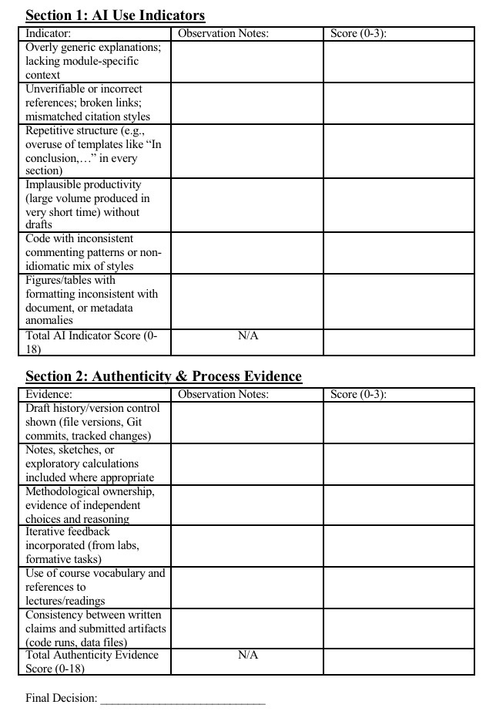
Appendices Overview – Part 2
JAMIE
Supports transparency
Helps with marking consistency
Improves documentation
Supports fair decisions

Slide 14
Conclusion
PATEL
Workflow supports fairness
Helps responsible AI use
Provides reliable tools
Reduces dependence on AI detectors
Creates consistent assessments

Slide 15
References
PATEL
https://arxiv.org/pdf/2304.02819
https://teaching.unl.edu/ai-exchange/challenge-ai-checkers/
https://opendatascience.com/ai-detectors-wrongly-accuse-students-of-cheating-sparking-controversy/
https://www.nbcnews.com/tech/chatgpt-texas-college-instructor-backlash-rcna84888
Spies, A. R., 2010. Use of Laptops and Other Technology in the Classroom. American Journal of Pharmaceutical Education, 74(8), p. 152.
Perera, P. & Lankathilaka, M., 2023. AI in Higher Education: A Literature Review of ChatGPT and. International Journal of Research and Innovation in Social Science, 7(6), pp. 307-314.
Lim, W. M. et al., 2023. Generative AI and the future of education: Ragnarök or reformation? A paradoxical perspective from management educators. The International Journal of Management Education, 21(2), p. 100790.

