Slide 1
KitGuard
사진·BOM 디지털 검토 Agent
주문이 바뀌면
사진의 판단 근거도 다시 확인합니다
내 사진으로 시작하고, 현재 버전의 AI 결과와 검토 이력을 함께 남깁니다.
해피 팀 2026.10.02 0.8.0.dev1 preview
Notes:
KitGuard is a local prototype for digital review of a photograph against a bill of materials, not a field-completion result. Audience use is a hypothesis for small assembly/education/photo-document review teams. User-owned or lawfully obtained public images can be used without procuring physical hardware for this digital workflow. Version0.8.0.dev1 preview is not an official submission or eligibility decision. The project began2026-09-26; current additions and historical implementation are distinguished on slide8.
근거 / Sources
docs/v0.8/PHOTO_DOCUMENT_GUIDE_KO_ZH.md SHA256 43fa77fa06e0f4d9eec07cca61dbcf30b9d90247eaf9fc239932922e7f750710
docs/v0.8/DELIVERY_UPDATE_PLAN.md SHA256 df6a160c375108278b80512746b6e9b59b4d114eb8195652c716dbce2b1c7a14
pyproject.toml SHA256 8929c37526c2cab49ba953f3999f42ecf8e76194fbed0d2275e96686f96b57bd
docs/v0.7/CONTEST_PERIOD_CONTRIBUTIONS.md SHA256 71f32990ec6b860e2385d83f2c5ba001199a309c9226a8c788eb82f11f9913d0

Slide 2
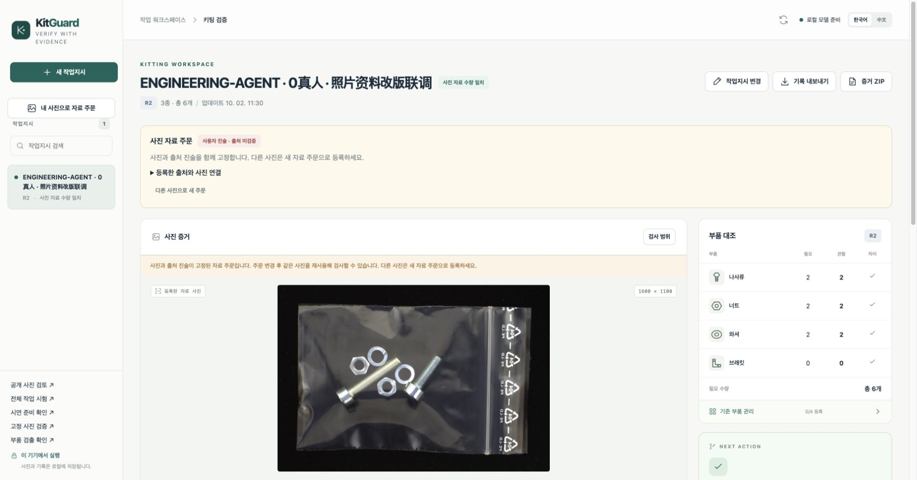
내 사진으로 만드는 자료 주문
JPEG / PNG / WebP
사진 1장
출처 설명
종류별 BOM 0–3개
출처·허가는 사용자 진술
확인되지 않은 상태 유지
URL은 사진을
대신 내려받지 않습니다.
실제 MLX 이력 화면 / ENGINEERING-AGENT 자동화 검수 / 실제 참여자 0명
KitGuard 0.8.0.dev1 preview
02
Notes:
The new local-photo entry requires a JPEG/PNG/WebP file, source_note and legal BOM with each class0–3. URL/license_note are optional and unverified. Source URLs are not fetched. The root photograph and source declaration are bound; replacing a photograph requires a new document order. Public/web photographs may be used only with appropriate rights, never by claiming a license has been certified. This screenshot is currentR2 displayed by a cold realLocalVision service after the completed real API run; the browser performed GET only, no additional model call. API multipart upload succeeded. Browser file-chooser upload remains unverified due extension permission restrictions; no bypass was used. Displayed source photo: MVTec LOCO AD screw_bag/train/good/016.png, an already exposed public development example, CC BY-NC-SA 4.0. https://www.mvtec.com/research-teaching/datasets/mvtec-loco-ad ; https://creativecommons.org/licenses/by-nc-sa/4.0/ . Its upload declaration remains user-declared and unverified in the product. These are original screenshots, unmodified and fitted without cropping. No new inference, generated imagery, human feedback or physical replenishment is represented.
근거 / Sources
docs/v0.8/PHOTO_DOCUMENT_GUIDE_KO_ZH.md SHA256 43fa77fa06e0f4d9eec07cca61dbcf30b9d90247eaf9fc239932922e7f750710
test-results/v0.8/photo-document-live-api-v1/receipt.json SHA256 b86f4f3d9f989ce3c07da986465b0e44d662e3b9e6bd469b413351a43a05d29d
test-results/browser/photo-document-live-v08/browser-receipt.json SHA256 9db664fa5089c1f3fb25297cbd796b3d78eeb99290e8e3245583935f8f83c431
test-results/browser/photo-document-live-v08/order.json SHA256 fd8bc96628358b60611a8b4b4976b5ed3cdef30b9d3325bd040ea056e7f853d8
test-results/browser/photo-document-live-v08/r2-ko.jpg SHA256 209a3d542ecf6dcffc20ccc81a77e5d0429baaa3fe53aa1dadef57dc9f339805

Slide 3
Agent 도구와 버전별 근거
도구 | 실제 동작 | 후속 처리·범위
사진 관찰 | 원본과 90° 회전에서 물체 목록 생성 | 일치할 때 조건부 국소 확인
수량 대조 | 프로그램이 목록을 계수하고 BOM과 비교 | 불확실한 수량은 보류
참고 이미지 추적 | 당시 이미지와 실제 참여 단계 표시 | 기본 국소 확인은 참고 미입력
상태·근거 저장 | 새 버전은 재검사, 현재 실패는 재시도 안내 | AI 결과·의견·이력을 ZIP 보존
Qwen3.6-27B / MLX 4-bit 기본 절차 spatial_guarded
BOM 수량은 시각 모델에 주지 않습니다. 반복 관찰은 같은 모델의 상관된 판단입니다.
KitGuard 0.8.0.dev1 preview
03
Notes:
This native editable table describes implemented fixed-rule Agent responsibilities, not autonomous control of physical parts. Original and rotated inventories condition the nut/washer identity check; program code counts, compares and updates evidence validity. The added product reference trace does not change prompt/count/call order. Actual reference integration receipt: original and rotate received indices[2,3], identity received[];1actual observation,3generations,51.650s. Historical records missing reference fields are not backfilled. Prepared reference PNG bytes are not retained by the product, so no full historical pixel-vault claim. Failure recovery was tested in a separate synthetic browser fixture:4synthetic calls,0models,0humans. Its current revision/photo/epoch failed/interrupted warning survives refresh and clears after newer evidence/success. These engineering scopes do not contribute to image recognition accuracy.
근거 / Sources
docs/v0.8/REFERENCE_INPUT_EVIDENCE_CHANGE.md SHA256 ed98907139808bcda98883025d201f6016bada483fc0b4b7581f7290a84793db
test-results/v0.8/reference-live-api-v1/receipt.json SHA256 240aeaeff7059ee737cb31ed359af17585f94229c171cff7a83a38c27b4c8a12
docs/v0.8/INSPECTION_RECOVERY_FIX.md SHA256 4c3161419b428ec0341d15872ea3732fb469c2a6de2ff68b01d228aacb94fad5
test-results/browser/workflow-readonly-v08/final-receipt.json SHA256 d591ff0928309ac765757414f0eadddd8365689d5739c3b3fa38055613f5567b
docs/v0.8/PHOTO_DOCUMENT_GUIDE_KO_ZH.md SHA256 43fa77fa06e0f4d9eec07cca61dbcf30b9d90247eaf9fc239932922e7f750710

Slide 4
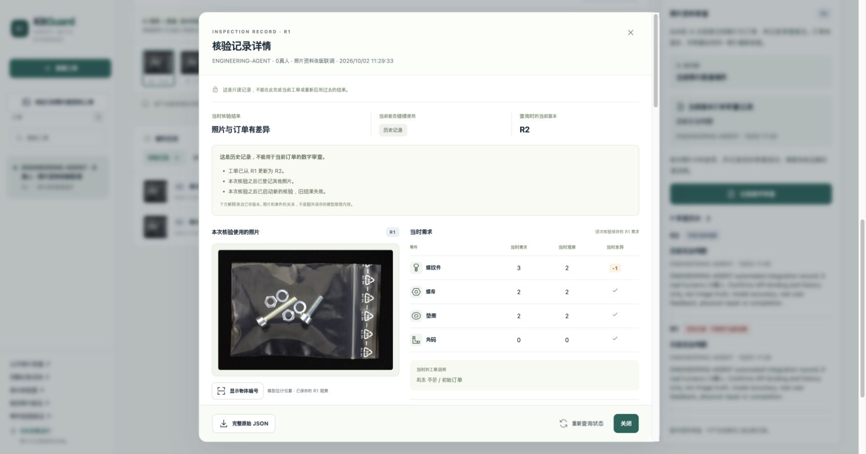
같은 사진, 바뀐 주문, 새로운 검사
R1 볼트 필요 3개
관찰 2개 / 차이 −1
50.909초
예정된 요구 변경 승인
R2 볼트 필요 2개
같은 사진으로 새 추론
관찰 2개 / 수량 일치
47.728초
R1 차이와 이력 유지 / 새 촬영·실물 보충 없음
실제 MLX 이력 화면 / ENGINEERING-AGENT 자동화 검수 / 실제 참여자 0명
KitGuard 0.8.0.dev1 preview
04
Notes:
R1 requires bolt/nut/washer/bracket3/2/2/0 and observes2/2/2/0, decisioncorrect(difference). The operator explicitly commits the predefined requirement change to2/2/2/0. This is an order-change engineering scenario, never physical replenishment or the AI editing its target to pass. R1check and R1review become historical-invalid; a recorded same-byte replay does not run the model and requires a new R2inspection. R2observes2/2/2/0 and decisionready only means digital photo/BOM agreement. R1latency50,909ms and R2latency47,728ms are persisted machine observation durations, not human task times. Six actual generations total, no retry. No references were supplied in this two-version integration. Displayed source photo: MVTec LOCO AD screw_bag/train/good/016.png, an already exposed public development example, CC BY-NC-SA 4.0. https://www.mvtec.com/research-teaching/datasets/mvtec-loco-ad ; https://creativecommons.org/licenses/by-nc-sa/4.0/ . Its upload declaration remains user-declared and unverified in the product. These are original screenshots, unmodified and fitted without cropping. No new inference, generated imagery, human feedback or physical replenishment is represented.
근거 / Sources
test-results/v0.8/photo-document-live-api-v1/receipt.json SHA256 b86f4f3d9f989ce3c07da986465b0e44d662e3b9e6bd469b413351a43a05d29d
test-results/browser/photo-document-live-v08/browser-receipt.json SHA256 9db664fa5089c1f3fb25297cbd796b3d78eeb99290e8e3245583935f8f83c431
test-results/browser/photo-document-live-v08/order.json SHA256 fd8bc96628358b60611a8b4b4976b5ed3cdef30b9d3325bd040ea056e7f853d8
test-results/browser/photo-document-live-v08/r1-history-zh.jpg SHA256 79cbdbed67547c62f841beab34658f01aa2fcbe45f698fc46bc74db79b4075cf

Slide 5
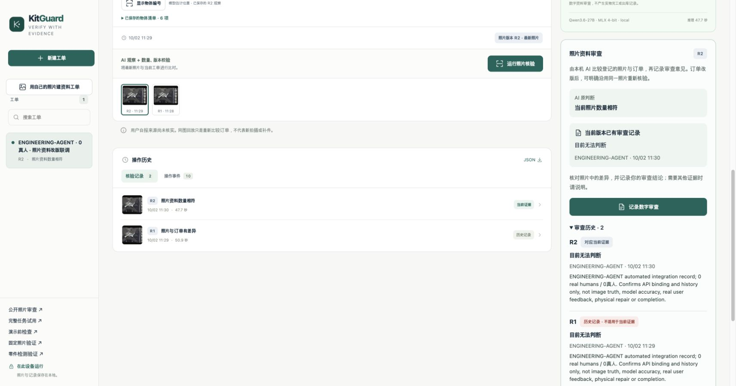
디지털 의견과 내려받는 기록
검사 2회
디지털 의견 2건
같은 사진 재사용 1회
실물 완료 0건
ENGINEERING-AGENT
두 의견 모두 “판단 보류”
실제 참여자 0명
사용자 검증 실적 없음
출처·버전·원 AI 결과·의견을 ZIP으로 보존
실제 MLX 이력 화면 / ENGINEERING-AGENT 자동화 검수 / 실제 참여자 0명
KitGuard 0.8.0.dev1 preview
05
Notes:
The two saved opinions are ENGINEERING-AGENT automated integration records, both inconclusive, user_validationfalse and physical_completionfalse. They prove API binding/history, not human acceptance, image truth or model accuracy. The real read-only browser pass verified R2current and R1history in Korean/Chinese and downloaded a ZIP. Four payload hashes across six ZIP members verified; saved order remained identical to prior API output. Source declaration remains unverified; physical completion and root replacement are blocked. The archive contains JSON/photos/standaloneHTML with history, but file:// visual inspection was blocked by browser policy and not bypassed. No offline visual pass is claimed. Displayed source photo: MVTec LOCO AD screw_bag/train/good/016.png, an already exposed public development example, CC BY-NC-SA 4.0. https://www.mvtec.com/research-teaching/datasets/mvtec-loco-ad ; https://creativecommons.org/licenses/by-nc-sa/4.0/ . Its upload declaration remains user-declared and unverified in the product. These are original screenshots, unmodified and fitted without cropping. No new inference, generated imagery, human feedback or physical replenishment is represented.
근거 / Sources
test-results/browser/photo-document-live-v08/browser-receipt.json SHA256 9db664fa5089c1f3fb25297cbd796b3d78eeb99290e8e3245583935f8f83c431
test-results/browser/photo-document-live-v08/download-verification.json SHA256 3dfe499a345cf42232a0b4d4546df12e6aa339cd79bc02f85b59ad764d76e7d0
test-results/v0.8/photo-document-live-api-v1/receipt.json SHA256 b86f4f3d9f989ce3c07da986465b0e44d662e3b9e6bd469b413351a43a05d29d
test-results/browser/photo-document-live-v08/order.json SHA256 fd8bc96628358b60611a8b4b4976b5ed3cdef30b9d3325bd040ea056e7f853d8
test-results/browser/photo-document-live-v08/reviews-zh.jpg SHA256 4b10c2bfef81552d0f9a87f4055604c96a4bda525bd68d0c9281b4d415fc0a8c

Slide 6
LOCO 수량 조합 24장 전체 결과
정확·실행 가능 23 오답 0 보류 1 실패 0 미실행 0
너트 / 와셔 | 사진 수 | 정답 / 보류 | 정답과 같은 BOM
0 / 4 | 6 | 6 / 0 | N/A (4개 관찰)
1 / 3 | 6 | 5 / 1 | 적용 가능
3 / 1 | 6 | 6 / 0 | 적용 가능
4 / 0 | 6 | 6 / 0 | N/A (4개 관찰)
저자 조합 라벨로 정답 도출. 관찰 4개도 유효 / BOM은 종류별 최대 3개
오확정 관측 사진 0/24¹ 일치 주문 11/12 나머지 12장은 N/A
분석 대조: 상수 2/2/2/0은 오답 24장 / 전체 보류는 보류 24장
¹ 255개 BOM의 관련 규칙 검사 / 동일 도메인 / 모두 총 6개·볼트 2개·브래킷 0개
KitGuard 0.8.0.dev1 preview
06
Notes:
Full frozen G-only24, completed and independent v2audit passed. C23W0U1E0N0; group truths bolt/nut/washer/bracket2/0/4/0,2/1/3/0,2/3/1/0,2/4/0/0 each6. Ground truth derives once-per-class global deltas from author labels, not mask instance counts or native count fields. The24sources were absent from the bounded prior exposure registry/rawRGBduplicate check, not proven unseen by pretraining or all people, and not independent physical/session samples. Count4is a valid observed inventory; it is never clipped or markedE. Twelve count4cases cannot have a legal exactly matched BOM(max3), hence matched taskN/A, but remain in all24 observation andfalse-ready denominators. Other12matched tasks11correctready. Main255panel6120relatedorders/6108mismatches,0/24anyfalse-ready; secondary63panel1500mismatches also0/24. Repeated rule panels are correlated, not additional independent images. Constant2/2/2/0controlC0W24U0andAFR24/24; alwaysabstainC0W0U24andAFR0/24. SingleUcase125originalwasher3/rotated2; finalwasherunknown,recapture,identityskipped. No post-hoc prompt or truth change. Saved71calltexts/163inputs were replay-audited without loading a model; replay proves consistency of saved artifacts, not independent historical generation authentication. P50all24observations46.901s, not whole product/user time. Production remains a research/digital aid, no promotion.
근거 / Sources
docs/v0.8/LOCO_COMBINED_RESULT.md SHA256 bc45c7c076a492cbbbeeb28f5bafb8b1d550b552525c1a27efe8e5a75d9c28b1
docs/v0.8/LOCO_COMBINED_DECISION.json SHA256 688044080f1f11d951c53e9e25707dd0156272c8c785643ddced0ed7c7625e9b
test-results/v0.8-loco-combined-independent-audit-v2.json SHA256 f9f1256442934061982c3aaca7f96c15a365d83e2a5aff000a5fef13ea20f263

Slide 7
기존 51장의 오류는 그대로 남아 있습니다
기존 51장 별도 비교 | C / W / U / E / N | 오확정 위험
기본 G, 역사적 기록 | 41 / 3 / 7 / 0 / 0 | 3/51
정체 확인 단계 참고 후보 I | 40 / 3 / 8 / 0 / 0 | 3/51
같은 세 오류 유지, 기존 정답 한 장을 추가 보류
후보 거절 / 기본 절차 유지
Screws type_007을 사전 규칙으로 nut에 투영한 3건을 washer로 오인
참고 이미지 참여 기록은 추적 기능이며, 인식 개선을 입증하지 않습니다.
C 정답·실행 가능 / W 명확한 오답 / U 보류 / E 실패 / N 미실행
KitGuard 0.8.0.dev1 preview
07
Notes:
Historical G on complete old51 remainsC41W3U7E0N0(all-fourAFR3/51),35Screwsviews+16LOCOnormal. Identity-onlyfixedrefcandidateI full51C40W3U8E0N0, same3wrong plus1CtoU, rejected; no default change. Type007is the preserved author type projected by prior project/educationalalias mapping to nut, not an author-native literalnut annotation, and truth was not changed based on visual appearance. Both calls and identity use the same correlated model. Ireference roles appear only in conditional identity, not current default product identity. This exposed, nonconcurrent development comparison cannot establish causal or fresh-domain performance. It is not pooled with24. Historicalnormal16C14W0U2alone, alltruth2/2/2/0, constantnormalcouldmatch16/16. The24same-domain composition validation does not repair the3oldScrews errors. A separate two-spatial-reference candidate also rejected(C41W4U6), kept in research index rather than main results narrative.
근거 / Sources
docs/v0.8/IDENTITY_REFERENCE_GUARDED_RESULT.md SHA256 76fa3cf0ae85a5e21e61c68bf57485b1d0cd9dfacb67e543a64b990a83626f5b
docs/v0.8/IDENTITY_REFERENCE_GUARDED_DECISION.json SHA256 d19cf9f82e10f815e37b5a812c48f8841c4602151f12b3a8a8bec830f82b543f
docs/v0.8/LOCO_COMBINED_DECISION.json SHA256 688044080f1f11d951c53e9e25707dd0156272c8c785643ddced0ed7c7625e9b
docs/v0.7/FINAL_EVALUATION.md SHA256 3499d854ce327f67744e7a8eb10666406398b6812b5675b7c85cd496f33a0b5f

Slide 8
개발 이력과 다음 검증
2026.09.26 실제 개발 시작
공학 회귀 1,530개 통과
공식 개발기간 09.29–10.06
사전 원형 사용 자격은 주최 측 확인 대기
API·상태 처리 검증 수
모델 사진 수·실제 사용자 수와 구분
10.02 이번 제품 추가분
다음 실제 업무 검증
내 사진 주문, 참고 참여 기록, 실패 복구
기존 관찰·버전 엔진 재사용
권한 있는 사진으로 담당자가 직접 검토
완료·실패·도움 요청과 전체 시간 기록
기반 모델·공개 자료·AI 코딩 도움 공개
연구 사진 CC BY-NC-SA 4.0 조건 유지
현재 단일 로컬 사용 / 현장 효용 미검증
SKU·규격·재질·브래킷 양성 미검증
KitGuard 0.8.0.dev1 preview
08
Notes:
Actual development started2026-09-26. Official competition development period2026-09-29 through10-06 appears in saved official rule https://contest.gnict.org/rule.php . A prior-development clause and disclosure allowance require organizer clarification; no organizer approval of the9/26prototype is attached. Neither eligibility approval nor disqualification is claimed. The whole project is not represented as built from zero during the competition period. Oct2currentwork added own-photo documents,actualreference tracing,recovery and corresponding evidence, reusing earlier observation/state engine. The current contribution comparison is against the earlier sealedOct2v0.7source, not a competition-start snapshot or authorship certificate. Qwen/MLX,FastAPI/SQLite/Pillow,publicdata and OpenAICodexcodinghelp are disclosed in project sources; base model was not trained from scratch by the team. Full engineering suite1530passed,2existingwarnings,42.49s from exact log. This is not image accuracy or user-study sample count. Source-package extracted smoke is separate and pending at deck authoring; no fresh-machine install claim. Modelweights and researchraw are separate dependencies. Future actual human trial should preserve failures/assistance and all-task time; no0humanengineeringopinion becomes humanfeedback. No field automatic release, material/SKU authentication,commercialROI or award guarantee.
근거 / Sources
docs/v0.7/CONTEST_PERIOD_CONTRIBUTIONS.md SHA256 71f32990ec6b860e2385d83f2c5ba001199a309c9226a8c788eb82f11f9913d0
docs/v0.8/CONTEST_PERIOD_CONTRIBUTIONS.md SHA256 5f2d8f5a450466a8eb20f5943373e8c68fb4ff22de74b2b7491ac59aa77d8905
docs/v0.7/OFFICIAL_RULE_CHECK_20261002.txt SHA256 fcec8818eb1b30277e80d18b0a5574358525aebdda7c1843282de51ac34be72a
docs/v0.8/PHOTO_DOCUMENT_GUIDE_KO_ZH.md SHA256 43fa77fa06e0f4d9eec07cca61dbcf30b9d90247eaf9fc239932922e7f750710
test-results/v0.8-preview-full-v1.log SHA256 fee1e1e353c87c9c3bedc3f02821f208bf5b41f5ddb29f3332092c29503785da
docs/v0.8/REFERENCE_INPUT_EVIDENCE_CHANGE.md SHA256 ed98907139808bcda98883025d201f6016bada483fc0b4b7581f7290a84793db
docs/v0.8/INSPECTION_RECOVERY_FIX.md SHA256 4c3161419b428ec0341d15872ea3732fb469c2a6de2ff68b01d228aacb94fad5
test-results/v0.8/photo-document-live-api-v1/receipt.json SHA256 b86f4f3d9f989ce3c07da986465b0e44d662e3b9e6bd469b413351a43a05d29d

