Slide 1
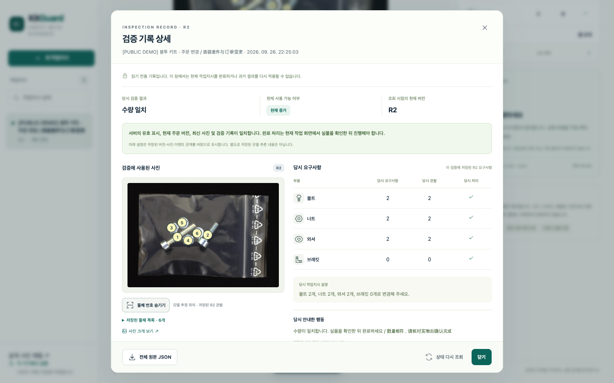
KitGuard, 수량 확인을 검토 가능한 작업으로
잘못된 확정을 줄이고
다음 확인을 남깁니다
목표 수량과 사진 관찰을 분리
애매하면 촬영 또는 수량 수정 안내
새 버전과 증거를 읽기 전용 기록으로
v0.3: 회전 일치 확인 · 국소 정체 확인
이전 결과 무효화 · 오프라인 증거 보고서
공개 개발 사진을 쓴 실제 앱 실행입니다. 실물 보충·출하 완료는 수행하지 않았습니다.
KitGuard v0.3 · 1/6
Notes:
Business intent is an implemented workflow, not measured operator savings. Current deployment mode: spatial_guarded.
holdout_gate: evaluation-runs/v03_guarded_holdout_v1/gate_report_v1.json SHA256 8f8fa784b9abca802ffab08e1fc8b23efd75407a2ede9cc235c3496b442f599f
development_gate: evaluation-runs/v03_guarded_integrated_development_v1/gate_report_v1.json SHA256 fc54ee5cbac231a3aa214235de1d8ae494055ef744d94b0e5fca28ab8a95d4e8
independent_audit: test-results/audit/v03-guarded-holdout-analysis.json SHA256 76a878c1b75fc09dcbaf4ae5d3139c97f46cfdc859c8c0200f0014215c5b3408
engineering_junit: test-results/engineering-v03-final.xml SHA256 5842e15b5d851940dd2b13168064dbae277f483a062de8038710f7a2dbfede92
real_api_demo: test-results/browser/real-api-v03/runs/candidate-real-api-v2/browser/result.json SHA256 cab064f757d7c4e984b76a64c31ab5f47a2ed7040226fa128838881dbe8d01f7
protocol: docs/v0.3/HOLDOUT_GATES_V1.json SHA256 563bf149286d6cacb7e14992b5ee9d1b1895752fae7f407a4da37ab11d65b8b6
v03_owl_development_v1: evaluation-runs/v03_owl_development_v1/run.json SHA256 a33635eb96fa231c79745e7ba12851fcae5e12b275c6cff4759b58ad56cec383
v03_grounding_dino_development_v1: evaluation-runs/v03_grounding_dino_development_v1/run.json SHA256 e174cdd952f82e9385ba34ceba35f7039e1f95e2bc982b381f7768e9c1df56bf
Screenshot /Users/lkc/Downloads/AI·SW/kitguard/test-results/browser/real-api-v03/runs/candidate-real-api-v2/browser/screenshots/bag-revision-r2-audit.png SHA256 e73edb273bd0da8c380d36d04b4f8f19db667dec978b1a0dfaaa936b6b00b00f
MVTec LOCO AD and MVTec Screws, CC BY-NC-SA 4.0. https://www.mvtec.com/research-teaching/datasets/mvtec-loco-ad ; https://www.mvtec.com/research-teaching/datasets/mvtec-screws ; https://creativecommons.org/licenses/by-nc-sa/4.0/ . Public development photographs shown inside actual API screenshots, not new field photographs. Same-source grouping is not independent factories; pretrained overlap unknown. Original author labels and conservative exact count projection, never AI ground truth.

Slide 2
목표 수량을 보지 않는 단계적 관찰
1
2
3
공간 목록
회전 일치 확인
국소 정체 확인
원본의 물체별 분류와 위치
코드가 목록에서 수량을 계산
같은 사진을 반시계 90° 회전
두 관찰이 어긋나면 불확실
너트·와셔 후보 부분 확대
정체·구멍 판단 충돌 시 보류
모델 입력에 BOM 목표 없음
확정 수량을 다른 정수로 고치지 않음
승인된 요구와의 비교는 관찰 뒤에 규칙으로 수행합니다.
충돌 범주의 수량만 null로 바꾸고 사용자에게 다시 확인을 요청합니다.
모두 같은 27B 모델의 관련된 호출입니다. 추정 좌표·구멍 판단은 실측 진실이 아니며 확대 보간은 정보를 만들지 않습니다.
KitGuard v0.3 · 2/6
Notes:
Native editable architecture. Model Qwen3.6-27B MLX 4-bit,1536px. Spatial inventory max900 tokens per orientation; identity geometry v2 uses only model-selected ring candidates. Same model and same photograph, not independent evidence. Null-only candidate policy, no integer correction. Source kitguard/identity.py, consensus.py, vision.py and schemas.py; actual frozen hashes in gate reports.
holdout_gate: evaluation-runs/v03_guarded_holdout_v1/gate_report_v1.json SHA256 8f8fa784b9abca802ffab08e1fc8b23efd75407a2ede9cc235c3496b442f599f
development_gate: evaluation-runs/v03_guarded_integrated_development_v1/gate_report_v1.json SHA256 fc54ee5cbac231a3aa214235de1d8ae494055ef744d94b0e5fca28ab8a95d4e8
independent_audit: test-results/audit/v03-guarded-holdout-analysis.json SHA256 76a878c1b75fc09dcbaf4ae5d3139c97f46cfdc859c8c0200f0014215c5b3408
engineering_junit: test-results/engineering-v03-final.xml SHA256 5842e15b5d851940dd2b13168064dbae277f483a062de8038710f7a2dbfede92
real_api_demo: test-results/browser/real-api-v03/runs/candidate-real-api-v2/browser/result.json SHA256 cab064f757d7c4e984b76a64c31ab5f47a2ed7040226fa128838881dbe8d01f7
protocol: docs/v0.3/HOLDOUT_GATES_V1.json SHA256 563bf149286d6cacb7e14992b5ee9d1b1895752fae7f407a4da37ab11d65b8b6
v03_owl_development_v1: evaluation-runs/v03_owl_development_v1/run.json SHA256 a33635eb96fa231c79745e7ba12851fcae5e12b275c6cff4759b58ad56cec383
v03_grounding_dino_development_v1: evaluation-runs/v03_grounding_dino_development_v1/run.json SHA256 e174cdd952f82e9385ba34ceba35f7039e1f95e2bc982b381f7768e9c1df56bf

Slide 3
맞힌 수와 거절한 수를 함께 공개
C 정확한 확정 W 틀린 확정 U 불확실·보류 E 실행 오류
자료·사진 수 | 같은 실행 첫 관찰 C / W / U / E | 최종 확인 C / W / U / E | 최종 확정 비율 | 전체 시간 중앙값
개발 LOCO 16장 | 15 / 1 / 0 / 0 | 14 / 0 / 2 / 0 | 87.5% | 47.26초
개발 Screws 12장 | 10 / 2 / 0 / 0 | 10 / 0 / 2 / 0 | 83.3% | 21.38초
새 평가 LOCO 정상 16장 | 16 / 0 / 0 / 0 | 16 / 0 / 0 / 0 | 100.0% | 47.27초
새 평가 LOCO 수량 이상 16장 | 16 / 0 / 0 / 0 | 15 / 0 / 1 / 0 | 93.8% | 45.03초
새 평가 Screws 32장 | 30 / 2 / 0 / 0 | 28 / 0 / 4 / 0 | 87.5% | 22.40초
새 평가 64장: 59C · 0W · 5U · 0E
첫 관찰 오류 2건 차단 · 정확했던 3건도 보류
첫 관찰은 같은 실행의 관찰 결과이며 별도 전체 지연 측정은 없습니다. 표의 시간에는 업로드 처리와 모델 관찰을 포함하고 사람 작업은 제외합니다.
KitGuard v0.3 · 3/6
Notes:
All C/W/U/E rows are mutually exclusive and sum to every planned image. Development28 selected the method; newholdout64 never folded into that denominator. Rates are descriptive, not a population performance estimate. Final latency is actual integrated app-upload/observe duration including cold first row; first-pass baseline has no separately measured total latency. Guarded inspect API timing is shown separately on slide5. No pooling model-only, historical replay combined, or detector CPU timing.
holdout_gate: evaluation-runs/v03_guarded_holdout_v1/gate_report_v1.json SHA256 8f8fa784b9abca802ffab08e1fc8b23efd75407a2ede9cc235c3496b442f599f
development_gate: evaluation-runs/v03_guarded_integrated_development_v1/gate_report_v1.json SHA256 fc54ee5cbac231a3aa214235de1d8ae494055ef744d94b0e5fca28ab8a95d4e8
independent_audit: test-results/audit/v03-guarded-holdout-analysis.json SHA256 76a878c1b75fc09dcbaf4ae5d3139c97f46cfdc859c8c0200f0014215c5b3408
engineering_junit: test-results/engineering-v03-final.xml SHA256 5842e15b5d851940dd2b13168064dbae277f483a062de8038710f7a2dbfede92
real_api_demo: test-results/browser/real-api-v03/runs/candidate-real-api-v2/browser/result.json SHA256 cab064f757d7c4e984b76a64c31ab5f47a2ed7040226fa128838881dbe8d01f7
protocol: docs/v0.3/HOLDOUT_GATES_V1.json SHA256 563bf149286d6cacb7e14992b5ee9d1b1895752fae7f407a4da37ab11d65b8b6
v03_owl_development_v1: evaluation-runs/v03_owl_development_v1/run.json SHA256 a33635eb96fa231c79745e7ba12851fcae5e12b275c6cff4759b58ad56cec383
v03_grounding_dino_development_v1: evaluation-runs/v03_grounding_dino_development_v1/run.json SHA256 e174cdd952f82e9385ba34ceba35f7039e1f95e2bc982b381f7768e9c1df56bf
Development audit /Users/lkc/Downloads/AI·SW/kitguard/test-results/audit/v03-guarded-integrated-development-analysis.json SHA256 da054cdb515b11b4bec968944c0c5b0d51516897fad0cea991e14fc55eed2961
MVTec LOCO AD and MVTec Screws, CC BY-NC-SA 4.0. https://www.mvtec.com/research-teaching/datasets/mvtec-loco-ad ; https://www.mvtec.com/research-teaching/datasets/mvtec-screws ; https://creativecommons.org/licenses/by-nc-sa/4.0/ . Public development photographs shown inside actual API screenshots, not new field photographs. Same-source grouping is not independent factories; pretrained overlap unknown. Original author labels and conservative exact count projection, never AI ground truth.

Slide 4
실패한 대안도 남기고 채택 조건을 고정
완료한 개발 실험 | LOCO / Screws 수량 전부 정확 | 판단
OWLv2 Base Ensemble | 0/16 · 0/12 | 현 설정은 미채택
Grounding DINO Tiny | 0/16 · 1/12 | 현 설정은 미채택
초기 정체 확인 v1 | Screws 10/12 · 틀린 확정 1건 | 오류가 남아 수정
통합 v2 | 14/16 · 10/12 | 새 평가 전에 고정
내부 사전 기준 충족 후 강화 확인을 기본값으로 채택
새 평가 문턱 통과 · 오류 차단 이득 관측
현재 모드: spatial_guarded
탐지기는 수량 정확도만 비교합니다. 업무 확정 지표는 해당 없습니다. CPU 시간·과거 결과 재생 시간은 통합 지연과 별도로 기록합니다.
KitGuard v0.3 · 4/6
Notes:
These detector trials do not establish the best achievable detector performance: specific pretrained settings, no task-specific training. Their business-actionability metrics are null, not0. Identityv1 is replay on development outputs, not integrated end-to-end timing. Frozen research gates are not contest scoring and do not guarantee first place or shipping safety.
holdout_gate: evaluation-runs/v03_guarded_holdout_v1/gate_report_v1.json SHA256 8f8fa784b9abca802ffab08e1fc8b23efd75407a2ede9cc235c3496b442f599f
development_gate: evaluation-runs/v03_guarded_integrated_development_v1/gate_report_v1.json SHA256 fc54ee5cbac231a3aa214235de1d8ae494055ef744d94b0e5fca28ab8a95d4e8
independent_audit: test-results/audit/v03-guarded-holdout-analysis.json SHA256 76a878c1b75fc09dcbaf4ae5d3139c97f46cfdc859c8c0200f0014215c5b3408
engineering_junit: test-results/engineering-v03-final.xml SHA256 5842e15b5d851940dd2b13168064dbae277f483a062de8038710f7a2dbfede92
real_api_demo: test-results/browser/real-api-v03/runs/candidate-real-api-v2/browser/result.json SHA256 cab064f757d7c4e984b76a64c31ab5f47a2ed7040226fa128838881dbe8d01f7
protocol: docs/v0.3/HOLDOUT_GATES_V1.json SHA256 563bf149286d6cacb7e14992b5ee9d1b1895752fae7f407a4da37ab11d65b8b6
v03_owl_development_v1: evaluation-runs/v03_owl_development_v1/run.json SHA256 a33635eb96fa231c79745e7ba12851fcae5e12b275c6cff4759b58ad56cec383
v03_grounding_dino_development_v1: evaluation-runs/v03_grounding_dino_development_v1/run.json SHA256 e174cdd952f82e9385ba34ceba35f7039e1f95e2bc982b381f7768e9c1df56bf
Failed identity run /Users/lkc/Downloads/AI·SW/kitguard/evaluation-runs/v03_screws_identity_probe_v1/run.json SHA256 04e2708c6d66c4137014f690db24ce02a0fe1a078df0a010eac1b93c0352246a

Slide 5
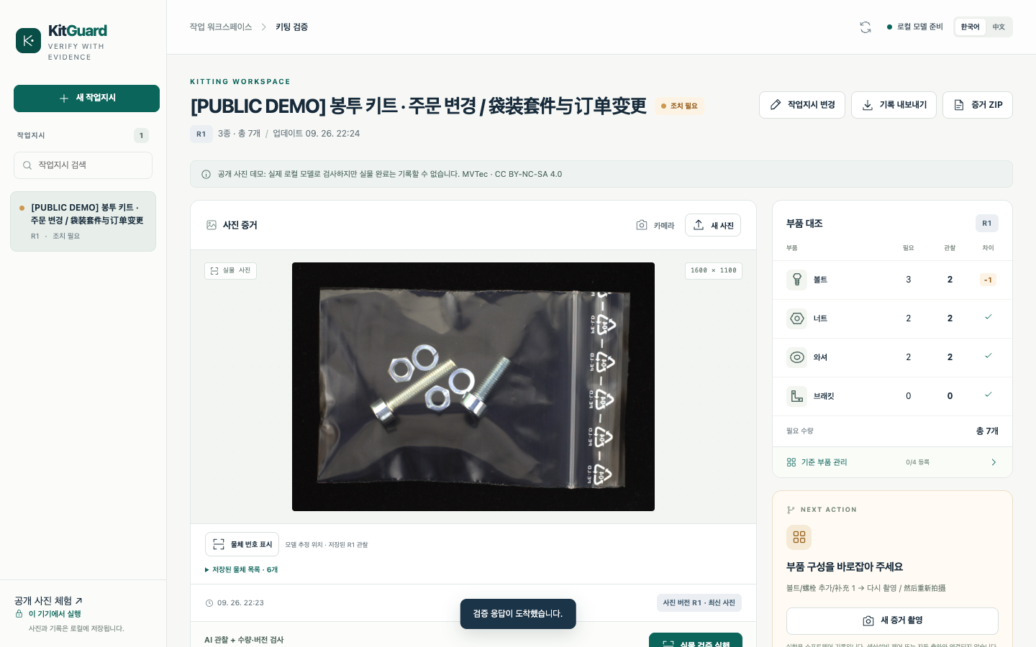
실제 API로 변경·재검사·기록까지
428/428 공학 테스트
상태·입력·기록 동작 검증
시각 정확도와 다른 분모
시각 검사 요청 4회
한국어 제안 후 명시적 승인
R2에 같은 공개 사진 재업로드
R1 51.49초 / R2 48.92초
자연어 제안 7.92초
검사 기록 4회 · 실행 오류 0회
자연어 1회 · 실물 완료 0건
이 시연은 이미 사용한 공개 개발 사진입니다. 주문만 변경했으며 새로운 현장 촬영이나 실물 보충을 입증하지 않습니다.
KitGuard v0.3 · 5/6
Notes:
Actual API demonstration separate from benchmark. bag-revisionR1: HTTP200, 수량 조정 필요, actual request 51.492s
bag-revisionR2: HTTP200, 수량 일치·본인 확인 대기, actual request 48.922s
small-partR1: HTTP200, 다시 촬영 필요, actual request 21.644s
mixed-screwsR1: HTTP200, 수량 일치·본인 확인 대기, actual request 15.908s
NL status proposal_returned, fallback false, approval via natural_proposal; no claim that4visual endpoint requests equals4low-level VLM generations: each guarded request can include multiple correlated calls, plus1NLrequest. Browser-operated explicit approval is not a human-user study. No physical completions. Screenshot /Users/lkc/Downloads/AI·SW/kitguard/test-results/browser/real-api-v03/runs/candidate-real-api-v2/browser/screenshots/bag-revision-r1-workspace.png SHA256 1621ebbb0442308d31a663b1086432ae93941aebce914861b00153467872dcca
holdout_gate: evaluation-runs/v03_guarded_holdout_v1/gate_report_v1.json SHA256 8f8fa784b9abca802ffab08e1fc8b23efd75407a2ede9cc235c3496b442f599f
development_gate: evaluation-runs/v03_guarded_integrated_development_v1/gate_report_v1.json SHA256 fc54ee5cbac231a3aa214235de1d8ae494055ef744d94b0e5fca28ab8a95d4e8
independent_audit: test-results/audit/v03-guarded-holdout-analysis.json SHA256 76a878c1b75fc09dcbaf4ae5d3139c97f46cfdc859c8c0200f0014215c5b3408
engineering_junit: test-results/engineering-v03-final.xml SHA256 5842e15b5d851940dd2b13168064dbae277f483a062de8038710f7a2dbfede92
real_api_demo: test-results/browser/real-api-v03/runs/candidate-real-api-v2/browser/result.json SHA256 cab064f757d7c4e984b76a64c31ab5f47a2ed7040226fa128838881dbe8d01f7
protocol: docs/v0.3/HOLDOUT_GATES_V1.json SHA256 563bf149286d6cacb7e14992b5ee9d1b1895752fae7f407a4da37ab11d65b8b6
v03_owl_development_v1: evaluation-runs/v03_owl_development_v1/run.json SHA256 a33635eb96fa231c79745e7ba12851fcae5e12b275c6cff4759b58ad56cec383
v03_grounding_dino_development_v1: evaluation-runs/v03_grounding_dino_development_v1/run.json SHA256 e174cdd952f82e9385ba34ceba35f7039e1f95e2bc982b381f7768e9c1df56bf
MVTec LOCO AD and MVTec Screws, CC BY-NC-SA 4.0. https://www.mvtec.com/research-teaching/datasets/mvtec-loco-ad ; https://www.mvtec.com/research-teaching/datasets/mvtec-screws ; https://creativecommons.org/licenses/by-nc-sa/4.0/ . Public development photographs shown inside actual API screenshots, not new field photographs. Same-source grouping is not independent factories; pretrained overlap unknown. Original author labels and conservative exact count projection, never AI ground truth.

Slide 6
다음 증거는 실제 작업에서 확보
현재 입증한 것은 공개 실사진의 수량 확인과
소프트웨어 상태·감사 기록의 연결입니다.
다음 검증 | 확보할 증거
현장 촬영 | 조명·가림·겹침·브래킷 양성 사례를 포함해 새로 촬영
실물 수정 전후 | 실제로 더하고 뺀 뒤 새 사진과 담당자 확인을 연결
작업자 비교 | 완료 시간·재촬영 수·잘못된 수량 확정을 함께 측정
이번 표본에서 오류를 관측하지 않아도 현장 위험은 남습니다.
공개 데이터 사전학습 중복은 미확인 · 다른 공장 일반화 미검증
실제 개발 시작 2026.09.26 · 사전 개발 규정과 참가 자격은 주최 측 확인 필요
KitGuard v0.3 · 6/6
Notes:
Future field plan, not claimed executed work. No measured physical correction, user efficiency, novel acquisition domain, bracket-positive validation or commercial-use permission. Public data CC BY-NC-SA4.0 requires attribution/noncommercial/sharealike compliance. This supplemental deck is a research/development record, not ready-to-submit authorization. Official judging weights are not fabricated. AI-assisted implementation documented; actual predevelopment September26 preserved.
holdout_gate: evaluation-runs/v03_guarded_holdout_v1/gate_report_v1.json SHA256 8f8fa784b9abca802ffab08e1fc8b23efd75407a2ede9cc235c3496b442f599f
development_gate: evaluation-runs/v03_guarded_integrated_development_v1/gate_report_v1.json SHA256 fc54ee5cbac231a3aa214235de1d8ae494055ef744d94b0e5fca28ab8a95d4e8
independent_audit: test-results/audit/v03-guarded-holdout-analysis.json SHA256 76a878c1b75fc09dcbaf4ae5d3139c97f46cfdc859c8c0200f0014215c5b3408
engineering_junit: test-results/engineering-v03-final.xml SHA256 5842e15b5d851940dd2b13168064dbae277f483a062de8038710f7a2dbfede92
real_api_demo: test-results/browser/real-api-v03/runs/candidate-real-api-v2/browser/result.json SHA256 cab064f757d7c4e984b76a64c31ab5f47a2ed7040226fa128838881dbe8d01f7
protocol: docs/v0.3/HOLDOUT_GATES_V1.json SHA256 563bf149286d6cacb7e14992b5ee9d1b1895752fae7f407a4da37ab11d65b8b6
v03_owl_development_v1: evaluation-runs/v03_owl_development_v1/run.json SHA256 a33635eb96fa231c79745e7ba12851fcae5e12b275c6cff4759b58ad56cec383
v03_grounding_dino_development_v1: evaluation-runs/v03_grounding_dino_development_v1/run.json SHA256 e174cdd952f82e9385ba34ceba35f7039e1f95e2bc982b381f7768e9c1df56bf
MVTec LOCO AD and MVTec Screws, CC BY-NC-SA 4.0. https://www.mvtec.com/research-teaching/datasets/mvtec-loco-ad ; https://www.mvtec.com/research-teaching/datasets/mvtec-screws ; https://creativecommons.org/licenses/by-nc-sa/4.0/ . Public development photographs shown inside actual API screenshots, not new field photographs. Same-source grouping is not independent factories; pretrained overlap unknown. Original author labels and conservative exact count projection, never AI ground truth.

