Slide 1
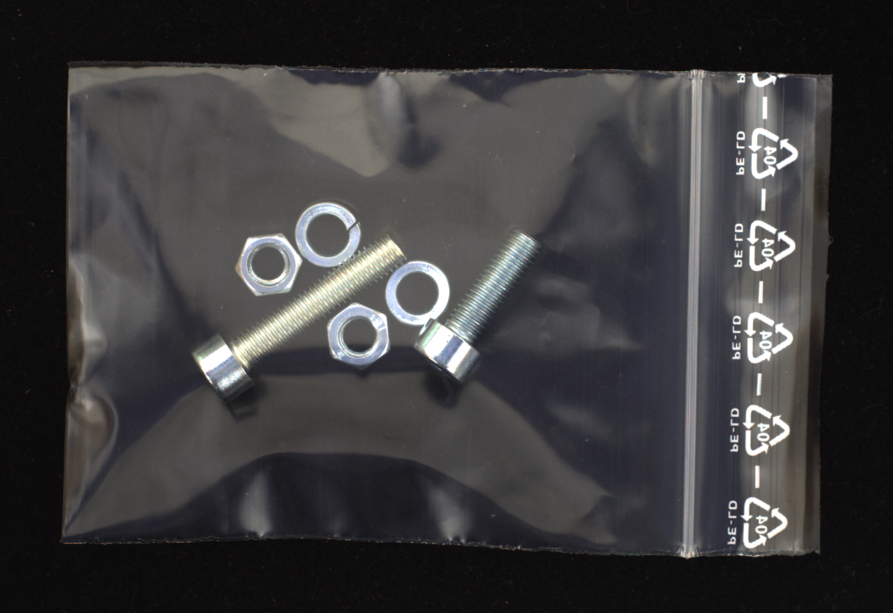
KitGuard
로컬 AI 기반
소형 부품 수량 확인 에이전트
해피
국립창원대학교 인공지능융합공학과
공개 실촬영 자료 MVTec LOCO AD
CC BY-NC-SA 4.0
실제 개발 2026.09.26 · v0.2 검증본 · 제출 전 검토
Notes:
MVTec Software GmbH, MVTec LOCO AD. https://www.mvtec.com/research-teaching/datasets/mvtec-loco-ad . License: Creative Commons Attribution-NonCommercial-ShareAlike 4.0 International. https://creativecommons.org/licenses/by-nc-sa/4.0/ . Original photos shown without cropping or visual alteration, scaled to fit. Original author paper: https://link.springer.com/article/10.1007/s11263-022-01578-9 . Local provenance: docs/DATA_PROVENANCE.md . Images are public static dataset observations, not this team’s physical field validation.
Local source: docs/INDEPENDENT_REVIEW.md and docs/DEVELOPMENT_ACCEPTANCE.md, reviewed 2026-09-26. Team prototype development started 2026-09-26. Competition agreement includes a restriction on pre-development outside the official period. Organizer interpretation and eligibility confirmation remain pending. This deck is an internal draft and does not represent a ready-to-submit or eligible submission. Detailed judging weights have not been published and are not invented here.
Original photograph: screw_bag/train/good/016.png. Team: 해피, members 남청청 and 이개심. Private contact information is intentionally absent.

Slide 2
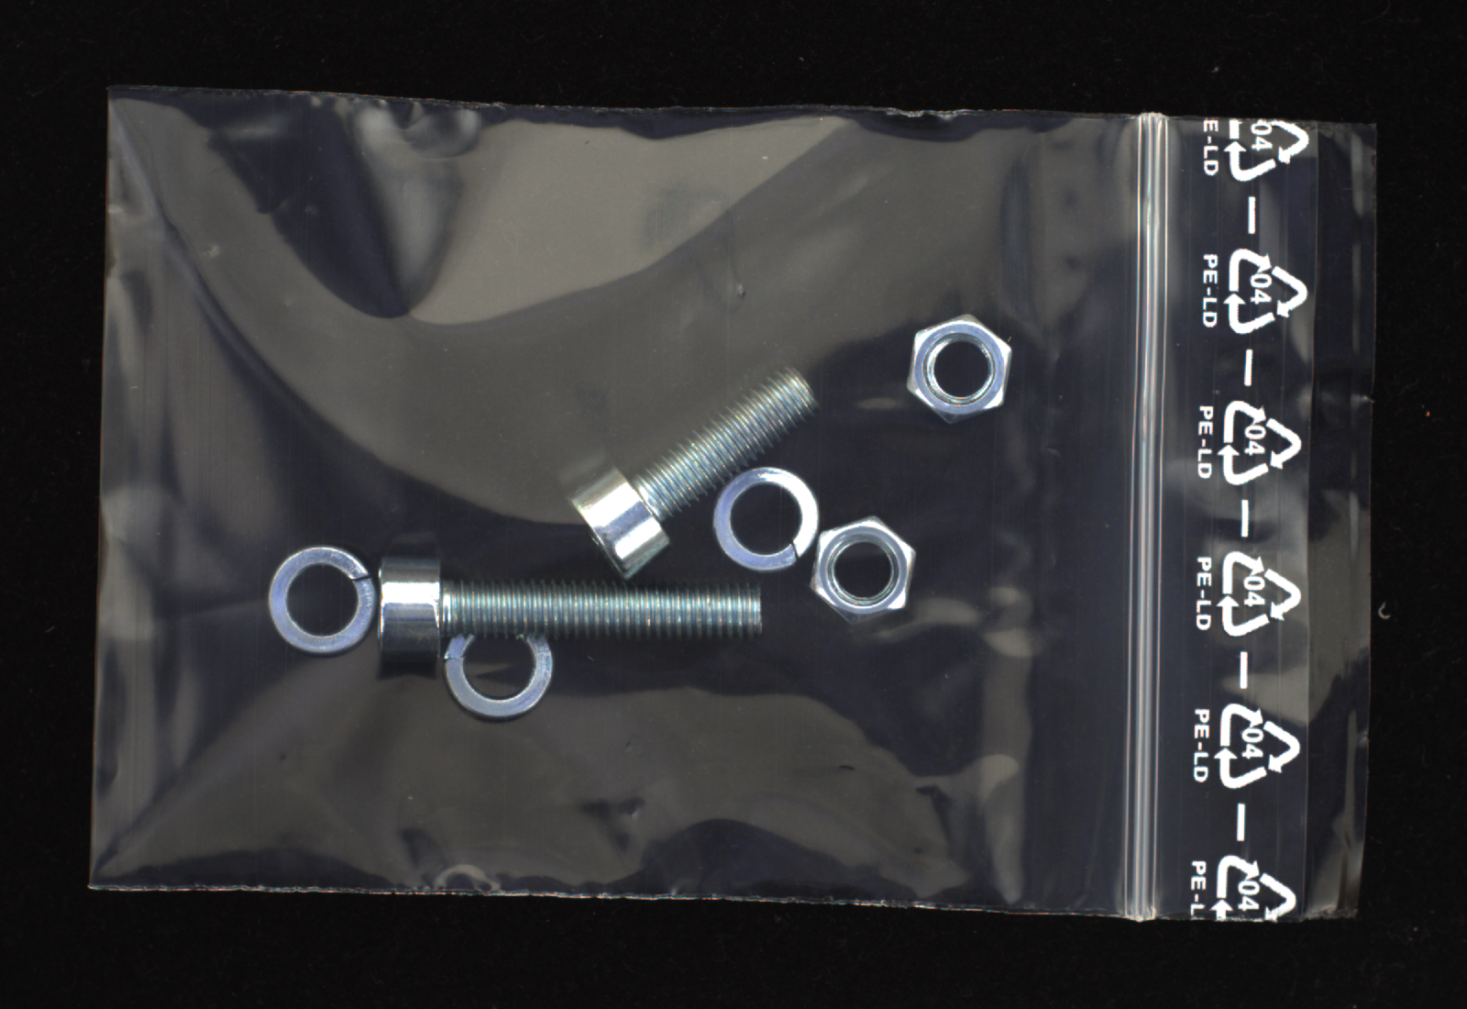
확인 대상과 작업 범위
목표 수량과 실제 구성을
같은 기록으로 비교
부품을 더하거나 빼야 할 때는
새 사진으로 다시 확인합니다.
4개 대분류 · 종류별 0~3개
한 작업의 전체 부품 1~12개
나사류 2 · 너트 2 · 와셔 3
공식 결함 라벨에 따른 수량 예시
출처: MVTec LOCO AD · CC BY-NC-SA 4.0
나사류 · 너트 · 와셔 · 브래킷. 길이, 재질, 나사산과 정밀 품번 검사는 범위 밖입니다.
Notes:
MVTec Software GmbH, MVTec LOCO AD. https://www.mvtec.com/research-teaching/datasets/mvtec-loco-ad . License: Creative Commons Attribution-NonCommercial-ShareAlike 4.0 International. https://creativecommons.org/licenses/by-nc-sa/4.0/ . Original photos shown without cropping or visual alteration, scaled to fit. Original author paper: https://link.springer.com/article/10.1007/s11263-022-01578-9 . Local provenance: docs/DATA_PROVENANCE.md . Images are public static dataset observations, not this team’s physical field validation.
Original: screw_bag/test/logical_anomalies/043.png. defect pixel value 247 = 1_additional_washer. Normal baseline bolt2/nut2/washer2/bracket0, projected truth 2/2/3/0. bolt is a broad headed threaded fastener class, not a specific bolt SKU. Product scope: kitguard/schemas.py and docs/IMPLEMENTATION_CONTRACT.md.

Slide 3
사람의 확인을 거치는 작업 흐름
01
02
03
04
요구 제안
사람의 승인
사진 관찰
규칙 비교
자연어를 수량 변경안으로 변환
승인한 요구만 새 버전에 반영
로컬 모델이 목표 수량 없이 관찰
확정된 요구와 관찰 수량 비교
05
06
07
08
수정 안내
새 증거
실물 확인
기록 보존
불명확하면 촬영, 차이면 수량 수정
새 사진으로 다시 관찰하고 비교
담당자가 실제 구성을 확인
현재 유효한 결과와 감사 ZIP 저장
모델 관찰은 판단 자료입니다. 주문 완료에는 최신 버전, 최신 사진, 유효한 검사와 사람의 확인이 필요합니다.
Notes:
Actual implemented workflow: kitguard/app.py, kitguard/store.py, kitguard/feedback.py, kitguard/evidence.py, kitguard/static/app.js. State transitions and UI covered by local engineering regression. The diagram describes implemented software behavior, not evidence that real physical correction has been completed. Local source: test-results/engineering-current.xml; test-results/browser/workbench-core/browser-results.json; test-results/browser/evidence-feedback/result.json; test-results/browser/audit-details/result.json; test-results/browser/orientation-details/result.json. Browser screenshots use explicitly labelled synthetic engineering fixtures through the actual isolated application. They demonstrate UI/state behavior, not real model recognition or physical completion.

Slide 4
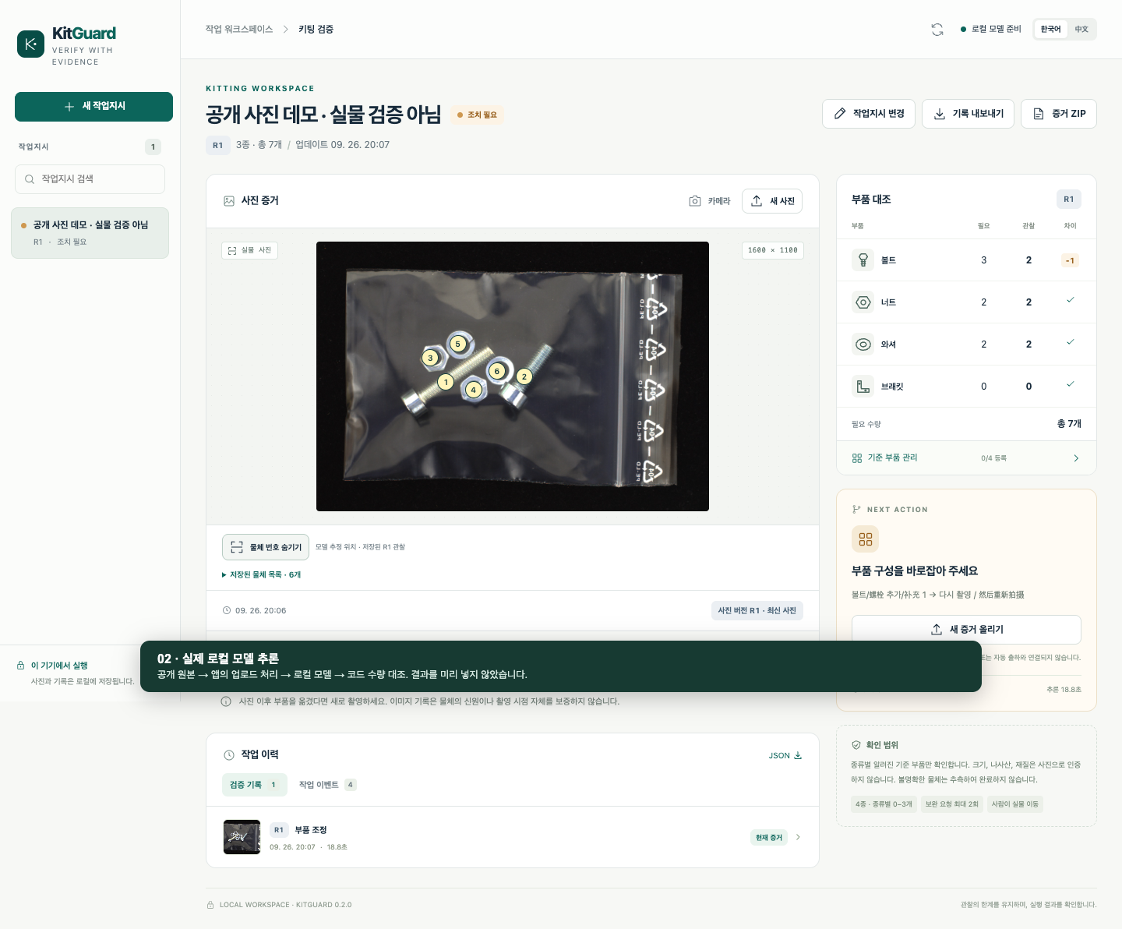
실제 작업 화면
요구 3 · 관찰 2
나사류 1개 부족으로
수량 수정 행동을 제안
로컬 27B 실행
물체 목록 → 코드 계수
현재 주문과 규칙 대조
실제 API 응답 기록
실제 로컬 27B·API 화면 · 사진: MVTec LOCO AD, CC BY-NC-SA 4.0 · 실물 수정 검증 아님
Notes:
Actual Chrome application walkthrough: output/demo/recording.json, success:true, two genuine backend:mlx inspection responses. Frozen Qwen3.6-27B MLX 4-bit spatial_inventory/1536, model revision c000ac2c2057d94be3fa931000c31723aac53282. Original public photograph MVTec LOCO AD screw_bag/train/good/016.png, CC BY-NC-SA 4.0, reused from development; not an additional evaluation sample. Initial R1 requires 3 screws, observed 2/2/2/0, action add 1. Approved natural-language revision changes target to 2 screws; same original photo submitted again for R2, ready; R1 result is invalid/read-only. No physical correction, new physical evidence, or human completion claimed. The full original screenshot is shown without bitmap modification; overlay points are model estimates, not ground truth.
Screenshot: output/demo/01-real-inspection.png

Slide 5
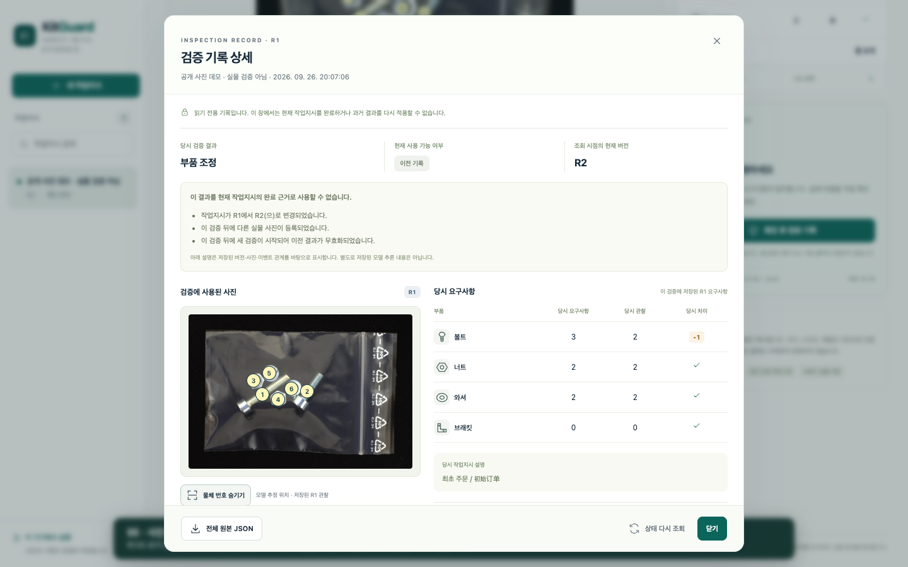
검사 근거와 이전 결과의 유효성
당시의 요구를 보존
검사 버전, 사진, 관찰과
실행 단계를 함께 기록
새 변경은 다시 검사
요구·사진·참조가 바뀌면
이전 결과로 완료 불가
같은 사진을 R2에 다시 제출
실물 변경·새 촬영 증거 아님
읽기 전용 과거 기록과 현재 완료 권한을 분리합니다. 감사 ZIP에 사진, 기록과 해시를 보존합니다.
Notes:
Actual Chrome application walkthrough: output/demo/recording.json, success:true, two genuine backend:mlx inspection responses. Frozen Qwen3.6-27B MLX 4-bit spatial_inventory/1536, model revision c000ac2c2057d94be3fa931000c31723aac53282. Original public photograph MVTec LOCO AD screw_bag/train/good/016.png, CC BY-NC-SA 4.0, reused from development; not an additional evaluation sample. Initial R1 requires 3 screws, observed 2/2/2/0, action add 1. Approved natural-language revision changes target to 2 screws; same original photo submitted again for R2, ready; R1 result is invalid/read-only. No physical correction, new physical evidence, or human completion claimed. The full original screenshot is shown without bitmap modification; overlay points are model estimates, not ground truth.
Screenshot: output/demo/03-audit.png
Audit ZIP implementation: kitguard/evidence.py and kitguard/app.py; archived exports are evidence records, not proof of physical task completion.

Slide 6
로컬 실행과 추적 가능한 데이터
계층 | 현재 구성 | 역할
작업 화면 | 브라우저 · FastAPI | 요구 승인과 사진 입력
관찰 모델 | Qwen3.6-27B · 4-bit | 물체별 분류·추정 위치 목록
상태와 판단 | SQLite · 결정적 규칙 | 목록 계수, 비교, 완료 조건
기록 내보내기 | JSON · 사진 · SHA-256 | 검사 재검토와 감사 ZIP
MacBook Pro M5 Pro · 통합 메모리 64 GB
공개 실사진과 원본 라벨을 보존하고 모델 결과와 분리합니다.
LOCO 개발 16장과 사전 고정한 평가용 48장을 구분합니다.
MVTec 사진: CC BY-NC-SA 4.0. 전체 압축파일과 원본 1,007개를 해시로 검증했습니다.
Notes:
MVTec Software GmbH, MVTec LOCO AD. https://www.mvtec.com/research-teaching/datasets/mvtec-loco-ad . License: Creative Commons Attribution-NonCommercial-ShareAlike 4.0 International. https://creativecommons.org/licenses/by-nc-sa/4.0/ . Original photos shown without cropping or visual alteration, scaled to fit. Original author paper: https://link.springer.com/article/10.1007/s11263-022-01578-9 . Local provenance: docs/DATA_PROVENANCE.md . Images are public static dataset observations, not this team’s physical field validation.
Complete frozen runs: evaluation-runs/loco_holdout_release_v1/run.json; evaluation-runs/loco_holdout_27b_single_control_v1/run.json; evaluation-runs/loco_development_release_v1/run.json. All visual runs use original public LOCO images normalized through the application upload pipeline; all selected cases retained. Freeze 2026-09-26T10:44:49.603420+00:00 (2026-09-26 19:44:49.603 KST); first held-out run 2026-09-26T10:45:00.717797+00:00. Same-model comparison changes prompt/output structure and output-token cap (900 vs 450) together, not an isolated causal ablation. Pretraining overlap unknown; no population confidence interval or physical action success claim. Normal and quantity-anomaly groups have separate denominators. No bracket-positive photos. Manifest 3166a331b981635170794dbef4989ed7294a54f89fd56e1aeac4993163700cfb.
Hardware/runtime verified in docs/VALIDATION.md. Public data inventories and SHA checks: datasets/manifests and docs/DATA_PROVENANCE.md. 761 complete screw_bag original photos +243 masks +3 documents decoded and per-file SHA checked. Full archive SHA verified and 1,007 staged originals compared with zero differences. Historical pending-source metadata remains preserved in its original records. All 64 evaluation photos within product quantity range, no positive bracket examples.

Slide 7
개발과 별도 평가를 구분한 검증
검증 대상 | 관측 결과 | 해석 범위
소프트웨어 회귀 | 186 / 186 | 상태·입력·동시성 동작
다국어 지시 개발 | 24 / 24 | 직접 작성한 사례, 사용자 실험 아님
시각 개발 16장 | 15 / 16 | 모델과 관찰 방식 선택에 사용
사전 고정 평가 48장 | 46 / 48 (95.8%) | 큰 분류별 수량이 전부 정확한 사진
잘못된 확정 수량 | 2 / 48 | 불확실성 표시 없이 틀린 사진
평가 48장: 정상 구성과 수량 이상을 각각 보고
정상 23 / 24장 · 수량 이상 23 / 24장
공개 실사진의 정적 수량 평가입니다. 공학 테스트 통과율이나 현장 작업 성공률과 합치지 않습니다.
Notes:
Local source: test-results/engineering-current.xml; test-results/browser/workbench-core/browser-results.json; test-results/browser/evidence-feedback/result.json; test-results/browser/audit-details/result.json; test-results/browser/orientation-details/result.json. Browser screenshots use explicitly labelled synthetic engineering fixtures through the actual isolated application. They demonstrate UI/state behavior, not real model recognition or physical completion.
evaluation-runs/instructions_27b_v1/run.json and predictions.jsonl. 24 author-written development cases (8 Korean, 8 Chinese, 8 English); 9 proposals and 15 expected clarification/rejection responses. All passed. This completed run predates final spatial integration and retains its own source snapshot; no user-study claim.
Complete frozen runs: evaluation-runs/loco_holdout_release_v1/run.json; evaluation-runs/loco_holdout_27b_single_control_v1/run.json; evaluation-runs/loco_development_release_v1/run.json. All visual runs use original public LOCO images normalized through the application upload pipeline; all selected cases retained. Freeze 2026-09-26T10:44:49.603420+00:00 (2026-09-26 19:44:49.603 KST); first held-out run 2026-09-26T10:45:00.717797+00:00. Same-model comparison changes prompt/output structure and output-token cap (900 vs 450) together, not an isolated causal ablation. Pretraining overlap unknown; no population confidence interval or physical action success claim. Normal and quantity-anomaly groups have separate denominators. No bracket-positive photos. Manifest 3166a331b981635170794dbef4989ed7294a54f89fd56e1aeac4993163700cfb.
Metrics file: .presentation-build/metrics.json with source references. Always-normal 2/2/2/0 baseline: 24 / 48 count exact and 24 / 24 quantity anomalies falsely ready. Selected observer execution errors 0 / 48. Baseline and selected outcomes from same photographs are paired, not independent additional samples. One fixed bolt-count perturbation per image yields selected false-ready 1 / 48; distinct denominator from nominal anomaly cases. Source receipt: .presentation-build/final-sources.json.

Slide 8
동일 모델 대조와 남은 오류
수량 이상을 일치로 판단한 사례가 남음
같은 27B 모델·입력에서 직접 수량 응답과 비교했습니다.
프롬프트·출력 구조·토큰 상한이 함께 달라집니다.
평가 항목 | 선택 방식 / 직접 수량 응답 대조
수량 전부 정확 | 46 / 48 (95.8%) / 34 / 48 (70.8%) · +25%p
오류 일치 판정 | 1 / 24장 / 2 / 24장 · 정상 주문 기준
응답 시간 중앙값 | 14.62초 / 8.99초 · 업로드 처리 포함
남은 검증 | 실물 수정 전후·브래킷·작업 시간·현장 조건
공개 사전학습 중복 여부는 미확인입니다. 좌표는 모델 추정이며, 실제 출하 또는 물리적 완료를 보증하지 않습니다.
Notes:
Complete frozen runs: evaluation-runs/loco_holdout_release_v1/run.json; evaluation-runs/loco_holdout_27b_single_control_v1/run.json; evaluation-runs/loco_development_release_v1/run.json. All visual runs use original public LOCO images normalized through the application upload pipeline; all selected cases retained. Freeze 2026-09-26T10:44:49.603420+00:00 (2026-09-26 19:44:49.603 KST); first held-out run 2026-09-26T10:45:00.717797+00:00. Same-model comparison changes prompt/output structure and output-token cap (900 vs 450) together, not an isolated causal ablation. Pretraining overlap unknown; no population confidence interval or physical action success claim. Normal and quantity-anomaly groups have separate denominators. No bracket-positive photos. Manifest 3166a331b981635170794dbef4989ed7294a54f89fd56e1aeac4993163700cfb.
Fixed evaluation protocol: datasets/manifests/mvtec_loco_screw_bag_pending/benchmark_v2.json. Nominal order 2/2/2/0, introduced after 8B development review and before holdout model inference. Case selection remained identical to v1. 48 holdout cases were preselected from official test, excluding the 8 test anomalies reassigned to development. Constant 2/2/2/0 baseline 8/16 is a dataset-structure diagnostic, not evidence of the model using this policy. Physical continuous-action study not performed. Always-normal 2/2/2/0 baseline: 24 / 48 count exact and 24 / 24 quantity anomalies falsely ready. Selected observer execution errors 0 / 48. Baseline and selected outcomes from same photographs are paired, not independent additional samples. One fixed bolt-count perturbation per image yields selected false-ready 1 / 48; distinct denominator from nominal anomaly cases. Source receipt: .presentation-build/final-sources.json.

Slide 9
시연 구성과 제출 전 확인
요구 변경부터 감사 기록까지
01 공개 사진에서 나사류 1개 부족 확인
02 자연어로 목표 3 → 2개 변경·승인
03 같은 사진 재검사와 R1 결과 무효화 확인
04 실물 완료 확인은 보류하고 감사 ZIP 검토
개발 시작일 2026.09.26
공식 개발 기간 이전 작업에 대한 참가 자격과 규정 해석은
주최 측 확인이 필요합니다. 현재 자료는 제출 전 초안입니다.
Notes:
Local source: docs/INDEPENDENT_REVIEW.md and docs/DEVELOPMENT_ACCEPTANCE.md, reviewed 2026-09-26. Team prototype development started 2026-09-26. Competition agreement includes a restriction on pre-development outside the official period. Organizer interpretation and eligibility confirmation remain pending. This deck is an internal draft and does not represent a ready-to-submit or eligible submission. Detailed judging weights have not been published and are not invented here.
Actual Chrome application walkthrough: output/demo/recording.json, success:true, two genuine backend:mlx inspection responses. Frozen Qwen3.6-27B MLX 4-bit spatial_inventory/1536, model revision c000ac2c2057d94be3fa931000c31723aac53282. Original public photograph MVTec LOCO AD screw_bag/train/good/016.png, CC BY-NC-SA 4.0, reused from development; not an additional evaluation sample. Initial R1 requires 3 screws, observed 2/2/2/0, action add 1. Approved natural-language revision changes target to 2 screws; same original photo submitted again for R2, ready; R1 result is invalid/read-only. No physical correction, new physical evidence, or human completion claimed. The full original screenshot is shown without bitmap modification; overlay points are model estimates, not ground truth.
Demo items describe the intended reproducible software walkthrough. Do not imply public static photos establish physical recapture or correction success. Contest detailed scoring weights are unknown and no weights or winning probability are fabricated.

