Slide 1
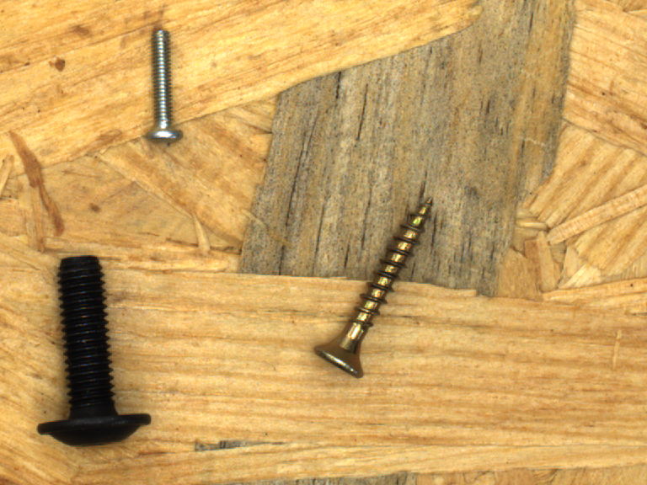
KitGuard
사진·BOM 자료 검토 Agent
사진은 그대로인데
주문 수량이 바뀌면?
현재 버전과 사진, 판단 근거를
함께 확인하고 기록합니다.
같은 사진도 주문이 바뀌면 다시 검토
공개 연구용 사진 MVTec / CC BY-NC-SA 4.0
해피 팀 v0.7.0 2026.10.02
Notes:
Target users are a hypothesis: small assembly, education and photo-document review teams. The problem is stale evidence after a BOM version change. No customer, field throughput, paid adoption or ROI is claimed. The displayed photo has been used in development and is not in the new-51 evaluation. MVTec LOCO AD and MVTec Screws public research data, CC BY-NC-SA 4.0. https://www.mvtec.com/research-teaching/datasets/mvtec-loco-ad ; https://www.mvtec.com/research-teaching/datasets/mvtec-screws ; https://creativecommons.org/licenses/by-nc-sa/4.0/ . Images are public development examples, not field or user-validation photographs. Native editable diagrams describe implemented program flow.
Sources:
docs/v0.7/RESULT_REPORT_KO_FINAL.md SHA256 2a43f39987d43d62e908fb5fca78b991bb1a49e82173afcb2fb23b1e26da1cff
kitguard/public_demo_catalog.py

Slide 2
구현한 디지털 업무 흐름
사진 검토부터 근거 내보내기까지
하나의 주문에 버전별 사진과 판단을 연결합니다.
주문·사진
로컬 AI 관찰
수량 대조
검토 기록
근거 저장
BOM과 출처
물체 목록과 위치
프로그램 규칙
동의·보류·이견
JSON·ZIP·HTML
불확실하면 추가 자료 또는 수동 검토
새 버전·추가 자료
이전 결과 무효화
공개 사진의 디지털 검토는 실물 보충·출고 완료를 기록하지 않습니다.
해피 팀 KitGuard v0.7.0 2026.10.02
02
Notes:
Native editable flow diagram. Implemented observation and deterministic count/version rules, digital public review and export are shown. A changed BOM invalidates prior checks, while preserving history. Reviewer opinions never overwrite original AI observations. Repeated uncertain evidence can route to manual review. Public-photo replay is explicit and requires a new inference. MVTec LOCO AD and MVTec Screws public research data, CC BY-NC-SA 4.0. https://www.mvtec.com/research-teaching/datasets/mvtec-loco-ad ; https://www.mvtec.com/research-teaching/datasets/mvtec-screws ; https://creativecommons.org/licenses/by-nc-sa/4.0/ . Images are public development examples, not field or user-validation photographs. Native editable diagrams describe implemented program flow.
Sources:
docs/v0.7/RESULT_REPORT_KO_FINAL.md SHA256 2a43f39987d43d62e908fb5fca78b991bb1a49e82173afcb2fb23b1e26da1cff
docs/v0.7/AGENT_TECH_KO_FINAL.md SHA256 286aa4ee13090c7c8110135fd9b65859066f41af11cd3f90e715b45f25b84c1d
docs/v0.7/PUBLIC_REVIEW_API.md SHA256 b6bb2359f6d0f411ffe47d19dea1cb62453a40401ae5f263d355beb587444879
kitguard/app.py
kitguard/store.py
kitguard/public_review.py

Slide 3
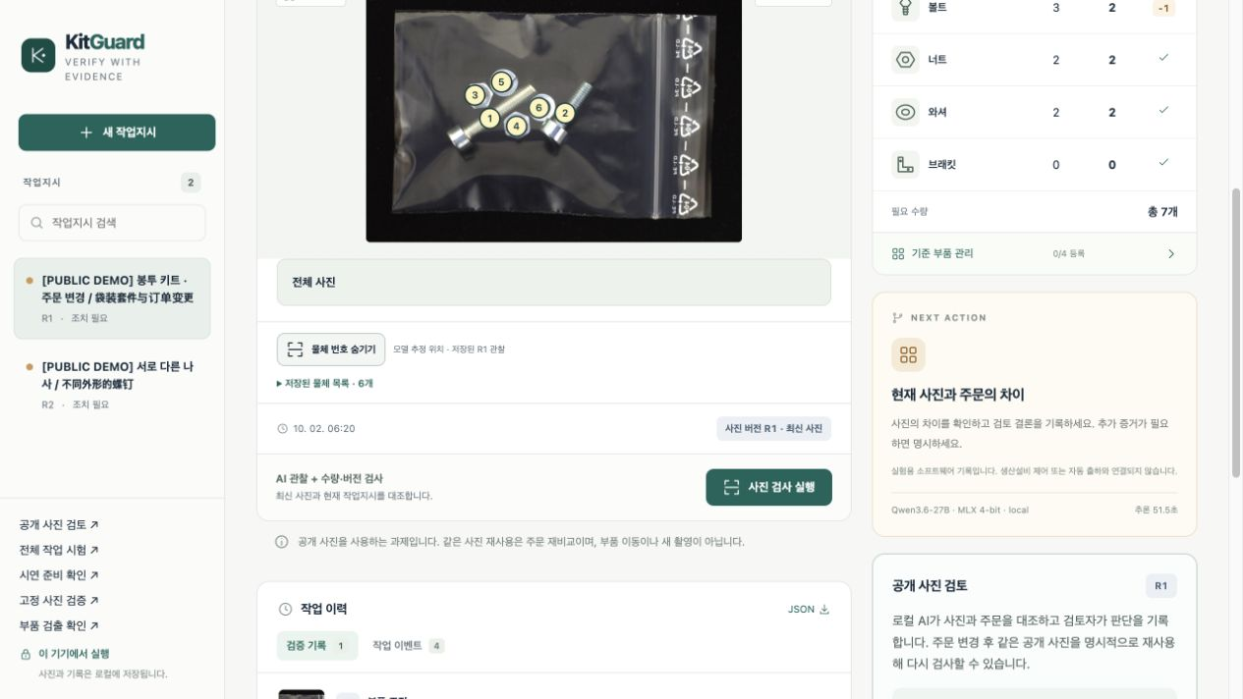
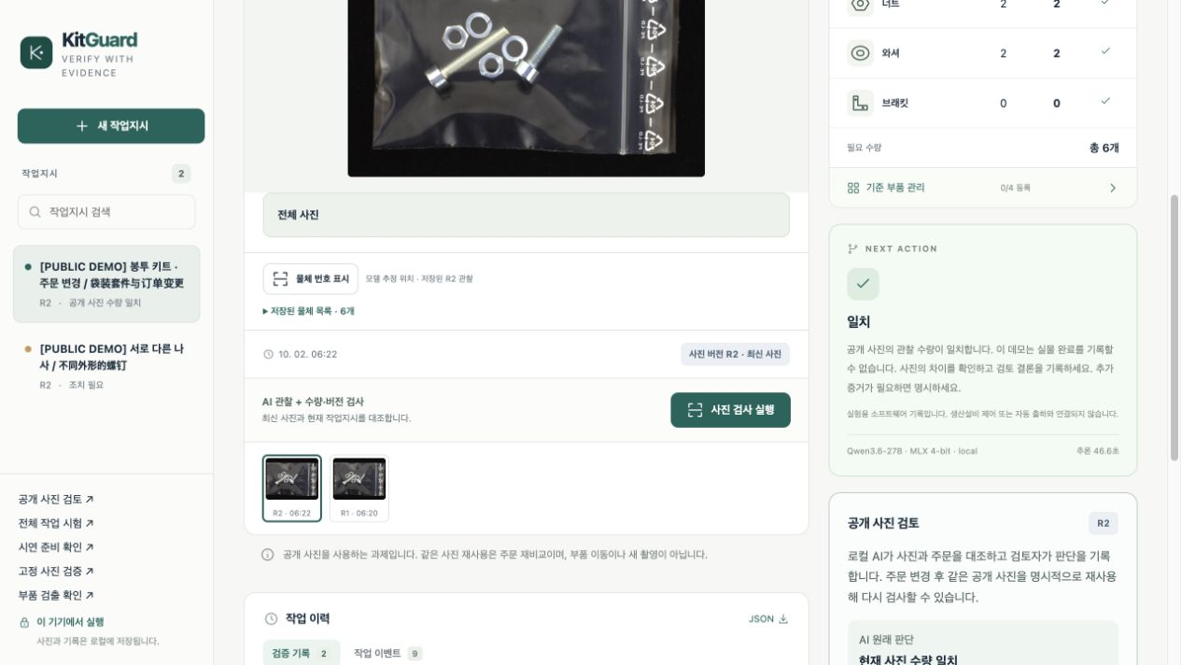
같은 공개 사진을 명시적으로 재사용
실제 실행: R1 차이 확인, R2 다시 검사
R1 볼트 필요 3개 / 관찰 2개
R2 볼트 필요 2개 / 관찰 2개
사용자 지시·승인으로만 주문 변경
R1의 차이는 그 버전 이력에 유지
R2에서 새 추론을 실행합니다.
새 촬영이나 실물 이동은 없습니다.
자동화 개발 검수 화면입니다. 실제 사용자 연구나 현장 완료 실적이 아닙니다.
해피 팀 KitGuard v0.7.0 2026.10.02
03
Notes:
Screenshots captured in the actual local Korean browser workflow on 2026-10-02 KST, order ord_01a0e1e0cd8f49b3bb67, bag-revision public development photo. R1 target bolt/nut/washer/bracket=3/2/2/0 and observed=2/2/2/0. The 3-to-2 change is a predetermined demo order scenario requested by the operator and committed only after explicit approval. The AI does not alter the target BOM to make a result ready. The shortage under fixed R1 remains in its history, and a match under R2 does not demonstrate physical replenishment. Korean instruction proposes bolt count 2, explicitly approved; R2 target=2/2/2/0, old R1 check invalidated; identical source photo explicitly replayed and independently re-inferred. R2 matches 2/2/2/0. Both actual checks match the exported JSON. R1 latency51,488ms and R2 latency46,614ms refer to machine observation only, not full human task duration. The three tool observations use the same model and are correlated. Public sources cannot produce physical completion. This is engineering integration evidence, not an accuracy sample or human review study. MVTec LOCO AD and MVTec Screws public research data, CC BY-NC-SA 4.0. https://www.mvtec.com/research-teaching/datasets/mvtec-loco-ad ; https://www.mvtec.com/research-teaching/datasets/mvtec-screws ; https://creativecommons.org/licenses/by-nc-sa/4.0/ . Images are public development examples, not field or user-validation photographs. Native editable diagrams describe implemented program flow.
Sources:
test-results/browser/public-review-v07/demonstration/timeline.json SHA256 3f158271798f4fd7e0847d920448a22ba0ba3eebe4da3a12fcf053d9dd485a97
test-results/browser/public-review-v07/demonstration/order.json SHA256 7cee00d6c4eb7a6f6cfe4db83f672e88c69acf4b4ca0edacbbd71b38155606fb
test-results/browser/public-review-v07/demonstration/04-r1-actual-difference.png
test-results/browser/public-review-v07/demonstration/08-r2-invalidates-r1.png
test-results/browser/public-review-v07/demonstration/10-r2-real-result.png

Slide 4
목표: 현재 버전에 맞는 수량 판단
Agent 도구와 판단 규칙
역할 | 실제로 실행하는 일
사진 관찰 | 원본과 90° 회전 사진에서 물체 목록 생성
조건부 확인 | 두 관찰이 일치하면 너트·와셔를 국소 확인
수량·다음 단계 | 프로그램이 계수·BOM 대조, 불확실하면 보류
상태·피드백 | 버전 변경 시 무효화, 추가 근거 또는 수동 검토
Qwen3.6-27B / MLX 4-bit 연구·디지털 검토 보조용 기본 절차
기대 BOM 수량은 시각 모델에 주지 않습니다. 같은 모델의 반복 관찰은 서로 독립적이지 않습니다.
해피 팀 KitGuard v0.7.0 2026.10.02
04
Notes:
Current default spatial_guarded is a fixed-rule Agent. Original and rotated spatial inventories must clearly agree; conditional nut/washer identity checks follow when applicable. Program counts object lists and applies BOM difference and evidence validity. Unknown remains null rather than 0 or expected count. The base model is reused, not trained by this team. Self-developed components include inventory validation/counting, consensus and conditional identity, version/evidence state machine, digital review, UI and exports. The two orientations and local checks share one model and may repeat common errors. Source-specific physical category and SKU limitations remain.
Sources:
docs/v0.7/AGENT_TECH_KO_FINAL.md SHA256 286aa4ee13090c7c8110135fd9b65859066f41af11cd3f90e715b45f25b84c1d
docs/v0.7/RESULT_REPORT_KO_FINAL.md SHA256 2a43f39987d43d62e908fb5fca78b991bb1a49e82173afcb2fb23b1e26da1cff
kitguard/vision.py
kitguard/spatial.py
kitguard/identity.py
kitguard/app.py
kitguard/feedback.py

Slide 5
사진·코드·순서를 추론 전에 동결
새 원본 51개, 3방법의 별도 실행 비교
35
16
Screws 원본별 1개 영역 / 12가지 수량
LOCO 정상 원본
단일 관찰 | 현재 강화 절차 | 단방향 확인 후보
spatial_inventory | spatial_guarded | selective identity
각 51장 별도 실행 | 각 51장 별도 실행 | 각 51장 별도 실행
총 153회 관찰 같은 모델·입력·기록 경계 순서 균형
저자 표기 기반 정답. 기존 사용 자료는 출처별 제외.
LOCO 16장은 모두 2/2/2/0으로 상수 출력도 일치 가능.
브래킷 양성·새 공장 검증 없음. 사전학습 중복은 미확인.
해피 팀 KitGuard v0.7.0 2026.10.02
05
Notes:
Frozen protocol SHA256 cec1cf5362a5154cfd6e4d27e5ed9dbb49d7757a12189474c13e643f1dc67be7. 51 distinct source originals, 35 Screws views selected by deterministic crop rule without viewing predictions, 16 LOCO normal originals. All training/evaluation/development/demo source families found in local exposure audit were excluded, but pretrained overlap cannot be certified. Each arm uses app upload, identical normalized bytes, Qwen3.6-27B 4bit, max side 1536, same raw-text/image recording; each arm occurs 17 times in each of three order positions. Full denominator retains failures/unattempted cases. Any-false-ready is per-photo behavior over 255 legal BOM panels, not 255 additional photos or real orders. Source domain remains familiar. LOCO16 all have count vector2/2/2/0, so the constant-output comparator also matches all16; this stratum cannot establish superiority in anomaly discrimination. Screws35 includes12 distinct count vectors. No bracket-positive or fresh LOCO anomaly samples remain. MVTec LOCO AD and MVTec Screws public research data, CC BY-NC-SA 4.0. https://www.mvtec.com/research-teaching/datasets/mvtec-loco-ad ; https://www.mvtec.com/research-teaching/datasets/mvtec-screws ; https://creativecommons.org/licenses/by-nc-sa/4.0/ . Images are public development examples, not field or user-validation photographs. Native editable diagrams describe implemented program flow.
Sources:
docs/v0.7/public_paired_freeze_v1/freeze.json SHA256 cec1cf5362a5154cfd6e4d27e5ed9dbb49d7757a12189474c13e643f1dc67be7
datasets/derived/v0.7/public_paired_v1/manifest.json SHA256 efe4633e873d45032101a26e035c23d267bafa6605d147d3d2f7fcb51b697643
docs/v0.7/PUBLIC_EVALUATION_PLAN.md SHA256 f277123d6c74e0d51c8627d4de20edf162eebad13451050ca1f8afc4b8789b35
test-results/v0.7/development28-audit-v1.json SHA256 d9e4753a7f362f47ea171cd946a3674611c9887c8c67fec5644b6532e0fe8cb4

Slide 6
153/153 관찰 완료 · 원시 근거 독립 감사 통과
새 51장: 두 강화 방법 모두 기준 미통과
방법 | C / W / U / E / N | 오확정 위험¹ | 중앙값 | P90
단일 관찰 | 46 / 5 / 0 / 0 / 0 | 5/51 | 8.962초 | 14.550초
현재 강화 절차 | 41 / 3 / 7 / 0 / 0 | 3/51 | 21.814초 | 46.231초
단방향 확인 후보 | 46 / 4 / 1 / 0 / 0 | 4/51 | 15.625초 | 31.896초
C 정답·확정 가능 W 확정 가능하지만 오답 U 보류 E 실패 N 미실행
강화: 오류 2건을 보류했지만, 맞은 5건도 보류
후보: 중앙값 28.4% 단축, 오답 4건 남음 → 승격 없음
¹ 255개 합법 BOM 중 한 번이라도 잘못 준비됨을 표시할 사진 수 / 51
과거 64장: 강화 C59/W0/U5 · 개발 28장: 후보 C25/W0/U3 — 이번 51장과 합산 안 함
해피 팀 KitGuard v0.7.0 2026.10.02
06
Notes:
Completed frozen new51 trial; full planned denominator51 per method,153 observations total. Inventory C46/W5/U0/E0/N0, guarded C41/W3/U7/E0/N0, candidate C46/W4/U1/E0/N0. Any-false-ready over all four broad categories is5/51,3/51,4/51. The source-supported panel is0/51 for every arm because the misclassified washers are outside the Screws positive-class domain; this narrower panel does not eliminate the observed nut-to-washer errors. Each photo is evaluated against255 legal BOMs, excluding its matched truth for the mismatched-order denominator; not extra photos or real customer orders. P50=8.962/21.814/15.625s; P90=14.550/46.231/31.896s; full attempt sums499.130/1352.628/927.090s. Timing includes upload and recorded observation, first cold load retained, same image/max-side/model and logging boundary. Candidate median is28.4% lower than guarded, but W4 and any-false-ready4 violate its preregistered safety gates. Guarded blocks2 wrong, abstains5 correct, retains3 wrong. Both enhancement methods fail preregistered acceptance; descriptive safety superiority is NOT established. No automatic promotion. Audit independently reconstructed153 normalized inputs,272 raw calls,444 actual model images and172 identity crops from62 snapshot source/resources; no model loaded. The nested candidate first-pass wall timer is preserved and bounded, not expected to equal CPU replay duration. Historical64 is a separate prior experiment: same-run correlated first pass62/2/0/0 versus guarded59/0/5/0; its first pass is not an independent complete pipeline. Development28 is exposed: old guarded24/0/4/0 versus candidate25/0/3/0; timing boundaries differ, so no historical speed claim. Neither historical dataset contributes to new51 results.
Sources:
test-results/v0.7/public-paired-audit-v1.json SHA256 94c71e45341a5065ee90fe601e606cd3a54242094d5dcc08770f6aae8c588fe9
evaluation-runs/v0.7/public_paired_v1/analysis.json SHA256 13f1775f4f6c57a6f21e01dbb6584654d4beb36a1749ae5430179d7a95f037c4
evaluation-runs/v0.7/public_paired_v1/predictions.jsonl SHA256 9b525702cb2665274c37a7d7740c1d93c05562ab5fb5a17e171e31b75a6859ee
scripts/v07/audit_public_paired.py SHA256 4ed25dcb8b832adf027c72abddea76b0363d3b06125ad6e864621d6340d7a5f6
docs/v0.7/PUBLIC_PAIRED_AUDIT.md SHA256 ef54924ff8085b67f6915e3dbb150013d162116ea1d11c4397293e3a12b2d2f9
evaluation-runs/v03_guarded_holdout_v1/gate_report_v1.json SHA256 8f8fa784b9abca802ffab08e1fc8b23efd75407a2ede9cc235c3496b442f599f
test-results/v0.7/development28-audit-v1.json SHA256 d9e4753a7f362f47ea171cd946a3674611c9887c8c67fec5644b6532e0fe8cb4
docs/v0.7/public_paired_freeze_v1/freeze.json SHA256 cec1cf5362a5154cfd6e4d27e5ed9dbb49d7757a12189474c13e643f1dc67be7

Slide 7
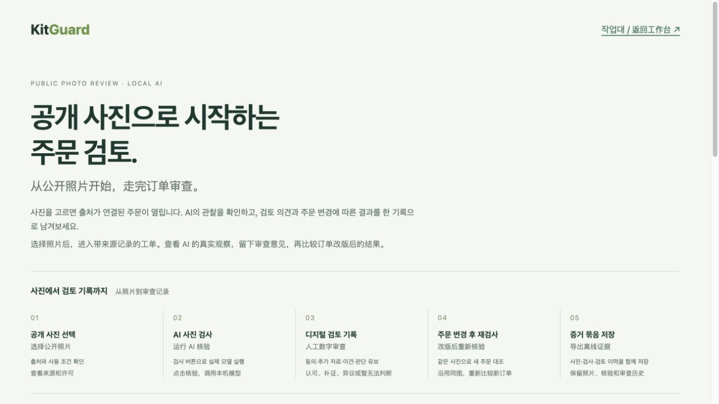
활용 대상과 사업화는 검증할 가설
로컬 자료 검토 도구로 시작합니다
사진과 BOM을 가진 소규모 팀
반복 수량 확인과 주문 변경 검토
버전별 근거를 관리자에게 전달
수익 모델 가설
팀 단위 이용·유지보수
초기 설치와 BOM 연동 지원
검증 환경: Apple M5 Pro / 64GB
로컬 단일 사용자, 조직 권한 관리 미제공
유료 고객·매출·가격 수용도·인건비 절감률은 아직 검증하지 않았습니다.
해피 팀 KitGuard v0.7.0 2026.10.02
07
Notes:
The screenshot is the actual local library start page, not a mockup. Verified host Apple M5 Pro64GB, Python3.12, localhost127.0.0.1. Regular inference uses local MLX without external model upload. Product adoption and team subscriptions/maintenance or installation/BOM integration support are hypotheses, with no paid customers, pricing study or ROI claim. Existing model weights and configured environment are required; another machine or CUDA throughput not tested. Customers must hold rights to their own photos. Public research image license does not grant commercial customer-data usage rights. MVTec LOCO AD and MVTec Screws public research data, CC BY-NC-SA 4.0. https://www.mvtec.com/research-teaching/datasets/mvtec-loco-ad ; https://www.mvtec.com/research-teaching/datasets/mvtec-screws ; https://creativecommons.org/licenses/by-nc-sa/4.0/ . Images are public development examples, not field or user-validation photographs. Native editable diagrams describe implemented program flow.
Sources:
docs/v0.7/RESULT_REPORT_KO_FINAL.md SHA256 2a43f39987d43d62e908fb5fca78b991bb1a49e82173afcb2fb23b1e26da1cff
test-results/browser/public-review-v07/demonstration/timeline.json SHA256 3f158271798f4fd7e0847d920448a22ba0ba3eebe4da3a12fcf053d9dd485a97
test-results/browser/public-review-v07/demonstration/01-public-library.png
docs/v0.7/SOURCE_PACKAGING.md

Slide 8
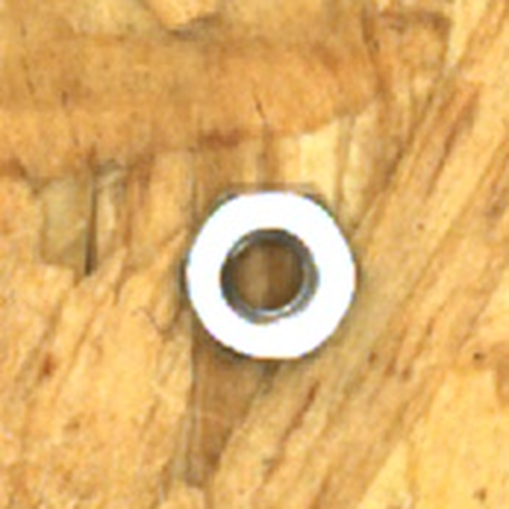
실제 오류와 다음 검증
같은 모델의 반복 확인도 함께 틀립니다
저자 정답: 너트
다음 실제 업무 검증
원본 관찰 → 와셔
90° 관찰 → 와셔
국소 확인 → 와셔
권한 있는 자료로 담당자가 검토
전체 검토 시간·잘못된 확정 측정
별도 현장 자료에서 오류 확인
강화 절차 오류 3건 모두 같은 유형
저자 정답 유지 · 사후 정답 수정 없음
4종 거친 분류 · 종류별 0–3개
SKU·규격·재질, 현장 효용은 미검증
기본 절차는 연구·디지털 보조 범위에 유지
연구용 공개 사진: 비상업 조건 적용. 해시는 새 촬영·실물 완료를 인증하지 않습니다.
해피 팀 KitGuard v0.7.0 2026.10.02
08
Notes:
Displayed image is the actual retained model identity input, attempt92 spatial_guarded, casev07-screws-screws_120-3e86c9ca51d9, not an illustration or a new evaluation. Author truth bolt1/nut1/washer0/bracket0 remains unchanged. Both orientations and identity classify its nut as washer; source-backed exact raw outputs are retained. The3 guarded wrong cases are Screws120,024,172 and share nut-to-washer confusion. This qualitative selection is post-hoc error explanation, not evidence for an improved method and not used to change truth or tune a new candidate on these51. The crop is interpolation of existing pixels, not new evidence. Current default remains research/digital-review assistance and is not a field-safety release. Four broad classes,0–3 each,total1–12; benchmark has no bracket-positive evidence. Unknown SKU/spec/material and real customer field usefulness remain. Real people must supply user review time and feedback; ENGINEERING-CODEX records are integration tests. Future tasks require authorized own materials and independently collected field evidence. Public data license is not a commercial-data authorization. MVTec LOCO AD and MVTec Screws public research data, CC BY-NC-SA 4.0. https://www.mvtec.com/research-teaching/datasets/mvtec-loco-ad ; https://www.mvtec.com/research-teaching/datasets/mvtec-screws ; https://creativecommons.org/licenses/by-nc-sa/4.0/ . Images are public development examples, not field or user-validation photographs. Native editable diagrams describe implemented program flow.
Sources:
test-results/v0.7/public-paired-audit-v1.json SHA256 94c71e45341a5065ee90fe601e606cd3a54242094d5dcc08770f6aae8c588fe9
evaluation-runs/v0.7/public_paired_v1/predictions.jsonl SHA256 9b525702cb2665274c37a7d7740c1d93c05562ab5fb5a17e171e31b75a6859ee
datasets/derived/v0.7/public_paired_v1/manifest.json SHA256 efe4633e873d45032101a26e035c23d267bafa6605d147d3d2f7fcb51b697643
docs/v0.7/RESULT_REPORT_KO_FINAL.md SHA256 2a43f39987d43d62e908fb5fca78b991bb1a49e82173afcb2fb23b1e26da1cff
docs/v0.7/PUBLIC_REVIEW_API.md SHA256 b6bb2359f6d0f411ffe47d19dea1cb62453a40401ae5f263d355beb587444879
evaluation-runs/v0.7/public_paired_v1/cases/092-spatial_guarded/call-03/image-02.png

