Slide 1
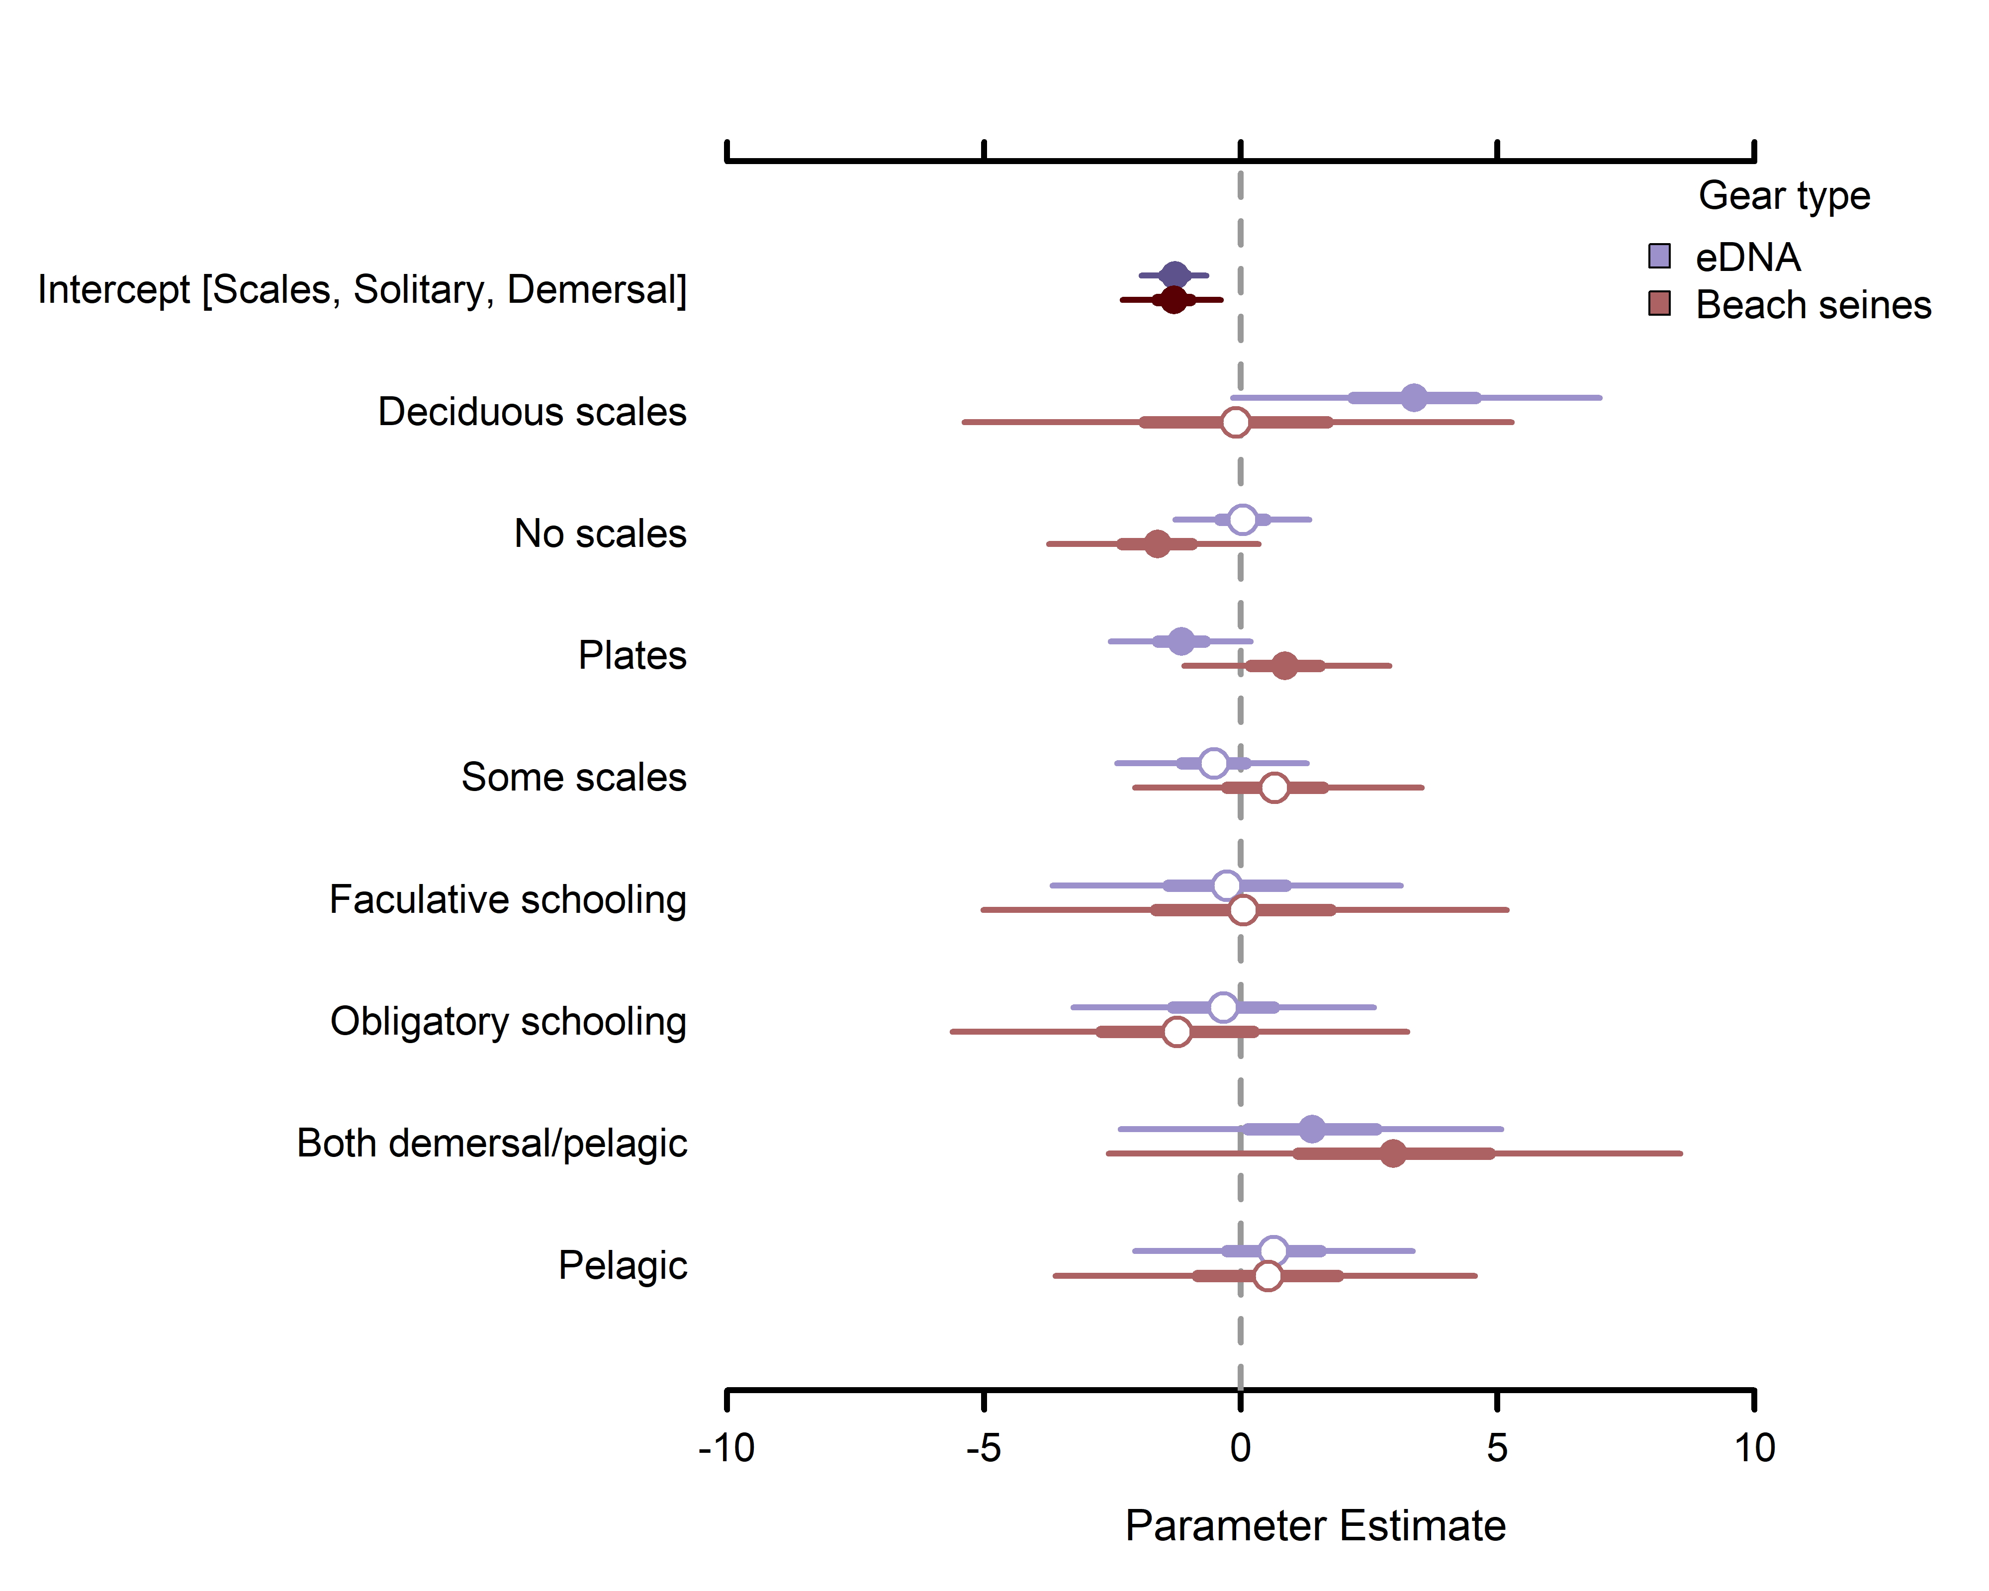
Scale type
Schooling behavior
Position-in-water-column

