Slide 1
Verifying The DDOS Resiliency Of CCNs
Jack Wilburn, Leo Kell, and Dalton Clift

Slide 2
What is a CCN?

Slide 3
What is a CCN?
CCN: Content Centric Network
Completely Different Approach Than IP Based Internet
Content Caching
Data is requested via content
Content has unique identifiers
Name resolving no longer needed
All traffic is directed by the content requested
No need to reach across entire network

Slide 4
What is a CCN?
Two Types of Packets
Interest (Request)
Data (Response)
Routing Process
FIB
Forwarding Information Base
PIT
Pending Interest Table

Slide 5
Threat Model
DDoS Resiliency
Network Traffic is Greatly Reduced by Design
Route Changes
Much shorter routes taken overall
Cached content prevents DDoS close to source
How does a CCN respond to DDoS compared to IP Based Networking?

Slide 6
What did we make?

Slide 7
What did we make?
Discrete event simulation in Python using SimPy library
Our simulation contains a Node class to represent CCN clients, routers, and servers
The Node class has the following attributes:
Dictionary of immediate neighbors
FIFO queue of incoming packets
Pending interests table (PIT) used to consolidate requests
Content Cache that uses LRU eviction policy
FIB to forward requests to the most appropriate neighbor
To initialize FIB/routing tables:
We use modified Bellman-Ford/Routing Information Protocol
Each node broadcasts its known content paths and associated hop distance to neighbor

Slide 8
What did we make?
How the simulation works:
Each network node runs a separate process (using SimPy)
Routers and servers process one request or response packet per time step
All clients send out a new request packet on a fixed time step interval (simulates DDoS)
Simulation complets after a set number of timesteps
Data is recorded throughout the simulation:
Routers and Servers record their incoming packet queue length at each time step
Clients record all outbound and inbound packet

Slide 9
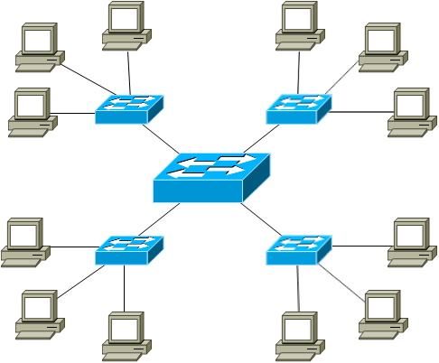
What did we make?
Router
Router
Final simulation uses a star network topology
Server is at the tree root
Clients make up the outer leaves
Each cluster of clients is connected to a shared router
Server contains 100 content path/data pairs
Router cache sizes vary between 0 and 100
Optional “IP mode” sets cache size to 0 and disables PIT
Clients send out a random data request every 3 time steps
Simulation run for 20,000 time steps
Server
Router
Router
Client
https://blog.boson.com/hs-fs/hub/70217/file-27052587-png/images/9_-_extended_star_topology.png

Slide 10
Our results

Slide 11
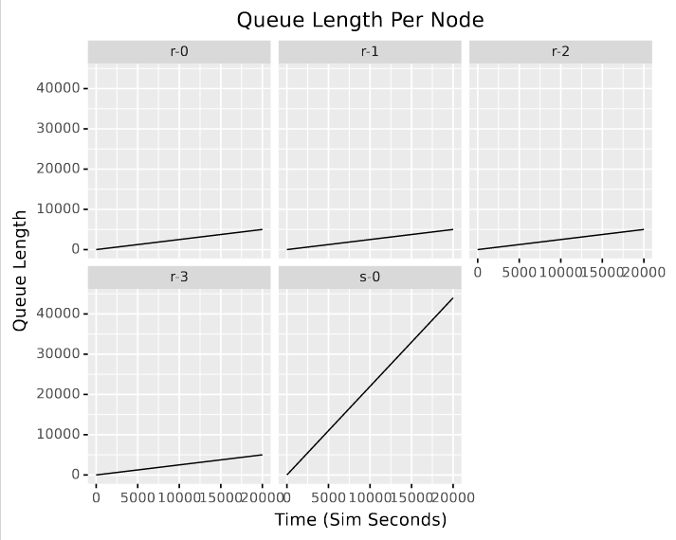
Our results - IP

Slide 12
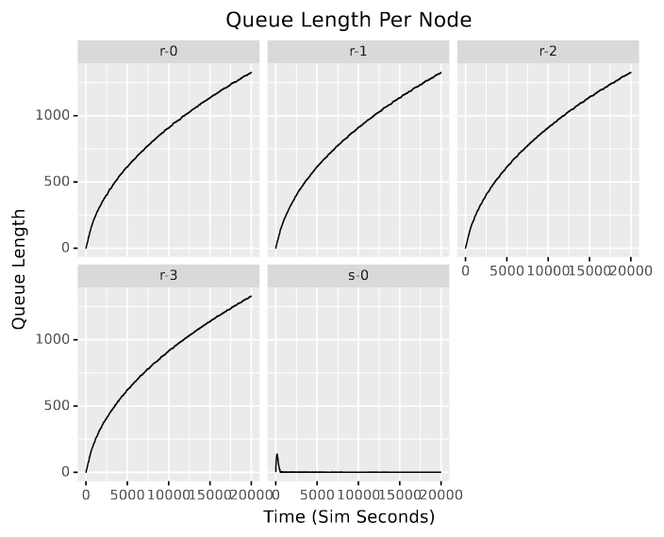
Our results - Cache 50

Slide 13
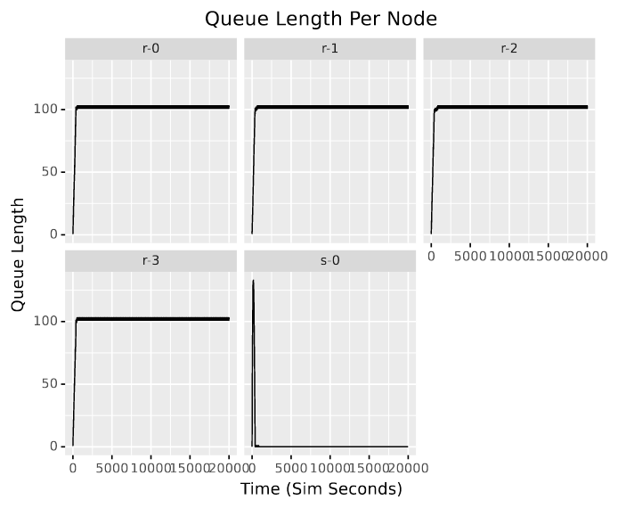
Our results - Cache 100

Slide 14
Our results
We were able to reduce the impact of DDoS attacks (less load)
With certain cache setups, the server is entirely isolated
CCN works as advertised

Slide 15
Future work
Clients can request unique data that doesn’t exist
Causes large PIT and lots of upstream packets
Paper suggests rate limiting, we could run our experiment in that mode

Slide 16
References
Van Jacobson, Diana K. Smetters, James D. Thornton, Michael Plass, Nick Briggs, and Rebecca Braynard. 2012. Networking named content. Commun. ACM 55, 1 (January 2012), 117–124. https://doi.org/10.1145/2063176.2063204
Ontje Lünsdorf and Stefan Scherfke, SimPy, (2002-2022), GitLab repository, https://gitlab.com/team-SimPy/SimPy/
Hassan Kibirige, et al. (2021). has2k1/plotnine: v0.8.0 (v0.8.0). Zenodo. https://doi.org/10.5281/zenodo.4636791
Kelson Lawrence, Kailin Acheson, and Delana Hallstedt. Back to the Basics: Networks and Topologies. https://blog.boson.com/bid/87993/Back-to-the-Basics-Networks-and-Topologies

