Slide 1

Capture The Flag
NAME: Latasha Kellon
Team Name: team 2
“Cache me if you can”

Slide 2
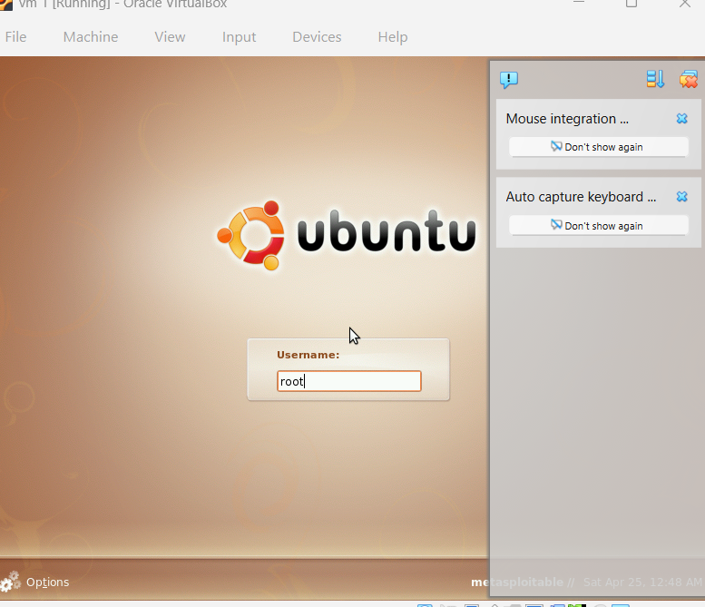
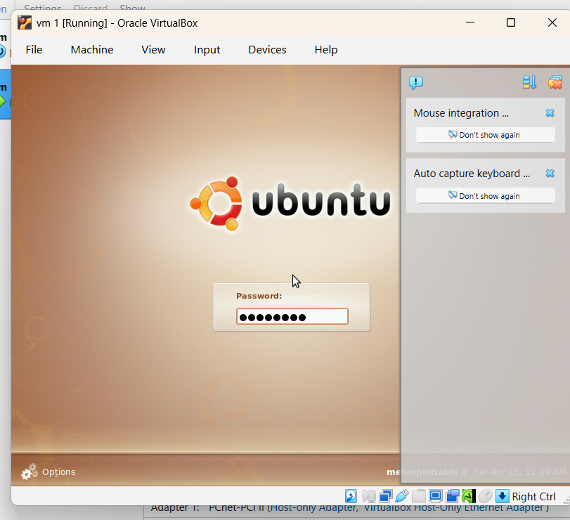

Introduction
Question 10. Download the Virtual Machines Challenges 1-10 VM file. The username is root, and the password is msfadmin. On the warning about running as root when you first log in, click Continue. On the VM provided, find the hash for cookiemonster, and then crack it to get the password. This will be the flag.
Notes:
The purpose of this project is to explain how I approached and solved a password-cracking Capture the Flag (CTF) challenge. CTF competitions are widely used in cybersecurity training to simulate real-world security scenarios where analysts must identify vulnerabilities, investigate systems, and recover sensitive information such as passwords or hidden files.

Slide 3
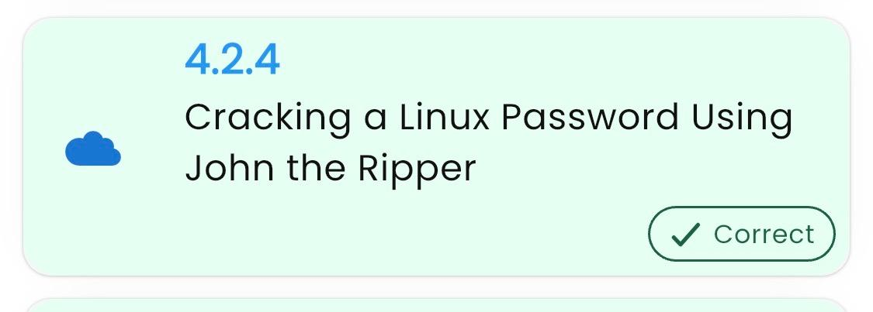
CTF Category Description
Notes:
Category of the Question Attempted
The Capture the Flag (CTF) challenge falls under the category of password cracking and hash analysis. The task required locating a stored password hash for the user cookiemonster in a virtual machine environment and then cracking the hash to recover the original password.
Important Background Knowledge Needed
To complete this challenge, it was necessary to understand how operating systems store passwords using cryptographic hashing algorithms. Hashing algorithms such as MD5, SHA-256, or SHA-512 convert plaintext passwords into fixed-length encrypted values that cannot easily be reversed (National Institute of Standards and Technology, 2020). Knowledge of Linux system files, password storage locations, and tools used to crack hashes was also essential.
Relation to the Ethical Hacking Course
This challenge directly relates to the ethical hacking course because it demonstrates how attackers may attempt to recover passwords from compromised systems. Ethical hackers use these same techniques in controlled environments to identify weaknesses in password security and improve defensive security measures.
Related Course Lab
The lab most closely related to this CTF problem is Lab 4.2.4 (Cracking a Linux Password using John the Ripper), it covered password cracking and hash identification techniques. In that lab, students practiced identifying hashing algorithms and using tools to test password strength. The skills learned in that exercise helped apply practical methods to locate and crack the hash within the virtual machine environment.

Slide 4
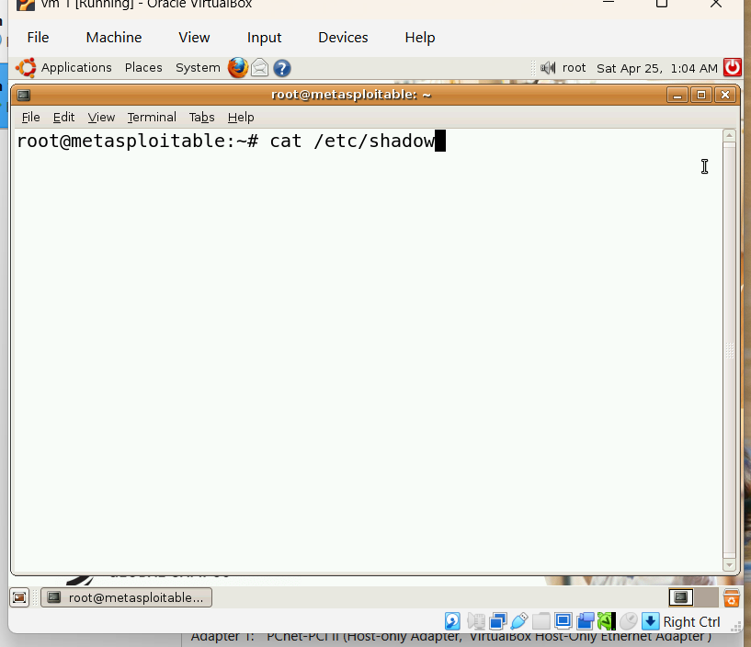
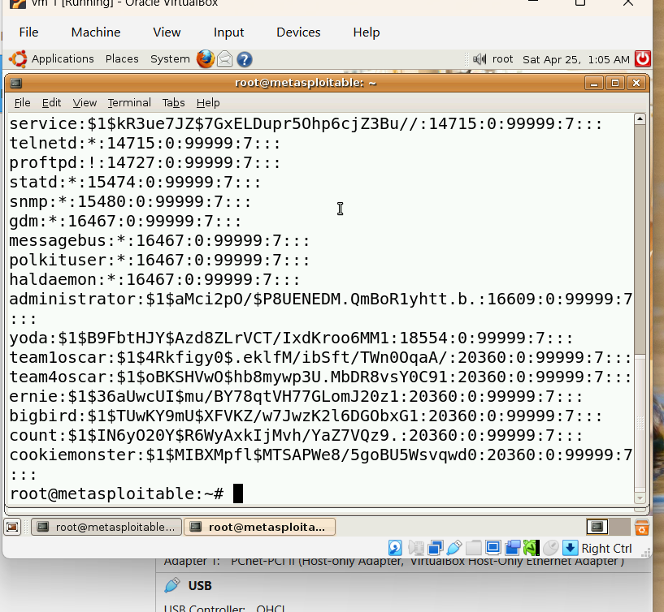
Introduction to the Problem
Notes:
The first step was to start the vulnerable machine in Oracle VM VirtualBox and login using the provided credentials. After accessing the system, I began searching for where the system stored user password hashes.
On Linux systems, password hashes are stored in the /etc/shadow file. To identify the specific entry for the cookiemonster account, I used the command grep cookiemonster /etc/shadow. This command filtered the file contents and displayed the line associated with the user. The output contained a long string beginning with $1$, which represents the encrypted password hash.

Slide 5
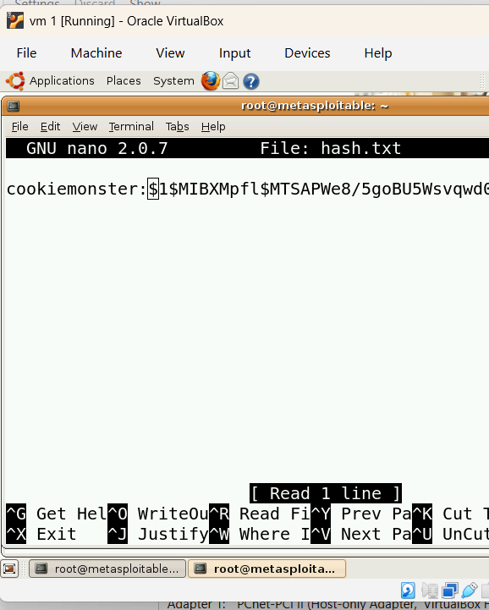
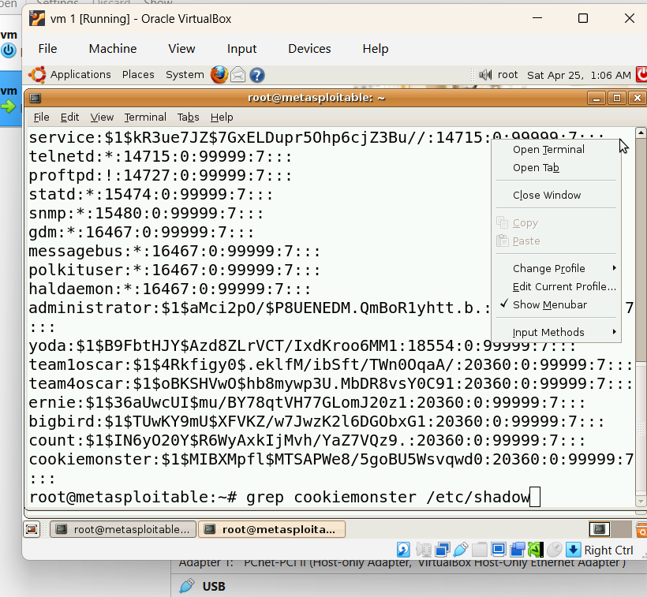
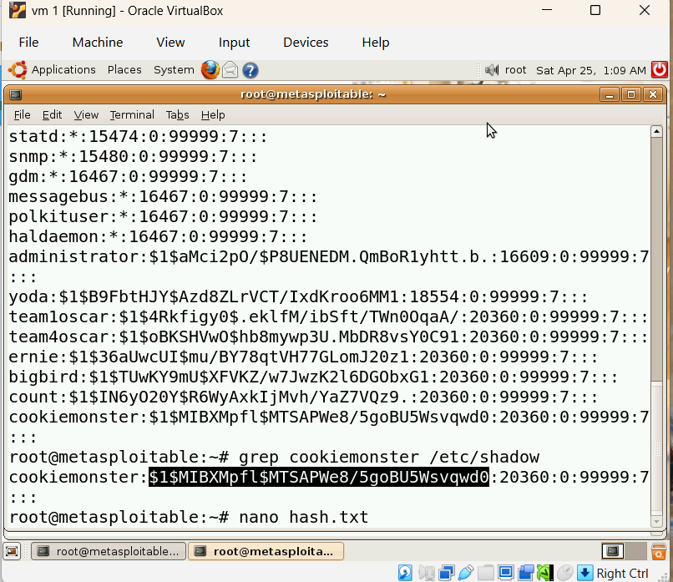
Working Toward a Solution
Notes:
Once I located the hash, I copied it into a separate file called hash.txt. This step was necessary so the password-cracking tool could analyze the hash independently.

Slide 6
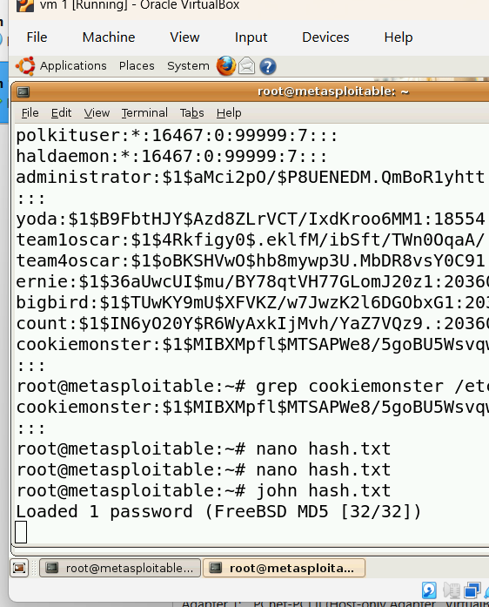
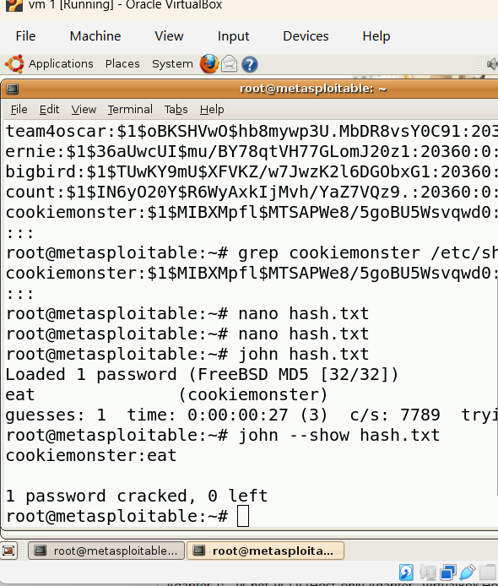
Arriving at the Solution
This provided me with the flag and allowed me to solve the network capture problem for Team #2.
The screenshot on Slide 2 includes the date/time from the host system.
Notes:
Next, I used John the Ripper to attempt to crack the password by running the command john hash.txt. The tool compared the hash against common password patterns and dictionary lists to determine the original password. After processing, the program successfully identified the plain text password.
To confirm the result, I ran the command john –show hash.txt, which displayed the username and the recovered password. The result showed that the password associated with the cookiemonster account was eat, which served as the flag for completing the challenge.

Slide 7
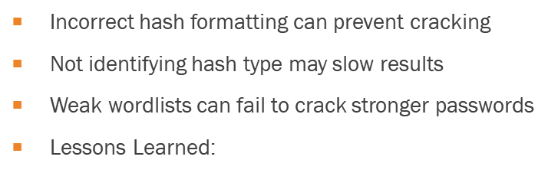
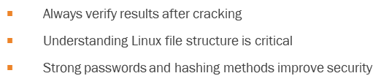
Strategies, Pitfalls, Lessons Learned
Identified password hash in /etc/shadow efficiently using grep
Used a structured approach: locate → extract → crack → verify
Recognized hash format (MD5-style $1$) before cracking
Notes:
One of the key lessons from this challenge was the importance of understanding how Linux systems manage user authentication and password storage. The /etc/shadow file contains encrypted password hashes that are protected from normal users but accessible to administrators.
A common challenge when solving password-cracking exercises is identifying the correct hash format. Different operating systems may use hashing algorithms such as MD5, SHA-256, or SHA-512 (William Stallings, 2017). Recognizing the hash type helps determine the most effective cracking method.
Another potential pitfall is relying only on default cracking settings. If the password is complex, a larger wordlist or additional cracking modes may be required. Security professionals must be prepared to adjust their approach depending on the complexity of the hash.
A recommended strategy for similar challenges is to follow a structured process: identify the location of sensitive data, extract the relevant information, determine the encryption or hash type, and then apply appropriate analysis tools (NIST, 2020). This approach improves efficiency and reduces errors when performing security investigations.

Slide 8
The Relationship to the Workplace
Simulates real-world cybersecurity investigations
Demonstrates how attackers exploit weak passwords
Shows importance of password auditing and security testing
Workplace Applications:
Security analysts assess password strength
Penetration testers simulate attacks to find vulnerabilities
Organizations implement:
Strong password policies
Multi-factor authentication
Secure hashing algorithms
Aligns with best practices from National Institute of Standards and Technology
Notes:
Capture the Flag (CTF) challenges provide valuable hands-on experience that mirrors tasks performed by cybersecurity professionals. Security analysts often investigate compromised systems, identify vulnerabilities, and evaluate whether weak authentication methods contributed to a breach. Password security remains a critical component of organizational cybersecurity. According to guidance from the National Institute of Standards and Technology, organizations should implement strong authentication practices and secure password storage methods to reduce the risk of credential compromise (NIST, 2020).
Learning how password hashes can be extracted and cracked demonstrates why organizations must implement strong password policies, multi-factor authentication, and secure hashing algorithms. These defensive measures help prevent attackers from exploiting weak credentials.
Overall, CTF exercises strengthen practical cybersecurity skills such as system analysis, Linux command-line usage, and security tool implementation. These experiences help prepare students for professional roles such as security analyst, penetration tester, and incident responder.

Slide 9
Summary
Hack The Box https://www.hackthebox.com
TryHackMe https://tryhackme.com
OverTheWire https://overthewire.org
CTFtime https://ctftime.org
PicoCTF https://picoctf.org
Root Me https://www.root-me.org
Key Takeaways:
Password hashes can still be vulnerable if passwords are weak
Understanding system files like /etc/shadow is essential
CTF challenges build real-world cybersecurity skills
Notes:
This presentation demonstrated how a Capture the Flag (CTF) challenge can simulate real-world cybersecurity tasks such as password hash discovery and cracking. By working within a virtual machine environment, the process involved locating the cookiemonster account hash in the Linux /etc/shadow file and using password-cracking tools to recover the original password.
One important takeaway is that password hashes stored in operating systems can be vulnerable if weak passwords or outdated hashing algorithms are used. Different systems may rely on algorithms such as MD5, SHA-256, or SHA-512 to protect stored credentials, but weak passwords can still be cracked with tools like John the Ripper (National Institute of Standards and Technology, 2020).
Another key point is that CTF exercises help develop practical cybersecurity skills. These challenges reinforce concepts learned in ethical hacking courses, including Linux system exploration, password security, and vulnerability testing. Practicing these techniques prepares cybersecurity professionals to identify weaknesses, strengthen system defenses, and protect sensitive information in real-world environments.

Slide 10
References
National Institute of Standards and Technology. (2020). Digital identity guidelines. https://pages.nist.gov/800-63-3/
Openwall. (n.d.). John the Ripper password cracker. https://www.openwall.com/john/
Rapid7. (n.d.). Metasploitable vulnerable virtual machine. https://docs.rapid7.com/metasploit/metasploitable-2/
Oracle. (n.d.). Oracle VM VirtualBox. https://www.virtualbox.org/
William Stallings. (2017). Cryptography and Network Security: Principles and Practice (7th ed.). Pearson.

