Slide 1
Vehicle Manager
Group 4
Lizzie Brantley
Lucas Hawkins
Arshan Mungala
Sadik Abtahee Tahmeed
Final Project Demonstration
CSE 1325 · Object-Oriented Programming
Java
Swing
OOP Design
A desktop application for tracking, searching, renting, and returning vehicles.
Vehicle Manager Final Project
1

Slide 2
Purpose of the Application
The problem
The solution
A rental business needs a clear way to store vehicle records, see availability, and manage reservations without manually tracking everything.
A program that organizes cars and trucks in one system, using a GUI front end and a manager class that controls all vehicle data.
Store vehicle records
Track availability
Support rental workflow
License plate, manufacturer, year, color, price, seats, status, gas tank size, and reservations.
Availability updates based on vehicle status and reservation queue.
Users can add, remove, search, sort, reserve, and return vehicles from the GUI.
Vehicle Manager Final Project
2

Slide 3
Core Features and Functionality
Add vehicles
Remove vehicles
More Information
Create a Vehicle, Car, or Truck from form inputs.
Delete records by license plate and shift the array cleanly.
Easy to see all available information about a specific vehicle.
Reservations
Sort and Filter
GUI display
Add customer names, return vehicles, and remove names from the queue.
Optional filtering to remove unavailable vehicles and sort by price and seats.
Show vehicle records with buttons for actions directly on each row.
Vehicle Manager Final Project
3

Slide 4
Class Structure and Design Overview
Vehicle
Vehicle
Enums
Parent class containing fields and methods shared by all vehicles.
Manufacturer, Color, Status, and Type restrict choices to valid values and support dropdowns in the GUI.
Car
Car
Truck
Child class that adds gas mileage and car type.
GUI
stores Vehicle[]
VehicleManagerFE_GUI uses Swing to connect user actions to the backend manager.
Truck
VehicleManager
Child class that adds cargo capacity and load capacity.
Vehicle Manager Final Project
4

Slide 5
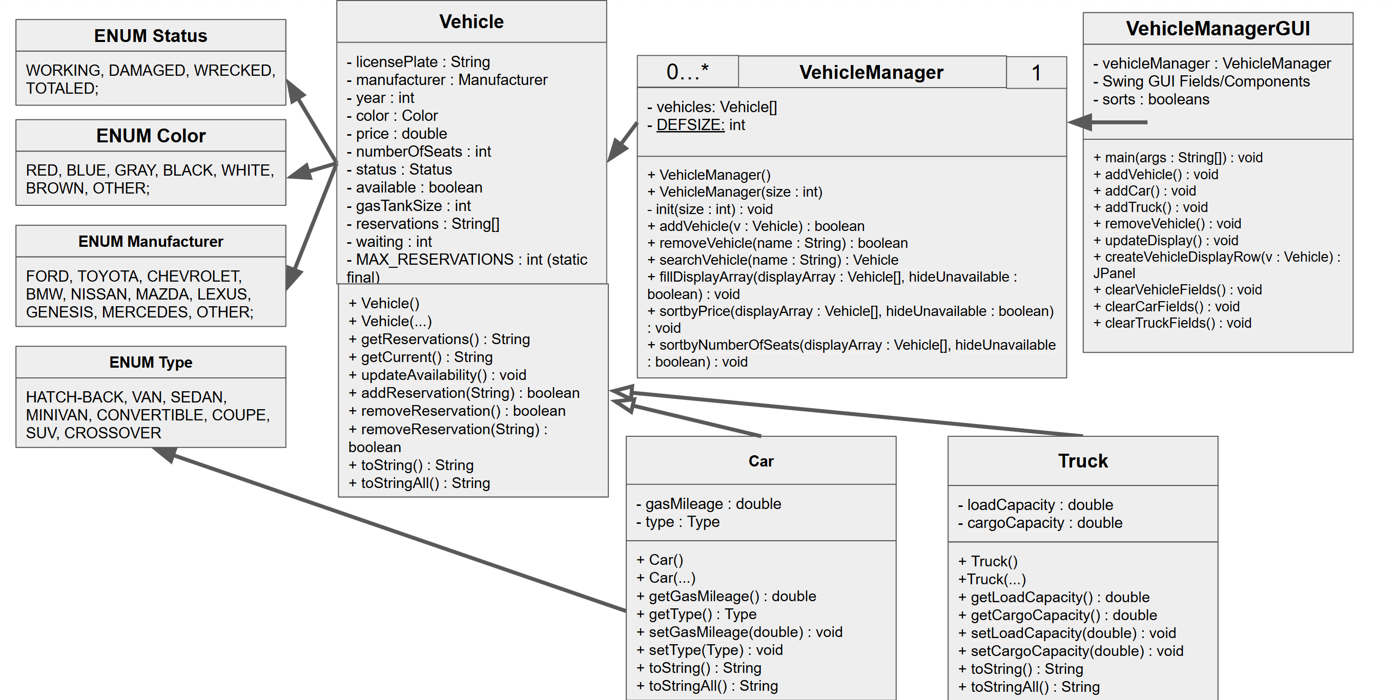
UML Diagram
The design separates the front end, backend manager, parent vehicle class, child classes, and enum types.
Vehicle Manager Final Project
5

Slide 6
Back End Design
VehicleManager
Add and remove
Sort logic
Stores all records in a Vehicle[] array and keeps constructed objects grouped together.
Add finds the first null slot. Remove shifts later elements left and sets the last slot to null.
Vehicles are sorted by availability first, then by price when availability is the same.
Input
Create
Store
Display
GUI form
Vehicle object
Vehicle[]
Rows update
Vehicle Manager Final Project
6

Slide 7
Demonstration Highlights
Add a regular Vehicle, a Car, and a Truck
Add a reservation to a displayed vehicle row
Return a vehicle and show availability changes
Sort and show how available/cheaper vehicles move up
Vehicle Manager GUI
Vehicle Information
Car / Truck Options
Filter
Vehicle Records
Action Buttons
Vehicle Manager Final Project
7

Slide 8
Save/load vehicles from CSV or JSON
Edit vehicle information from the GUI
Add date-based rental history
Improve search with combined filters
Testing Checklist and Future Enhancements
Project compiles and GUI opens
Add Vehicle, Car, and Truck successfully
Duplicate license plates are rejected
Invalid number inputs show an error message
Search/filter and sort update the display
Reservations and returns update availability
Testing checklist
Future enhancements
Vehicle Manager Final Project
8

Slide 9
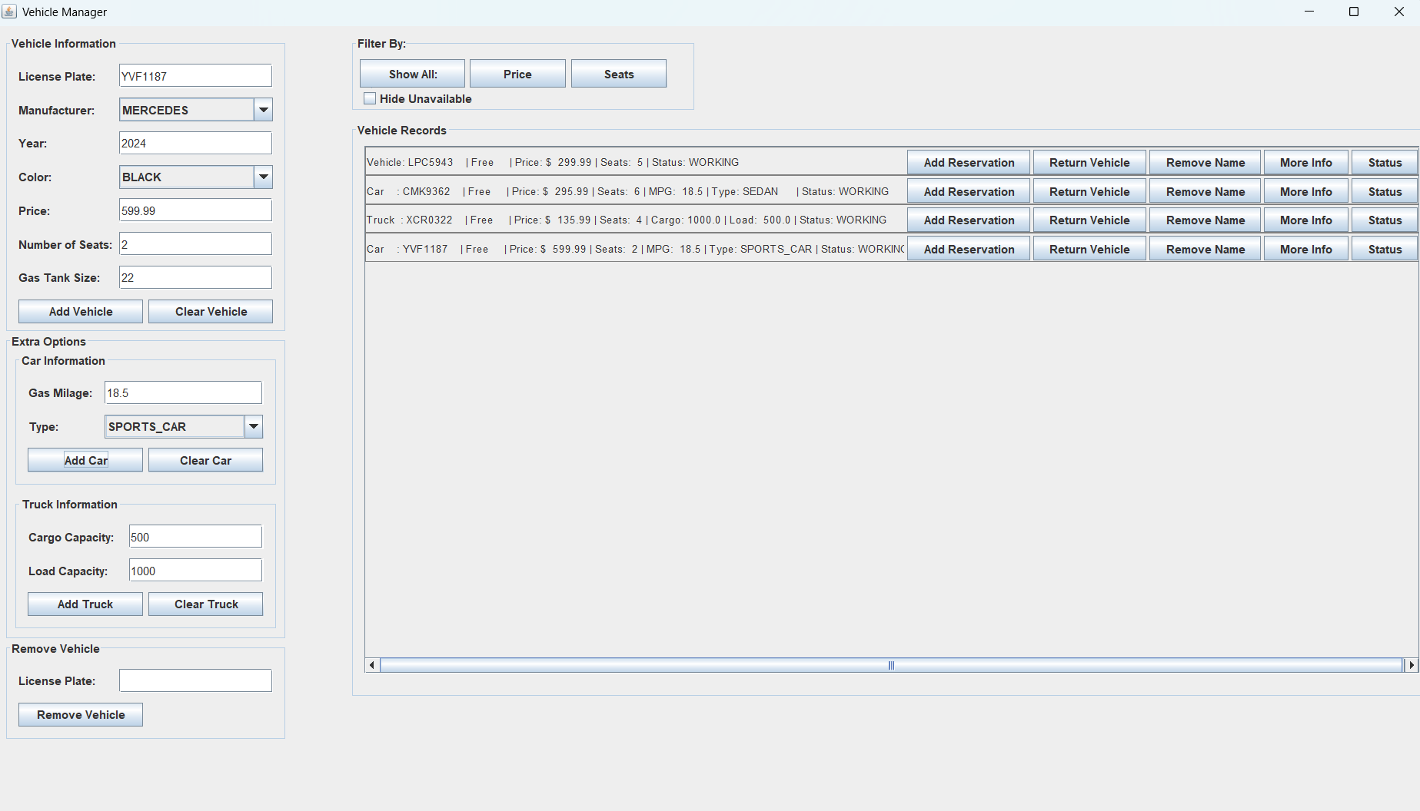
Vehicle Manager Final Project
8

Slide 10
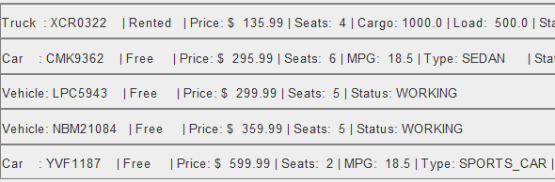
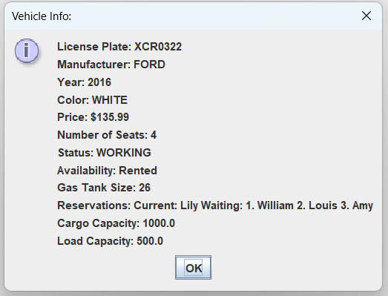
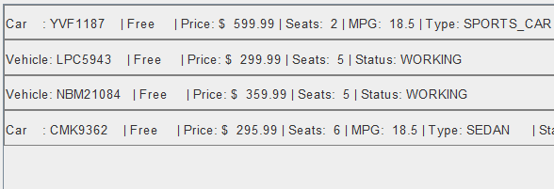
GUI Display sorted by price to rent.
The Pop-up Window with all of a Vehicle’s Information when the More Info button is triggered.
GUI Display sorted by number of seat and only available options.
Vehicle Manager Final Project
8

Slide 11
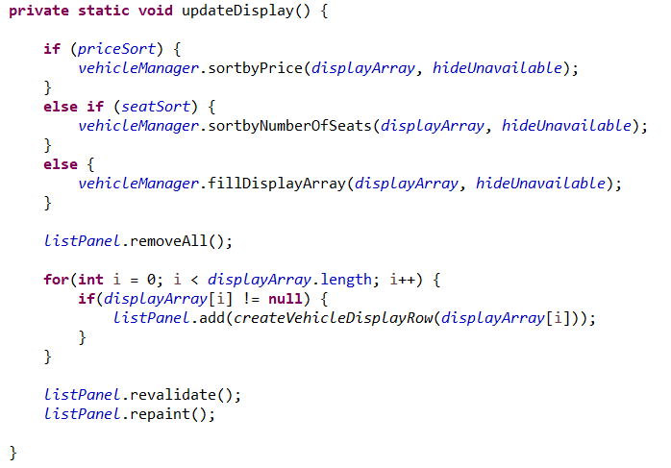
Class Structure and Design Overview
Problem
GUI would only update on interaction with JComboBoxes
This was caused by it interacting with null elements.
Solution
An if statement to avoid creating rows for null entries.
Vehicle Manager Final Project
4

