Slide 1
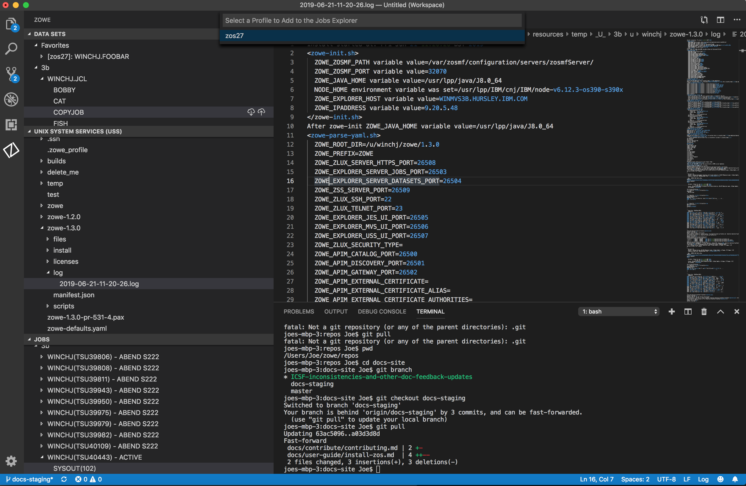
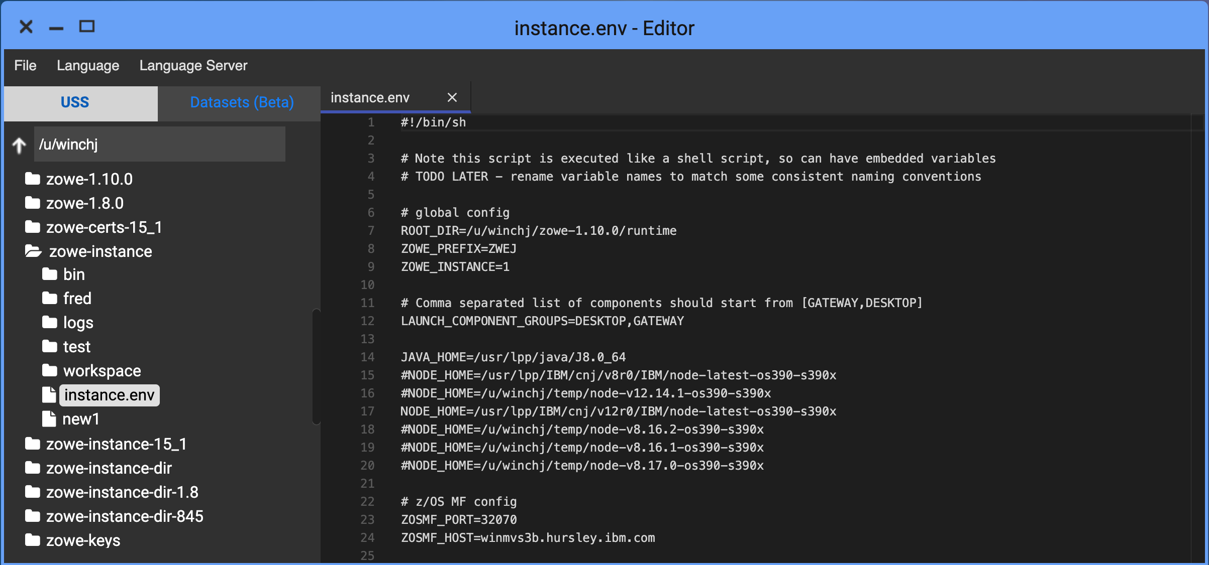
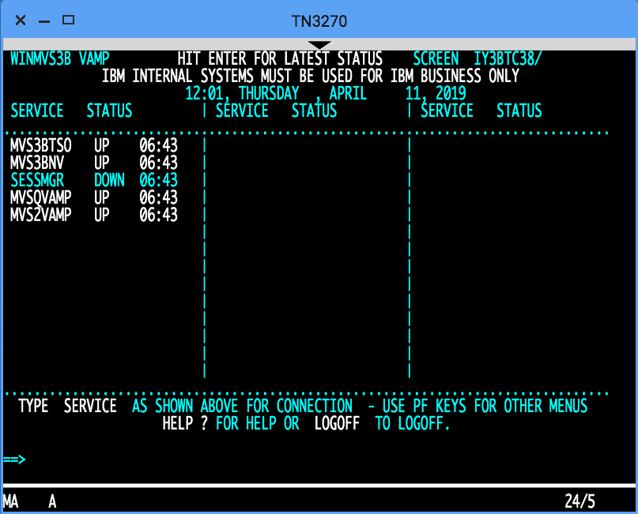
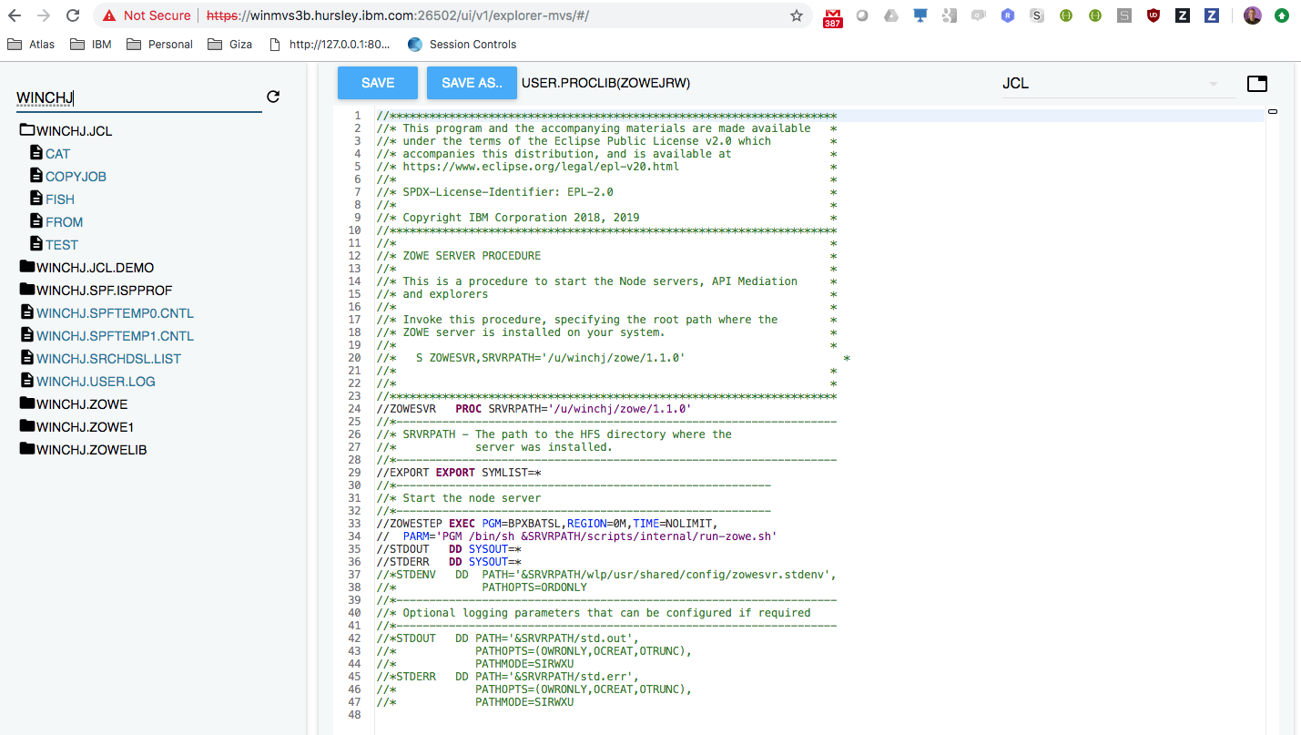
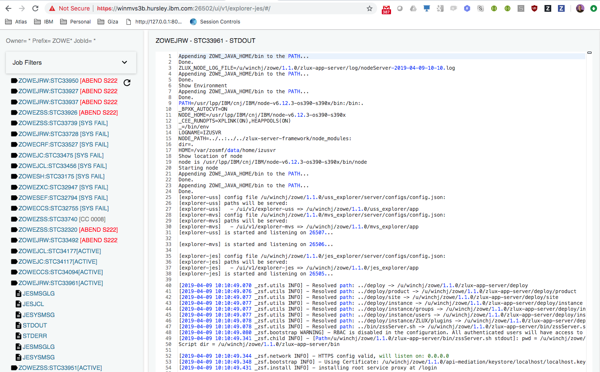
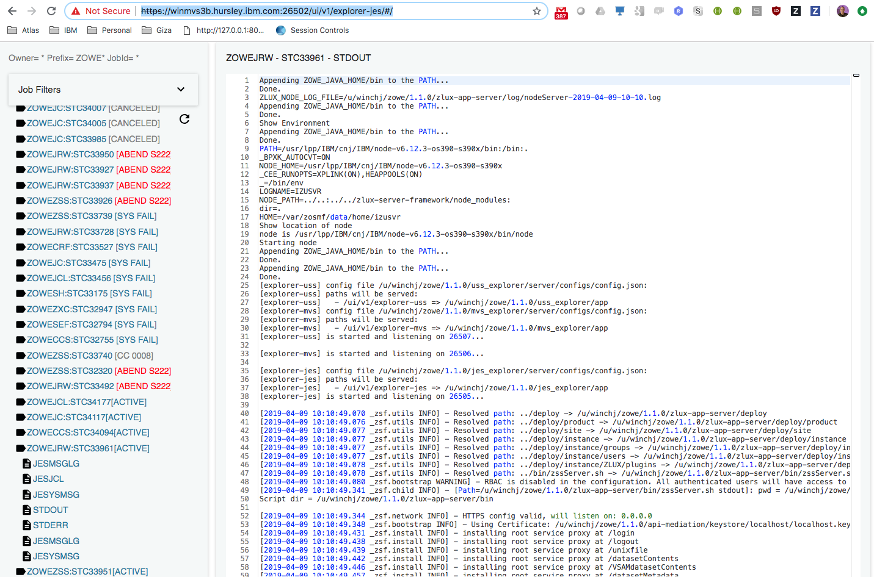
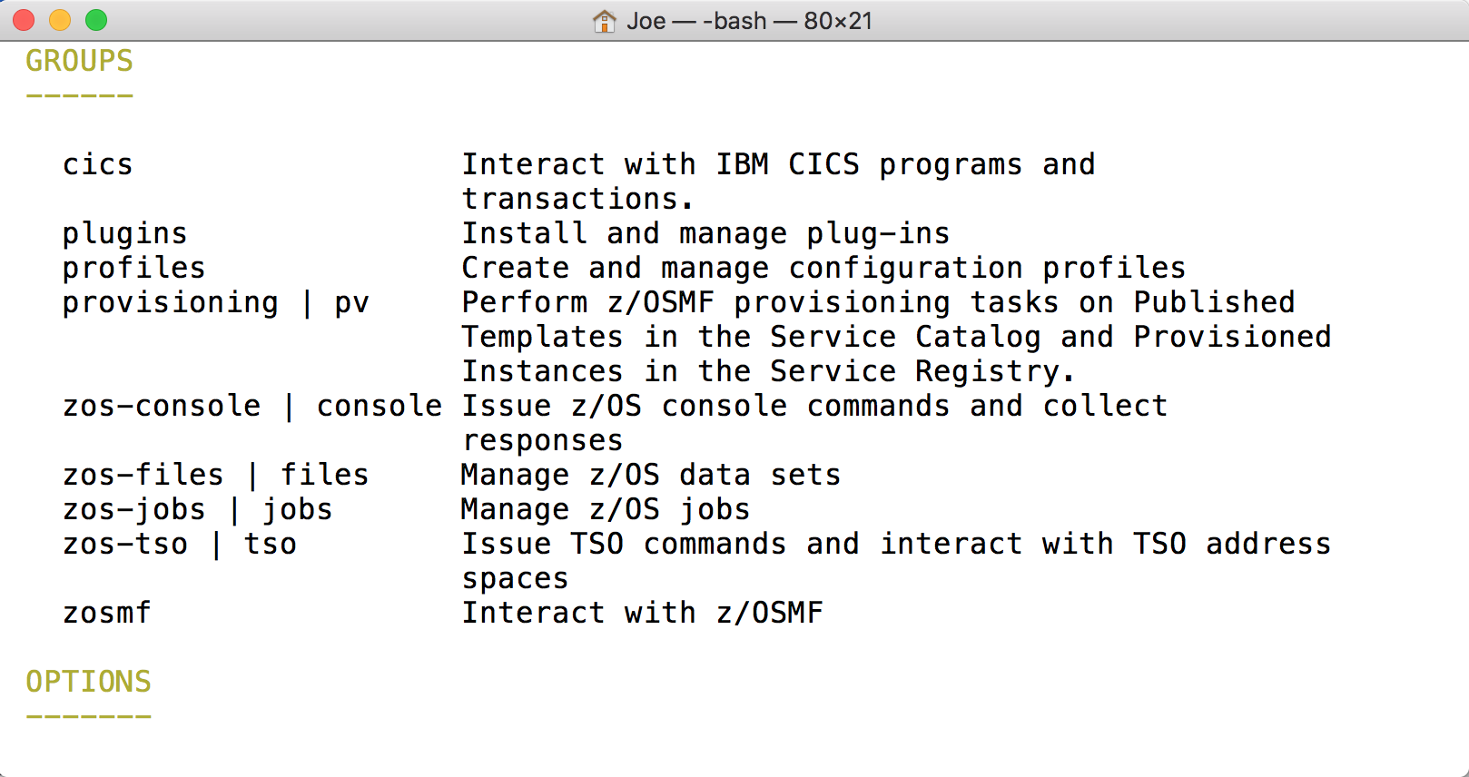
Visual
Studio
Core desktop apps
Extension Plugins
Extension
Plugins
Core CLI
Core Extensions
File Editor
TN 2170
MVS Explorer
JES Explorer
USS Explorer
iFrame
HTML
CLI
extension
CICS
IMS
DB2
Zowe Desktop running in web browser
Zowe CLI running in desktop shell
7554
API Gateway
7552
7553
Java
8544
API Catalog
API Discovery
ZLUX
8548
8546
8550
File Editor
3270
Included as apps
MVS UI
JES UI
USS
UI
node
8542
8547
8545
zssServer
metal C
/S ZWESVSTC
File API
JES API
nnnn
7443
Existing REST API Server
z/OSMF
CICS
CMCI
IMS Connect
DB2
REST APIs
Workflows
TSO + MVS Commands
Files, USS, JES
SSO token generation
X-MEM
IMS Plex
C
/S ZWESISTC
ZWESIS01

Slide 2
Visual
Studio
Core desktop apps
Extension Plugins
Extension
Plugins
Core CLI
Core Extensions
File Editor
TN 2170
MVS Explorer
JES Explorer
USS Explorer
iFrame
HTML
CLI
extension
CICS
IMS
DB2
Zowe Desktop running in web browser
Zowe CLI running in desktop shell
7554
API Gateway
7552
7553
Java
8544
API Catalog
API Discovery
ZLUX
8548
8546
8550
File Editor
3270
Included as apps
MVS UI
JES UI
USS
UI
2
node
8542
8547
8545
zssServer
metal C
/S ZWESVSTC
File API
JES API
nnnn
7443
1
Existing REST API Server
z/OSMF
CICS
CMCI
IMS Connect
DB2
REST APIs
Workflows
TSO + MVS Commands
Files, USS, JES
SSO token generation
X-MEM
IMS Plex
C
/S ZWESISTC
ZWESIS01

