Slide 1

Less painful data analysis with

Slide 2
Thought Experiment
You are given a text file with some data
3/17/15 15:01:25 27.7591 351.591 -30.3979 -77.434 -83.152 -2.40644 -72.8673 26.1987
3/17/15 15:01:33 28.226 351.458 -16.5643 -76.0488 -77.0998 10.6493 -71.3933 26.1995
3/17/15 15:01:37 28.4593 351.391 -9.64744 -76.4128 -75.0009 17.5172 -71.6472 26.5629
...
You are also emailed a list of the column names
Date/time
geolat
geolong
...
How would you read it in?
How would you make a plot?

Slide 3
Thought Experiment
Where can things get messy?
3/17/15 15:01:25 27.7591 351.591 -30.3979 -77.434 -83.152 -2.40644 -72.8673 26.1987
3/17/15 15:01:33 28.226 351.458 -16.5643 -76.0488 -77.0998 10.6493 -71.3933 26.1995
3/17/15 15:01:37 28.4593 351.391 -9.64744 -76.4128 -75.0009 17.5172 -71.6472 26.5629
...
Keep track of what each column is
Date/time
geolat
geolong
...
Turn these dates into some kind of number?
Also variable time between datapoints

Slide 4
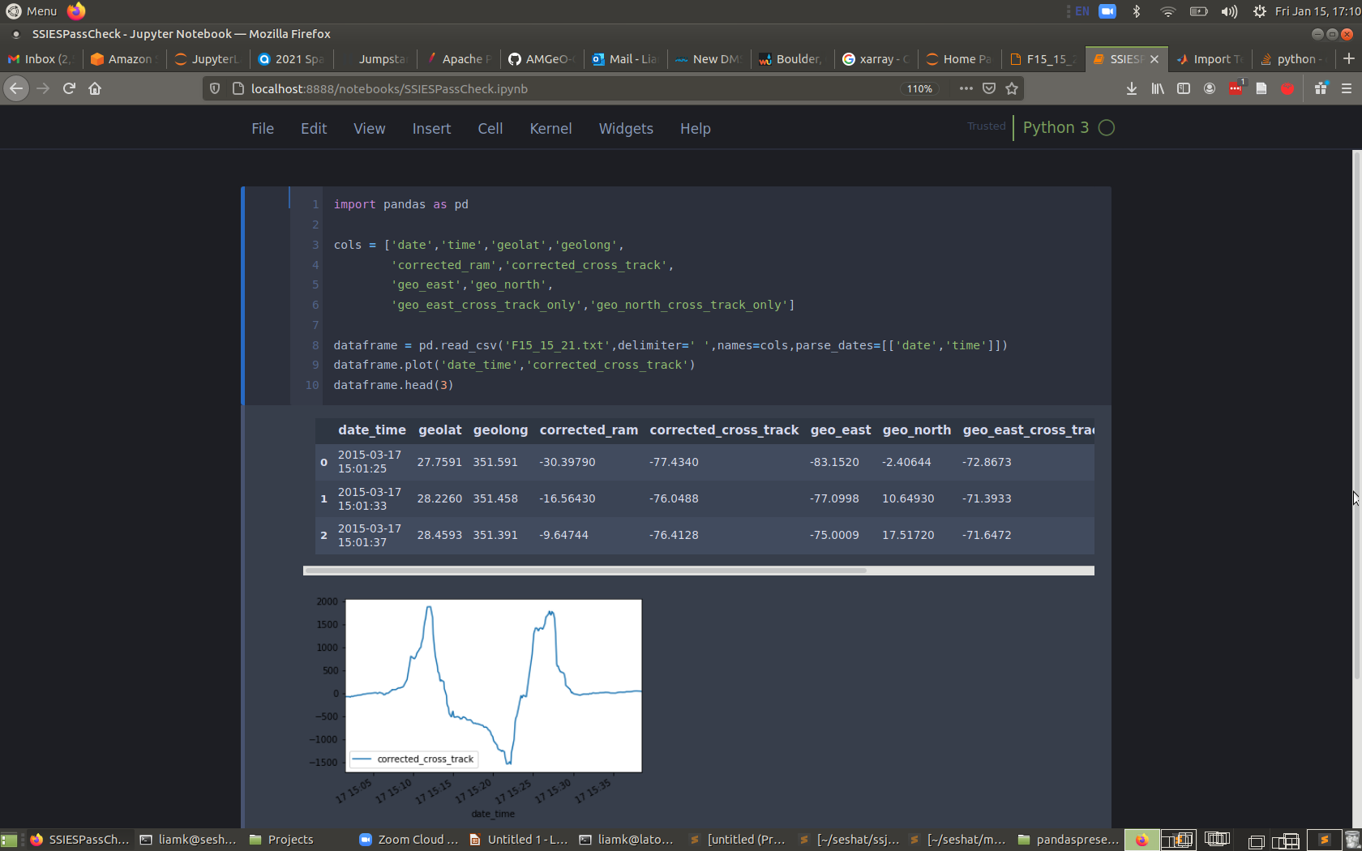

Slide 5
Dataframes are Tables
Column
Index

Slide 6
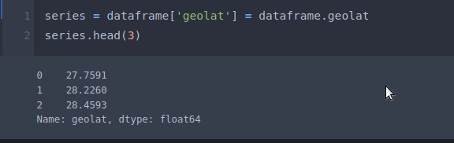
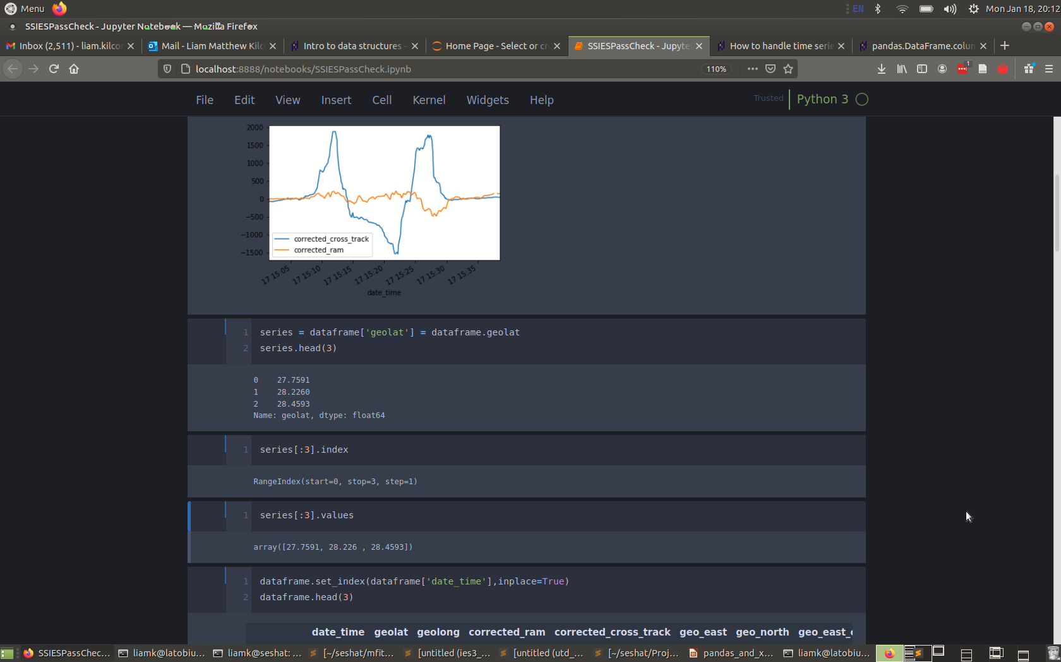
Every Column is A Series
Series have an index and values
The index labels each value
The values are a numpy array of the actual data

Slide 7
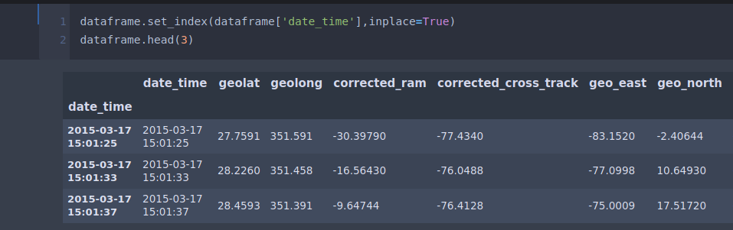
The Index can be a date/time
(and often is)

Slide 8
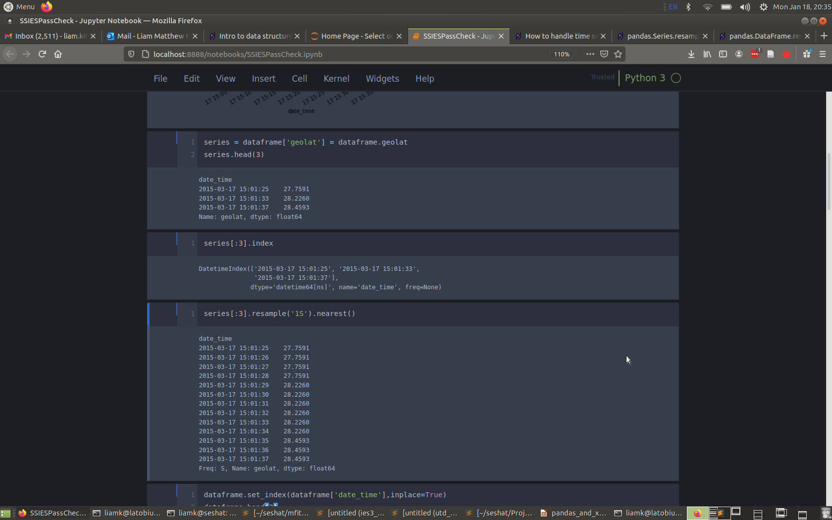
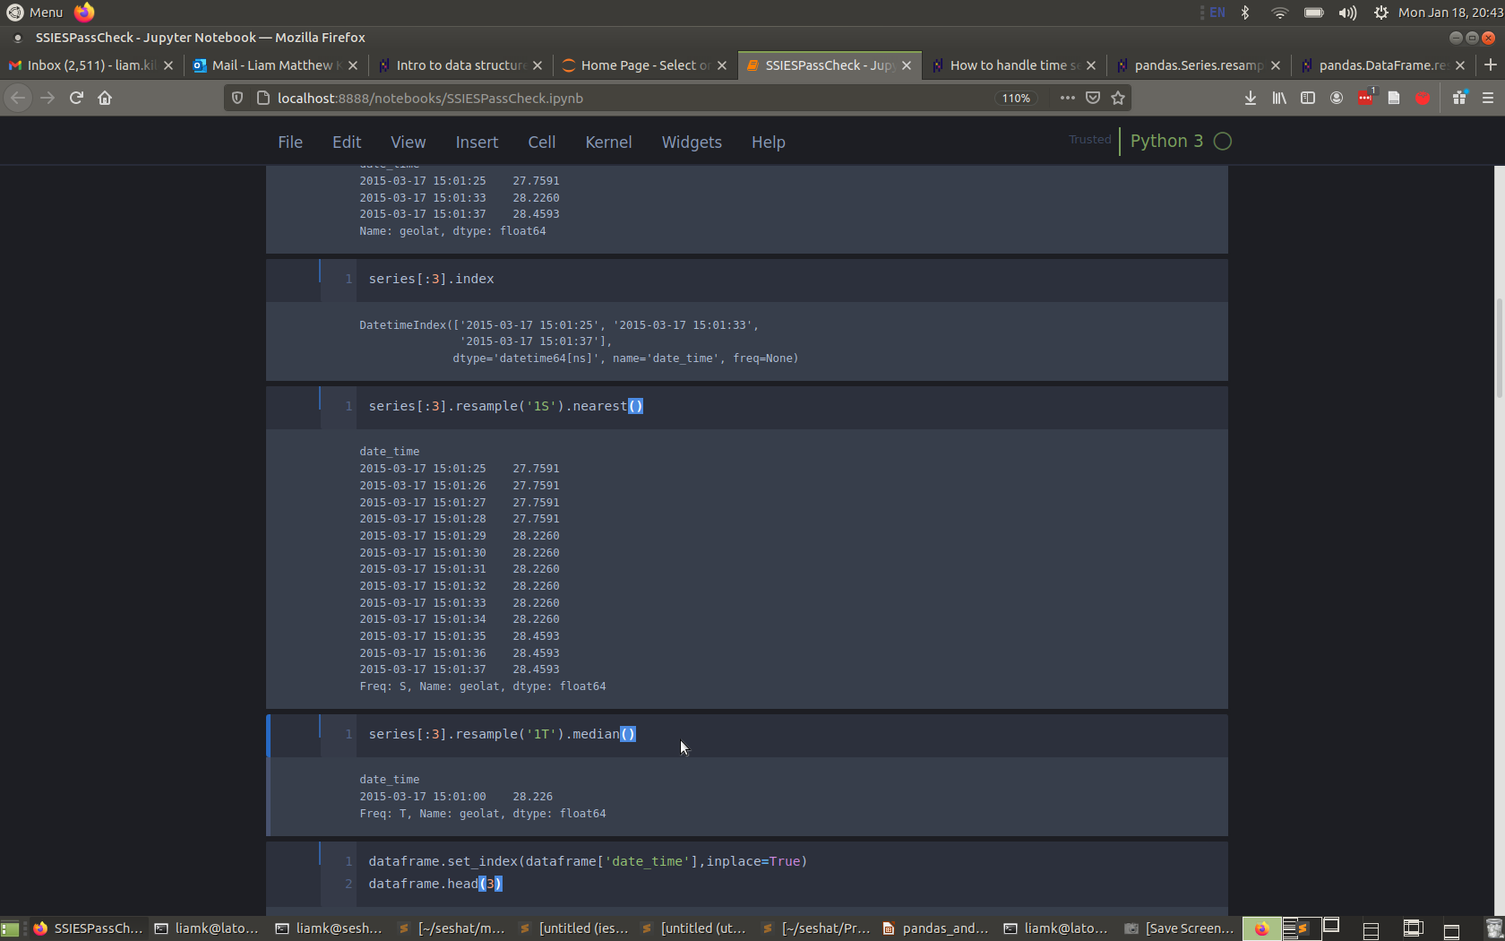
Series with a date/time index
Can be resampled
This also works for entire
dataframes

Slide 9
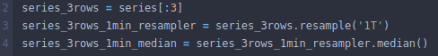
Aside: Method Chaining
Concise way of writing
Pandas was designed with method chaining in mind
MATLAB can’t do this kind of syntax (AFAIK)

Slide 10
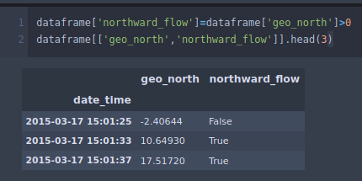
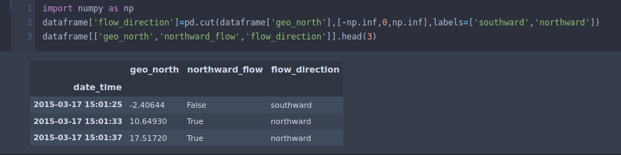
Series can be categorical
Simplest categories: True or False
cut method: make numerical data categorical by binning

Slide 11
Key Concepts
Dataframes (are tables)
Series (are dataframe columns)
Index (labels dataframe/series rows)
Index can be date/time
Timeseries can be resampled
Series can be non-numeric (categorical)

Slide 12
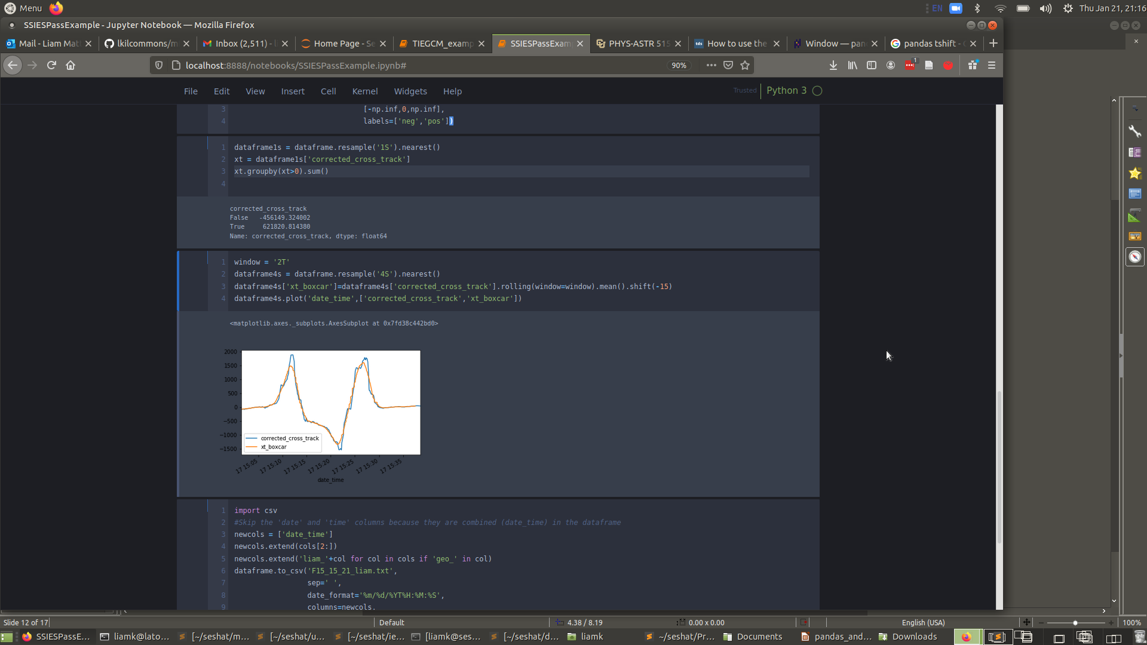
Windowing
The rolling series method organizes data as a sliding window (example: boxcar average)

Slide 13
Split-Apply-Combine
Common data analysis pattern
You probably already use it
Can require a lot of code/time (without pandas)
Examples:
  Any kind of bin-and-average or bin-and-sum

Slide 14
GroupBy: split-apply-combine
Would the integral of this curve be positive or negative?

Slide 15
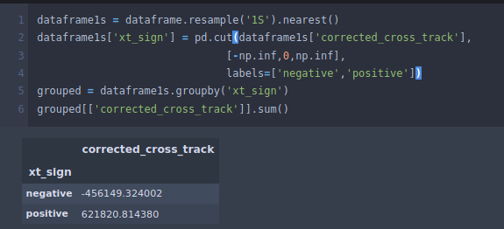
GroupBy: split-apply-combine

Slide 16
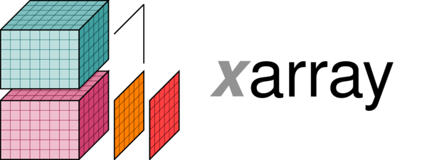
There are tons of other resources for Pandas
There is a learning curve but if you do a lot of data analysis it is definitely worth it
But...what if your data doesn’t organize nicely into a rows/columns table?
Same concepts applied to higher-dimensional data, with 1st class netCDF support

