Slide 1

Documenting Python Code With

Slide 2
Installing Sphinx
I’ll work in an Anaconda virtual environment
The way we called `conda create`
installed sphinx for us
This is how you can test if its installed

Slide 3
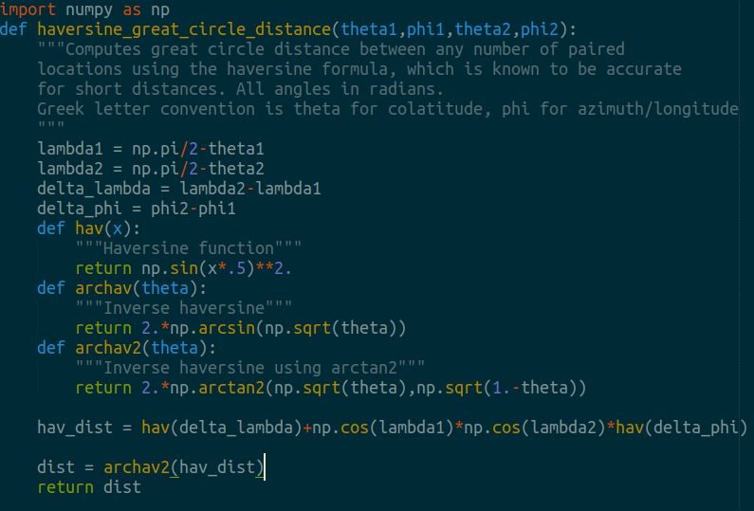
What Will We Document?

Slide 4
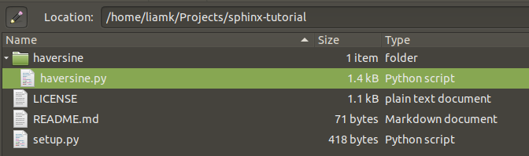
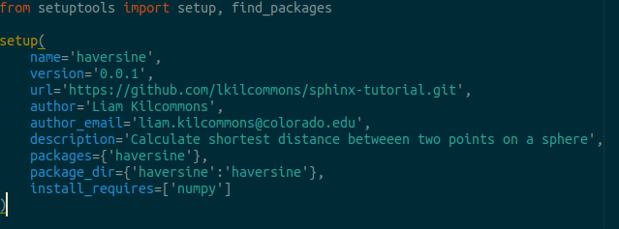
Make It A Python Package
setup.py
Install it!

Slide 5
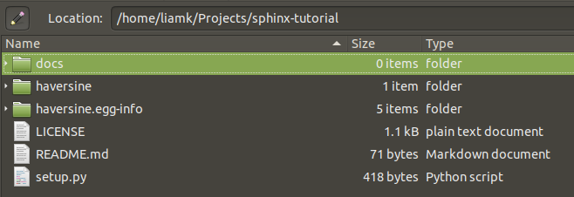
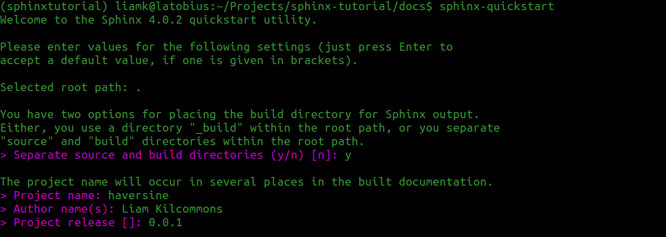
Run the Sphinx Quickstart

Slide 6
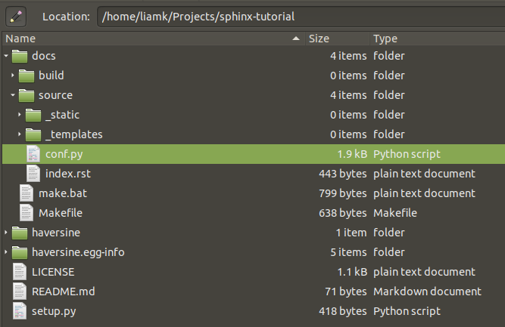
Quickstart Makes A Lot of Files

Slide 7
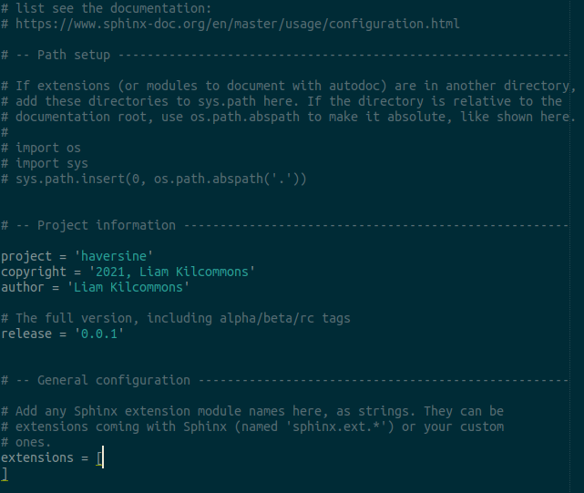
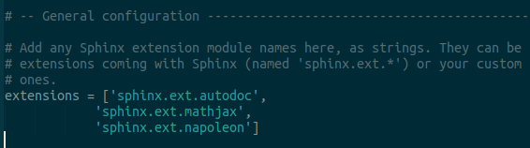
Customize Sphinx Config
conf.py
Autodoc: automatically turns your python docstrings into an API reference
Mathjax: Use LaTeX in your docstrings
Napoleon: enables numpy-style docstrings (much simpler than default)

Slide 8
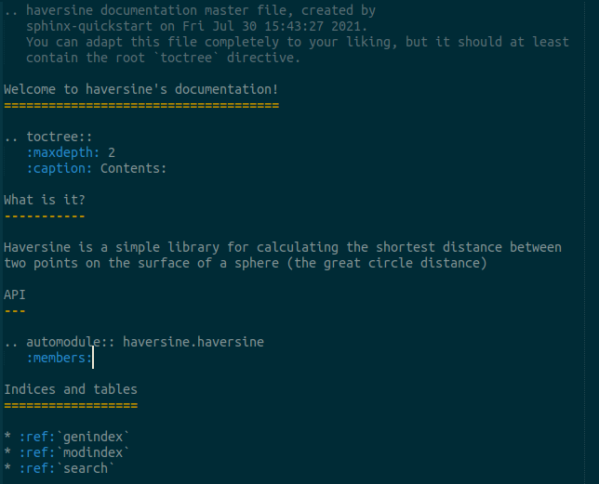
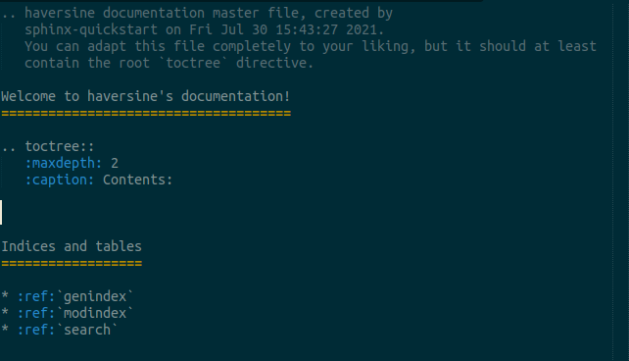
Change Your Documentation Frontpage (index.rst)

Slide 9
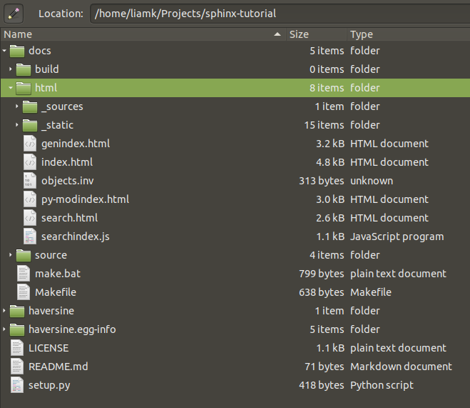
Build Your Documentation

Slide 10
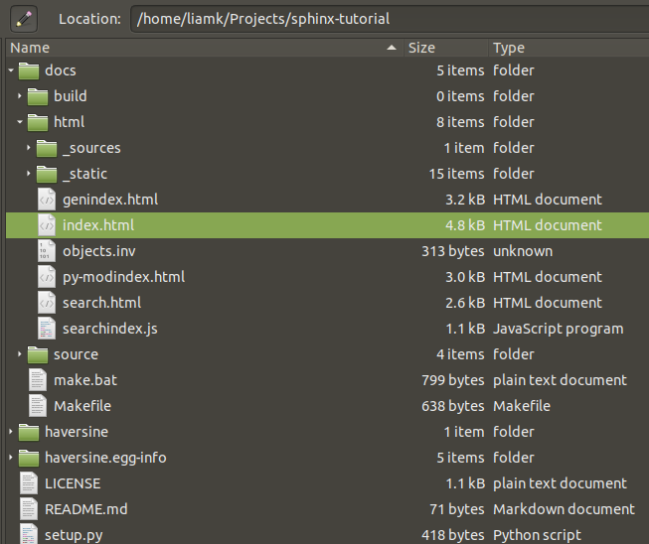
Open index.html

Slide 11
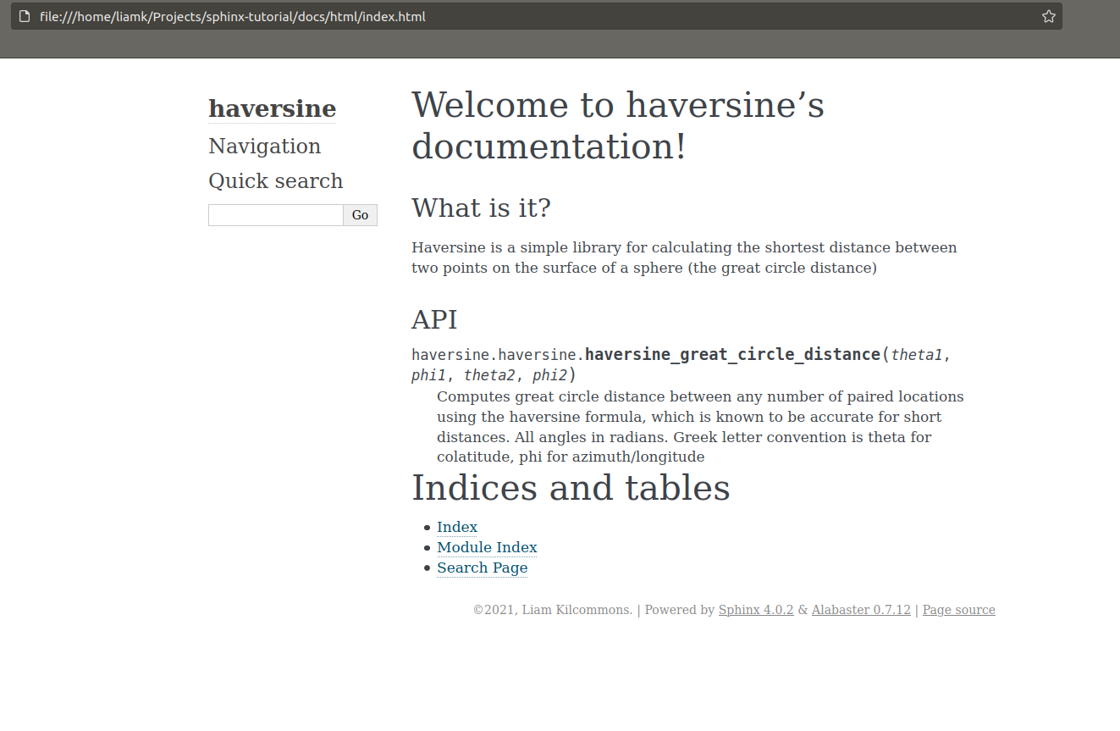
Rejoice!

Slide 12
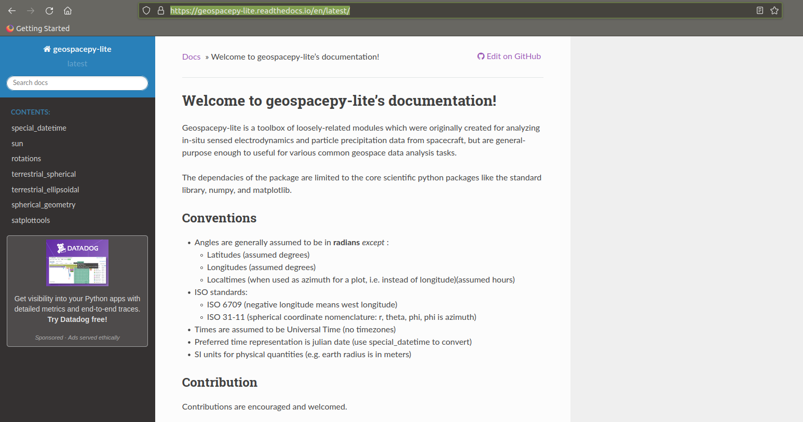
A more complete example
Thanks!

