Slide 1
Obesity
Lori Kim & Cindy So
Notes:
Lori: Hi we’re current students of the UCLA Intensive Data Science extension program and we wanted to display a little bit of what we learned, so far, from our program with this project.
Lori: My name is Lori Kim
Cindy: And my name is Cindy So
Our project focuses on the question of obesity.

Slide 2
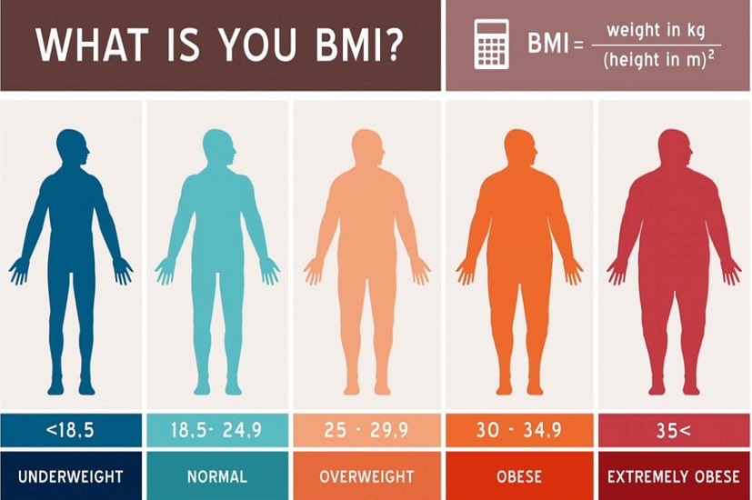
What is Obesity?
Notes:
Cindy: Now, what is obesity?
Well obesity is one of the classifications for weight measured by BMI. As you can see on the slide, the other classifications of weight: are underweight, normal, overweight, and extremely obese.
The measurement for these classifications are based off of an individual’s BMI, which is calculated by the person’s weight in kg divided by the person’s squared height in meters.
And a person would be classified as obese if their BMI is between 30 to 34.9
So, we decided to focus on obesity because we were questioning the trend of obesity; whether or not it’s growing in the US.
The big question we asked ourselves is: is there a growing trend in obesity? And if it is, what are some of the factors causing this trend?
- BMI = body mass index = Calculation of weight and height
We are concerned about the growing trend towards obesity
Big question to ask: Why is the US growing more obese and what are its factors

Slide 3




Where did we start?
Notes:
Cindy: Some of the data points we decided to analyze to find a correlation with obesity was the percent population of people in poverty, who were inactive, who had diabetes, and who exercised 300 minutes a week by state from 2011-2016. And, we also analyzed the average educational attainment of adults, and the growth of fast food chains by state between the years 2011-2016. The sources for these data points came from the CDC, the United States Census Bureau, and the USDA data libraries. Also, we used the language of R to analyze and present our findings.
- CDC Data Values:
Obesity
Inactivity
Poverty
Diabetes
- American Fact Finder Data Values:
Population
Education level
CHCI (calculated)
USDA data
Fast food

Slide 4
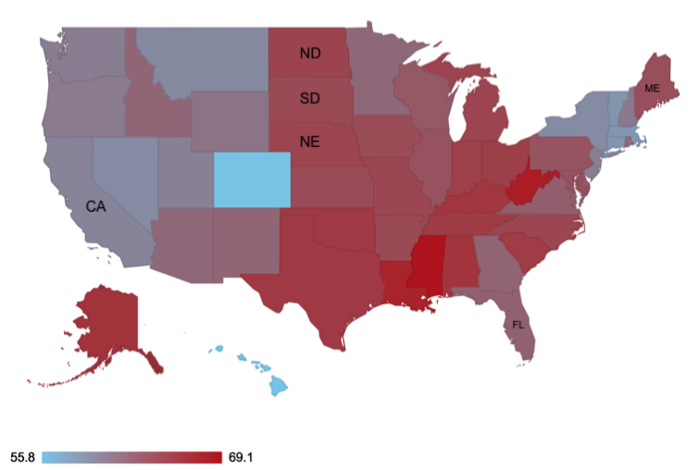
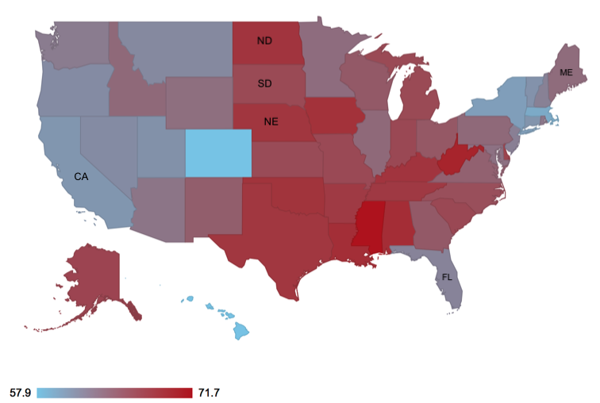
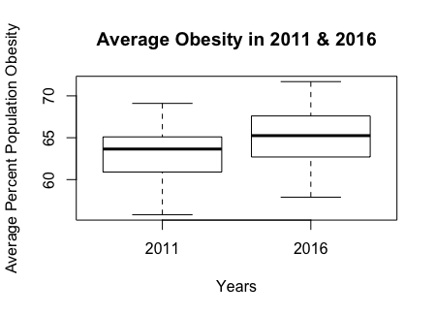
Obesity in the U.S (percentage)
2011 2016
2011 Avg. -> 63.1% 2016 Avg. -> 65.2%
Notes:
Lori: What we found was that there’s a subtle increase in the percent population of people who are obese from the year 2011 to 2016. For example, the min and max value from 2011-2016 increase by 2%. (show the maps) Now, although the colors don’t show a great variance, you can see more specifically that there are increases in the states of North Dakota, South Dakota, Nebraska, and decreases in the states of Florida, Maine, and California. Also, if you look below at our box and whisker plots you can find that the average percent population of obesity in 2011 was 63.1%, which increased to 65.2% in 2016.
Very slight shift increase in obesity from 2011 to 2016 about 1-2 %
Min value for 2011 is 55.85 and in 2016 it’s 57.95
Max value for 2011 is 69.1% and in 2016 it’s 71.6%
Point out some states: Florida, Maine, California dropped.
Point out some states: North Dakota, South Dakota, Nebraska increased.
< Demo of US map in 2016 >

Slide 5
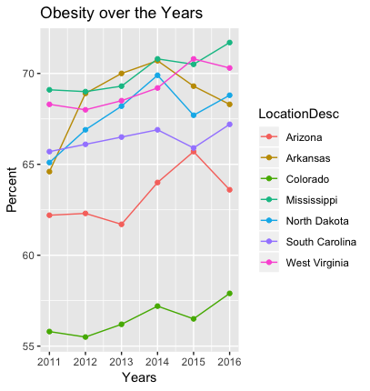
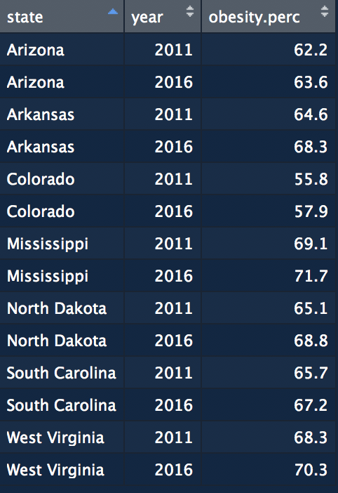
Obesity in the U.S – SELECTED
Notes:
Cindy: Here, we have a line graph with its data table of the highest ranked states for percent population of obesity, which are Arizona, Arkansas, Mississippi, North Dakota, South Carolina, and West Virginia, and the lowest ranked state for percent population of obesity, which is Colorado over the years 2011-2016.

Slide 6
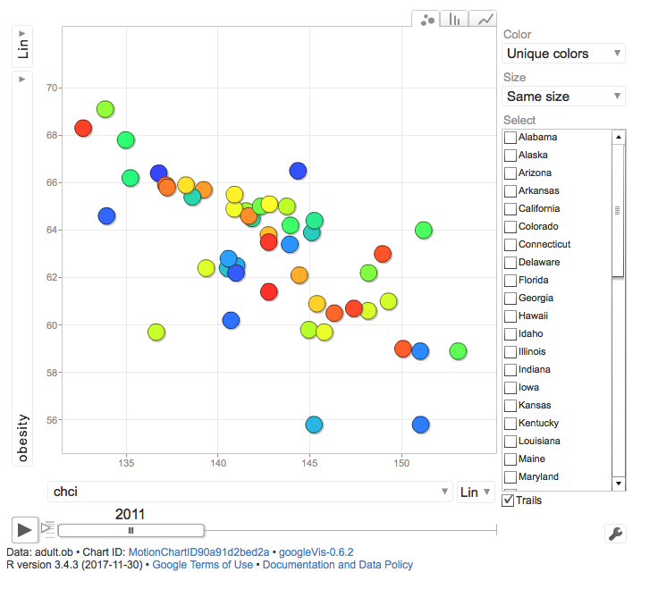
Dynamic graph: OBESITY vs …
Notes:
Lori: And, we also used a dynamic graph to show the correlation of the different features against obesity over the year. The best correlated variable we found using this graph was educational attainment against obesity. But the best display using this graph was Diabetes vs. obesity and here it is….
< Demo of Dynamic Graph>
Talking points (NOT planning to run):
- Obesity vs CHCI
Dynamic (Play and explanation):
- Obesity vs Diabetes (Alabama + Mississippi)

Slide 7
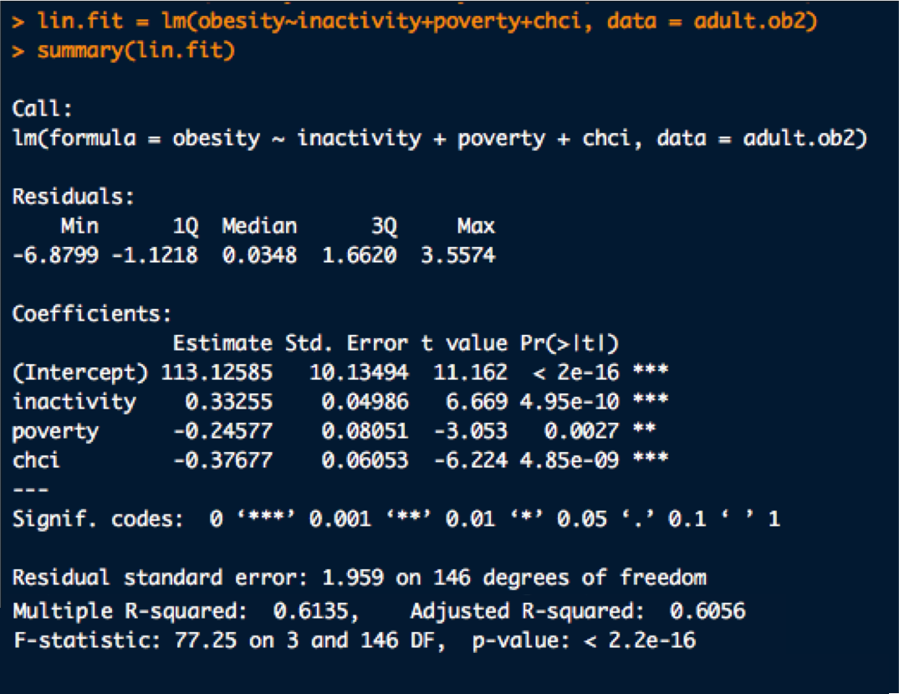
Best fit regression model
Notes:
Cindy: Finally, this is our best fit linear regression model where obesity is our response and inactivity, poverty, and chci are our independent variables. For example, we can see here that inactivity is highly statistically significant with a t-value of 6.669 and has a positive coefficient of 0.33. In other words this means inactivity has a positive impact on obesity which makes sense because if people are inactive then that means they aren’t burning a lot of calories which leads them to gaining weight. Also, if you look at chchi, this is also a very statistically significant variable that has a t-value of 6.22 and has a negative coefficient of 0.37 which means that educational attainment has a negative impact on obesity.
Overall, these were the findings that we found utilizing our program’s material, the R language, and from the government data libraries.

Slide 8
The end

Slide 9
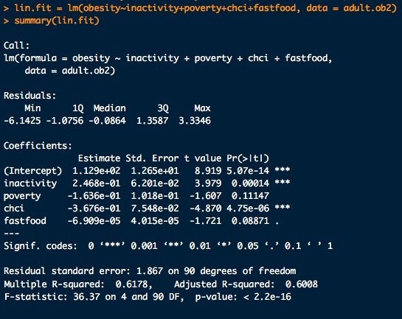
Alternate Regression Analysis
Notes:
Now, we’ve tested many linear regression models where we analyzed the different features against obesity to see which combination of features showed the best correlation of the growth of obesity, and this is one of them. Here we ran this model to check our assumption of whether or not the growth of fast food restaurants positively correlated with the percent population increase in obesity. But as you see here, it turns out that that is not true according to our data. It actually shows that fast food is not strongly statistically significant and it has a very small negative impact. So we decided to take that out and we ended up with our our best fit regression model which is….

