Slide 1
Obesity
Lori Kim & Cindy So

Slide 2
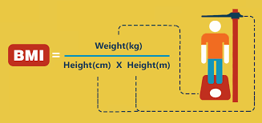
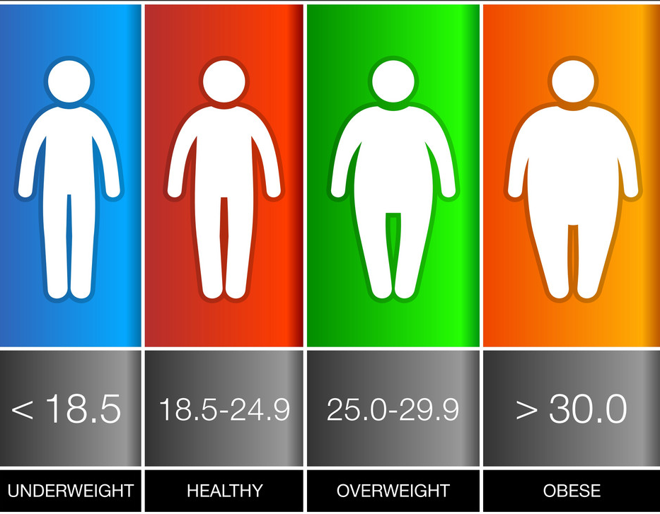
What is Obesity?
Notes:
Obesity is determined by BMI > 30
BMI = body mass index = Calculation of weight and height
We are concerned about the growing trend towards obesity
Big question to ask: Why is the US growing more obese and what are its factors

Slide 3


Where did we start?
Notes:
- CDC Data Values:
Obesity
Inactivity
Poverty
Diabetes
- American Fact Finder Data Values:
Population
Education level
→ CHCI (calculated)

Slide 4
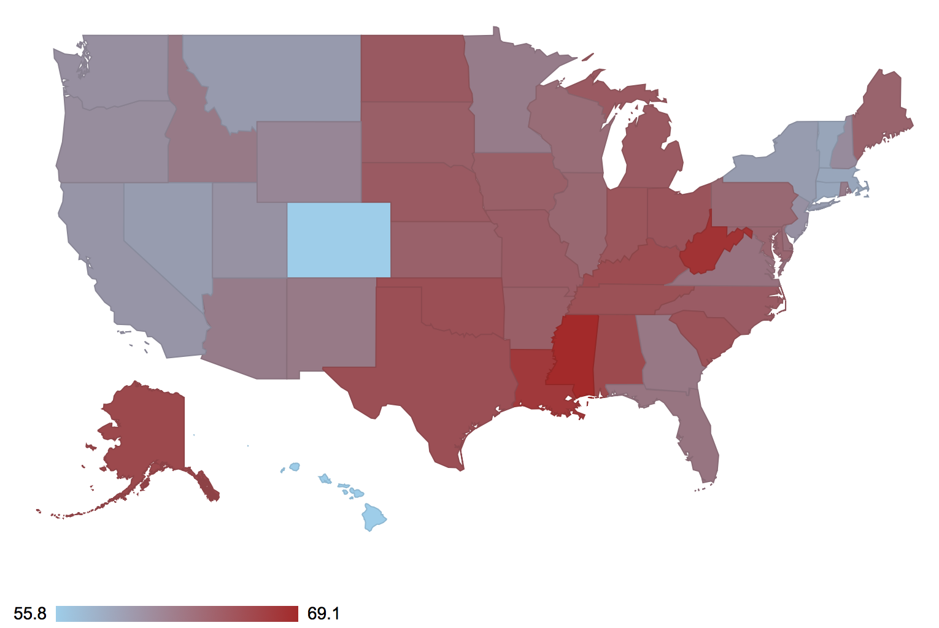
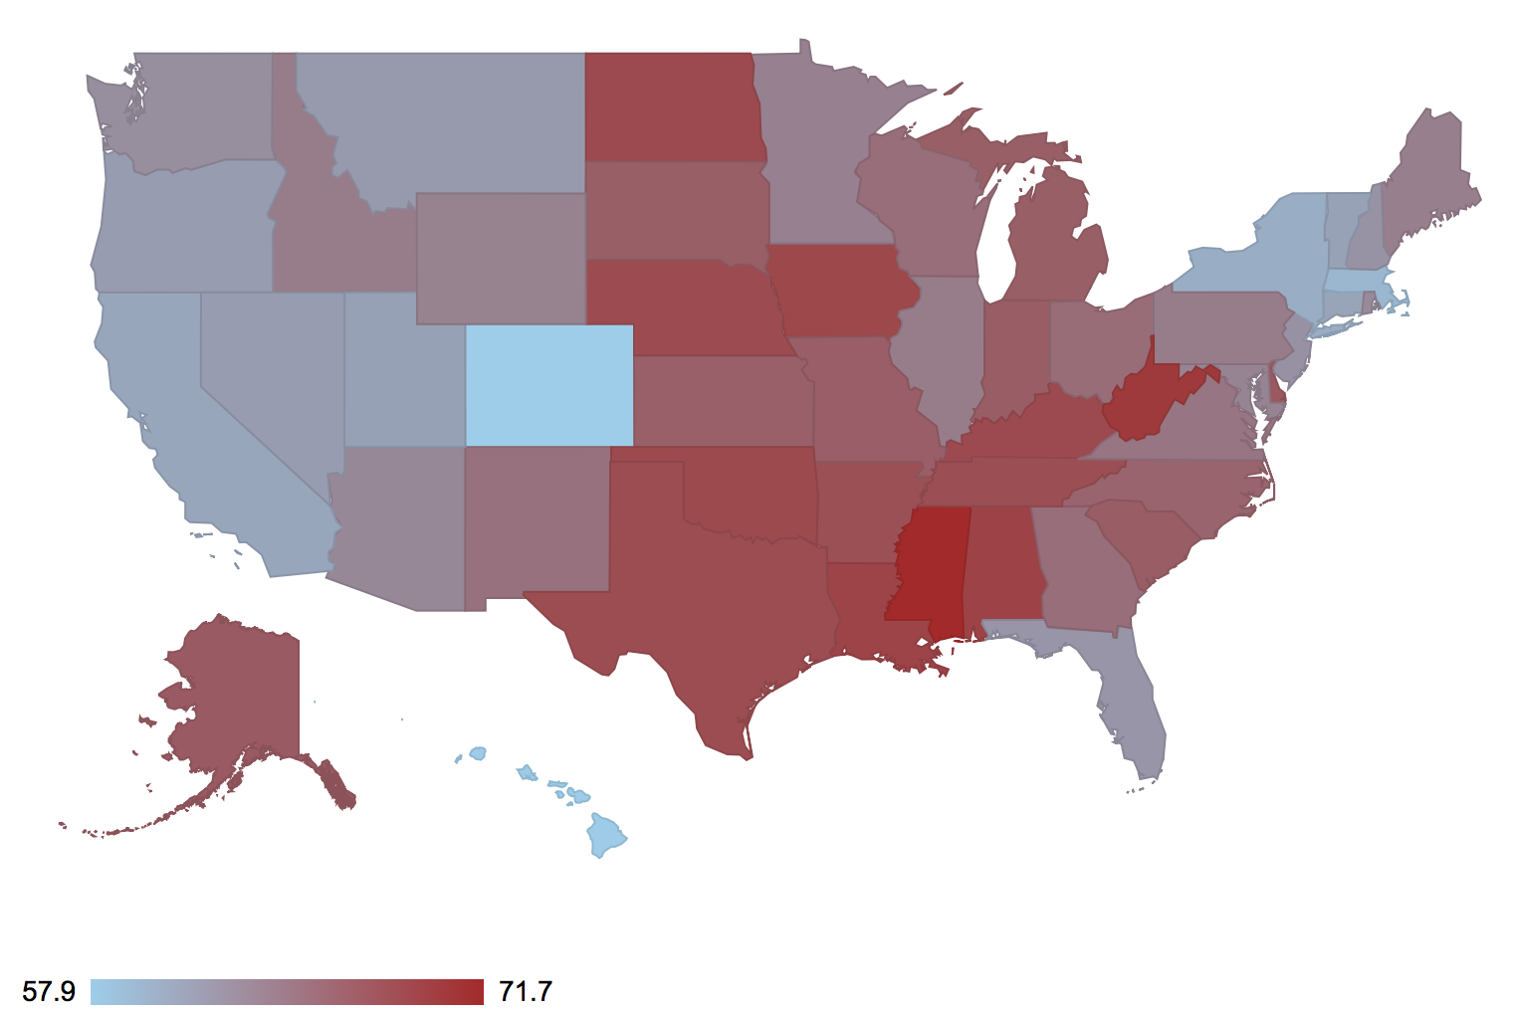
Obesity in the U.S (percentage)
2011 2016
<Demo of US map>
Notes:
Very slight shift towards obesity between 2011 to 2016 about 1-2 %
Min value for 2011 is 55.8 and in 2016 it’s 57.9
Max value for 2011 is 69.1 and in 2016 it’s 71.6
< Demo of US map in 2016 >

Slide 5
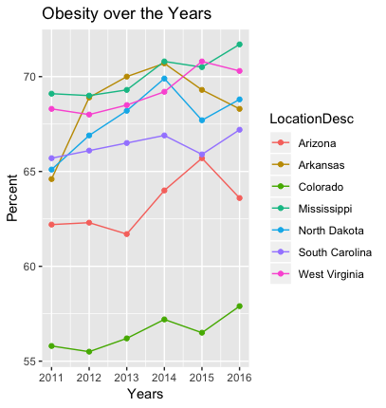
Obesity in the U.S – SELECTED
Notes:
Graph of highest ranked obesity and the lowest ranked state

Slide 6
Dynamic graph: OBESITY vs …
Notes:
< Demo of Dynamic Graph>
Topic:
Obesity vs Inactivity
Obesity vs chci
Obesity vs poverty

Slide 7
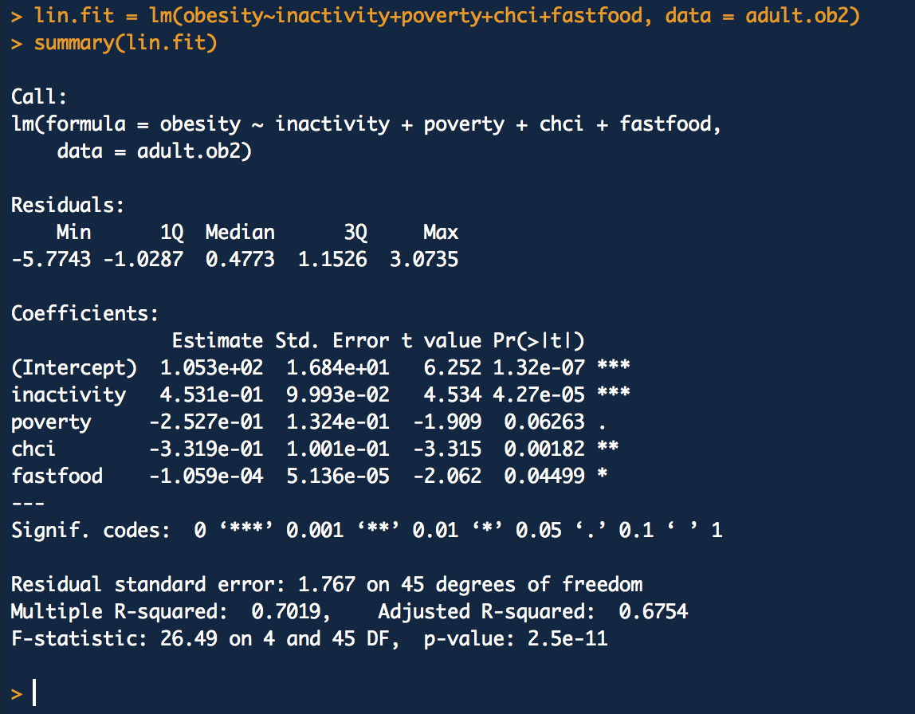
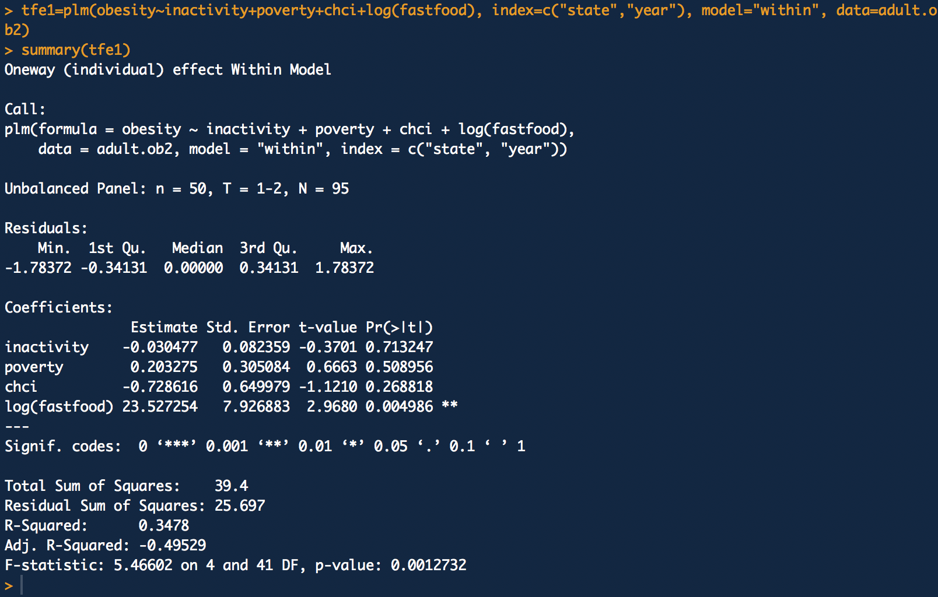
Regression Analysis
Notes:
TBD – Need a finalized regression analysis

Slide 8
The end

