Slide 1
Obesity
Lori Kim & Cindy So

Slide 2
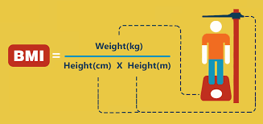
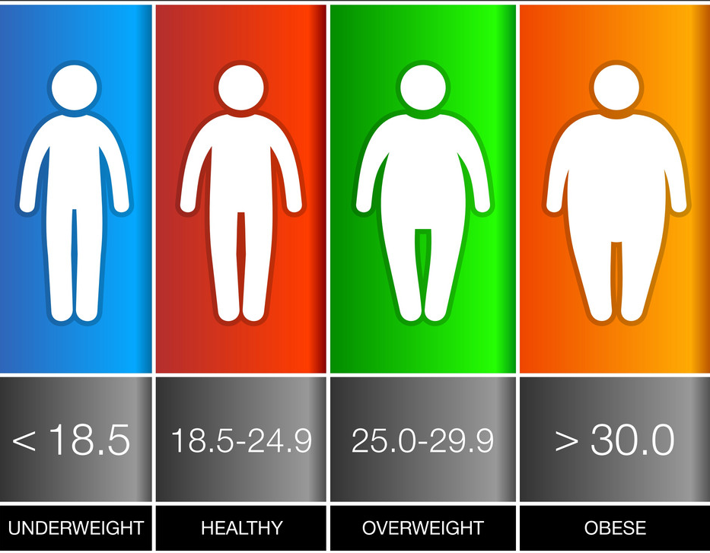
What is Obesity?
Notes:
Obesity is determined by BMI > 30
BMI = body mass index = Calculation of weight and height
We are concerned about the growing trend towards obesity
Big question to ask: Why is the US growing more obese and what are its factors

Slide 3




Where did we start?
Notes:
- CDC Data Values:
Obesity
Inactivity
Poverty
Diabetes
- American Fact Finder Data Values:
Population
Education level
CHCI (calculated)
USDA data
Fast food

Slide 4
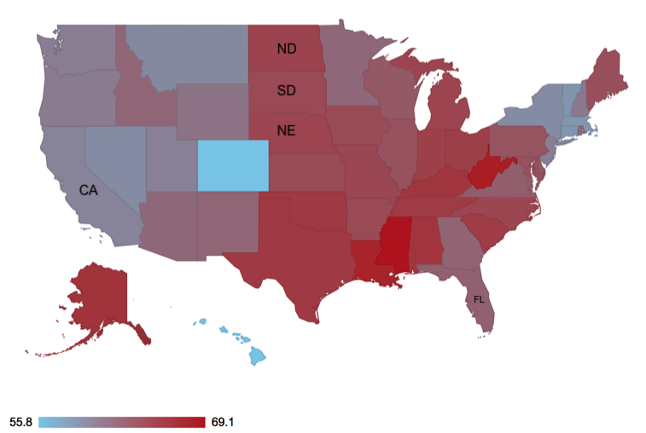
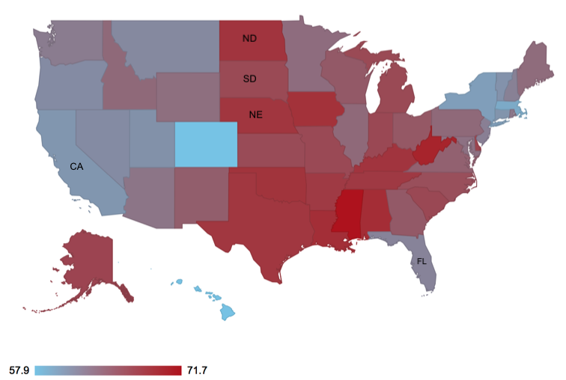
Obesity in the U.S (percentage)
2011 2016
Notes:
Very slight shift increase in obesity from 2011 to 2016 about 1-2 %
Min value for 2011 is 55.85 and in 2016 it’s 57.95
Max value for 2011 is 69.1% and in 2016 it’s 71.6%
Point out some states: Florida, Maine, California dropped.
Point out some states: North Dakota, South Dakota, Nebraska increased.
< Demo of US map in 2016 >

Slide 5
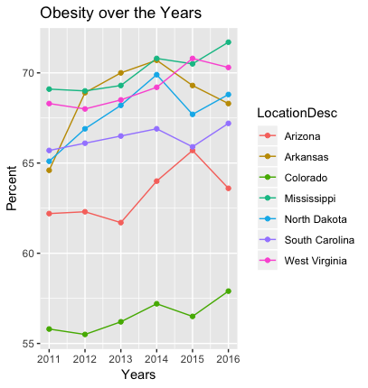
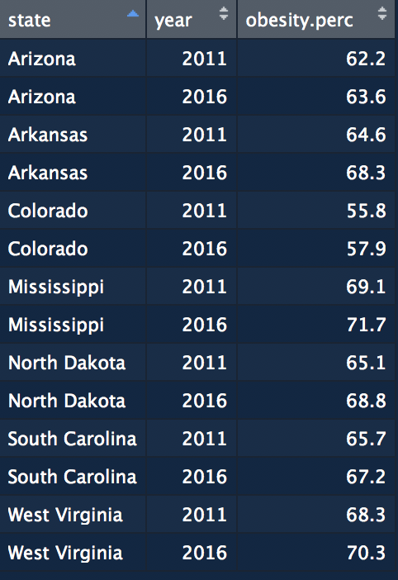
Obesity in the U.S – SELECTED
Notes:
Graph of highest ranked obesity and one lowest ranked state

Slide 6
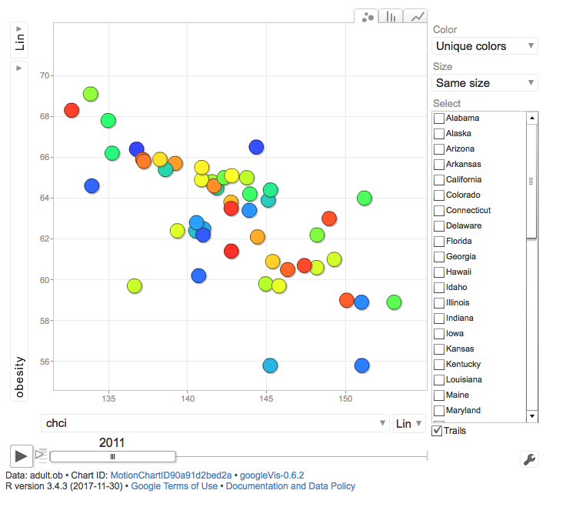
Dynamic graph: OBESITY vs …
Notes:
< Demo of Dynamic Graph>
Talking points (NOT planning to run):
- Obesity vs CHCI
Dynamic (Play and explanation):
- Obesity vs Diabetes (Alabama + Mississippi)

Slide 7
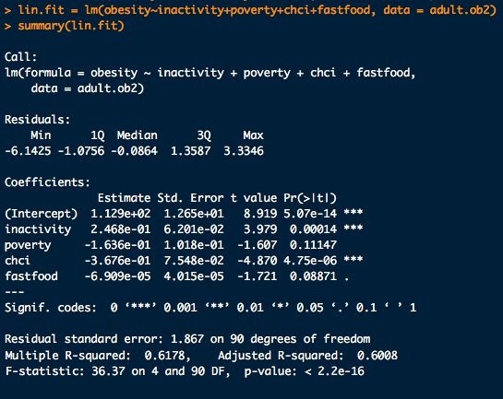
Regression Analysis 1

Slide 8
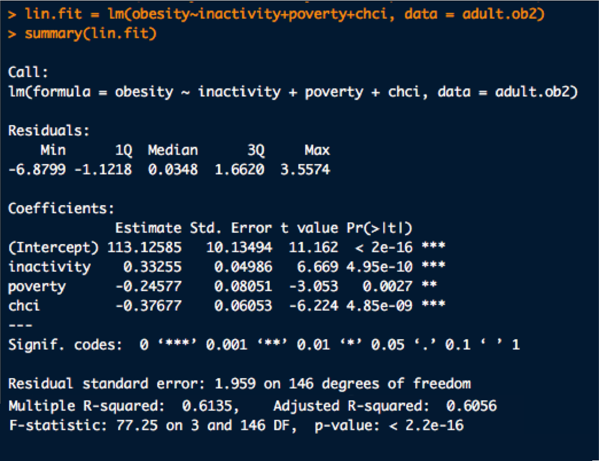
Regression analysis 2

Slide 9
The end

