Slide 1
Obesity
Lori Kim & Cindy So
Notes:
Lori: Hi we’re current students of the UCLA Intensive Data Science extension program.
Lori: My name is Lori Kim and this
Cindy: And my name is Cindy So
We focused on the question of obesity.

Slide 2
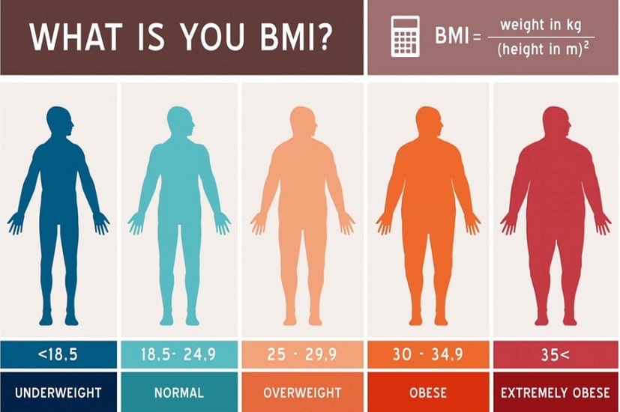
What is Obesity?
Notes:
Now what is obesity?
Obesity is one of the categories that classifies weight based on BMI.
BMI is a calculation of a person’s weight in kg divided by the person’s squared height in meters.
The other classifications for weight are underweight, normal, overweight, and extremely obese
And a person is classified as obese if their BMI is between 30 to 34.9
- BMI = body mass index = Calculation of weight and height
We are concerned about the growing trend towards obesity
Big question to ask: Why is the US growing more obese and what are its factors

Slide 3




Where did we start?
Notes:
- CDC Data Values:
Obesity
Inactivity
Poverty
Diabetes
- American Fact Finder Data Values:
Population
Education level
CHCI (calculated)
USDA data
Fast food

Slide 4
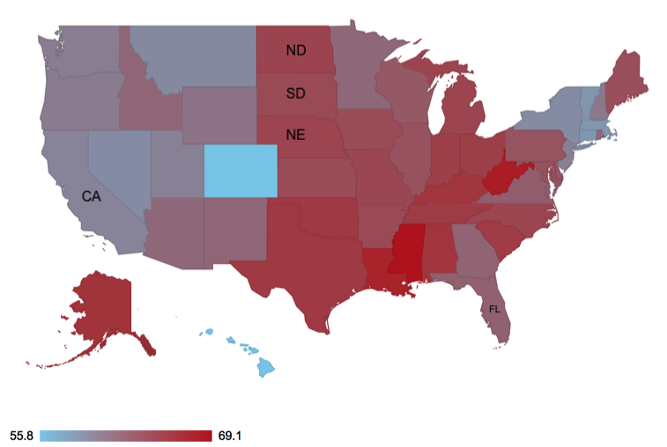
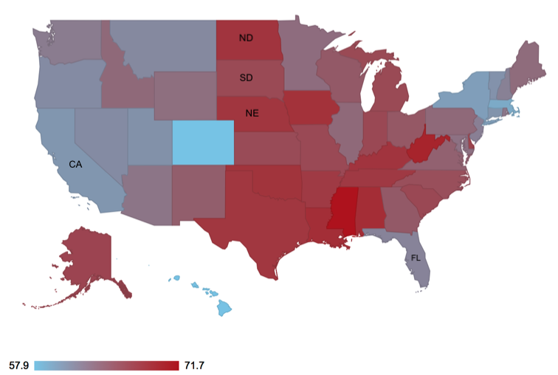
Obesity in the U.S (percentage)
2011 2016
Notes:
Very slight shift increase in obesity from 2011 to 2016 about 1-2 %
Min value for 2011 is 55.85 and in 2016 it’s 57.95
Max value for 2011 is 69.1% and in 2016 it’s 71.6%
Point out some states: Florida, Maine, California dropped.
Point out some states: North Dakota, South Dakota, Nebraska increased.
< Demo of US map in 2016 >

Slide 5
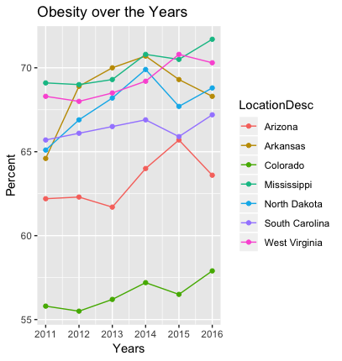
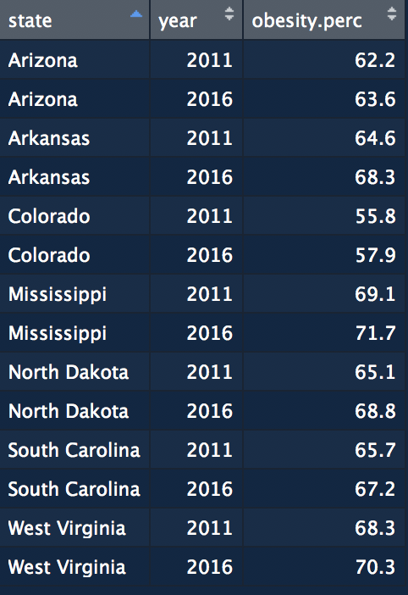
Obesity in the U.S – SELECTED
Notes:
Graph of highest ranked obesity and one lowest ranked state

Slide 6
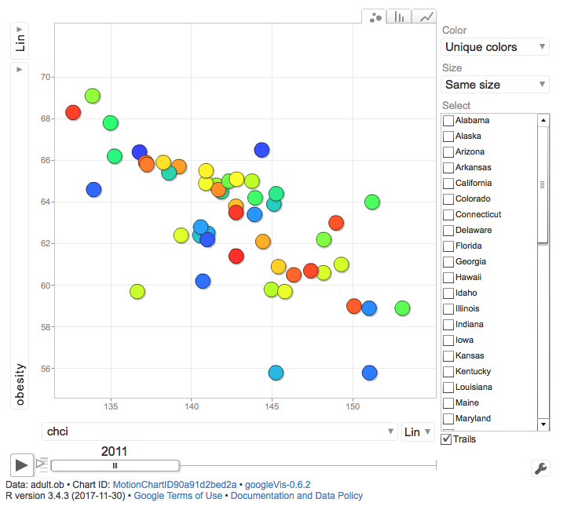
Dynamic graph: OBESITY vs …
Notes:
< Demo of Dynamic Graph>
Talking points (NOT planning to run):
- Obesity vs CHCI
Dynamic (Play and explanation):
- Obesity vs Diabetes (Alabama + Mississippi)

Slide 7
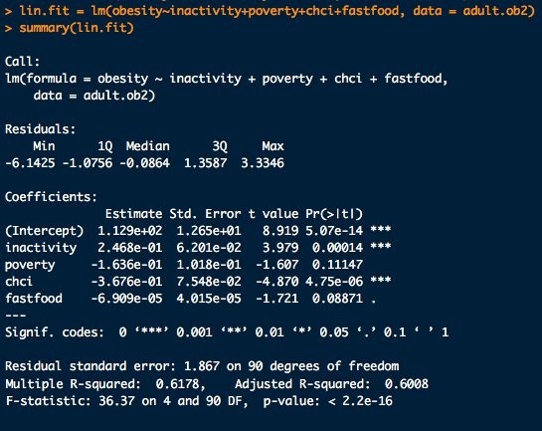
Regression Analysis 1

Slide 8
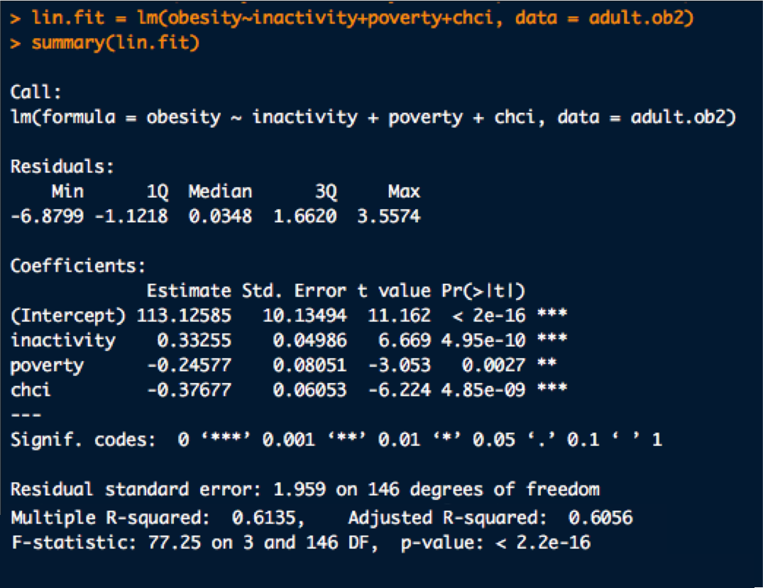
Regression analysis 2

Slide 9
The end

