Slide 1
NEXT meeting – 24th Monday 7-8pm
Role play – 27th Thursday 9pm
Last sync up (buffer) – 28th friday

Slide 2

Group 3: 9:30-10:30~~~

Slide 3
To develop a data-driven approach to provide actionable market insights with data pipeline from car listing site.

Slide 4
Agenda
About Car-Smart Consultancy (Background)
Business statement (high-level DB) – (Soon Hang, Zhang Tao)
Overall architecture – (Kim Hui, Soon Hang)
  Showcase scalable data processing pipelines (Brief data understanding & data prep)
  To show BIG DATA PROCESS
  Data Understanding & Data Preparation (Features)
Recommender Systems (RCS) – (Kwan, Ivan)
  Types of RCS & Evaluations
Predictive Modelling - (Kim Hui, Khai Shing)
  Showcase Pyspark module
User Interface (Dashboard) – (Soon Hang, Zhang Tao)
Actionable Insights– (Soon Hang, Zhang Tao, ALL)
Future Work – (ALL)
Q&A – (ALL)

Slide 5
1. Background

Slide 6
BACKGROUND
Car-Smart consultancy is a data driven consultancy firm specializing in providing an end-to-end data driven approach for related industry analytic project.
Our aim is to provide a one-stop reliable source for potential car owners
foster collaborative thinking to further drive workplace innovation. By closing the loop and leveraging greener commercial buildings, we help businesses grow and nurture a consumer first mindset.

Slide 7
Market Overview
To show business understanding

Slide 8






MEET THE TEAM
Ivan ONG
Zhang Tao
TAN Kwan Yick
RCS Specialist,
Data Scientist
Data & BI Analyst
Web UI Designer
RCS Specialist,
Data Scientist
LIM Kim Hui
EE Soon Hang
CHUA Khai Shing
Big Data Engineer
Data Scientist
Data & BI Analyst
Big Data Engineer
Web UI Designer
Data Analyst

Slide 9
2. Business Statement

Slide 10
Business OBJECTIVE
To develop a data-driven approach project
DATA SELECTION
IDENTIFYING TRENDS
Leveraging on SG Carmart platform with over 17,000 car listings and thousands of transactions every month
& LTA Annual Vehicle Statistics data for market trend
By identifying trends in the market, data driven decisions can be made to optimize sales strategies for car dealers & improve buying decision for potential car owners
IDENTIFYING KEY FACTORS
Notes from Proposal:
To develop a data-driven approach project which enhance the understanding of Singapore’s car market. Through data analysis, insights can be gained by identifying factors that influence car prices and predicts them, identify trends in the market and make data driven decisions to optimize sales strategies for car dealer, and to improve buying decision for potential car owners.
Car-Smart consultancy believes that amidst the incoming trend of Electric Cars and Car Sharing, leveraging the volume of data from car listing will help to build a better user experience when searching for information on the subject.
At the same time for car dealers, such insights may be used to increase market share and profitability by leveraging the power of data analytics to gain a competitive edge in the car dealership industry.
Crucial to point out factors that influence and that can aid in predicting car price

Slide 11
SOLUTION
CLOSE THE GAP
Our product offers the style and function of traditional commercial spaces, but with a plan for energy efficiency
TARGET AUDIENCE
Gen Z (18-25 years old)
COST SAVINGS
Reduce expenses for building electricity and air conditioning
EASY TO USE
A simple building that gives customers the space they need without the high cost of building maintenance

Slide 12
3. Overall Architecture

Slide 13
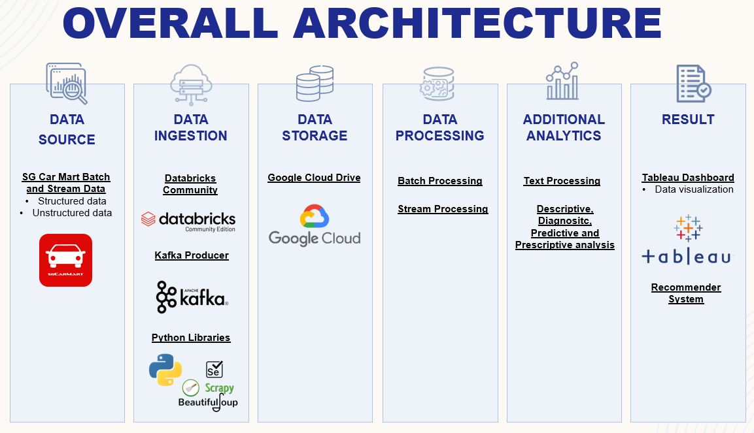

Slide 14







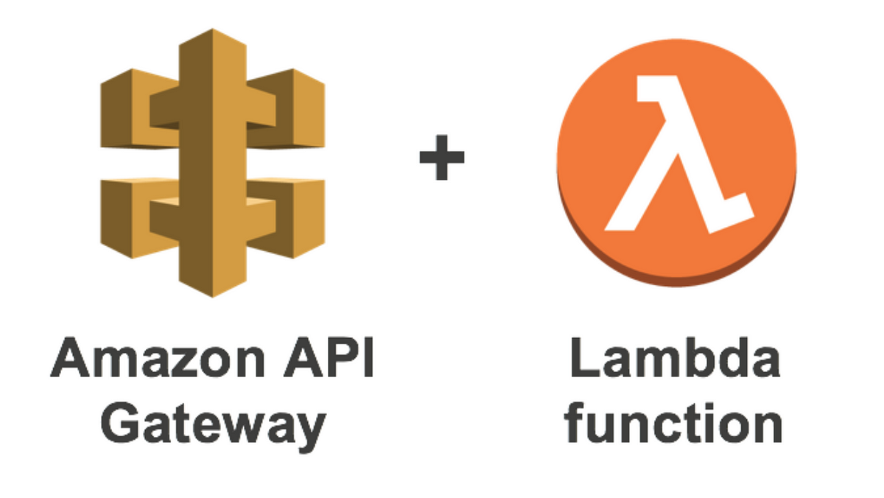








OVERALL ARCHITECTURE
Data Source
Data Ingestion
Data Storage
Data Processing
Analytics Stacks
Results
Structured Data
LTA Data Mall statics tabular data
AWS Lambda
Serverless cloud on-demand web scrape function execution
AWS S3 – Simple Storage Service
Cloud data storage
PySpark
On-Premise Data processing using PySpark
Tableau Dashboarding
Predictive Modeling
Recommender System
Web Application
Recommender System Application
Semi-Structured Data
Sgcarmart.com web scrape text data
AWS CloudWatch
Scheduled batch data ingestion to AWS S3
Cloud Computing with Kubenetes and MapReduce
Hosting PySpark with on-demand cloud computing and enabling Big Data Processing Scaling capability
Unstructured Data
Sgcarmart.com web scrape images data
Python Packages
Beautiful Soup for web scrape

Slide 15
CarSmartConsulting
CarSmartConsulting
14/04/2023
1.0
Be confident when taking in cars
A market overview on car listing in open market
A benefit is what your product does for the customer. The benefits are the ways that the features make your customer’s life easier by increasing pleasure or decreasing pain. The benefits of your product are the really core of your value proposition. The best way to list out the benefits of your product on the canvas is to imagine all the ways that your product makes your customer’s life better.
The product experience is the way that owning your product makes the customer feel. It’s the sum total of the combined features and benefits. Product experience is different to features and benefits because it’s more about the emotional reasons why people buy your product and what it means for them in their own lives. The product experience is the kernel that will help identify the market positioning and brand essence that is usually built out of the value proposition.
The emotional drivers of decision making are things that we want to be, do or have. Our wants are usually conscious (but aspirational) thoughts about how we’d like to improve our lives. They sometimes seem like daydreams but they can be powerful motivators of action. The wants speak more to the pull of our hearts and our emotions.
Be confident in optimal pricing of product to capture both the selling oppt and profit margin
An insight on car pricing in open market
Up to date car market insight
Fears can be a strong driver of purchasing behaviour and can be the hidden source of wants and needs. For any product there is a secret “pain of switching“. Even if your product is better than the competition, it might not be a big enough improvement to overcome the inertia of the status quo.
An insight on car type selling rate in open market
Not quick enough to know which model is the market overall best selling
Be early to know which model going to pickup selling
High confidence to provide best price guaranteed offer
Worry of over stocking of slow selling car model
Peace of mind to think of which car to be recommended with good relevance
Quick to know which model becomes fast moving
Informative Dashboard
The customer’s needs are the rational things that the customer needs to get done. Interestingly, needs are not always conscious. Customers can have needs that they may not know about yet. Designers call these “latent needs“. The needs speak more to the pull of our heads and rational motivations.
Non optimal pricing for their product causes slow transaction, and unable to capture best profit margin
A feature is a factual description of how your product works. The features are the functioning attributes of your product. The features also provide the ‘reasons to believe’. Many FMCG marketers deride the importance of features because features are no longer a point of difference in most FMCG marketing. But for technology products and innovative new services the features on offer can still be an important part of your value proposition.
Pricing prediction
Smart in inventory management especially for the higher end model
Great recommender to improve reseller customers satisfaction
Sharp in pricing their products
These are not just the obvious competitors, but also existing behaviours and coping mechanisms. Remember that people made it this far in life without your product. If your product isn’t better than the existing solutions then you don’t have a real-world value proposition.
Other car listing site
Other consulting firm offering similar insight
By SME staff experiences
CarSmartConsulting Web App
Car Listing companies, any car reseller, any car agencies
Using internal transaction data
Designed by: Peter J. Thomson, based on the work of Steve Blank, Clayton Christensen, Seth Godin, Yves Pigneur and Alex Osterwalder. (https://www.strategyzer.com/canvas/value-proposition-canvas). PowerPoint implementation by: Neos Chronos Limited (https://neoschronos.com). License: CC BY-SA 3.0

Slide 16
PREDICTION TASK Car Price Prediction. Recommender Systems on which car to recommend based on customer input. | DECISIONS Help client to obtain advantage in product pricing. Help client to confidently recommend relevant car type to customer. | VALUE PROPOSITION Who is the end-user? What are their objectives? How will they benefit from the ML system? Mention workflow/interfaces. | DATA COLLECTION Web scrape. Data retrieval in LTA portal. | DATA SOURCES All open listing sites.
IMPACT SIMULATION Can models be deployed? Which test data to assess performance? Cost/gain values for (in)correct decisions? Fairness constraint? | MAKING PREDICTIONS When do we make real-time / batch pred.? Time available for this + featurization + post-processing? Compute target? |  | BUILDING MODELS How many prod models are needed? When would we update? Time available for this (including featurization and analysis)? | FEATURES Input representations available at prediction time, extracted from raw data sources.
 | MONITORING Metrics to quantify value creation and measure the ML system’s impact in production (on end-users and business)?

Slide 17
Data PIPELINE
BATCH DATA PIPELINE
ETL PROCESSING?
Hourly_refresh
Using AWS EventBridge (CloudWatch Events)
Conducted testing with young business owners in the area
DATA WAREHOUSE
AUTHENTIC
First beautifully designed building that's both stylish and functional
Designed with the help and input of architecture experts in the field

Slide 18
AWS OVERVIEW
UNIQUE
TESTED
Only product specifically dedicated to the commercial market
Conducted testing with young business owners in the area
FIRST TO MARKET
AUTHENTIC
First beautifully designed building that's both stylish and functional
Designed with the help and input of architecture experts in the field

Slide 19

Data processing flow
DATA VALIDATION
DATA CLEANING
USING GREAT EXPECTATIONS
CARRIED OUT IN PYTHON CODE
DATA ROLLUP
FEATURE ENGINEERING
TO REDUCE SPARSITY (TO HELP BUILD A MORE EFFECTIVE RECOMMENDER SYSTEM)
Designed with the help and input of architecture experts in the field

Slide 20
4. RCS & Evaluation

Slide 21



RCS OVERVIEW
5 Recommender in total
1.) basic, just price range (done)
2.) Similarity based on product text descritpion columns (done)
3.) base on all non text features
4.) base on combine feature, text and non text (This is for user who dunno what they want)
5.) based on user input, price, car type and age (This is for user who roughly know what they want)
Simple and quick to build
Creates spaces for community interactions
Reduces carbon footprint

Slide 22
5. Predictive Modelling

Slide 23
6. User interface
Webpage/ product demo
Deployment

Slide 24
Webpage/ product demo
https://carsmartconsultancy.com/#
Can use GIF file/ screenshot
TESTED
Only product specifically dedicated to the commercial market
Conducted testing with young business owners in the area
FIRST TO MARKET
AUTHENTIC
First beautifully designed building that's both stylish and functional
Designed with the help and input of architecture experts in the field

Slide 25
Dashboard
https://carsmartconsultancy.com/#
CONCEPTS
TESTED
Only product specifically dedicated to the commercial market
Conducted testing with young business owners in the area
FIRST TO MARKET
AUTHENTIC
First beautifully designed building that's both stylish and functional
Designed with the help and input of architecture experts in the field

Slide 26
7. Actionable Insights

Slide 27
Big picture of all the insights from rcs to predictive model
In future then use AWS for the whole infrastructure

Slide 28
8. Future work

Slide 29
Future work
In future then use AWS for the whole infrastructure

Slide 30
THANK YOU
Q&A

Slide 31
Backup slides

Slide 32
Project timeline

